Slide 1


FuSa_SW

Slide 2
Safety Architecture & Analysis
Reliability Block Diagram
Failure Modes
Bus Failure modes as per ISO 26262 safety standard part 5 and part 11
ESP_I_I2C1
Engine / coolant / ambient temp sensing
FM1 → Downstream block stalls due to Requested transaction not delivered
Failure mode replica → Switch is open (sensor I2C Data bus is s-a-Z
STL at Initiator or Target → Consistency Monitor
ESP_T [1]
Switch
FI
FI
Temp_S[1]
ESP_I2C0
STL
Ambient Light Sensor (ALS)
FM2 → Incorrect configuration due to I2C bus transfer incorrect data due to Transaction delivered without a request
Failure mode replica → By default Sensors are giving data without a call function
STL at Target → FIFO Overflow
ESP_T[2]
FI
Amb_light_S[2]
ESP_I[1]
STL
Traffic Signal Recognition (TSR) Sensor
STL
FM3 → I2C bus transfer repeated data/data loss due to Transaction delivered with incorrect timing
Failure mode replica →
Repeated Data : Introduce fault in Target by sending repeat data instead of sensor data
Data loss : Switch open
STL at Initiator or target→ No change in incoming data at LSBs
ESP_T[3]
FI
TSR[3]
STL
Rotary encoder
ESP_T[4]
FI
Rotation_S[4]
FM4 → Down stream block consumes Incorrect data due to Transaction delivered with incorrect data
Failure mode replica → incorrect command
STL at Target → Incorrect commond should result to timeout
STL
Document# AiSemi Confidential
Notes:
CASE_ computer Aided sw engg

Slide 3
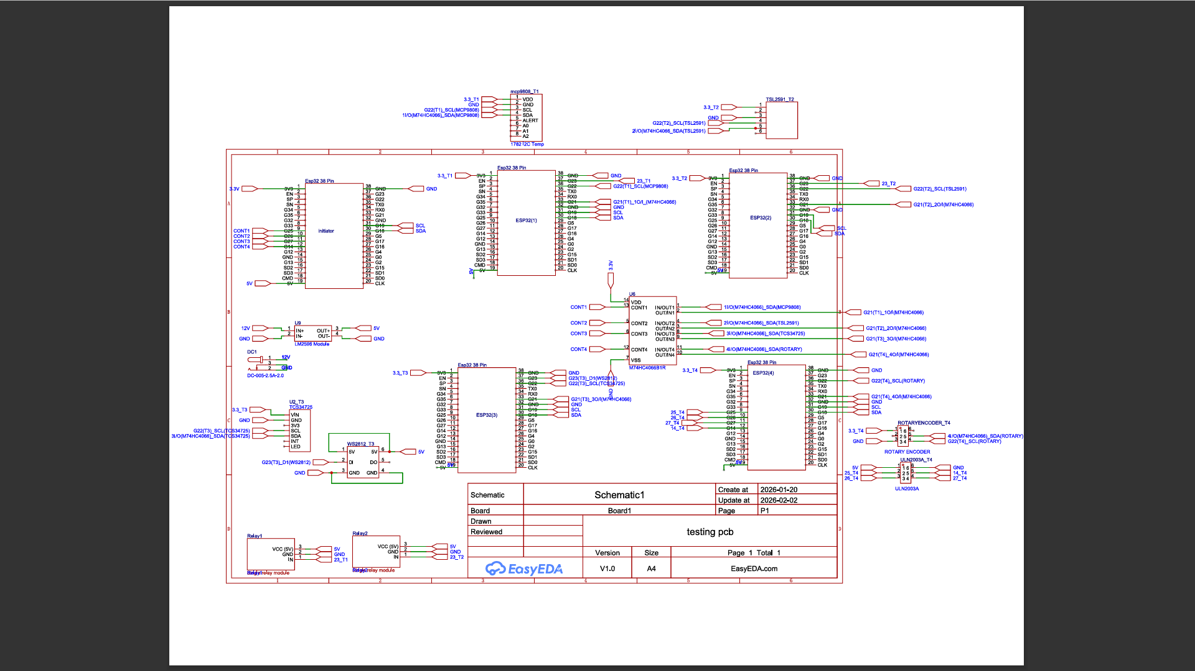
Schematics
Document# AiSemi Confidential
SW V-MODEL
Notes:
CASE_ computer Aided sw engg

Slide 4
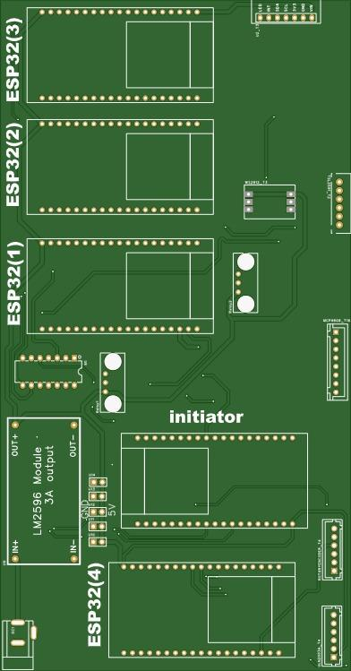
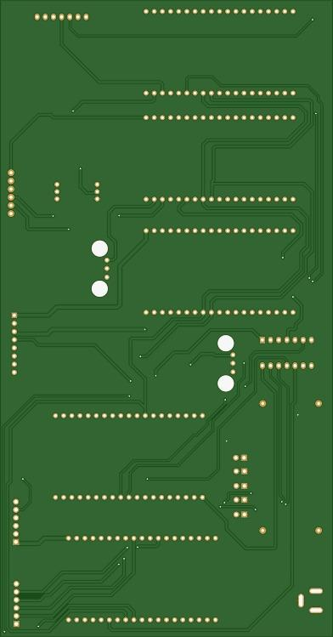
Layout
Document# AiSemi Confidential
SW V-MODEL
Notes:
CASE_ computer Aided sw engg

Slide 5
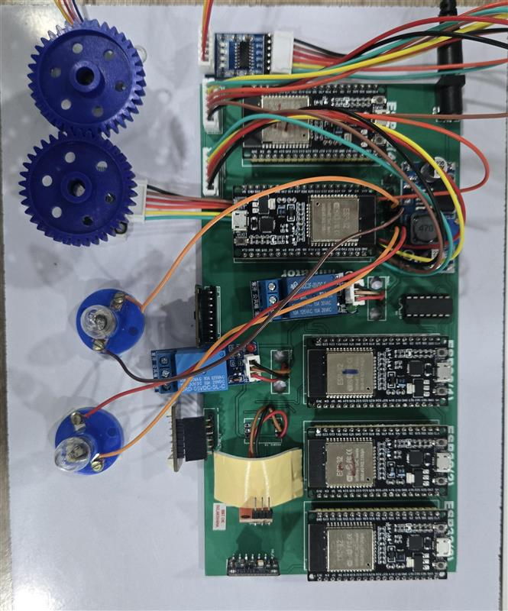
Final Board
Document# AiSemi Confidential

Slide 6
SW architecture Design - “Integration at User Application”
self_test_TS [Target]
FI
User Application
Periodic STLs
self_test_AL[Target]
FI
Safety function = T1
self_test_init
self_test_ROT[Target]
FI
self_test_TSR[Target]
FI
self_test_TS [Initiator]
FI
Configurable window “T2”
self_test_AL[Initiator]
FI
self_test_ROT[Initiator]
FI
self_test_TSR[Initiator]
FI
Document# AiSemi Confidential
SW V-MODEL
Notes:
CASE_ computer Aided sw engg

Slide 7
UNIT Level Design TS(S1) - Analysis
S
TS_V[0]
TS_V[1]
TS_V[2]
TS_V[3]
TS_V[4]
TS_V[9]
TS_V[0]
TS_V[1]
TS_V[2]
TS_V[9]
5
11
T
3
Begin Transmission
FIFO
Self Test_TS_T
Begin Transmission
FIFO
Self Test_TS_I
P
10
F
1
7
8
14
I
Self test initi
Collect Sample
Self Test_TS_I
P
Self test initi
FI
Collect Sample
Self Test_TS_I
F
9
12
SW Design Explanation
Initialize the system.
Establish I²C communication between Initiator and Target ESP32
Initiator ESP32 configures switch(M74HC4066B1) for normal sensor mode
Initiator ESP32 sends sensor read command to Target ESP32
Target ESP32 receives command and performs MCP9808 temperature sensor read operation upto 10 samples
Target ESP32 sends 10 samples data to Initiator ESP32 on request
Initiator ESP32 receives 10 samples data from Target ESP32 and checks the diagnostics
The MCP9808 temperature readings remain within the specified range, therefore, the test passes.
Initiator ESP32 injects fault condition (e.g., SDA line fault)
Initiator ESP32 sends sensor read command to Target ESP32
Target ESP32 receives command and performs MCP9808 temperature sensor read operation upto 10 samples
Target ESP32 sends 10 samples data or error status back to Initiator ESP32 on request
Initiator ESP32 receives 10 samples data from Target ESP32 and checks the diagnostics
The MCP9808 temperature samples are outside the specified range or contain NaN values, therefore, the test fails.
Document# AiSemi Confidential
SW V-MODEL
Notes:
CASE_ computer Aided sw engg

Slide 8
UNIT Level Design AL(S2) - Analysis
S
AL_
V[0]
AL
_V[1]
AL_V[2]
AL_V[3]
AL_V[4]
AL_V[9]
AL_V[0]
AL_V[1]
AL_V[2]
AL_V[9]
5
11
T
3
Begin Transmission
FIFO
Self Test_TS_T
10
Begin Transmission
FIFO
Self Test_AL_I
P
F
1
7
8
14
I
Self test initi
Collect Sample
Self Test_TS_I
P
Self test initi
FI
Collect Sample
Self Test_AL_I
F
9
12
SW Design Explanation
Initialize the system.
Establish I²C communication between Initiator and Target ESP32
Initiator ESP32 configures switch(M74HC4066B1) for normal sensor mode
Initiator ESP32 sends sensor read command to Target ESP32
Target ESP32 receives command and performs TSL2591 Ambient light sensor read operation upto 10 samples
Target ESP32 sends 10 samples data to Initiator ESP32 on request
Initiator ESP32 receives 10 samples data from Target ESP32 and checks the diagnostics
The Ambient light readings remain within the specified range, therefore, the test passes.
Initiator ESP32 injects fault condition (e.g., SDA line fault)
Initiator ESP32 sends sensor read command to Target ESP32
Target ESP32 receives command and performs Ambient light sensor read operation upto 10 samples
Target ESP32 sends 10 samples data or error status back to Initiator ESP32 on request
Initiator ESP32 receives 10 samples data from Target ESP32 and checks the diagnostics
The Ambient light samples are outside the specified range or contain NaN values, therefore, the test fails.
Document# AiSemi Confidential
SW V-MODEL
Notes:
CASE_ computer Aided sw engg

Slide 9
UNIT Level Design TSR(S3) - Analysis
S
TSR_V[0]
TSR_V[1]
TSR_V[2]
TSR_V[3]
TSR_V[4]
TSR_V[9]
TSR_V[0]
TSR_V[1]
TSR_V[2]
TSR_V[9]
5
11
T
3
Begin Transmission
FIFO
Self Test_TSR_T
Begin Transmission
FIFO
Self Test_TSR_T
P
10
F
1
7
8
14
I
Self test initi
Collect Sample
Self Test_TSR_I
P
Self test initi
FI
Collect Sample
Self Test_TSR_I
F
9
12
SW Design Explanation
Initialize the system.
Establish I²C communication between Initiator and Target ESP32
Initiator ESP32 configures switch(M74HC4066B1) for normal sensor mode
Initiator ESP32 sends sensor read command to Target ESP32
Target ESP32 receives command and performs TSR sensor read operation upto 10 samples
Target ESP32 sends 10 samples data to Initiator ESP32 on request
Initiator ESP32 receives 10 samples data from Target ESP32 and checks the diagnostics
The TSR sensor readings remain within the specified range, therefore, the test passes.
Initiator ESP32 injects fault condition (e.g., SDA line fault)
Initiator ESP32 sends sensor read command to Target ESP32
Target ESP32 receives command and performs TSR sensor read operation upto 10 samples
Target ESP32 sends 10 samples data or error status back to Initiator ESP32 on request
Initiator ESP32 receives 10 samples data from Target ESP32 and checks the diagnostics
The TSR sensor samples are outside the specified range, therefore, the test fails.
Document# AiSemi Confidential
SW V-MODEL
Notes:
CASE_ computer Aided sw engg

Slide 10
UNIT Level Design RE(S3) - Analysis
S
RE_V[0]
RE_V[1]
RE_V[2]
RE_V[3]
RE_V[4]
RE_V[9]
RE_V[0]
RE_V[1]
RE_V[2]
RE_V[9]
5
11
T
3
Begin Transmission
FIFO
Self Test_RE_T
10
Begin Transmission
FIFO
Self Test_RE_T
P
F
1
7
8
14
I
Self test initi
Collect Sample
Self Test_RE_I
P
Self test initi
FI
Collect Sample
Self Test_RE_I
F
9
12
SW Design Explanation
Initialize the system.
Establish I²C communication between Initiator and Target ESP32
Initiator ESP32 configures switch(M74HC4066B1) for normal sensor mode
Initiator ESP32 sends sensor read command to Target ESP32
Target ESP32 receives command and performs Rotary encoder sensor read operation upto 10 samples
Target ESP32 sends 10 samples data to Initiator ESP32 on request
Initiator ESP32 receives 10 samples data from Target ESP32 and checks the diagnostics
The MCP9808 temperature readings remain within the specified range, therefore, the test passes.
Initiator ESP32 injects fault condition (e.g., SDA line fault)
Initiator ESP32 sends sensor read command to Target ESP32
Target ESP32 receives command and performs Rotary encoder sensor read operation upto 10 samples
Target ESP32 sends 10 samples data to Initiator ESP32 on request
Initiator ESP32 receives 10 samples data from Target ESP32 and checks the diagnostics
The Rotary encoder samples are outside the specified range, therefore, the test fails.
Document# AiSemi Confidential
SW V-MODEL
Notes:
CASE_ computer Aided sw engg

Slide 11
User Guide
Link: https://docs.google.com/document/d/13aHn3kwmMn2G-gFHdg0QetyjP2wbk6i3lwdx7ko-RCU/edit?tab=t.0

Slide 12
Thank you
Document# AiSemi Confidential
SW V-MODEL
Notes:
CASE_ computer Aided sw engg

