Slide 1
Hotel Management System
CAPSTONE PROJECT 02
Salesforce Admin and Development Capstone
LNCT Group of Colleges | Salesforce COE
Vraddhi Srivastava | 0176AL231155
Notes:
Introduce yourself, the program and that you chose Project 02, Hotel Management System. No screenshot needed here.

Slide 2
Project Overview
Admin-focused hotel app on Salesforce Lightning
Rooms, guests, reservations, check-in and check-out
Record-Triggered Flows and email notifications
Role-based security with sharing rules
One Apex Trigger plus SOQL queries
4
3
Custom objects
Record-triggered flows
6
9
Users in 5 roles
Reports, 2 dashboards
Notes:
Explain the goal: an admin-focused hotel app using declarative automation plus one Apex trigger and SOQL. No screenshot needed.

Slide 3
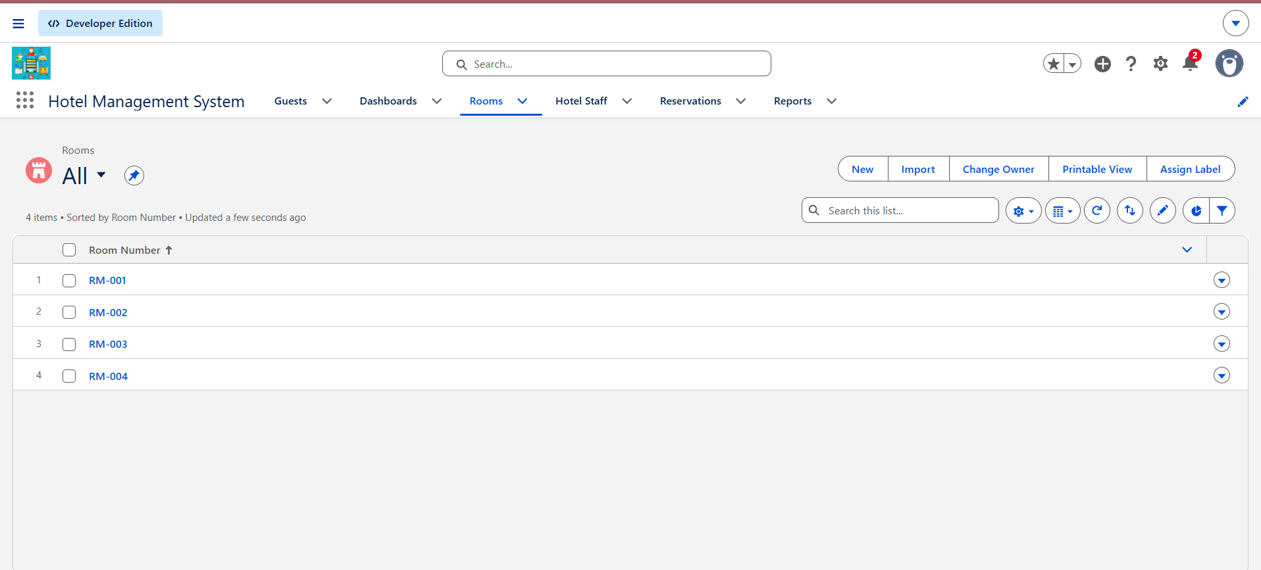
Application setup
App name: Hotel Management System
Lightning app with Standard Navigation
Custom logo uploaded in App Manager
Tabs: Rooms, Guests, Reservations, Hotel Staff, Reports, Dashboards
SCREENSHOT
App home page with logo and navigation items
Notes:
Screenshot: open the Hotel Management System app from the App Launcher and capture the home page showing the logo and navigation tabs. Optional extra: the App Manager list entry.

Slide 4
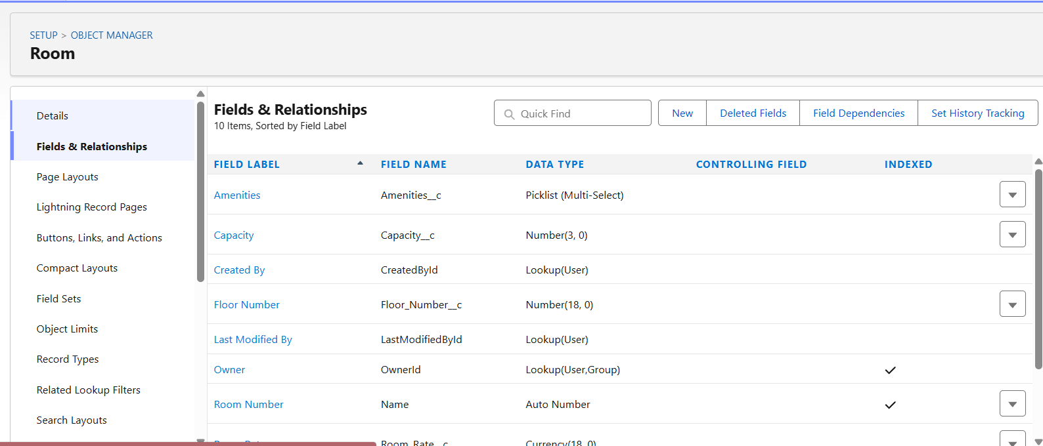
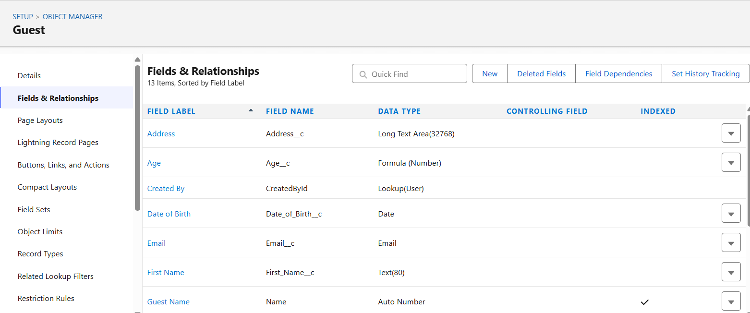
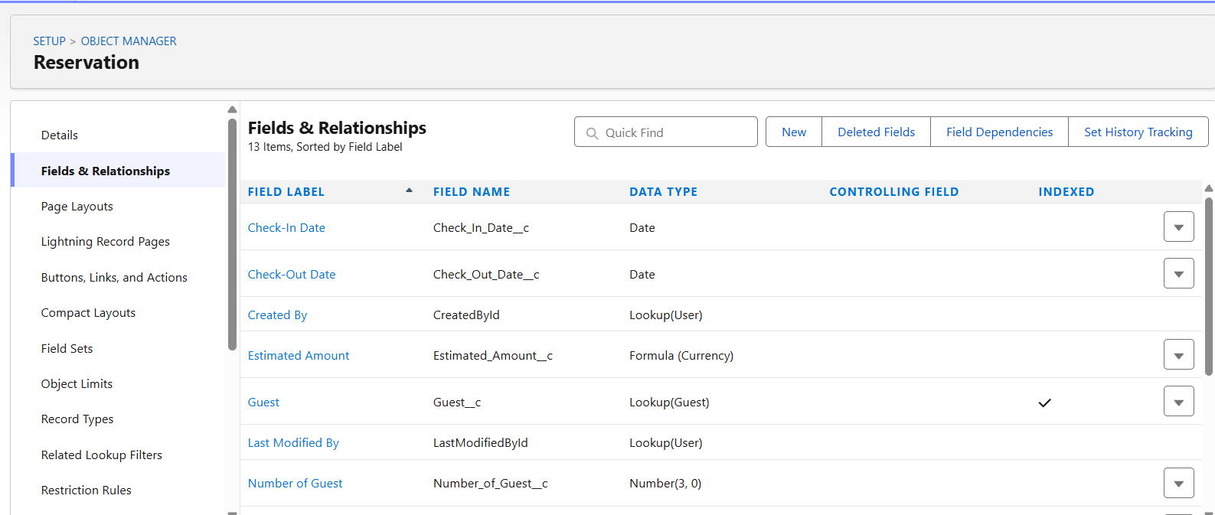
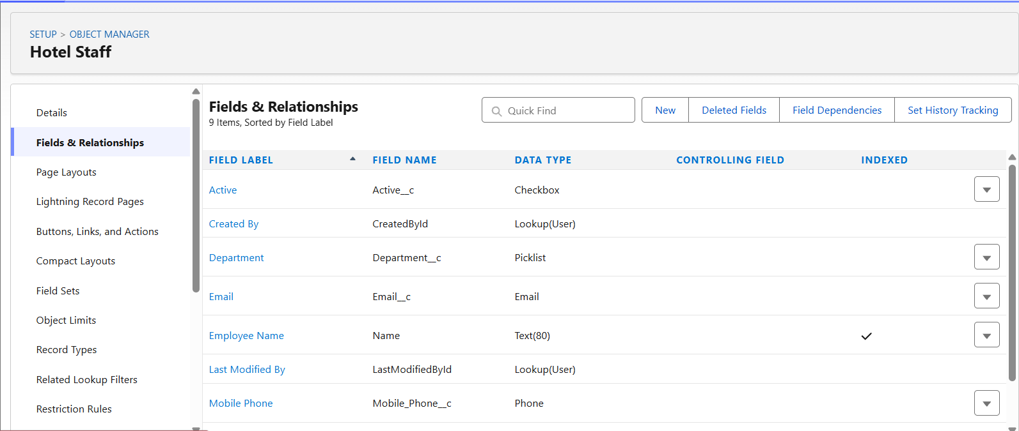
Data model
SCREENSHOT
Room: Fields & Relationships
SCREENSHOT
Guest: Fields & Relationships
SCREENSHOT
Reservation: Fields & Relationships
SCREENSHOT
Hotel Staff: Fields & Relationships
Reservation looks up Guest and Room. Hotel Staff stands alone.
Notes:
Four screenshots from Setup > Object Manager > (object) > Fields & Relationships: Room, Guest, Reservation, Hotel Staff. Make sure the Data Type column is visible, including Lookup(Room) and Lookup(Guest) on Reservation.

Slide 5
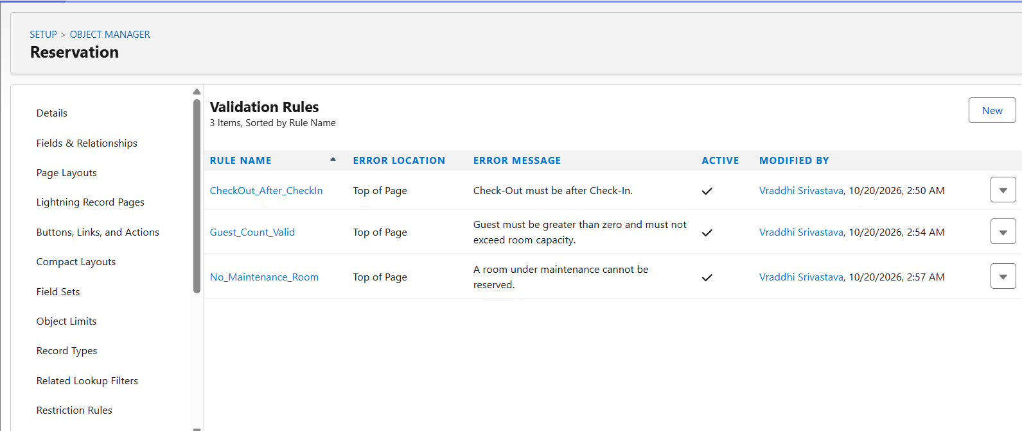
Validation rules and formulas
Object | Rule or formula
Room | Rate and capacity above zero
Guest | Date of birth not in the future
Reservation | Check-out after check-in
Reservation | Guests within room capacity
Reservation | No Maintenance room
Defaults | Room: Available | Reservation: Confirmed
Formulas | Age, Nights, Estimated Amount
Reservation validation rules list
Notes:
Screenshot: Object Manager > Reservation > Validation Rules list. Optionally add one open rule showing its formula and error message.

Slide 6
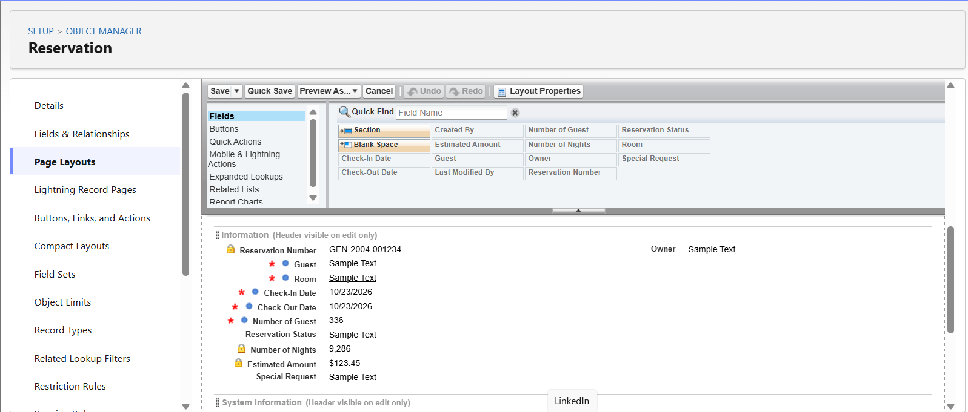
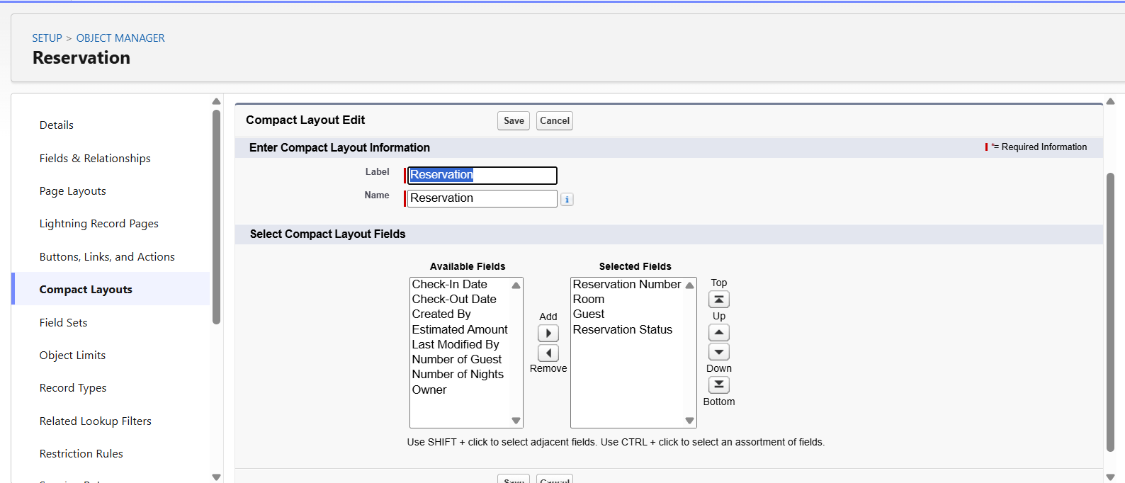
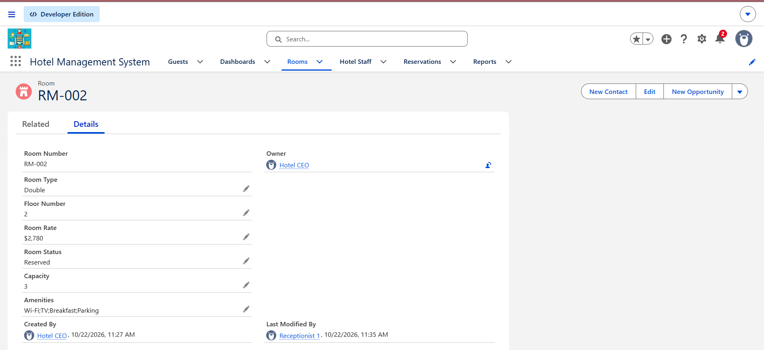
Layouts and related lists
Reservation page layout
Compact layout / record highlights
Room record with Reservations related list
Page layouts, compact layouts and related lists for each object
Notes:
Three screenshots: (1) a page layout editor for Reservation, (2) Compact Layouts list or the highlights panel on a record, (3) a Room record showing the Reservations related list.

Slide 7
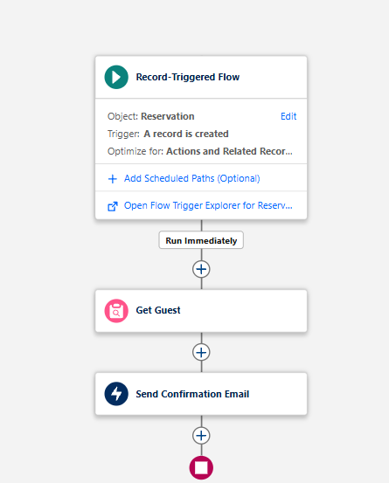
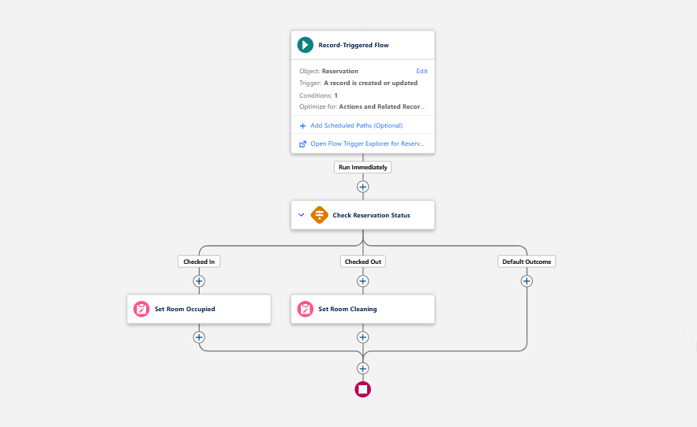
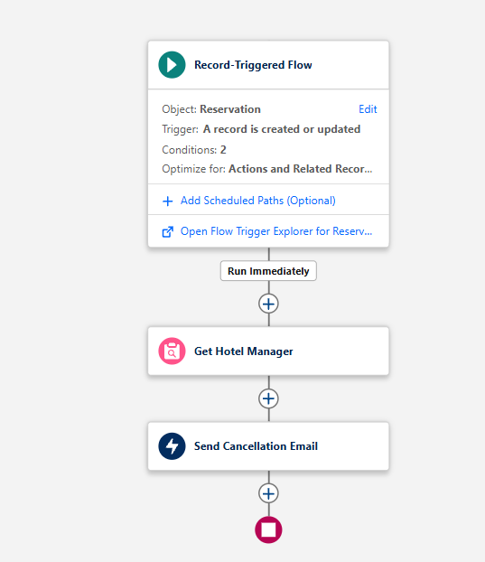
Record-triggered flows
1. Guest confirmation
On create: gets the Guest and emails a confirmation
2. Room status
Checked-In sets Occupied; Checked-Out sets Cleaning
3. Cancellation
Cancelled sends an email to the Hotel Manager
SCREENSHOT
Flow 1 canvas
SCREENSHOT
Flow 2 canvas
SCREENSHOT
Flow 3 canvas
Notes:
Three screenshots of the Flow Builder canvas, one per flow. Capture the whole flow with the elements and conditions visible, and show that each flow is Active.

Slide 8
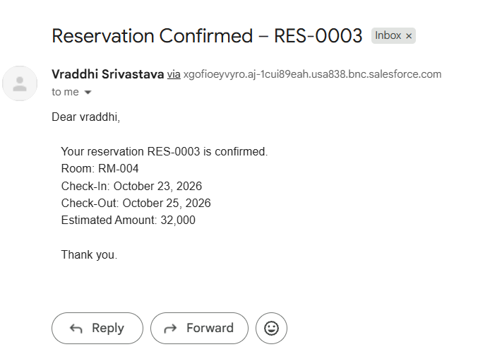
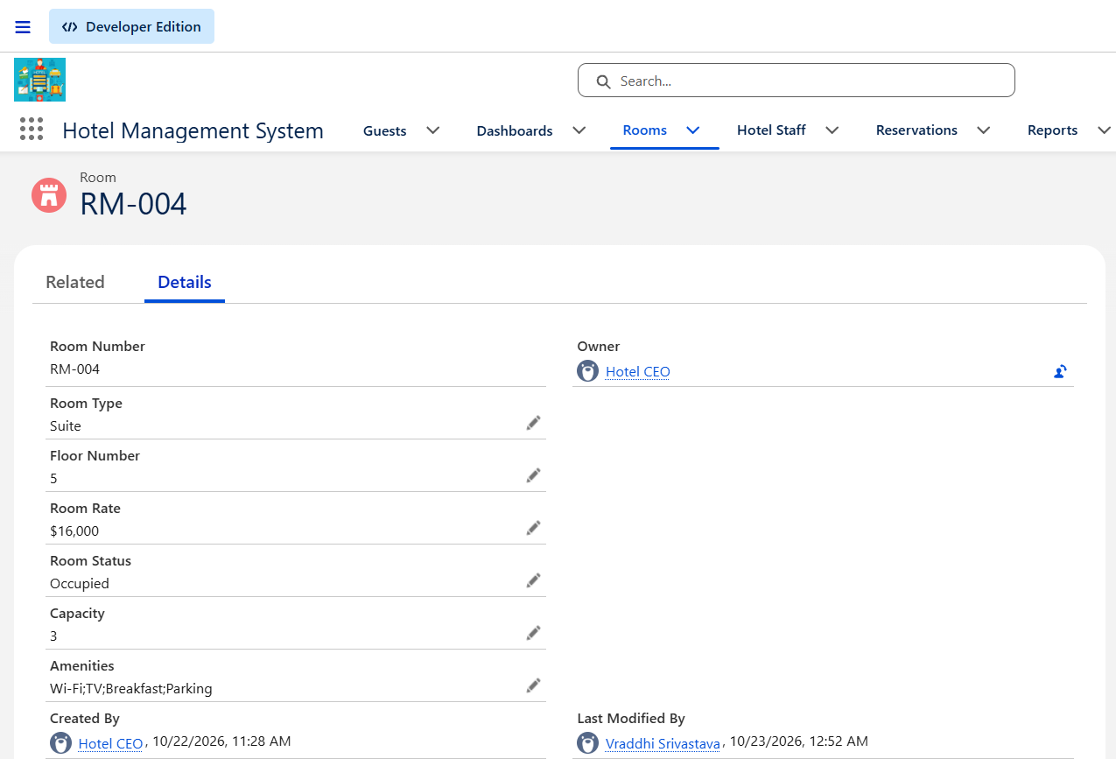
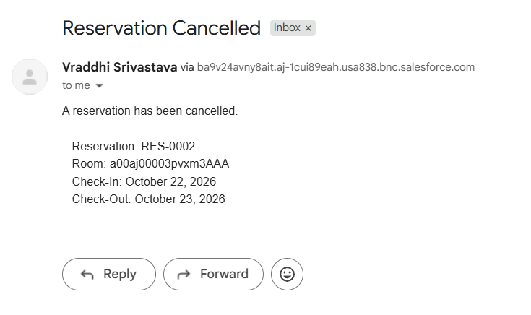
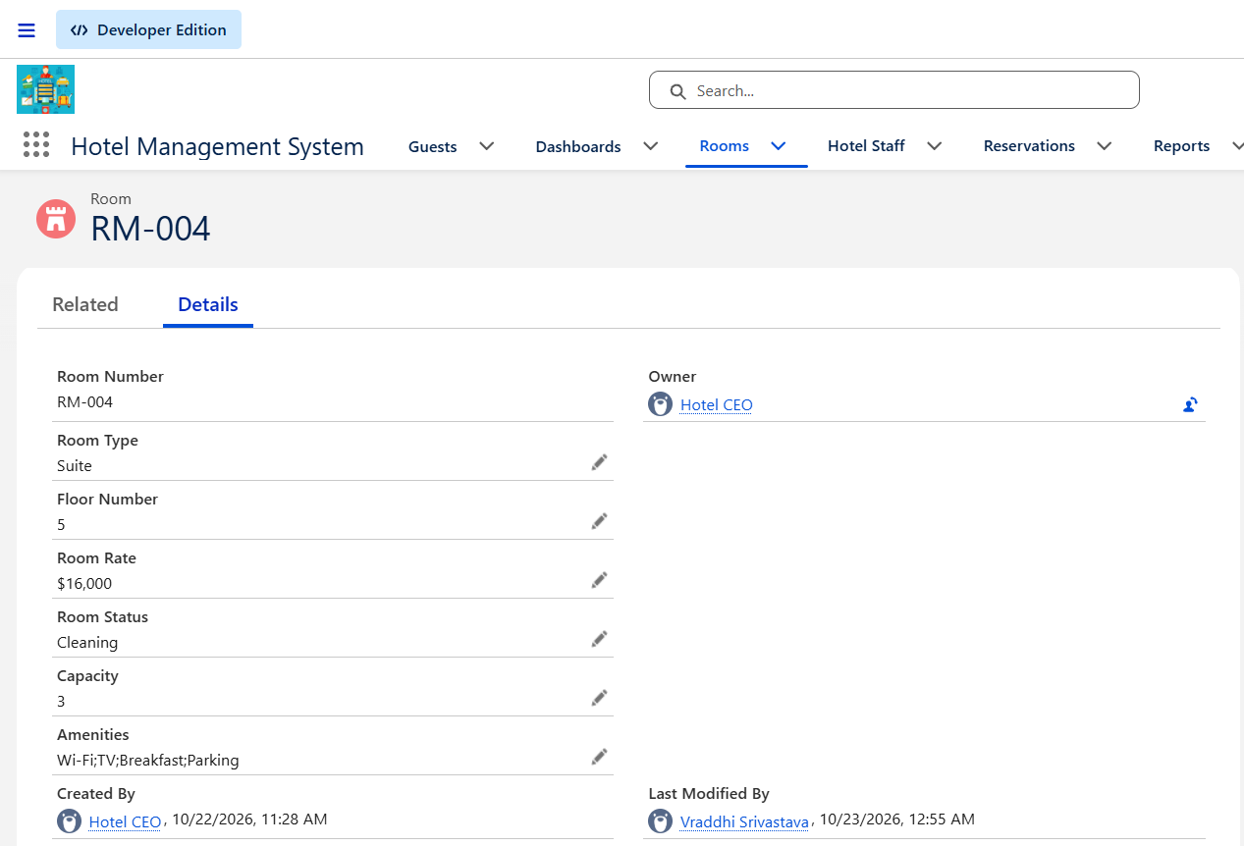
Flows in action
Confirmation email received by the guest
Room status changing to Occupied, then Cleaning
Cancellation email to the Hotel Manager
Create a reservation, check in, check out, then cancel another one
Notes:
Screenshots: (1) the confirmation email in the guest's inbox, (2) a Room record showing Occupied after check-in and Cleaning after check-out (two quick captures side by side if you like), (3) the cancellation email received by the Hotel Manager.

Slide 9
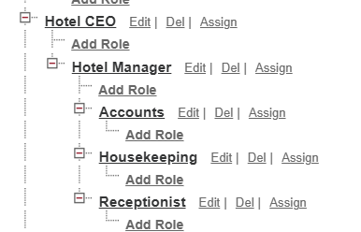
Roles and users
Hotel CEO
SCREENSHOT
Users list with role and profile columns
Hotel Manager
Receptionist
Housekeeping
Accounts
Receptionist 1 and 2 share one role. All six users have the Salesforce Platform license.
Notes:
Screenshots: Setup > Users list showing role and profile columns. Optional: the role hierarchy page (Setup > Roles > Expand All) in place of or beside the users list.

Slide 10
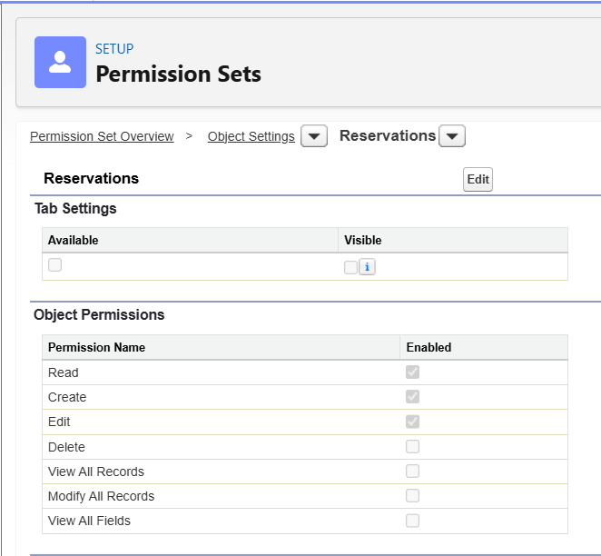
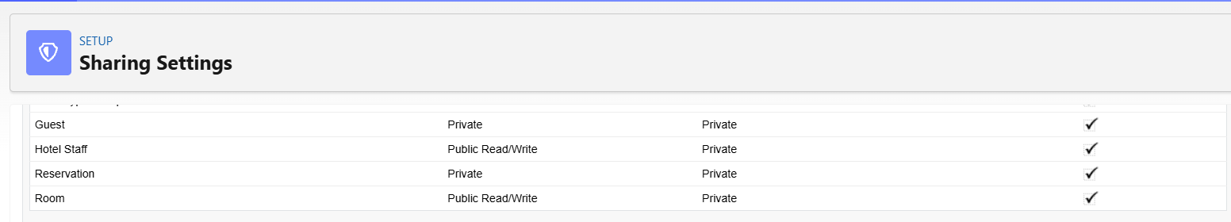
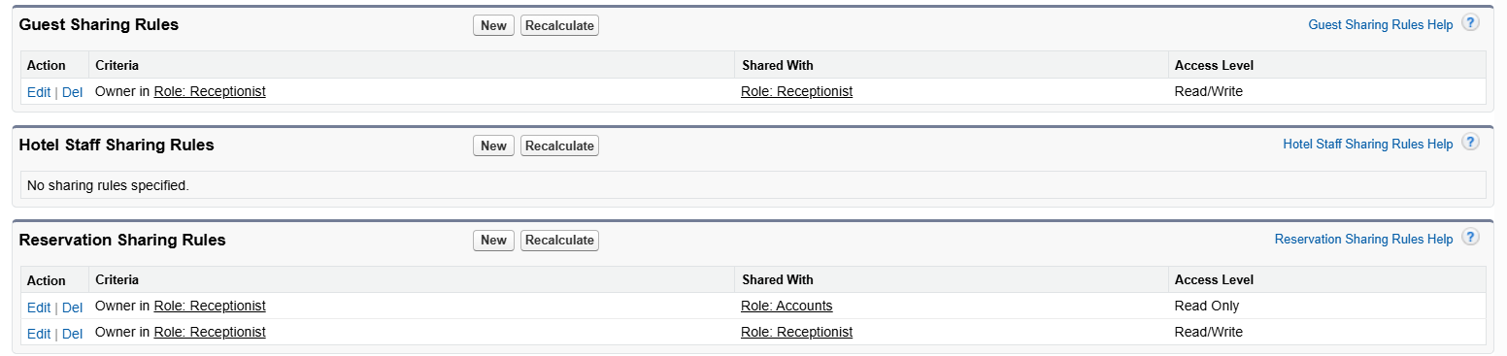
Access and sharing
Organization-wide defaults
Room: Public Read/Write. Guest and Reservation: Private
Sharing rules
Receptionists share Reservations and Guests; Accounts reads Reservations
Organization-Wide Defaults
Sharing rules list
Permission set object settings
Notes:
Three screenshots: (1) Setup > Sharing Settings, Organization-Wide Defaults section, (2) the Sharing Rules lists for Reservation and Guest, (3) one permission set's Object Settings page, for example Receptionist Access.

Slide 11
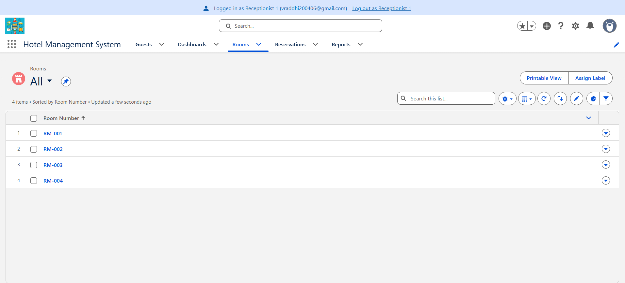
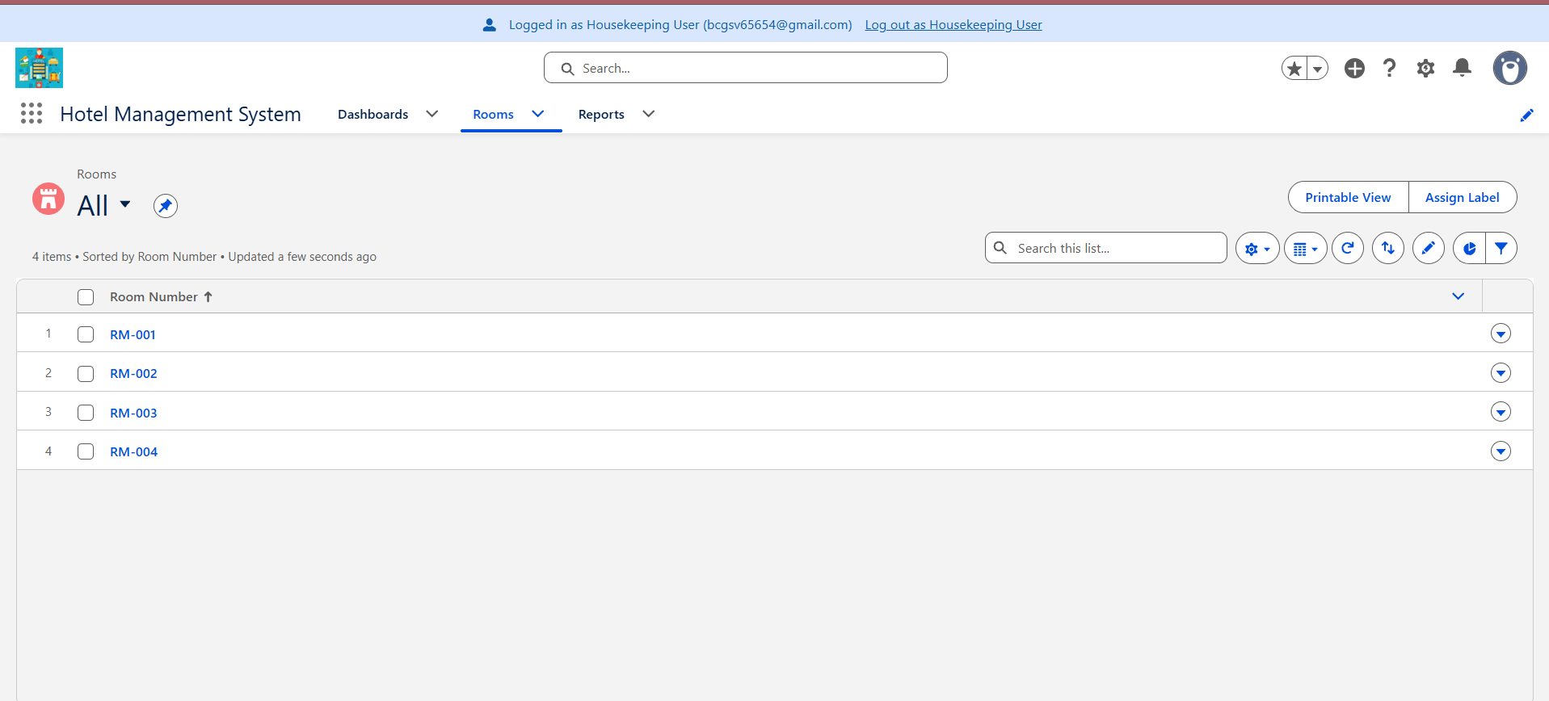
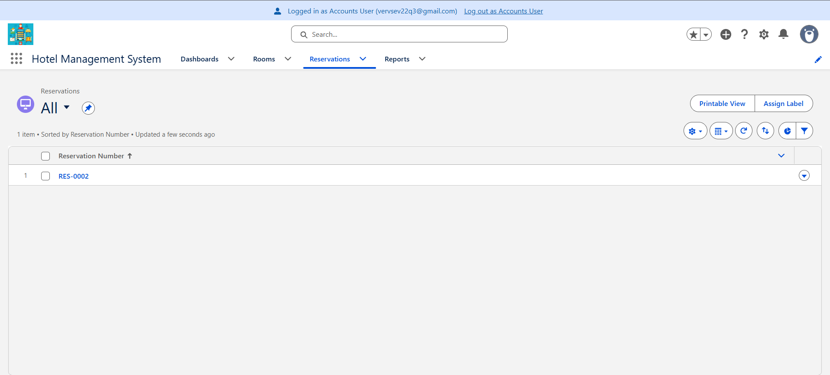
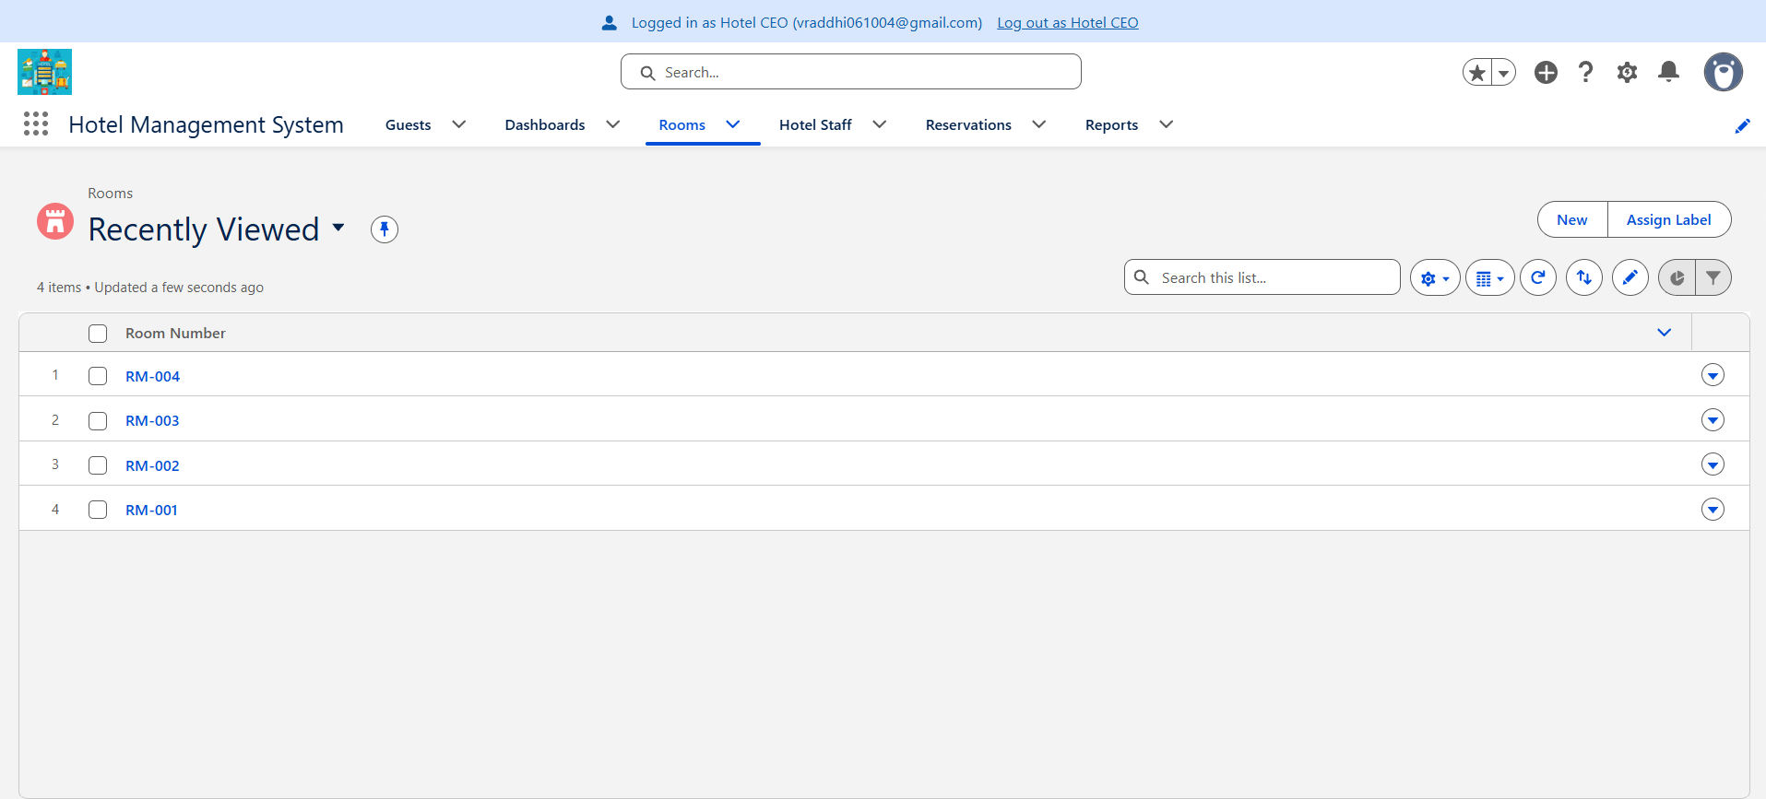
Access checked per user
Receptionist
Create and edit reservations, no Delete
Housekeeping
Edits Room Status only, no guest data
Accounts
Sees Estimated Amount, cannot edit status
Manager and CEO
See all reservations and rooms
Receptionist login view
Housekeeping login view
Accounts login view
Manager and CEO login view
Notes:
Use Setup > Users > Login to view the org as each user, and capture each view: Receptionist (reservation without a Delete option), Housekeeping (Rooms tab only, Room Status editable), Accounts (Estimated Amount visible, Room Status read-only), Hotel Manager or CEO (all reservations visible).

Slide 12
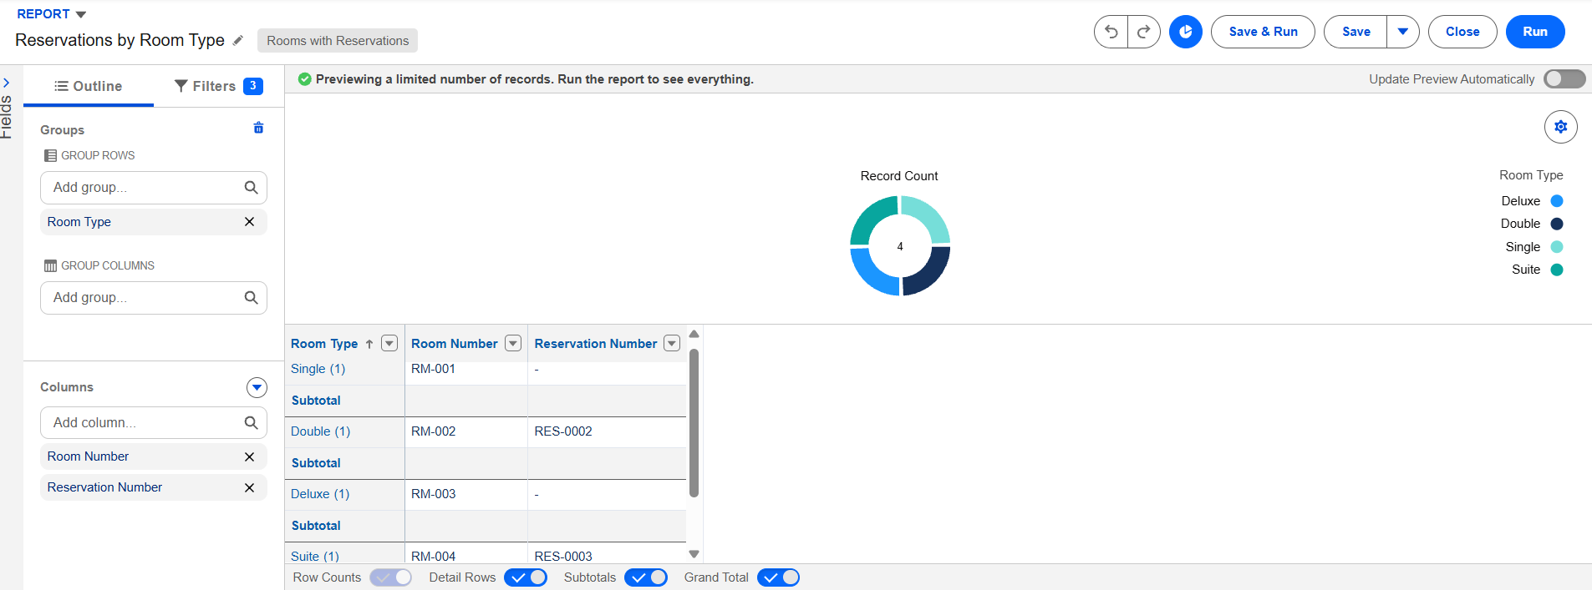
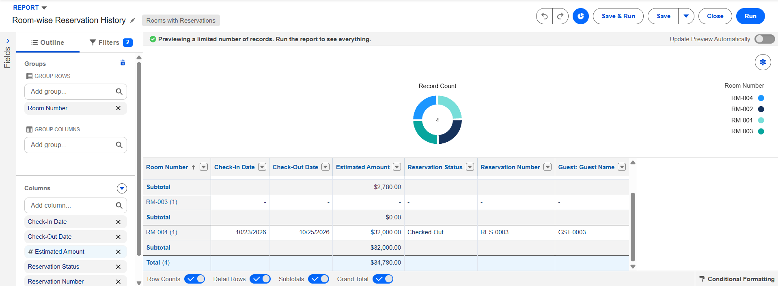
Reports and dashboards
Today's check-ins and check-outs
Rooms by status
Current month and cancelled reservations
Room-wise and guest-wise history
Reservations by room type (pie)
Monthly estimated revenue
SCREENSHOT
Pie chart: reservations by room type
SCREENSHOT
Monthly estimated revenue report
SCREENSHOT
Dashboard: check-ins and check-outs
SCREENSHOT
Dashboard: room counts by status
Notes:
Screenshots: (1) the Reservations by Room Type pie chart, (2) the Monthly Estimated Revenue report, (3) the Today's Check-Ins and Check-Outs dashboard, (4) the Room Counts by Status dashboard. Other reports can go in an appendix slide if you want.

Slide 13
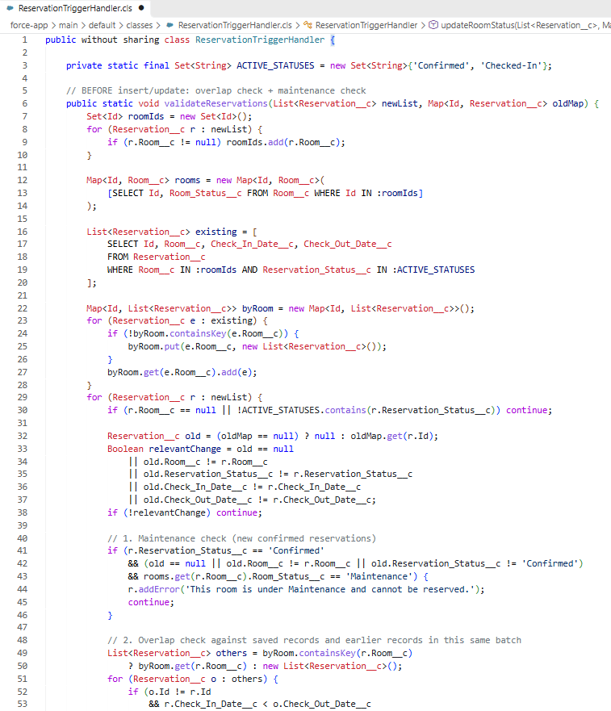
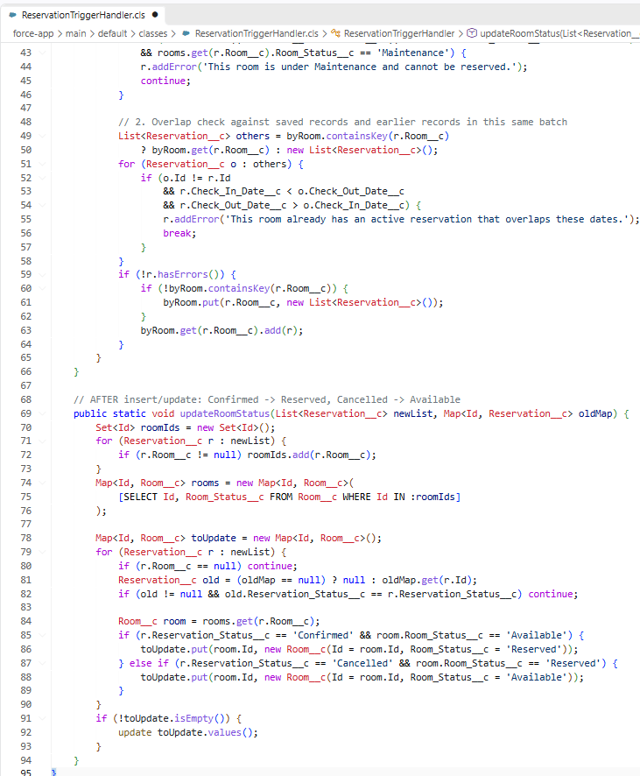
Apex trigger: ReservationTrigger
ReservationTrigger and handler code
Blocks overlapping active reservations for a room
Blocks Confirmed reservations for Maintenance rooms
Created sets the room to Reserved; Cancelled sets it to Available
Logic sits in a handler class
Check-in and check-out updates stay in the flow
Notes:
Screenshot: the ReservationTrigger and ReservationTriggerHandler code (Setup > Apex Classes / Object Manager > Reservation > Triggers, or Developer Console). Explain the three rules and that Flow 2 handles check-in and check-out.

Slide 14
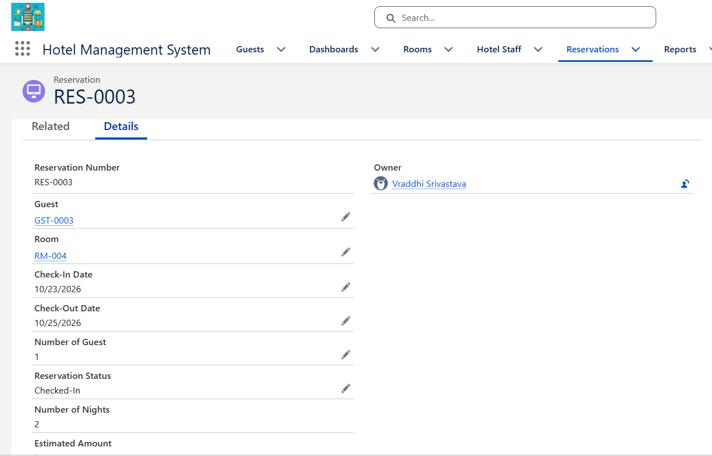
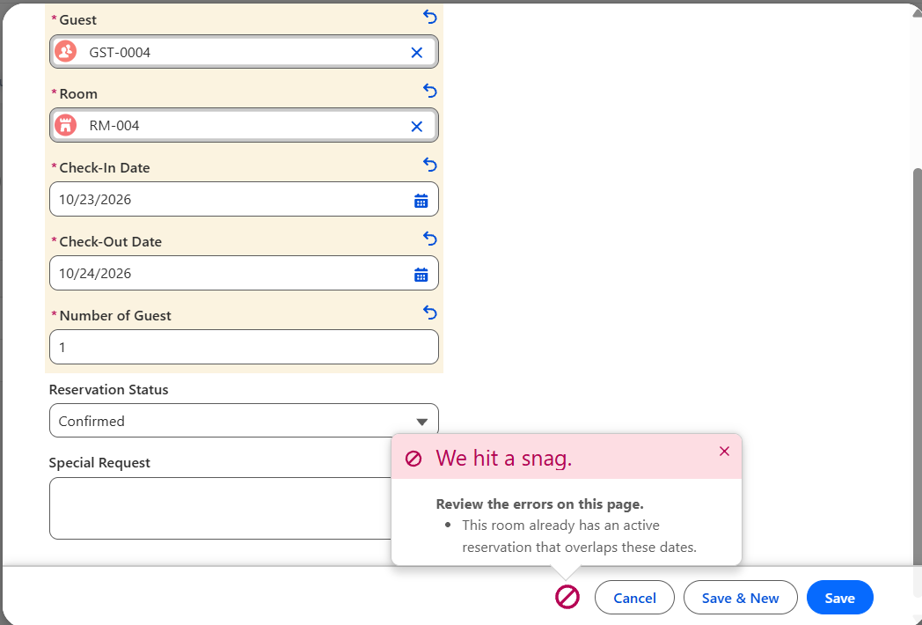
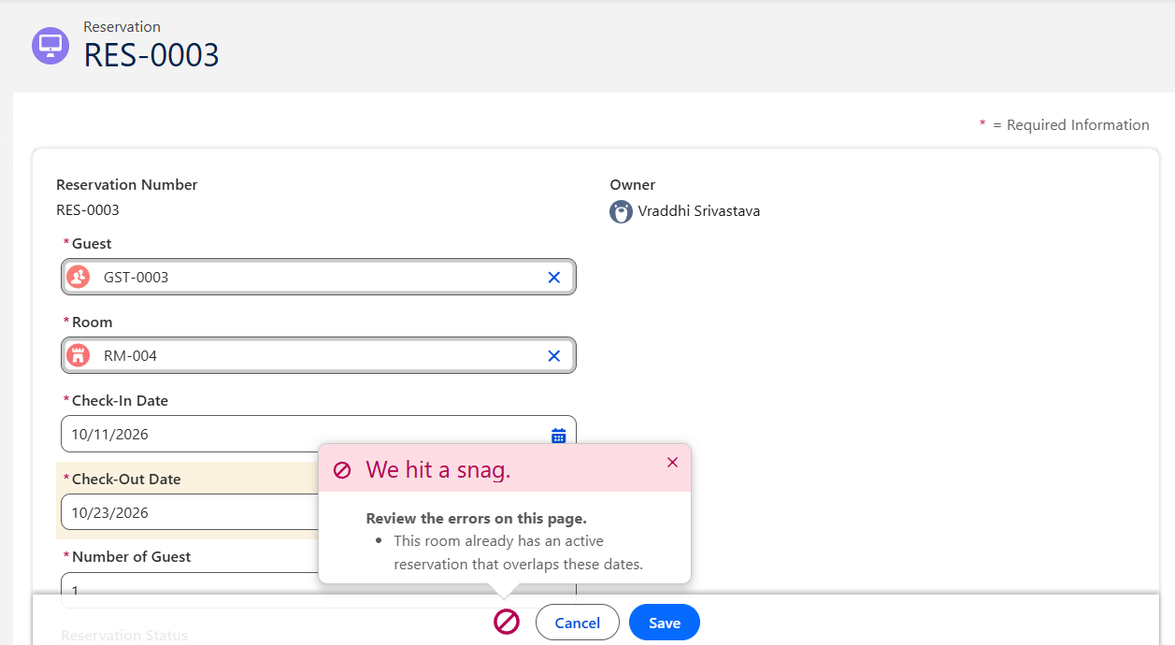
Trigger test scenarios
# | Scenario | Expected result
1 | Valid insert | Saves; room becomes Reserved
2 | Overlapping insert | Blocked with overlap error
3 | Valid update | Saves with the new dates
4 | Overlapping update | Blocked with overlap error
5 | Relationship query | Parent and child fields returned
Valid insert saved, room Reserved
Blocked: overlapping insert
Blocked: overlapping update
Notes:
Screenshots: (1) a valid reservation saved and the room showing Reserved, (2) the overlap error on a second insert, (3) the overlap error on an update. Test 5 is covered by the SOQL slide.

Slide 15
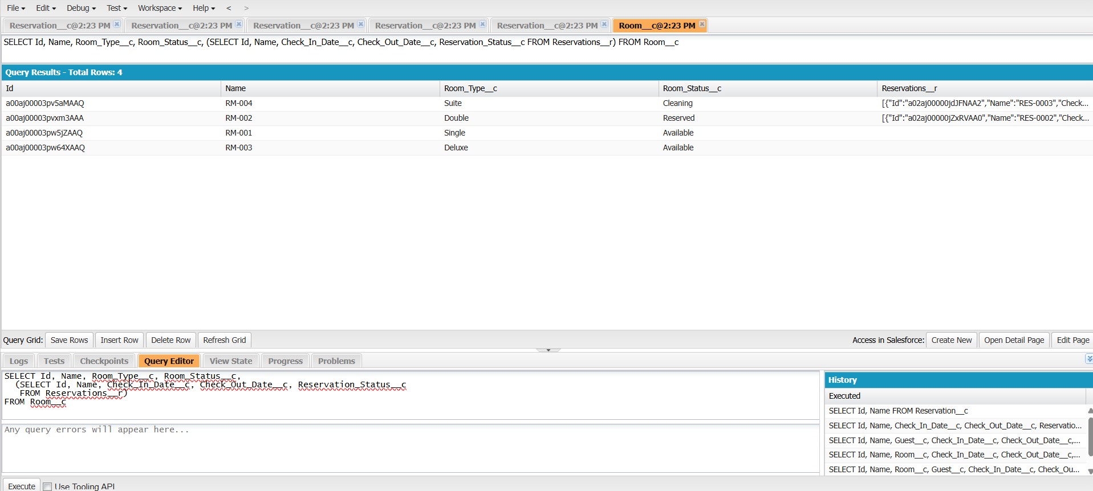
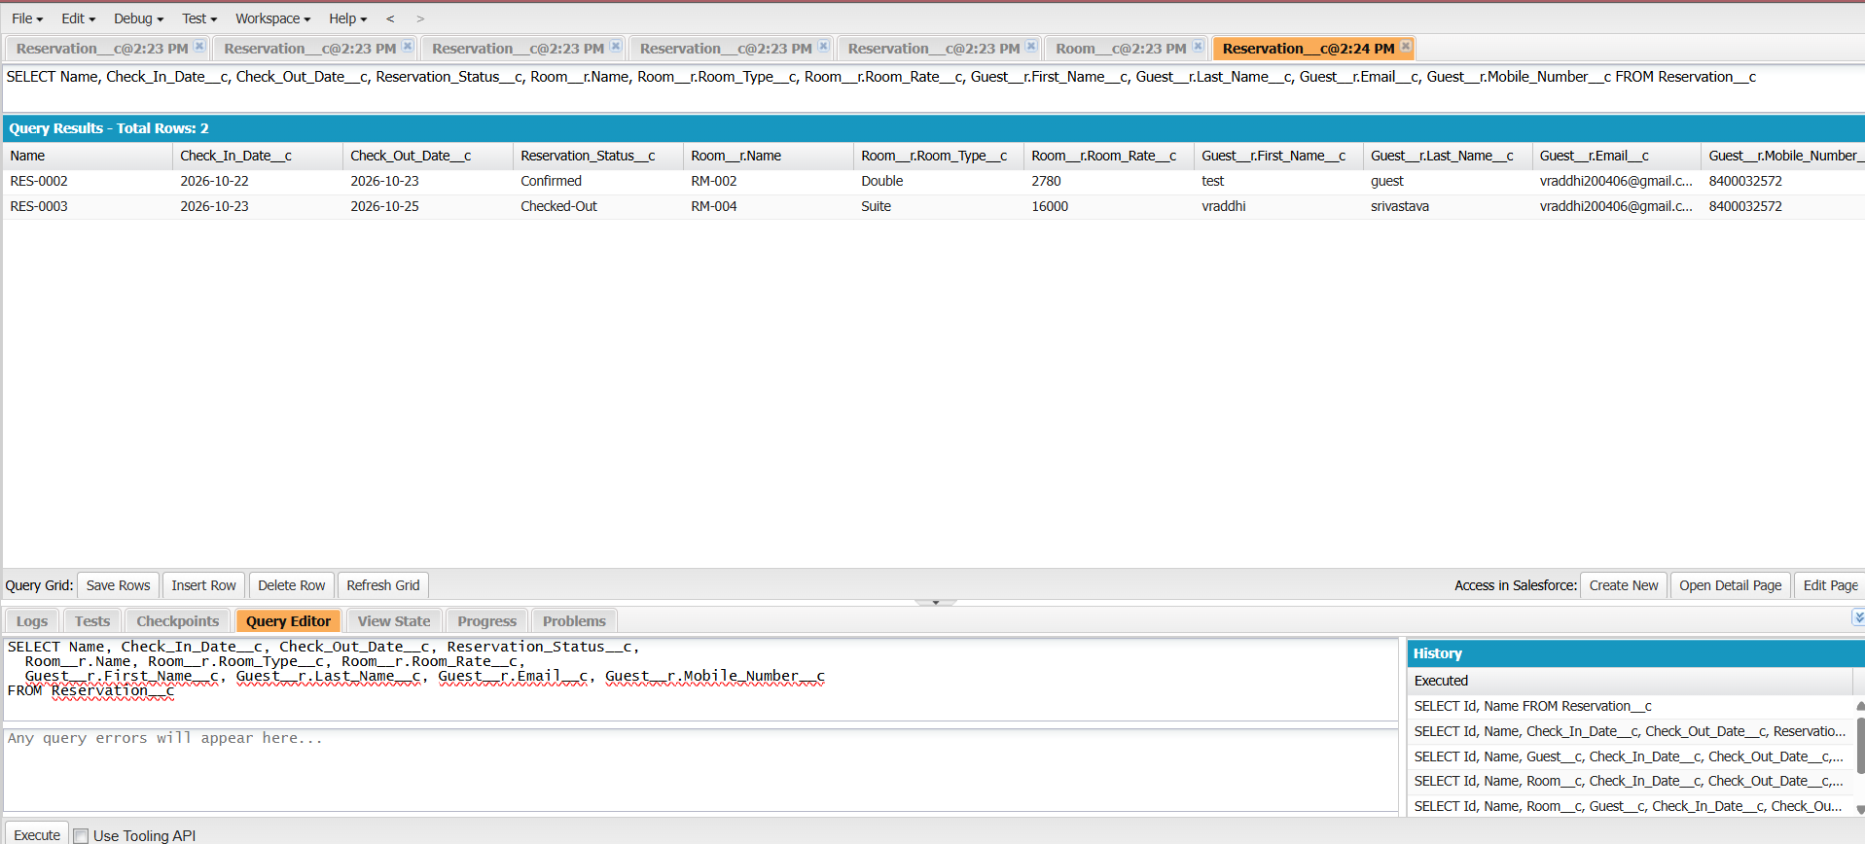
SOQL relationship queries
Parent-to-child: Room to Reservations
Child-to-parent: Reservation to Room and Guest
SELECT Id, Name, Room_Type__c,
(SELECT Name, Check_In_Date__c
FROM Reservations__r)
FROM Room__c
SELECT Name, Room__r.Name,
Room__r.Room_Type__c,
Guest__r.First_Name__c
FROM Reservation__c
Notes:
Screenshots: Developer Console Query Editor showing Query 5 (parent-to-child) and Query 6 (child-to-parent) with the result grids. Queries 1 to 4 (room, guest, active, date range) can go in an appendix.

Slide 16
Video Presentation: https://drive.google.com/drive/folders/16PEJO3l_uV21CiDHBBvz2OTBH9vUqDLY?usp=sharing
Notes:
Close by walking through the checklist and mention the implementation notes: flow handles check-in/out room status, trigger handles Reserved and Available, and the Active checkbox covers the inactive-staff rule.

