Slide 1
FinTech Startups: Disruption and Ecosystem

Slide 2
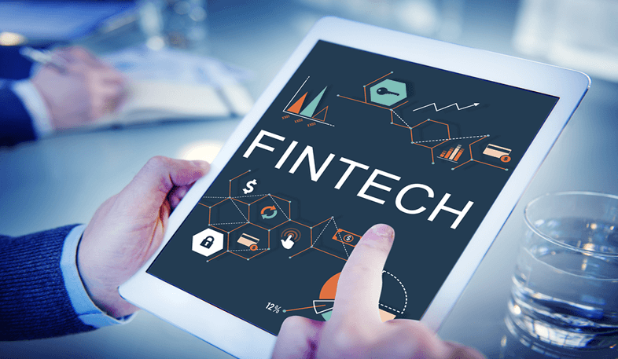
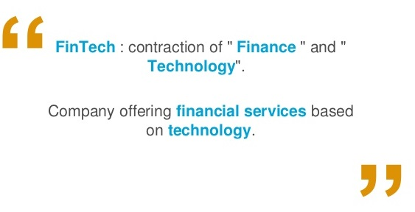
Introduction

Slide 3
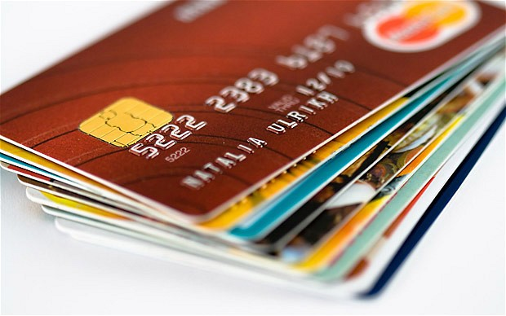
Introduction (cont…)
A new market which is a hybrid of traditional processes.
Replaces traditional structure with a new technology
based process.

Slide 4
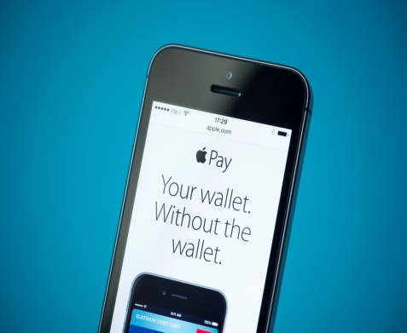
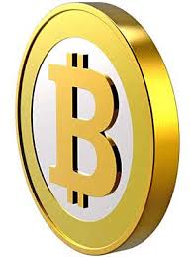

Introduction (cont…)
Apple Pay, Bitcoin, Pay Pal are Fintechs.
Use modern technologies to make it easy to pay
and to get paid.

Slide 5
FinTech Startups are growing!
Ventures in FinTech have tripled last year.
Global investments in FinTech reached almost $50 billion in five years.
Innovative and imaginative technological solutions from FinTech have an amazing advantage of easily expandable abroad.

Slide 6
New Stakeholders are Entering!
Tech companies dominating other spaces have started entering the competition for innovation in finances.
Microsoft is involved in FinTech with a great variety of initiatives. Google, Intel and others have also demonstrated an interest in FinTech with their active investments.

Slide 7
New Types of Partnerships
Social media and communication giants like Facebook or WeChat realized the power of applying financial transaction features into their extensive social networks.
WeChat, China’s biggest messaging app with more than 600 million users, announced an agreement which enables its users in the US to send money to 200 countries.

Slide 8
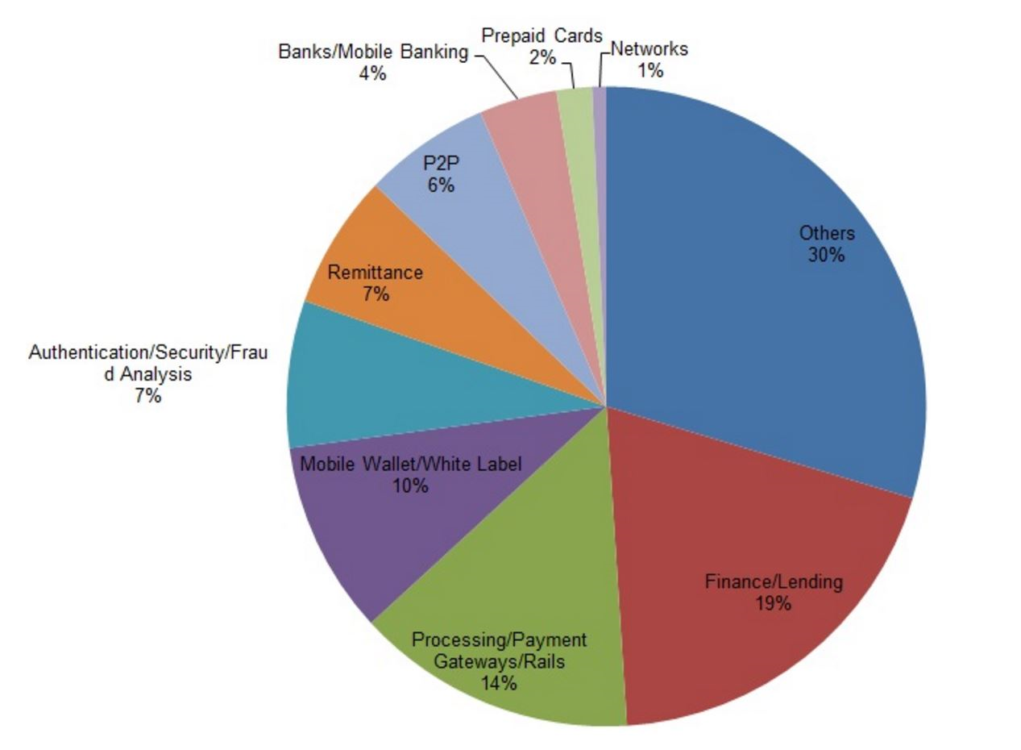
Players within the FinTech Industry
There is a great diversity among the types of players within the FinTech industry, we cannot distribute financial and innovative attractiveness of the overall industry on all players equally.

Slide 9
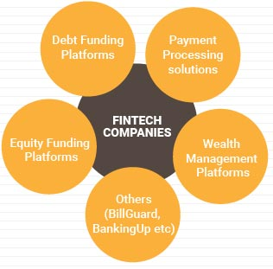
Categories of FinTech Companies

Slide 10
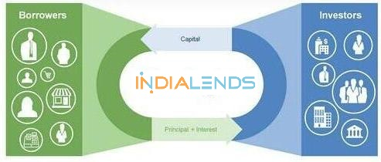

Categories of FinTech Companies (cont…)
Debt Funding Platforms:
Online platforms for small businesses
and entrepreneurs to access loans.
E.g.: Capital Float, IndiaLends
Equity Funding Platforms:
Online platforms for equity investments in
start-ups and early stage businesses.
E.g.: Globevestor

Slide 11
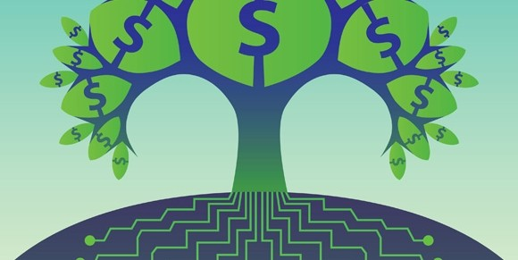

Categories of FinTech Companies (cont…)
Wealth Management Platforms:
Technology driven solutions for automated
wealth management recommendations.
E.g.: Wealthfront, Betterment
Payment Processing solutions:
Products for simplifying and/or automating
various steps of the payment / cash flow value
chains. E.g.:Currency Cloud, Square

Slide 12
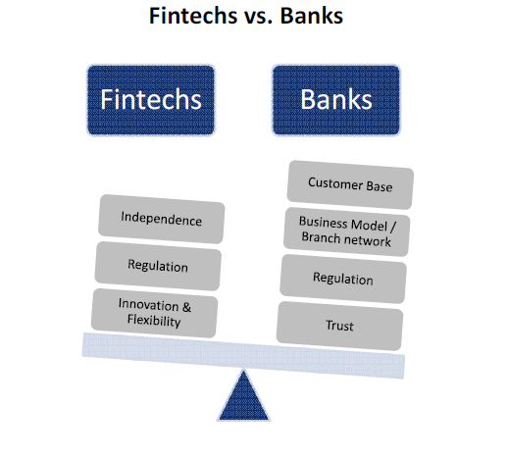
Differences between FinTech and non-FinTech:

Slide 13
Differences between FinTech and non-FinTech (Cont…)
Customer Base
Business Model
Innovation & Flexibility
Independence
Trust

Slide 14
Disruption
One of the major disadvantages of most FinTech firms today is that they lack the scalability that most banking firms possess.
Fund transfer could lose up to 28% of their market share,
while bankers estimate they are likely to lose 24%

Slide 15
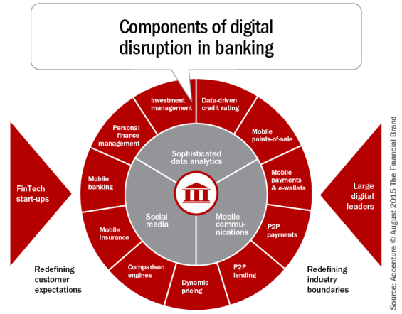
Disruption (cont…)

Slide 16
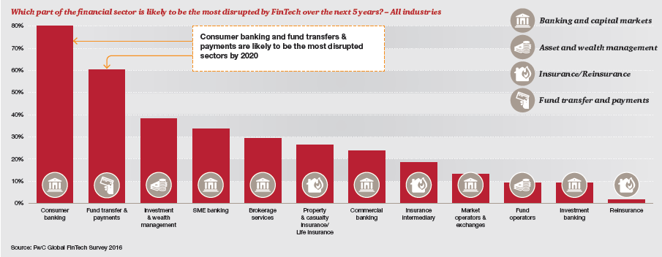
Disruption (cont…)
The epicenter of disruption:
Targets mostly consumer banking and payments.

Slide 17
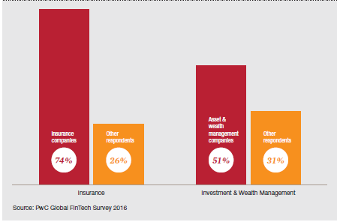
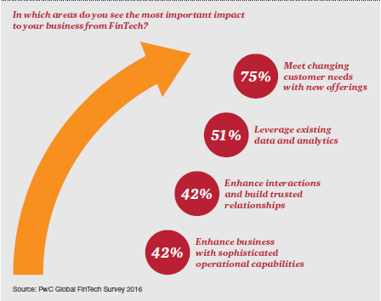
Disruption (cont…)
Asset Management and Insurance are also on disruption radar
Direct relationship between insurers and customers
Customer centricity is fuelling disruption
Expect the customer experience

Slide 18

FinTech Ecosystem
A Collaborative Network
FinTech start-up firms engage in external partnerships with financial institutions, universities , government agencies, industry consultants and associations.
Growth and market success of any FinTech hub originate from an integrated ecosystem.
A successful FinTech ecosystem is where all the market participants connect, engage and share ideas

Slide 19
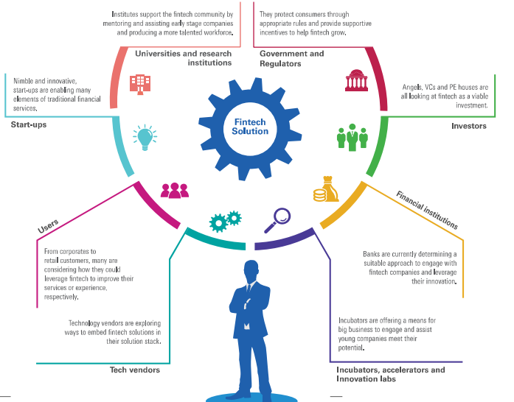
Pillars of FinTech Ecosystem

Slide 20
Pillars of FinTech Ecosystem (cont…)
The government is naturally the important catalyst for the success or failure of FinTech in a heavily regulated financial industry.
The Government of India along with regulators such as SEBI and RBI are aggressively supporting the ambition of the Indian economy.
The Start-Up India initiative launched by the Government of India in January 2016 includes USD 1.5 billion fund for start-ups.
Jan Dhan Yojana added over 200 million unbanked individuals into the banking sector.

Slide 21
Investing in FinTech
Consumer finance
Online
FINTECH

Slide 22


Investing in FinTech (cont…)
An amount of money lent to an individual (usually on a no secured basis) for personal, family, or household purposes. Consumer loans are monitored by government regulatory agencies for their compliance with consumer protection regulations such as the Truth in Lending Act.

Slide 23
FinTech in India
According to a report by Nasscom there are close to 400 companies in India focused at the FinTech market globally.
In 2016, UK-banking giant Barclays will operationalise its FinTech innovation hub Rise in India.
Yes Bank, Bengaluru bases, Star Tank are also setting up their centres.
The government’s initiatives of digital India is proving to be a major positive factor for Fintech Entrepreneurs.

Slide 24
Top FinTech Companies in India
Shiksha Finance:
Shiksha Financial is an education lending company offering financing for low-income students and the educational institutions that provide education to those students.
Catalyst Labs:
Catalyst Labs is a mobile software platform.
By aggregating small suppliers together farmers can avoid India’s numerous middlemen.
Profitbooks:
ProfitBooks is a simplified cloud accounting software designed for the average non-accountant business owner and for accountants in small organizations.
ProfitBooks is growing fast in India and it has 6000+ companies on its platform.

Slide 25

Conclusion
Single product line and One synergise environment.
Digital Interfaces.
Safe conventional approach.
Platforms for new innovators.
Established companies launching FinTech solutions.

Slide 26
Thank You!

