Slide 1
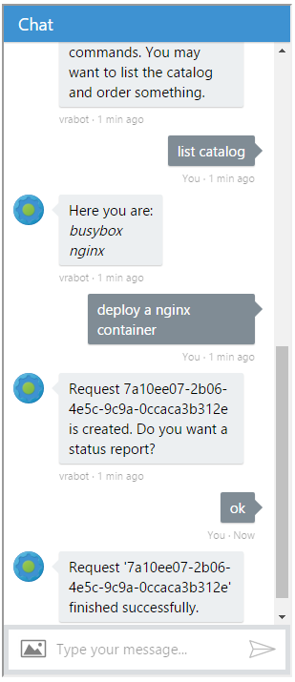

Hi, I’m your vRA Chat Bot!

Slide 2
vRA Bot for popular chat clients
Borathon 2016
Ventsyslav Raikov
Dimitar Ivanov

Slide 3
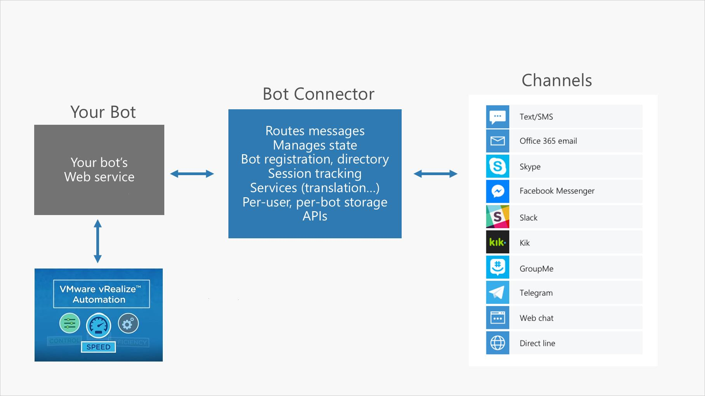
Chat Bot Architecture

Slide 4
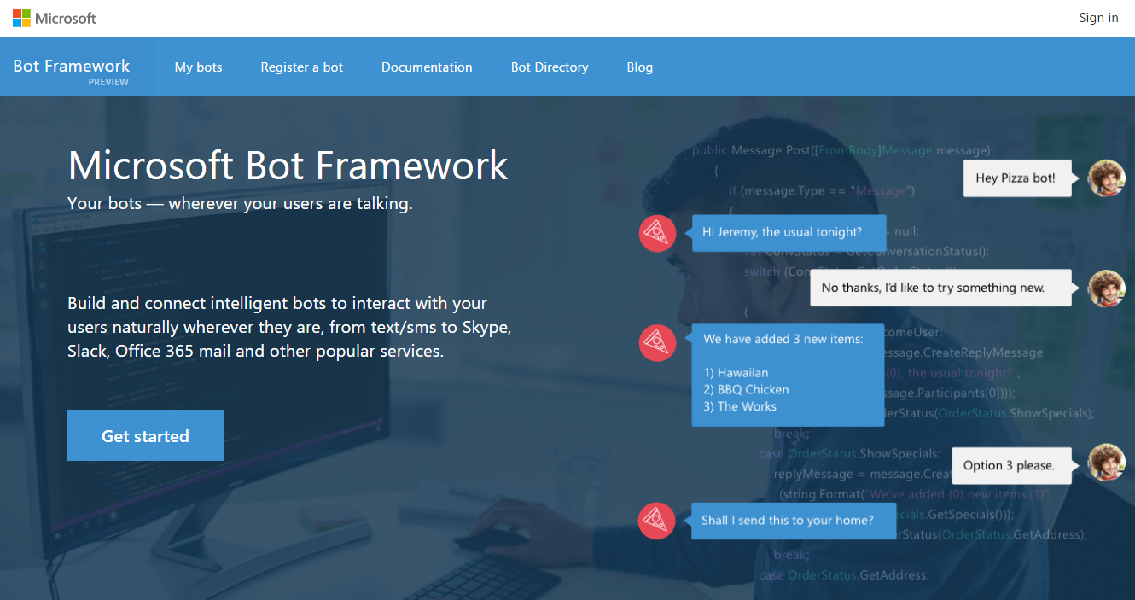
Technologies and Tools
Microsoft Bot Framework
Preview version
LUIS
Language understanding intelligent service
Microsoft Azure
App Services
GitHub auto deploy
Visual Studio 2015 and C# 6
One click Azure deployment

Slide 5
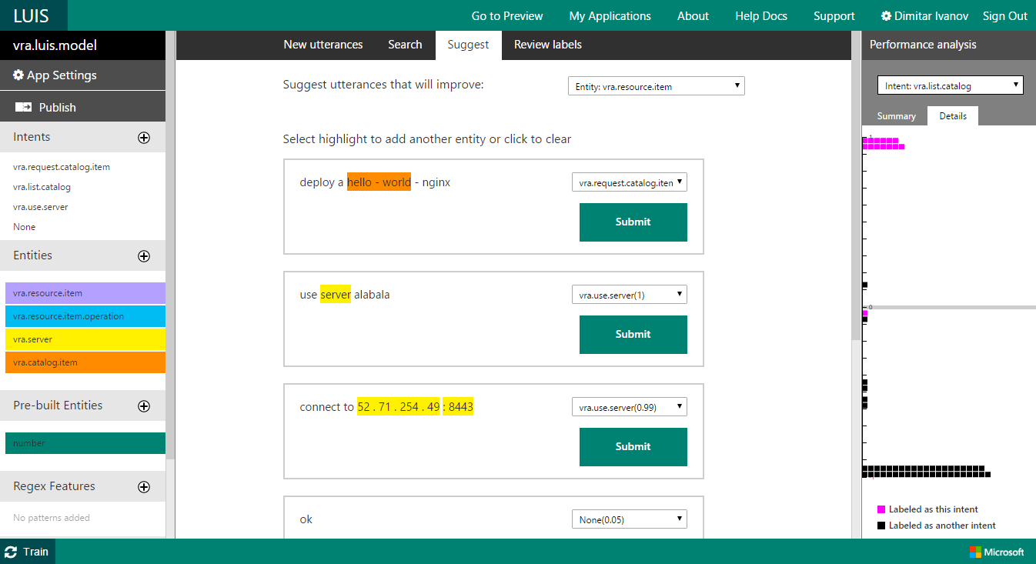
Technologies and Tools
Microsoft Bot Framework
Preview version
LUIS
Language understanding intelligent service
Microsoft Azure
App Services
GitHub auto deploy
Visual Studio 2015 and C# 6
One click Azure deployment

Slide 6
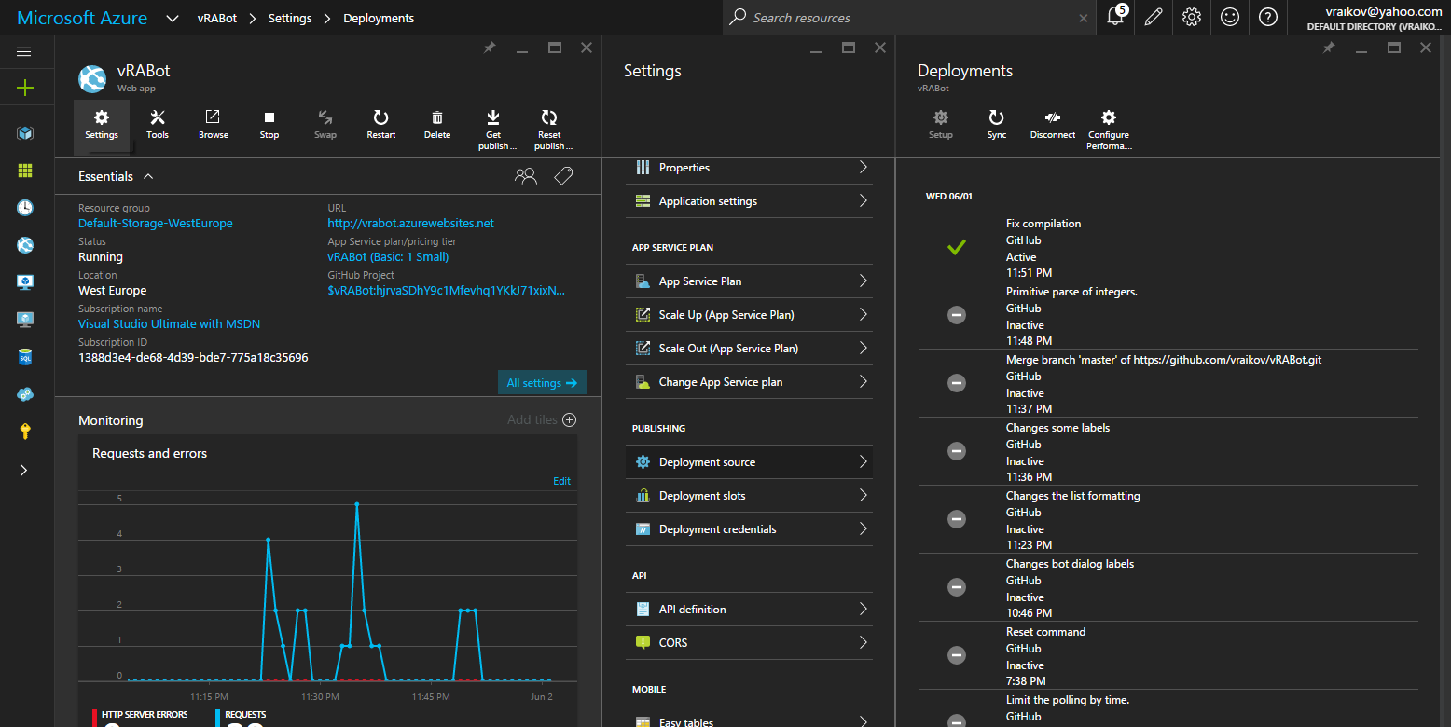
Technologies and Tools
Microsoft Bot Framework
Preview version
LUIS
Language understanding intelligent service
Microsoft Azure
App Services
GitHub auto deploy
Visual Studio 2015 and C# 6
One click Azure deployment

Slide 7
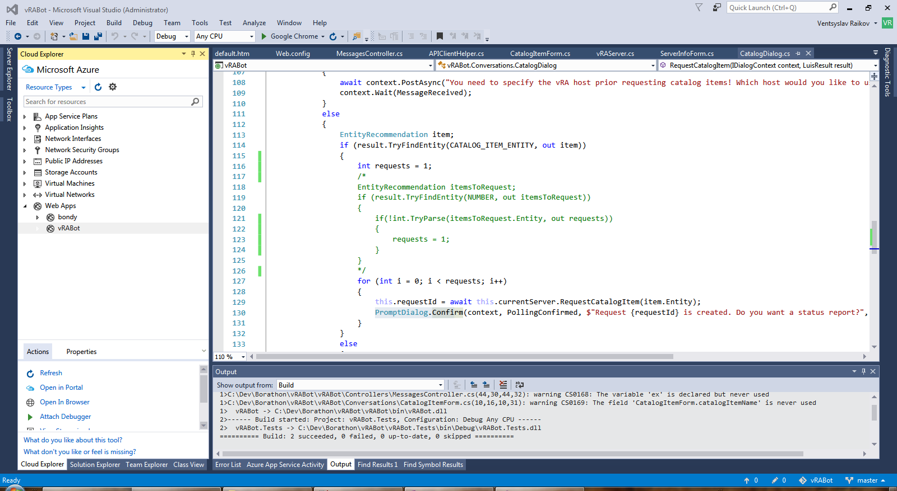
Technologies and Tools
Microsoft Bot Framework
Preview version
LUIS
Language understanding intelligent service
Microsoft Azure
App Services
GitHub auto deploy
Visual Studio 2015 and C# 6
One click Azure deployment

Slide 8
The Good
Natural language communication
Supports multiple chat clients
Skype, Slack, Facebook, Office 365, SMS, Web chat
You can integrate your own chat client
Implemented features
vRA authentication
List catalog items
Request catalog item
Report request status

Slide 9
The Bad
Password transferred in clear text
vRA or the Bot should be accessible from Azure
Not implemented
Request form fields
Second day operations

Slide 10
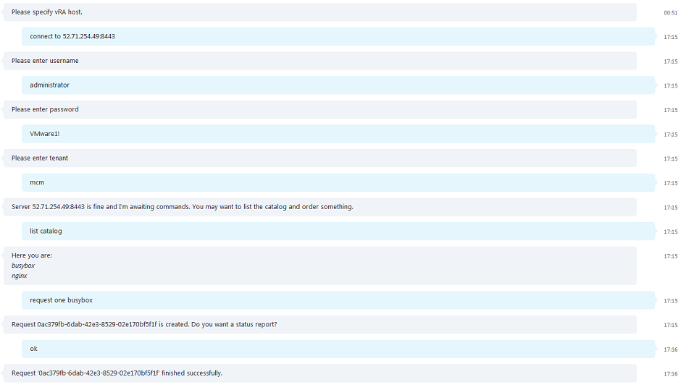
Demo

Slide 11
Thank You
vraikov@vmware.com
ivanovd@vmware.com

