Slide 1
Activity Diagrams
Activity diagram is basically a flowchart to represent the flow from one activity to another activity. The activity can be described as an operation of the system.
The control flow is drawn from one operation to another. This flow can be sequential, branched, or concurrent.
They display the order in which activities happen and whether they occur one after the other (sequential) or at the same time (concurrent).

Slide 2
Activity Diagram: what is it?
Describes activities and flows of data or decisions between activities
Provides a very broad view of business processes
Can be used to break out the activities that occur within a use case
Good for showing parallel threads
Notes:
Describes activities and flows of data or decisions between activities
Provides a very broad view of business processes
Can be used to break out the activities that occur within a use case
Commonly shows many different activities that will be handled by lots of different symbols
Good for showing parallel threads

Slide 3
Activity Diagram
Activity diagrams show the flow of control between activities
They can model the sequential and concurrent steps in a computational process
They can also model the flow of an object as it moves from state to state at different points in the activity

Slide 4
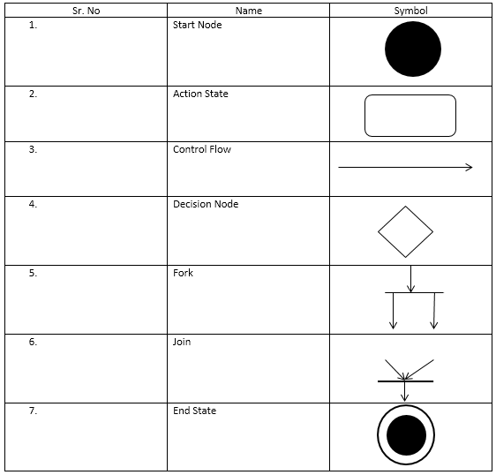
UML Activity symbols
Notes:
Action state:
In a conceptual diagram an activity is a task that needs to be done – either by a human or a computer
In a specification-perspective diagram or an implementation-diagram, an activity is a method on a class
State transition
In an activity diagram the states are activities representing the performance of operations. The transitions are triggered by the completion of the operations.
A transition is a relationship between two states. This transition indicates that control is passed from the first state of the second state once the work of the source state is complete.
The emphasized functional flow of control, transitions can be labelled, and contain parameters, guard conditions and action expressions.
Initial state
A pseudo state to establish the start of the event into an actual state.
Final state
Signifies when a state transition ends.
Decision
As in a flowchart, a conditional flow of control is modelled using the decision element. A decision is shown by labelling each output transition of a decision with a different guard condition.
SwimLane
It is a “package” for organizing activities within a class. Each zone or lane represents the responsibilities of a particular class or department. Swimlanes depict both the activity diagram’s logic along with the depiction (voorstelling,beschrijving) of responsibility. To use swimlanes, you must arrange your activity diagrams into vertical zones separated by dashed lines. Transitions may cross swimlane boundaries.
Merge Branch bar
The merge branch bar symbol is also known as a “synchronization bar”. It merges concurrent transitions to a single target. It splits a single transition into parallel transitions.

Slide 5
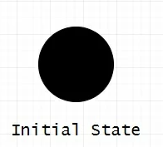
Initial State
The starting state before an activity takes place is depicted using the initial state.
use a black filled circle to depict the initial state of a system.

Slide 6
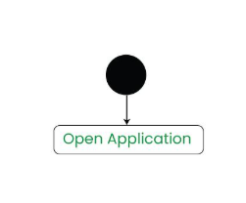
Action or Activity State
An activity represents execution of an action on objects or by objects.
We represent an activity using a rectangle with rounded corners.
Basically any action or event that takes place is represented using an activity.

Slide 7
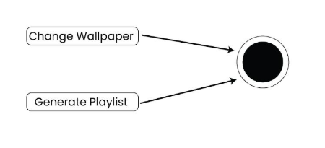
Action Flow or Control flows
Action flows or Control flows are also referred to as paths and edges. They are used to show the transition from one activity state to another activity state.
An activity state can have multiple incoming and outgoing action flows.
We use a line with an arrow head to depict a Control Flow.

Slide 8
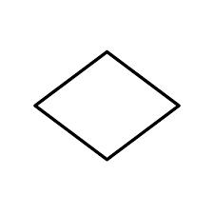
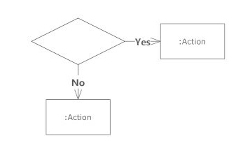
Decision node and Branching
When we need to make a decision before deciding the flow of control, we use the decision node.
The outgoing arrows from the decision node can be labelled with conditions or guard expressions. It always includes two or more output arrows.

Slide 9
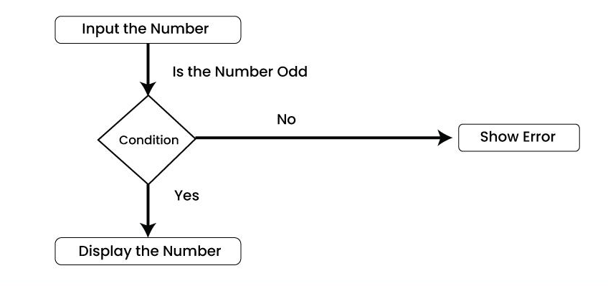
Example
When we have condition,
a) if number is odd then display the number.
b) If number is even then display the error.

Slide 10
Fork
Fork nodes are used to support concurrent activities.
When we use a fork node when both the activities get executed concurrently i.e. no decision is made before splitting the activity into two parts.
Both parts need to be executed in case of a fork statement.
We use a rounded solid rectangular bar to represent a Fork notation with incoming arrow from the parent activity state and outgoing arrows towards the newly created activities.

Slide 11
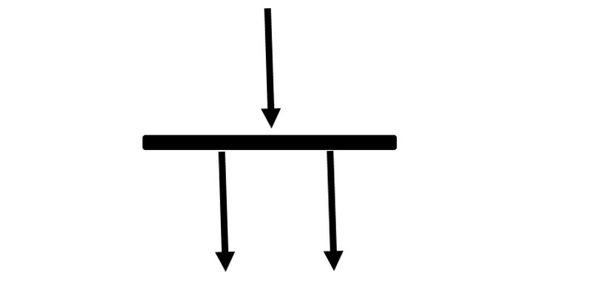
Fork
A fork node is used to split a single incoming flow into multiple concurrent flows.

Slide 12
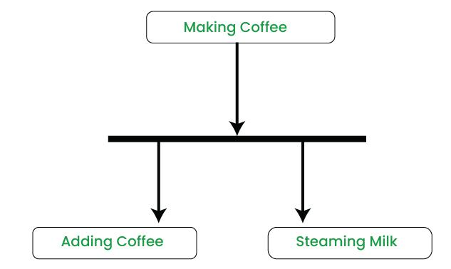
Example
In the example below, the activity of making coffee can be split into two concurrent activities and hence we use the fork notation.

Slide 13
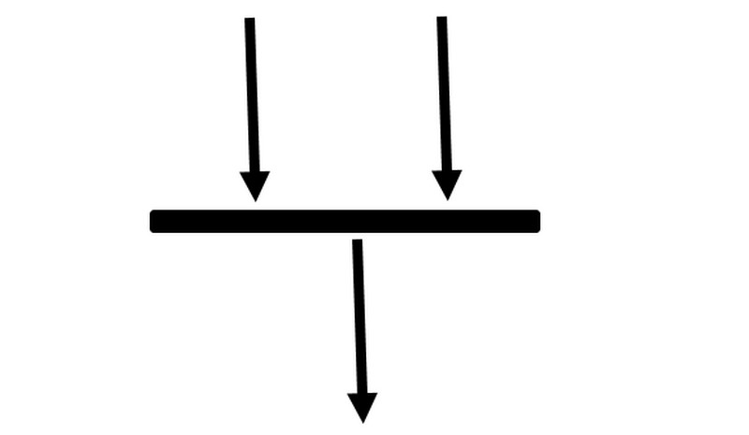
Join
Join nodes are used to support concurrent activities converging into one. For join notations we have two or more incoming edges and one outgoing edge.

Slide 14
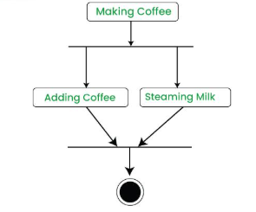
When both activities i.e. steaming the milk and adding coffee get completed, we converge them into one final activity.

Slide 15
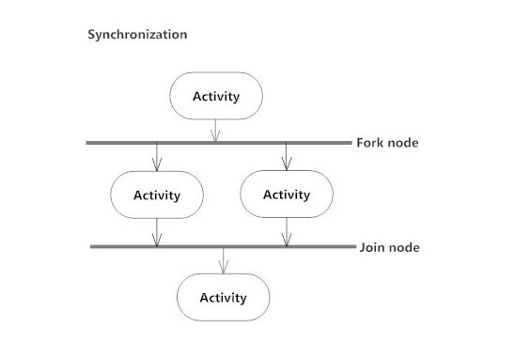

Slide 16
Fork & Join

Slide 17
Merge or Merge Event
Scenarios arise when activities which are not being executed concurrently have to be merged.
We can merge two or more activities into one if the control proceeds onto the next activity irrespective of the path chosen.
Notes:
Guards should therefore not overlap but cover all possibilities.
You can label one transition with [else]; if all other guards elate to false, then the [else] transition is taken.

Slide 18
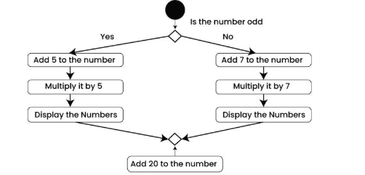

Slide 19
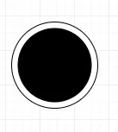
Final state
The state which the system reaches when a particular process or activity ends is known as a Final State or End State.
We use a filled circle within a circle notation to represent the final state in a state machine diagram.
A system or a process can have multiple final states.

Slide 20
Swim lanes
Swimlanes are used for grouping related activities in one column.
Swimlanes group related activities into one column or one row.
Swimlanes can be vertical and horizontal.
Swimlanes are used to add modularity to the activity diagram.
It is not mandatory to use swimlanes.

Slide 21
Swim lanes
It's similar to creating a function in a program. It's not mandatory to do so, but, it is a recommended practice.
Swimlanes are used to add modularity to the activity diagram. It is not mandatory to use swimlanes. They usually give more clarity to the activity diagram. It's similar to creating a function in a program. It's not mandatory to do so, but, it is a recommended practice.

Slide 22
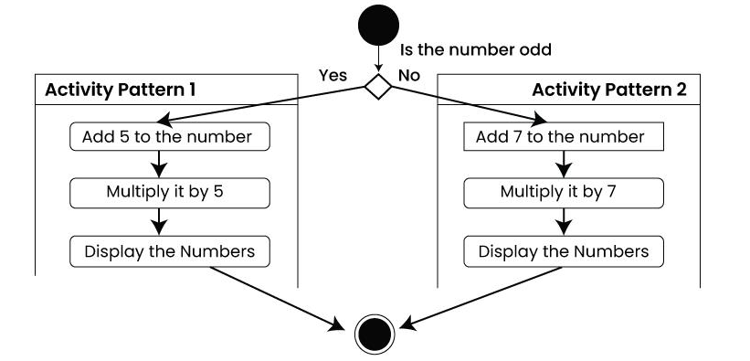
different set of activities are executed based on if the number is odd or even. These activities are grouped into a swimlane.

Slide 23
Swim lanes

Slide 24
Sequential Branching
A sequential branch is represented as a diamond
It may have one incoming transition and two or more outgoing transitions
Guards are associated with each transition. The guards are evaluated upon entering the branch, and the one that evaluates to true is then taken
Notes:
Guards should therefore not overlap but cover all possibilities.
You can label one transition with [else]; if all other guards elate to false, then the [else] transition is taken.

Slide 25
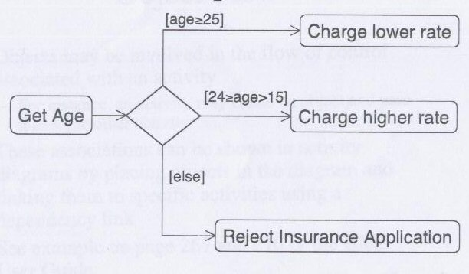
Example

Slide 26
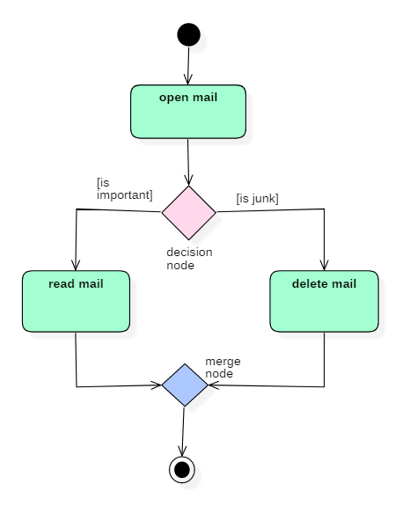
Simple Activity Diagram

Slide 27
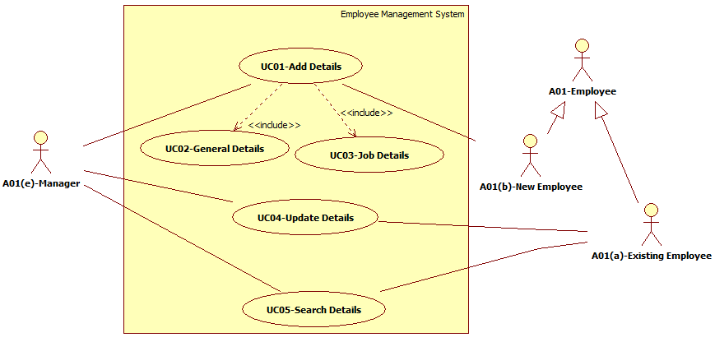
Employee Management System

Slide 28
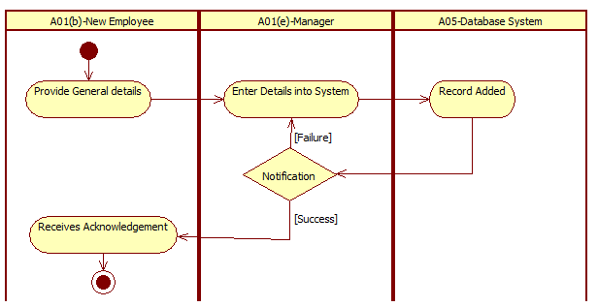
Add Details

Slide 29
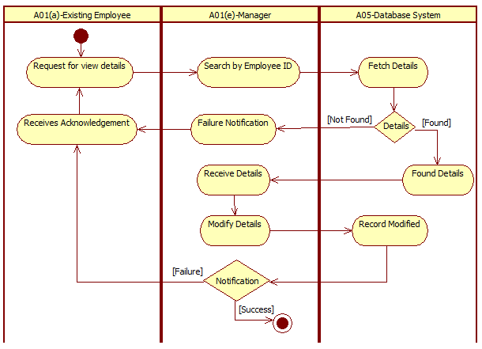
Update Details

Slide 30
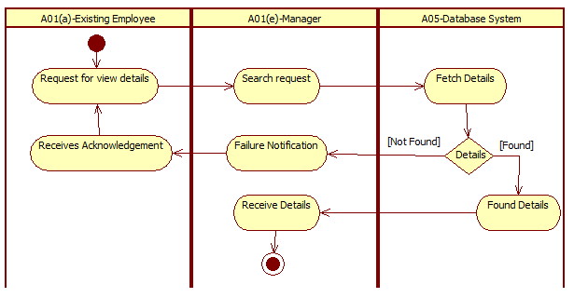
Search Details

Slide 31
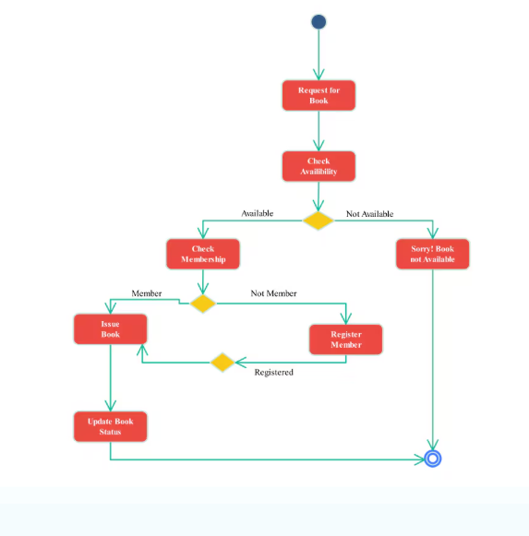

Slide 32
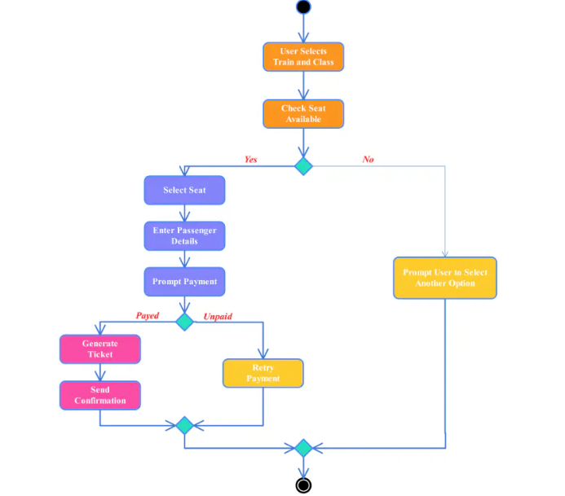

Slide 33
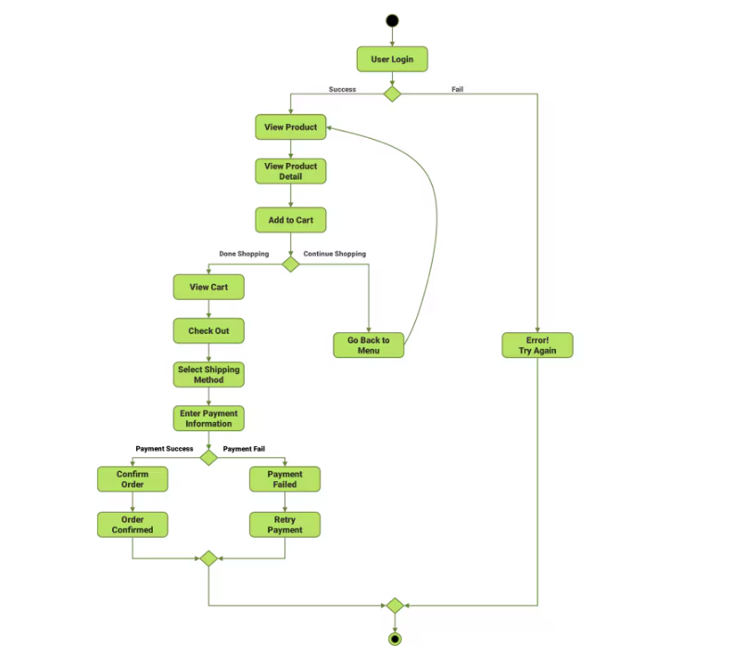

Slide 34
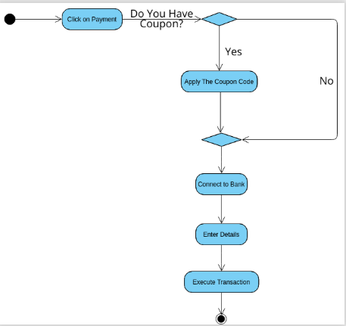

Slide 35
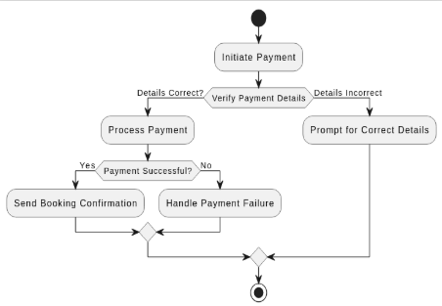

Slide 36
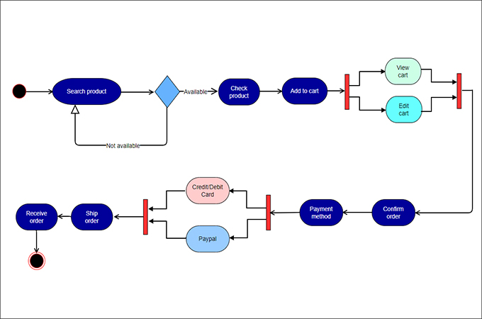

Slide 37
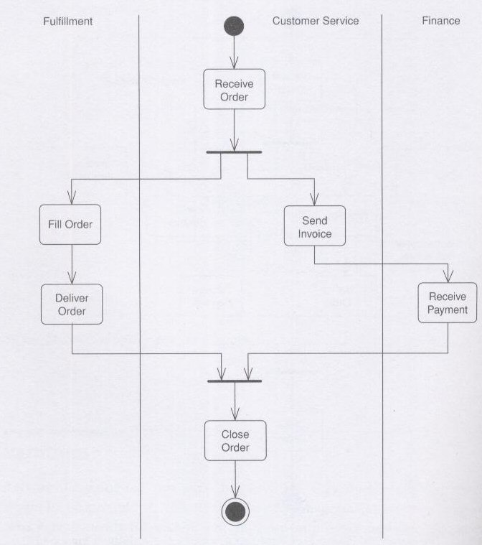

Slide 38
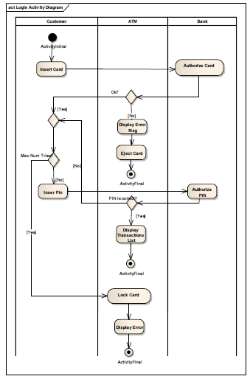

Slide 39
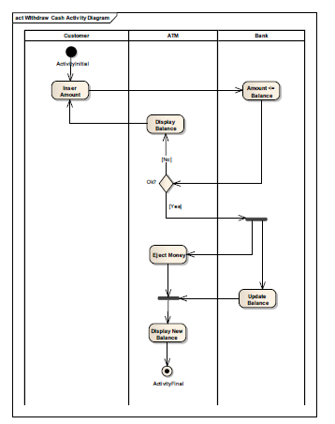

Slide 40
