Slide 1
Evolution of computers
00110001
Vraj
01001000 01001001
(Hi)
FY D EC

Slide 2
Index:-
00110010
Introduction
First generation of computer
Second generation of computer
Third generation of computer
Fourth generation of computer
Fifth generation of computer

Slide 3

What is a Computer?
00110011
Computer is an electronic device which is capable of receiving data in a particular form and performing a sequence of operation on predetermined instructions to give output.
?

Slide 4
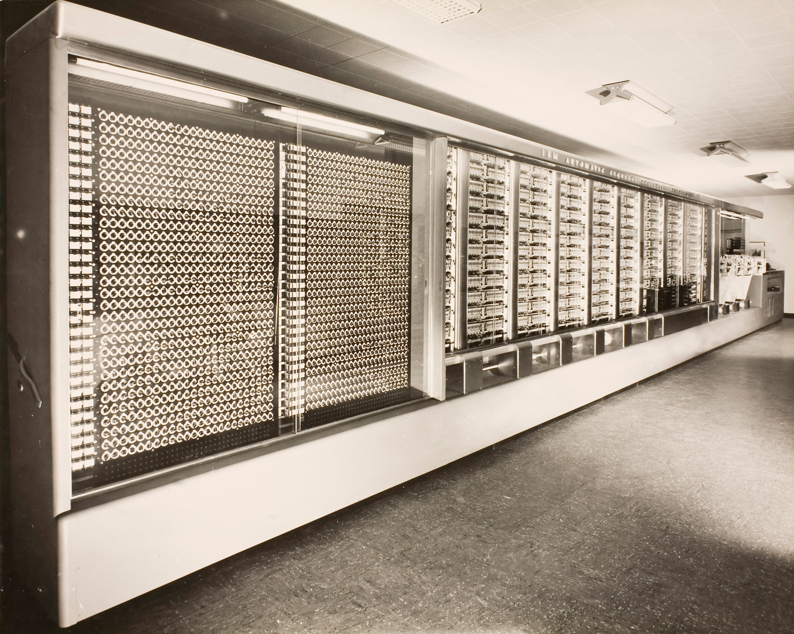
Mark 1
00110100
Mark 1 made in 1944 which is used for purely for calculation at that time.
The weight of this computer was around 5 tons which is equal to 4535.92 Kg.

Slide 5

First generation of computers
00110101
Time period:- 1940 to 1956
Size:- Very large in size
Note:- These machines required magnetic drums for memory and vacuum tubes that worked as switch and amplifiers.

Slide 6
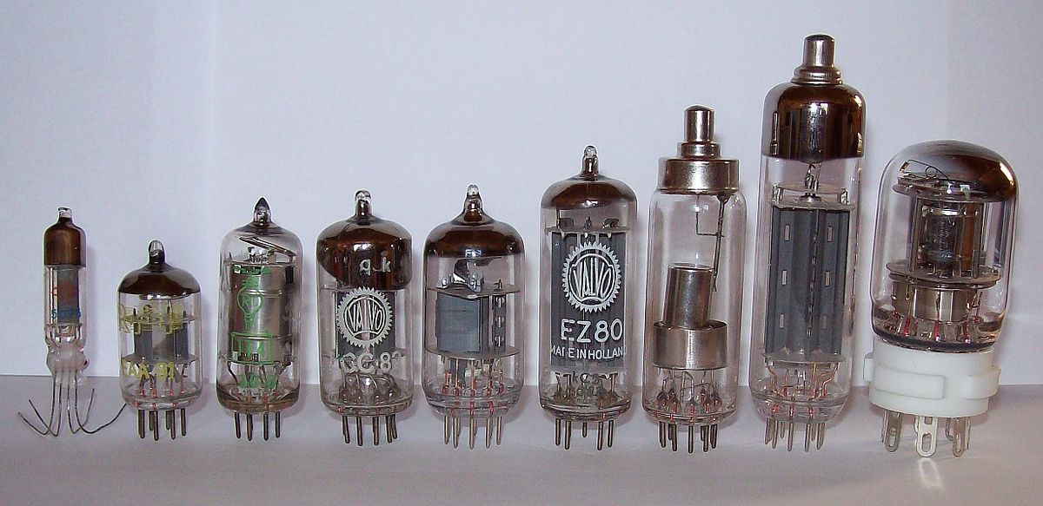
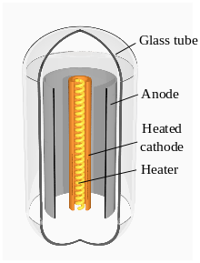

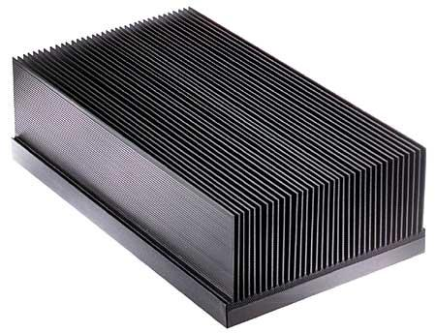
What are vacuum tubes?
00110110
Bigger size!
Of
computer
+
=

Slide 7
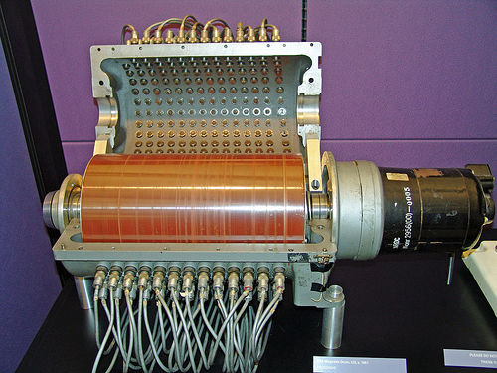
What are magnetic drums?
00110111
A metallic cylinder with metal oxide material on which data can be stored.

Slide 8
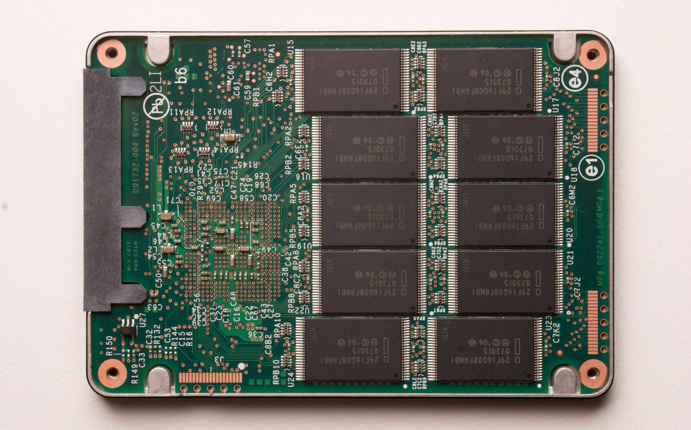
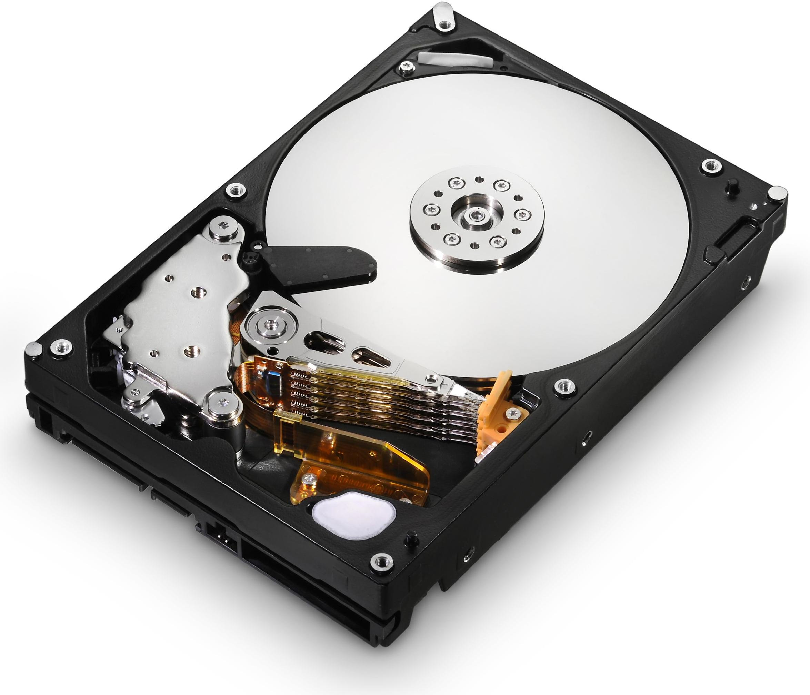
00111000
S.S.D
H.D.D

Slide 9
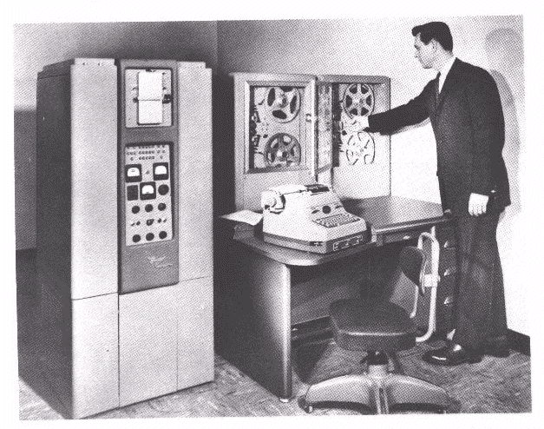
Second generation of computers
00111001
Time period:- 1956 to 1963
Size:- Smaller than the previous due to transistor.
Note:- Second Generation computers were faster and used core memory for storage along with magnetic drums.

Slide 10
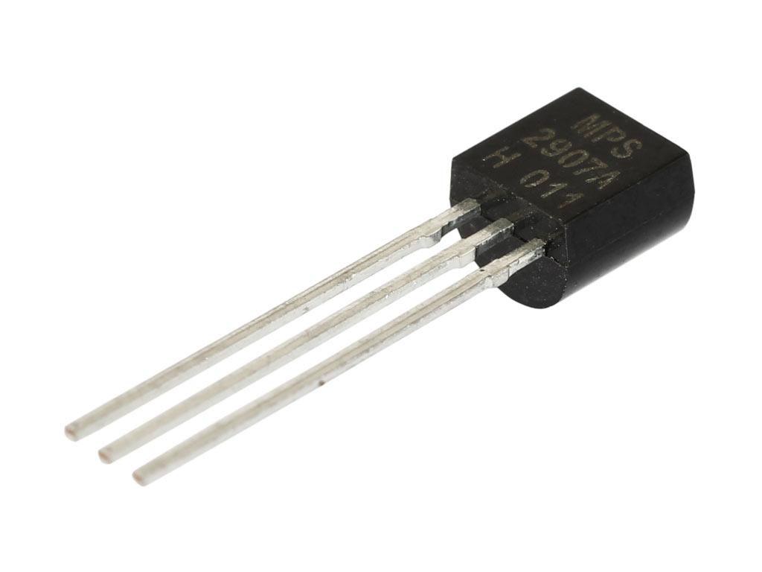
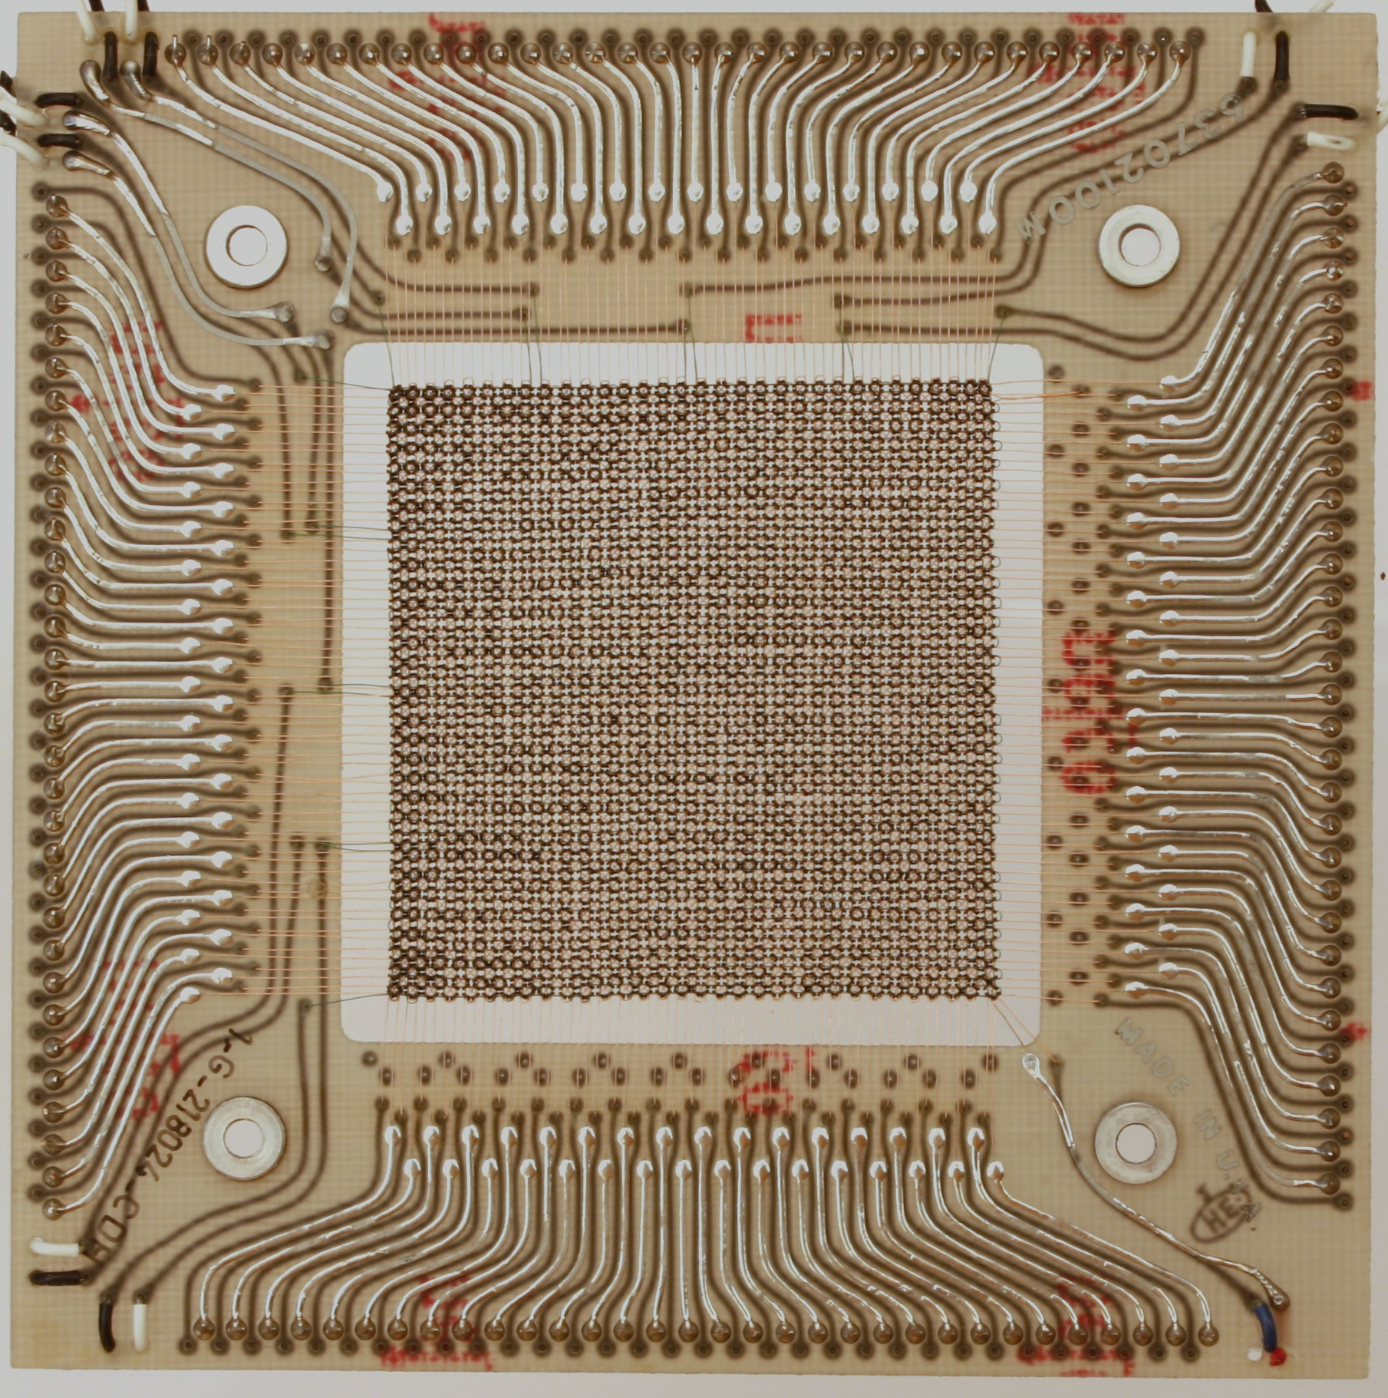
00110001 00110000
Transistor
Core Memory

Slide 11
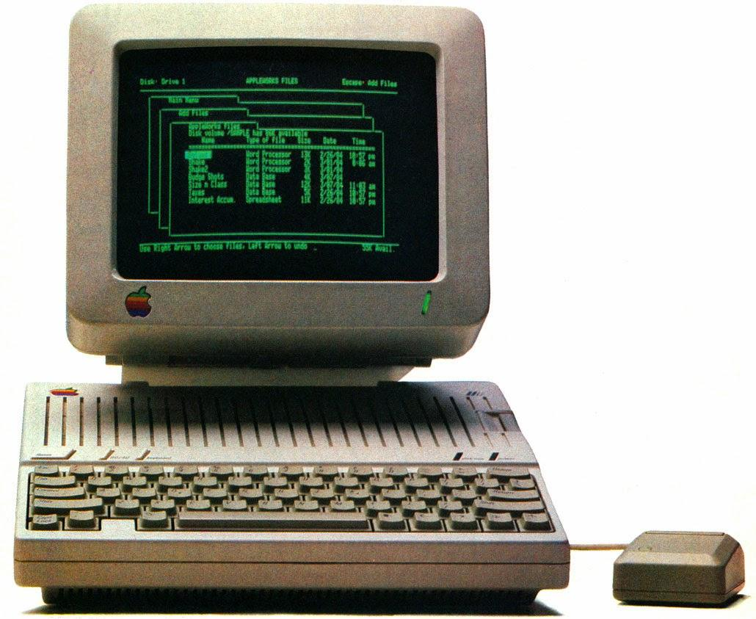
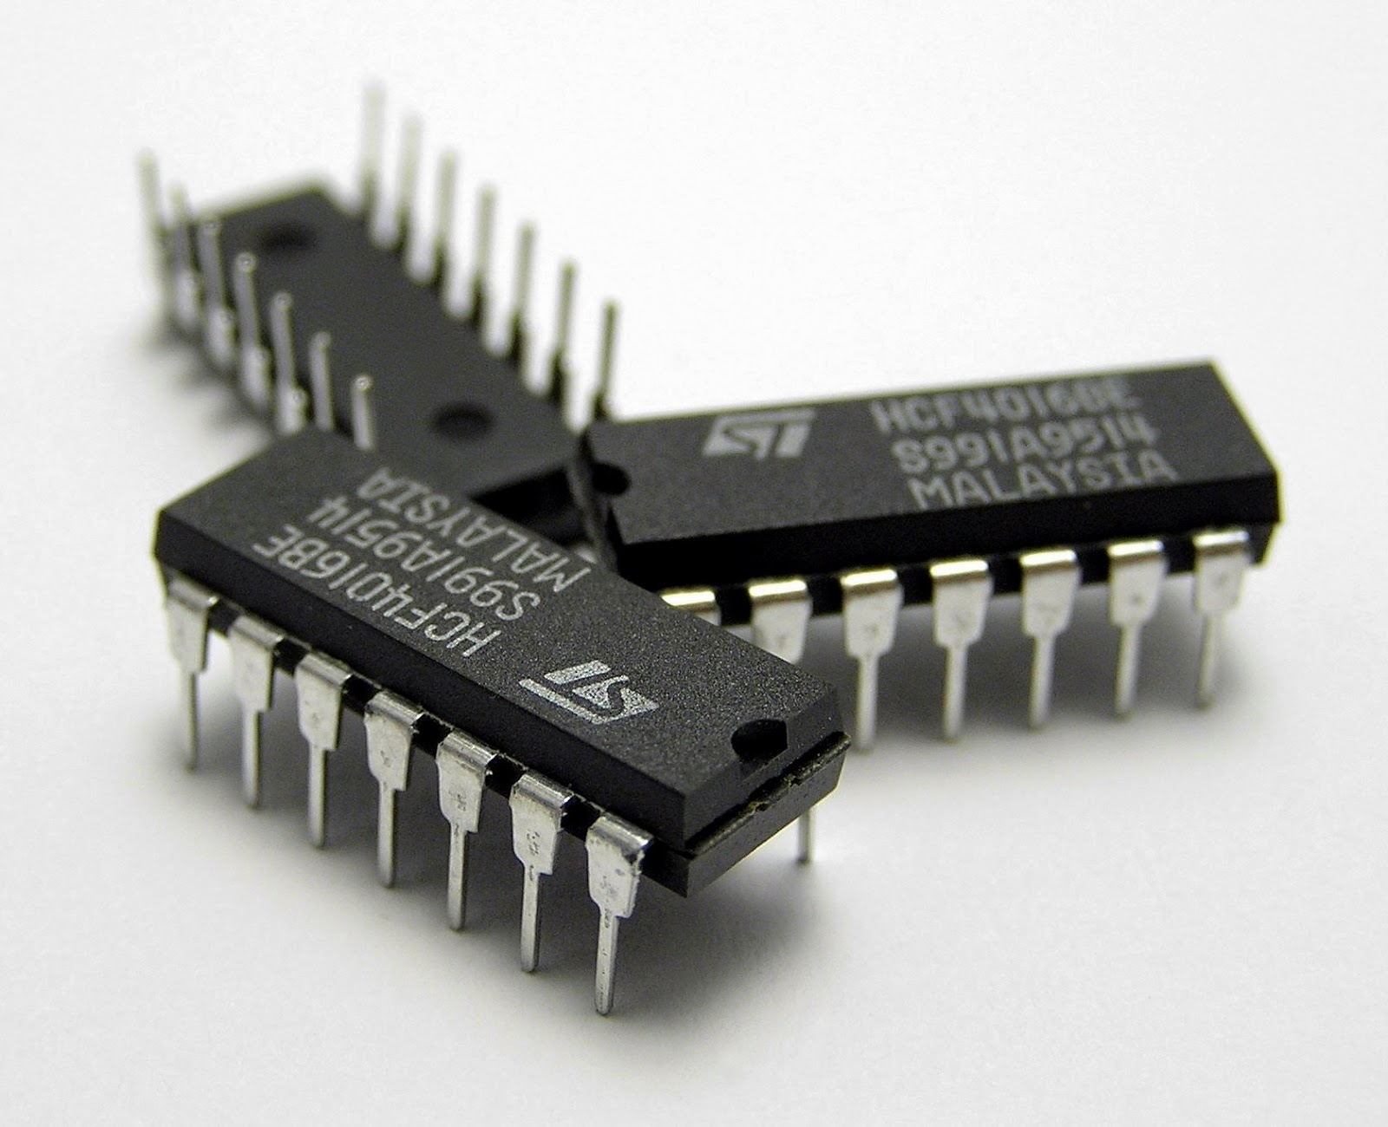
Third generation of computers
00110001 00110001
Time period:- 1964 to 1961
Size:- Very smaller than the previous.

Slide 12
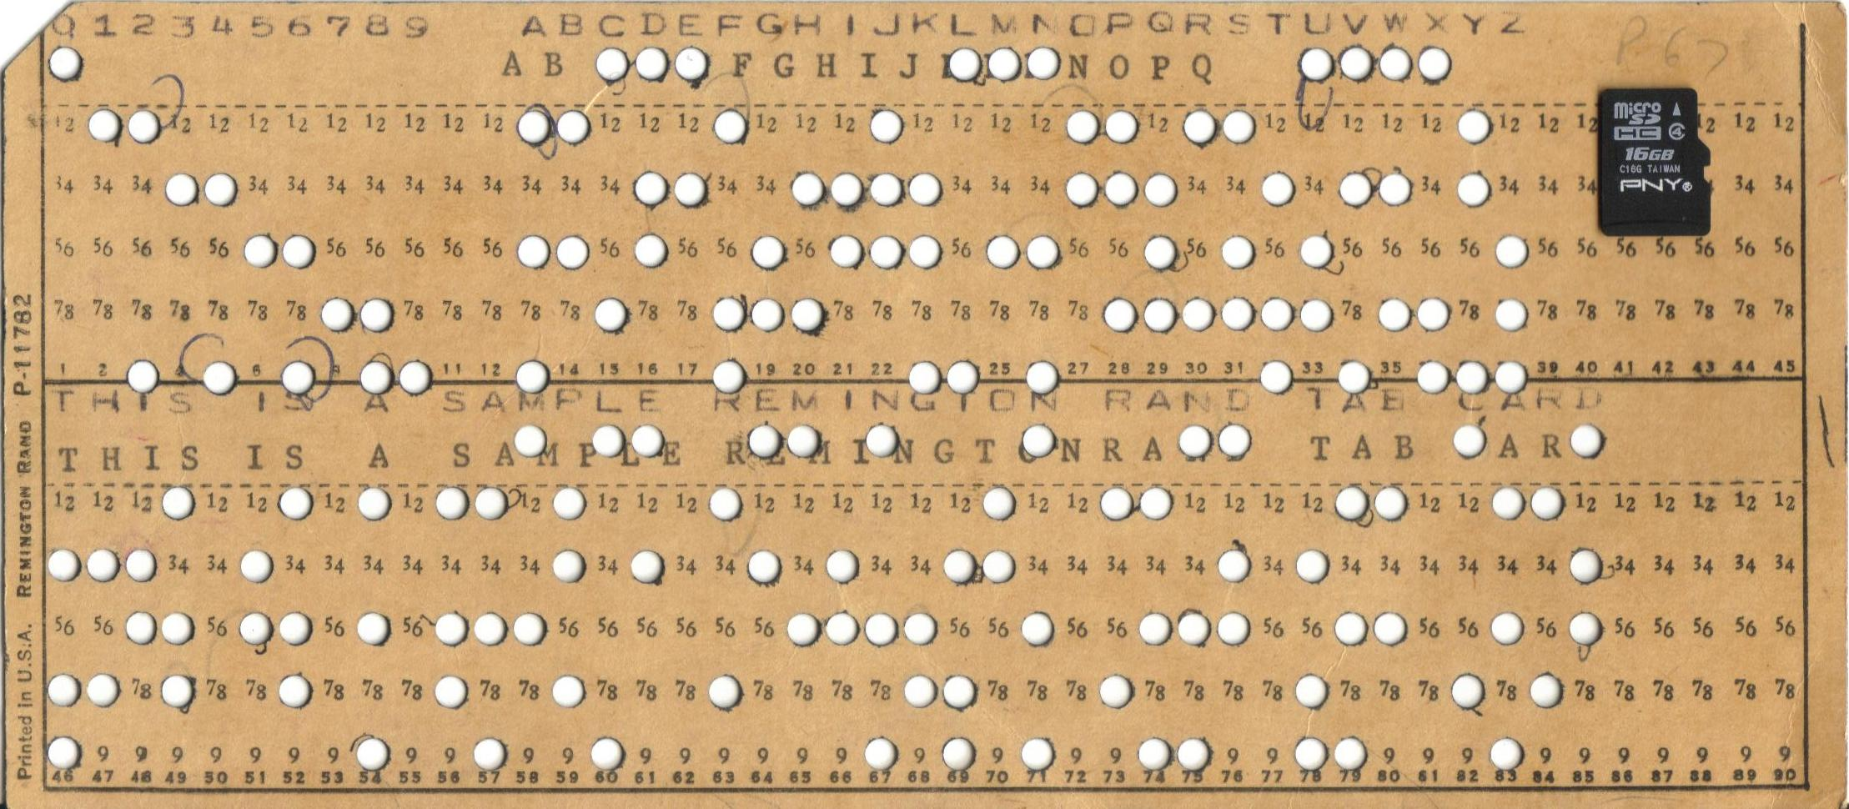
00110001 00110010

Slide 13
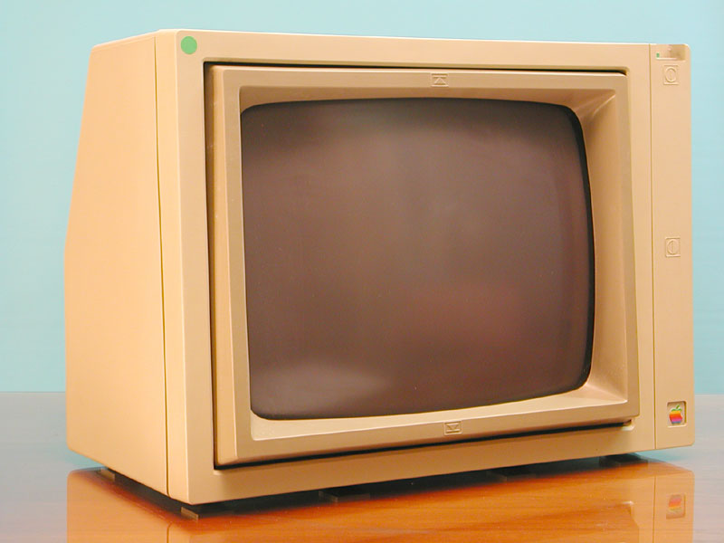
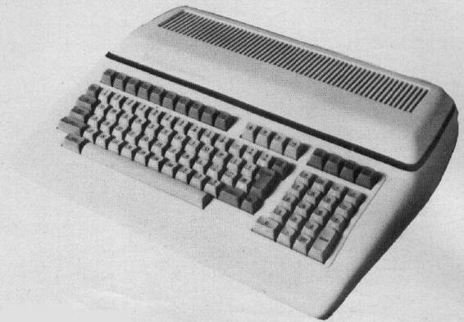
00110001 00110011
Moniter
Keyboard

Slide 14
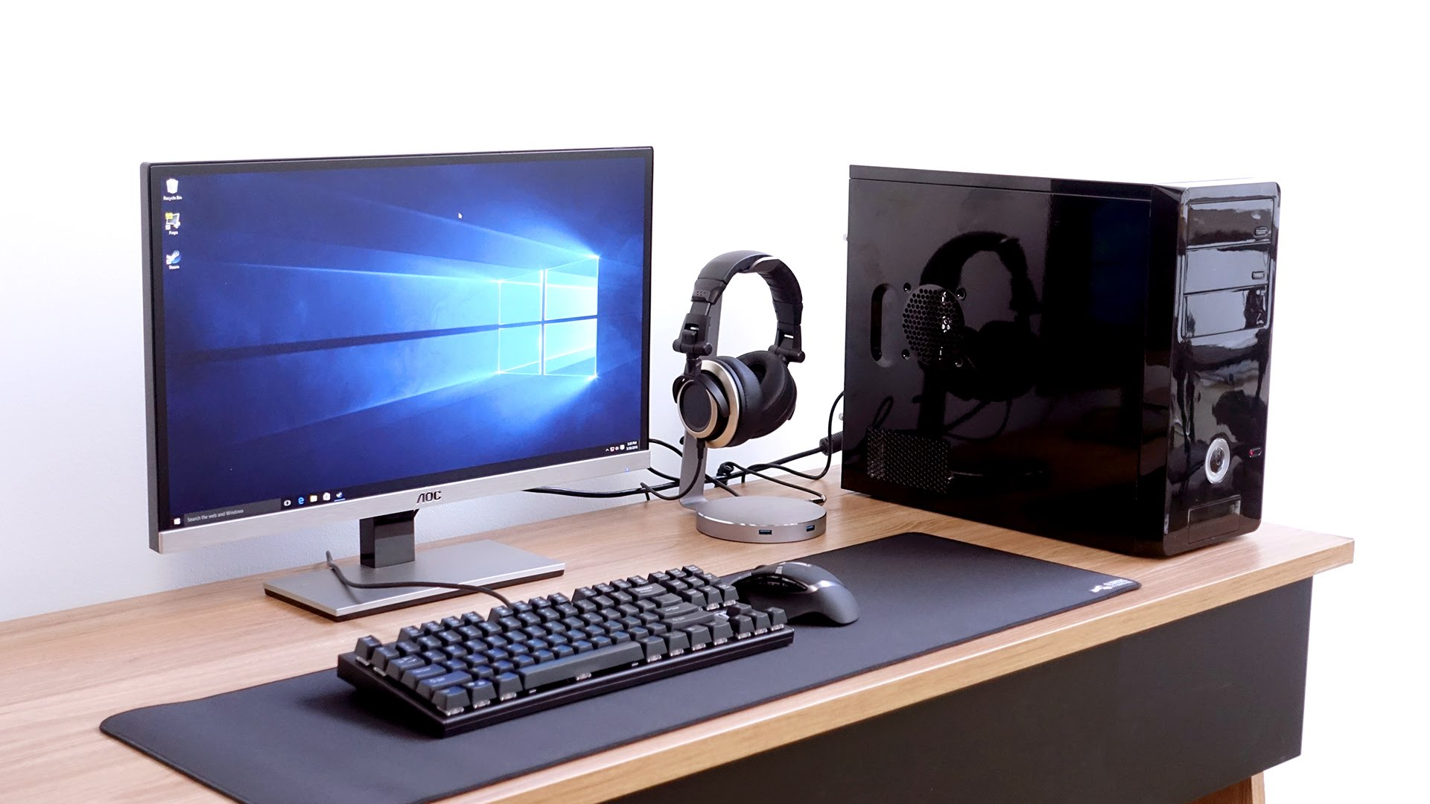
Fourth generation of computers
00110001 00110100
Time period:- 1971 to Present
Note:- In this generation the companies like intel, Amd, etc. could put millions of transistors on a single silicon chip. And in this time period Microprocessor were commercially available in the market which allowed users to make there own pc at home.

Slide 15
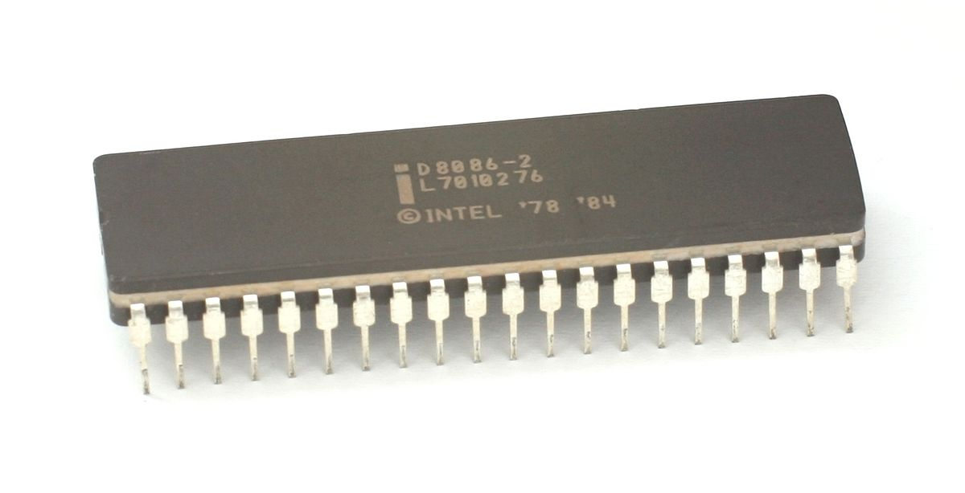
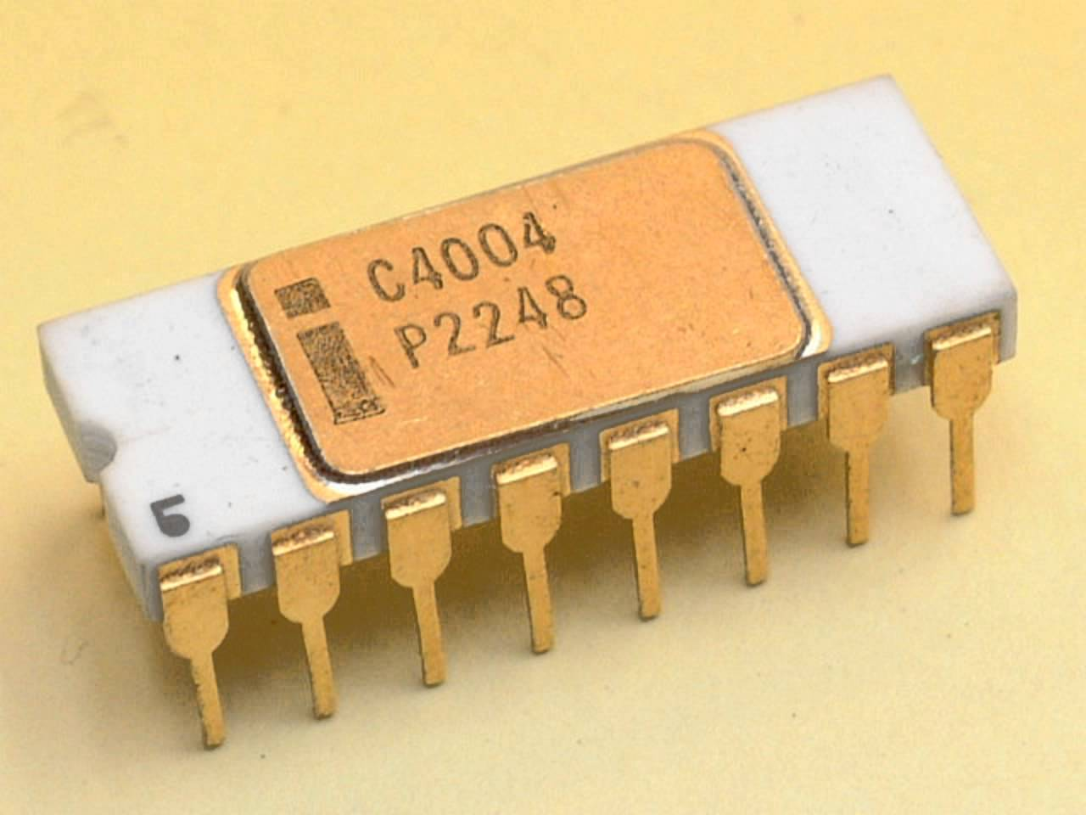
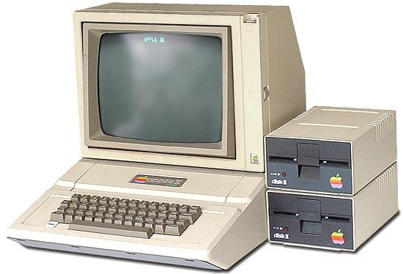
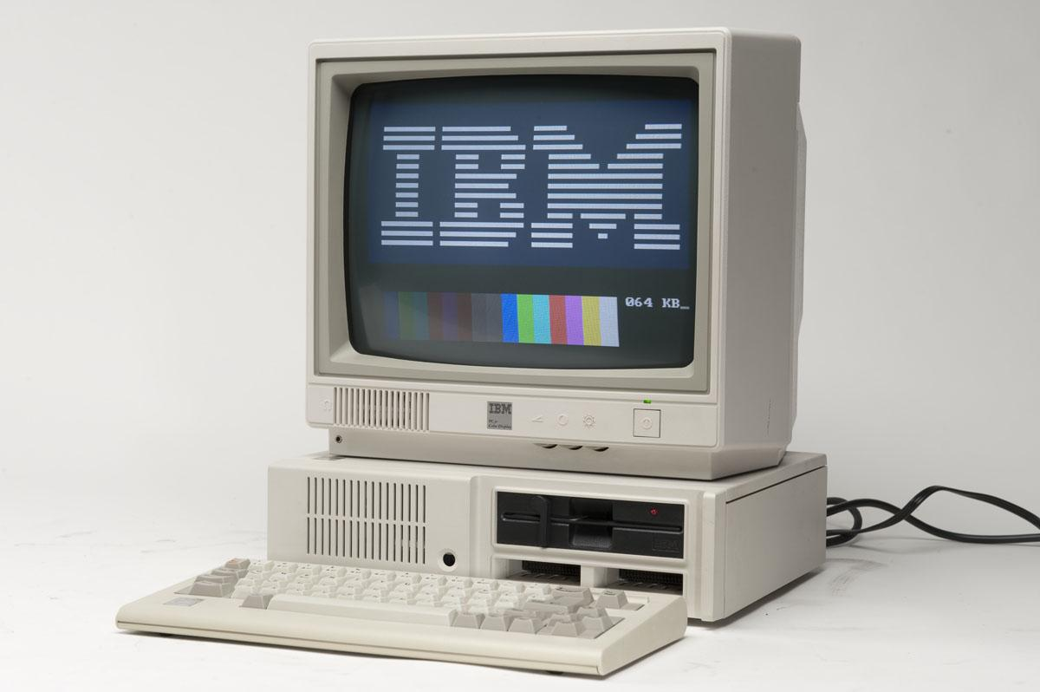
00110001 00110101

Slide 16
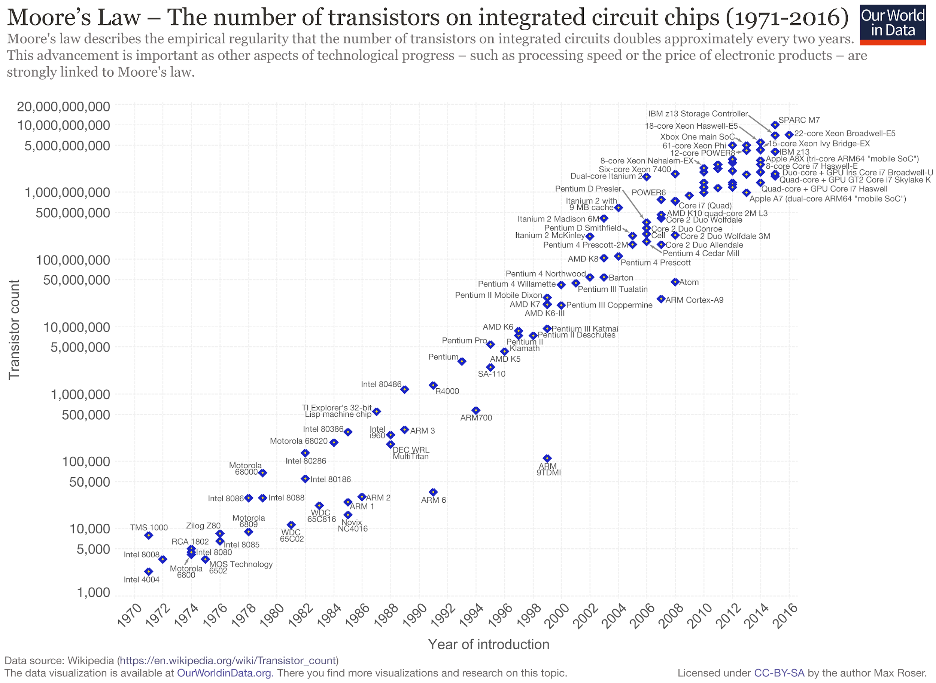
00110001 00110110
M
O
O
R’
S
L
A
W

Slide 17
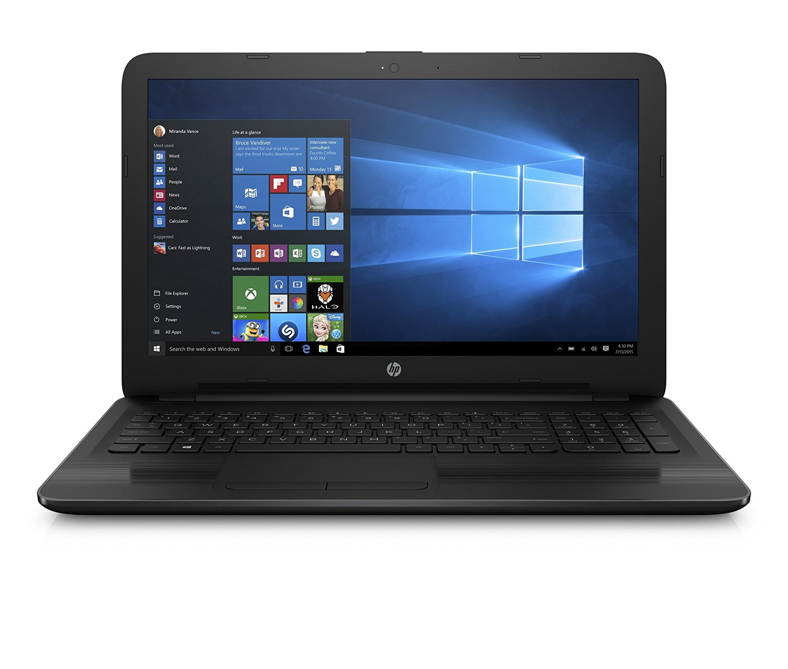
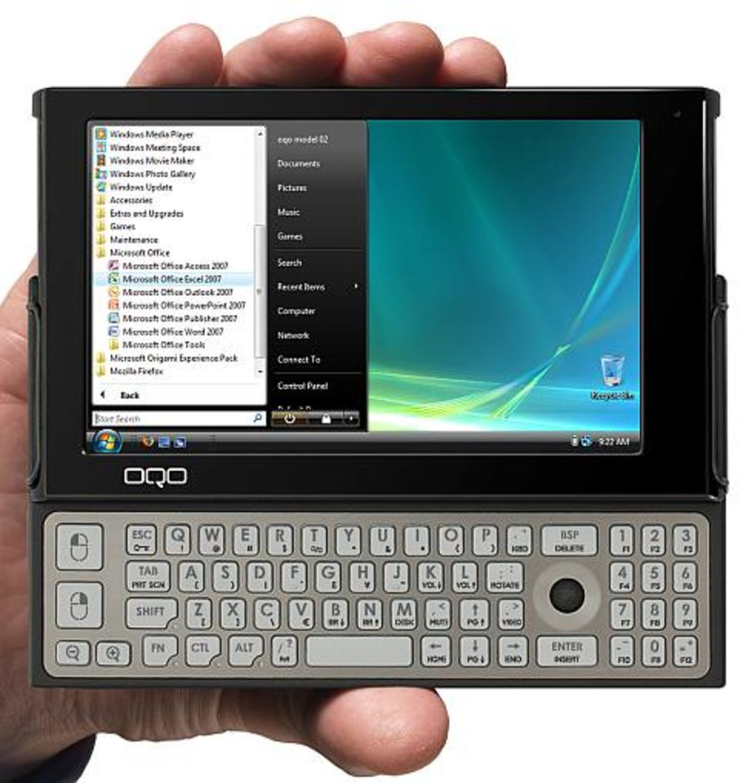
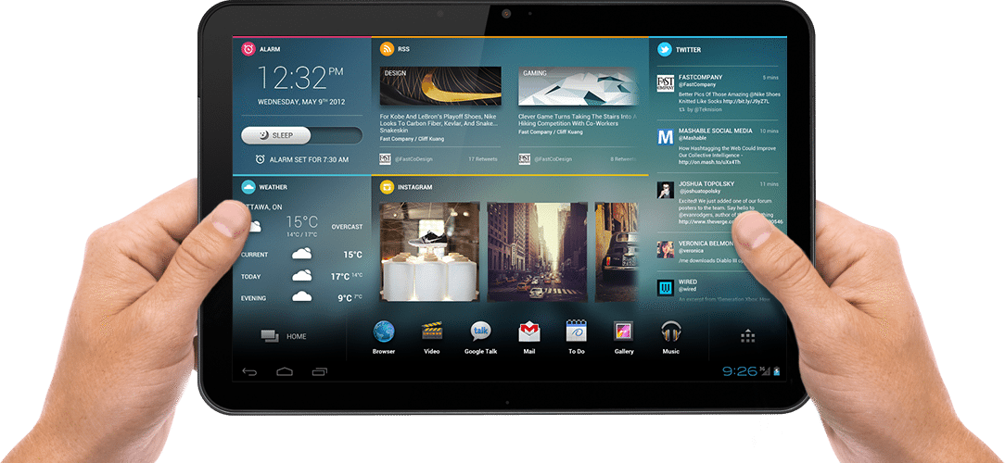
00110001 00110111
Era of portable devices begin

Slide 18
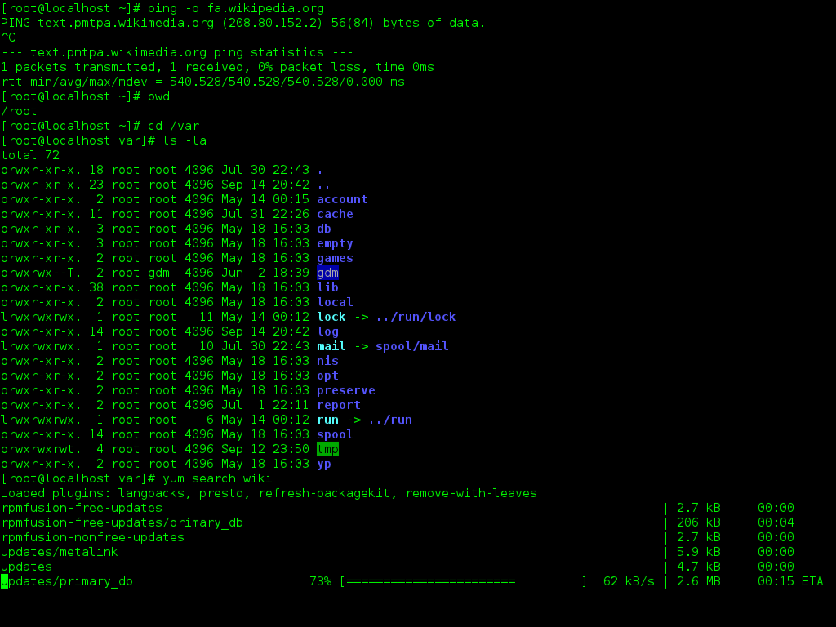
00110001 00111000
C
U
I
Notes:
00110001 00111000

Slide 19
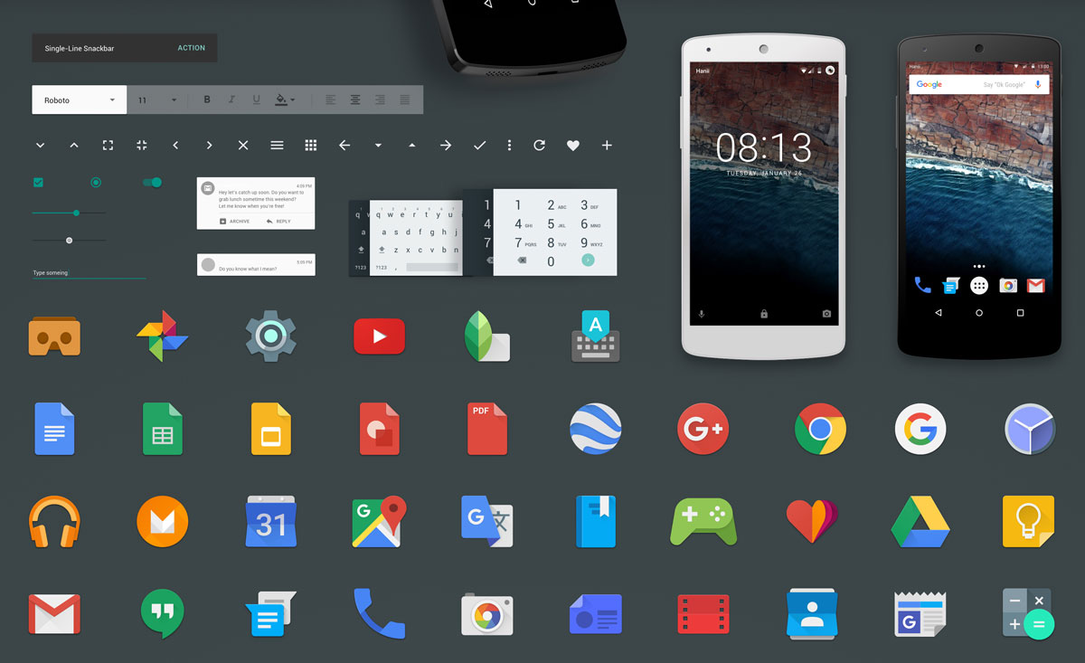
00110001 00111001
G
U
I

Slide 20
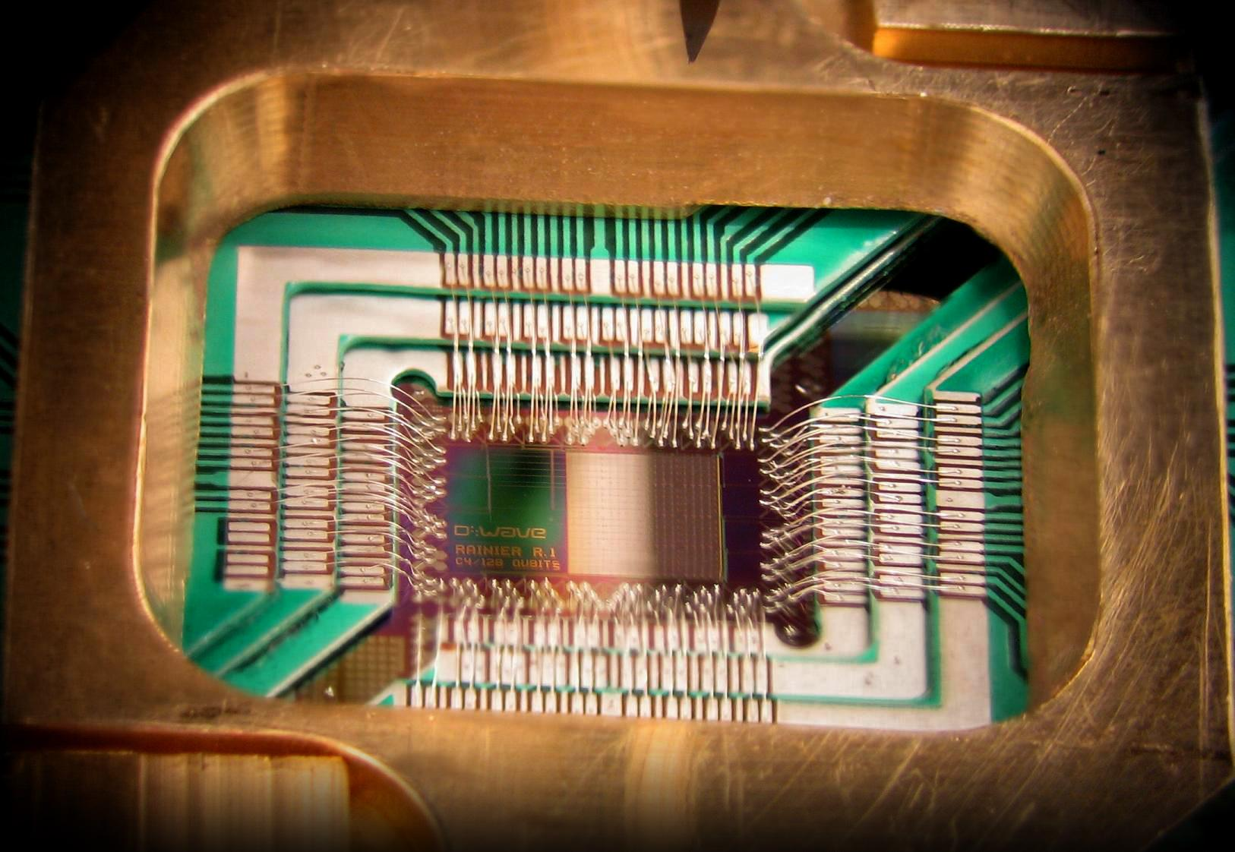
Fifth generation of computers
00110010 00110000
Time period:- Future
Technology:- Quantum Computing

Slide 21
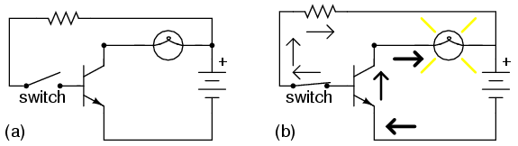
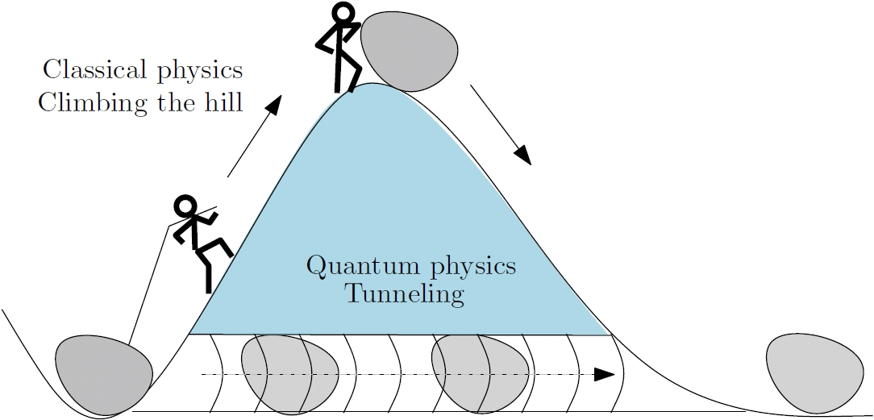
What is the need of quantum computers?
00110010 00110001
32 nm
22 nm
14 nm
10 nm
7 nm
5 nm
END

Slide 22
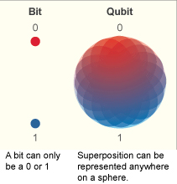
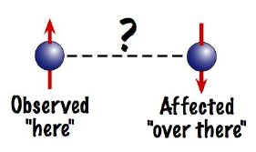
00110010 00110010
QUBIT
Superposition

Slide 23
00110010 00110011
I/P
Quantum computer
O/P
Dgital
O/P
I/P
0
0
1
O/P
O/P
O/P
O/P

Slide 24
This were the various generation of computers through which we got till today and the possible future of computing data.
00110010 00110100

Slide 25
00110010 00110101
01010100 01101000 01100001 01101110 01101011 00100000 01111001 01101111 01110101
(Thank you)

Slide 26
https://www.qbit.it/lab/bintext.php for (01001000 01001001) http://sites.harvard.edu/~chsi/markone/futurism.html (mark 1) https://www.google.co.in/imgres?imgurl=https%3A%2F%2Fourworldindata.org%2Fwp-content%2Fuploads%2F2013%2F05%2FTransistor-Count-over-time.png&imgrefurl=https%3A%2F%2Fourworldindata.org%2Ftechnological-progress%2F&docid=BzqaLBX3g2cKhM&tbnid=oVM3Tla_jMxNbM%3A&vet=1&w=3000&h=2191&bih=613&biw=1024&q=moore%27s%20law&ved=0ahUKEwi7hvKbmtbSAhUBuY8KHR_lCwsQMwg4KAgwCA&iact=mrc&uact=8#h=2191&imgrc=oVM3Tla_jMxNbM:&vet=1&w=3000(moors law) http://www.gadgette.com/wp-content/uploads/2016/04/DWave_128chip.jpg(quanum computers) https://kimminseodimension.files.wordpress.com/2014/04/image_127.jpg(quatum tounling) https://smd-prod.s3.amazonaws.com/science-red/s3fs-public/mnt/medialibrary/2004/01/20/23jan_entangled_resources/entangled_sm.jpg(entanglement) http://cdn.wonderfulengineering.com/wp-content/uploads/2014/06/What-is-Transistor-12.jpg(transistor) https://www.google.co.in/url?sa=i&rct=j&q=&esrc=s&source=images&cd=&ved=0ahUKEwiElqu6tNbSAhUFuo8KHV8nCP0QjBwIBA&url=http%3A%2F%2Fwww.corememoryshield.com%2Fvintage-core-full.jpg&bvm=bv.149397726,d.c2I&psig=AFQjCNFx-p8gmAS2-nUBw0fNqSeQyrkhHA&ust=148959512477440(corememory) https://upload.wikimedia.org/wikipedia/commons/thumb/d/d7/Desktop_computer_clipart_-_Yellow_theme.svg/1280px-Desktop_computer_clipart_-_Yellow_theme.svg.png(computer) https://www.google.co.in/imgres?imgurl=http%3A%2F%2Fwww.techiwarehouse.com%2Fuserfiles%2F1956Transistors.png&imgrefurl=http%3A%2F%2Fwww.techiwarehouse.com%2Fengine%2Fa046ee08%2FGenerations-of-Computer&docid=9f_YbHT8i1zTMM&tbnid=ItdmWmcrZUNH5M%3A&vet=1&w=627&h=494&bih=662&biw=1024&q=First%20generation%20of%20computers&ved=0ahUKEwi-rZPHudbSAhXFtY8KHdP0DQsQMwhXKB0wHQ&iact=mrc&uact=8#h=494&imgrc=ItdmWmcrZUNH5M:&vet=1&w=627(secound gen computer)http://ecx.images-amazon.com/images/I/81fVND6gGHL._SL1500_.jpg(laptop) http://oldcomputers.net/pics/appleii-system.jpg(apple 2) http://www.popsci.com/sites/popsci.com/files/styles/large_1x_/public/import/2013/images/2009/01/2inhand_white.jpg?itok=Meucnajg(hand held) http://2.bp.blogspot.com/-IbtMWQa9egw/VBg_laE20CI/AAAAAAAAABY/Pxz21GDkHJo/s1600/3rd.jpg(hend held) http://www.nortonsecurityonline.com/security-center/evolution-of-computers.html(data)
00110010 00110110
Reference:-

