Slide 1

Movie Recommendation System
Final Project for Massive Data Mining – Spring 2020
Team-16
Vraj Shah, Parva Shah, Rajiv Patel

Slide 2
Motivation of the project
In recent times companies like Netflix, YouTube, Amazon Prime, Hulu etc are always looking forward to increase their profit.
Their profit can be increased only if they engage more customers by providing what they want.
That’s why Item Recommendation Systems come into picture. In above mentioned examples items are nothing but the movies, videos or T.V. series.

Slide 3
Dataset Description
Dataset(MovieLens) consists of several files, but we have used below two files in order to build recommendation model.
Rating.csv: Contains all the ratings given by all the users. Ratings are provided on the scale of 1-5.
Movies.csv: Contains all the movies and their metadata.

Slide 4
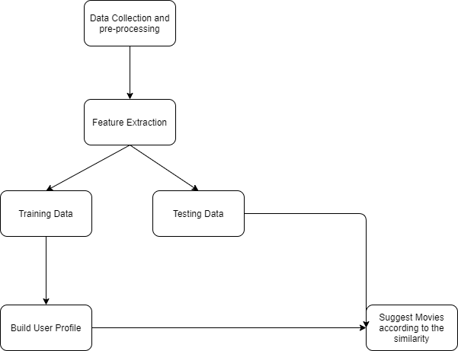
Recommendation Procedure
Goal: Recommend movies to individual user in which they might be interested in.
The movies we suggest ideally it should match testing data.

Slide 5
Recommender System
Content Based Filtering:
It does not depend on other user’s rating in order to recommend movies.
Able to recommend new and unpopular items.
You also could provide explanation for recommended items.
But it suffers from cold start problem.
Item-Item Collaborative Filtering:
We also implemented this algorithm to overcome above mentioned problem.
But it suffers from the problem called “Harry Potter Effect” i.e. it tends to recommend popular items because neighbourhood of any item would include popular items.
And also because most of the users might not have rated most of the movies, hence user-rating matrix would be sparse.
In conclusion, we got better result in Content Based Filtering than Item-Item CF. So, we decided to go with that approach.

Slide 6
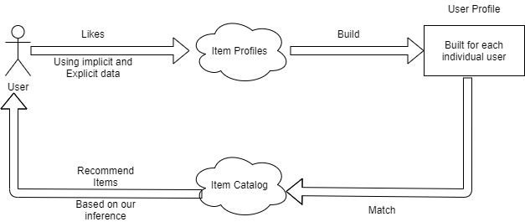
High Level Diagram of Content Based Filtering

Slide 7
Building Model
From the given dataset we first built item profiles using genres as features.
And from that we built user profiles for each user considering normalized ratings and taking weighted average.
We then used cosine similarity to find the similar items to the user’s preference.
And then recommended top 10 items whose similarity is highest.

Slide 8
Comparing result of both system
Approach | RMSE
Content Based Filtering | 0.91
Item-Item CF | 1.04

Slide 9
Final Outcome
Once we developed our model, we developed UI to display our data. For that we used open source library in python called Flask.
Working: You enter userID and it calls server where we have hosted our model and it recommends top 10 movies and response is rendered on UI.

Slide 10
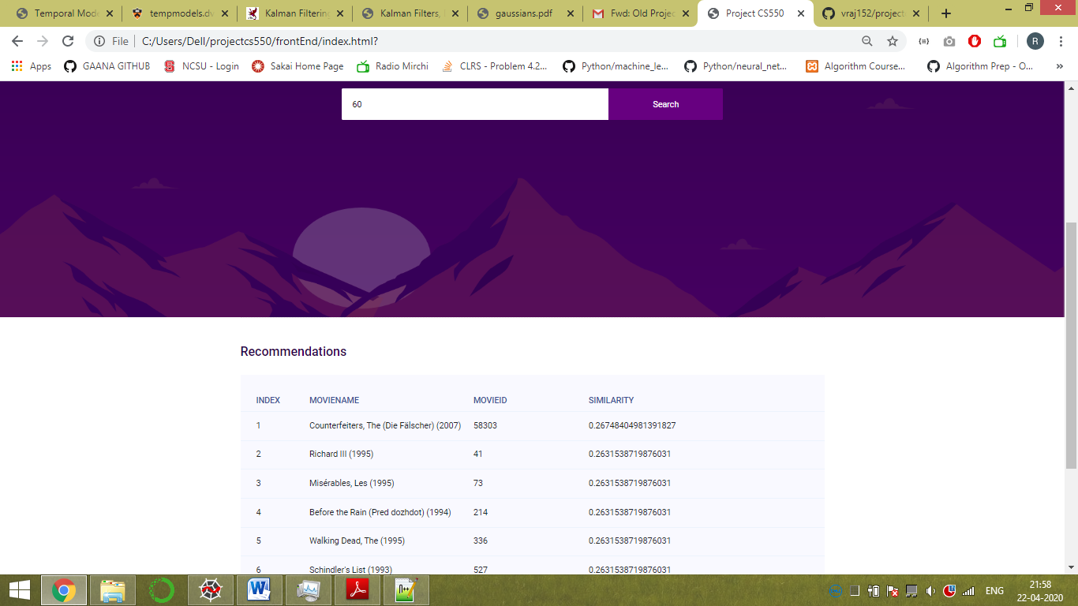
Recommendation Result for Particular User

Slide 11
Questions?

Slide 12
References:
We developed this model using standard libraries available in python like Numpy, Pandas, flask etc.
https://towardsdatascience.com/how-to-build-a-simple-recommender-system-in-python-375093c3fb7d
Template taken from : https://colorlib.com/preview/theme/hostza/

Slide 13
Thank You!

