Slide 1
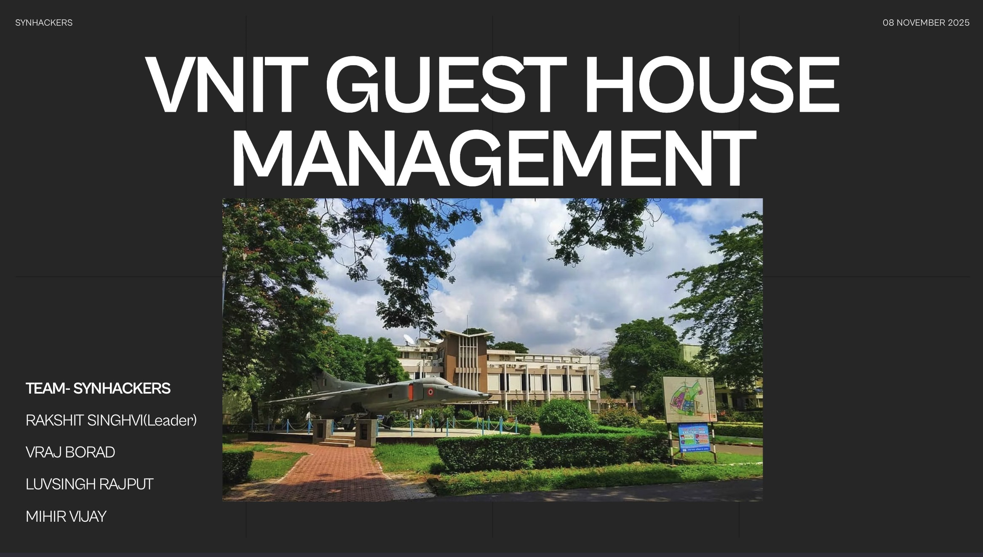

Slide 2
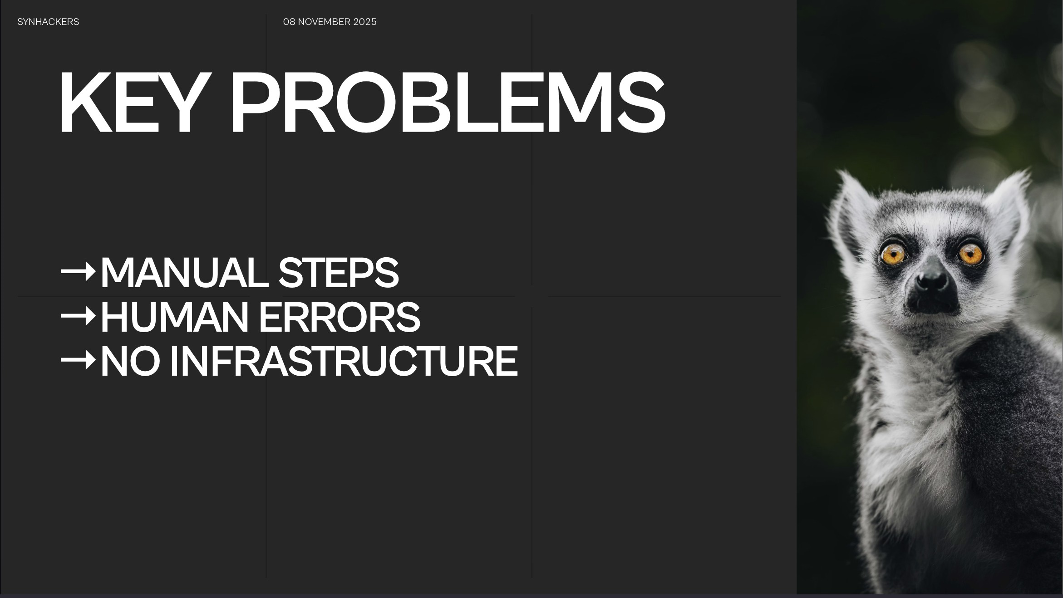

Slide 3

SYNHACK ERS
08 NOVEMBER 2025
VNIT Guest House
Booking System
The Login and Signup page allows users to securely access and create accounts on the
platform. Existing users can log in quickly with their credentia ls or social accounts, while new users can register easily through a
simple, user-friendly form. The page combines security,
validation, and intuitive design to ensure a smooth and seamless authentication experience across
all devices.
Email
Enter your email
Password
Enter your password
Login
Demo Credentials:
Student: student@vnit.ac.in / student123 Faculty: faculty@vnit.ac.i n I faculty123 Admin:admin@vnit.ac.in/ admin123
LOGIN/SIGN UP PAGE,

Slide 4
Boys Guest House
0Unavail.able
SYNHACKERS
08 NOVEMBER 2025
Room 101
Room 102
•Avaiabje
C.poaty: 2 Price:'500/nlght
Amenities: AC, Wifi, Altadled Battvoom
Capacity: 2
Pnce: '500ml0ht
Amembes: AC, WiF1, Al1ached Bathroom
Newprtce
Newpnce
PROPOSED HERO SECTION FRAMEWORK
Girls Guest House
Room 201
Room 202
.Avai•"'"
C.pocity:2
Price: ,500/nlght
AmeniOes: AC. WiFi, Attached Battvoom
Capocity: 2
Pnce: '500.llloht
Amenities: AC. WiFi, Attached Bathroom
Newpnce
Newpr\ce
Home Page
Introducing a digital booking system and an automated approval workflow to streamline the guest house booking process at VN IT. By implementing these solutions,we aim to eliminate manual steps, reduce errors, and improve transparency in approval and payment tracking for a seamless user experience.

Slide 5






SYNHACKERS
AVAILABLE ROOMS AND BOOKING DETAILS
08 NOVEMBER 2025
New Booking Request
ect Rooms
Boyt: <iuest House
Girts Guest HouM
Institute Guert House
Rooml02
Room201
Room 102
Room202
The Available Rooms and Booking Details section provides a clear overview of rooms currently available, along with essential booking information such as dates, prices, and amenities. Users can easily check availability, compare options, and make reservations seamlessly, ensuring a smooth and convenient booking experience.
Booking DH.iils
.,
Submrt Booking Reque

Slide 6
SYNHACKERS
08 NOVEMBER 2025
KEY FEATURES
Bookings Overview
Revenue
Room Status
Bookings by Guest House
Total Bookings:
Total
nue:
2600
Total Rooms:
6
Boys Guest House:
Pending:
0
Available :
4
Institute Guest House:
Approved:
0
Occupied:
2
Paid:
Rejected:
0
Bookings Overview
Revenue
Room Status
Bookings by Guest House
shows boys and overall bookings
Online room requests
Automated Revenue Calculation
Availale and occupied rooms

Slide 7
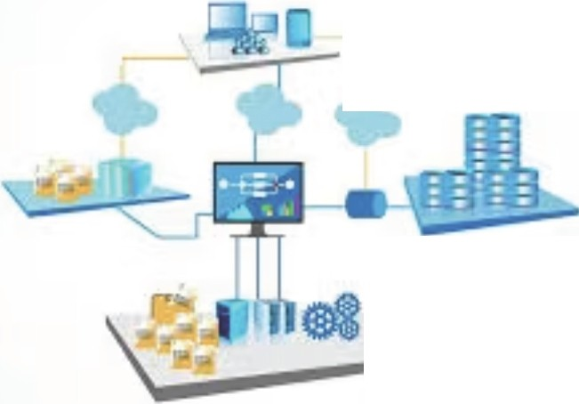

SYNHACKERS
08 NOVEMBER 2025
CHALLENGES AHEAD
•
F
T
aoNUSl
Bonus Features Implement
e
-
Systems Integration
Better Frontend
Align with current tech tools for seamless workflow.
Ensure user-friendly design and training for smooth transition.
Implement strategies for a successful organizational shift.

Slide 8

SYNHACKERS
08 NOVEMBER 2025
THANK YOU
Website:
yet to be deployed in github pages

