Slide 1
Table of contents
1. Problem Statement
2. Proposal & Solution
3. AutoML(TPOT)
4. Outcomes (Prototype)
5. Further Improvements
6. Conclusion
7. Q & A
8. References

Slide 2

1. Problem statement
Colleges and universities have an obligation to provide a curriculum that enhances students' academic achievement.
If it is not a trendy course or not developed enough, students may lose their motivation for college.
Education industry is transforming, colleges and universities are competing to offer latest courses which market demands.
When a university creates a course that students want and has many needs and attracts students
As it is a course with a lot of needs, university marketing can be carried out with ease.
[Image] https://previews.123rf.com/images/lculig/lculig1909/lculig190900184/129415594-school-curriculum-word-cloud-concept.jpg

Slide 3
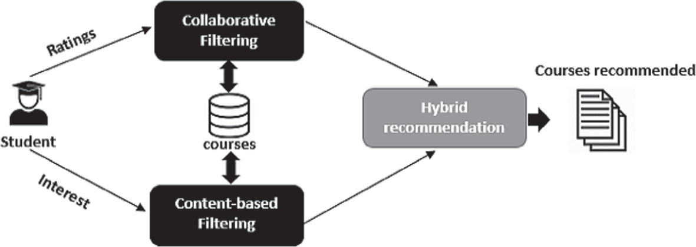
2. Proposal & Solution
Universities should find out in advance the courses they may need most on the market.
The Universities will be able to prepare the facilities for that courses in advance.
In this project, we will try to figure it out from the online trends what is getting the attention of people and if it is classified as a proper course or not.
[Image] https://media.springernature.com/original/springer-static/image/chp%3A10.1007%2F978-3-030-73882-2_60/MediaObjects/507212_1_En_60_Fig2_HTML.png

Slide 4


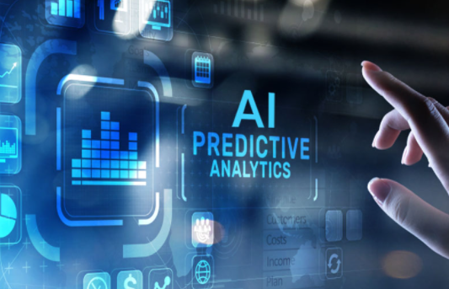
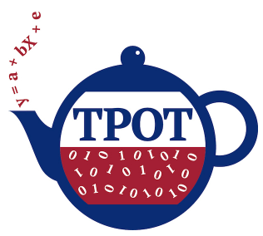
2. Proposal & Solution
[ Feedback ]
Course Name
Comments
Rating
Category
…
We found research on customer segmentation using clustering and Cluster-then-predict for classification.
Build model in TPOT to predict which new courses should be offered to students.
[ Student ]
[ Recommender AI ]

Slide 5
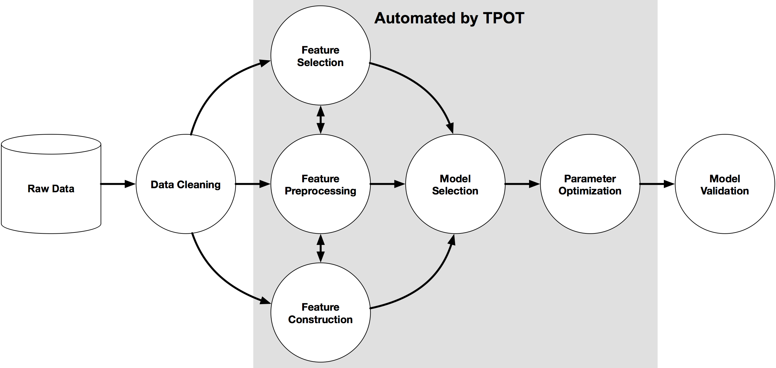
3. AotoML Tool : TPOT

Slide 6


Slide 7
3. AotoML Tool : TPOT
TPOT is …
TPOT stands for Tree-based Pipeline Optimization Tool.
Consider TPOT your Data Science Assistant.
Using Genetic Algorithms
Automatically provide Feature Engineering and model selection and learning
Classification and regression ML support
Automatic categorical function processing
Does not support unstructured data and time series data
Very simple to implement
It always chooses the best model for same dataset

Slide 8
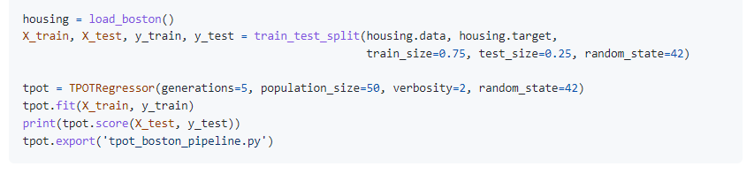
3. AotoML Tool : TPOT
Regressor Example code & Hyperparameters
generations = The number of iterations to the run pipeline optimization process. Generally, TPOT will work better when you give it more generations (and therefore time) to optimize the pipeline.
population_size = The number of individuals to retain in the genetic programming population every generation. Generally, TPOT will work better when you give it more individuals with which to optimize the pipeline.
https://epistasislab.github.io/tpot/api/

Slide 9
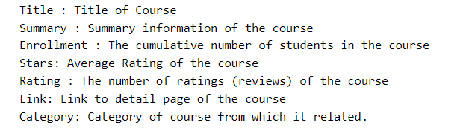
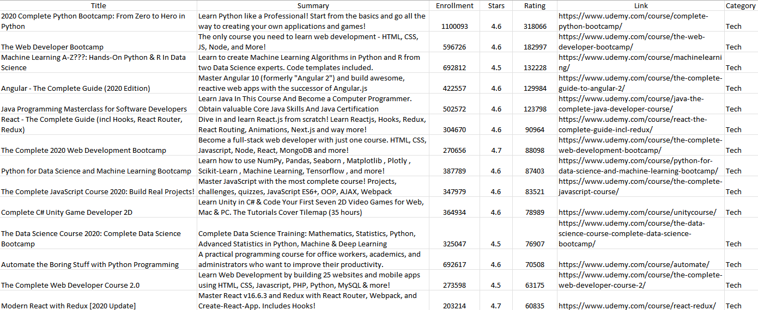
4. Outcomes (Prototype)
Dataset
Udemy_Courses.csv

Slide 10
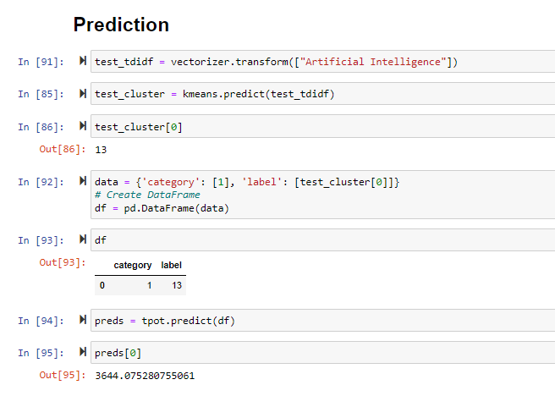
4. Outcomes (Prototype) - Python Code
Prediction
Predicting number of students in Artificial Intelligence, if the course is introduced.
Insert multiple course names to get multiple outputs.

Slide 11
5. Further Improvements
Analyzing Live Trends via Social Media
Implementation source code to finalize
Look up live trends and topics.
Classifying the topics according to existing courses.
Comparison of TPOT optimization result according to various hyperparameter settings
Using tf-tdf features directly to determine the course quality
With number of student enrollment, will try to predict the quality of the course.

Slide 12
6. Conclusion
Achieved :
- Importing Libraries, Loading Dataset, Data Cleaning
- Implementation EDA
- Modeling : Clustering and Regressor using TPOT AutoML tool
- Evaluating Models
Challenges:
- Getting appropriate APIs to fetch live data.
- While predicting students for one institute, limits are needed to be bounded as per the capacity of the institute.
- Computational limits while training clustering algorithm.
In future:
- Location feature can be added, as different regions have different trends.

Slide 13
References
https://www.kaggle.com/karnikakapoor/customer-segmentation-clustering#Customer-Segmentation
https://ai.plainenglish.io/targeted-marketing-with-machine-learning-38de28162483
https://www.kaggle.com/nafisur/customer-segmentation-analysis-cluster-analysis
https://towardsdatascience.com/cluster-then-predict-for-classification-tasks-142fdfdc87d6
https://towardsdatascience.com/machine-learning-algorithms-part-9-k-means-example-in-python-f2ad05ed5203
https://www.kaggle.com/prashant111/k-means-clustering-with-python
https://www.datacamp.com/community/tutorials/k-means-clustering-python

