Slide 1


Aadishwar College of Technology
Group Number:04
Group Members:
Atul Jose 150810107003
Moxita Shah 150810107047
Vrajesh Trivedi 150810107055

Slide 2

GenDrug

Slide 3






Index
Company Details.
Project Profile.
Existing System.
Proposed System.
Tools & Technology.
List of Modules

Slide 4

Company Details
Akash Technolabs
Akash Technolabs offers experienced and comprehensive help for a wide range of business needs and can help you to work smarter and reach your goals.
They have rich experience of 7+ years in offering Website Design, Web Development, CMS, Ecommerce Solutions, Mobile Apps and Digital Marketing Services to business of all statures whether you are a small business or a corporate company.
Website::www.akashtechnolabs.com
Phone Number::+91 99786 21654
Address::K/6,Shree Krishna Center Above Crossword Mithakhali Six Road, Navrangpura Ahmedabad,Gujarat-380009

Slide 5

Project Profile
Generic Application is useful to customer who want to search generic medicine for their prescribed medicine.
The customer can also buy the generic medicine they want.
They can also search medicines for specific symptoms.

Slide 6
Existing System
Currently there are application that offers generic medicines. But there are currently no application where you can search the prescribed medicines and get their respective generic medicines, or search the generic medicines by their symptoms.
In some application we can search the medicine through prescription but they only show us the name of the generic medicine, we are not able to buy the medicine through the application.
Some application just shows from which shop we can get the medicine and where the store is located.

Slide 7
Proposed System
Users can search the application for the generic medicines according to their symptoms, or search by the prescribed medicines to find their respective generic medicines.
User will be able to add those medicines in their wishlist or in the cart or even buy those medicines from the store if they want.

Slide 8







Tools And Technology
:-
Android
Front End
Back End
:-
MySQL 5.5
Reporting Tool
:-
PHP report maker
IDE
:-
NetBeans 8.2
Server
:-
Apache 2
Software
:-
XAMPP 3.2.2 (Cross-platform Apache MySQL PHP Perl)
Other tools
MS Word 2016 (For Documentation)
MS PowerPoint 2016 (For Presentation)
MS Visio 2016 (For Diagrams)

Slide 9










List Of Modules
Search
Prescription
Symptoms
Notification
Cart
Previous buyer record
Complaint, Feedback
Inventory
Order
Order Tracking

Slide 10


Brief Description
Search
You can search the prescribed medicines and get their respective generic medicines
Can also search the generic medicines by their symptoms.
Prescription
Users can search the medicines prescribed by the doctor and get their respective generic medicines.
Symptoms
Users can find the generic medicines by searching their symptoms in the search bar.

Slide 11




Brief Description
Notification
Users will be notified about their order through email.
Cart
User can also add or remove product from the cart.
Previous Buyer Record
Our database will keep the details of previous purchases.
Complaint, Feedback
Users can complaint if they are not satisfied by the service or product.
Users can provide feedback for the product they bought.

Slide 12
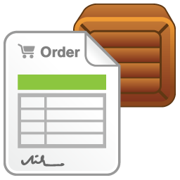


Brief Description
Inventory
Admin can manage the stock of the product.
Admin will also able to manage the Purchase of the medicines.
Order
Admin manage order of the products.
Admin manage status of order.
Admin can also view order details and product details.
Order Tracking
Admin will update the status on various activity like Order Placed, Order Dispatch, Order On way etc.
User can track the order details.

Slide 13
Table List
Category
Brand
Medicine Details
Prescription
Symptoms
User Details
Supplier Details
Supply Details
Order Details
Delivery man
Area Details
Shipping Details
Feedback

Slide 14
Category Details
Table Name | Category Details
Table Description | This table stores information about the category of the medicine.
Primary key | CATEG_ID
Field Name | Data type | Size | Constraint | Description
CATEG_ID | INTEGER | 3 | PRIMARY KEY | It Stores the CATEGORY ID.
CATEG_TYPE | VARCHAR | 12 | NOT NULL | It Stores the data about the category of the medicine.

Slide 15
Brand
Table Name | Brand
Table Description | This table stores information about the brand of the medicine.
Primary key | BRAND_ID
Field Name | Data type | Size | Constraint | Description
BRAND_ID | INTEGER | 3 | PRIMARY KEY | It Stores the Brand ID.
BRAND_NAME | VARCHAR | 12 | NOT NULL | It Stores the name of the Brand.

Slide 16
User Details
Table Name | User Details
Table Description | This table store the information about User Details
Primary key | U_ID
Field Name | Data type | Size | Constraint | Description
U_ID | INTEGER | 6 | PRIMARY KEY | It Stores the User ID.
U_NAME | VARCHAR | 15 | NOT NULL | It Stores the User Name.
PHONENUM | INTEGER | 10 | NOT NULL | It Stores the Mobile no.
GENDER | VARCHAR | 6 | NOT NULL | It Stores the User Gender.
EMAIL | VARCHAR | 15 | NOT NULL | It Stores the User Email.
Password | VARCHAR | 12 | NOT NULL | It Stores the Password.
ADD | VARCHAR | 160 | NOT NULL | It Stores the Address.

Slide 17
Medicine Details
Table Name | Medicine Details
Table Description | This table stores information about the medicines.
Primary key | P_ID
Field Name | Data type | Size | Constraint | Description
P_ID | INTEGER | 3 | PRIMARY KEY | It Stores the Product ID.
P_NAME | VARCHAR | 15 | NOT NULL | It Stores the Product name.
CATEG_ID | INTEGER | 3 | FOREIGN KEY | It Stores the CATEGORY ID.
DETAILS | VARCHAR | 20 | NOT NULL | It Stores the Product details.
BRAND_ID | INTEGER | 3 | FOREIGN KEY | It Stores the Brand ID.
PRICE | FLOAT | - | NOT NULL | It Stores the Product price.
STOCK | INTEGER | 3 | NOT NULL | It Stores the Product stock.

Slide 18
Prescription
Table Name | Prescription
Table Description | This table stores information about the prescription.
Primary key | PRES_ID
Field Name | Data type | Size | Constraint | Description
PRES_ID | INTEGER | 3 | PRIMARY KEY | It Stores the ID of prescribed medicine.
P_ID | INTEGER | 3 | FOREIGN KEY | It Stores the Product ID.
DETAILS | VARCHAR | 20 | FOREIGN KEY | It Stores the Product details.
BRAND_ID | INTEGER | 2 | FOREIGN KEY | It Stores the Brand ID.
PRICE | FLOAT | - | FOREIGN KEY | It Stores the Product price.
STOCK | INTEGER | 3 | FOREIGN KEY | It Stores the Product stock.

Slide 19
Symptoms
Table Name | Symptoms
Table Description | This table stores information about the symptoms.
Primary key | SYMP_ID
Field Name | Data type | Size | Constraint | Description
SYMP_ID | INTEGER | 3 | PRIMARY KEY | It Stores the ID of symptoms.
P_ID | INTEGER | 3 | FOREIGN KEY | It Stores the Product ID.
DETAILS | VARCHAR | 20 | FOREIGN KEY | It Stores the Product details.
BRAND_ID | INTEGER | 2 | FOREIGN KEY | It Stores the Brand ID.
PRICE | FLOAT | - | FOREIGN KEY | It Stores the Product price.
STOCK | INTEGER | 3 | FOREIGN KEY | It Stores the Product stock.

Slide 20
Supplier Details
Table Name | Supplier Details
Table Description | This table stores information about the Supplier.
Primary key | SUPP_ID
Field Name | Data type | Size | Constraint | Description
SUPP_NAME | VARCHAR | 15 | NOT NULL | It Stores the SUPPLIER NAME.
SUPP_ID | INTEGER | 6 | PRIMARY KEY | It Stores the SUPPLIER ID.
SUPP_ADD | VARCHAR | 160 | NOT NULL | It Stores the SUPPLIER ADDRESS.
SUPP_MOBNO | INTEGER | 12 | NOT NULL | It Stores the SUPPLIER MOBILE NUMBER.

Slide 21
Supply Details
Table Name | Supply Details
Table Description | This table stores information about who supplied what.
Primary key | SUPP_ID
Field Name | Data type | Size | Constraint | Description
SUPP_ID | INTEGER | 3 | FORIEGN KEY | It Stores the Supplier ID.
SUPPLY_NAME | VARCHAR | 12 | NOT NULL | It Stores the data about the supplies.

Slide 22
Delivery Man
Table Name | Delivery Man
Table Description | This table stores information about the Delivery man.
Primary key | DELIMAN_ID
Field Name | Data type | Size | Constraint | Description
DELIMAN_ID | INTEGER | 6 | PRIMARY KEY | It Stores the DELIVERY MAN ID.
DELIMAN_NAME | VARCHAR | 15 | NOT NULL | It Stores the DELIVERY MAN NAME.
DELIMAN_ADD | VARCHAR | 60 | NOT NULL | It Stores the DELIVERY MAN ADDRESS.
DELIMAN_MOBNO | INTEGER | 12 | NOT NULL | It Stores the DELIVERY MAN MOBILE NUMBER.

Slide 23
Order Details
Table Name | Order Details
Table Description | This table stores information about the order.
Primary key | O_ID
Field Name | Data type | Size | Constraint | Description
O_ID | INTEGER | 2 | PRIMARY KEY | It Stores the Order ID.
P_ID | INTEGER | 3 | FOREIGN KEY | It Stores the Product ID.
QTY | INTEGER | 2 | NOT NULL | It Stores the quantity.
AMOUNT | INTEGER | 4 | NOT NULL | It Stores the amount.

Slide 24
Area Details
Table Name | Area Details
Table Description | This table stores information about the Area.
Primary key | AREA_ID
Field Name | Data type | Size | Constraint | Description
AREA_ID | INTEGER | 3 | PRIMARY KEY | It Stores the AREA ID.
AREA_NAME | VARCHAR | 10 | NOT NULL | It Stores the data about Area name.

Slide 25
Shipping Details
Table Name | Shipping Details
Table Description | This table stores information about the shipping.
Primary key | SHIP_ID
Field Name- | Data type | Size | Constraint | Description
SHIP_ID | INTEGER | 6 | PRIMARY KEY | It Stores the Shipping ID.
O_ID | INTEGER | 2 | FOREIGN KEY | It Stores the Order ID.
C_PH | INTEGER | 10 | NOT NULL | It Stores the Customer mobile no.
C_ADD | VARCHAR | 160 | NOT NULL | It Stores the Customer address.
S_STATUS | VARCHAR | 10 | NOT NULL | It Stores the Shipping status.
AREA_ID | INTEGER | 3 | FOREIGN KEY | IT stores the Area ID.
AREA_NAME | VARCHAR | 10 | NOT NULL | It stores the Area name.

Slide 26
Feedback
Table Name | Feedback
Table Description | This table stores information about the feedback.
Primary key | FEEDBACK_ID
Field Name | Data type | Size | Constraint | Description
FEEDBACK_ID | INTEGER | 5 | PRIMARY KEY | It Stores the Complain ID.
FEEDBACK_DETAILS | VARCHAR | 30 | NOT NULL | It Stores the Complain details.
FEEDBACK_DATE | DATE | - | NOT NULL | It Stores the Complain date.
FEEDBACK_STATUS | VARCHAR | 10 | NOT NULL | It Stores the Complain status.

Slide 27
Use Case Diagram

Slide 28
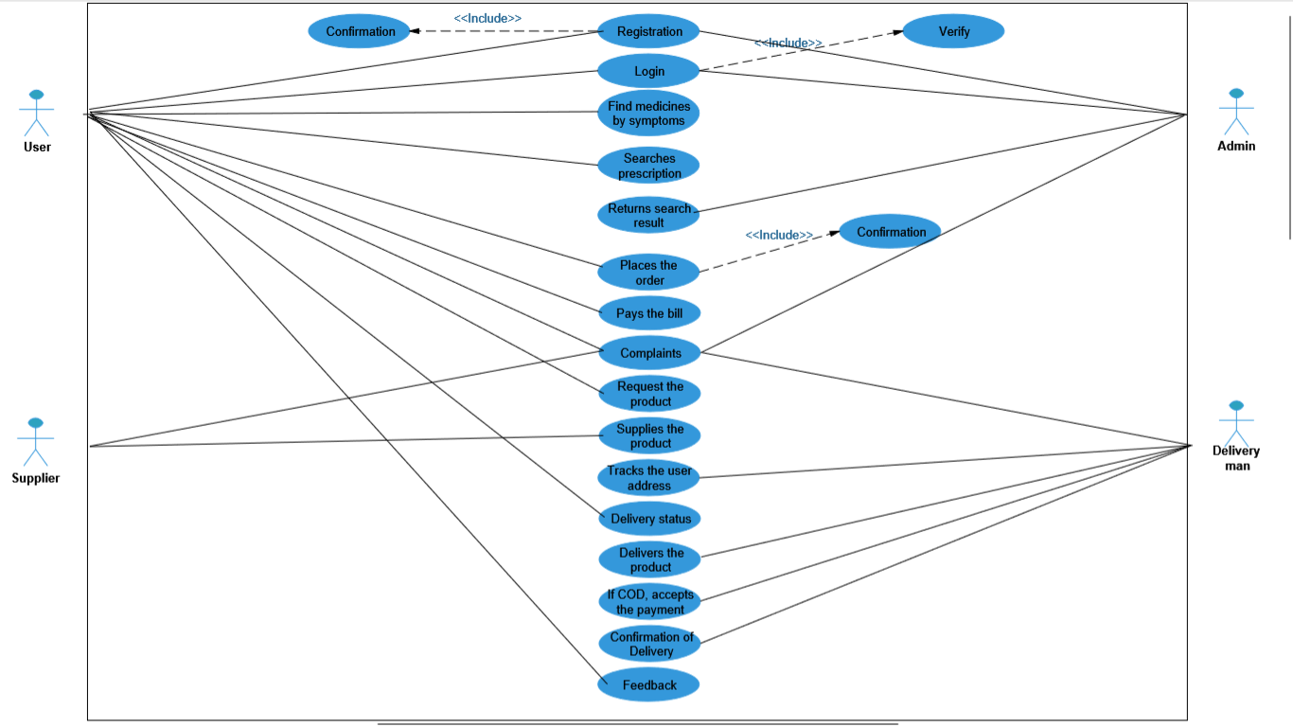
Use Case Diagram

Slide 29
Sequence Diagram

Slide 30
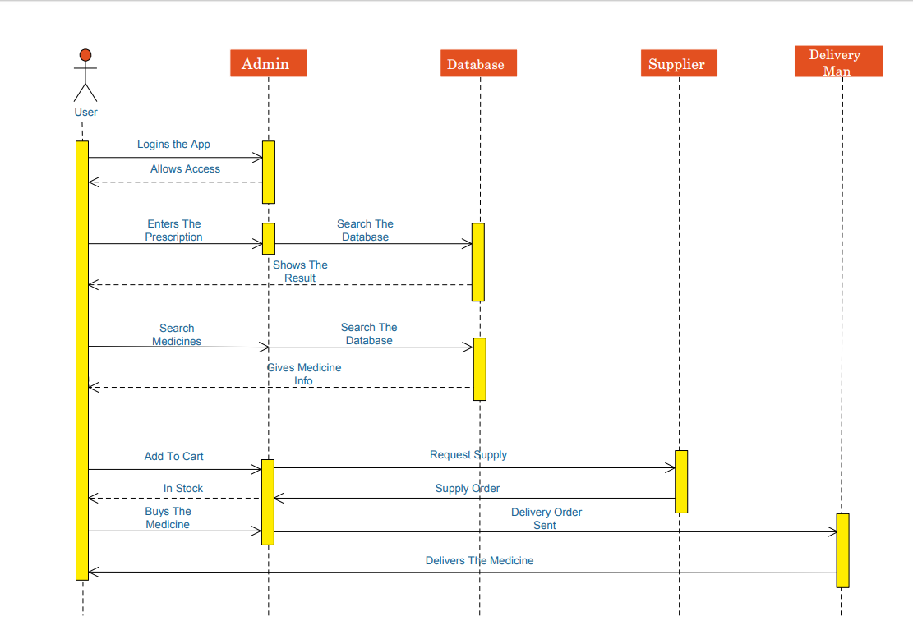

Slide 31
Activity Diagram

Slide 32
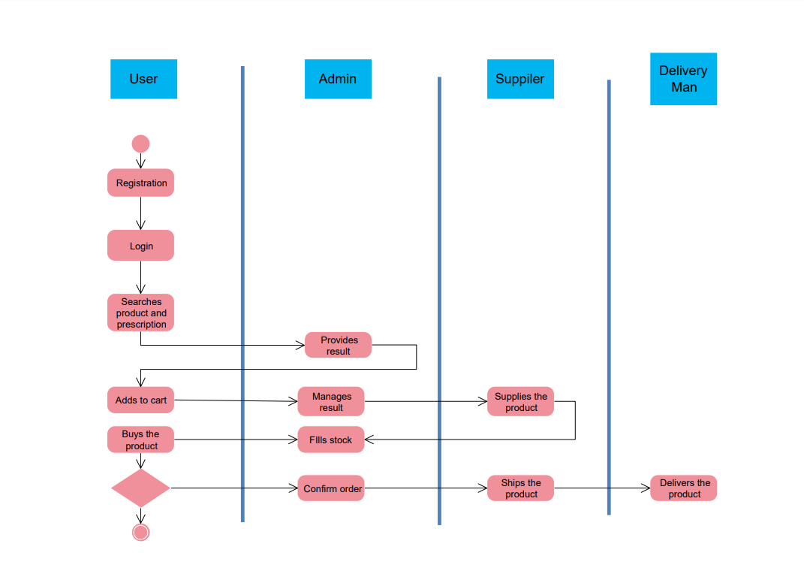

Slide 33
Class Diagram

Slide 34
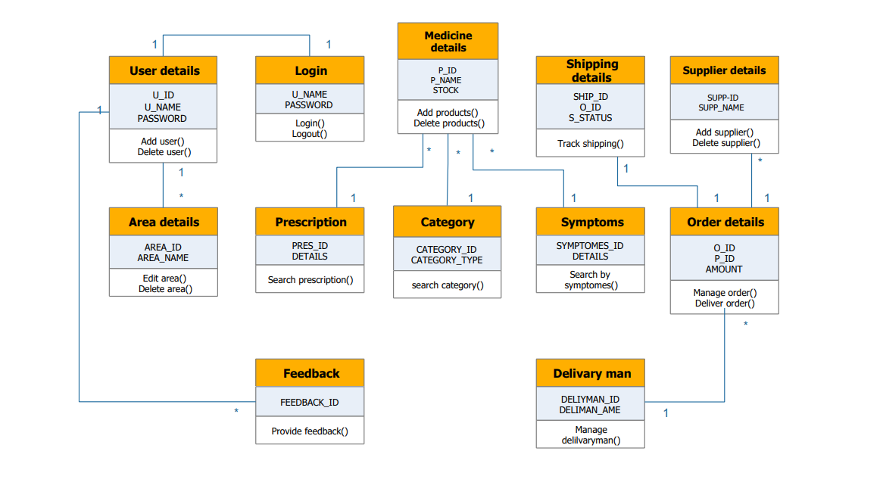

Slide 35
State Chart Diagram

Slide 36
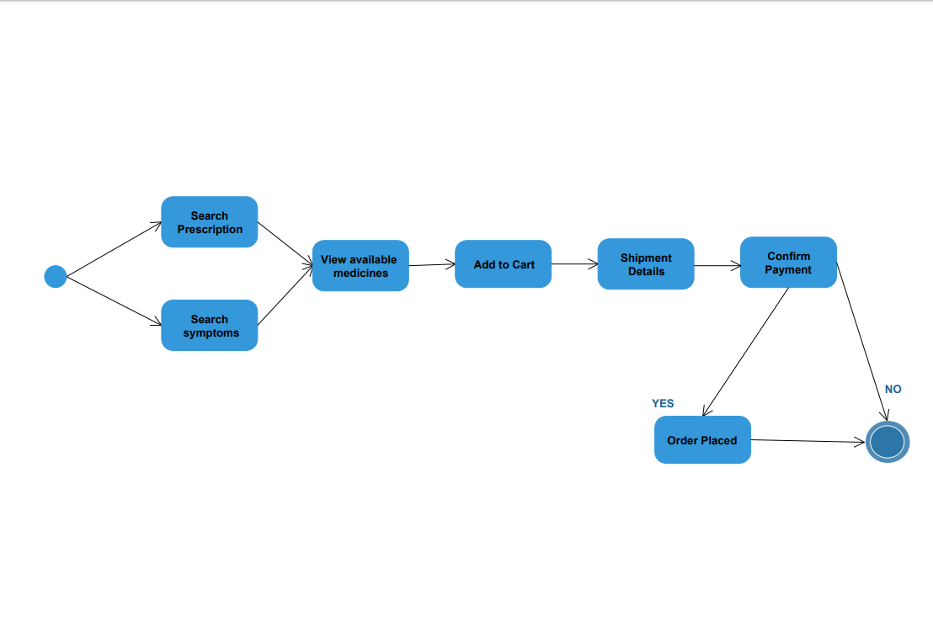

Slide 37
Thank You….

