Slide 1
Introduction to Webpack

Slide 2


Why Webpack

Slide 3
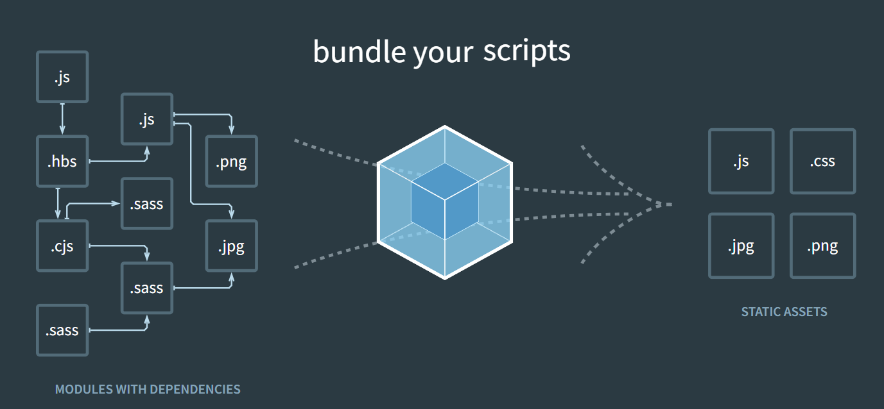
JavaScript,CSS,SCSS,TS etc., are becoming more complex in size now a days.
Loading all these files individually will take a huge hit on performance of browser/mobile device.
Webpack is a module bundler for JavaScript based applications and bundles JavaScript, CSS, images, and more into a single output file or multiple files.

Slide 4
Webpack has zero config by default that it expects us have our .js files in src/ folder so that it can generate the file in dist/main.js.
Entry: The starting point of your application.
Output: Where Webpack will emit the bundled files.
Loaders: Transform files before bundling (e.g., Babel, CSS).
Plugins: Extend Webpack’s functionality (e.g., minification, cleaning).

Slide 5
Loaders and Plugins
Loaders inform Webpack on how to interpret, translate and transform our source code. They preprocess the files.
Plugins are present to enhance Webpack functionality. They can instantiated and can take arguments

Slide 6
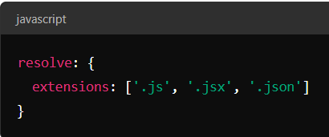
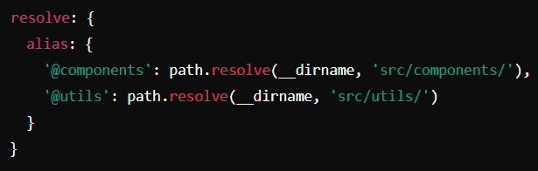
Resolve :
This property tells us on how to resolve modules. It specifies the options for resolving module paths, aliases, extensions and other related things.
Extensions: Automatically resolve certain file extensions. This allows you to omit file extensions when importing modules.
So, in this example webpack can automatically resolve imports for .js, .jsx, and .json files,
so you can import like this: import App from './App' without needing to specify the file extension.
Aliases: Create aliases for module paths to simplify imports and manage long or complex paths.

Slide 7
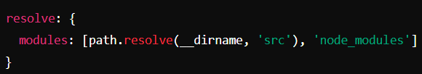

Modules: This explains us where Webpack should look for modules
This tells Webpack to first look for ‘src’ folder for packages before looking into ‘node_modules’ folder.
mainfields: Specifies which fields in package.json to look for resolving modules.
This means Webpack will first look for ‘browser’ field followed by ‘module’ followed by ‘main’ to
determine which entry point to use.

