Slide 1
FALLARM FINDER WEBSYSTEM
RAYSS-TEAM
SRAVANTHI-10484
SOWJANYA-10280
RAJITHA-10420
ANUSHA-10245
YANSONG-10101
UNDER THE GUIDANCE OF
HENRY CHANG
MICHEAL WANG

Slide 2




CONTRIBUTION
ANUSHA NADIPALLY
YANSONG ZHANG-DATABASE
RAJITHA VODELA-
INTERNET
SOWJANYA-
TESTING
SRAVANTHI RAJAPURAM-NETWORK

Slide 3



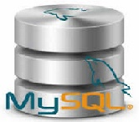
FallArm Architecture
Client
Web Server
Patient
Email/SMS
Linux
Tomcat
Servlet/Jsp
6#,pid
Android Virtual Device
Sensor
-Accelerometer
-Gyroscope
Windows PC
Web Browser
Enquiry
JDBC

Slide 4

Internet

Slide 5
Concepts Covered
HTML5
JavaScript
Tomcat
Form Validation
MVC

Slide 6
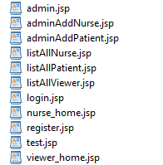
User registration
User Authentication
Add Patient/Staff
Delete Patient/Staff
Send Email Alert
Display All Nurse
Display All Patient
Functionalities Implemented

Slide 7
User Registration and Login

Slide 8
DATABASE
MY SQL

Slide 9
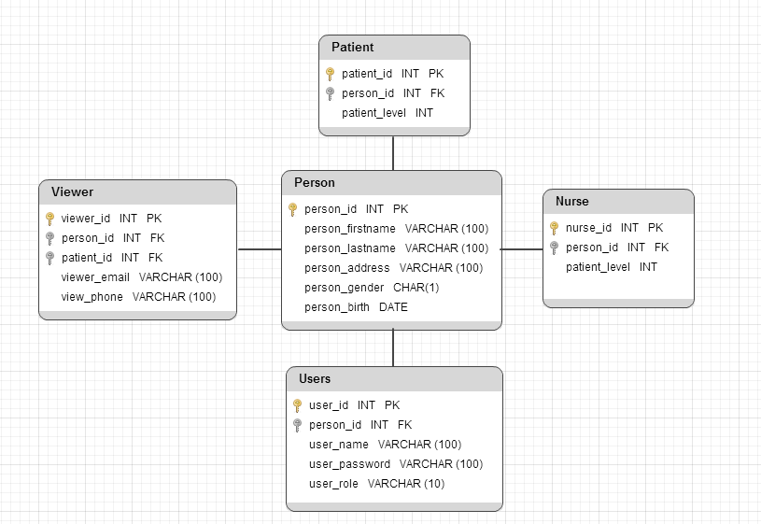
Database Diagram

Slide 10
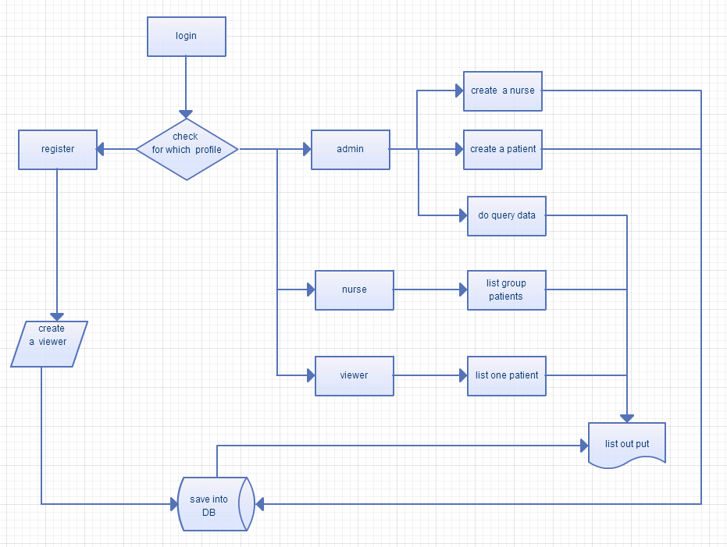
Website Function structure

Slide 11
JDBC(Java Database Connectivity)
1
Mysql-connector-java.jar file is required to connect to Mysql database from java
2
Obtain a connection to the database.
3
Process the Resultset.
Create a querystatement and execute it.
Close the Resultset once it is processed.

Slide 12
NETWORK

Slide 13
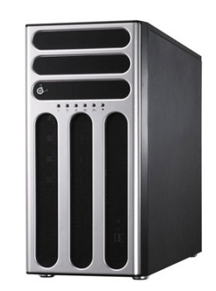
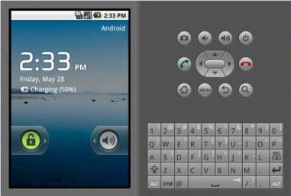

Socket Programming
▪ Telnet sensor values (accelerometer and orientation) values to Android Virtual Device(AVD).
▪ Send Sensor values from AVD to Server Program.
▪ Calculate Risk and send Email to the staff.
Communication between Android Virtual device and Server Java Application.

Slide 14
How it works??
Server Receives data from AVD
It receives 6 number sensor data (accelerometer and orientation values)
Calculate Risk
Based on the sensor data Calculates Risk level.
Detects fall
Based on Risk level it detects whether it is a fall or not.
Updates fall event in the database.
It receives patient id.
If it is fall sends email alert to staff.

Slide 15
Set Sensor Values
Telnet Sensor data
Sensor data in AVD.

Slide 16


Slide 17
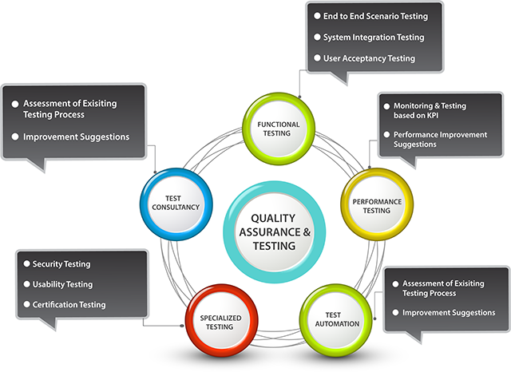
LEVELS OF TESTING

Slide 18
Types of Testing
Using Selenium IDE
Project UI is tested using Selenium IDE in a web browser.
Using Junit Test
Java Classes of Internet and Database are tested using Junit Testing.

Slide 19
Classes that are tested
RegesterService,
LoginService,
PatientRecordService

Slide 20
Selenium IDE Testing
Selenium IDE is a tool to record and playback test cases from a web browser.
FallArm Finder web application is opened from mozilla firefox and being tested using selenium IDE.

Slide 21
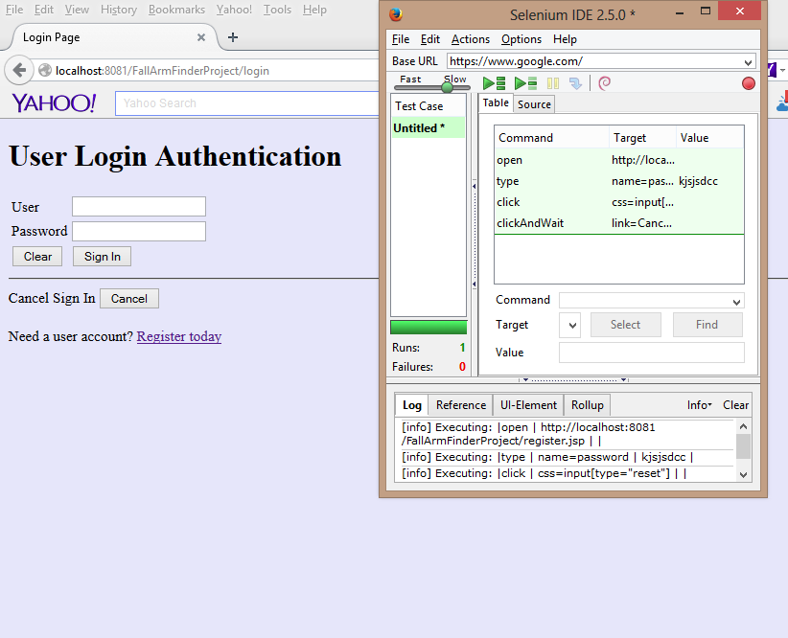

Slide 22
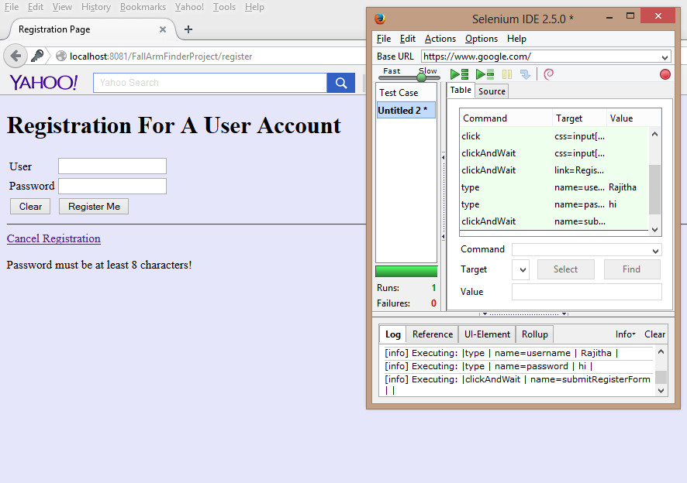

Slide 23

HENRY CHANG
&
MICHEAL WANG
FOR GIVING US THIS OPPORTUNITY!!!!

