Slide 1
ARM Architecture & Instruction Set
Subhasis Bhattacharjee

Slide 2
ARM Features
ARM: Advanced RISC Machines
Most popular category of processors
ARM 7(1995): ipod
ARM 9(1997): Benq, sony erricson
ARM 11(2003): Apple iphone, Nokia N93
90% of the 32-bit embedded system uses ARM
ARM 32bit and above:
Reasonably powerful
Low power consumption
Useful in battery operated devices.
ARM processor family share a common set of instructions.

Slide 3
ARM Architecture
The ARM is a Reduced Instruction Set Computer (RISC) system and includes the attributes similar to that type of system:
A large array of uniform registers.
A load/store model of data-operations can only operate on registers and not directly on memory.
A uniform ﬁxed length instruction (32-bit).
A small number of addressing modes with all load/store addresses being determined from registers and instruction ﬁelds only.
Notes:
A load/store model of data-operations can only operate on registers and not directly on memory. This requires that all data be loaded into registers before an operation can be preformed, the result can then be used for further processing or stored back into memory.

Slide 4
ARM Architecture (additional features)
In addition ARM provides a number of additional features which are deviating from RISC:
Inline Barrel Shifter: h/w which allows multiple bit shifting very efficiently in a single clock cycle.
Auto-increment and Auto-decrement addressing modes to improve the operation of program loops.
Conditional execution of instructions to maximize execution throughput.
Configuration in Thumb Mode, operating over a subset of ARM instructions in 16 bit mode.

Slide 5
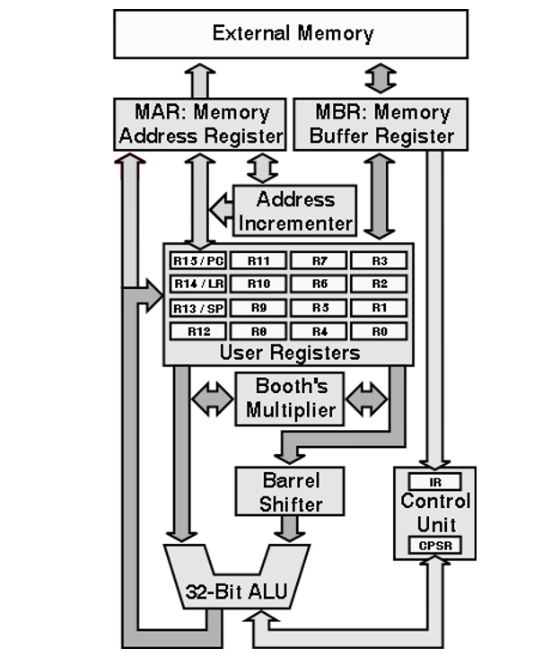
ARM Block Diagram

Slide 6

Registers
The ARM has a total of 37 registers.
30 General purpose registers (over various modes), 1 program counter
6 Status Registers
The general purpose registers can be used to handle 8-bit bytes, 16-bit half-words1, or 32-bit words.
R13 - Stack Pointer, R14 -Link Register (Return Address), and R15 -Program Counter
There are also one or two status registers depending on which mode the processor is in:
Current Processor Status Register (CPSR) : information about the current status of the processor (including its current mode).
Saved Processor Status Register (SPSR) : information on the processors state before changing mode, i.e., the processor status just before an exception
Structure of the Processor Status Registers

Slide 7
ARM Machine Model
Memory (Von Neumann Architecture)
Register
Abbrv.
Name
r11
fp
frame pointer
r12
ip
intra-procedure-call scratch register
r13
sp
stack pointer
r14
lr
link register
r15
pc
program counter

Slide 8
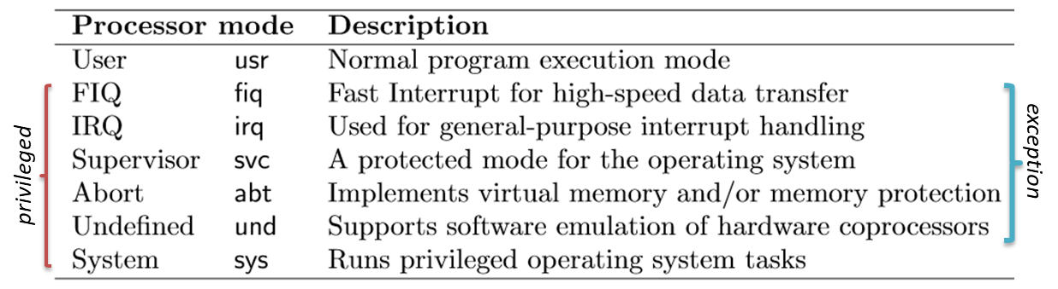
ARM Processor Modes
ARM supports the seven processor modes:
Mode changes can be made under software control, or by external interrupts or exception processing.
Privileged modes have full access to system resources.
System mode is not entered by any exception

Slide 9
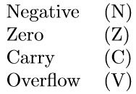
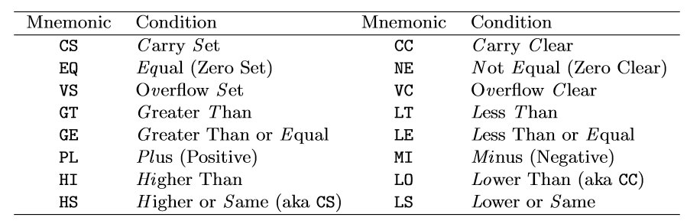
User Mode
Most application programs execute in User mode.
Registers: R0-R15
R13 - Stack Pointer, R14 -Link Register (Return Address), and R15 -Program Counter
One Status Register: CPSR
Structure of the Processor Status Registers
<cc> (Condition code) Mnemonics

Slide 10
Generic Format
Generic Format
4
2
cond
type
32
29
28
27
cond → instruction condition (eq, ne, … )
type → instruction type

Slide 11
ARM Instruction Encoding
cond → instruction condition (eq, ne, … )
type → instruction type (00: data processing, 01: Memory instruction, 10: branch )
4
2
4
4
4
12
cond
type
I
opcode
S
rs
rd
shifter operand/
32
29
28
27
26
25
22
21
20
17
16
13
Immediate/reg
12
1
I → Immediate bit, if I=0, second source operand is register
opcode → Instruction code
S → 'S' suffix bit (for setting the condition codes in CPSR)
rs, rd → source register, destination register

Slide 12
ARM programmer model
The state of an ARM system is determined by the content of visible registers and memory.
A user-mode program can see 15 32-bit general-purpose registers (R0-R14), program counter (PC) and CPSR.
Instruction set defines the operations that can change the state.

Slide 13
Memory system
Memory is a linear array of bytes addressed from 0 to 2³²-1
Word, half-word, byte
Little-endian
0x00000000
00
10
20
30
FF
FF
FF
00
00
00
0x00000001
0x00000002
0x00000003
0x00000004
0x00000005
0x00000006
0xFFFFFFFD
0xFFFFFFFE
0xFFFFFFFF

Slide 14
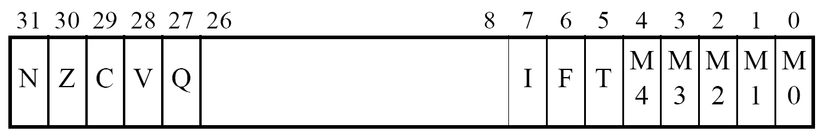
ARM programmer model
0x00000000
00
10
20
30
FF
FF
FF
00
00
00
0x00000001
R0 | R1 | R2 | R3
R4 | R5 | R6 | R7
R8 | R9 | R10 | R11
R12 | R13 | R14 | PC
0x00000002
0x00000003
0x00000004
0x00000005
0x00000006
0xFFFFFFFD
0xFFFFFFFE
0xFFFFFFFF

Slide 15
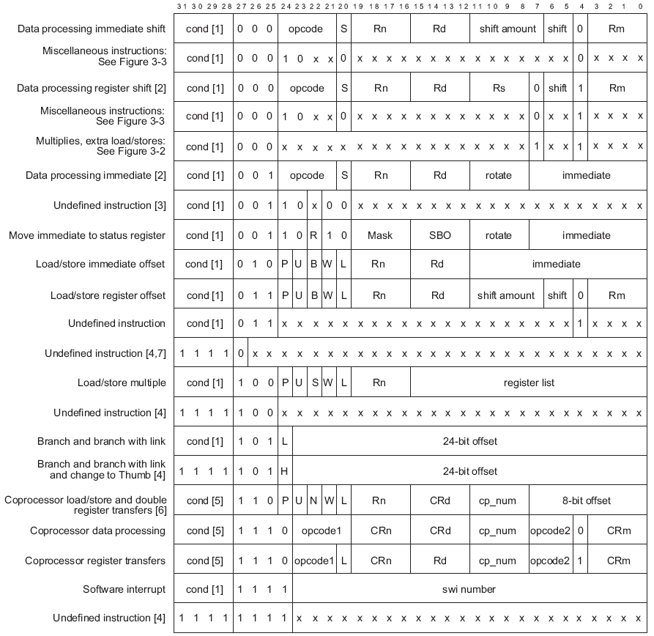
Instruction set
ARM instructions are all 32-bit long (except for Thumb mode). There are 2³² possible machine instructions. Fortunately, they are structured.

Slide 16
Features of ARM instruction set
Load-store architecture
3-address instructions
Conditional execution of every instruction
Possible to load/store multiple registers at once
Possible to combine shift and ALU operations in a single instruction

Slide 17
Instruction set
Data processing
Data movement
Flow control

Slide 18
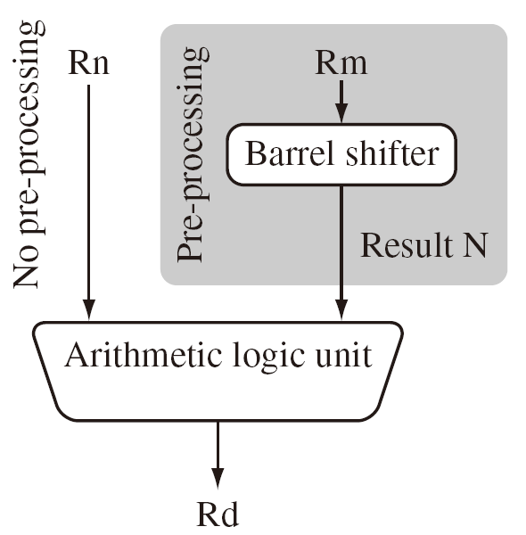
Data processing
They are move, arithmetic, logical, comparison and multiply instructions.
Most data processing instructions can process one of their operands using the barrel shifter.
General rules:
All operands are 32-bit, coming from registers or literals.
The result, if any, is 32-bit and placed in a register (with the exception for long multiply which produces a 64-bit result)
3-address format

Slide 19
Instruction set
MOV<cc><S> Rd, <operands>
MOVCS R0, R1 @ if carry is set
@ then R0:=R1
MOVS R0, #0 @ R0:=0
@ Z=1, N=0
@ C, V unaffected

Slide 20
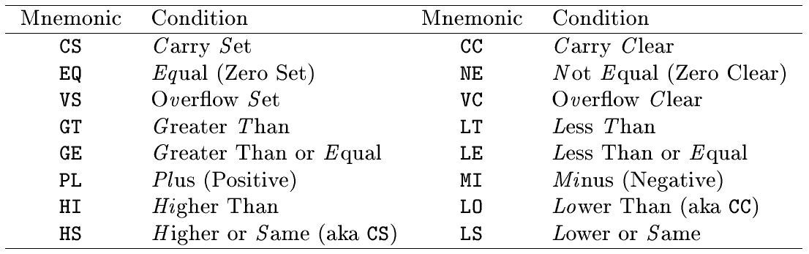
Conditional execution
Almost all ARM instructions have a condition field which allows it to be executed conditionally.
movcs R0, R1

Slide 21
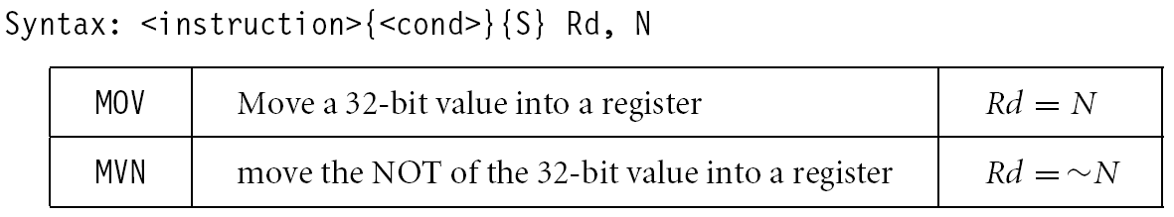
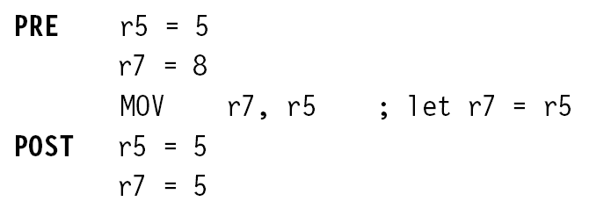
Register movement
immediate,register,shift
MOV R0, R2 @ R0 = R2
MVN R0, R2 @ R0 = ~R2
move negated

Slide 22
Addressing modes
Register operands
ADD R0, R1, R2
Immediate operands
ADD R3, R3, #1 @ R3:=R3+1
AND R8, R7, #0xff @ R8=R7[7:0]
a literal; most can be represented
by (0..255)x2^{2n} 0<n<12
a hexadecimal literal
This is assembler dependent syntax.

Slide 23
Shifted register operands
One operand to ALU is routed through the Barrel shifter. Thus, the operand can be modified before it is used. Useful for fast multipliation and dealing with lists, table and other complex data structure. (similar to the displacement addressing mode in CISC.)
Some instructions (e.g. MUL, CLZ, QADD) do not read barrel shifter.

Slide 24
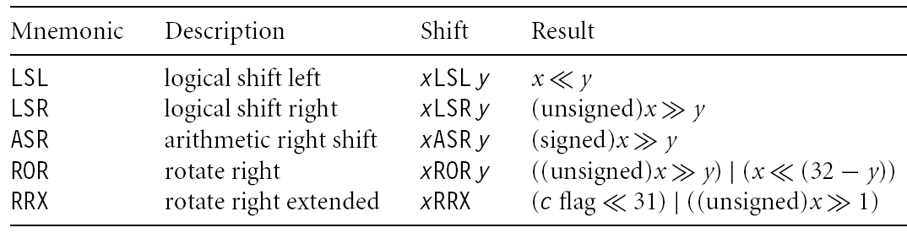
Shifted register operands

Slide 25
Logical shift left
C
register
0
MOV R0, R2, LSL #2 @ R0:=R2<<2
@ R2 unchanged
Example: 0…0 0011 0000
Before R2=0x00000030
After R0=0x000000C0
R2=0x00000030

Slide 26
Logical shift right
0
register
C
MOV R0, R2, LSR #2 @ R0:=R2>>2
@ R2 unchanged
Example: 0…0 0011 0000
Before R2=0x00000030
After R0=0x0000000C
R2=0x00000030

Slide 27
Arithmetic shift right
MSB
register
C
MOV R0, R2, ASR #2 @ R0:=R2>>2
@ R2 unchanged
Example: 1010 0…0 0011 0000
Before R2=0xA0000030
After R0=0xE800000C
R2=0xA0000030

Slide 28
Rotate right
register
MOV R0, R2, ROR #2 @ R0:=R2 rotate
@ R2 unchanged
Example: 0…0 0011 0001
Before R2=0x00000031
After R0=0x4000000C
R2=0x00000031

Slide 29
Rotate right extended
C
register
C
MOV R0, R2, RRX @ R0:=R2 rotate
@ R2 unchanged
Example: 0…0 0011 0001
Before R2=0x00000031, C=1
After R0=0x80000018, C=1
R2=0x00000031

Slide 30
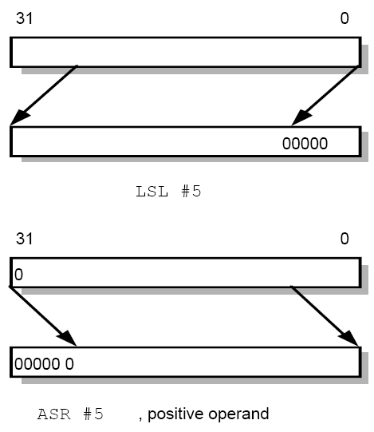
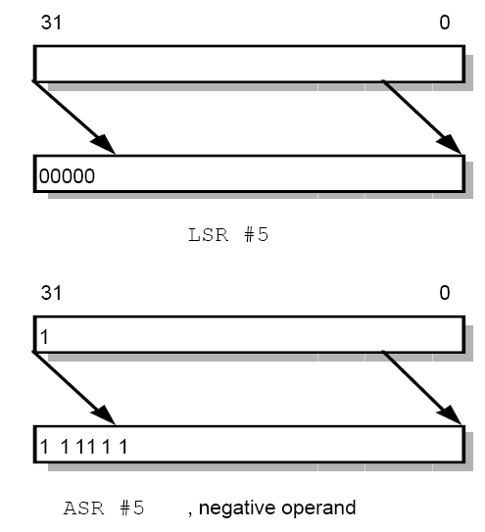
Shifted register operands

Slide 31
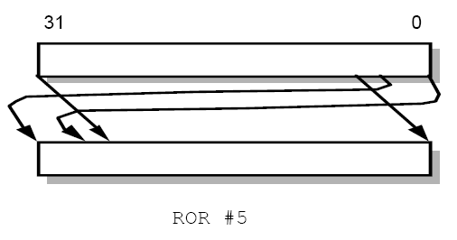
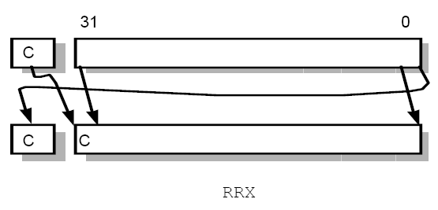
Shifted register operands

Slide 32
Shifted register operands
It is possible to use a register to specify the number of bits to be shifted; only the bottom 8 bits of the register are significant.
@ array index calculation
ADD R0, R1, R2, LSL R3 @ R0:=R1+R2*2^{R3}
@ fast multiply R2=35xR0
ADD R0, R0, R0, LSL #2 @ R0’=5xR0
RSB R2, R0, R0, LSL #3 @ R2 =7xR0’

Slide 33
Multiplication
MOV R1, #35
MUL R2, R0, R1
or
ADD R0, R0, R0, LSL #2 @ R0’=5xR0
RSB R2, R0, R0, LSL #3 @ R2 =7xR0’

Slide 34
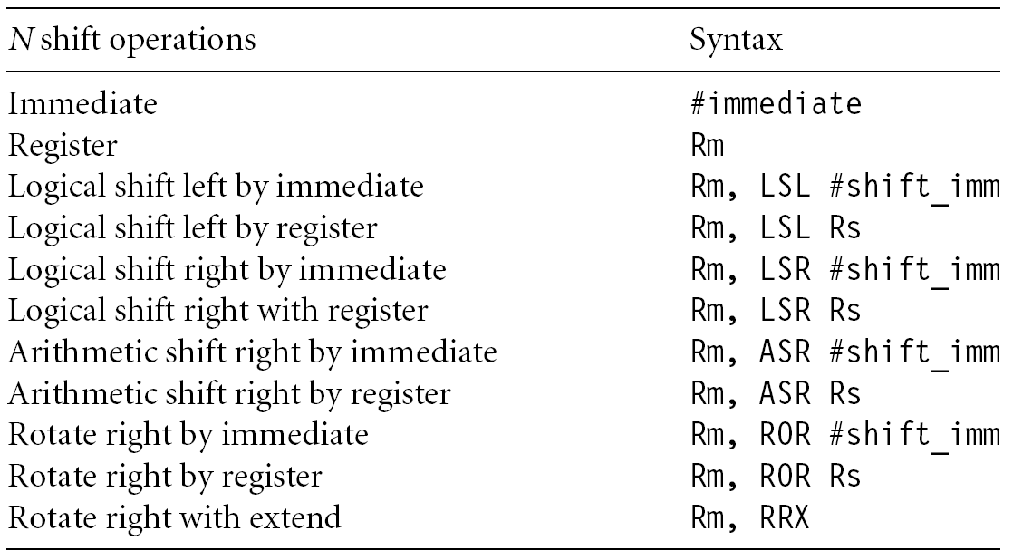
Shifted register operands

Slide 35
Encoding data processing instructions
31
28
27
26
25
24
21
20
19
16
15
12
1
1
0
cond
0 0
#
opcode
S
Rn
Rd
operand 2
destination register
first operand register
set condition codes
arithmetic/logic function
25
1
1
8
7
0
1
#rot
8-bit immediate
immediate alignment
1
1
7
6
5
4
3
0
#shift
Sh
0
Rm
25
immediate shift length
0
shift type
second operand register
1
1
8
7
6
5
4
3
0
Rs
0
Sh
1
Rm
register shift length

Slide 36
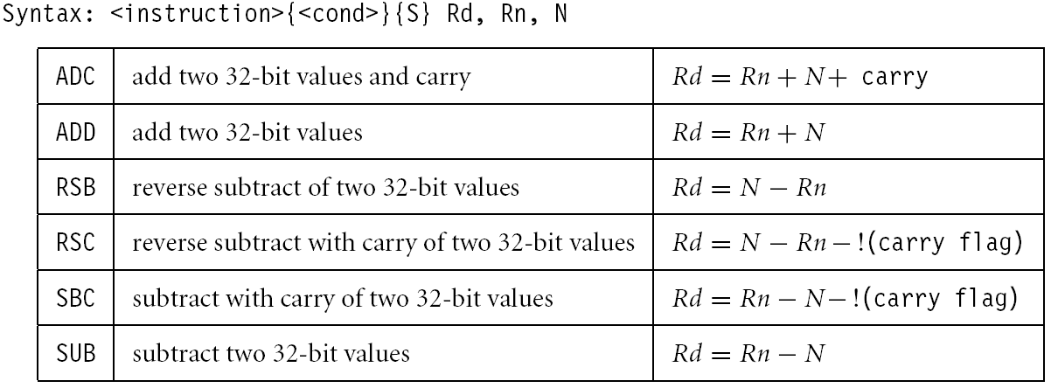
Arithmetic
Add and subtraction

Slide 37
Arithmetic
ADD R0, R1, R2 @ R0 = R1+R2
ADC R0, R1, R2 @ R0 = R1+R2+C
SUB R0, R1, R2 @ R0 = R1-R2
SBC R0, R1, R2 @ R0 = R1-R2-!C
RSB R0, R1, R2 @ R0 = R2-R1
RSC R0, R1, R2 @ R0 = R2-R1-!C
-1
-128
127
0
-5
3
255
128
127
0
3-5=3+(-5) → sum<=255 → C=0 → borrow
5-3=5+(-3) → sum > 255 → C=1 → no borrow

Slide 38
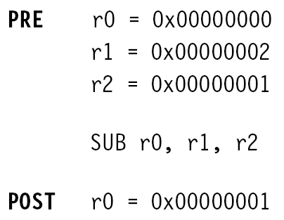
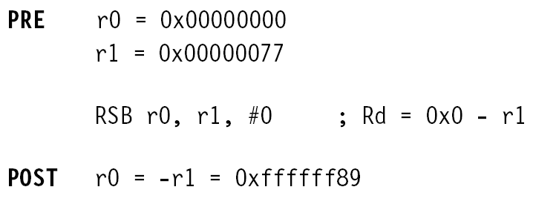
Arithmetic

Slide 39
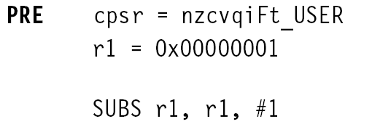

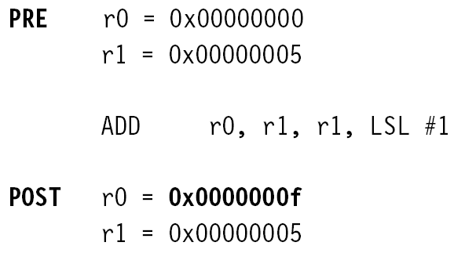
Arithmetic

Slide 40
Setting the condition codes
Any data processing instruction can set the condition codes if the programmers wish it to
64-bit addition
ADDS R2, R2, R0
ADC R3, R3, R1
R1
R0
+
R3
R2
R3
R2

Slide 41
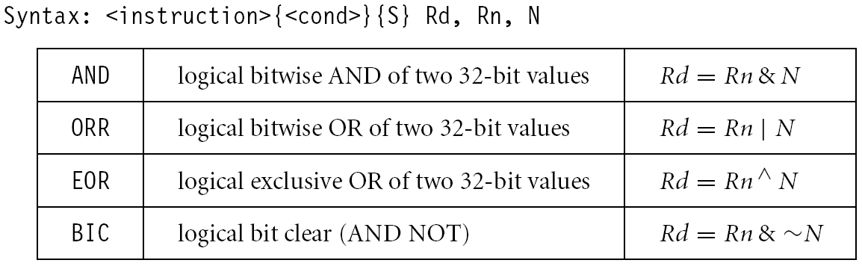
Logical

Slide 42
Logical
AND R0, R1, R2 @ R0 = R1 and R2
ORR R0, R1, R2 @ R0 = R1 or R2
EOR R0, R1, R2 @ R0 = R1 xor R2
BIC R0, R1, R2 @ R0 = R1 and (~R2)
bit clear: R2 is a mask identifying which
bits of R1 will be cleared to zero
R1=0x11111111 R2=0x01100101
BIC R0, R1, R2
R0=0x10011010

Slide 43
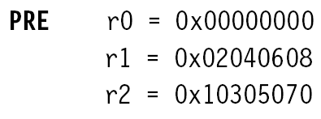
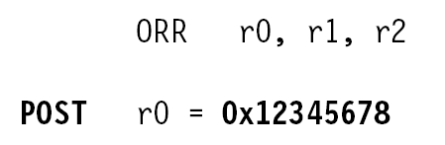
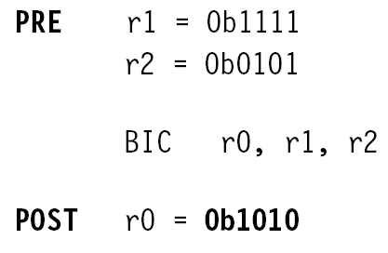
Logical

Slide 44
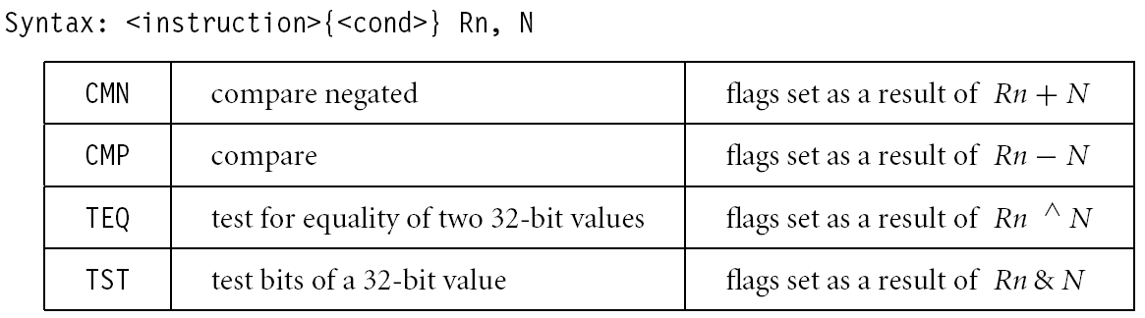
Comparison
These instructions do not generate a result, but set condition code bits (N, Z, C, V) in CPSR. Often, a branch operation follows to change the program flow.

Slide 45
Comparison
CMP R1, R2 @ set cc on R1-R2
CMN R1, R2 @ set cc on R1+R2
TST R1, R2 @ set cc on R1 and R2
TEQ R1, R2 @ set cc on R1 xor R2
compare
compare negated
bit test
test equal

Slide 46
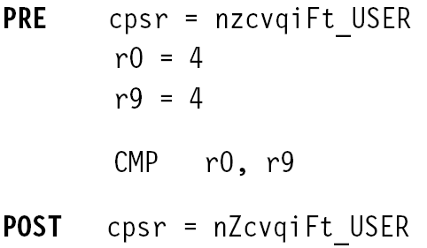
Comparison

Slide 47
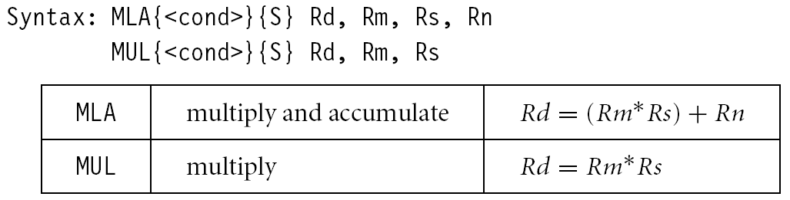
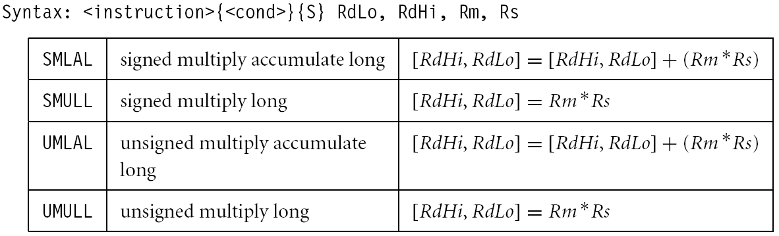
Multiplication

Slide 48
Multiplication
MUL R0, R1, R2 @ R0 = (R1xR2)_{[31:0]}
Features:
Second operand can’t be immediate
The result register must be different from the first operand
Cycles depends on core type
If S bit is set, C flag is meaningless
See the reference manual (4.1.33)

Slide 49
Multiplication
Multiply-accumulate (2D array indexing)
MLA R4, R3, R2, R1 @ R4 = R3xR2+R1
Multiply with a constant can often be more efficiently implemented using shifted register operand
MOV R1, #35
MUL R2, R0, R1
or
ADD R0, R0, R0, LSL #2 @ R0’=5xR0
RSB R2, R0, R0, LSL #3 @ R2 =7xR0’

Slide 50
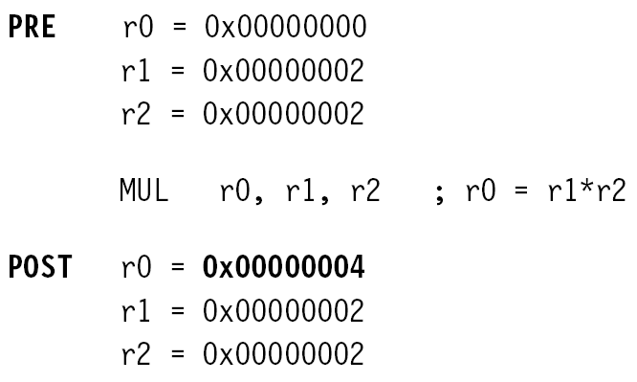
Multiplication

Slide 51
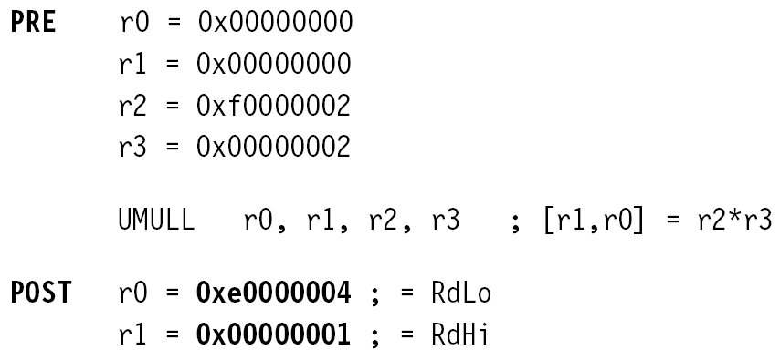
Multiplication

Slide 52
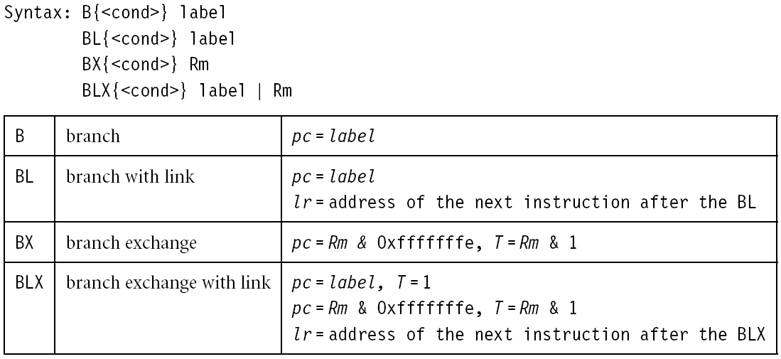
Flow control instructions
Determine the instruction to be executed next
pc-relative offset within 32MB

Slide 53
Flow control instructions
Branch instruction
B label
…
label: …
Conditional branches
MOV R0, #0
loop: …
ADD R0, R0, #1
CMP R0, #10
BNE loop

Slide 54
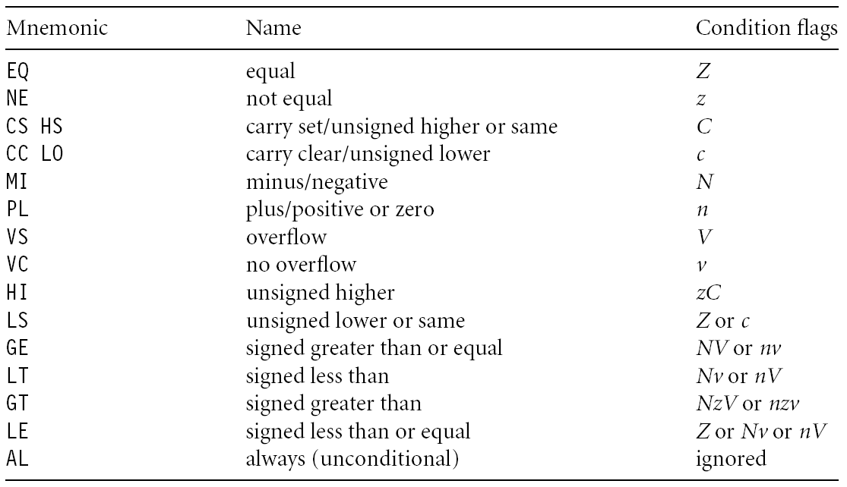
Branch conditions

Slide 55
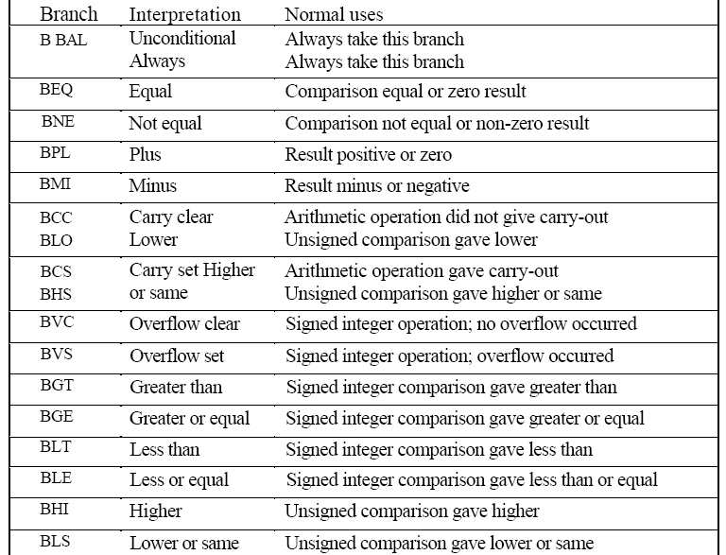
Branches

Slide 56
Branch and link
BL instruction save the return address to R14 (lr)
BL sub @ call sub
CMP R1, #5 @ return to here
MOVEQ R1, #0
…
sub: … @ sub entry point
…
MOV PC, LR @ return

Slide 57
Branch and link
BL sub1 @ call sub1
…
sub1: STMFD R13!, {R0-R2,R14}
BL sub2
…
LDMFD R13!, {R0-R2,PC}
sub2: …
…
MOV PC, LR
use stack to save/restore the return address and registers

Slide 58
Conditional execution
CMP R0, #5
BEQ bypass @ if (R0!=5) {
ADD R1, R1, R0 @ R1=R1+R0-R2
SUB R1, R1, R2 @ }
bypass: …
CMP R0, #5
ADDNE R1, R1, R0
SUBNE R1, R1, R2
smaller and faster
Rule of thumb: if the conditional sequence is three instructions
or less, it is better to use conditional execution than a branch.

Slide 59
Conditional execution
if ((R0==R1) && (R2==R3)) R4++
CMP R0, R1
BNE skip
CMP R2, R3
BNE skip
ADD R4, R4, #1
skip: …
CMP R0, R1
CMPEQ R2, R3
ADDEQ R4, R4, #1

Slide 60
Data transfer instructions
Move data between registers and memory
Three basic forms
Single register load/store
Multiple register load/store
Single register swap: SWP(B), atomic instruction for semaphore

Slide 61
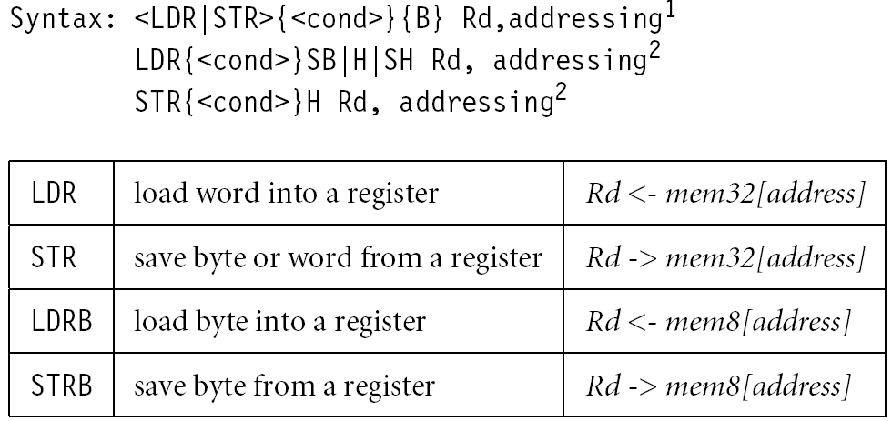
Single register load/store

Slide 62
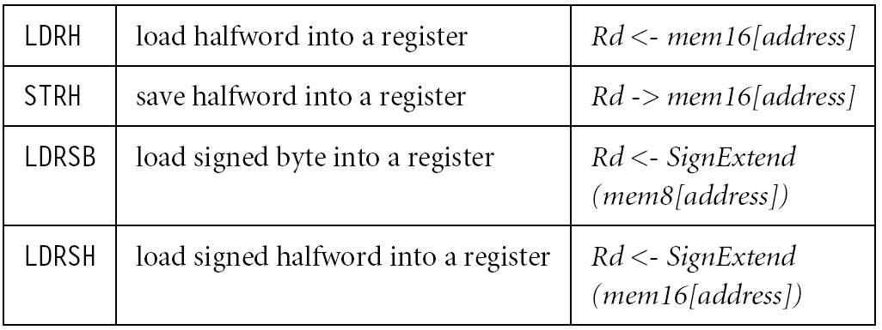
Single register load/store
No STRSB/STRSH since STRB/STRH stores both
signed/unsigned ones

Slide 63
Single register load/store
The data items can be a 8-bit byte, 16-bit half-word or 32-bit word. Addresses must be boundary aligned. (e.g. 4’s multiple for LDR/STR)
LDR R0, [R1] @ R0 := mem₃₂[R1]
STR R0, [R1] @ mem₃₂[R1] := R0
LDR, LDRH, LDRB for 32, 16, 8 bits
STR, STRH, STRB for 32, 16, 8 bits

Slide 64
Addressing modes
Memory is addressed by a register and an offset.
LDR R0, [R1] @ mem[R1]
Three ways to specify offsets:
Immediate
LDR R0, [R1, #4] @ mem[R1+4]
Register
LDR R0, [R1, R2] @ mem[R1+R2]
Scaled register @ mem[R1+4*R2]
LDR R0, [R1, R2, LSL #2]

Slide 65
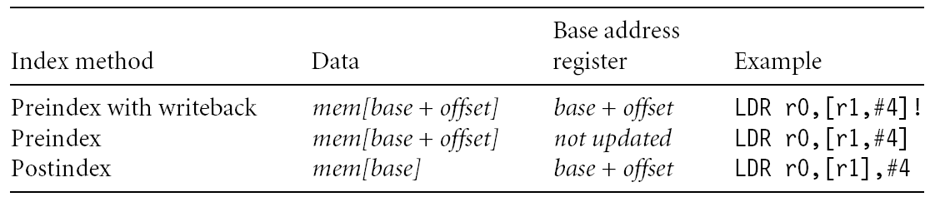
Addressing modes
Pre-index addressing (LDR R0, [R1, #4])
without a writeback
Auto-indexing addressing (LDR R0, [R1, #4]!)
Pre-index with writeback
calculation before accessing with a writeback
Post-index addressing (LDR R0, [R1], #4)
calculation after accessing with a writeback

Slide 66
Pre-index addressing
LDR R0, [R1, #4] @ R0=mem[R1+4]
@ R1 unchanged
LDR R0, [R1, ]
R1
+
R0

Slide 67
Auto-indexing addressing
LDR R0, [R1, #4]! @ R0=mem[R1+4]
@ R1=R1+4
No extra time; Fast;
LDR R0, [R1, ]!
R1
+
R0

Slide 68
Post-index addressing
LDR R0, R1, #4 @ R0=mem[R1]
@ R1=R1+4
LDR R0,[R1],
R1
R0
+

Slide 69
Comparisons
Pre-indexed addressing
LDR R0, [R1, R2] @ R0=mem[R1+R2]
@ R1 unchanged
Auto-indexing addressing
LDR R0, [R1, R2]! @ R0=mem[R1+R2]
@ R1=R1+R2
Post-indexed addressing
LDR R0, [R1], R2 @ R0=mem[R1]
@ R1=R1+R2

Slide 70
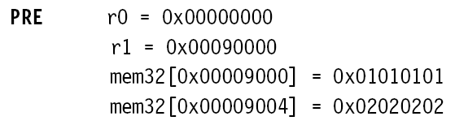

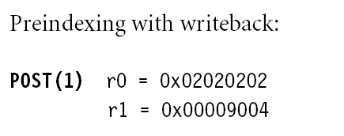
Example

Slide 71

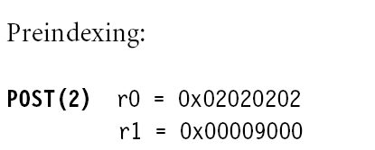
Example

Slide 72

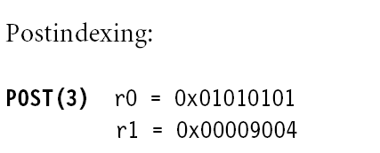
Example

Slide 73
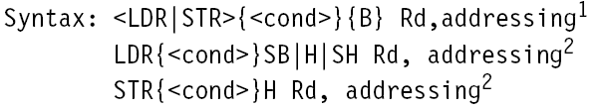
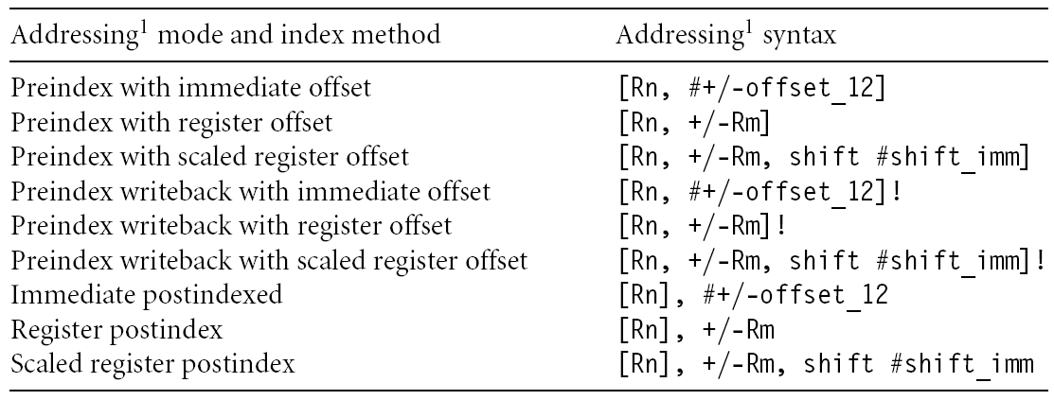
Summary of addressing modes

Slide 74
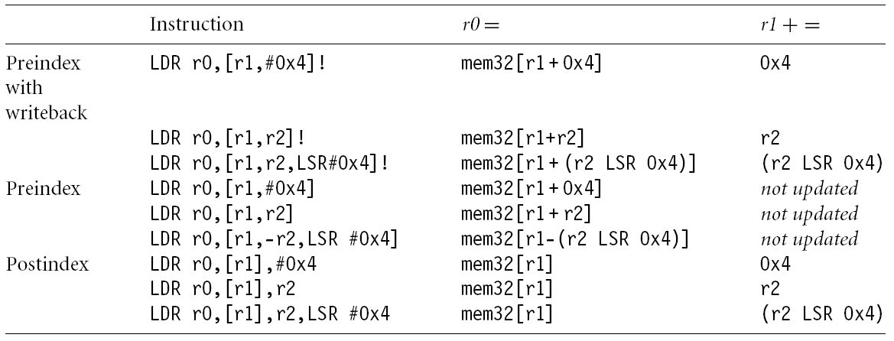
Summary of addressing modes

Slide 75
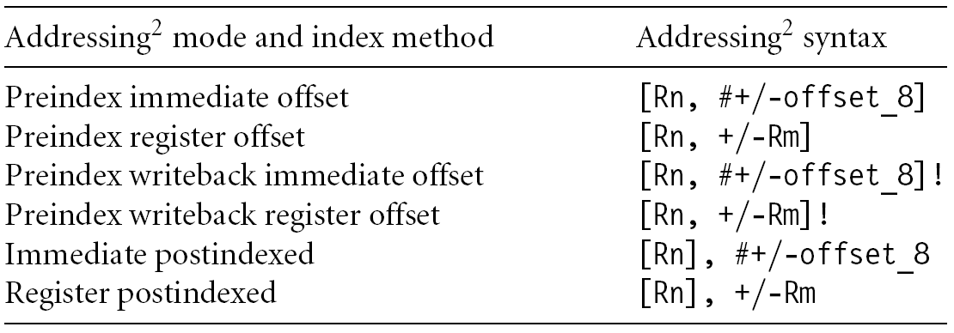
Summary of addressing modes

Slide 76
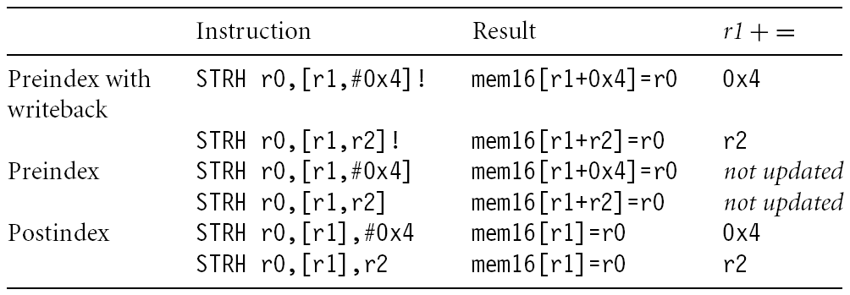
Summary of addressing modes

Slide 77
Load an address into a register
Note that all addressing modes are register-offseted. Can we issue LDR R0, Table? The pseudo instruction ADR loads a register with an address
table: .word 10
…
ADR R0, table
Assembler transfer pseudo instruction into a sequence of appropriate instructions
sub r0, pc, #12

Slide 78
Application
ADR R1, table
loop: LDR R0, [R1]
ADD R1, R1, #4
@ operations on R0
…
ADR R1, table
loop: LDR R0, [R1], #4
@ operations on R0
…
table
R1

Slide 79
Multiple register load/store
Transfer a block of data more efficiently.
Used for procedure entry and exit for saving and restoring workspace registers and the return address
For ARM7, 2+Nt cycles (N:#words, t:time for a word for sequential access). Increase interrupt latency since it can’t be interrupted.
registers are arranged an in increasing order; see manual
LDMIA R1, {R0, R2, R5} @ R0 = mem[R1]
@ R2 = mem[r1+4]
@ R5 = mem[r1+8]

Slide 80
Multiple load/store register
LDM load multiple registers
STM store multiple registers
suffix meaning
IA increase after
IB increase before
DA decrease after
DB decrease before

Slide 81
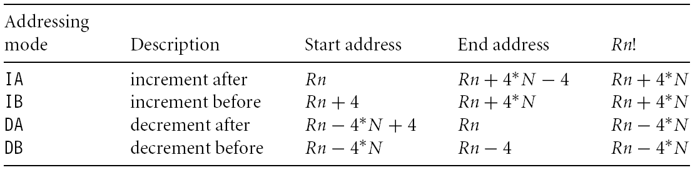
Addressing modes

Slide 82
Multiple load/store register
LDM<mode> Rn, {<registers>}
IA: addr:=Rn
IB: addr:=Rn+4
DA: addr:=Rn-#<registers>*4+4
DB: addr:=Rn-#<registers>*4
For each Ri in <registers>
IB: addr:=addr+4
DB: addr:=addr-4
Ri:=M[addr]
IA: addr:=addr+4
DA: addr:=addr-4
<!>: Rn:=addr
Rn
R1
R2
R3

Slide 83
Multiple load/store register
LDM<mode> Rn, {<registers>}
IA: addr:=Rn
IB: addr:=Rn+4
DA: addr:=Rn-#<registers>*4+4
DB: addr:=Rn-#<registers>*4
For each Ri in <registers>
IB: addr:=addr+4
DB: addr:=addr-4
Ri:=M[addr]
IA: addr:=addr+4
DA: addr:=addr-4
<!>: Rn:=addr
Rn
R1
R2
R3

Slide 84
Multiple load/store register
LDM<mode> Rn, {<registers>}
IA: addr:=Rn
IB: addr:=Rn+4
DA: addr:=Rn-#<registers>*4+4
DB: addr:=Rn-#<registers>*4
For each Ri in <registers>
IB: addr:=addr+4
DB: addr:=addr-4
Ri:=M[addr]
IA: addr:=addr+4
DA: addr:=addr-4
<!>: Rn:=addr
R1
R2
R3
Rn

Slide 85
Multiple load/store register
LDM<mode> Rn, {<registers>}
IA: addr:=Rn
IB: addr:=Rn+4
DA: addr:=Rn-#<registers>*4+4
DB: addr:=Rn-#<registers>*4
For each Ri in <registers>
IB: addr:=addr+4
DB: addr:=addr-4
Ri:=M[addr]
IA: addr:=addr+4
DA: addr:=addr-4
<!>: Rn:=addr
R1
R2
R3
Rn

Slide 86
Multiple load/store register
LDMIA R0, {R1,R2,R3}
or
LDMIA R0, {R1-R3}
R1: 10
R2: 20
R3: 30
R0: 0x10
addr | data
0x010 | 10
0x014 | 20
0x018 | 30
0x01C | 40
0x020 | 50
0x024 | 60
R0

Slide 87
Multiple load/store register
LDMIA R0!, {R1,R2,R3}
R1: 10
R2: 20
R3: 30
R0: 0x01C
addr | data
0x010 | 10
0x014 | 20
0x018 | 30
0x01C | 40
0x020 | 50
0x024 | 60
R0

Slide 88
Multiple load/store register
LDMIB R0!, {R1,R2,R3}
R1: 20
R2: 30
R3: 40
R0: 0x01C
addr | data
0x010 | 10
0x014 | 20
0x018 | 30
0x01C | 40
0x020 | 50
0x024 | 60
R0

Slide 89
Multiple load/store register
LDMDA R0!, {R1,R2,R3}
R1: 40
R2: 50
R3: 60
R0: 0x018
addr | data
0x010 | 10
0x014 | 20
0x018 | 30
0x01C | 40
0x020 | 50
0x024 | 60
R0

Slide 90
Multiple load/store register
LDMDB R0!, {R1,R2,R3}
R1: 30
R2: 40
R3: 50
R0: 0x018
addr | data
0x010 | 10
0x014 | 20
0x018 | 30
0x01C | 40
0x020 | 50
0x024 | 60
R0

Slide 91

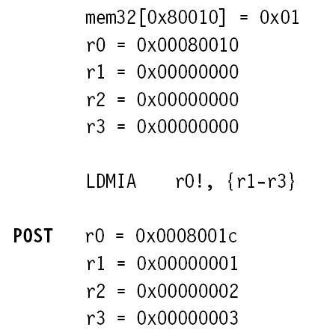
Example

Slide 92
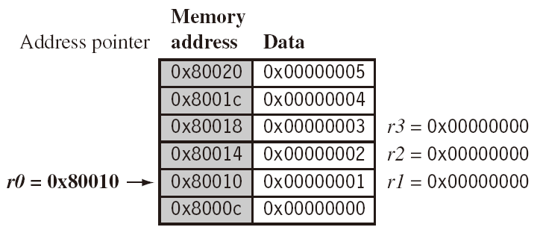
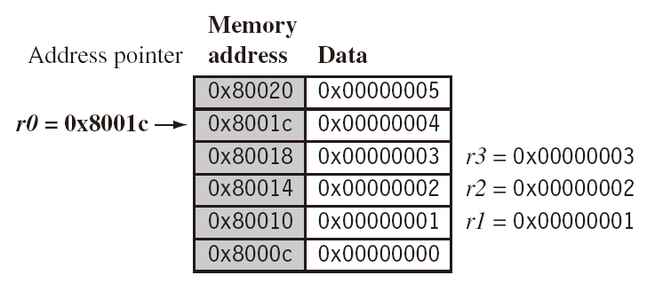
Example
LDMIA r0!, {r1-r3}

Slide 93

Example
LDMIB r0!, {r1-r3}

Slide 94

Application
Copy a block of memory
R9: address of the source
R10: address of the destination
R11: end address of the source
loop: LDMIA R9!, {R0-R7}
STMIA R10!, {R0-R7}
CMP R9, R11
BNE loop

Slide 95
Application
Stack (full: pointing to the last used; ascending: grow towards increasing memory addresses)
LDMFD R13!, {R2-R9} @ used for ATPCS
… @ modify R2-R9
STMFD R13!, {R2-R9}
mode | POP | =LDM | PUSH | =STM
Full ascending (FA) | LDMFA | LDMDA | STMFA | STMIB
Full descending (FD) | LDMFD | LDMIA | STMFD | STMDB
Empty ascending (EA) | LDMEA | LDMDB | STMEA | STMIA
Empty descending (ED) | LDMED | LDMIB | STMED | STMDA

Slide 96



Example

Slide 97

Swap instruction
Swap between memory and register. Atomic operation preventing any other instruction from reading/writing to that location until it completes

Slide 98


Example

Slide 99

Application
Process A
OS
Process B
S=0/1
While (1) {
if (s==0) {
s=1;
}
}
// use the
// resource
While (1) {
if (s==0) {
s=1;
}
}
// use the
// resource

Slide 100

Software interrupt
A software interrupt instruction causes a software interrupt exception, which provides a mechanism for applications to call OS routines.

Slide 101

Example

Slide 102

Load constants
No ARM instruction loads a 32-bit constant into a register because ARM instructions are 32-bit long. There is a pseudo code for this.

Slide 103
Immediate numbers
31
28
27
26
25
24
21
20
19
16
15
12
1
1
0
cond
0 0
#
opcode
S
Rn
Rd
operand 2
destination register
v=n ror 2r
first operand register
set condition codes
arithmetic/logic function
r
n
25
1
1
8
7
0
1
#rot
8-bit immediate
immediate alignment
1
1
7
6
5
4
3
0
#shift
Sh
0
Rm
25
immediate shift length
0
shift type
encoding for
data processing
instructions
second operand register
1
1
8
7
6
5
4
3
0
Rs
0
Sh
1
Rm
register shift length

Slide 104


Load constants
Assemblers implement this usually with two options depending on the number you try to load.

Slide 105
Load constants
Assume that you want to load 511 into R0
Construct in multiple instructions
mov r0, #256
add r0, #255
Load from memory; declare L511 .word 511
ldr r0, L511 ldr r0, [pc, #0]
Guideline: if you can construct it in two instructions, do it; otherwise, load it.
The assembler decides for you
ldr r0, =255 mov r0, 255
ldr r0, =511 ldr r0, [pc, #4]

Slide 106

PC-relative modes
Impossible to use
direct addressing
encoding for
data transfer
instructions

Slide 107
PC-relative addressing
main:
MOV R0, #0
ADR R1, a @ add r1, pc, #4
STR R0, [R1]
SWI #11
a: .word 100
.end
PC
fetch
decode
exec
fetch
decode
exec
fetch
decode
exec

Slide 108

Instruction set

