Slide 1
Outline
Performance Metrics

Slide 2
Measuring Performance
What do we mean by the performance of a processor ?
ANSWER : Almost nothing
What should we ask instead ?
What is the performance with respect to a given program or a set of programs ?
Performance is inversely proportional to the time it takes to execute a program

Slide 3
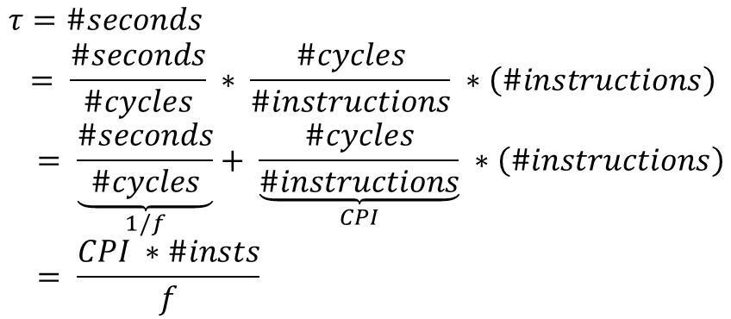
Computing the Time a Program Takes
$$τ=\#seconds \\ = \frac{\#seconds}{\#cycles} ∗ \frac{\#cycles}{\#instructions} ∗\left(\#instructions\right) \\ = \underset{1/f}{\underbrace{\frac{\#seconds}{\#cycles}}}+ \underset{CPI}{\underbrace{\frac{\#cycles}{\#instructions}}} ∗\left(\#instructions\right) \\ = \frac{CPI ∗\#insts}{f}$$
CPI → Cycles per instruction
f → frequency (cycles per second)

Slide 4
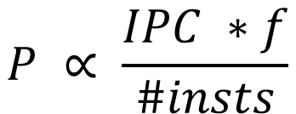
The Performance Equation
$$P ∝ \frac{IPC ∗f}{\#insts}$$
IPC → 1/CPI (Instructions per Cycle)
What are the units of performance ?
ANSWER : arbitrary

Slide 5
Number of Instructions (#insts)
Static Instruction: The binary or executable of a program, contains a list of static instructions.
Dynamic Instruction: A dynamic instruction is a running instance of a static instruction, which is created by the processor when an instruction
enters the pipeline.
Note that these are dynamic instructions
NOT static instructions
A smart compiler can reduce the number of executed instructions

Slide 6
Number of Instructions(#insts) – 2
Dead code removal
Often programmers write code that does not determine the final output
This code is redundant
It can be identified and removed by the compiler
Function inlining
Very small functions have a lot of overhead → call, ret instructions, register spilling, and restoring
Paste the code of the callee in the code of the caller (known as inlining)

Slide 7
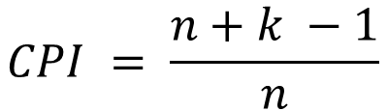
Computing the CPI
CPI for a single cycle processor = 1
CPI for an ideal pipeline(no hazards)
Assume we have n instructions, and k stages
The first instruction enters the pipeline in cycle 1
It leaves the pipeline in cycle k
The rest of the (n-1) instructions leave in the next (n-1) consecutive cycles
$$CPI = \frac{n+k −1}{n}$$

Slide 8
Computing the Maximum Frequency
Let the maximum amount of time that it takes to execute any instruction be :
t_{max} (also known as algorithmic work)
Minimum clock cycle time of a single cycle pipeline → t_{max}
In the case of a pipeline, let us assume that all the pipeline stages are balanced
Time per stage → t_{max} / k

Slide 9


Maximum Frequency - II
Let the latch delay be l
We thus have :
$$t_{stage}= \frac{t_{max}}{k}+l$$
The minimum cycle time (1/f) is equal
to t_{stage} . Let us thus, assume that
our cycle time is as low as possible.
$$\frac{1}{f}= \frac{t_{max}}{k}+l$$

Slide 10
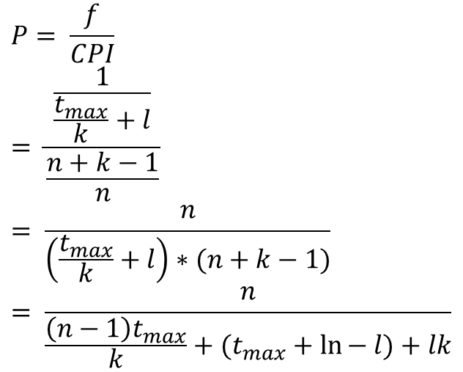
Performance of an Ideal Pipeline
Let us assume that the number of instructions are a constant
$$P= \frac{f}{CPI} \\ = \frac{\frac{1}{\frac{t_{max}}{k}+l}}{\frac{n+k−1}{n}} \\ = \frac{n}{\left(\frac{t_{max}}{k}+l\right)∗(n+k−1)} \\ = \frac{n}{\frac{\left(n−1\right)t_{max}}{k}+(t_{max}+\ln{− l)+lk}}$$

Slide 11
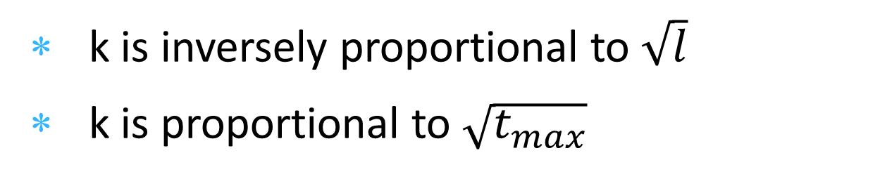
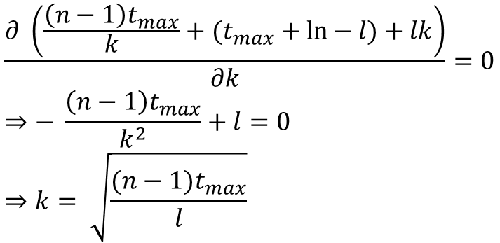
Optimal Number of Pipeline Stages
$$\frac{∂ \left(\frac{\left(n−1\right)t_{max}}{k}+(t_{max}+\ln{− l)+lk}\right)}{∂k}=0 \\ ⇒− \frac{\left(n−1\right)t_{max}}{k^{2}}+l=0 \\ ⇒k= \sqrt{\frac{(n−1)t_{max}}{l}}$$
k is inversely proportional to $\sqrt{l}$
k is proportional to $\sqrt{t_{max}}$

Slide 12
Implications
As we increase the latch delay, we should have less pipeline stages
We need to minimise the time wasted in accessing latches
As we increase the amount of algorithmic work, we require more pipeline stages for ideal performance
More pipeline stages help distribute the work better, and increase the overlap across instructions

Slide 13
Implications - II
As the number of instructions tends to ∞, the number of ideal pipeline stages also tends to ∞
The higher startup time gets amortized in the long run

Slide 14
A Non-Ideal Pipeline
Our ideal CPI (CPI_{ideal} = 1) is 1
However, in reality, we have stalls
Let us assume that the stall rate is a function of the program, and its nature of dependences
$$CPI= {CPI}_{ideal }+stall_rate∗stall_penalty$$

Slide 15
Non-Ideal Pipeline - II
Let us assume that the stall penalty is proportional to the number of pipeline stages
Both these assumptions are strictly not correct. They are being used to make a coarse grained mathematical model.
CPI = (n+k-1)/n + rck
r → stall rate, c → constant of proportionality

Slide 16
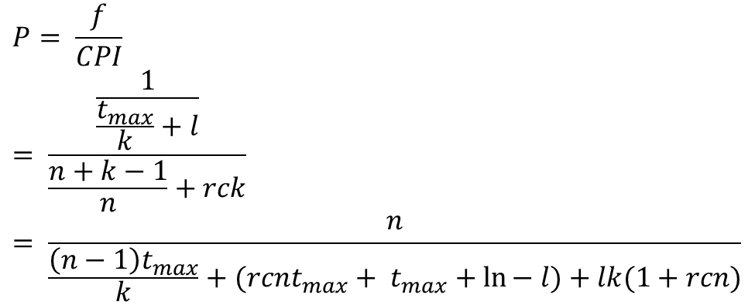
Mathematical Model
$$P= \frac{f}{CPI} \\ = \frac{\frac{1}{\frac{t_{max}}{k}+l}}{\frac{n+k−1}{n}+rck} \\ = \frac{n}{\frac{\left(n−1\right)t_{max}}{k}+(rcnt_{max}+ t_{max}+\ln{− l)+lk(1+rcn)}}$$

Slide 17
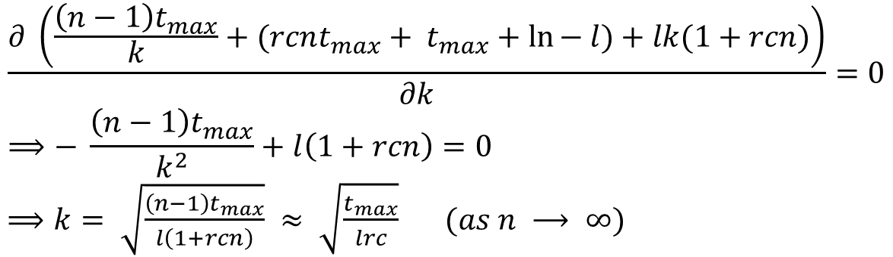
Mathematical Model - II
$$\frac{∂ \left(\frac{\left(n−1\right)t_{max}}{k}+(rcnt_{max}+ t_{max}+\ln{− l)+lk(1+rcn)}\right)}{∂k}=0 \\ ⟹− \frac{\left(n−1\right)t_{max}}{k^{2}}+l\left(1+rcn\right)=0$$ $⟹k= \sqrt{\frac{\left(n−1\right)t_{max}}{l\left(1+rcn\right)}} ≈ \sqrt{\frac{t_{max}}{lrc}} (as n ⟶ ∞)$

Slide 18
Implications
For programs with a lot of dependences (high value of r) → Use less pipeline stages
For a pipeline with forwarding → c is smaller (than a pipeline that just has interlocks)
It requires a larger number of pipeline stages for optimal performance

Slide 19
Implications
The optimal number of pipeline stages is directly proportional to √(t_{max} / l)
This ratio is not significantly changing across technologies.
This explains why the number of pipline stages has remained more or less constant for the last 5-10 years

Slide 20
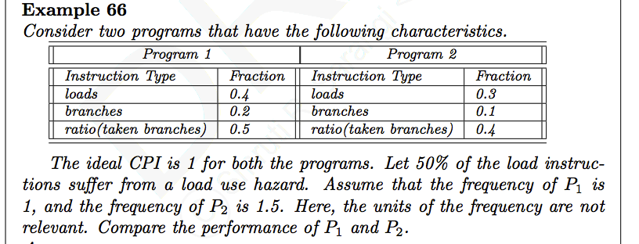
Example
Example Consider two programs that have the following characteristics.
Program 1 |  | Program 2
Instruction Type | Fraction | Instruction Type | Fraction
loads | 0.4 | loads | 0.3
Branches | 0.2 | Branches | 0.1
ratio(taken branches) | 0.5 | ratio(taken branches) | 0.4

Slide 21
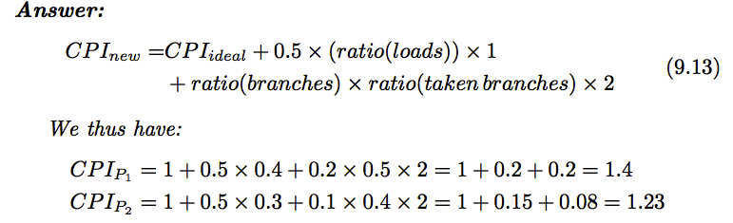
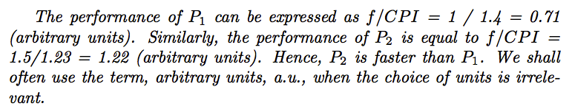
Example

Slide 22


Performance, Architecture, Compiler
P
f
IPC
Technology
Compiler
Architecture
Architecture

Slide 23
THE END

