Slide 1
Introduction to Digital Logic Design
Subhasis Bhattacharjee

Slide 2
Scope

Slide 3
Major Parts in this course
We will cover the following major things in this course:
Combinational Logic
Sequential Networks
Standard Modules

Slide 4
Combinational Logic vs Sequential Network
x₁
.
.
.
x_{n}
x₁
.
.
.
x_{n}
x₁
.
.
.
x_{n}
f_{i}(x)
f_{i}(x)
f_{i}(x)
f_{i}(x)
f_{i}(x)
f_{i}(x)
s_{i}
CLK
Combinational logic:
Sequential Networks
1) Memory 2) Time Steps (Clock)
y_{i} = f_{i}(x₁,..,x_{n})
y_{i}^{t} = f_{i} (x₁^{t},…,x_{n}^{t}, s₁^{t}, …,s_{m}^{t})
S_{i}^{t+1} = g_{i}(x₁^{t},…,x_{n}^{t}, s₁^{t},…,s_{m}^{t})

Slide 5
Scope
Subjects | Building Blocks | Theory
Combinational Logic | AND, OR, NOT,XOR | Boolean Algebra
Sequential Network | FF, Counter, Registers | Finite State Machine
Standard Modules | Operators, Interconnects, Memory | Arithmetics, Universal Logic

Slide 6
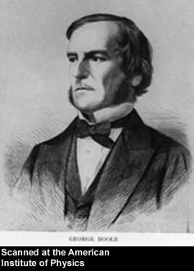
George Boole, 1815 - 1864
Born to working class parents
Taught himself mathematics and joined the faculty of Queen’s College in Ireland.
Wrote An Investigation of the Laws of Thought (1854)
Introduced binary variables
Introduced the three fundamental logic operations: AND, OR, and NOT.

Slide 7
Combinational Logic

Slide 8
Combinational Logic vs Boolean Algebra Expression
a
b
ab
ab + cd
c
d
y=e (ab+cd)
cd
e
Schematic Diagram:
5 primary inputs
4 components
9 signal nets
12 pins
Boolean Algebra:
5 literals
4 operators

Slide 9
Some Definitions
Complement: variable with a bar over it
A, B, C
Literal: variable or its complement
A, A, B, B, C, C
Implicant: product of literals
ABC, AC, BC
Minterm: product that includes all input variables
ABC, ABC, ABC
Maxterm: sum that includes all input variables
(A+B+C), (A+B+C), (A+B+C)

Slide 10
Digital Discipline: Binary Values
Typically consider only two discrete values:
1’s and 0’s
1, TRUE, HIGH
0, FALSE, LOW
1 and 0 can be represented by specific voltage levels, rotating gears, fluid levels, etc.
Digital circuits usually depend on specific voltage levels to represent 1 and 0
Bit: Binary digit
1-<10>

Slide 11
Digital (logic) Elements: Gates
Digital devices or gates have one or more inputs and produce an output that is a function of the current input value(s).
All inputs and outputs are binary and can only take the values 0 or 1
A gate is called a combinational circuit because the output only depends on the current input combination.
Digital circuits are created by using a number of connected gates such as the output of a gate is connected to the input of one or more gates in such a way to achieve specific outputs for input values.
Digital or logic design is concerned with the design of such circuits.

Slide 12
Truth Tables
Provide a listing of every possible combination of values of binary inputs to a digital circuit and the corresponding outputs.
Truth Table
Inputs |  | Outputs
x | y | x.y | x+y
0 | 0 | 0 | 0
0 | 1 | 0 | 1
1 | 0 | 0 | 1
1 | 1 | 1 | 1
Example (2 inputs, 2 outputs):
inputs
outputs
x
x . y
Digital circuit
y
x + y

Slide 13
AND Gate
Truth Table
Inputs |  | Output
A | B | A.B
0 | 0 | 0
0 | 1 | 0
1 | 0 | 0
1 | 1 | 1
A
B
A.B
Symbol
SHARED TERMINALS (We will not mention them - Usually)
GND | Connected to ground
VCC | Connected to positive voltage to provide power to all four gates

Slide 14
OR Gate
A
B
Truth Table
Inputs |  | Output
A | B | A + B
0 | 0 | 0
0 | 1 | 1
1 | 0 | 1
1 | 1 | 1
A+B
Symbol

Slide 15
NAND Gate
A
B
Truth Table
Inputs |  | Output
A | B | (A . B)’
0 | 0 | 1
0 | 1 | 1
1 | 0 | 1
1 | 1 | 0
(A.B)'
Symbol

Slide 16
The NAND Gate
Multiple equivalent symbols / logical representations
NAND gate is self-sufficient (can build any logic circuit with it).
Can be used to implement AND/OR/NOT
A
B
≡
A
B
(A.B)'
(A.B)'
Equivalent Symbols

Slide 17
Logic Gates
Symbol set 1
Symbol set 2
(ANSI/IEEE Standard 91-1984)
a
b
a
b
&
AND
a.b
a.b
OR
a
b
a
b
+
a+b
a+b
NOT
a
a'
a
1
a'
a
b
a
b
&
NAND
(a.b)'
(a.b)'
a
b
a
b
≥1
NOR
(a+b)'
(a+b)'
a
b
a
b
=1
EXCLUSIVE OR
a ⊕ b
a ⊕ b

Slide 18
Useful Circuits using Logic Gates

Slide 19
Binary Addition
5
+ 7
1 2
Carry Sum
1 1 1
1 0 1
+ 1 1 1
Carry bits
5
7
12
1 1 0 0
Carryout Sums

Slide 20
Binary Addition: Hardware
Half Adder: Two inputs (a,b) and two outputs (carry, sum).
Full Adder: Three inputs (a,b,c) and two outputs (carry, sum).

Slide 21
Half Adder
Truth Table
a
a b carry sum
0 0 0 0
0 1 0 1
1 0 0 1
1 1 1 0
Sum
b
Carry

Slide 22
Switching Function
Switching Expressions:
Sum (a,b) = a’b + ab’
Carry (a, b) = a*b
Ex:
Sum (0,0) = 0’0 + 0*0’ = 0 + 0 = 0
Sum (0,1) = 0’1 + 0*1’ = 1 + 0 = 1
Sum (1,1) = 1’1 + 1*1’ = 0 + 0 = 0
a
a
sum
carry
b
b

Slide 23
Full Adder
Truth Table
Cin
Id a b c_{in} carry sum
0 0 0 0 0 0
1 0 0 1 0 1
2 0 1 0 0 1
3 0 1 1 1 0
4 1 0 0 0 1
5 1 0 1 1 0
6 1 1 0 1 0
7 1 1 1 1 1
a
Sum
b
Carry

Slide 24
Minterm and Maxterm
Id a b c_{in} carryout
0 0 0 0 0 a+b+c
1 0 0 1 0 a+b+c’
2 0 1 0 0 a+b’+c
3 0 1 1 1 a’ b c
4 1 0 0 0 a’+b+c
5 1 0 1 1 a b’c
6 1 1 0 1 a b c’
7 1 1 1 1 a b c
minterm
maxterm

Slide 25
Minterms
f1(a,b,c) = a’bc + ab’c + abc’ + abc
a’bc = 1 iff (a,b,c,) = (0,1,1)
ab’c = 1 iff (a,b,c,) = (1,0,1)
abc’ = 1 iff (a,b,c,) = (1,1,0)
abc = 1 iff (a,b,c,) = (1,1,1)
f1(a,b,c) = 1 iff (a,b,c) = (0,1,1), (1,0,1), (1,1,0), or (1,1,1)
Ex: f1(1,0,1) = 1’01 + 10’1 + 101’ + 101 = 1
f1(1,0,0) = 1’00 + 10’0 + 100’ + 100 = 0

Slide 26
Maxterms
f2(a,b,c) = (a+b+c)(a+b+c’)(a+b’+c)(a’+b+c)
a + b + c = 0 iff (a,b,c,) = (0,0,0)
a + b + c’ = 0 iff (a,b,c,) = (0,0,1)
a + b’ + c = 0 iff (a,b,c,) = (0,1,0)
a’ + b + c = 0 iff (a,b,c,) = (1,0,0)
f2(a,b,c) = 0 iff (a,b,c) = (0,0,0), (0,0,1), (0,1,0), (1,0,0)
Ex: f2(1,0,1) = (1+0+1)(1+0+1’)(1+0’+1)(1’+0+1) = 1
f2(0,1,0) = (0+1+0)(0+1+0’)(0+1’+0)(0’+1+0) = 0

Slide 27
Other - Two-Input Logic Gates

Slide 28
Which Gates are Important

Slide 29
Universal Set
Universal Set: A set of gates such that every switching function can be implemented with gates in this set.
Ex:
{AND, OR, NOT}
{AND, NOT}
{OR, NOT}

Slide 30
Universal Set
Universal Set: A set of gates such that every Boolean function can be implemented with gates in this set.
Ex:
{AND, OR, NOT}
{AND, NOT} OR can be implemented with AND & NOT gates a+b = (a’b’)’
{OR, NOT} AND can be implemented with OR & NOT gates ab = (a’+b’)’
{AND, OR} This is not universal.

Slide 31
Standard Combinational Modules (Combinational Building Blocks)

Slide 32
Some (Common) Building Blocks?
Decoder: Decode address
Encoder: Encode address
Multiplexer (Mux): Select data by address
Demultiplexier (DeMux): Direct data by address
Shifter: Shift bit location
Adder: Add two binary numbers

Slide 33
Part III. Standard Modules
Interconnect Modules:
1. Decoder, 2. Encoder
3. Multiplexer, 4. Demultiplexer

Slide 34
Multiplexer
Definition
Logic Diagram
Application

Slide 35
3. Mux (Multiplexer): Definition
En
Description
If En = 1
y = D_{i} where i = (S_{n-1}, .. , S₀)
Else
y = 0
D₂^{n}₋₁-D₀
y
(Data input)
S_{n-1,0}
(Control input)

Slide 36
Multiplexer (Mux): Definition
Selects between one of N inputs to connect to the output.
log₂N-bit select input – control input
Example: 2:1 Mux

Slide 37
Multiplexer Definition: Example
En
If D₀ = 0 and S₁S₀ = 00 => y = 0
If D₀ = 1 and S₁S₀ = 00 => y = 1
D₀
0
D₁
1
y
D₂
2
D₃
3
S₁
S₀

Slide 38
Multiplexer: Logic Diagram
Tristates
For an N-input mux, use N tristates
Turn on exactly one to select the appropriate input
Logic gates
Sum-of-products form

Slide 39
4. Demultiplexers
En
y_{i} = x if i = (S_{n-1}, .. , S₀) & En = 1
y_{i} = 0 otherwise
x
y₂n₋₁ -y₀
S(n-1,0)
Control Input

Slide 40
Shifter
x_{n}
x_{n-1}
x₀
x₋₁
y_{i} = x_{i-1} if En = 1, s = 1, and d = L
= x_{i+1} if En = 1, s = 1, and d = R
= x_{i} if En = 1, s = 0
= 0 if En = 0
s
s / n
En
d
l / r
yn₋₁
y0
x_{i+1}
x_{i}
x_{i-1}
Can be implemented with a mux
s
1
3 2 1 0
d
En
0
yi

Slide 41
Barrel Shifter
shift
x
0 1
0 1
0 1
s₀
O or 1 shift
s₁
O or 2 shift
0 1
0 1
0 1
0 1
0 1
s₂
O or 4 shift
y
0 1
0 1
0 1
0 1
0 1
0 1

Slide 42
Interconnect: Decoder, Encoder, Mux, DeMux
Arbiter
Data 1
P1
Mux,
Memory Bank
Address 1
Data
P2
Demux
n-m
Address 2
Mux
Address
Address k
n
m
2^{m}
Decoder
Pk
Data k

Slide 43
1. Decoder
Definition
Logic Diagram
Application (Universal Set)
Tree of Decoders

Slide 44
1. Decoder: Definition
EN (enable)
I₀
0
0
1
2
3
4
5
6
7
y₀
y₁
y₇
I₁
1
.
.
I₂
2
n to 2^{n} decoder function:
n inputs
n= 3
2^{n} outputs
2³= 8
y_{i} = 1 if En= 1 & (I_{2,} I_{1,} I₀ ) = i
y_{i}= 0 otherwise

Slide 45
1. Decoder: Definition
N inputs, 2^{N} outputs
One-hot outputs: only one output HIGH at once

Slide 46
Decoder: Logic Diagram
En
y_{i} = m_{i} En
y₀ = 1 if (I_{2,} I_{1,} I₀ ) = (0,0,0) & En = 1
I₀’
I₁’
y₀
I₂’
I₀’
I₁’
y₁
I₂
.
.
I₀
I₁
y₇
y₇ = I₂I₁I₀En
I₂

Slide 47
Decoder Application: universal set {Decoder, OR}
Example:
Implement functions f₁(a,b,c) = Σm(1,2,4)
f₂(a,b,c) = Σm(2,3), and
f₃(a,b,c) = Σm(0,5,6)
with a 3-input decoder and OR gates.
y₁
y₂
En
y₄
f₁
y₀
y₁
.
.
y₇
y₂
c
I₀
0
1
2
3
4
5
6
7
b
I₁
y₃
f₂
a
I₂
y₀
y₅
y₆
f₃

Slide 48
Decoders
OR minterms

Slide 49
Tree of Decoders
Implement a 4-2⁴ decoder with 3-2³ decoders.
d
I₀
0
1
2
3
4
5
6
7
y₀
y₁
y₇
c
I₁
b
I₂
I₀
0
1
2
3
4
5
6
7
y₈
y₉
y₁₅
I₁
I₂
a

Slide 50
Tree of Decoders
Implement a 6-2⁶ decoder with 3-2³ decoders.
En
En
y₀
D0
I_{2,} I_{1,} I₀
y₇
I_{5,} I_{4,} I₃
y₈
D1
I_{2,} I_{1,} I₀
…
y₁₅
…
y₅₆
D7
I_{2,} I_{1,} I₀
y₆₃

Slide 51
2. Encoder
Definition
Logic Diagram
Priority Encoder

Slide 52
2. Encoder: Definition
En
I₂^{n}-1…I₀
y_{n-1 …}y₀
A
Encoder Description:
En
At most one I_{i} = 1.
(y_{n-1},.., y₀ ) = i if I_{i} = 1 & Εn = 1
(y_{n-1},.., y₀ ) = 0 otherwise.
A = 1 if En = 1 and one i s.t. I_{i} = 1
A = 0 otherwise.
I₀
0
1
2
3
4
5
6
7
y₀
0
1
2
y₁
y₂
I₇
8 inputs
A
3 outputs

Slide 53
Encoder: Logic Diagram
En
y₀
I₁
I₃
I₅
I₇
En
y₁
I₂
I₃
I₆
I₇

Slide 54
Encoder: Logic Diagram
En
y₂
I₄
I₅
I₆
I₇
En
I₀
A
I₁
.
.
I₆
I₇

Slide 55
Priority Encoder: Definition
Description: Input (I₂^{n}-1,…, I₀), Output (y_{n-1} ,…,,y₀)
(y_{n-1} ,…,,y₀) = i if I_{i} = 1 & En = 1 & I_{k} = 0
for all k > i (high bit priority) or
for all k< i (low bit priority).
En
E_{o} = 1 if En = 1 & I_{i} = 0 for all i,
G_{s} = 1 if En = 1 & i s.t. I_{i} = 1.
I₀
0
1
2
3
4
5
6
7
y₀
0
1
2
E
y₁
(G_{s} is like A, and E_{o} tells us if enable is true or not).
y₂
I₇
Eo
Gs

Slide 56
Priority Encoder: Implement a 32-input priority encoder w/ 8 input priority encoders (high bit priority).
En
I₃₁₋₂₄
y_{32,} y_{31,} y₃₀
Eo
Gs
I₂₅₋₁₆
y_{22,} y_{21,} y₂₀
Eo
Gs
I₁₅₋₈
y_{12,} y_{11,} y₁₀
Eo
Gs
I₇₋₀
y_{02,} y_{01,} y₀₀
Eo
Gs

Slide 57
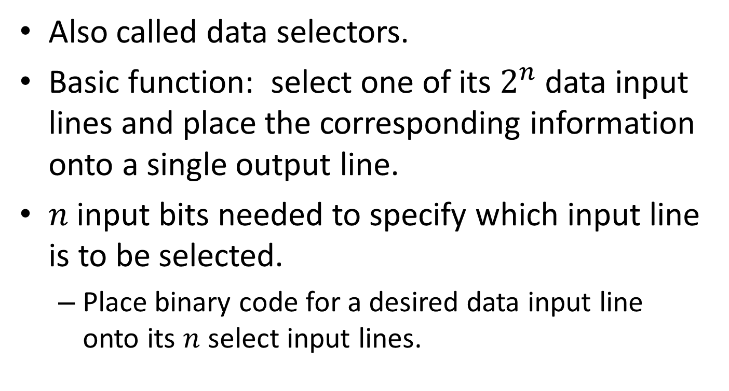
Multiplexer
Also called data selectors.
Basic function: select one of its $2^{n}$ data input lines and place the corresponding information onto a single output line.
$n$ input bits needed to specify which input line is to be selected.
Place binary code for a desired data input line onto its $n$ select input lines.

Slide 58
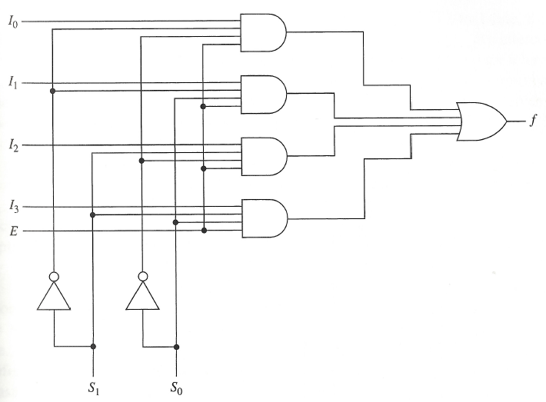
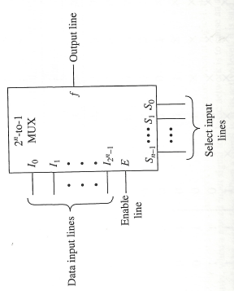
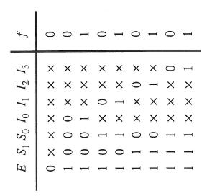
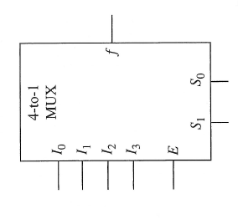
Realization of 4-to-1 line multiplexer
Symbol
Logic Diagram
Truth Table

Slide 59
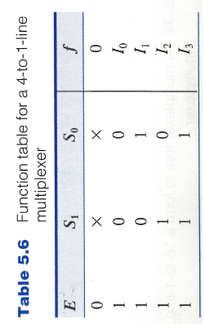

Realization of 4-to-1 line multiplexer
Alternate description:
Algebraic description of multiplexer:
$$f= \left(I_{0}{\overline{S}}_{1}{\overline{S}}_{0}+I_{1}{\overline{S}}_{1}S_{0}+I_{2}S_{1}{\overline{S}}_{0}+I_{3}S_{1}S_{2}\right)E$$

Slide 60
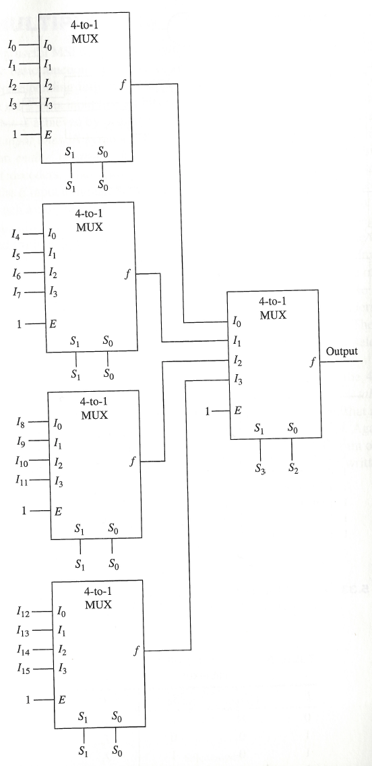
Building a Large Multiplexer

Slide 61
Multiplexers
One of the primary applications of multiplexers is to provide for the transmission of information from several sources over a single path.
This process is known as multiplexing.
Demultiplexer = decoder with an enable input.

Slide 62
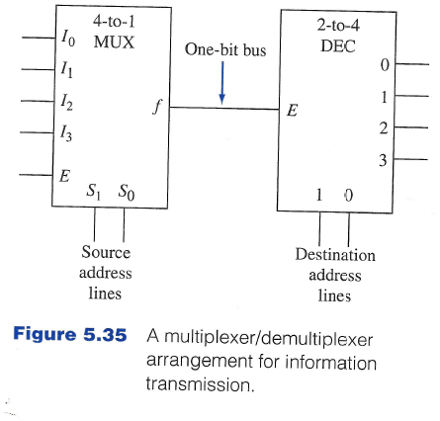
Multiplexer/De-multiplexer for information transmission

