Slide 1
Overview of CMOS & Logic Gates
Introduction to CMOS circuits
MOS transistor theory, processing technology
CMOS circuit and logic design

Slide 2
Transistor Types
Metal Oxide Semiconductor Field Effect Transistors
  nMOS and pMOS MOSFETS
  Voltage applied to insulated gate controls current between source and drain
  Low power allows very high integration
Complementary Metal Oxide Semiconductor
  Fast, cheap, low power transistors

Slide 3
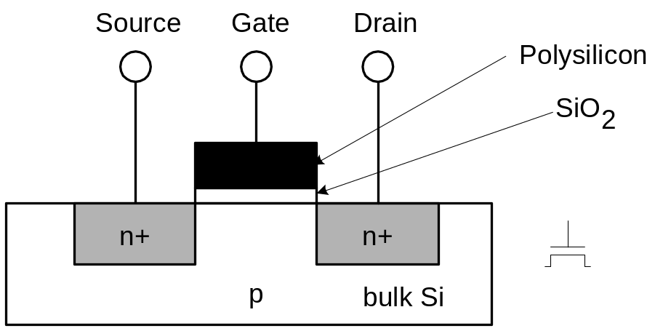
nMOS Transistor
Four terminals: gate, source, drain, body
Gate – oxide – body stack looks like a capacitor
  Gate and body are conductors
  SiO₂ (oxide) is a very good insulator
  Called metal – oxide – semiconductor (MOS) capacitor
  Even though gate is
  no longer made of metal

Slide 4
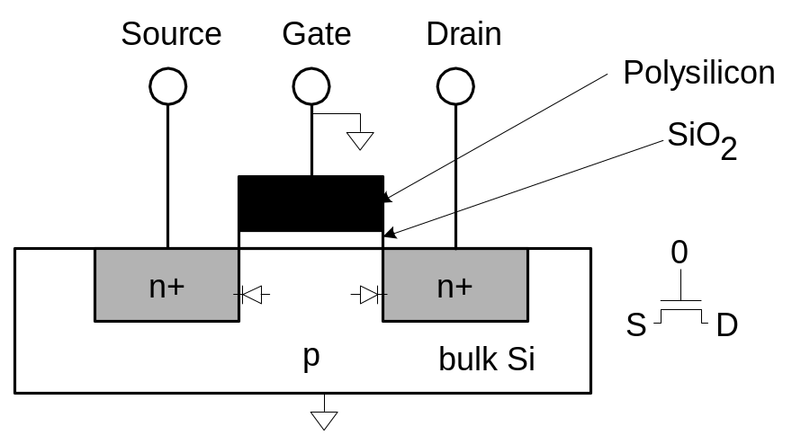
nMOS Operation
Body is commonly tied to ground (0 V)
When the gate is at a low voltage:
  P-type body is at low voltage
  Source-body and drain-body diodes are OFF
  No current flows, transistor is OFF

Slide 5

nMOS Operation Cont.
When the gate is at a high voltage:
  Positive charge on gate of MOS capacitor
  Negative charge attracted to body
  Inverts a channel under gate to n-type
  Now current can flow through n-type silicon from source through channel to drain, transistor is ON

Slide 6
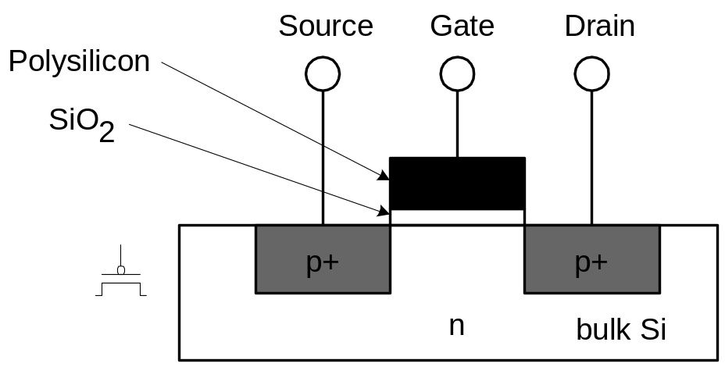
pMOS Transistor
Similar, but doping and voltages reversed
  Body tied to high voltage (V_{DD})
  Gate low: transistor ON
  Gate high: transistor OFF
  Bubble indicates inverted behavior

Slide 7
Power Supply Voltage
GND = 0 V
In 1980’s, V_{DD} = 5V
V_{DD} has decreased in modern processes
  High V_{DD} would damage modern tiny transistors
  Lower V_{DD} saves power
V_{DD} = 3.3, 2.5, 1.8, 1.5, 1.2, 1.0, …

Slide 8
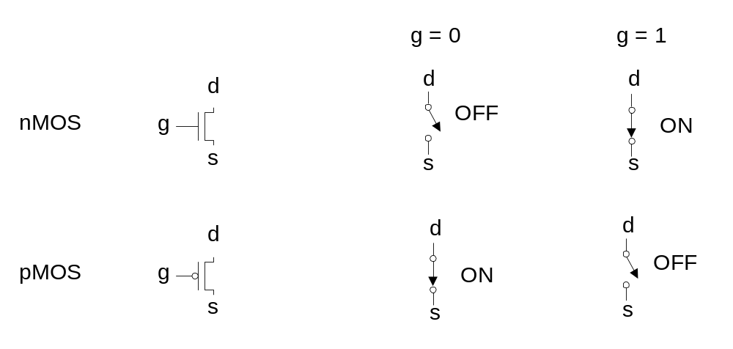
Transistors as Switches
We can view MOS transistors as electrically controlled switches
Voltage at gate controls path from source to drain

Slide 9
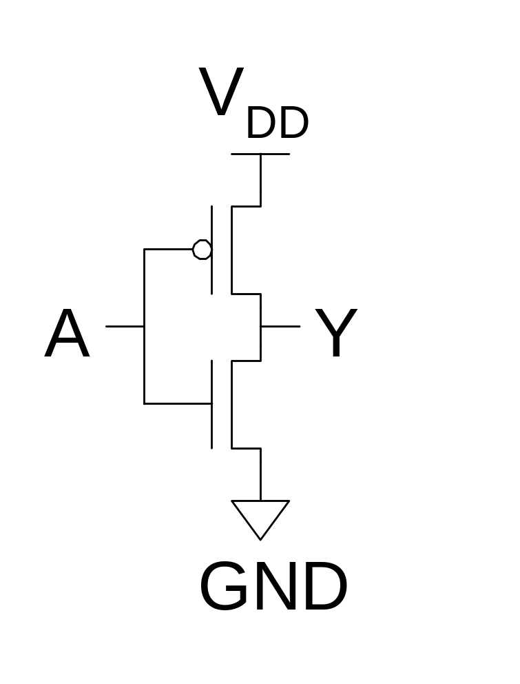
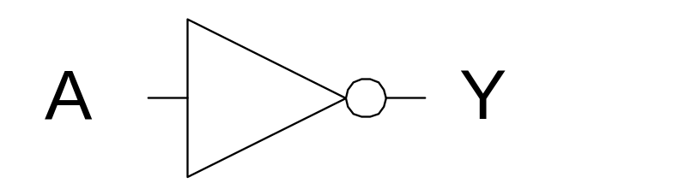
CMOS Inverter
A | Y
0
1

Slide 10
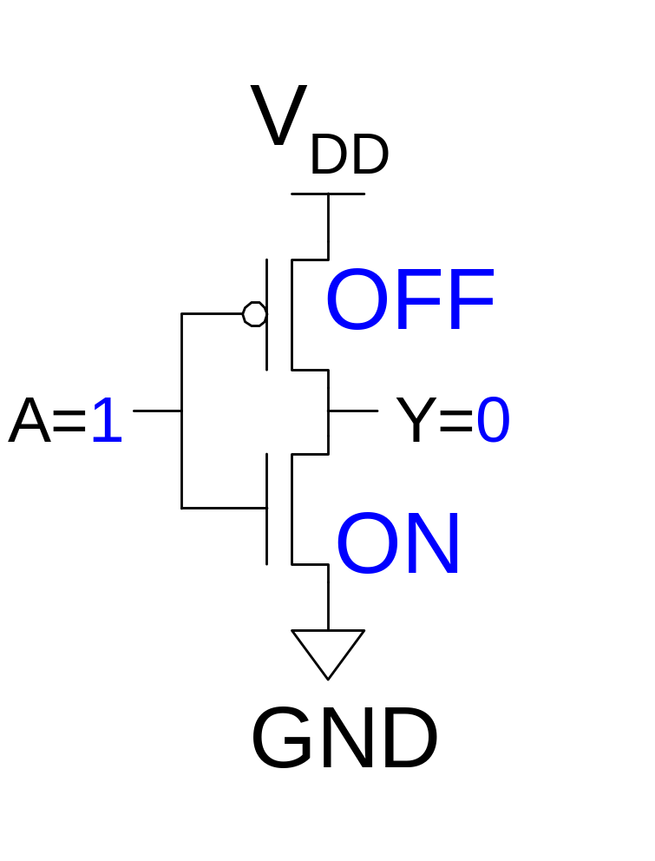
CMOS Inverter
A | Y
0
1 | 0

Slide 11
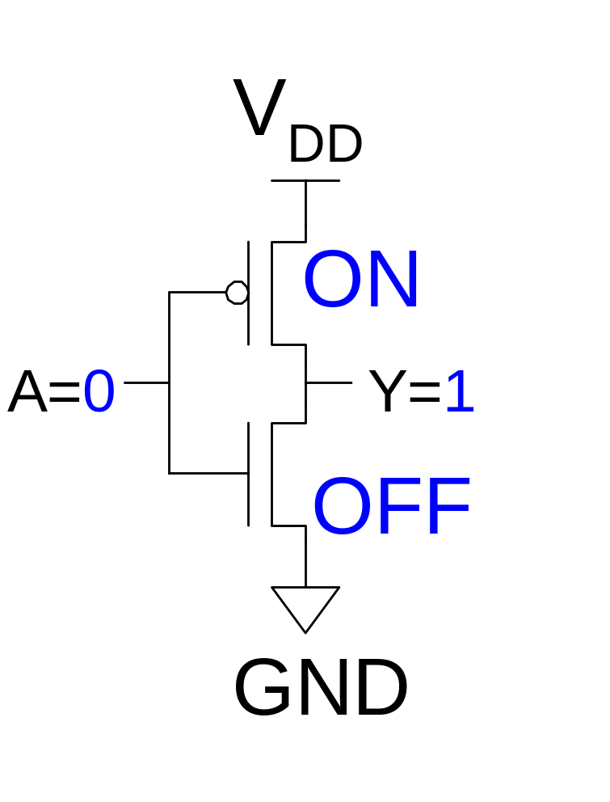
CMOS Inverter
A | Y
0 | 1
1 | 0

Slide 12
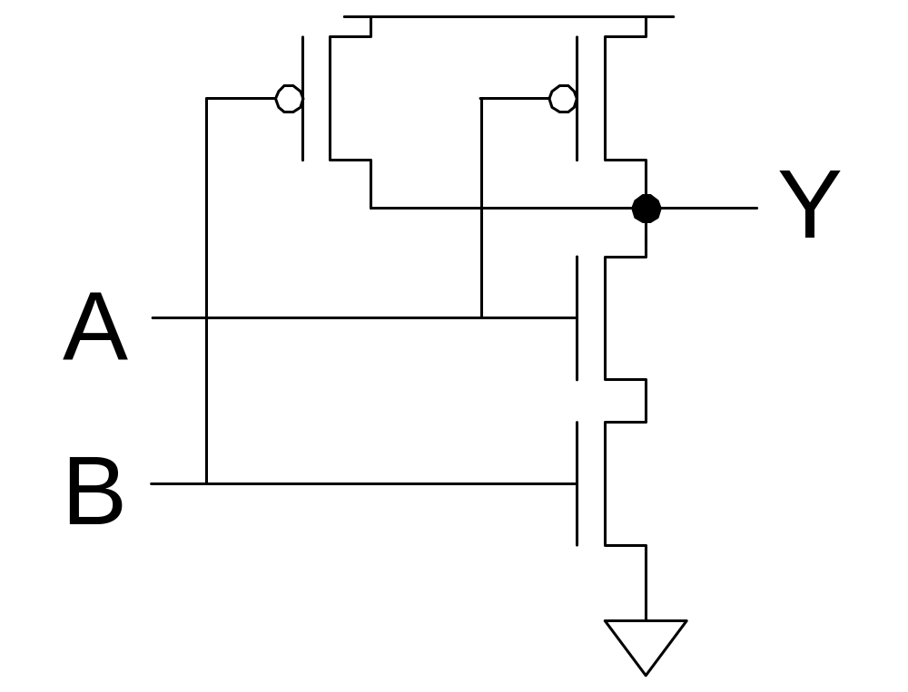
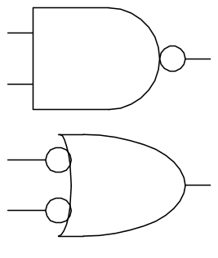
CMOS NAND Gate
A | B | Y
0 | 0
0 | 1
1 | 0
1 | 1

Slide 13
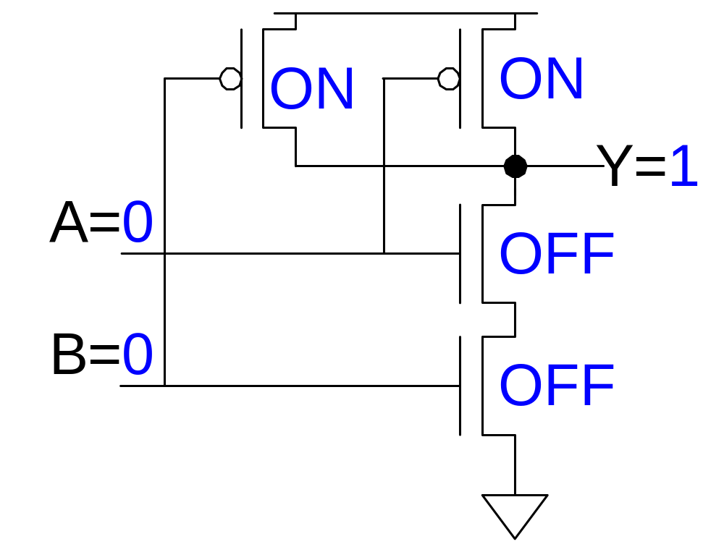
CMOS NAND Gate
A | B | Y
0 | 0 | 1
0 | 1
1 | 0
1 | 1

Slide 14
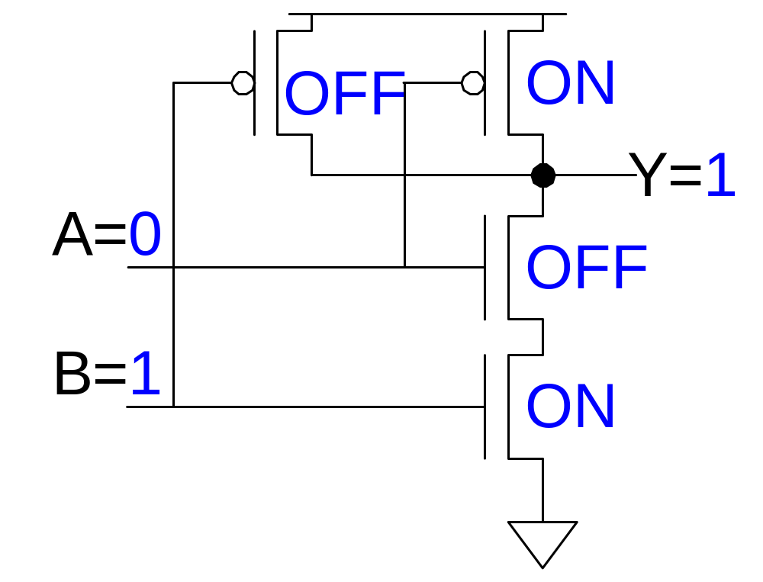
CMOS NAND Gate
A | B | Y
0 | 0 | 1
0 | 1 | 1
1 | 0
1 | 1

Slide 15
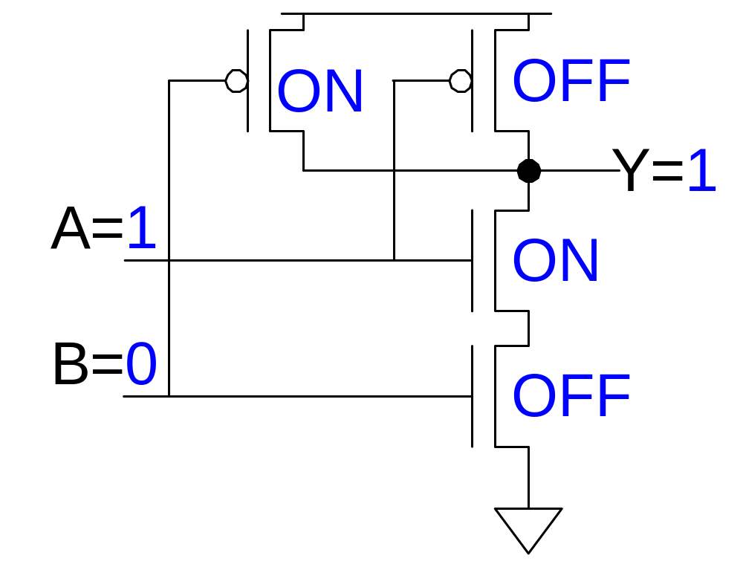
CMOS NAND Gate
A | B | Y
0 | 0 | 1
0 | 1 | 1
1 | 0 | 1
1 | 1

Slide 16
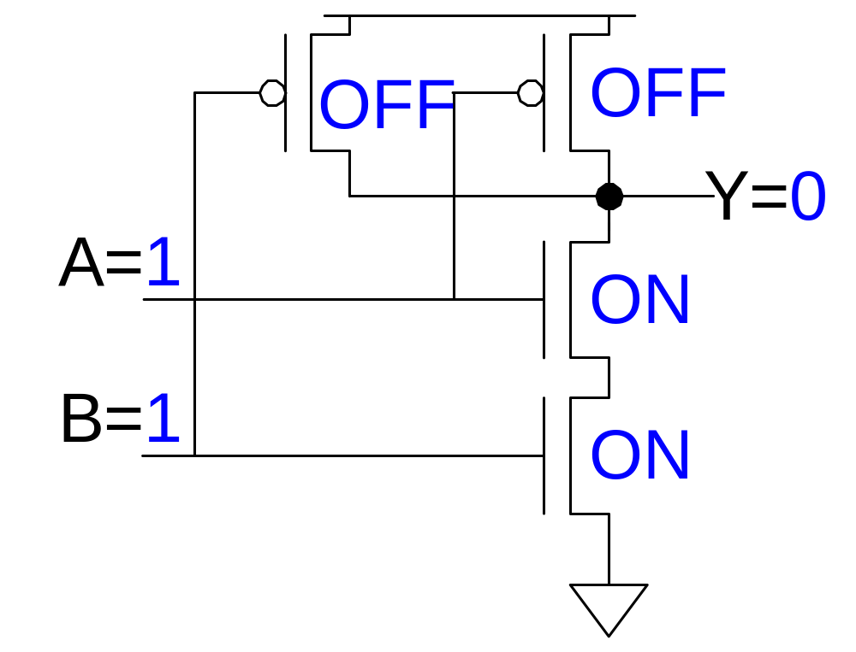
CMOS NAND Gate
A | B | Y
0 | 0 | 1
0 | 1 | 1
1 | 0 | 1
1 | 1 | 0

Slide 17
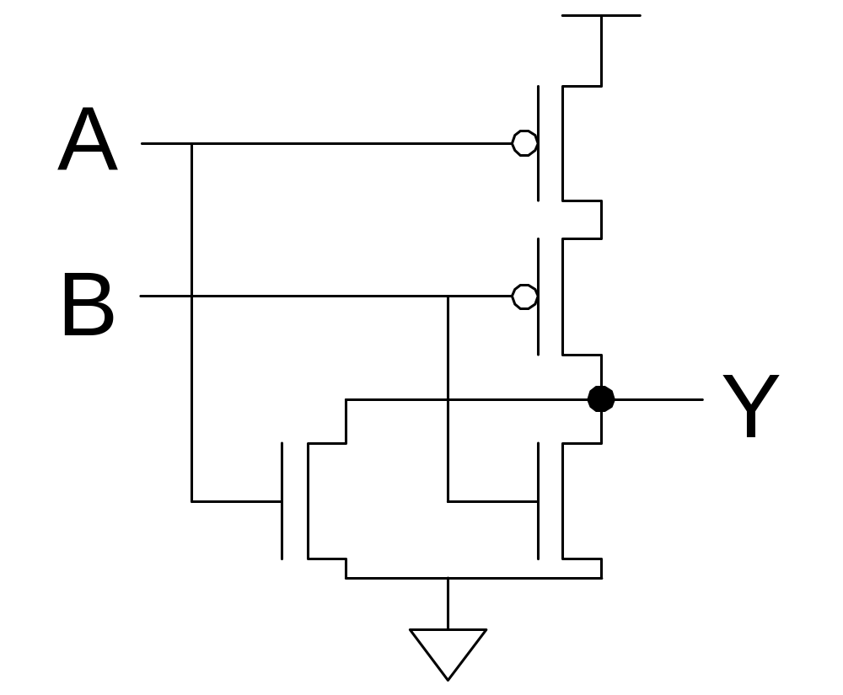
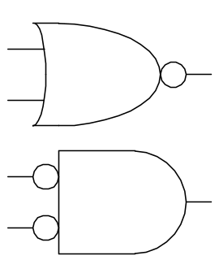
CMOS NOR Gate
A | B | Y
0 | 0 | 1
0 | 1 | 0
1 | 0 | 0
1 | 1 | 0

Slide 18
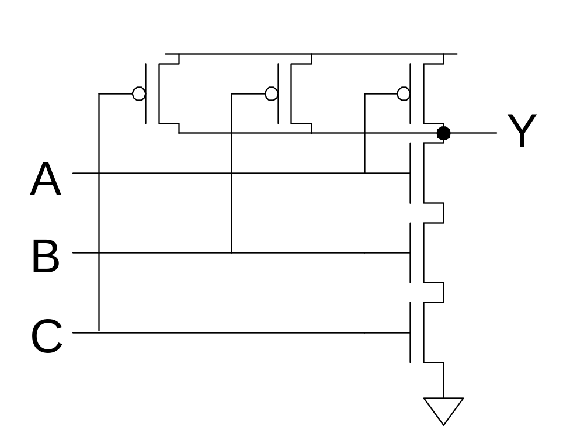
3-input NAND Gate
Y pulls low if ALL inputs are 1
Y pulls high if ANY input is 0

Slide 19
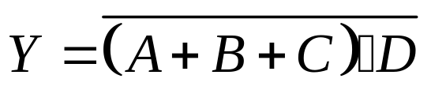
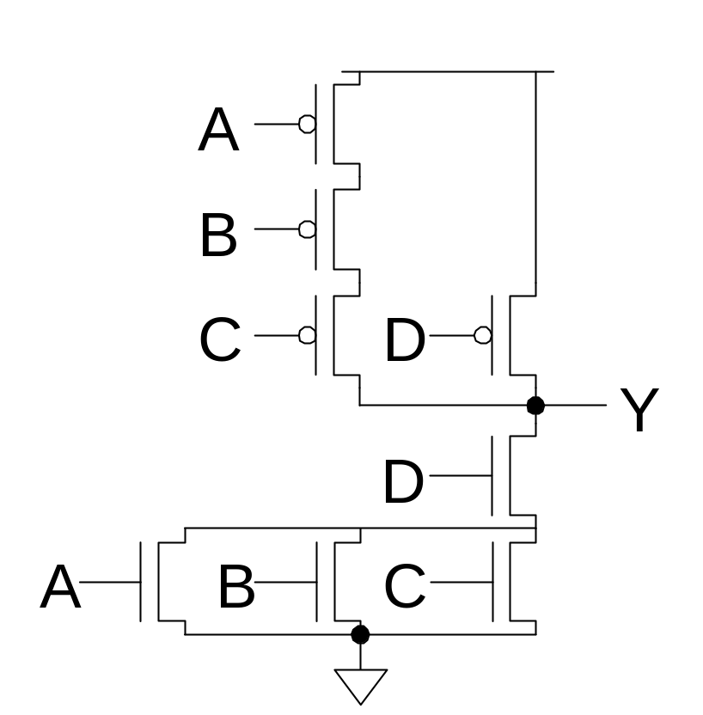
Example: O3AI

Slide 20
CMOS Fabrication
CMOS transistors are fabricated on silicon wafer
Lithography process similar to printing press
On each step, different materials are deposited or etched
Easiest to understand by viewing both top and cross-section of wafer in a simplified manufacturing process

Slide 21
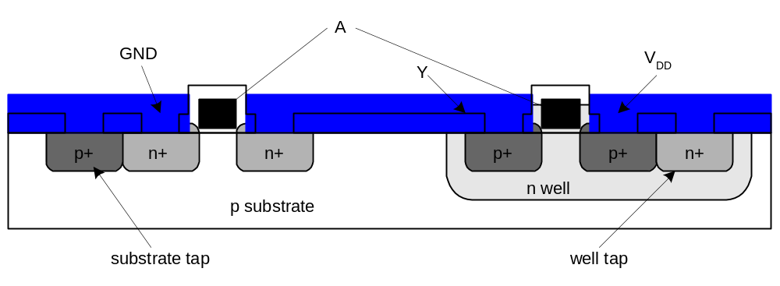
Well and Substrate Taps
Substrate must be tied to GND and n-well to V_{DD}
Metal to lightly-doped semiconductor forms poor connection (used for Schottky Diode)
Use heavily doped well and substrate contacts / taps

