Slide 1
Sequential Logic
Subhasis Bhattacharjee

Slide 2
Sequential Networks
Memory / Time steps
s_{i}
x_{i}
y_{i}
Clock
y_{i}=f_{i}(S^{t},X)
s_{i}^{t+1}=g_{i}(S^{t},X)
Memory: Flip flops
Specification: Finite State Machines
Implementation: Excitation Tables
Notes:
A combinational logic cannot have some sort of feedback loop where the output of a logic is also the input of it. A sequential network on the other hand can have this feature.

Slide 3
Memory Devices
Memory Storage
Latches
Flip-Flops
  SR, D, T

Slide 4
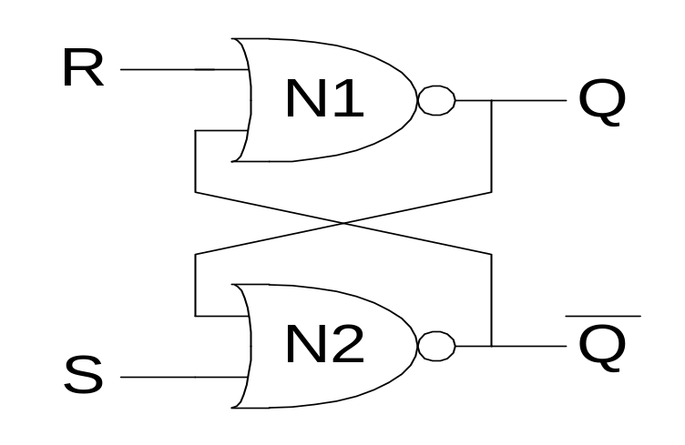
SR (Set/Reset) Latch
SR Latch
Consider the four possible cases:
  S = 1, R = 0
  S = 0, R = 1
  S = 0, R = 0
  S = 1, R = 1

Slide 5
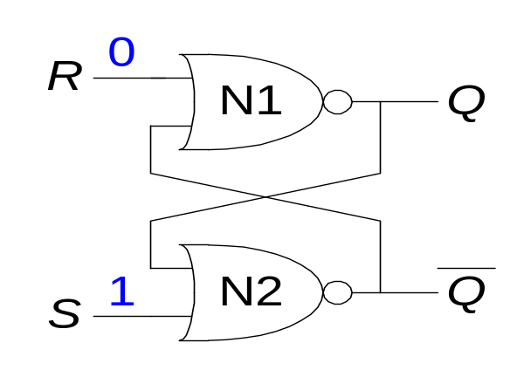
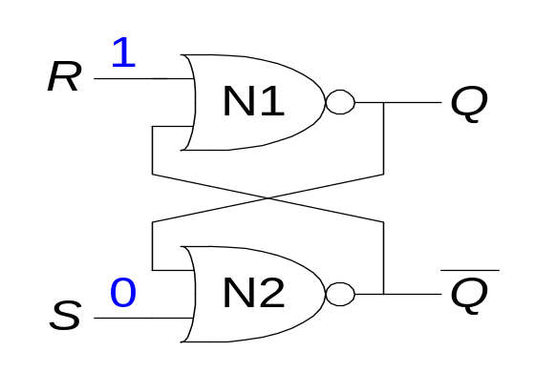
SR Latch Analysis
  S = 1, R = 0: then Q = 1 and Q = 0
  S = 0, R = 1: then Q = 0 and Q = 1

Slide 6
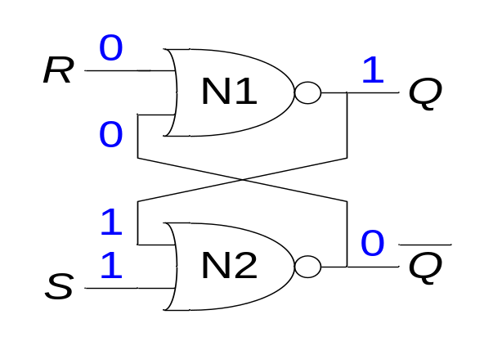
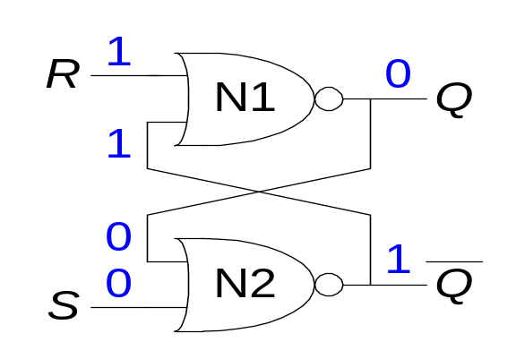
SR Latch Analysis
  S = 1, R = 0: then Q = 1 and Q = 0
  S = 0, R = 1: then Q = 0 and Q = 1

Slide 7
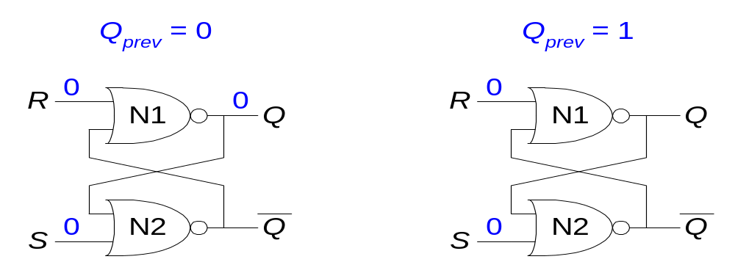
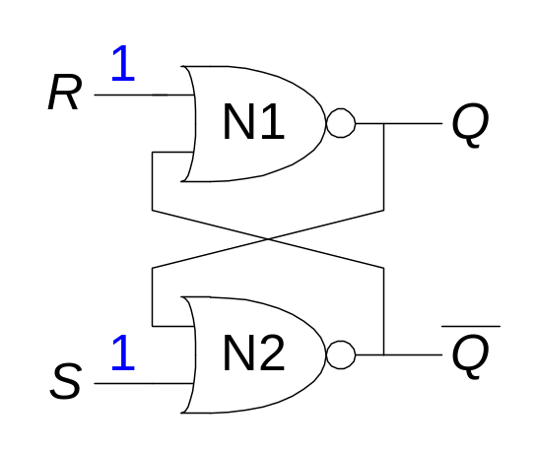
SR Latch Analysis
  S = 0, R = 0: then Q = Q_{prev}
  S = 1, R = 1: then Q = 0 and Q = 0

Slide 8
S
y
y = (S+Q)’
Q
R
Q = (R+y)’

Slide 9
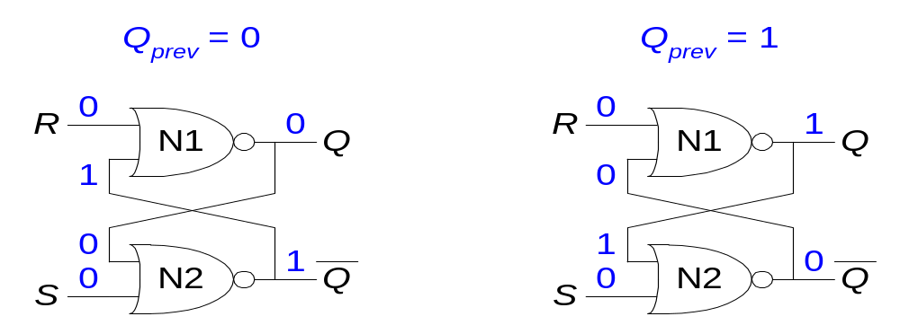
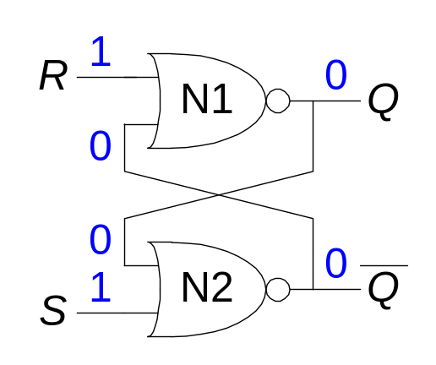
SR Latch Analysis
  S = 0, R = 0: then Q = Q_{prev} and Q = Q_{prev} (memory!)
  S = 1, R = 1: then Q = 0 and Q = 0 (invalid state: Q ≠ NOT Q)

Slide 10
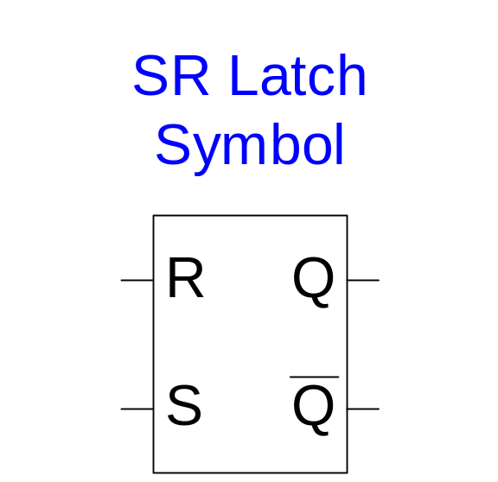
SR Latch Symbol
SR stands for Set/Reset Latch
  Stores one bit of state (Q)
Control what value is being stored with S, R inputs
  Set: Make the output 1 (S = 1, R = 0, Q = 1)
  Reset: Make the output 0 (S = 0, R = 1, Q = 0)
Must do something to avoid
invalid state (when S = R = 1)

Slide 11
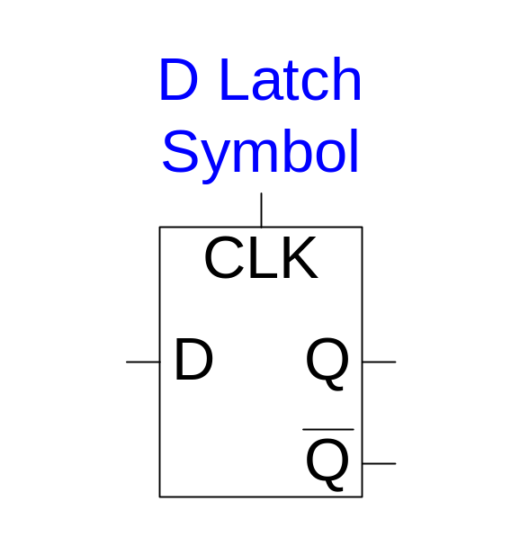
D Latch
Two inputs: CLK, D
  CLK: controls when the output changes
  D (the data input): controls what the output changes to
Function
  When CLK = 1, D passes through to Q (the latch is transparent)
  When CLK = 0, Q holds its previous value (the latch is opaque)
Avoids invalid case when Q ≠ NOT Q

Slide 12
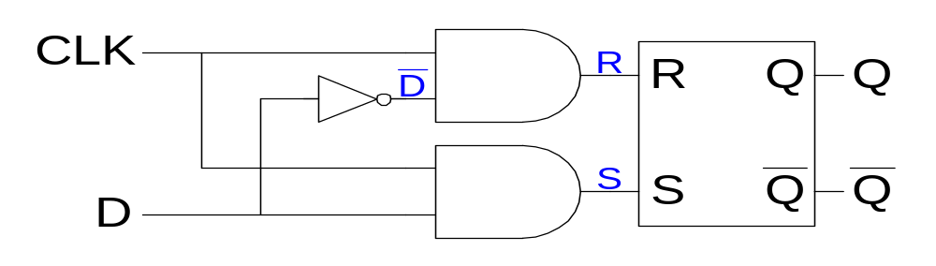
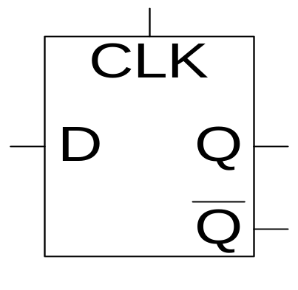
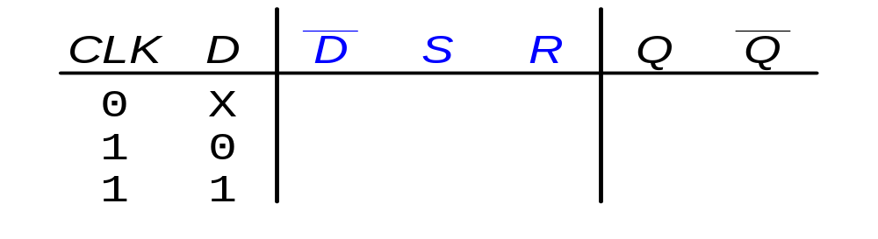
D Latch Internal Circuit

Slide 13
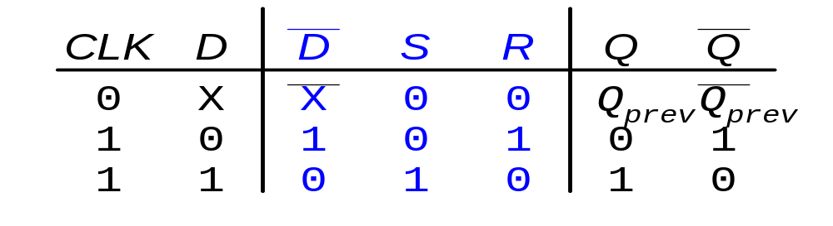
D Latch Internal Circuit

Slide 14
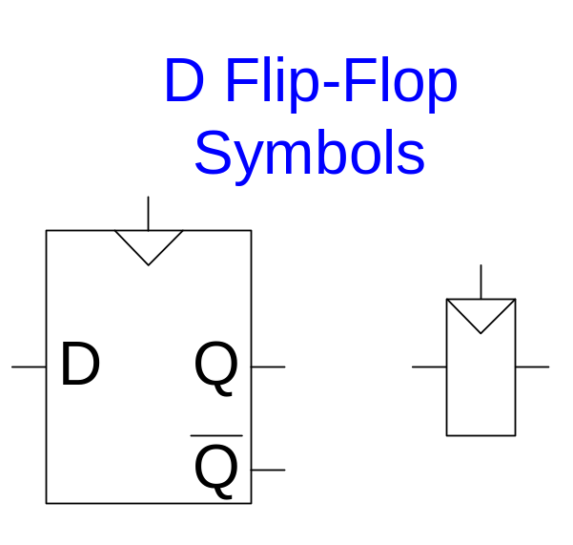
D Flip-Flop
Two inputs: CLK, D
Function
  The flip-flop “samples” D on the rising edge of CLK
    When CLK rises from 0 to 1, D passes through to Q
    Otherwise, Q holds its previous value
  Q changes only on the rising edge of CLK
A flip-flop is called an edge-triggered device because it is activated on the clock edge

Slide 15
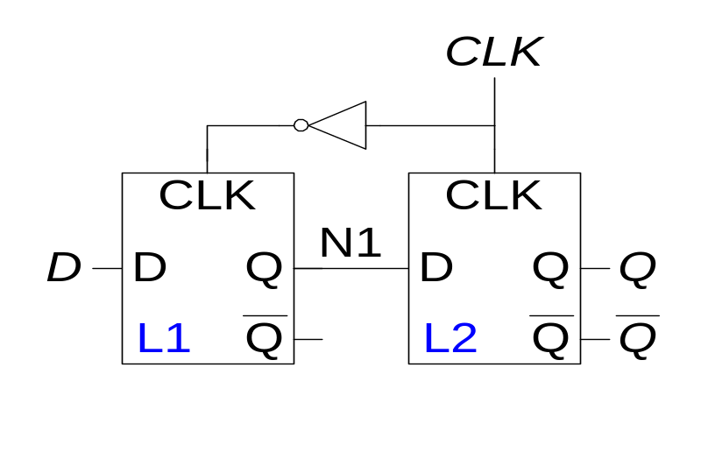
D Flip-Flop Internal Circuit
Two back-to-back latches (L1 and L2) controlled by complementary clocks
When CLK = 0
  L1 is transparent, L2 is opaque
  D passes through to N1
When CLK = 1
  L2 is transparent, L1 is opaque
  N1 passes through to Q
Thus, on the edge of the clock (when CLK rises from 0 1)
  D passes through to Q

Slide 16
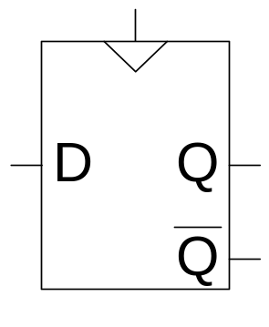
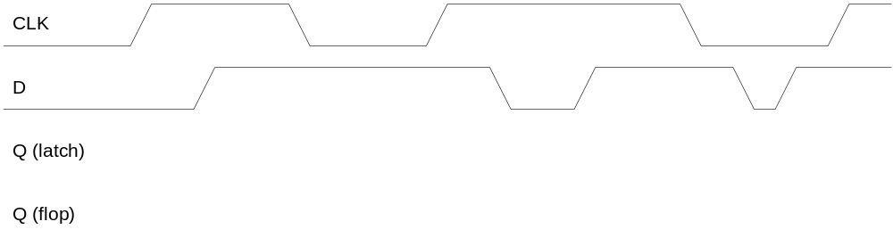
D Flip-Flop vs. D Latch

Slide 17
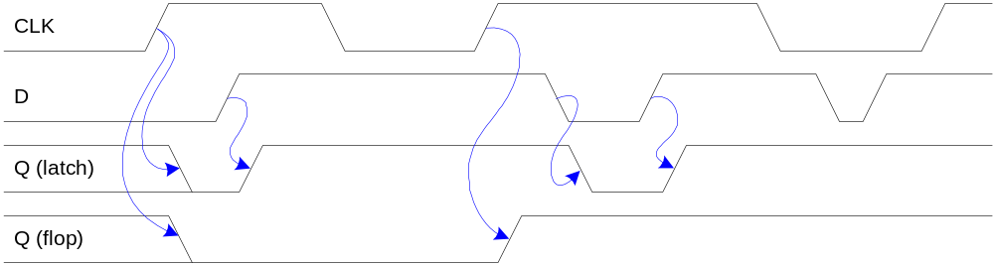
D Flip-Flop vs. D Latch

Slide 18
D Flip-Flop (Delay)
Id D Q(t) Q(t+1)
0 0 0 0
1 0 1 0
2 1 0 1
3 1 1 1
D
Q
CLK
Q’
State table
Characteristic Expression
Q(t+1) = D(t)
PS
D
0 1
0 0 1
1 0 1
NS= Q(t+1)

Slide 19
Sequential Modules: Introduction
Slice operation bitwise
Perform process in a series of time
Advantage:
  Cheaper hardware
  Fit for FPGA architecture
  Pipelining for excellent throughput
Disadvantage: Longer latency

Slide 20
Serial Adder: Perform serial bit-addition
At time i, read a_{i} and b_{i}. Produce s_{i} and c_{i+1}
Internal state stores c_{i}. Carry bit c₀ is set as c_{in}
a₃ b₃
a₀ b₀
c_{in}
Serial
Adder
a_{i}
a
b
sum
s_{i}
b_{i}
c_{out}
s₃
s₀

Slide 21
Serial Adder using D F-F
a_{i}
C1
b_{i}
s_{i}
C1
D
Q
Q’
D
Clk
Feed a_{i} and b_{i} and generate s_{i} at time i.
Where is c_{i} and c_{i+1}?

Slide 22
Serial Adder using a D Flip-Flop
id | a_{i} | b_{i} | c_{i} | c_{i+1} | s_{i}
0 | 0 | 0 | 0 | 0 | 0
1 | 0 | 0 | 1 | 0 | 1
2 | 0 | 1 | 0 | 0 | 1
3 | 0 | 1 | 1 | 1 | 0
4 | 1 | 0 | 0 | 0 | 1
5 | 1 | 0 | 1 | 1 | 0
6 | 1 | 1 | 0 | 1 | 0
7 | 1 | 1 | 1 | 1 | 1
D=c_{i+1}
Q=c_{i}

Slide 23
Serial Adder using a D Flip-Flop
Logic Diagram
a_{i}
s_{i}
b_{i}
D
Q
Q’
c_{i}
Clk

Slide 24
Serial Adder using an SR Flip-Flop
Excitation Table
id | a_{i} | b_{i} | c_{i} (Q) | c_{i+1} | S | R
0 | 0 | 0 | 0 | 0 | 0 | -
1 | 0 | 0 | 1 | 0 | 0 | 1
2 | 0 | 1 | 0 | 0 | 0 | -
3 | 0 | 1 | 1 | 1 | - | 0
4 | 1 | 0 | 0 | 0 | 0 | -
5 | 1 | 0 | 1 | 1 | - | 0
6 | 1 | 1 | 0 | 1 | 1 | 0
7 | 1 | 1 | 1 | 1 | - | 0
SR generate c_{i+1}
Q=c_{i}

Slide 25
Excitation Table of SR Flip-Flop
State table
S
b_{i}
SR
inputs
0 0 1 0
PS
00 01 10 11
c_{i}
0 - - -
0 0 0 1 -
1 1 0 1 -
a_{i}
Q(t+1)
R
Excitation table
b_{i}
NS
Q(t+1)
- - 0 -
PS
0 1
Q(t)
0
1
0 - 1 0
0 1 - 0
c_{i}
1 0 0 0
a_{i}

Slide 26
Serial Adder using an SR Flip-Flop
Logic Diagram
S = a_{i}b_{i}
R = a_{i}’b_{i}’
a_{i}
s_{i}
b_{i}
a_{i}
S
R
Q
Q’
c_{i}
b_{i}
Clk

Slide 27
Multiplication using Serial Addition
3 X 5 = 15
0 1 1
a₂ a₁ a₀
x
1 0 1
x
b₂ b₁ b₀
0 1 1
a₂b₀ a₁b₀ a₀b₀
0 0 0
a₂b₁ a₁b₁ a₀b₁
+
0 1 1
+
a₂b₁ a₁b₁ a₀b₁
0 1 1 1 1
m₁
m₀
For m=AxB, set m⁽⁰⁾=0
At time i, perform m^{(i+1)}=m^{(i)}+Ab_{i}2^{i}

Slide 28
Standard Sequential Modules
Register
Shift Register
Counter

Slide 29
Register

Slide 30
We Will Study Rest of the Topics Later on

Slide 31
Shift Register

Slide 32
Counter

Slide 33
Counter: Applications
Program Counter
Address Keeper: FIFO, LIFO
Clock Divider
Sequential Machine

Slide 34
Counter
Modulo-n Counter
Modulo Counter (m<n)
Counter (a-to-b)
Counter of an Arbitrary Sequence
Cascade Counter

Slide 35
Modulo-n Counter
D
CNT
TC
LD
CLR
Clk
Q
Q (t+1) = (0, 0, .. , 0) if CLR = 1
= D if LD = 1 and CLR = 0
= (Q(t)+1)mod n if LD = 0, CNT = 1 and CLR = 0
= Q (t) if LD = 0, CNT = 0 and CLR = 0
TC = 1 if Q (t) = n-1 and CNT = 1
= 0 otherwise

Slide 36
Modulo-m Counter (m< n)
Given a mod 16 counter, construct
a mod-m counter (0 < m < 16) with AND, OR, NOT gates
m = 6
Q3 Q2 Q1 Q0
3 2 1 0
CLR
CLK
X
CNT
LD
D3 D2 D1 D0
Q2
Q0
0 0 0 0
Set LD = 1 when X = 1 and (Q3Q2Q1Q0) = (0101), ie m-1

Slide 37
Counter (a-to-b)
Given a mod 16 counter, construct an a-to-b counter
(0 < a < b < 15)
A 5-to-11 Counter
Q3 Q2 Q1 Q0
CLR
Clk
X
CNT
LD
D3 D2 D1 D0
Q3
(b)
Q1
0 1 0 1 (a)
Q0
Set LD = 1 when X = 1 and (Q3Q2Q1Q0) = b (in this case, 1011)

Slide 38
Counter of an Arbitrary Sequence
Given a mod 8 counter, construct
a counter with sequence 0 1 5 6 2 3 7
When Q = 1, load D = 5
When Q = 6, load D = 2
When Q = 3, load D = 7
Q2 Q1 Q0
CLR
Clk
X
CNT
LD
D2 D1 D0
Q2’
Q0
Q2
Q0 Q1 Q0
Q0’

