Slide 1

Unit-1 Introduction of Operating System
Operating System (OS)
DU # 2304CS205
CO1: At the end of this unit, students will be able to,
discuss the basics of Operating System fundamentals.
Prof. Umesh H Thoriya
Computer Science & Engineering Department
umesh.thoriya@darshan.ac.in
9714233355

Slide 2

Topics
Operating System – Definition
Functions of Operating System
Features of Operating System
Types of Operating System
Batch Operating System
Multiprogramming Operating System
Time-Sharing Operating System
Single user and Multiuser Operating System
Components of Operating System
Operating System Services
System Calls
Programs
System Structure
Looping

Slide 3
Operating System – Definition
Section - 1

Slide 4
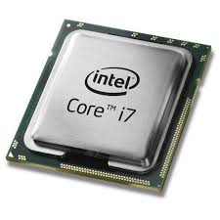
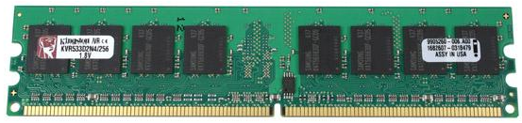

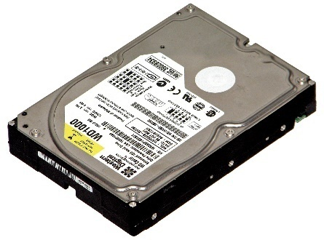

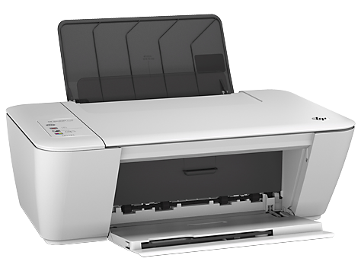

Why we need Operating System?
A Computer System consists of various hardware such as
Processor
RAM
Keyboard & Mouse
Hard Disk
Monitor
Printer
Who manages these hardwares???

Slide 5
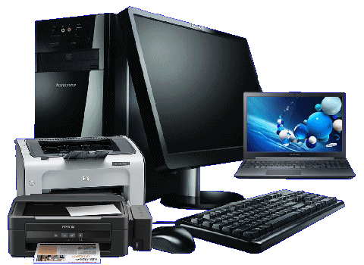



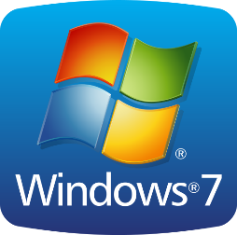
Definition of Operating System
An Operating System (OS) is a program/software that
Manages computer hardware
Provides simple interface between user and the hardware.
Operating System
User
Computer Hardware

Slide 6
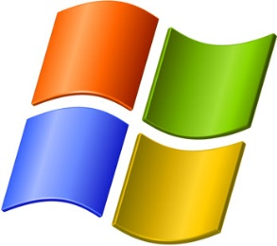
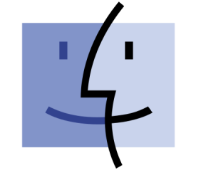



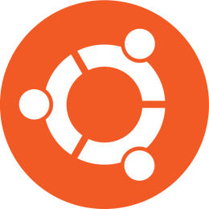
Examples of Operating System
Windows
Mac OS
Examples
of
Operating System
Android
Linux
Fedora
Ubuntu

Slide 7
Functions of Operating System
Section - 2

Slide 8

Operating System Functions
Program development
It provides editors and debuggers to assist (help) the programmer in creating programs.
Exercise
Give the name of any five code editor for windows?

Slide 9
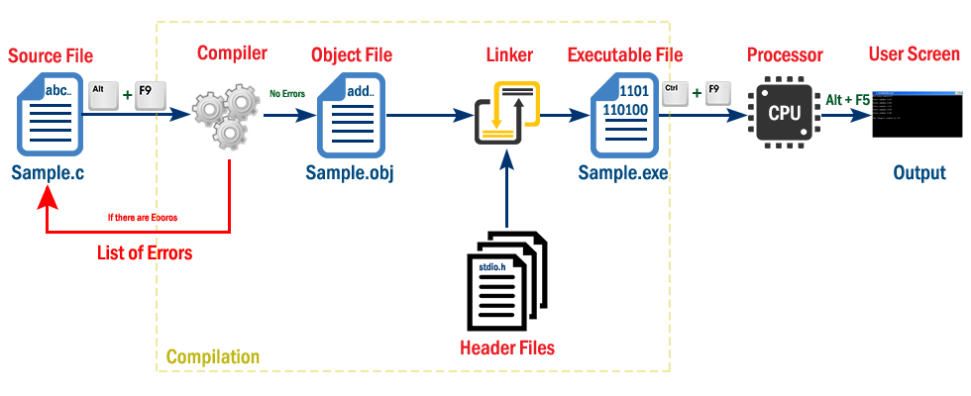
Operating System Functions
Program execution
Following tasks need to be perform to execute a program:
Instructions and data must be loaded into main memory.
I/O devices and files must be initialized.
The OS handles all these duties for the user.

Slide 10

Operating System Functions
Access to I/O devices (Resource allocation)
A running program may require I/O, which may involve file or an I/O device.
For efficiency and protection, users cannot control I/O devices directly.
Therefore, the OS controls these I/O devices and provides to program as per requirement.

Slide 11
Operating System Functions
Memory management
OS manages memory hierarchy.
OS keeps the track of which part of memory area in use and free memory.
It allocates memory to program when they need it.
It de-allocate the memory when the program finish execution.
P1
P2

Slide 12
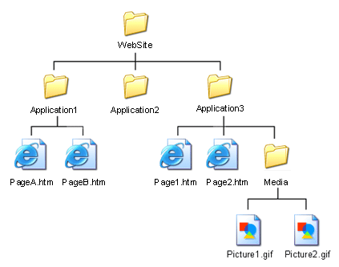
Operating System Functions
Controlled access to file
In case of file access, OS provides a directory hierarchy for easy access and management of file.
OS provides various file handling commands using which user can easily read, write and modify file.

Slide 13
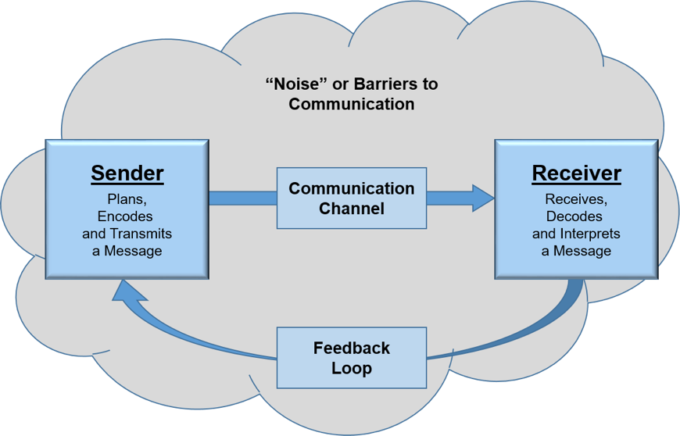
Operating System Functions
Communication
In multitasking environment, the processes need to communicate with each other and to exchange their information.
Operating system performs the communication among various types of processes in the form of shared memory.

Slide 14
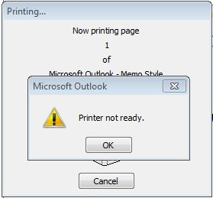

Operating System Functions
Error detection and response
An error may occur in CPU, in I/O devices or in the memory hardware.
Following are the major activities of an operating system with respect to error handling −
The OS constantly checks for possible errors.
The OS takes an appropriate action to ensure correct and consistent computing.

Slide 15

Operating System Functions
Accounting
It keeps track of time & resources used by various jobs and users.

Slide 16


Operating System Functions
Protection & Security
Protection involves ensuring that all accesses to system resources is controlled.
To make a system secure, the user needs to authenticate himself or herself to the system.

Slide 17
Summary of OS Functions
Program Development
Program Execution
Access to I/O Devices (Resource Allocation)
Memory Management
Controlled Access to File
Communication
Error Detection and Response
Accounting
Protection & Security

Slide 18
Features of Operating System
Section - 3

Slide 19
Features of Operating system
Interface between user and the computer
An OS provides a very easy way to interact with the computer.
It provides different features and GUI so that we can easily work on a computer.
We have to interact just by clicking the mouse or through the keyboard.
Thus, we can say that an OS makes working very easy and efficient.
Managing the Input / Output Device
The OS helps to operate the different input/output devices.
The OS decides which program or process can use which device. Moreover, it decides the time for usage.
In addition to this, it controls the allocation and deallocation of devices.

Slide 20
Features of Operating system
Multitasking
The OS helps to run more than one application at a time on the computer.
It plays an important role while multitasking.
Since it manages memory and other devices during multitasking. Therefore, it provides smooth multitasking on the system.
Manages the Memory
It helps in managing the main memory of the computer.
Moreover, It allocates and deallocates memory to all the applications/tasks.
Manages the system files
It helps to manage files on the system.
As we know, all the data on the system is in the form of files. It makes interaction with the files easy.

Slide 21
Features of Operating system
Provides Security
It keeps the system and applications safe through authorization. Thus, the OS provides security to the system.
Booting
Booting is basically the process of starting the computer.
When the CPU is first switched ON it has nothing inside the memory. So, to start the computer, we load the operating system into the main memory.
Therefore, loading the OS to the main memory to start the computer is booting. Hence, the OS helps to start the computer when the power is switched ON.

Slide 22
Types of Operating System
Section - 4

Slide 23
Types of Operating System
Types of Operating Systems
Multiprogramming Operating System
Batch Operating System
Time Sharing Operating System
Single user Operating System
Multiuser Operating System

Slide 24
Batch Operating System
Section – 4.1

Slide 25
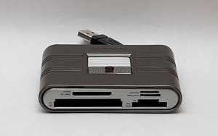
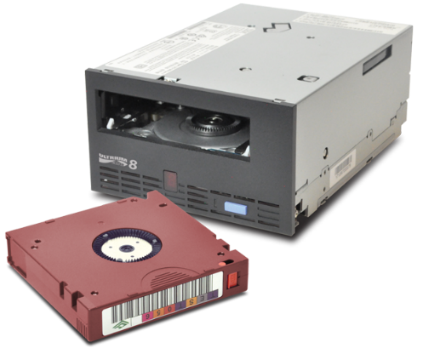
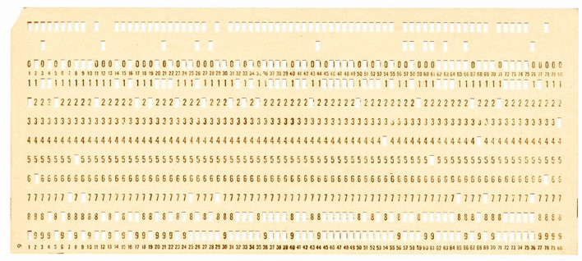
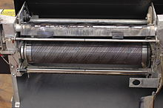
Batch Operating System
In past, computer were large machines.
Input devices: Card readers, Tap drives
Output devices: Line printers, Punch cards and Tap drives
The OS was very simple and always reside in main memory.
Card Reader
Tap Drives
Punch Card
Line Printer

Slide 26
Batch Operating System Working
Programmer
Job
Batch
Programmer
Jobs
Job
Operator
Computer
Job
Programmer
Jobs
Batches are processed through computer
At some later time (Hours/Days), output appeared. The output consist of the result of the program and error information.
Batch
Job
Input Devices :Card Readers , Tap Drives
Programmer Prepared Input Job(program, data and some control information.)
Submit to Operator.
Operator would sort them in batches with similar requirements, and as computer available, run them batch wise.
Programmer

Slide 27
Batch Operating System
Advantages
Multiple users can share the batch systems.
It is easy to manage large work repeatedly in batch systems.
Disadvantages
Low throughput- CPU remain idle when I/O is going on.
Programmers do not have direct interaction with job.
Debugging is possible only offline, after output appears.
Operations were too much time consuming.

Slide 28
Multiprogramming Operating System
Section – 4.2

Slide 29
Multiprogramming Operating System
A multiprogramming OS provides the ability to run more than one program concurrently.
Here more than one program(or Job) can be loaded in main memory simultaneously.
These programs can be executed concurrently.
Secondary Storage
Main Memory
Operating System
Job 1
Job 2
Job 3
...
Job n
Job 1 ‘s Execution is in Progress in CPU
Job 1
Both are in
Wait state
CPU

Slide 30
Multiprogramming Operating System
A multiprogramming OS provides the ability to run more than one program concurrently.
Here more than one program(or Job) can be loaded in main memory simultaneously.
These programs can be executed concurrently.
Secondary Storage
Main Memory
Operating System
Job 1
Job 2
Job 3
...
Job n
When Execution is Completed
Job 1
Job 1
Both are in
Wait state
CPU

Slide 31
Multiprogramming Operating System
A multiprogramming OS provides the ability to run more than one program concurrently.
Here more than one program(or Job) can be loaded in main memory simultaneously.
These programs can be executed concurrently.
Secondary Storage
Main Memory
Operating System
Job 1
Job 2
Job 3
...
Job n
At the same time Job 2’s Execution is in Progress in CPU
Job 1 goes to write o/p data in secondary storage
Job 1
Job 3 is in
Wait state
Job 2
CPU

Slide 32
Multiprogramming Operating System
Multiprogramming OS works in a non-preemptive way, any other process which enters the queue has to wait until the current process finishes its CPU cycle.
Program is allowed to execute until it voluntarily gives up the CPU.
A program voluntarily gives up the CPU in following two conditions
It waits for some events like I/O operations, Memory read/write, etc.
It terminates after successful completion.
Once CPU becomes free, It can be allocated to some other programme.
Objective of multiprogramming OS : Maximize CPU usage.

Slide 33
Example of Multiprogramming with three programs
At a time when CPU has been allocated to Program A, So now Program A is executing.
At the same time Program B and Program C is in Waiting state.
Now Program A requires some I/O operation so it will go to secondary memory.
At that time CPU has been allocated to Program B which was ready to execute next.
At the same time Program A and Program C is in Waiting state.
Like wise once CPU become free, it can be allocated to another program which is ready to execute next.
Run
Wait
Wait
Program A
Wait
Run
Wait
Program B
Wait
Wait
Run
Program C
A
A
B
B
C
A
C
C
B
Combined

Slide 34
Multiprogramming Operating System
Advantages
Multiprogramming significantly improves system throughput and resource utilization.
Various resource such as CPU, can be utilized as much as possible among various simultaneously executing programs.
Disadvantages
Hardware and OS become significantly more complex for handling and scheduling multiple jobs.
Large memory needed.

Slide 35
Time-Sharing Operating System
Section – 4.3

Slide 36
Time Sharing Operating System
Time Sharing OS is a logical extension of the Multiprogramming OS.
The CPU shares its time between different programs stored in the main memory.
It works in Preemptive manner.
A program is allowed to execute only for some maximum time duration.
After this, CPU is forcibly taken away from that program and allocated to another program.
Smaller programs need not to wait for other large program to finish its execution.
So it minimize the response time for user.
Suitable for interactive programs in which user can directly interact with program.
Such type of system also referred as multitasking system.
User can perform more than one task simultaneously.

Slide 37
Time Sharing Operating System: Example
User can execute program like MS-Word to prepare document as well as can run other program like php, C++ and windows media player to play a song.

Slide 38
Example of Time-Sharing Operating System
More than one processes are being executed at a particular time with the help of the time-sharing concept.
In this example there are total 4 process are being executed.
When the process starts its execution then the execution continues for only that amount of time.
After that, other processes will be given chance for that amount of time only.
This process will continue.
Process 2
Process 3
CPU
Process 1
Process 4

Slide 39
Time Sharing Operating System
Advantages
Improvement in system throughput and resource utilization.
Allows sharing of computer among multiple users simultaneously.
Gives impression to each user as if the entire computer resources are available to him only.
Required features
Memory management & Protection
Swapping and virtual memory
CPU scheduling
Disk management
Synchronization & Communication

Slide 40
Single User Operating System
Section – 4.4

Slide 41
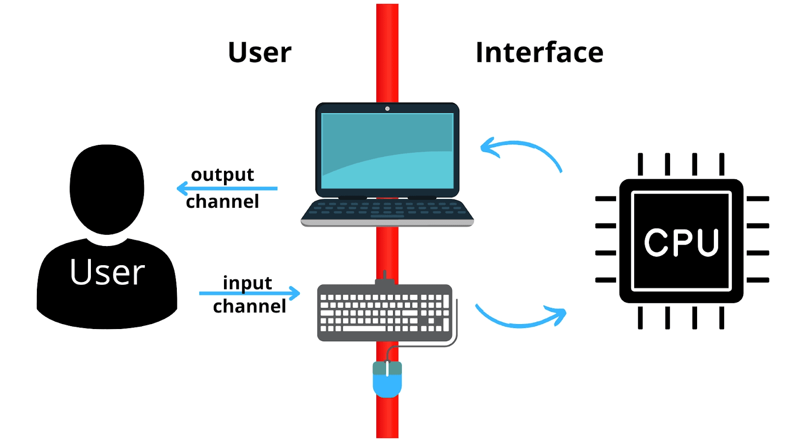
Single User Operating System
A single-user operating system is a type of operating system developed for use on a computer or similar machine that will only have a single user at any given time.
This type of OS is typically used on devices like wireless phones and two-way messaging devices.
Single user operating system can only run one program or application at a time.
So, it is not as useful for a computer or other device intended to run multiple programs at once.

Slide 42
Single User Operating System
Advantages
This OS occupies less space in memory.
Easy to maintain.
Less chance of damage.
In this operating system only one user work at a time, so there will be no interruption of others.
Disadvantages
It can perform only a single task.
The main drawback is, the OS remains idle for most of the time and is not utilized to its maximum.
Tasks take longer to complete.
It has a high response time.

Slide 43
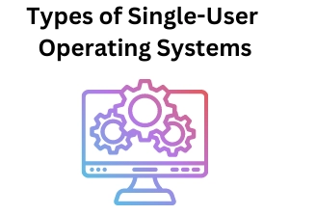
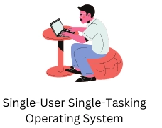
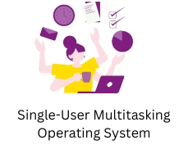
Types of Single User Operating System
A single-user operating system is categorized into two parts:

Slide 44
Multiuser Operating System
Section – 4.5

Slide 45
Multiuser Operating System
In a multiuser operating system, multiple users can access different resources of a computer at the same time.
A multi-user operating system allows the permission of multiple users for accessing a single machine at a time.
The various personal computers can send and receive information to the mainframe computer system.
Thus, the mainframe computer acts as the server and other personal computers act as clients for that server.
Users will usually sit at terminals or computers connected to the system via a network and other system machines like printers.
Central Computer OS
Client 1
Client 2
Client 3

Slide 46
Multiuser Operating System
Advantages
It helps in the sharing of data and information among different users.
It also helps in the sharing of hardware resources such as printers.
Users can share their work with other users.
Disadvantages
It requires expensive hardware to set up a mainframe computer
When multiple users log on or work on the same system it reduces the overall performance of the system.
Information is shared with the public so privacy loss.

Slide 47
Summary of Types of Operating System with Example
Types of OS with example
Multiprogramming Operating System ➔Example: Mainframe Environments
Batch Operating System ➔ Example : Payroll Processing, Billing System
Time Sharing Operating System ➔ Example : Mac OS, Latest Windows OS
Single user Operating System ➔ Example : MS-DOS, Windows 95/98
Multiuser Operating System ➔ Example : Unix, Linux, Windows Server
Real-Time Operating System ➔ Example : Online reservation, Airbag Deployment in Car
Distributed Operating System ➔ Example : Microsoft Windows Server
Multi-Processing Operating System ➔ Example : Unix, Linux, Windows Server
Network Operating System ➔ Example : Any Server, i.e. Web Server, Mail Server, etc.
Mobile Operating System ➔ Example : Android, iOS

Slide 48
Components of Operating System
Section – 5

Slide 49
Components of OS
User comes at top level.
Interacts with the system by using Application program to perform tasks.
Ex. People, machines, other computers
USER
Define the ways in which the system resources are used to solve the computing problems of the users
Ex. MS office, Web browsers, video games etc.
Application Programs
Controls and coordinates use of hardware among various applications and users
Operating System
Hardware comes at lowest level.
Contains Physical devices like Keyboard, Mouse, Monitor etc.
Hardware

Slide 50
Operating System Services
Section – 6

Slide 51
Operating System Services
Operating System Provides Two Types of Services:
User Point of View
System Point of View
User Point of View
This is a top-down view.
OS hides all the details of the hardware, providing a user-friendly environment.
For example, running a text editor without worrying about the hardware specifics.
System Point of view
This is a bottom-up view.
The OS acts as a Resource Manager.
OS manages all the resources such as
CPU
Memory
I/O devices.
For example, the OS allocates memory for applications like browsers and ensures efficient
CPU scheduling.

Slide 52
Operating System Services- User Point of View
Program Execution
Provides an efficient and convenient environment for the execution of programs.
So, an OS must provide functions for Load program into main memory, Execute it and after execution, Terminate it.
After execution
Terminate
Load
Execute

Slide 53
Operating System Services- User Point of View
Input / Output Operations:
A running program needs I/O operations for reading input data, and for outputting the results.
This I/O may be with a file or with device.
Example :

Slide 54
Operating System Services- User Point of View
Communication :
In multitasking OS more than one processes are running simultaneously.
Sometimes there is a need to exchanging information among processes.
The OS provide communications for such internal processes.
Example:
OS
Process 1
Process 2

Slide 55
Operating System Services- User Point of View
File system manipulation:
Program needs to read a file or write a file.
OS provide file system manipulation functionalities like create, read, write and delete a file.
OS gives permission to the program for operation on file.
Permission varies from read only, read-write, and denied.
OS provides an interface to the user to create/delete files.
OS provides an interface to the user to create/delete directories.
OS provides an interface to create the backup of file system.
Error Detection:
Errors may be in user programs. CPU and memory hardware, or in I/O devices.
OS detects such errors and makes user aware from them.

Slide 56
Operating System Services- System Point of View
Resource Allocation :
When multiple user are sharing the same machine or when multiple jobs are running simultaneously, there is a need of fair allocation of resources among them.
Accounting :
OS keeps information about the users uses which resources, and for what duration of time.
Such information can be used to bill the users in multi-user environment, or to get information of future usage of resources.

Slide 57
Operating System Services- System Point of View
Security :
OS ensures that all access to system resources is controlled.
Also security from outsiders is important.

Slide 58
System Calls
Section - 7

Slide 59
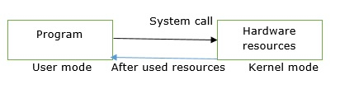
What is System calls?
A system call is a mechanism that provides the interface between a process and the operating system.
A computer program makes a system call when it makes a request to the operating system's kernel.
A kernel is a core component of an operating system (OS) that acts as a bridge between the OS and the computer's hardware.
When the application requests the help of the operating system that time system call occurs.
When it will require hardware then only it will come to kernel mode.
After compilation of the work of hardware resources it will again come back to user mode.

Slide 60
Types of system calls
Process Control: This system calls perform the task of process creation, process termination, etc.
Functions:
End and abort
Load and execute
Create process and terminate process
Wait and signed event
Allocate and free memory
File Management: File management system calls handle file manipulation jobs like creating a file, reading, and writing, etc.
Functions:
Create a file
Delete file
Open and close file
Read, write and reposition
Get and set file attributes

Slide 61
Types of system calls
Device Management: Device management does the job of device manipulation like reading from device buffers, writing into device buffers, etc.
Functions
Request and release device
Logically attach/ detach devices
Get and Set device attributes
Information Maintenance: It handles information and its transfer between the OS and user program.
Functions:
Get or set time and date
Get process and device attributes

Slide 62
Programs
Section – 8

Slide 63
System Programs
In an operating system a user is able to use different types of system programs and the system program is responsible for all the application software performance of the computer.
The system programs are responsible for the development and execution of a program.
System programs communicate and coordinate the activities and functions of hardware and software of a system and also controls the operations of the hardware.
Following are various types of task perform by programs:
File management
Status information
Programming language supports
Programming Loading and execution
Communication
Background services

Slide 64
Types of System programs
Utility Program
It manages, maintains and controls various computer resources.
Example − antivirus software, backup software.
Device Drivers
It controls the particular device connected to a computer system. Device drivers basically act as a translator between the operating system and device connected to the system.
Example − printer driver, scanner driver, storage device driver etc.

Slide 65
System Structure
Section – 9

Slide 66
Operating Systems Structure
An operating system is a structure that allows the user application programs to interact with the system hardware.
Following are various popular implementations of Operating System structures.
Monolithic systems
Layered systems
Client-server model

Slide 67
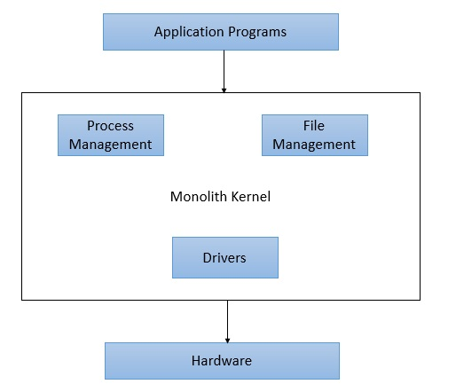
Monolithic systems
In monolith structured operating system, a central piece of code called kernel is responsible for all major operations of an operating system.
Such operations includes file management, memory management, device management and so on.
The kernel is the main component of an operating system and it provides all the services of an operating system.
The kernel has access to the all the resources and it acts as an interface with application programs and the underlying hardware.
A monolithic kernel structure promotes timesharing, multiprogramming model and was used in old banking systems.

Slide 68
Monolithic systems
Advantages
Easy Development :
As kernel is the only layer to develop with all major functionalities, it is easier to design and develop.
Performance:
As Kernel is responsible for memory management, other operations and have direct access to the hardware, it performs better.
Disadvantages
Crash Prone:
As Kernel is responsible for all functions, if one function fails entire operating system fails.

Slide 69
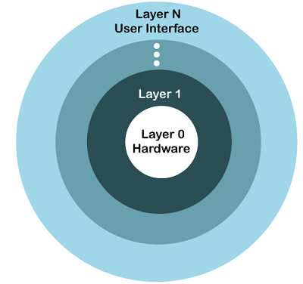
Layered systems
In this system, the OS is organized as a hierarchy of layers.
In this structure, the OS is broken into a number of layers (levels). The bottom layer (layer 0) is the hardware, and the topmost layer (layer N) is the user interface.
The functionalities of each layer are separated in this method.
This simplifies the debugging process, if lower-level layers are debugged and an error occurs during debugging, then the error must be on that layer only, as the lower-level layers have already been debugged.

Slide 70
Client-Server model
Processes are divided into two categories:
Servers: Provide services
Clients: Uses services
Client and server run on different computers, connected by LAN or WAN and communicate via message passing.
To obtain a service, a client construct a message saying what it wants and send it to server.
The server then does the work and send reply back to the client.
Machine 1
Machine 2
Machine 3
Machine 4
Client
Kernel
File Server
Kernel
Process Server
Kernel
Terminal Server
Kernel
. . .
Network
Message from Client to Server

Slide 71
Frequently asked Questions in Exam
Define Operating System and discuss functions of Operating System.
Describe features of Operating System in brief.
Explain Batch Operating System with suitable example.
Describe Multiprogramming Operating System with suitable example.
Discuss Time-Sharing Operating System with proper example.
Write a short note on Single User and Multiuser Operating System.
Discuss services of Operating System.
What is System Call? Explain types of System Calls.
Explain System Program with its types.
Describe different types of Operating System Structures with proper diagram.

Slide 72
Operating System (OS)
DU # 2304CS205
Prof. Umesh H Thoriya
Computer Science & Engineering Department
umesh.thoriya@darshan.ac.in
9714233355

