Slide 1

Unit-2 Process Management
Operating System (OS)
DU # 2304CS205
CO2: At the end of this unit, students will be able to,
implement the CPU scheduling algorithms for Process management.
Prof. Umesh H. Thoriya
Computer Science & Engineering Department
umesh.thoriya@darshan.ac.in
9714233355

Slide 2

Looping
Topics
Process Overview
Process States
Process State Transitions
Process Control Block
Context switching
Threads Concept
Types of threads
Basic concepts of CPU scheduling
Types of schedulers

Slide 3

Looping
Topics
Scheduling criteria
Types of Scheduling Algorithms
Pre-emptive and Non-Pre-emptive
First Come First Serve
Shortest Job First
Shortest Remaining Time Next
Round Robin
Priority Algorithms
Non-Preemptive Priority Algorithm
Preemptive Priority Algorithm

Slide 4
Process Overview
Section - 1

Slide 5
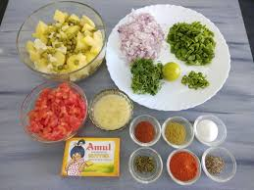
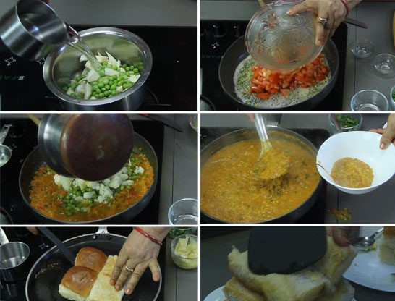
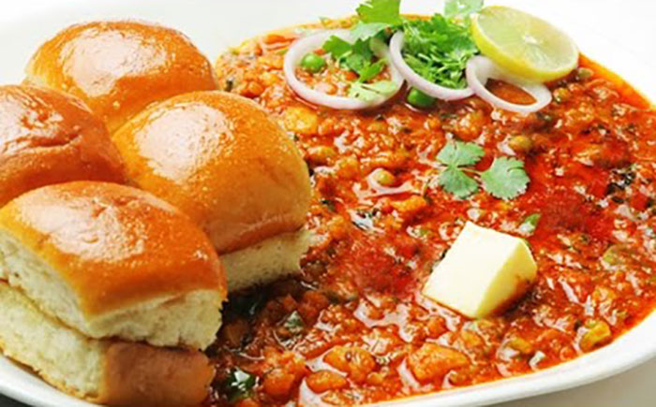
Definition of Program & Process
A Program is a organized collection of instruction/statements.
For example recipe for cooking. It contains list of ingredients and list of statements.
A Process is an instance of computer program that being executed.
For example to cook as per written in recipe of cooking.
Example :
Ingredients
List of Statements(How to Prepare)
Recipe(Food)

Slide 6
Definition of Program & Process
List of Statements
Input
Output
echo -n "Enter the 1st number :"
Enter the 1st number :
read num1
2
echo -n "Enter the 2nd number :"
Enter the 2nd number :
Ingredients
read num2
2
sum=`expr $num1 + $num2`
2 + 2
Process
echo “$sum"
4
Result(Output)

Slide 7
Program VS Process
Program | Process
A Program is an organized collection of instructions/statement. | A Process is an execution of a program.
A Program has a Static/Passive entity. It will remain as it is until user modifies it. | A Process is a Dynamic/Active entity. It takes start, execution and terminate.
A Program has a Longer life span. | A Process has Limited life span.
A Program stored on disk. So, its life may be in months/years. | It performs various operations after it terminates.
A Program is stored on Disk, in some file. | A Process requires various resources like as Memory space, Disk, Printers etc.

Slide 8
Program VS Process
Program | Process
A Program requires memory space on disk to store all the instructions only. | A Process requires memory space which is called its address space. Address space contains three parts: An executable program or code. Program's data. Stack

Slide 9
Process States
Section - 2

Slide 10
Process Life Cycle
NEW
TERMINATE
NEW
READY
RUNNING
WAITING
New:
When a process is first created, it occupies “New” state.
In this state, process awaits to enter in “Ready” state.

Slide 11
Process Life Cycle
NEW
TERMINATE
NEW
Admitted
READY
READY
RUNNING
WAITING
Ready:
A process, which is in “Ready” state, has been loaded into main memory.
In this state, process awaits for execution on a CPU.
It is possible that more then one process may be “Ready” state at any time.

Slide 12
Process Life Cycle
NEW
TERMINATE
Interrupt
Admitted
READY
RUNNING
RUNNING
Scheduler
Dispatch
WAITING
Running:
A process, which is in “Running” state, is currently executing on CPU.
In a One processor system, one and only one process can be in this state at a time

Slide 13
Process Life Cycle
NEW
TERMINATE
Interrupt
Admitted
READY
RUNNING
Scheduler
Dispatch
I/O or event
Completion
I/O or
Event wait
WAITING
WAITING
Waiting:
A process, which is in “Waiting” state, is waiting for some I/O completion or some event to occur.
Ex.-A process requiring a printer will wait in its current state until the printer, being used
by another process, becomes free.

Slide 14
Process Life Cycle
NEW
TERMINATE
Interrupt
Admitted
Exit
READY
RUNNING
Scheduler
Dispatch
I/O or event
Completion
I/O or
Event wait
WAITING
Terminate:
When process terminates. It acquires this state.
A process can terminate by completing its execution, or it can be killed explicitly.

Slide 15
Process State Transitions
Section - 3

Slide 16
Process State Transitions
When and how these transitions occur (process moves from one state to another)?
Process blocks for input or waits for an event (i.e. printer is not available)
Scheduler picks another process
End of time-slice or pre-emption.
Scheduler picks this process
Input becomes available, event arrives (i.e. printer become available)
Running
3
1
2
Blocked
Ready
4
Processes are always either executing (running) or waiting to execute (ready) or waiting for an event (blocked) to occur.

Slide 17
Five State Process Model and Transitions
HDD
RAM
RAM
-
New – process is being created
Ready – process is waiting to run (runnable), temporarily stopped to let another process run
Running – process is actually using the CPU
Blocked – unable to run until some external event happens
Exit (Terminated) – process has finished the execution
Admit
Dispatch
Release
New
Ready
Running
Exit
Time-out
Event
Occurs
Event
Wait
Blocked
RAM
Exercise
A process resides in which memory during different state?

Slide 18
Process State Transitions Overview
In Multitasking systems, more than one program are loaded into the main memory for execute concurrently.
In reality it provides only illusion that all processes are running concurrently.
But CPU can do only one work at a time so it can not execute more than one instruction at the same time.
The CPU can handle only single process at a time.
CPU
P1
P2

Slide 19
Example of Process State Transitions Overview
If Process A uses the CPU, all other Process(B, C and D) are in waiting state.
Other Processes will wait for the CPU to become free.
When currently running Process A waits for some event, Such as I/O operation, CPU becomes free.
Now another Process B is selected to use the CPU. At that time Process A, C & D are in waiting state
When Process B completes its execution Process C will be selected to the CPU, at that time Process A, B & D waits for some time.
And when Process C will be completes Process D will be selected for the execution and at that time other Processes(A, B & C) are in waiting state.
This cycle continues to execute all process.
Meanwhile new process are created to perform various tasks.
Process
Wait
Wait
Wait
Run
D
Wait
Wait
Run
Wait
C
Wait
Run
Wait
Wait
B
Run
Wait
Wait
Wait
A
Time

Slide 20
Process Control Block
Section - 4

Slide 21
Process Control Block(PCB)
OS maintains a table, called Process Table, to store all the information about each process.
Process Table contains Various Entries – One Entry per Process.
It is called Process Control Block or Task Control Block.
Process Identifiers
Process State
Program Counter
CPU Registers
CPU Scheduling Information
Memory Management Information
Accounting Information
I/O Status Information
Pointer

Slide 22
Fields of Process Control Block(PCB)
Process Identifiers
Process Identifiers
A unique Process ID (PID) on the PCB serves as the process's identifier within the operating system.
The operating system uses this ID to keep track of, manage, and differentiate among processes.
Process State
Program Counter
CPU Registers
CPU Scheduling Information
Memory Management Information
Accounting Information
I/O Status Information
Pointer

Slide 23
Fields of Process Control Block(PCB)
Process Identifiers
Process State
The current state of the process i.e., whether it is Ready, Running, Waiting, or whatever.
Process State
Program Counter
CPU Registers
CPU Scheduling Information
Waiting
Memory Management Information
Accounting Information
I/O Status Information
Ready
Running
Pointer

Slide 24
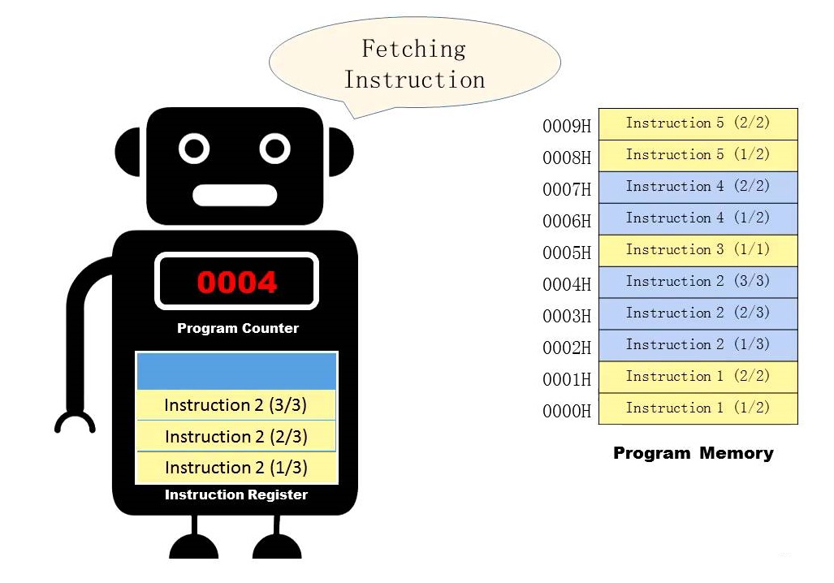
Fields of Process Control Block(PCB)
Process Identifiers
Program Counter
Program Counter is a pointer to the address of the next instruction to be executed for this process.
Process State
Program Counter
CPU Registers
CPU Scheduling Information
Memory Management Information
Accounting Information
I/O Status Information
Pointer

Slide 25
Fields of Process Control Block(PCB)
Process Identifiers
CPU Registers
Various CPU registers where process need to be stored for execution for running state.
Process State
Program Counter
CPU Registers
CPU Scheduling Information
Memory Management Information
Accounting Information
I/O Status Information
Pointer

Slide 26
Fields of Process Control Block(PCB)
Process Identifiers
CPU Scheduling Information
Process priority and other scheduling information which is required to schedule the process.
Process State
Program Counter
CPU Registers
CPU Scheduling Information
Memory Management Information
Accounting Information
I/O Status Information
Pointer

Slide 27
Fields of Process Control Block(PCB)
Process Identifiers
Memory Management Information
It includes information of Page table, Memory limits, Segment table depending on memory used by the OS.
Process State
Program Counter
CPU Registers
CPU Scheduling Information
Memory Management Information
Accounting Information
I/O Status Information
Pointer

Slide 28
Fields of Process Control Block(PCB)
Process Identifiers
Accounting Information
It includes the amount of CPU used for Process execution, Time limits, Execution ID etc.
Process State
Program Counter
CPU Registers
CPU Scheduling Information
Memory Management Information
Accounting Information
I/O Status Information
Pointer

Slide 29
Fields of Process Control Block(PCB)
Process Identifiers
I/O Status Information
It includes a list of I/O devices allocated to the process.
Process State
Program Counter
CPU Registers
CPU Scheduling Information
Memory Management Information
Accounting Information
I/O Status Information
Pointer

Slide 30
Fields of Process Control Block(PCB)
Process Identifiers
Pointer
It contains information about where the code, data and stack regions are stored in main memory.
Process State
Program Counter
CPU Registers
CPU Scheduling Information
Memory Management Information
Accounting Information
I/O Status Information
Pointer

Slide 31
Context Switching
Section - 5

Slide 32
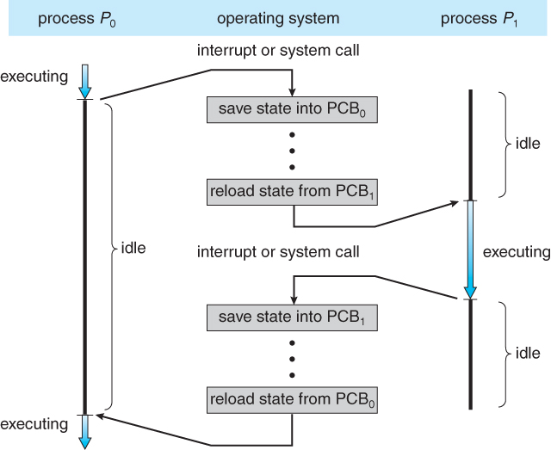
Context switching
Context switch means stopping one process and restarting another process.
When an event occur, the OS saves the state of an active process (into its PCB) and restore the state of new process (from its PCB).
Context switching is purely overhead because system does not perform any useful work while context switch.
Sequence of action:
OS takes control (through interrupt)
Saves context of running process in the process PCB
Reload context of new process from the new process PCB
Return control to new process
Time slice has elapsed
Process with a higher priority has become ready to run.
Exercise
What causes (Reasons for) context switching?

Slide 33
Threads Concept
Section - 6

Slide 34
Definition of Thread
A thread is the smallest unit of execution within a process.
Thread is a single, sequential flow of control, meaning it runs a series of instructions one after another.
A thread is also called a lightweight process.
A process of dividing single process into multiple threads instead of creating whole new process is known as multithreading.
Multithreading is used to achieve parallelism and to improve performance of application.

Slide 35
Process VS Thread
Process | Thread
Process executes in different memory spaces. | Thread of same process execute in shared memory space.
Creation and termination time of process is slower. | Creation and termination time of thread is faster as compare to process.
Process have their own code and data/file. | Thread shared code and data/file within process.
Communication between processes are slower. | Communication between threads are faster.
Context Switching in process is slower. | Context Switching in thread is faster.
Example: Opening two different browser. | Example: Opening two tabs in the same browser.

Slide 36
Thread Structure
Thread has program counter used to keep track of which instruction to execute next.
It has register which used to hold its current working variables.
It has stack which contains execution history.
Multiple thread running parallel in one process is similar to having multiple process running in parallel in one computer.

Slide 37
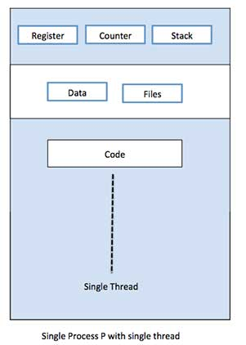
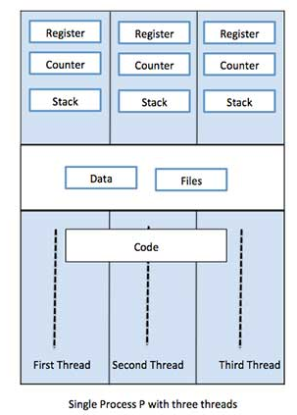
Single Threaded Process VS Multiple Threaded Process
A single-threaded process is a process with a single thread.
A multi-threaded process is a process with multiple threads.
The multiple threads have its own registers, stack and counter but they share the code and data segment.

Slide 38
Types of Threads
Section - 7

Slide 39
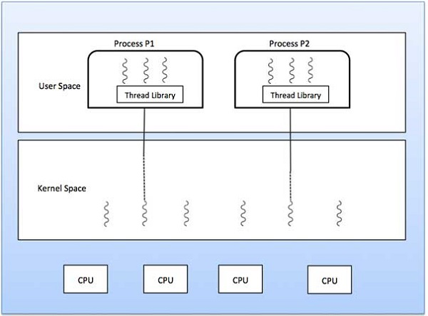
Types of Threads
Kernel Level Thread
User Level Thread
User
Level
Threads
Kernel
Level
Threads

Slide 40
Types of Threads
User Level Thread | Kernel Level Thread
User thread are implemented by users. | Kernel threads are implemented by OS.
OS doesn’t recognize user level threads. | Kernel threads are recognized by OS.
Implementation of user threads is easy. | Implementation of kernel thread is complex.
Context switch time is less. | Context switch time is more.
Context switch requires no hardware support. | Context switch requires hardware support.
If one user level thread perform blocking operation then entire process will be blocked. | If one kernel thread perform blocking operation then another thread with in same process can continue execution.
Example : Java thread | Example : Solaris (Unix-based OS)

Slide 41
Basic Concepts of CPU Scheduling
Section - 8

Slide 42



Scheduling
It is the process of making a choice of which process to run next whenever more than one processes are simultaneously in the 'Ready' state.
Scheduler
It is a part of OS which actually makes a choice of which process to run next whenever more than one processes are simultaneously in the 'Ready' State.
Scheduling Algorithm
It is an algorithm which process to run next whenever more than one processes are simultaneously in the 'Ready' state.
New
Ready
Run
P3
P2
P1
P3
P2
P1
P1
Process P1 is selected for Running state
Scheduler
Scheduling Algorithm
P4
P1
P3
P2
P1
P2
P3
P4

Slide 43
Types of Schedulers
Section - 9

Slide 44
Types of schedulers
A Process switches between the various scheduling queues throughout its lifetime.
It is the task of the schedulers to select processes from these queues based on some criteria.
There are Three types of schedulers:
Long Term Scheduler
Medium Term Scheduler
Sort Term Scheduler

Slide 45
Types of Schedulers
Long-Term Scheduler | Short-Term Scheduler | Medium-Term Scheduler
It is a job scheduler. | It is a CPU scheduler. | It is a process swapping scheduler.
It is a First Scheduler. | It is a Second Scheduler. | It is a Third Scheduler.
It selects processes from pool and loads them into memory for execution. | It selects those processes which are ready to execute. | It can re-introduce the process into memory and execution can be continued.
It executes infrequently | It runs very frequently | It runs occasionally
Speed is lesser than short term scheduler. | Speed is fastest among other two schedulers. | Speed is medium as compare to short- and long-term scheduler.
It is almost absent or minimal in time sharing system. | It is also minimal in time sharing system. | It is a part of time-sharing systems.

Slide 46
Scheduling Criteria
Section - 10

Slide 47
Scheduling criteria
CPU Scheduling is a process that allows one process to use the CPU while another process is delayed due to unavailability of any resources such as I / O etc.
The purpose of CPU Scheduling is to make the system more efficient, faster, and fairer.
Let’s discuss CPU Scheduling has several criteria. Some of them are mentioned below.
Scheduling Criteria
What to Maximize
What to minimize
Throughput
Waiting time
Turn around time
CPU utilization
Response Time

Slide 48
Scheduling Criteria
CPU Utilization:
It is an average fraction of time during which CPU is busy.
It ranges from 0 to 100%. In real system it should be between 40 to 90%.

Slide 49
Scheduling Criteria
Throughput:
Number of processes completed per time unit.
For long process, this rate may be 1 process per hour, for sort it might be 10 process per second.
Turn-around Time:
Time required to complete execution of a process.
Turn-around time = Process finish time – Process arrival time
Waiting Time:
It is total time duration spent by process waiting in ‘Ready’ queue.
Waiting time = Turn-around time – Actual execution time.
Response Time:
It is time between issuing a command/request and getting output/result.
Response time = First CPU Execution – Arrival time
Quantum:
In preemptive scheduling, each process is allowed to run for specified time duration, called its quantum.

Slide 50
Types of Scheduling
Section –11

Slide 51
Types of Scheduling
There are two types of Scheduling
Preemptive Scheduling
Non-Preemptive Scheduling
Non-Preemptive Scheduling | Preemptive Scheduling
Process runs until completion or waiting state. | OS can interrupt the process and switch the processes.
Scheduling take place when process switches from… Running to waiting state Running to terminated state | Scheduling take place when process switches from… Running to waiting state Running to terminated state Running to ready state Waiting to ready state
Simple, but it’s Not Efficient. | Complex but Very Efficient.
Slower response time | Faster response time
Not need of any timer or clock interrupt. | Need of any timer or clock interrupt.

Slide 52
Scheduling Algorithm
Section – 12

Slide 53
Scheduling Algorithm
Scheduling Algorithm is an algorithm which process to run next whenever more than one processes are simultaneously in ready state.
Priority Algorithm
Shortest Remaining Time Next (SRTN)
First Come First Serve (FCFS)
Scheduling Algorithm
Round Robin (RR)
Shortest Job First (SJF)/(SPN)

Slide 54
First Come, First Served (FCFS)
Section – 12.1

Slide 55
First Come, First Served(FCFS)
Selection criteria
The process that request first is served first.
It means that processes are served in the exact order of their arrival.
Head
Tail
P1
Head
P1
Tail
P2
Head
P1
P2
Tail
P3

Slide 56
First Come, First Served(FCFS)
Decision Mode
Non preemptive: Once a process is selected, it runs until it is blocked for an I/O or some other event or it is terminated.
Implementation
This strategy can be easily implemented by using FIFO (First In First Out) queue.
When CPU becomes free, a process from the first position in a queue is selected to run.

Slide 57
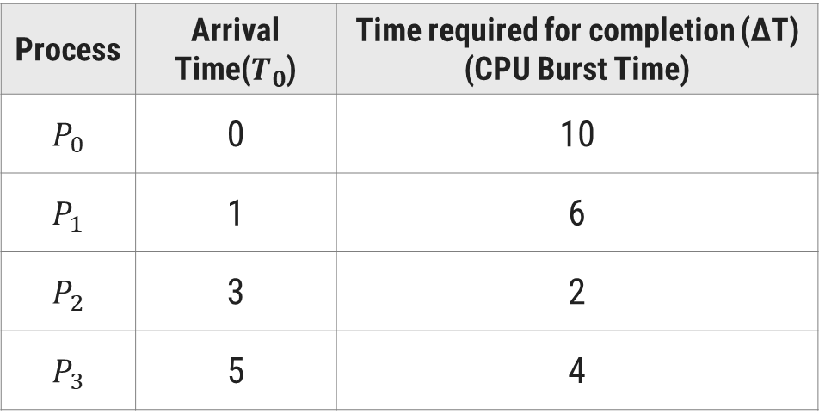
First Come, First Served(FCFS)
First Come, First Served Example
Consider the following set of four processes. Their arrival time and time required to complete the execution are given in following table. (Time value in milliseconds). Draw the Gantt chart and find Finish Time, Turn Around Time , Waiting Time , Average Turn Around Time, Average Waiting Time using FCFS algorithm.
Process | Arrival Time($T_{0}$) | Time required for completion (∆T) (CPU Burst Time)
$$P_{0}$$ | 0 | 10
$$P_{1}$$ | 1 | 6
$$P_{2}$$ | 3 | 2
$$P_{3}$$ | 5 | 4

Slide 58
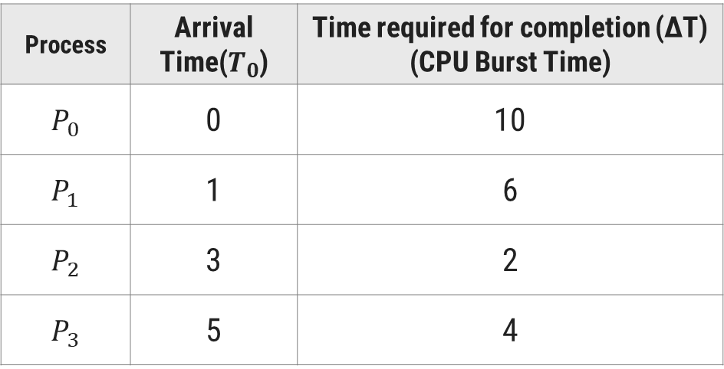
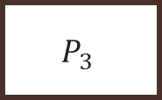
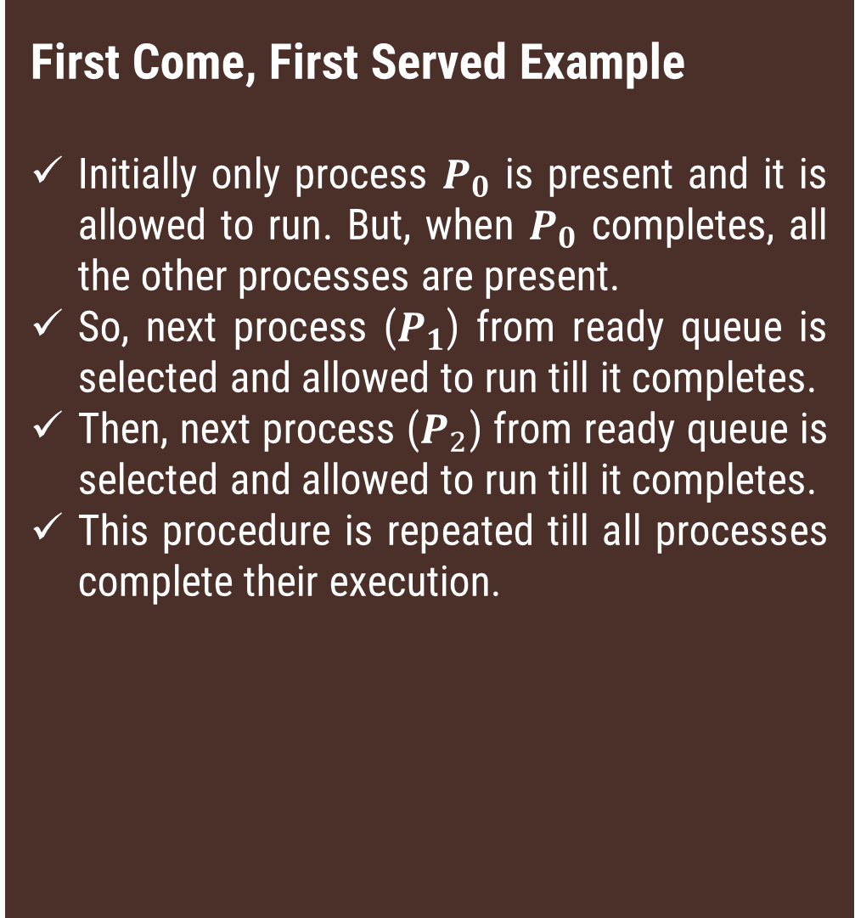



First Come, First Served Example
Initially only process $P_{0}$ is present and it is allowed to run. But, when $P_{0}$ completes, all the other processes are present.
So, next process ($P_{1}$) from ready queue is selected and allowed to run till it completes.
Then, next process ($P_{2}$) from ready queue is selected and allowed to run till it completes.
This procedure is repeated till all processes complete their execution.
Example
Process | Arrival Time($T_{0}$) | Time required for completion (∆T) (CPU Burst Time)
$$P_{0}$$ | 0 | 10
$$P_{1}$$ | 1 | 6
$$P_{2}$$ | 3 | 2
$$P_{3}$$ | 5 | 4
Gantt Chart
$$P_{0}$$
$$P_{1}$$
$$P_{2}$$
$$P_{3}$$
0
10
16
18
22

Slide 59
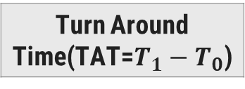

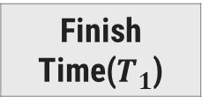
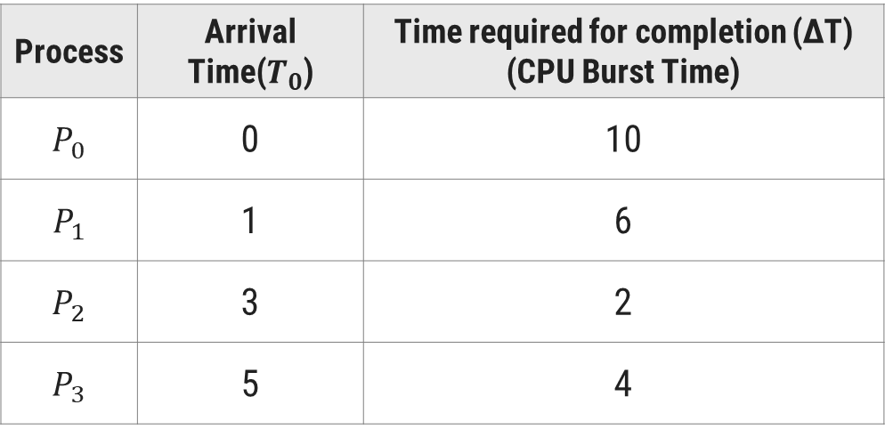



First Come, First Served(FCFS)
Process | Arrival Time($T_{0}$) | Time required for completion (∆T) (CPU Burst Time)
$$P_{0}$$ | 0 | 10
$$P_{1}$$ | 1 | 6
$$P_{2}$$ | 3 | 2
$$P_{3}$$ | 5 | 4
Finish Time($T_{1}$)
Turn Around Time(TAT=$T_{1}−T_{0}$)
10
10
16
15
18
15
22
17
$$P_{0}$$
$$P_{1}$$
$$P_{2}$$
$$P_{3}$$
0
10
16
18
22
Average Turnaround Time = Sum of all Process’s Turn Around Time/ Total Process
= (10+15+15+17)/4
= 14.25 Ms.

Slide 60
First Come, First Served(FCFS)
Process | Arrival Time($T_{0}$) | Time required for completion (∆T) (CPU Burst Time)
$$P_{0}$$ | 0 | 10
$$P_{1}$$ | 1 | 6
$$P_{2}$$ | 3 | 2
$$P_{3}$$ | 5 | 4
Finish Time($T_{1}$)
Turn Around Time(TAT=$T_{1}−T_{0}$)
Waiting Time (TAT-ΔT)
10
10
0
16
15
9
18
15
13
22
17
13
$$P_{0}$$
$$P_{1}$$
$$P_{2}$$
$$P_{3}$$
0
10
16
18
22
Average Waiting Time = Sum of all Process’s Waiting Time/ Total Process
= (0+9+13+13)/4
= 8.75 Ms.

Slide 61
First Come, First Served(FCFS)
Advantages
Simple, Fair and No Starvation.
Easy to understand and implement.
Disadvantages
Not efficient because average waiting time is too high.
Convoy effect is possible. All small processes wait for one big process to get usage of CPU.
CPU utilization is too low.

Slide 62
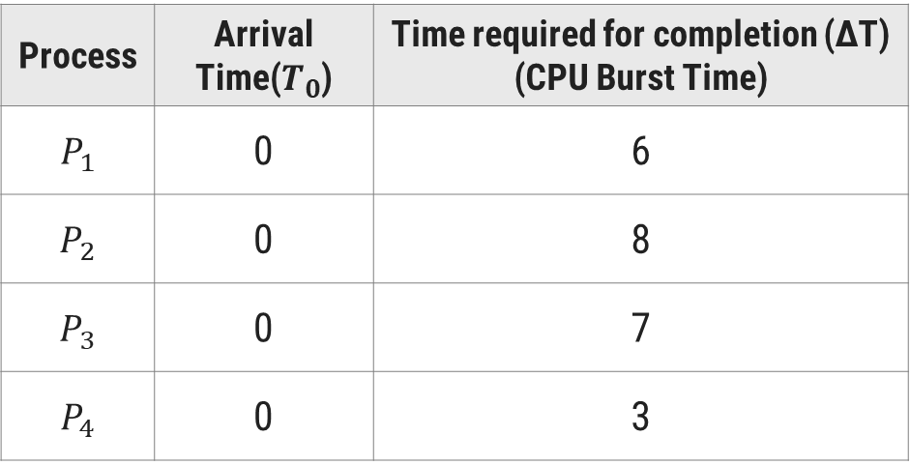
First Come, First Served(FCFS)
First Come, First Served Example(Self Study…)
Consider the following set of four processes. Their arrival time and time required to complete the execution are given in following table. (Time value in milliseconds). Draw the Gantt chart and find Finish Time, Average Waiting Time and Turn Around Time for FCFS algorithm
Process | Arrival Time($T_{0}$) | Time required for completion (∆T) (CPU Burst Time)
$$P_{1}$$ | 0 | 6
$$P_{2}$$ | 0 | 8
$$P_{3}$$ | 0 | 7
$$P_{4}$$ | 0 | 3

Slide 63
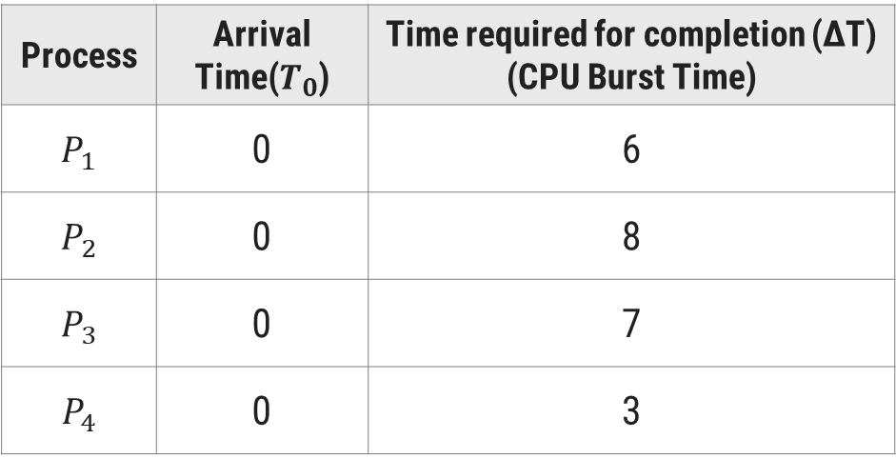
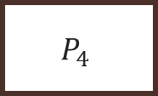
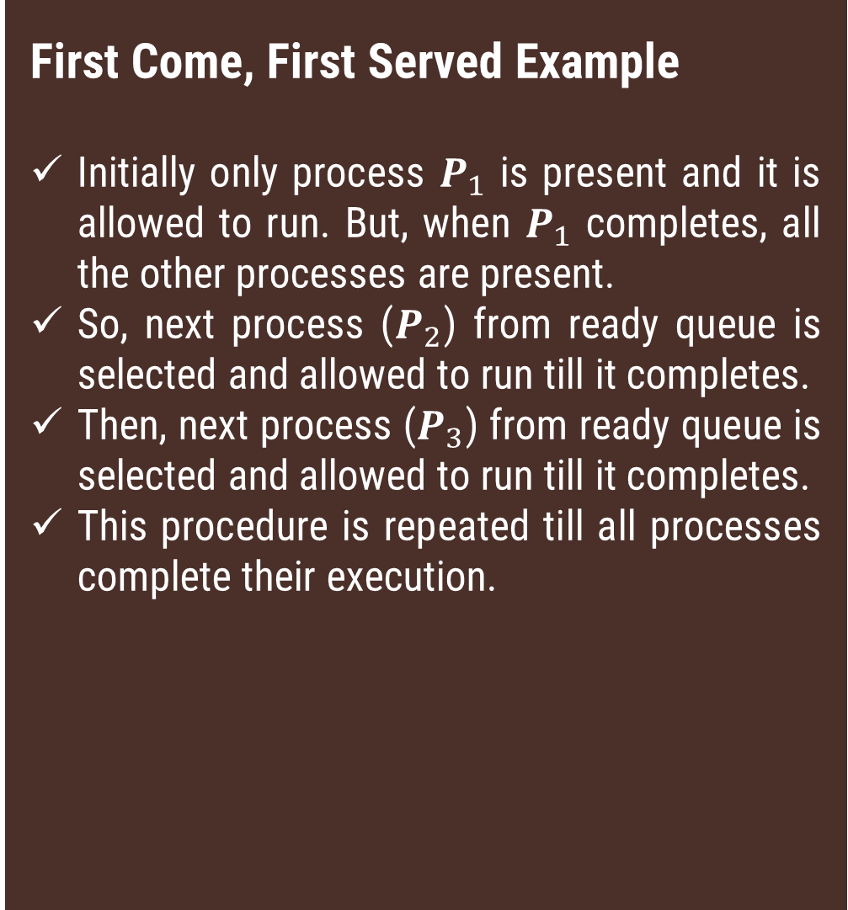



First Come, First Served Example
Initially only process $P_{1}$ is present and it is allowed to run. But, when $P_{1}$ completes, all the other processes are present.
So, next process ($P_{2}$) from ready queue is selected and allowed to run till it completes.
Then, next process ($P_{3}$) from ready queue is selected and allowed to run till it completes.
This procedure is repeated till all processes complete their execution.
Example
Process | Arrival Time($T_{0}$) | Time required for completion (∆T) (CPU Burst Time)
$$P_{1}$$ | 0 | 6
$$P_{2}$$ | 0 | 8
$$P_{3}$$ | 0 | 7
$$P_{4}$$ | 0 | 3
Gantt Chart
$$P_{1}$$
$$P_{2}$$
$$P_{3}$$
$$P_{4}$$
0
6
14
21
24

Slide 64

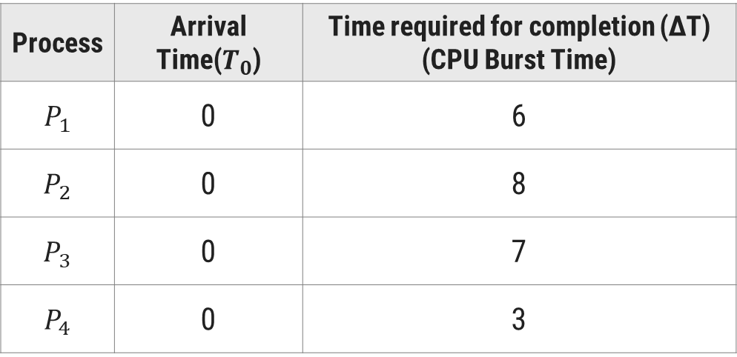



First Come, First Served(FCFS)
Process | Arrival Time($T_{0}$) | Time required for completion (∆T) (CPU Burst Time)
$$P_{1}$$ | 0 | 6
$$P_{2}$$ | 0 | 8
$$P_{3}$$ | 0 | 7
$$P_{4}$$ | 0 | 3
Finish Time($T_{1}$)
Turn Around Time(TAT=$T_{1}−T_{0}$)
6
6
14
14
21
21
24
24
$$P_{1}$$
$$P_{2}$$
$$P_{3}$$
$$P_{4}$$
0
6
14
21
24
Average Turnaround Time = Sum of all Process’s Turn Around Time/ Total Process
= (6+14+21+24)/4
= 16.25 Ms.

Slide 65
First Come, First Served(FCFS)
Process | Arrival Time($T_{0}$) | Time required for completion (∆T) (CPU Burst Time)
$$P_{1}$$ | 0 | 6
$$P_{2}$$ | 0 | 8
$$P_{3}$$ | 0 | 7
$$P_{4}$$ | 0 | 3
Finish Time($T_{1}$)
Turn Around Time(TAT=$T_{1}−T_{0}$)
Waiting Time (TAT-ΔT)
6
6
0
14
14
6
21
21
14
24
24
21
$$P_{1}$$
$$P_{2}$$
$$P_{3}$$
$$P_{4}$$
0
6
14
21
24
Average Waiting Time = Sum of all Process’s Waiting Time/ Total Process
= (0+6+14+21)/4
= 10.25 Ms.

Slide 66
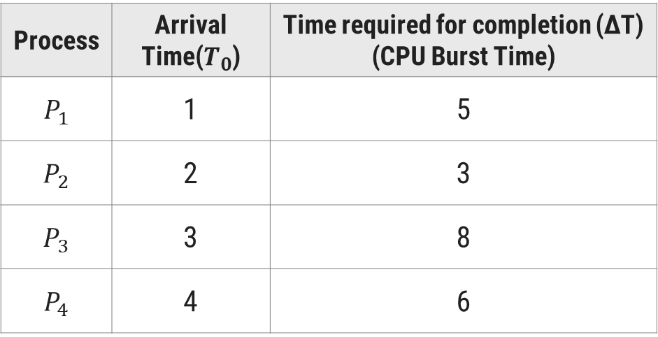
First Come, First Served - Exercise
Consider the following set of four processes. Their arrival time and time required to complete the execution are given in following table. (Time value in milliseconds).
Draw the Gantt chart and find Finish Time, Average Waiting Time and Turn Around Time for FCFS algorithm.
Process | Arrival Time($T_{0}$) | Time required for completion (∆T) (CPU Burst Time)
$$P_{1}$$ | 1 | 5
$$P_{2}$$ | 2 | 3
$$P_{3}$$ | 3 | 8
$$P_{4}$$ | 4 | 6

Slide 67
Shortest Job First (SJF)
Section – 12.2

Slide 68
Shortest Job First(SJF)
Selection criteria
The process, that requires shortest time to complete execution, is served first.
Decision Mode
Non preemptive: Once a process is selected, it runs until either it is blocked for an I/O or some other event or it is terminated.
Implementation
This strategy can be easily implemented by using FIFO (First In First Out) queue.
All processes in a queue are sorted in ascending order based on their required CPU bursts.
When CPU becomes free, a process from the first position in a queue is selected to run.

Slide 69
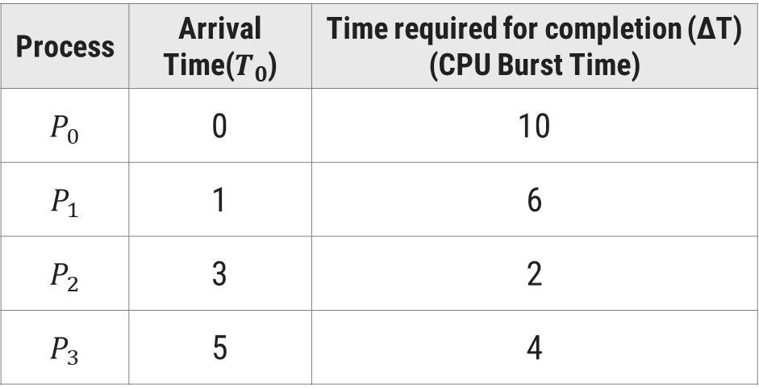
Shortest Job First(SJF)
Shortest Job First Example
Consider the following set of four processes. Their arrival time and time required to complete the execution are given in following table. (Time value in milliseconds). Draw the Gantt chart and find Finish Time, Turn Around Time , Waiting Time , Average Turn Around Time, Average Waiting Time using SJF algorithm.
Process | Arrival Time($T_{0}$) | Time required for completion (∆T) (CPU Burst Time)
$$P_{0}$$ | 0 | 10
$$P_{1}$$ | 1 | 6
$$P_{2}$$ | 3 | 2
$$P_{3}$$ | 5 | 4

Slide 70
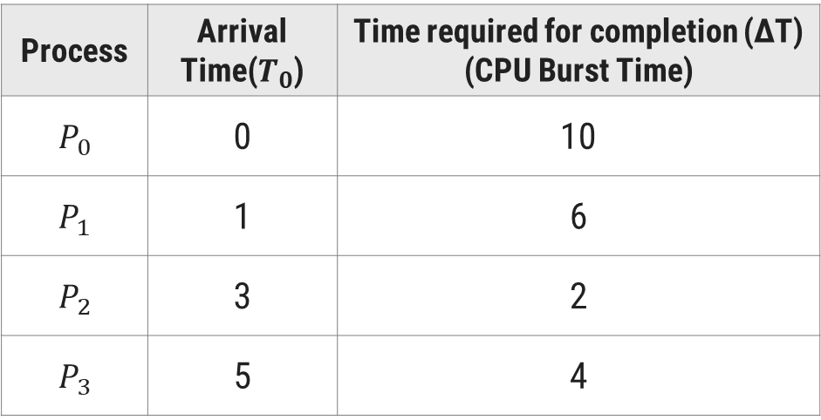
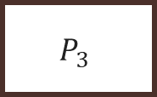
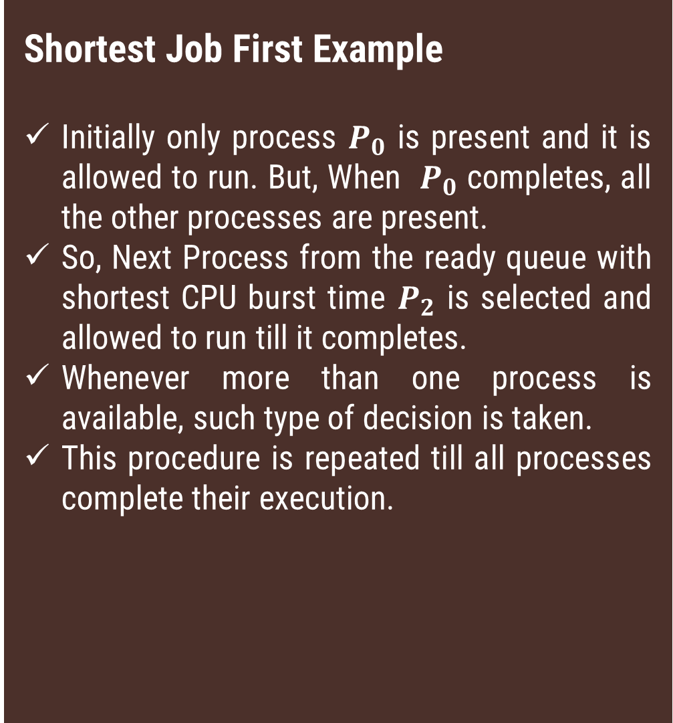


Shortest Job First Example
Initially only process $P_{0}$ is present and it is allowed to run. But, When $P_{0}$ completes, all the other processes are present.
So, Next Process from the ready queue with shortest CPU burst time $P_{2}$ is selected and allowed to run till it completes.
Whenever more than one process is available, such type of decision is taken.
This procedure is repeated till all processes complete their execution.
Example
Process | Arrival Time($T_{0}$) | Time required for completion (∆T) (CPU Burst Time)
$$P_{0}$$ | 0 | 10
$$P_{1}$$ | 1 | 6
$$P_{2}$$ | 3 | 2
$$P_{3}$$ | 5 | 4
Gantt Chart
$$P_{0}$$
$$P_{2}$$
$$P_{3}$$
$$P_{1}$$
0
10
12
16
22

Slide 71
Shortest Job First(SJF)
Process | Arrival Time($T_{0}$) | Time required for completion (∆T) (CPU Burst Time)
$$P_{0}$$ | 0 | 10
$$P_{1}$$ | 1 | 6
$$P_{2}$$ | 3 | 2
$$P_{3}$$ | 5 | 4
Finish Time($T_{1}$)
Turn Around Time(TAT=$T_{1}−T_{0}$)
10
10
22
21
12
9
16
11
P0
P2
P3
P1
0
10
12
16
22
Average Turnaround Time = Sum of all Process’s Turn Around Time/ Total Process
= (10+21+9+11)/4
= 12.75 ms.

Slide 72
Shortest Job First(SJF)
Process | Arrival Time($T_{0}$) | Time required for completion (∆T) (CPU Burst Time)
$$P_{0}$$ | 0 | 10
$$P_{1}$$ | 1 | 6
$$P_{2}$$ | 3 | 2
$$P_{3}$$ | 5 | 4
Finish Time($T_{1}$)
Turn Around Time(TAT=$T_{1}−T_{0}$)
Waiting Time (TAT-ΔT)
10
10
0
22
21
15
12
9
7
16
11
7
P0
P2
P3
P1
0
10
12
16
22
Average Waiting Time = Sum of all Process’s Waiting Time/ Total Process
= (0+15+7+7)/4
= 7.25 ms.

Slide 73
Shortest Job First(SJF)
Advantages
Less waiting time.
Good response for short processes.
Disadvantages
It is difficult to estimate time required to complete execution.
Starvation is possible for long process. Long process may wait forever.

Slide 74
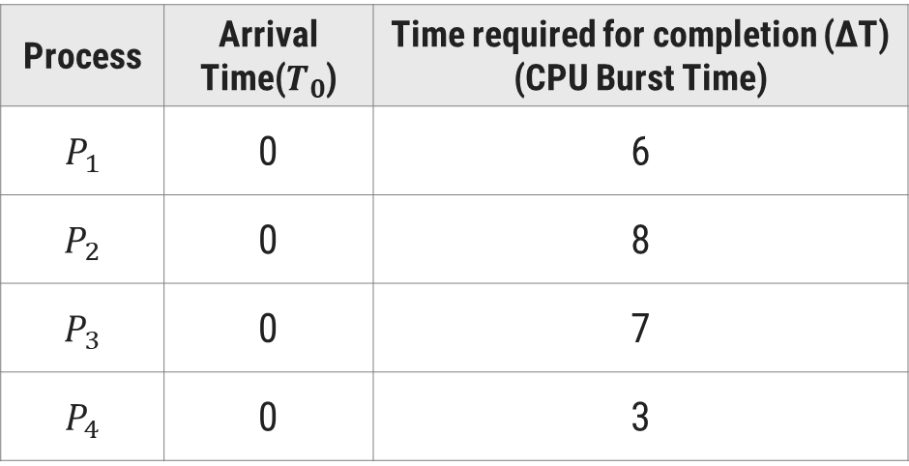
Shortest Job First(SJF)
Shortest Job First Example(Self Study)
Consider the following set of four processes. Their arrival time and time required to complete the execution are given in following table. (Time value in milliseconds). Draw the Gantt chart and find Finish Time, Turn Around Time , Waiting Time , Average Turn Around Time, Average Waiting Time using SJF algorithm.
Process | Arrival Time($T_{0}$) | Time required for completion (∆T) (CPU Burst Time)
$$P_{1}$$ | 0 | 6
$$P_{2}$$ | 0 | 8
$$P_{3}$$ | 0 | 7
$$P_{4}$$ | 0 | 3

Slide 75

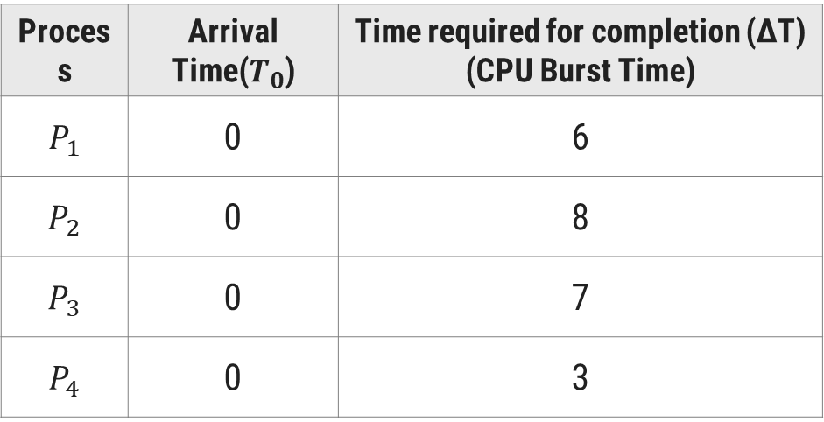
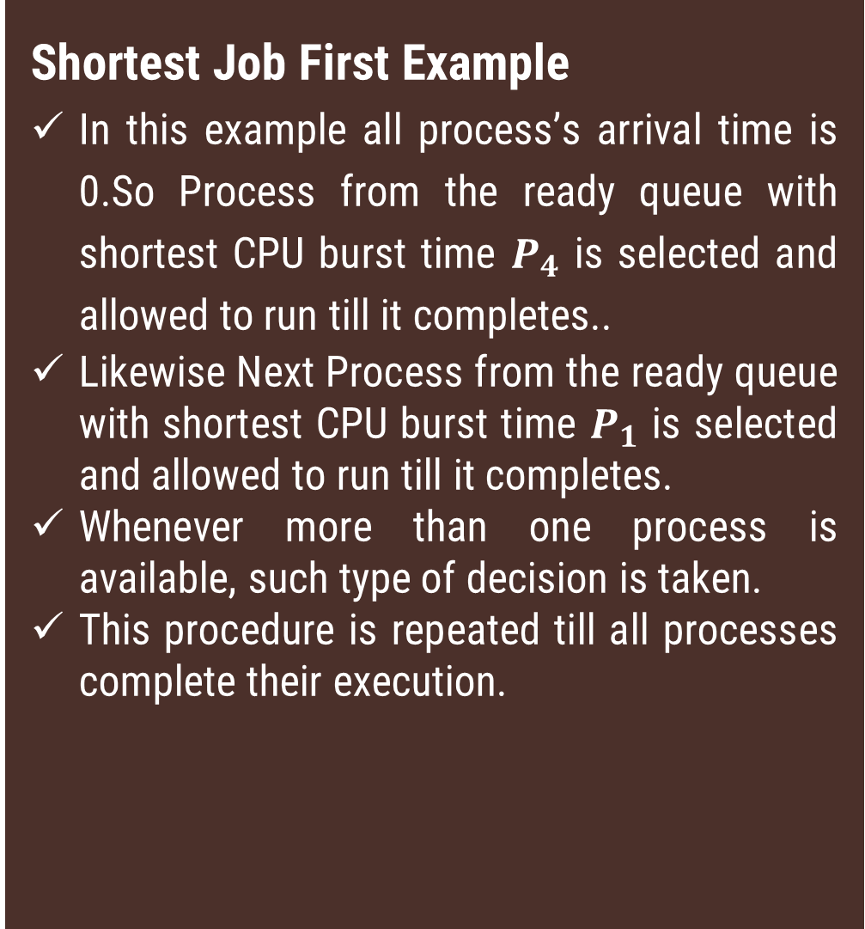
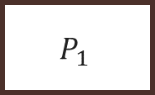


Shortest Job First Example
In this example all process’s arrival time is 0.So Process from the ready queue with shortest CPU burst time $P_{4}$ is selected and allowed to run till it completes..
Likewise Next Process from the ready queue with shortest CPU burst time $P_{1}$ is selected and allowed to run till it completes.
Whenever more than one process is available, such type of decision is taken.
This procedure is repeated till all processes complete their execution.
Example
Process | Arrival Time($T_{0}$) | Time required for completion (∆T) (CPU Burst Time)
$$P_{1}$$ | 0 | 6
$$P_{2}$$ | 0 | 8
$$P_{3}$$ | 0 | 7
$$P_{4}$$ | 0 | 3
Gantt Chart
$$P_{4}$$
$$P_{1}$$
$$P_{3}$$
$$P_{2}$$
0
3
9
16
24

Slide 76




Shortest Job First(SJF)
Process | Arrival Time($T_{0}$) | Time required for completion (∆T) (CPU Burst Time)
$$P_{1}$$ | 0 | 6
$$P_{2}$$ | 0 | 8
$$P_{3}$$ | 0 | 7
$$P_{4}$$ | 0 | 3
Finish Time($T_{1}$)
Turn Around Time(TAT=$T_{1}−T_{0}$)
9
9
24
24
16
16
3
3
$$P_{4}$$
$$P_{1}$$
$$P_{3}$$
$$P_{2}$$
0
3
9
12
16
24
Average Turnaround Time = Sum of all Process’s Turn Around Time/ Total Process
= (9+24+16+3)/4
= 13 ms.

Slide 77
Shortest Job First(SJF)
Process | Arrival Time($T_{0}$) | Time required for completion (∆T) (CPU Burst Time)
$$P_{1}$$ | 0 | 6
$$P_{2}$$ | 0 | 8
$$P_{3}$$ | 0 | 7
$$P_{4}$$ | 0 | 3
Finish Time($T_{1}$)
Turn Around Time(TAT=$T_{1}−T_{0}$)
Waiting Time (TAT-ΔT)
9
9
3
24
24
16
16
16
9
3
3
0
$$P_{4}$$
$$P_{1}$$
$$P_{3}$$
$$P_{2}$$
0
3
9
16
24
Average Waiting Time = Sum of all Process’s Turn Around Time/ Total Process
= (3+16+9+0)/4
= 7 ms.

Slide 78
Shortest Remaining Time Next (SRTN)
Section – 12.3

Slide 79
Shortest Remaining Time Next (SRTN)
Selection criteria
The process, whose remaining run time is shortest, is served first. This is a preemptive version of SJF scheduling.
Decision Mode
Preemptive: When a new process arrives, its total time is compared to the current process remaining run time.
If the new process needs less time to finish than the current process, the current process is suspended and the new job is started.
Implementation
This strategy can also be implemented by using sorted FIFO queue.
All processes in a queue are sorted in ascending order on their remaining run time.
When CPU becomes free, a process from the first position in a queue is selected to run.

Slide 80

Shortest Remaining Time Next (SRTN)
Shortest Remaining Time Next Example
Consider the following set of four processes. Their arrival time and time required to complete the execution are given in following table. (Time value in milliseconds). Draw the Gantt chart and find Finish Time, Turn Around Time , Waiting Time , Average Turn Around Time, Average Waiting Time using SRTN algorithm.
Process | Arrival Time($T_{0}$) | Time required for completion (∆T) (CPU Burst Time)
$$P_{0}$$ | 0 | 10
$$P_{1}$$ | 1 | 6
$$P_{2}$$ | 3 | 2
$$P_{3}$$ | 5 | 4

Slide 81

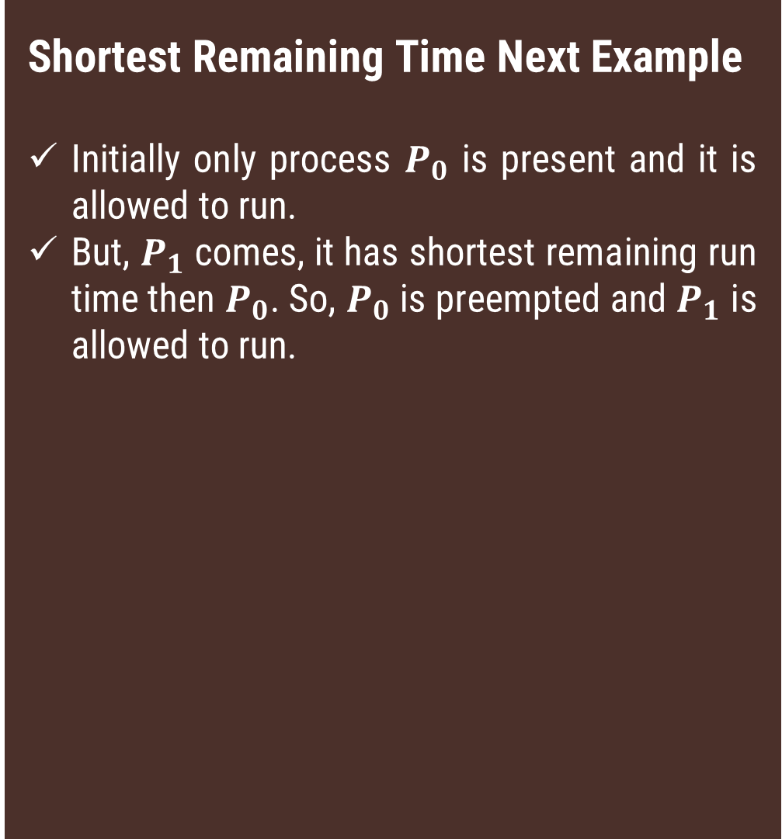
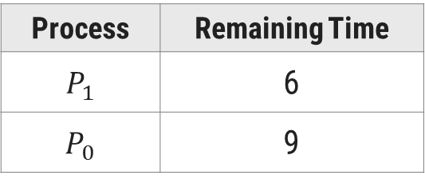
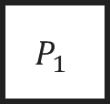
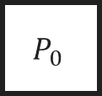
Example
Shortest Remaining Time Next Example
Initially only process $P_{0}$ is present and it is allowed to run.
But, $P_{1}$ comes, it has shortest remaining run time then $P_{0}$. So, $P_{0}$ is preempted and $P_{1}$ is allowed to run.
Process | Arrival Time($T_{0}$) | Time required for completion (∆T) (CPU Burst Time)
$$P_{0}$$ | 0 | 10
$$P_{1}$$ | 1 | 6
$$P_{2}$$ | 3 | 2
$$P_{3}$$ | 5 | 4
Gantt Chart
$$P_{0}$$
$$P_{1}$$
0
1
3
Process | Remaining Time
$$P_{1}$$ | 6
$$P_{0}$$ | 9

Slide 82
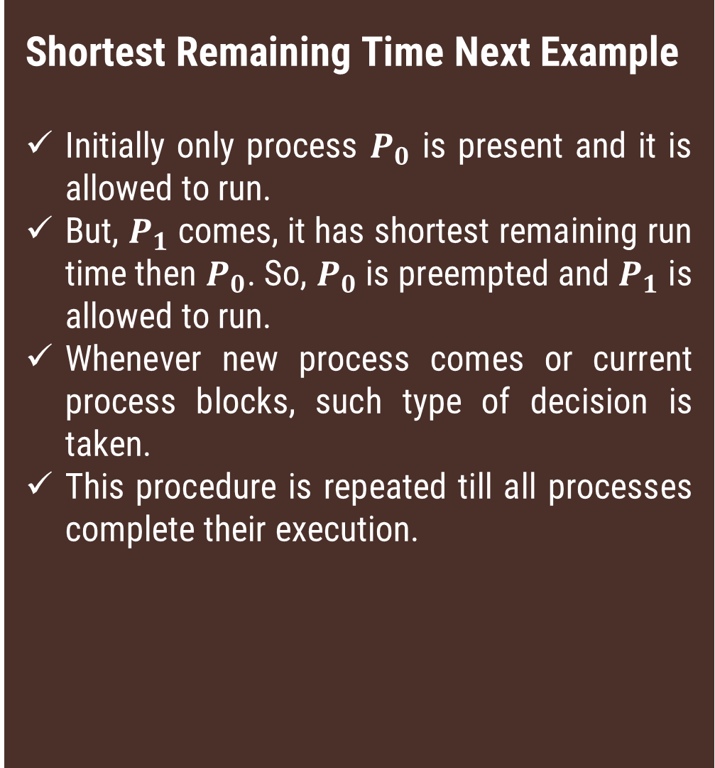

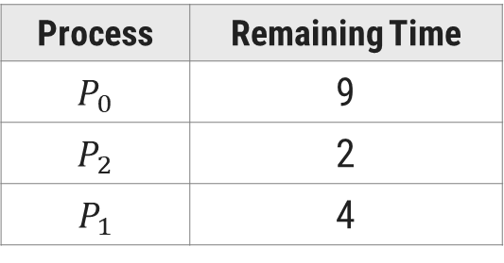
Example
Shortest Remaining Time Next Example
Initially only process $P_{0}$ is present and it is allowed to run.
But, $P_{1}$ comes, it has shortest remaining run time then $P_{0}$. So, $P_{0}$ is preempted and $P_{1}$ is allowed to run.
Whenever new process comes or current process blocks, such type of decision is taken.
This procedure is repeated till all processes complete their execution.
Process | Arrival Time($T_{0}$) | Time required for completion (∆T) (CPU Burst Time)
$$P_{0}$$ | 0 | 10
$$P_{1}$$ | 1 | 6
$$P_{2}$$ | 3 | 2
$$P_{3}$$ | 5 | 4
Gantt Chart
$$P_{0}$$
$$P_{1}$$
$$P_{2}$$
0
1
3
5
Process | Remaining Time
$$P_{0}$$ | 9
$$P_{2}$$ | 2
$$P_{1}$$ | 4

Slide 83
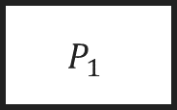
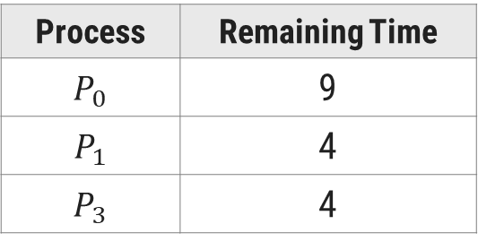
Example
Shortest Remaining Time Next Example
Initially only process $P_{0}$ is present and it is allowed to run.
But, $P_{1}$ comes, it has shortest remaining run time then $P_{0}$. So, $P_{0}$ is preempted and $P_{1}$ is allowed to run.
Whenever new process comes or current process blocks, such type of decision is taken.
This procedure is repeated till all processes complete their execution.
Process | Arrival Time($T_{0}$) | Time required for completion (∆T) (CPU Burst Time)
$$P_{0}$$ | 0 | 10
$$P_{1}$$ | 1 | 6
$$P_{2}$$ | 3 | 2
$$P_{3}$$ | 5 | 4
Gantt Chart
$$P_{0}$$
$$P_{1}$$
$$P_{2}$$
$$P_{1}$$
0
1
3
5
9
Process | Remaining Time
$$P_{0}$$ | 9
$$P_{1}$$ | 4
$$P_{3}$$ | 4

Slide 84
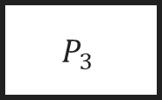
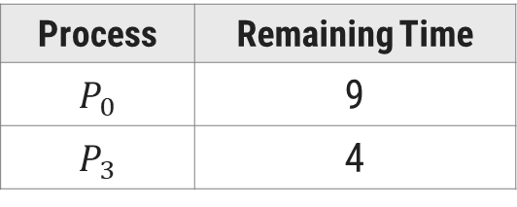
Example
Shortest Remaining Time Next Example
Initially only process $P_{0}$ is present and it is allowed to run.
But, $P_{1}$ comes, it has shortest remaining run time then $P_{0}$. So, $P_{0}$ is preempted and $P_{1}$ is allowed to run.
Whenever new process comes or current process blocks, such type of decision is taken.
This procedure is repeated till all processes complete their execution.
Process | Arrival Time($T_{0}$) | Time required for completion (∆T) (CPU Burst Time)
$$P_{0}$$ | 0 | 10
$$P_{1}$$ | 1 | 6
$$P_{2}$$ | 3 | 2
$$P_{3}$$ | 5 | 4
Gantt Chart
$$P_{0}$$
$$P_{1}$$
$$P_{2}$$
$$P_{1}$$
$$P_{3}$$
0
1
3
5
9
13
Process | Remaining Time
$$P_{0}$$ | 9
$$P_{3}$$ | 4

Slide 85

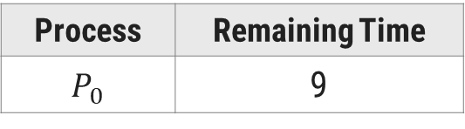
Example
Shortest Remaining Time Next Example
Initially only process $P_{0}$ is present and it is allowed to run.
But, $P_{1}$ comes, it has shortest remaining run time then $P_{0}$. So, $P_{0}$ is preempted and $P_{1}$ is allowed to run.
Whenever new process comes or current process blocks, such type of decision is taken.
This procedure is repeated till all processes complete their execution.
Process | Arrival Time($T_{0}$) | Time required for completion (∆T) (CPU Burst Time)
$$P_{0}$$ | 0 | 10
$$P_{1}$$ | 1 | 6
$$P_{2}$$ | 3 | 2
$$P_{3}$$ | 5 | 4
Gantt Chart
$$P_{0}$$
$$P_{1}$$
$$P_{2}$$
$$P_{1}$$
$$P_{3}$$
$$P_{0}$$
0
1
3
5
9
13
22
Process | Remaining Time
$$P_{0}$$ | 9

Slide 86






Shortest Remaining Time Next (SRTN)
Process | Arrival Time($T_{0}$) | Time required for completion (∆T) (CPU Burst Time)
$$P_{0}$$ | 0 | 10
$$P_{1}$$ | 1 | 6
$$P_{2}$$ | 3 | 2
$$P_{3}$$ | 5 | 4
Finish Time($T_{1}$)
Turn Around Time(TAT=$T_{1}−T_{0}$)
22
22
9
8
5
2
13
8
$$P_{0}$$
$$P_{1}$$
$$P_{2}$$
$$P_{1}$$
$$P_{3}$$
$$P_{0}$$
0
1
3
5
9
13
22
Average Turnaround Time = Sum of all Process’s Turn Around Time/ Total Process
= (22+8+2+8)/4
= 10 ms.

Slide 87
Shortest Remaining Time Next (SRTN)
Process | Arrival Time($T_{0}$) | Time required for completion (∆T) (CPU Burst Time)
$$P_{0}$$ | 0 | 10
$$P_{1}$$ | 1 | 6
$$P_{2}$$ | 3 | 2
$$P_{3}$$ | 5 | 4
Finish Time($T_{1}$)
Turn Around Time(TAT=$T_{1}−T_{0}$)
Waiting Time (TAT-ΔT)
22
22
12
9
8
2
5
2
0
13
8
4
$$P_{0}$$
$$P_{1}$$
$$P_{2}$$
$$P_{1}$$
$$P_{3}$$
$$P_{0}$$
0
1
3
5
9
13
22
Average Waiting Time = Sum of all Process’s Waiting Time/ Total Process
= (12+2+0+4)/4
= 4.5 ms.

Slide 88
Shortest Remaining Time Next (SRTN)
Advantages
Less waiting time.
Quite good response for short processes.
Disadvantages
Again, it is difficult to estimate remaining time necessary to complete execution.
Starvation is possible for long process. Long process may wait forever.
Context switch overhead is there.

Slide 89
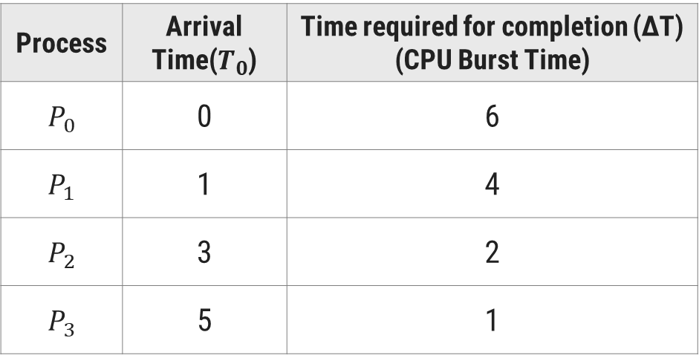
Shortest Remaining Time Next (SRTN)
Shortest Remaining Time Next Example(Self Study)
Consider the following set of four processes. Their arrival time and time required to complete the execution are given in following table. (Time value in milliseconds). Draw the Gantt chart and find Finish Time, Average Waiting Time and Turn Around Time for SRTN algorithm.
Process | Arrival Time($T_{0}$) | Time required for completion (∆T) (CPU Burst Time)
$$P_{0}$$ | 0 | 6
$$P_{1}$$ | 1 | 4
$$P_{2}$$ | 3 | 2
$$P_{3}$$ | 5 | 1

Slide 90
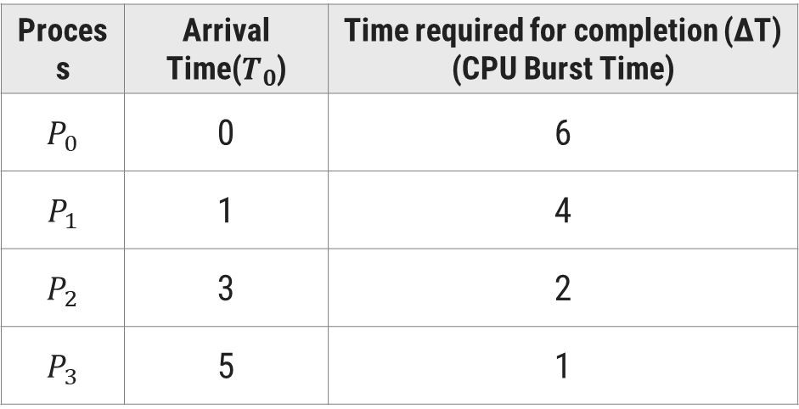
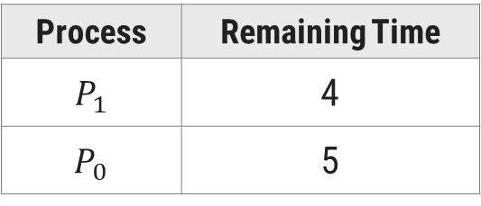
Example
Shortest Remaining Time Next Example
Initially only process $P_{0}$ is present and it is allowed to run.
But, $P_{1}$ comes, it has shortest remaining run time then $P_{0}$. So, $P_{0}$ is preempted and $P_{1}$ is allowed to run.
Process | Arrival Time($T_{0}$) | Time required for completion (∆T) (CPU Burst Time)
$$P_{0}$$ | 0 | 6
$$P_{1}$$ | 1 | 4
$$P_{2}$$ | 3 | 2
$$P_{3}$$ | 5 | 1
Gantt Chart
$$P_{0}$$
$$P_{1}$$
0
1
3
Process | Remaining Time
$$P_{1}$$ | 4
$$P_{0}$$ | 5

Slide 91


Example
Shortest Remaining Time Next Example
Initially only process $P_{0}$ is present and it is allowed to run.
But, $P_{1}$ comes, it has shortest remaining run time then $P_{0}$. So, $P_{0}$ is preempted and $P_{1}$ is allowed to run.
Whenever new process comes or current process blocks, such type of decision is taken.
This procedure is repeated till all processes complete their execution.
Process | Arrival Time($T_{0}$) | Time required for completion (∆T) (CPU Burst Time)
$$P_{0}$$ | 0 | 6
$$P_{1}$$ | 1 | 4
$$P_{2}$$ | 3 | 2
$$P_{3}$$ | 5 | 1
Gantt Chart
$$P_{0}$$
$$P_{1}$$
$$P_{1}$$
0
1
3
5
Process | Remaining Time
$$P_{0}$$ | 5
$$P_{1}$$ | 2
$$P_{2}$$ | 2

Slide 92

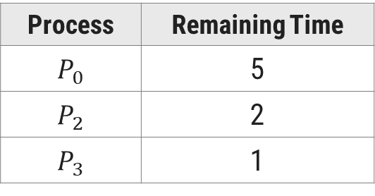
Example
Shortest Remaining Time Next Example
Initially only process $P_{0}$ is present and it is allowed to run.
But, $P_{1}$ comes, it has shortest remaining run time then $P_{0}$. So, $P_{0}$ is preempted and $P_{1}$ is allowed to run.
Whenever new process comes or current process blocks, such type of decision is taken.
This procedure is repeated till all processes complete their execution.
Process | Arrival Time($T_{0}$) | Time required for completion (∆T) (CPU Burst Time)
$$P_{0}$$ | 0 | 6
$$P_{1}$$ | 1 | 4
$$P_{2}$$ | 3 | 2
$$P_{3}$$ | 5 | 1
Gantt Chart
$$P_{0}$$
$$P_{1}$$
$$P_{1}$$
$$P_{3}$$
0
1
3
5
6
Process | Remaining Time
$$P_{0}$$ | 5
$$P_{2}$$ | 2
$$P_{3}$$ | 1

Slide 93

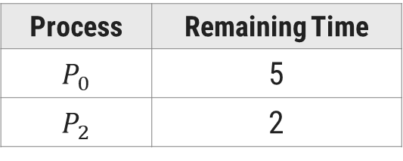
Example
Shortest Remaining Time Next Example
Initially only process $P_{0}$ is present and it is allowed to run.
But, $P_{1}$ comes, it has shortest remaining run time then $P_{0}$. So, $P_{0}$ is preempted and $P_{1}$ is allowed to run.
Whenever new process comes or current process blocks, such type of decision is taken.
This procedure is repeated till all processes complete their execution.
Process | Arrival Time($T_{0}$) | Time required for completion (∆T) (CPU Burst Time)
$$P_{0}$$ | 0 | 6
$$P_{1}$$ | 1 | 4
$$P_{2}$$ | 3 | 2
$$P_{3}$$ | 5 | 1
Gantt Chart
$$P_{0}$$
$$P_{1}$$
$$P_{1}$$
$$P_{3}$$
$$P_{2}$$
0
1
3
5
6
8
Process | Remaining Time
$$P_{0}$$ | 5
$$P_{2}$$ | 2

Slide 94
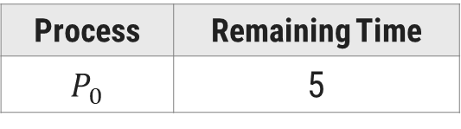

Example
Shortest Remaining Time Next Example
Initially only process $P_{0}$ is present and it is allowed to run.
But, $P_{1}$ comes, it has shortest remaining run time then $P_{0}$. So, $P_{0}$ is preempted and $P_{1}$ is allowed to run.
Whenever new process comes or current process blocks, such type of decision is taken.
This procedure is repeated till all processes complete their execution.
Process | Arrival Time($T_{0}$) | Time required for completion (∆T) (CPU Burst Time)
$$P_{0}$$ | 0 | 6
$$P_{1}$$ | 1 | 4
$$P_{2}$$ | 3 | 2
$$P_{3}$$ | 5 | 1
Gantt Chart
$$P_{0}$$
$$P_{1}$$
$$P_{1}$$
$$P_{3}$$
$$P_{2}$$
$$P_{0}$$
0
1
3
5
6
8
13
Process | Remaining Time
$$P_{0}$$ | 5

Slide 95


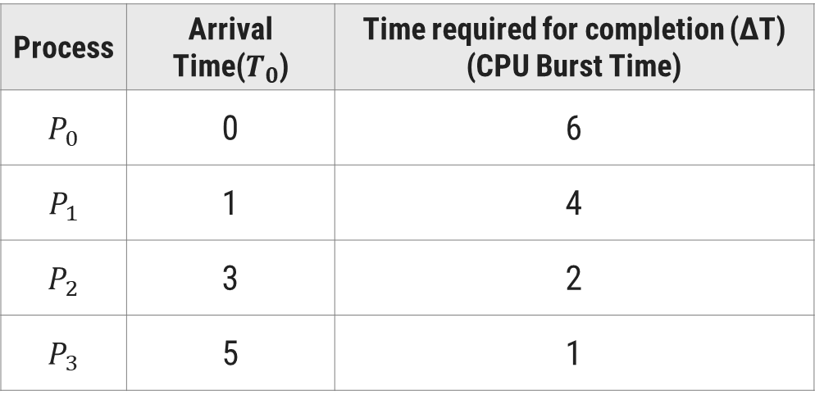

Shortest Remaining Time Next (SRTN)
Process | Arrival Time($T_{0}$) | Time required for completion (∆T) (CPU Burst Time)
$$P_{0}$$ | 0 | 6
$$P_{1}$$ | 1 | 4
$$P_{2}$$ | 3 | 2
$$P_{3}$$ | 5 | 1
Finish Time($T_{1}$)
Turn Around Time(TAT=$T_{1}−T_{0}$)
13
13
5
4
8
5
6
1
$$P_{0}$$
$$P_{1}$$
$$P_{1}$$
$$P_{3}$$
$$P_{2}$$
$$P_{0}$$
0
1
3
5
6
8
13
Average Turnaround Time = Sum of all Process’s Turn Around Time/ Total Process
= (13+4+5+1)/4
= 5.75 Ms.

Slide 96
Shortest Remaining Time Next (SRTN)
Process | Arrival Time($T_{0}$) | Time required for completion (∆T) (CPU Burst Time)
$$P_{0}$$ | 0 | 6
$$P_{1}$$ | 1 | 4
$$P_{2}$$ | 3 | 2
$$P_{3}$$ | 5 | 1
Finish Time($T_{1}$)
Turn Around Time(TAT=$T_{1}−T_{0}$)
Waiting Time (TAT-ΔT)
13
13
7
5
4
0
8
5
3
6
1
0
$$P_{0}$$
$$P_{1}$$
$$P_{1}$$
$$P_{3}$$
$$P_{2}$$
$$P_{0}$$
0
1
3
5
6
8
13
Average Waiting Time = Sum of all Process’s Waiting Time/ Total Process
= (7+0+3+0)/4
= 2.5 ms

Slide 97
Round Robin (RR)
Section – 12.4

Slide 98
Round Robin (RR)
Selection Criteria
The process that requests First is served first. It means that processes are served in the exact order as they come.
The selection criteria are same as in FCFS scheduling.
Decision Mode
Preemptive: each process is allowed to run for specified time duration, called its Quantum.
Process is allowed to run only for this time interval.
There are two possible way of execution current process
A process needs CPU burst less than time quantum – in this case, process will voluntarily release CPU and it will be moved to the end of the queue.
A process need CPU burst longer than time quantum – in this case, process will be running at the end of time quantum. After that it will be preempted and moved to end of queue. CPU will be allocated to another process.
Implementation
This strategy can be implemented by using circular FIFO queue. When new process comes, or process release CPU, or Process is preempted, it is moved to end of queue.
When CPU becomes free, a process from the first position in queue is selected to run.

Slide 99
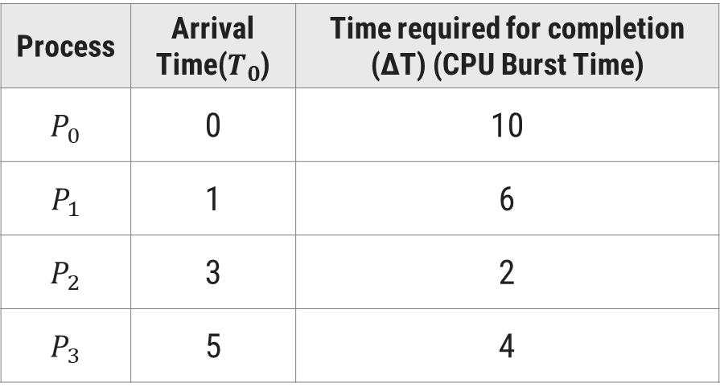
Round Robin (RR)
Round Robin (RR) Example
Consider the following set of four processes. Their arrival time and time required to complete the execution are given in following table. (Time value in milliseconds). Draw the Gantt chart and find Finish Time, Turn Around Time , Waiting Time , Average Turn Around Time, Average Waiting Time using RR algorithm.
Process | Arrival Time($T_{0}$) | Time required for completion (∆T) (CPU Burst Time)
$$P_{0}$$ | 0 | 10
$$P_{1}$$ | 1 | 6
$$P_{2}$$ | 3 | 2
$$P_{3}$$ | 5 | 4

Slide 100
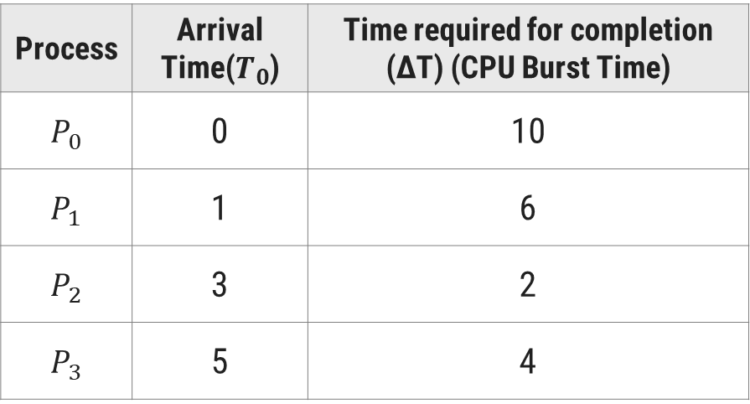



Example
Round Robin Example
Take Time quantum = 4 ms & Context switch overhead = 1 ms
At 4 ms, process $P_{0}$ completes its time quantum. So, it is preempted and another process $P_{1}$ is allowed to run.
1 ms is wasted on each context switch as overhead.
Process | Arrival Time($T_{0}$) | Time required for completion (∆T) (CPU Burst Time)
$$P_{0}$$ | 0 | 10
$$P_{1}$$ | 1 | 6
$$P_{2}$$ | 3 | 2
$$P_{3}$$ | 5 | 4
Gantt Chart
$$P_{0}$$
0
4
5
Process | Remaining Time
$$P_{1}$$ | 6
$$P_{2}$$ | 2

Slide 101



Example
Round Robin Example
Take Time quantum = 4 ms & Context switch overhead = 1 ms
At 4 ms, process $P_{0}$ completes its time quantum. So it is preempted and another process $P_{1}$ is allowed to run.
1 ms is wasted on each context switch as overhead.
Process | Arrival Time($T_{0}$) | Time required for completion (∆T) (CPU Burst Time)
$$P_{0}$$ | 0 | 10
$$P_{1}$$ | 1 | 6
$$P_{2}$$ | 3 | 2
$$P_{3}$$ | 5 | 4
Gantt Chart
$$P_{0}$$
$$P_{1}$$
0
4
5
9
10
Process | Remaining Time
$$P_{1}$$ | 6
$$P_{2}$$ | 2
$$P_{0}$$ | 6
$$P_{3}$$ | 4

Slide 102


Example
Round Robin Example
Take Time quantum = 4 ms & Context switch overhead = 1 ms
At 4 ms, process $P_{0}$ completes its time quantum. So it is preempted and another process $P_{1}$ is allowed to run.
1 ms is wasted on each context switch as overhead.
Process | Arrival Time($T_{0}$) | Time required for completion (∆T) (CPU Burst Time)
$$P_{0}$$ | 0 | 10
$$P_{1}$$ | 1 | 6
$$P_{2}$$ | 3 | 2
$$P_{3}$$ | 5 | 4
Gantt Chart
$$P_{0}$$
$$P_{1}$$
$$P_{2}$$
0
4
5
9
10
12
13
Process | Remaining Time
$$P_{2}$$ | 2
$$P_{0}$$ | 6
$$P_{3}$$ | 4
$$P_{1}$$ | 2

Slide 103



Example
Round Robin Example
Take Time quantum = 4 ms & Context switch overhead = 1 ms
At 4 ms, process $P_{0}$ completes its time quantum. So it is preempted and another process $P_{1}$ is allowed to run.
1 ms is wasted on each context switch as overhead.
At 12 ms, Process $P_{2}$ voluntarily release CPU, and another process $P_{0}$ is selected to run
This procedure is repeated till all processes complete their execution.
Process | Arrival Time($T_{0}$) | Time required for completion (∆T) (CPU Burst Time)
$$P_{0}$$ | 0 | 10
$$P_{1}$$ | 1 | 6
$$P_{2}$$ | 3 | 2
$$P_{3}$$ | 5 | 4
Gantt Chart
$$P_{0}$$
$$P_{1}$$
$$P_{2}$$
$$P_{0}$$
0
4
5
9
10
12
13
17
18
Process | Remaining Time
$$P_{0}$$ | 6
$$P_{3}$$ | 4
$$P_{1}$$ | 2

Slide 104



Example
Round Robin Example
Take Time quantum = 4 ms & Context switch overhead = 1 ms
At 4 ms, process $P_{0}$ completes its time quantum. So, it is preempted and another process $P_{1}$ is allowed to run.
1 ms is wasted on each context switch as overhead.
At 12 ms, Process $P_{2}$ voluntarily release CPU, and another process $P_{0}$ is selected to run
This procedure is repeated till all processes complete their execution.
Process | Arrival Time($T_{0}$) | Time required for completion (∆T) (CPU Burst Time)
$$P_{0}$$ | 0 | 10
$$P_{1}$$ | 1 | 6
$$P_{2}$$ | 3 | 2
$$P_{3}$$ | 5 | 4
Gantt Chart
$$P_{0}$$
$$P_{1}$$
$$P_{2}$$
$$P_{0}$$
$$P_{3}$$
0
4
5
9
10
12
13
17
18
22
23
Process | Remaining Time
$$P_{3}$$ | 4
$$P_{1}$$ | 2
$$P_{0}$$ | 2

Slide 105


Example
Round Robin Example
Take Time quantum = 4 ms & Context switch overhead = 1 ms
At 4 ms, process $P_{0}$ completes its time quantum. So it is preempted and another process $P_{1}$ is allowed to run.
1 ms is wasted on each context switch as overhead.
At 12 ms, Process $P_{2}$ voluntarily release CPU, and another process $P_{0}$ is selected to run
This procedure is repeated till all processes complete their execution.
Process | Arrival Time($T_{0}$) | Time required for completion (∆T) (CPU Burst Time)
$$P_{0}$$ | 0 | 10
$$P_{1}$$ | 1 | 6
$$P_{2}$$ | 3 | 2
$$P_{3}$$ | 5 | 4
Gantt Chart
$$P_{0}$$
$$P_{1}$$
$$P_{2}$$
$$P_{0}$$
$$P_{3}$$
$$P_{1}$$
0
4
5
9
10
12
13
17
18
22
23
25
26
Process | Remaining Time
$$P_{1}$$ | 2
$$P_{0}$$ | 2

Slide 106


Example
Round Robin Example
Take Time quantum = 4 ms & Context switch overhead = 1 ms
At 4 ms, process $P_{0}$ completes its time quantum. So it is preempted and another process $P_{1}$ is allowed to run.
1 ms is wasted on each context switch as overhead.
At 12 ms, Process $P_{2}$ voluntarily release CPU, and another process $P_{0}$ is selected to run
This procedure is repeated till all processes complete their execution.
Process | Arrival Time($T_{0}$) | Time required for completion (∆T) (CPU Burst Time)
$$P_{0}$$ | 0 | 10
$$P_{1}$$ | 1 | 6
$$P_{2}$$ | 3 | 2
$$P_{3}$$ | 5 | 4
Gantt Chart
$$P_{0}$$
$$P_{1}$$
$$P_{2}$$
$$P_{0}$$
$$P_{3}$$
$$P_{1}$$
$$P_{0}$$
0
4
5
9
10
12
13
17
18
22
23
25
26
28
Process | Remaining Time
$$P_{0}$$ | 2

Slide 107







Round Robin (RR)
Process | Arrival Time($T_{0}$) | Time required for completion (∆T) (CPU Burst Time)
$$P_{0}$$ | 0 | 10
$$P_{1}$$ | 1 | 6
$$P_{2}$$ | 3 | 2
$$P_{3}$$ | 5 | 4
Finish Time($T_{1}$)
Turn Around Time(TAT=$T_{1}−T_{0}$)
28
28
25
24
12
9
22
17
$$P_{0}$$
$$P_{1}$$
$$P_{2}$$
$$P_{0}$$
$$P_{3}$$
$$P_{1}$$
$$P_{0}$$
0
4
5
9
10
12
13
17
18
22
23
25
26
28
Average Turnaround Time = Sum of all Process’s Turn Around Time/ Total Process
= (28+24+9+17)/4
= 19.5 ms.

Slide 108
Round Robin (RR)
Process | Arrival Time($T_{0}$) | Time required for completion (∆T) (CPU Burst Time)
$$P_{0}$$ | 0 | 10
$$P_{1}$$ | 1 | 6
$$P_{2}$$ | 3 | 2
$$P_{3}$$ | 5 | 4
Finish Time($T_{1}$)
Turn Around Time(TAT=$T_{1}−T_{0}$)
Waiting Time (TAT-ΔT)
28
28
18
25
24
18
12
9
7
22
17
13
$$P_{0}$$
$$P_{1}$$
$$P_{2}$$
$$P_{0}$$
$$P_{3}$$
$$P_{1}$$
$$P_{0}$$
0
4
5
9
10
12
13
17
18
22
23
25
26
28
Average Waiting Time = Sum of all Process’s Waiting Time/ Total Process
= (18+18+7+13)/4
= 14.00 ms.

Slide 109
Round Robin (RR)
Advantages
Simplest, fairest and most widely used algorithms.
Disadvantages
Context switch overhead is there.
Determination of time quantum is too critical.
If it is too short, it causes frequent context switches and lowers CPU efficiency.
If it is too long, it causes poor response for short interactive process.

Slide 110

Round Robin (RR)
Round Robin (RR) Example(Self Study)
Consider the following set of four processes. Their arrival time and time required to complete the execution are given in following table. (Time value in milliseconds). Draw the Gantt chart and find Finish Time, Turn Around Time , Waiting Time , Average Turn Around Time, Average Waiting Time using RR algorithm.
Process | Arrival Time($T_{0}$) | Time required for completion (∆T) (CPU Burst Time)
$$P_{0}$$ | 0 | 6
$$P_{1}$$ | 1 | 4
$$P_{2}$$ | 3 | 2
$$P_{3}$$ | 5 | 1

Slide 111



Example
Round Robin Example
Take Time quantum = 4 ms & Context switch overhead = 1 ms
At 4 ms, process $P_{0}$ completes its time quantum. So, it is preempted and another process $P_{1}$ is allowed to run
1 ms is wasted on each context switch as overhead
Process | Arrival Time($T_{0}$) | Time required for completion (∆T) (CPU Burst Time)
$$P_{0}$$ | 0 | 6
$$P_{1}$$ | 1 | 4
$$P_{2}$$ | 3 | 2
$$P_{3}$$ | 5 | 1
Gantt Chart
$$P_{0}$$
0
4
5
Process | Remaining Time
$$P_{1}$$ | 4
$$P_{2}$$ | 2

Slide 112


Example
Round Robin Example
Take Time quantum = 4 ms & Context switch overhead = 1 ms
At 4 ms, process $P_{0}$ completes its time quantum. So it is preempted and another process $P_{1}$ is allowed to run
1 ms is wasted on each context switch as overhead
Process | Arrival Time($T_{0}$) | Time required for completion (∆T) (CPU Burst Time)
$$P_{0}$$ | 0 | 6
$$P_{1}$$ | 1 | 4
$$P_{2}$$ | 3 | 2
$$P_{3}$$ | 5 | 1
Gantt Chart
$$P_{0}$$
$$P_{1}$$
0
4
5
9
10
Process | Remaining Time
$$P_{1}$$ | 4
$$P_{2}$$ | 2
$$P_{0}$$ | 2
$$P_{3}$$ | 1

Slide 113

Example
Round Robin Example
Take Time quantum = 4 ms & Context switch overhead = 1 ms
At 4 ms, process $P_{0}$ completes its time quantum. So it is preempted and another process $P_{1}$ is allowed to run
1 ms is wasted on each context switch as overhead
Process | Arrival Time($T_{0}$) | Time required for completion (∆T) (CPU Burst Time)
$$P_{0}$$ | 0 | 6
$$P_{1}$$ | 1 | 4
$$P_{2}$$ | 3 | 2
$$P_{3}$$ | 5 | 1
Gantt Chart
$$P_{0}$$
$$P_{1}$$
$$P_{2}$$
0
4
5
9
10
12
13
Process | Remaining Time
$$P_{2}$$ | 2
$$P_{0}$$ | 2
$$P_{3}$$ | 1

Slide 114

Example
Round Robin Example
Take Time quantum = 4 ms & Context switch overhead = 1 ms
At 4 ms, process $P_{0}$ completes its time quantum. So it is preempted and another process $P_{1}$ is allowed to run
1 ms is wasted on each context switch as overhead
Process | Arrival Time($T_{0}$) | Time required for completion (∆T) (CPU Burst Time)
$$P_{0}$$ | 0 | 6
$$P_{1}$$ | 1 | 4
$$P_{2}$$ | 3 | 2
$$P_{3}$$ | 5 | 1
Gantt Chart
$$P_{0}$$
$$P_{1}$$
$$P_{2}$$
$$P_{0}$$
0
4
5
9
10
12
13
15
16
Process | Remaining Time
$$P_{0}$$ | 2
$$P_{3}$$ | 1

Slide 115

Example
Round Robin Example
Take Time quantum = 4 ms & Context switch overhead = 1 ms
At 4 ms, process $P_{0}$ completes its time quantum. So it is preempted and another process $P_{1}$ is allowed to run
1 ms is wasted on each context switch as overhead
Process | Arrival Time($T_{0}$) | Time required for completion (∆T) (CPU Burst Time)
$$P_{0}$$ | 0 | 6
$$P_{1}$$ | 1 | 4
$$P_{2}$$ | 3 | 2
$$P_{3}$$ | 5 | 1
Gantt Chart
$$P_{0}$$
$$P_{1}$$
$$P_{2}$$
$$P_{0}$$
$$P_{3}$$
0
4
5
9
10
12
13
15
16
17
Process | Remaining Time
$$P_{3}$$ | 1

Slide 116
Round Robin (RR)
Process | Arrival Time($T_{0}$) | Time required for completion (∆T) (CPU Burst Time)
$$P_{0}$$ | 0 | 6
$$P_{1}$$ | 1 | 4
$$P_{2}$$ | 3 | 2
$$P_{3}$$ | 5 | 1
Finish Time($T_{1}$)
Turn Around Time(TAT=$T_{1}−T_{0}$)
15
15
9
8
12
9
17
12
$$P_{0}$$
$$P_{1}$$
$$P_{2}$$
$$P_{0}$$
$$P_{3}$$
0
4
5
9
10
12
13
15
16
17
Average Turnaround Time = Sum of all Process’s Turn Around Time/ Total Process
= (15+8+9+12)/4
= 11 ms.

Slide 117
Round Robin (RR)
Process | Arrival Time($T_{0}$) | Time required for completion (∆T) (CPU Burst Time)
$$P_{0}$$ | 0 | 6
$$P_{1}$$ | 1 | 4
$$P_{2}$$ | 3 | 2
$$P_{3}$$ | 5 | 1
Finish Time($T_{1}$)
Turn Around Time(TAT=$T_{1}−T_{0}$)
Waiting Time (TAT-ΔT)
15
15
9
9
8
4
12
9
7
17
12
11
$$P_{0}$$
$$P_{1}$$
$$P_{2}$$
$$P_{0}$$
$$P_{3}$$
0
4
5
9
10
12
13
15
16
17
Average Waiting Time = Sum of all Process’s Waiting Time/ Total Process
= (9+4+7+11)/4
= 7.75 ms.

Slide 118
Priority Algorithm
Section – 12.5

Slide 119
Preemptive Priority Scheduling
Selection Criteria
The process which have highest priority is served first.
Decision Mode
When new process arrives, its priority is compared with current process priority. If the new process have highest priority, then the current process is suspended and new process is started.
Implementation
This strategy can be implemented using FIFO queue. All process in a queue are sorted based in priority with highest priority process at front end.
When CPU becomes free, the process from the first position in queue is selected to run.

Slide 120

Preemptive Priority Scheduling
Example
Consider the following set of four processes. Their priority, arrival and time required to complete the execution are given in following table. (Time value in milliseconds). The smallest value of priority will be considering as highest priority.
Process | Priority | Arrival Time(T0) | Completion Time (ΔT)
$$P_{0}$$ | 1 | 0 | 4
$$P_{1}$$ | 2 | 0 | 3
$$P_{2}$$ | 1 | 6 | 8
$$P_{3}$$ | 3 | 11 | 5

Slide 121






Example
Preemptive Priority Scheduling
In this example, Initially process P0 and P1 have same arrival time so process p0 will run first.
After completion of P0 at 4ms, the P1 will arrive and run for 2 second.
After that P1 will be preempted and P2 will allow to run because P2 has highest priority then P1.
P2 will run until its completion time 8ms and then again P1 will again allow to run for 1ms because P1 have highest priority then P3.
This process is repeated until all process complete its execution.
Process | Priority | Arrival Time(T0) | Completion Time (ΔT)
$$P_{0}$$ | 1 | 0 | 4
$$P_{1}$$ | 2 | 0 | 3
$$P_{2}$$ | 1 | 6 | 8
$$P_{3}$$ | 3 | 11 | 5
Gantt Chart
$$P_{0}$$
$$P_{1}$$
$$P_{2}$$
$$P_{1}$$
$$P_{3}$$
0
4
6
14
15
20

Slide 122






Preemptive Priority Scheduling
Process | Arrival Time($T_{0}$) | Time required for completion (∆T) (CPU Burst Time)
$$P_{0}$$ | 0 | 4
$$P_{1}$$ | 0 | 3
$$P_{2}$$ | 6 | 8
$$P_{3}$$ | 11 | 5
Finish Time($T_{1}$)
Turn Around Time(TAT=$T_{1}−T_{0}$)
4
4
15
15
14
8
20
9
$$P_{0}$$
$$P_{1}$$
$$P_{2}$$
$$P_{1}$$
$$P_{3}$$
0
4
6
14
15
20
Average Turnaround Time = Sum of all Process’s Turn Around Time/ Total Process
= (4+15+8+9)/4
= 9 Ms.

Slide 123
Preemptive Priority Scheduling
Process | Arrival Time($T_{0}$) | Time required for completion (∆T) (CPU Burst Time)
$$P_{0}$$ | 0 | 4
$$P_{1}$$ | 0 | 3
$$P_{2}$$ | 6 | 8
$$P_{3}$$ | 11 | 5
Finish Time($T_{1}$)
Turn Around Time(TAT=$T_{1}−T_{0}$)
Waiting Time (TAT-ΔT)
4
4
0
15
15
12
14
8
0
20
9
4
$$P_{0}$$
$$P_{1}$$
$$P_{2}$$
$$P_{1}$$
$$P_{3}$$
0
4
6
14
15
20
Average Waiting Time = Sum of all Process’s Waiting Time/ Total Process
= (0+12+0+4)/4
= 4 Ms.

Slide 124
Preemptive Priority Scheduling
Advantages
Easy to use scheduling method.
Processes are executed on the basis of priority so high priority does not need to wait for long which saves time
Disadvantages
If the system eventually crashes, all low priority processes get lost.
Starvation is possible for lowest priority process. This can be overcome by using technique called “Aging”.
Context switch overhead is there.

Slide 125

Preemptive Priority Scheduling
Preemptive Priority Algorithm
Consider the following set of four processes. Their priority, arrival time and time required to complete the execution are given in following table. (Time value in milliseconds). Draw the Gantt chart and find Finish Time, Average Waiting Time and Turn Around Time for SRTN algorithm.
Process | Priority | Arrival Time($T_{0}$) | Time required for completion (∆T) (CPU Burst Time)
$$P_{1}$$ | 2 | 0 | 6
$$P_{2}$$ | 1 | 1 | 4
$$P_{3}$$ | 3 | 3 | 2
$$P_{4}$$ | 1 | 5 | 1

Slide 126







Preemptive Priority Scheduling
In this example process P₁ arrival time is 0. So Process from the ready queue with $P_{1}$ is selected and allowed to run for 1s because next process with highest priority P₂ will arrives and allowed to run till it completes.
Likewise Next Process from the ready queue with highest priority $P_{4}$ is selected and allowed to run till it completes.
Next P₁ is selected to complete its remaining task.
Whenever more than one process is available, such type of decision is taken.
This procedure is repeated till all processes complete their execution.
Example
Process | Priority | Arrival Time($T_{0}$) | Time required for completion (∆T) (CPU Burst Time)
$$P_{1}$$ | 2 | 0 | 6
$$P_{2}$$ | 1 | 1 | 4
$$P_{3}$$ | 3 | 3 | 2
$$P_{4}$$ | 1 | 5 | 1
Gantt Chart
$$P_{1}$$
$$P_{2}$$
$$P_{4}$$
$$P_{1}$$
$$P_{3}$$
0
1
5
6
11
13

Slide 127






Preemptive Priority Scheduling
Process | Arrival Time($T_{0}$) | Time required for completion (∆T) (CPU Burst Time)
$$P_{1}$$ | 0 | 6
$$P_{2}$$ | 1 | 4
$$P_{3}$$ | 3 | 2
$$P_{4}$$ | 5 | 1
Finish Time($T_{1}$)
Turn Around Time(TAT=$T_{1}−T_{0}$)
11
11
5
4
13
10
6
1
$$P_{1}$$
$$P_{2}$$
$$P_{4}$$
$$P_{1}$$
$$P_{3}$$
0
1
5
6
11
13
Average Turnaround Time = Sum of all Process’s Turn Around Time/ Total Process
= (11+4+10+1)/4
= 6.5 Ms.

Slide 128
Preemptive Priority Scheduling
Process | Arrival Time($T_{0}$) | Time required for completion (∆T) (CPU Burst Time)
$$P_{1}$$ | 0 | 6
$$P_{2}$$ | 1 | 4
$$P_{3}$$ | 3 | 2
$$P_{4}$$ | 5 | 1
Finish Time($T_{1}$)
Turn Around Time(TAT=$T_{1}−T_{0}$)
Waiting Time (TAT-ΔT)
11
11
5
5
4
0
13
10
8
6
1
0
$$P_{1}$$
$$P_{2}$$
$$P_{4}$$
$$P_{1}$$
$$P_{3}$$
0
1
5
6
11
13
Average Waiting Time = Sum of all Process’s Waiting Time/ Total Process
= (5+0+8+0)/4
= 3.25 Ms.

Slide 129
Non-Preemptive Priority Scheduling
Selection Criteria
The process which have highest priority is served first.
Decision Mode
Once a process is selected, it runs until it blocks for I/O or some event, or it’s terminated.
Implementation
This strategy can be implemented by using sorted FIFO Queue. All process in a queue are sorted based on their priority, with highest priority process are at front end. When CPU get free, a process from the first position in a queue is selected to run.

Slide 130

Non-Preemptive Priority Scheduling
Example
Consider the following set of four processes. Their priority, arrival and time required to complete the execution are given in following table. (Time value in milliseconds). The smallest value of priority will be considering as highest priority
Process | Priority | Arrival Time(T0) | Completion Time (ΔT)
$$P_{0}$$ | 1 | 0 | 10
$$P_{1}$$ | 2 | 0 | 3
$$P_{2}$$ | 1 | 6 | 8
$$P_{3}$$ | 3 | 11 | 5

Slide 131





Example
Non Preemptive Priority Scheduling
In this example, Initially the process with highest priority P0 is present and it allowed to run.
But when P0 competes, all the other process are present.
The process with highest priority P2 will be selected and allowed to run till it completes.
After P2 next highest priority is P1 will be selected and allow to run till it complete.
This process is repeat until all processes completes their execution.
Process | Priority | Arrival Time(T0) | Completion Time (ΔT)
$$P_{0}$$ | 1 | 0 | 10
$$P_{1}$$ | 2 | 0 | 3
$$P_{2}$$ | 1 | 6 | 8
$$P_{3}$$ | 3 | 11 | 5
Gantt Chart
$$P_{0}$$
$$P_{2}$$
$$P_{1}$$
$$P_{3}$$
0
10
18
21
26

Slide 132





Non-Preemptive Priority Scheduling
Process | Arrival Time($T_{0}$) | Time required for completion (∆T) (CPU Burst Time)
$$P_{0}$$ | 0 | 10
$$P_{1}$$ | 0 | 3
$$P_{2}$$ | 6 | 8
$$P_{3}$$ | 11 | 5
Finish Time($T_{1}$)
Turn Around Time(TAT=$T_{1}−T_{0}$)
10
10
21
21
18
12
26
15
$$P_{0}$$
$$P_{2}$$
$$P_{1}$$
$$P_{3}$$
0
10
18
21
26
Average Turnaround Time = Sum of all Process’s Turn Around Time/ Total Process
= (10+21+12+15)/4
= 14.5 Ms.

Slide 133
Non-Preemptive Priority Scheduling
Process | Arrival Time($T_{0}$) | Time required for completion (∆T) (CPU Burst Time)
$$P_{0}$$ | 0 | 10
$$P_{1}$$ | 0 | 3
$$P_{2}$$ | 6 | 8
$$P_{3}$$ | 11 | 5
Finish Time($T_{1}$)
Turn Around Time(TAT=$T_{1}−T_{0}$)
Waiting Time (TAT-ΔT)
10
10
0
21
21
18
18
12
4
26
15
10
$$P_{0}$$
$$P_{2}$$
$$P_{1}$$
$$P_{3}$$
0
10
18
21
26
Average Waiting Time = Sum of all Process’s Waiting Time/ Total Process
= (0+18+4+10)/4
= 8 Ms.

Slide 134
Non-Preemptive Priority Scheduling
Advantages
Priority is considered. Critical processes get even better response time.
Disadvantages
Starvation is possible for lowest priority process. This can be overcome by using technique called “Aging”.
Aging is process that increase the priority of processes that wait in system for a long time.

Slide 135

Non Preemptive Priority Scheduling
Non Preemptive Priority Scheduling
Consider the following set of four processes. Their priority, arrival time and time required to complete the execution are given in following table. (Time value in milliseconds). Draw the Gantt chart and find Finish Time, Average Waiting Time and Turn Around Time for SRTN algorithm.
Process | Priority | Arrival Time($T_{0}$) | Time required for completion (∆T) (CPU Burst Time)
$$P_{1}$$ | 2 | 0 | 6
$$P_{2}$$ | 1 | 1 | 4
$$P_{3}$$ | 3 | 3 | 2
$$P_{4}$$ | 1 | 5 | 1

Slide 136





Non-Preemptive Priority Scheduling
In this example process P₁ arrival time is 0. So, Process from the ready queue with $P_{1}$ is selected and allowed to run until its completes.
Next process with highest priority P₂ will arrives and allowed to run till it completes.
Likewise Next Process from the ready queue with highest priority $P_{4}$ is selected and allowed to run till it completes.
Whenever more than one process is available, such type of decision is taken.
This procedure is repeated till all processes complete their execution.
Example
Process | Priority | Arrival Time($T_{0}$) | Time required for completion (∆T) (CPU Burst Time)
$$P_{1}$$ | 2 | 0 | 6
$$P_{2}$$ | 1 | 1 | 4
$$P_{3}$$ | 3 | 3 | 2
$$P_{4}$$ | 1 | 5 | 1
Gantt Chart
$$P_{1}$$
$$P_{2}$$
$$P_{4}$$
$$P_{3}$$
0
6
10
11
13

Slide 137




Non-Preemptive Priority Scheduling
Process | Arrival Time($T_{0}$) | Time required for completion (∆T) (CPU Burst Time)
$$P_{1}$$ | 0 | 6
$$P_{2}$$ | 1 | 4
$$P_{3}$$ | 3 | 2
$$P_{4}$$ | 5 | 1
Finish Time($T_{1}$)
Turn Around Time(TAT=$T_{1}−T_{0}$)
6
6
10
9
13
10
11
6
$$P_{1}$$
$$P_{2}$$
$$P_{4}$$
$$P_{3}$$
0
6
10
11
13
Average Turnaround Time = Sum of all Process’s Turn Around Time/ Total Process
= (6+9+10+6)/4
= 7.75 Ms.

Slide 138
Non-Preemptive Priority Scheduling
Process | Arrival Time($T_{0}$) | Time required for completion (∆T) (CPU Burst Time)
$$P_{1}$$ | 0 | 6
$$P_{2}$$ | 1 | 4
$$P_{3}$$ | 3 | 2
$$P_{4}$$ | 5 | 1
Finish Time($T_{1}$)
Turn Around Time(TAT=$T_{1}−T_{0}$)
Waiting Time (TAT-ΔT)
6
6
0
10
9
5
13
10
8
11
6
5
$$P_{1}$$
$$P_{2}$$
$$P_{4}$$
$$P_{3}$$
0
6
10
11
13
Average Waiting Time = Sum of all Process’s Waiting Time/ Total Process
= (0+5+8+5)/4
= 4.5 Ms.

Slide 139
Frequently asked Questions in Exam
Define Process. State the difference between Process and Program.
Explain Process Life-Cycle with a suitable diagram.
Explain Process States Transitions with a suitable diagram.
Write a short note on PCB (Process Control Block).
Discuss Context Switching with proper example.
What is Thread? State the difference between Thread and Process.
Explain Single VS Multiple Threaded Process.
Explain types of Thread with suitable example.
OR
Explain User Level Thread and Kernel Level Thread."
Define the following terms:
(i) Scheduling (ii) Scheduler (iii) Scheduling Algorithm

Slide 140
Frequently asked Questions in Exam
Explain different types of Schedulers in brief.
OR
Explain Shrot, Medium- and Long-Term Scheduler in brief.
Discuss Scheduling Criteria.
Explain FCFC (First Come, First Served) Scheduling Algorithm with a suitable example.
Explain SJF (Shortest Job First) Scheduling Algorithm with a suitable example.
Explain SRTN (Shortest Remaining Time Next) Scheduling Algorithm with a suitable example.
Explain RR (Round Robin) Scheduling Algorithm with a suitable example.
Explain Preemptive Priority Scheduling Algorithm with a suitable example.
Explain Non-Preemptive Priority Scheduling Algorithm with a suitable example.

Slide 141
Operating System (OS)
DU # 2304CS205
Prof. Umesh H. Thoriya
Computer Science & Engineering Department
umesh.thoriya@darshan.ac.in
9714233355

