Slide 1

Unit-5 I/O and File Management
Operating System (OS)
DU # 2304CS205
CO5: At the end of this unit, students will be able to,
practice file management and IO management methods.
Prof. Umesh H Thoriya
Computer Science & Engineering Department
umesh.thoriya@darshan.ac.in
9714233355

Slide 2

Topics
I/O Devices
I/O Buffering
Internal Structure of HDD (Hard Disk Drive)
Disk Scheduling Algorithms
Basic Concepts of File
File Types
File Attributes
File Operations
File Access Methods
Directory Structure
Looping

Slide 3
I/O Devices
Section - 1

Slide 4
I/O devices
An Input/Output (I/O) device is any hardware component that enables interaction between a computer and a human operator or another system.
Device management in an operating system refers to the process of controlling and coordinating input/output devices to ensure efficient operation.
There are three types of device in operating systems:
Dedicated Device
Shared Devices
Virtual Devices

Slide 5
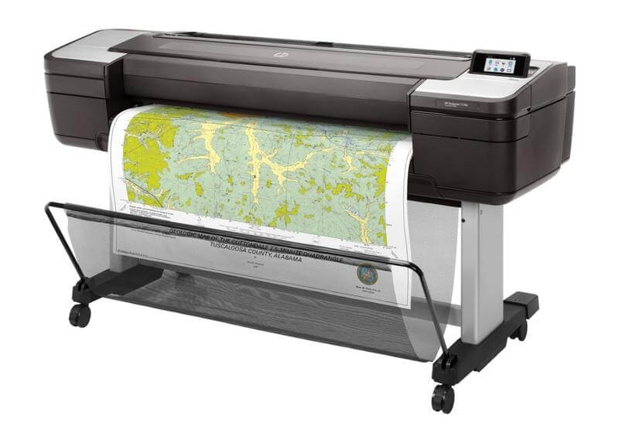
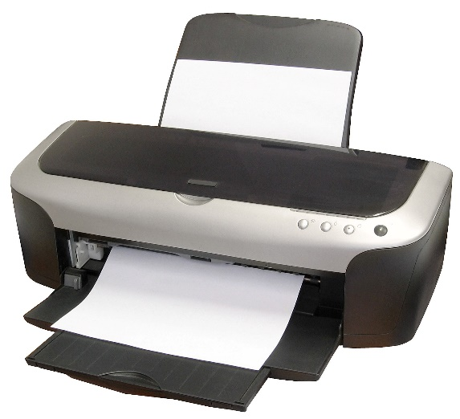
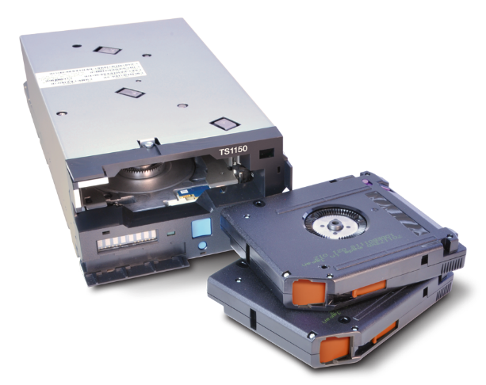
I/O devices (Conti…)
Dedicated Device
These devices are assigned to a single task at a time..
Sharing them among multiple users simultaneously can be inconvenient.
Examples include plotters, printers, and tape drives.

Slide 6
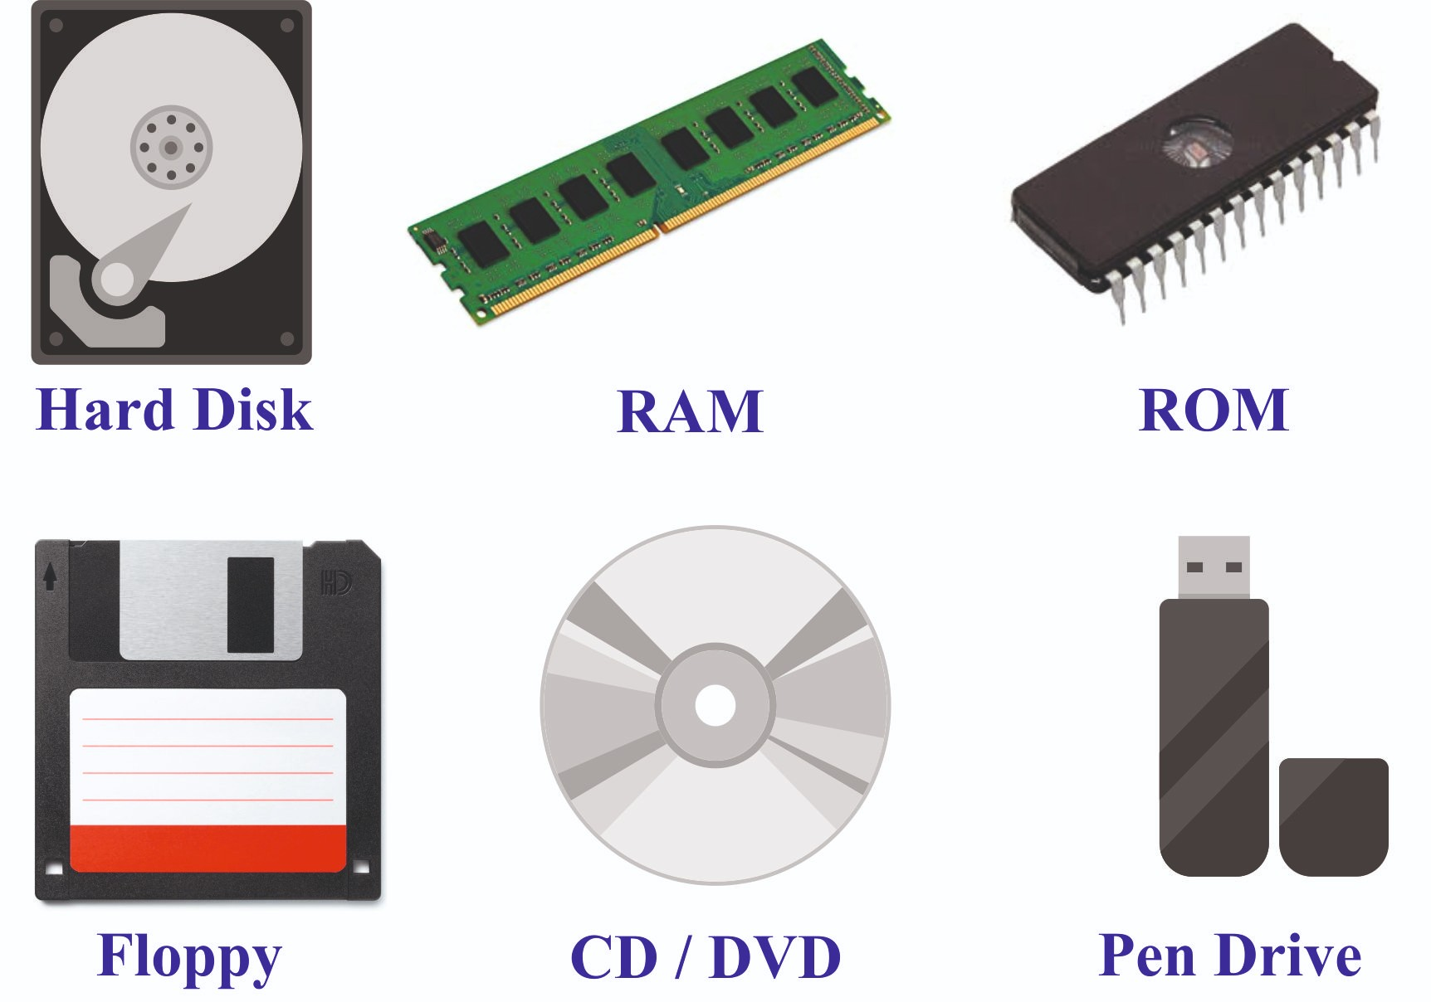
I/O devices (Conti…)
Shared Devices
These devices can be assigned to multiple processes simultaneously.
The Device Manager carefully controls the access of shared device.
For example, disk could be shared by multiple processes simultaneously.

Slide 7
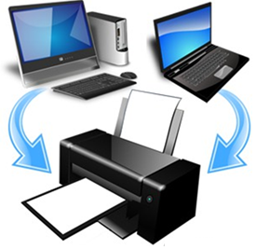
I/O devices (Conti…)
Virtual Devices
These devices function as a combination of dedicated and shared devices.
A dedicated device can be transformed into a shared device using software.
Example: A printer can be made shareable by using a program that redirects all print requests to a disk before processing them

Slide 8
I/O Buffering
Section - 2

Slide 9
Buffering
A buffer is a temporary memory region that stores data while it is being transferred between:
Two devices (e.g., disk and network interface),
A device and an application, or
Between processes.
I/O buffering is a technique used to synchronize data transfer speeds between:
Fast components (CPU, RAM) and
Slow components (hard disks, printers, network devices).
Buffering enhances data transfer efficiency by temporarily storing data in a reserved memory area.
This allows the CPU and I/O devices to work at their speeds without having to wait for each other improving overall system performance.

Slide 10
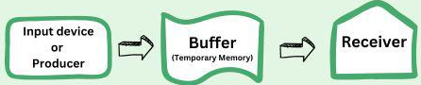
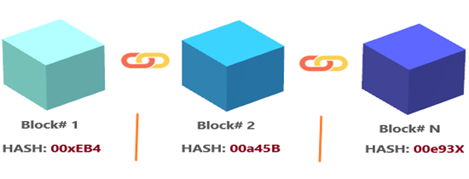

Buffering
A buffer is a temporary storage area in main memory (RAM) that holds data during I/O operations.
Types of I/O buffering:
Block oriented: Transfer data in fixed-size blocks (e.g., 512B, 4KB). and transfers are made one block at a time.
Hard disks, floppy disks and drives are block oriented devices.
Stream oriented: A stream-oriented device Transfer data as a continuous byte stream (no fixed blocks).
Terminals, printers, communications ports, keyboard, mouse and other pointing devices that are stream oriented.

Slide 11
I/O buffering
Operating System
User Process
I/O
Device
IN
Without a buffer, Operating system directly accesses the device when it needs
Operating System
User Process
I/O
Device
Single buffer, Operating system assigns a buffer in the main memory for an I/O request
IN
MOVE
Operating System
User Process
Double buffer, Operating system use two system buffers instead of one, also known as buffer swapping. A process can transfer data to or from one buffer while the operating system empties or fills the other buffer
I/O
Device
IN
MOVE
Operating System
User Process
Circular buffer, Operating system uses two or more buffers. Each individual buffer is one unit in a circular buffer.
I/O
Device
IN
MOVE
..

Slide 12
Internal Structure of Hard Disk Drive
Section – 3

Slide 13
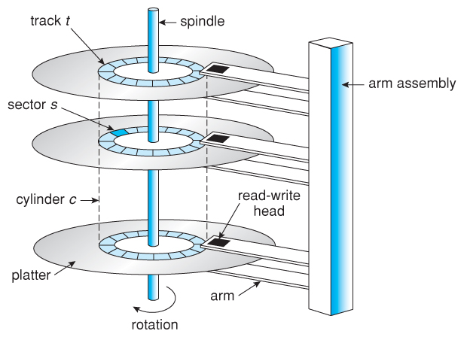
Internal structure of HDD
Platter: A circular, metal or glass disk coated with magnetic material where data is stored.
Read/Write Head: A disk read-and-write head is a small component of a disk drive that hovers above the disk platter.
Track: A concentric circular path on a platter where data is stored.
Sector: A sector is a subdivision of a track on a disk platter and typically holds 512 bytes or 4096 bytes (4 KB) of data in modern drives.
Cylinder: A vertical stack of tracks across all platters at the same radial position
Spindle: The central rotating shaft that holds the platters in place.
Actuator Arm: A mechanical arm that moves the read-write heads across the platters.

Slide 14
Internal structure of HDD (Conti…)
When a hard disk drive (HDD) operates, the disk platter rotates at a constant speed, to perform a read or write operation.
The read/write head must align with:
The desired track.
The beginning of the desired sector.
Track Selection Process:
In a movable-head system, the disk arm physically moves to the target track.
In a fixed-head system, the appropriate head is electronically activated for the track.
Key Timing Metrics:
Seek Time: The time taken by the read/write head to move to the correct track (cylinder) on the disk platter.
Rotational Latency (Rotational Delay): The time taken for the desired sector to rotate under the read/write head after the head is positioned on the correct track.
Access Time: The total time taken to locate and retrieve data, combining:
Seek Time + Rotational Latency

Slide 15
Disk Scheduling Algorithms
Section – 4

Slide 16
Disk Scheduling Algorithm
A disk scheduling algorithm is a method used by the operating system to determine the order in which disk I/O requests are processed.
Since disk drives have a mechanical read/write head that moves across cylinders to access data, an efficient scheduling strategy is needed to minimize seek time and improve overall system performance.
The main goal of disk scheduling algorithms in an operating system (OS) is to minimize the seek time.
The common disk arm scheduling algorithms in OS includes:
FCSC (First Come First Serve)
SSTF (Shorted Seek Time First)
SCAN (Elevator Algorithm)
C-SCAN (Circular SCAN)
LOOK
C-LOOK (Circular LOOK)

Slide 17
Example for Disk Arm Scheduling Algorithm
Consider an imaginary disk with 51 cylinders (numbered 0 to 50).
The initial request is to read a block on cylinder 11. While seeking cylinder 11, additional requests arrive for cylinders 1, 36, 16, 34, 9, and 12, in that order.
The disk head starts from its current position and must process all requests.
Calculate the total distance (in cylinders) that the disk arm moves to serve all pending requests using the following disk scheduling algorithms:
First-Come, First-Served
Shortest Seek Time First
SCAN
C-SCAN
LOOK
C-LOOK

Slide 18
FCSC (First Come First Serve)
Here requests are served in the order of their arrival.
Disk movement will be 11, 1, 36, 16, 34, 9 and 12.
Total cylinder movement: (11-1) + (36-1) + (36-16) + (34-16) + (34-9) + (12-9) = 111
0
1
9
12
16
34
36
50
11
1, 36, 16, 34, 9, 12
1
36
16
34
9
12

Slide 19
SSTF (Shortest Seek Time First)
We can minimize the disk movement by serving the request closest to the current position of the head.
Disk movement will be 11, 12, 9, 16, 1, 34 and 36.
Total cylinder movement: (12-11) + (12-9) + (16-9) + (16-1) + (34-1) + (36-34) = 61
0
1
9
12
16
34
36
50
11
1, 36, 16, 34, 9, 12
12
9
16
1
34
36

Slide 20
LOOK
The LOOK algorithm processes disk requests by continuing in the current direction until there are no more pending requests in that direction.
Once all requests in the current direction are served, the algorithm switches direction to handle any remaining requests.
Initially, the disk arm moves upward to serve requests.
After reaching the highest pending request, it reverses direction to serve requests in the opposite direction.
The algorithm maintains a direction bit, which indicates whether the current movement is UP or DOWN.

Slide 21
LOOK
Here first it moves in up direction then goes in down direction
Disk movement will be 11, 12, 16, 34, 36, 9 and 1.
Total cylinder movement: (12-11) + (16-12) + (34-16) + (36-34) + (36-9) + (9-1) = 60
0
1
9
12
16
34
36
50
11
1, 36, 16, 34, 9, 12
12
16
34
36
9
1

Slide 22
C-LOOK
The C-LOOK (Circular LOOK) algorithm processes disk requests by moving in one direction until all pending requests in that direction are served.
Instead of reversing direction, the disk arm jumps directly to the lowest-numbered pending request and continues moving upward again.

Slide 23
C-LOOK
Here first it moves in up direction then goes in down direction
Disk movement will be 11, 12, 16, 34, 36, 1 and 9.
Total cylinder movement: (12-11) + (16-12) + (34-16) + (36-34) +(36-1)+(9-1) = 68
0
1
9
12
16
34
36
50
11
1, 36, 16, 34, 9, 12
12
16
34
36
1
9

Slide 24
SCAN
The SCAN algorithm, also known as the Elevator Algorithm, processes disk requests by moving in one direction until it reaches the last request in that direction. Once it reaches the end, it reverses direction and serves the remaining requests on the way back.
The disk arm starts by moving upward, serving all pending requests along the way.
Upon reaching the highest request, it reverses direction and moves downward, serving the remaining requests.
This back-and-forth movement continues, similar to an elevator operation.

Slide 25
SCAN
Here first it moves in up direction then goes in down direction
Disk movement will be 11, 12, 16, 34, 36, 50, 9 and 1.
Total cylinder movement: (12-11) + (16-12) + (34-16) +(36-34) +(50-36) + (50-9) + (9-1) = 88
0
1
9
12
16
34
36
50
11
1, 36, 16, 34, 9, 12
12
16
34
36
9
50
1

Slide 26
C-SCAN
The C-SCAN (Circular SCAN) algorithm processes disk requests by moving upward from the current position, serving all requests along the way until it reaches the highest request.
Once the arm reaches the highest request, it jumps directly to the lowest cylinder with pending requests without serving any requests while moving down.
From there, it continues moving upward again, following the same pattern.

Slide 27
C-SCAN
Here first it moves in up direction then goes in down direction
Disk movement will be 11, 12, 16, 34, 36, 50, 0, 1 and 9.
Total cylinder movement: (12-11) + (16-12) + (34-16) +(36-34) +(50-36) + (50-0) + (1-0)+ (9-1) = 98
0
1
9
12
16
34
36
50
11
1, 36, 16, 34, 9, 12
12
16
34
36
0
50
1
9

Slide 28
Exercise
A disk drive has 200 cylinders (numbered 0 to 199).
Request queue: (82, 170, 43, 140, 24, 16, 190)
Current head position: 50
Starting from the current head position, what is the total distance (in cylinders) that the disk arm moves to satisfy all the pending requests, for each of the following disk scheduling Algorithms?
FCFS
SSTF
SCAN
C-SCAN
LOOK
C-LOOK
Answer: 642
Answer: 208
Answer: 332
Answer: 391
Answer: 314
Answer: 341

Slide 29
Basic Concepts of File
Section – 5

Slide 30





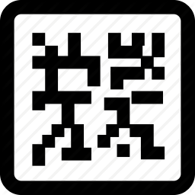
File
A file is a named collection of related data stored permanently on a secondary storage device (e.g., hard disk, SSD, or USB drive).
It serves as a basic unit for storing and organizing various types of information, including:
Text (Documents, Scripts)
Media (Images, Audio, Video)
Structured Data (Database tables, Spreadsheets)
Executable Code (Programs, Machine Code)

Slide 31
File (Conti…)
A file is an independent entity from processes, users, and machines.
The information stored in a file remains as it is even when:
The process that created the file terminates.
The user who owns the file logs off from the system.
The machine is switched off.
A file has a longer lifespan. Once a program is created and stored on a disk, it remains there until it is explicitly deleted. Its lifespan can extend to months or even years.

Slide 32

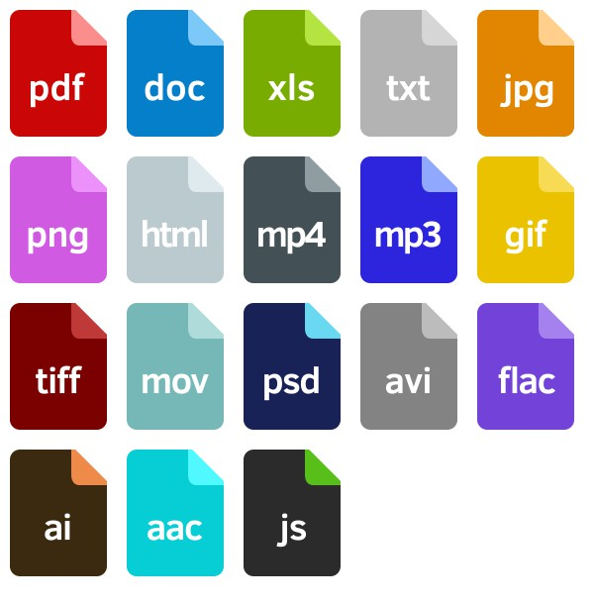
File System / Manager
The file manager is a fundamental component of an operating system that handles all file-related operations.
The operating system is responsible for managing all files on a computer system, including those with different extensions.
Exercise
List the full forms of the given file extensions…!!!

Slide 33

File Naming
A filename is a unique identifier assigned to a computer file when it's created and stored in an operating system.
The filename serves as the primary reference for accessing the file in the future, providing a human-readable way to organize and retrieve files.
Most modern operating systems enforce specific naming rules:
Typically allow 1-255 characters.
Permit letters (A-Z/a-z), digits (0-9), and certain special characters (like underscores or hyphens)
Examples:
Report_2023.pdf
Project1_Backup
Chapter-2.docx
Some file systems support case-sensitive filenames, while others do not.
Example
test1
Test1
TEST1
test1, Test1 and TEST1 are three different files in UNIX(case-sensitive)
test1
Test1
TEST1
test1, Test1 and TEST1 are
same files for windows (is not case-sensitive)

Slide 34
File Types
Section – 6

Slide 35
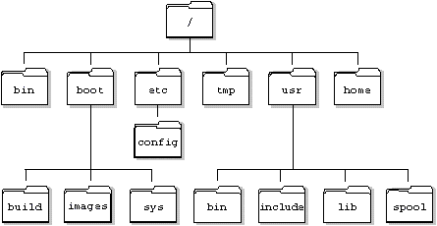
File Types
Regular Files: These files store user data and can be of various types, including text, binary, and executable files.
Directories: These serve as containers for files and subdirectories, helping to organize and manage the file system efficiently.
Character Special Files: These files represent serial I/O devices such as terminals and printers, handling data one character at a time.
Block Special Files: These files represent block I/O devices such as disks, processing data in fixed-size blocks for efficient storage and retrieval.

Slide 36
File Attributes
Section – 7

Slide 37
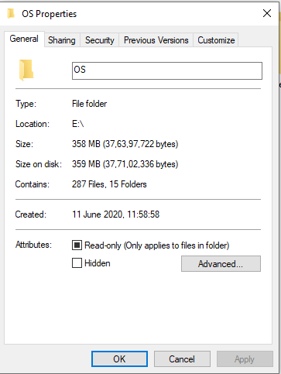
File Attributes
A file consists of not just its name and data content, but also associated metadata known as file attributes. These attributes help the operating system manage and organize files effectively.
The primary file attributes include:
Name: The human-readable identifier for the file.
Type: Indicates the file format (e.g., .txt, .jpg, .exe).
Location: A pointer to the physical storage location on the device.
Size: Current file size in bytes.
Timestamps: This data is used for creation time/date, last
modification time, last access time and also used for system
maintenance.
Security: This controls and assigns the power of reading, writing,
executing.

Slide 38
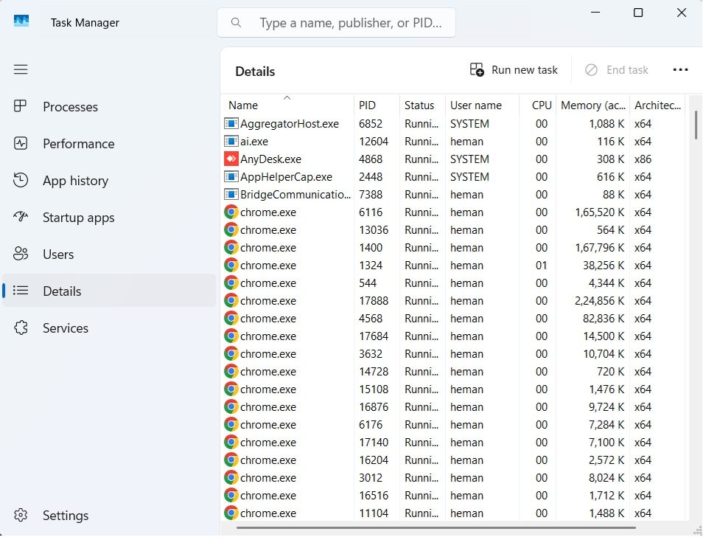
File Attributes (Conti…)
Identifier: Every file within a file system is identified by a unique tag number, known as a file identifier.

Slide 39
File Operations
Section – 8

Slide 40
File Operations
Create: Allocates space for a new file and initializes its metadata.
Delete: Removes the file from the storage and frees its allocated space.
Open: Used to open created file and loads the file’s metadata into memory for access.
Close: Used to close the file and releases the file’s resources and updates metadata if modified.
Read: Read (or Retrieves) data from the file at the current position.
Write: Write (or Stores) data into the file at the current position.
Append: Adds data exclusively to the end of the file.
Seek: Moves the file pointer to a specified position for random access.
Get Attributes: Retrieves metadata (e.g., permissions, size, timestamps) of a file.
Set Attributes: Modifies file metadata (e.g., permissions, ownership, or timestamps).
Rename: Used to change the existing file’s name without altering its content.

Slide 41
File Access Methods
Section – 9

Slide 42
File Access Methods
File access methods in an operating system are the techniques and processes used to read from and write to files stored on a computer’s storage devices.
These methods determine how data is organized, retrieved, and modified within a file system.
There are three ways to access a file in a computer system:
Sequential Access
Direct/ Random Access
Indexed Access

Slide 43
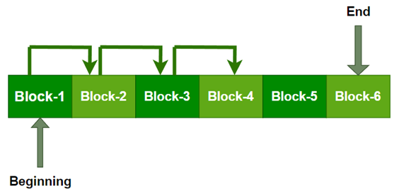
File Access Methods (Conti…)
Sequential Access:
It is the simplest file access method. In this approach, data is processed in a linear order, one record after another, from the beginning to the end of the file.
When we use read command, records are read one after another in sequence.
When we use write command, it will allocate memory and moves the pointer to the end of the file.
To access a specific record, the system must traverse all preceding records.
Example: Magnetic tapes (classic sequential access).

Slide 44
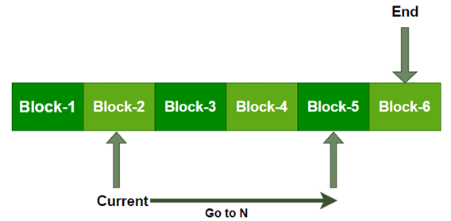
File Access Methods (Conti…)
Direct/Random Access:
Direct access (also called random access) is a file access method where data can be read or modified directly at any position without traversing preceding records.
Unlike sequential access, it allows instant access to any part of the file.
Thus, we may read block 14 then block 59, and then we can write block 17.
There is no restriction on the order of reading and writing for a direct access file.
Example: HDDs, SSDs, and RAM

Slide 45

File Access Methods (Conti…)
Indexed Access:
The indexed access method is a file access technique that combines direct (random) access with an index structure to quickly locate records.
Instead of scanning the entire file (sequential) or calculating offsets (direct), it uses an index table that maps keys to physical storage locations.
When the user makes a request for specific records it will find that index table first where that specific record is stored.
Secondary
Storage
Index Table
1
5
1
4
2
3
5
8
6
7
9
1

Slide 46
Directory Structure
Section – 10

Slide 47
Directory Structure
A directory is a container that holds files and subdirectories.
In GUI-based systems, directories are typically represented as folders.
Directories help in organizing and managing files efficiently by grouping related files and subdirectories.
Types of Directory Structures are as follows:
Single-Level Directory
Two-Level Directory
Tree-Structured Directory
Acyclic Graph Directory

Slide 48
Single-Level Directory
The simplest file system organization uses a flat, single-directory approach where all files reside in one directory with no subfolders.
The figure represents this directory structure, where directories are shown as rectangles and files as circles.
Advantage: Implementation is very easy.
Disadvantage: Name collision occurs because two files can have the same name.

Slide 49
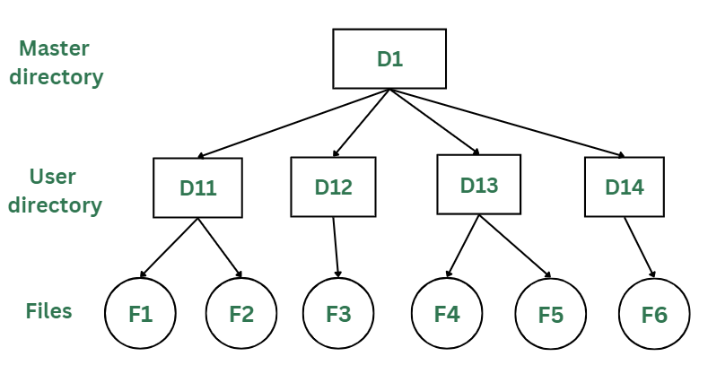
Two-Level Directory
In two-level directory systems, we can create a separate directory for each user.
Two levels of directories are used here:
Master File Directory (MFD) or Root directory
User File Directories (UFD) or User directories
Advantages:
It avoids file name collisions.
It can be used in multi-user systems.
Disadvantages:
It is not suitable for a large number of files in their personal directory.
User cannot share the file with the other users.

Slide 50
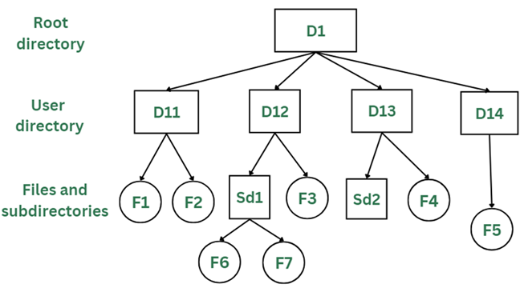
Tree Structured Directories
Tree directory structure of operating system is most commonly used in our personal computers. User can create files and subdirectories too.
In tree directory structure, the root directory is at the peak. This root contains all the directories for each user. The users can create subdirectories and even store files in their directory.
Tree structured directory system overcomes the drawbacks of two-level directory system.

Slide 51
Tree Structured Directories (Conti…)
Advantages:
This directory structure supports subdirectories within directories, enabling logical grouping of files into hierarchical categories.
It avoids file name collisions.
Disadvantages:
This directory structure does not support File or directory sharing between different users or groups.
As the user has the capability to make subdirectories, if the number of subdirectories increase the searching may become complicated.

Slide 52
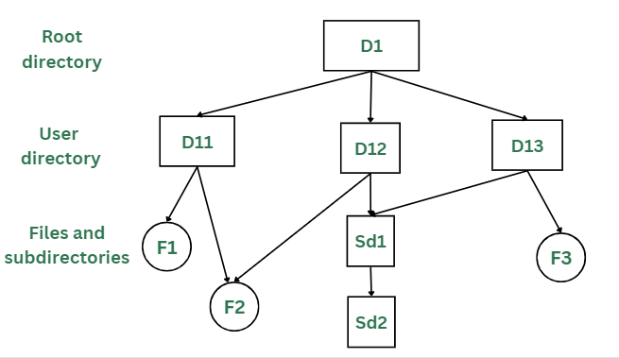
Acyclic Graph Directory
As we have seen the above three directory structures, where none of them have the capability to access one file from multiple directories.
This problem is solved in acyclic graph directory structure, where a file in one directory can be accessed from multiple directories using link, but without cycles (no infinite loops).
In the below figure, this explanation can be nicely observed, where a file is shared between multiple users. If any user makes a change, it would be reflected to both the users.

Slide 53
Acyclic Graph Directory (Conti…)
Advantages:
Sharing of files and directories is allowed between multiple users.
Flexibility is increased as file sharing and editing access is there for multiple users.
Disadvantages:
Deleting a shared file/directory requires removing all references (hard links) across directories.
A file with multiple paths may be copied multiple times during backups.
It is difficult to ensure that there are no cycles in directory structure.

Slide 54
Frequently asked Questions in Exam
What is I/O device? Explain types of devices in OS.
OR
What is I/O device? Explain dedicated, shared and virtual device with suitable example.
What is I/O buffering? Explain types of I/O buffering in brief.
Draw neat and clean diagram of internal structure of Hard Disk Drive.
Define the following terms:
Seek Time
Rotational Latency
Access Time
Explain First Come First Serve (FCFS) disk scheduling algorithm with suitable example.
Explain Shortest Seek Time First (SSTF) disk scheduling algorithm with suitable example.
Explain SCAN and C-SCAN disk scheduling algorithms with suitable examples.
Explain LOOK and C-LOOK disk scheduling algorithms with suitable examples.

Slide 55
Frequently asked Questions in Exam
Define the file. Discuss different types of files in brief.
List operations perform on files and discuss all in brief.
List attributes of file and explain in brief.
Define the directory. Write a short note on Directory Structures in OS.
Describe file access methods with a suitable example.
OR
Describe Sequential, Direct and Indexed file access methods with a suitable example.

Slide 56
Operating System (OS)
DU # 2304CS205
Prof. Umesh H Thoriya
Computer Science & Engineering Department
umesh.thoriya@darshan.ac.in
9714233355

