Slide 1
Details
Participants
15 healthy control (HC)
15 depression patients (DEP)
Task Paradigm
30-s pre-task baseline period > 60-s task period > 70-s post-task baseline period
Pre- and post-task baseline: Repeating ABCDE vowels
Task: Letter verbal fluency task (3 letters, 20-s each)

Slide 2
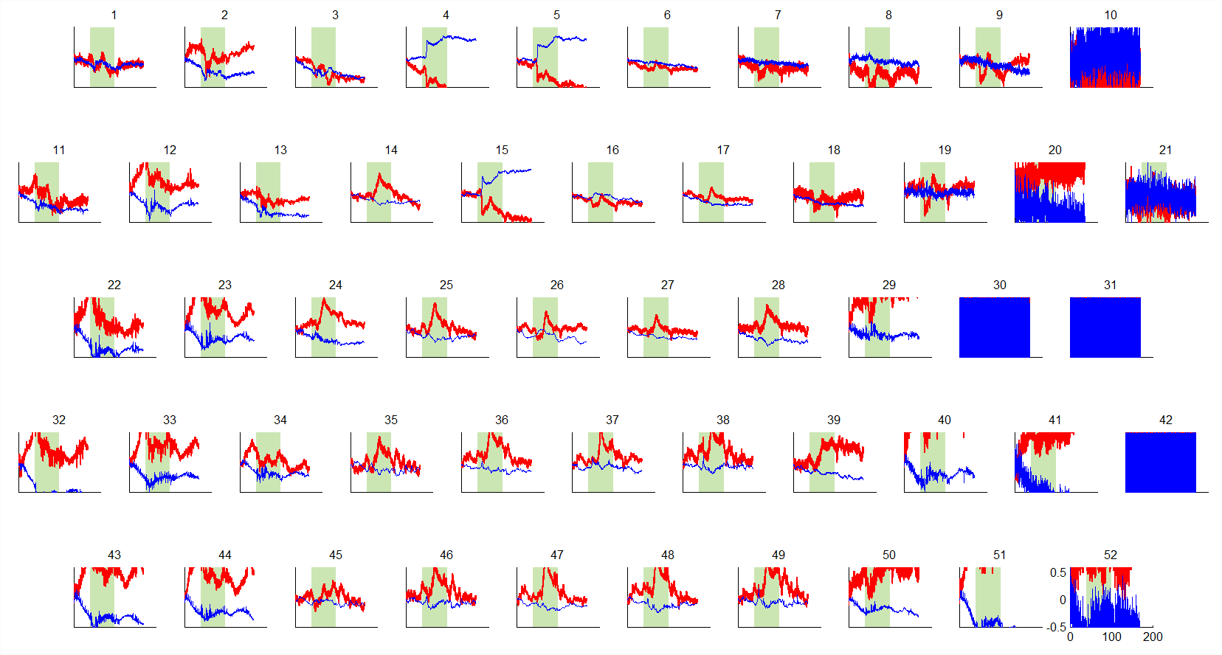
Processing (1)
Excluding noisy channels
where the product of digital and analogue gains is larger than the threshold set.
These channels are excluded for further analysis

Slide 3
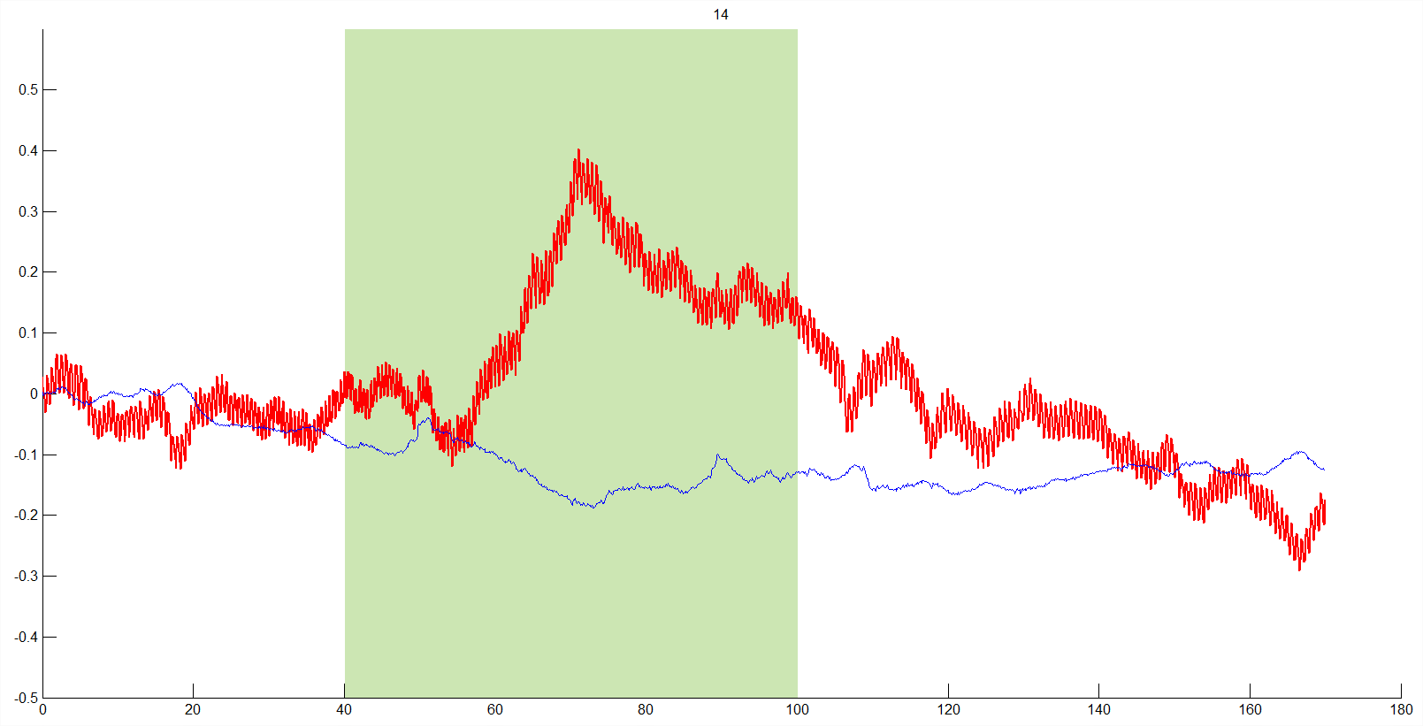
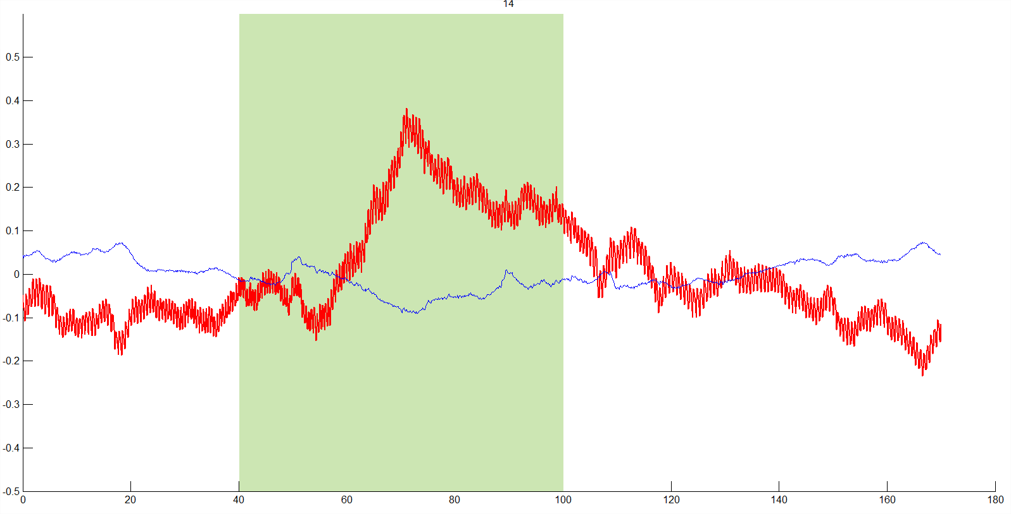
Processing (2)
Baseline correction
Before
After

Slide 4
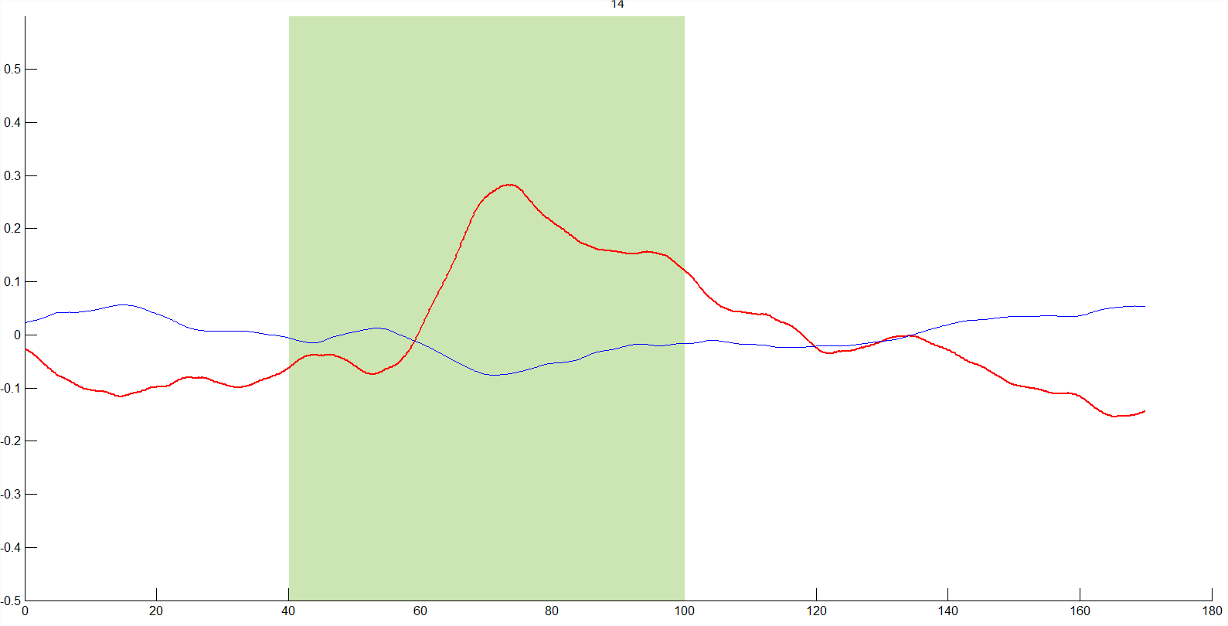
Processing (3)
Moving Average
To smooth the signals.
Windows size of 100 data points (10 s).
Before
After

Slide 5
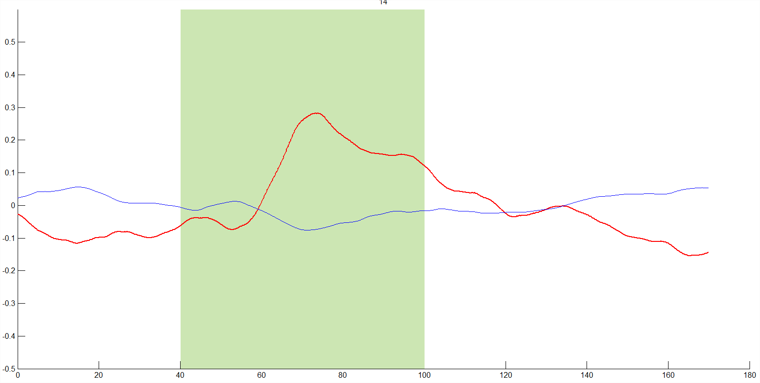
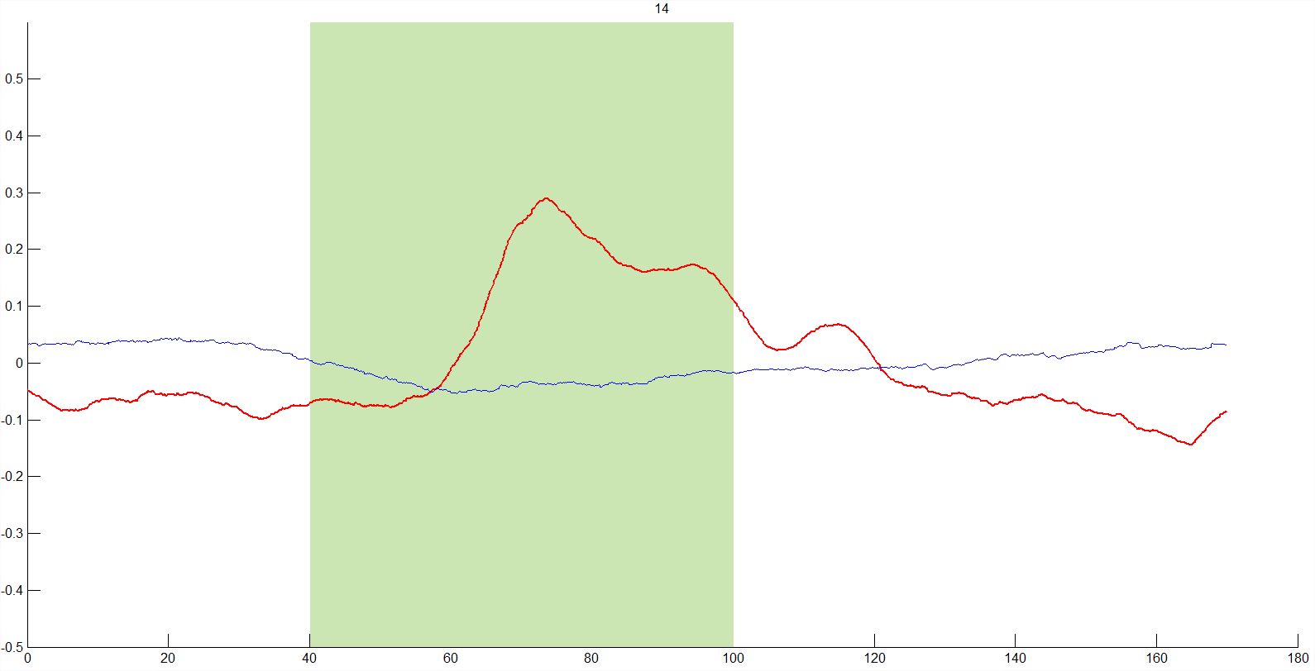
Processing (4)
Principal component analysis (PCA)
PCA simplifies the complexity in high-dimensional data while retaining trends and patterns
To bring out strong patterns in a dataset i.e. to extract principal components.
One component per channel. There are 52 components but we are using only 4 components.
PCA can sometimes have little effect on the results.
Before
After

Slide 6
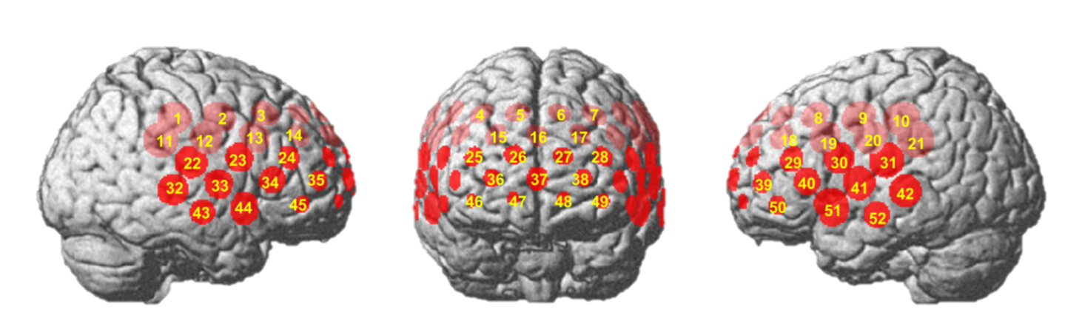
Processing (5)
Divide and average the channels
Into 2 regions of interest: R1 (Frontal) and R2 (Left and Right Temporal) .

Slide 7

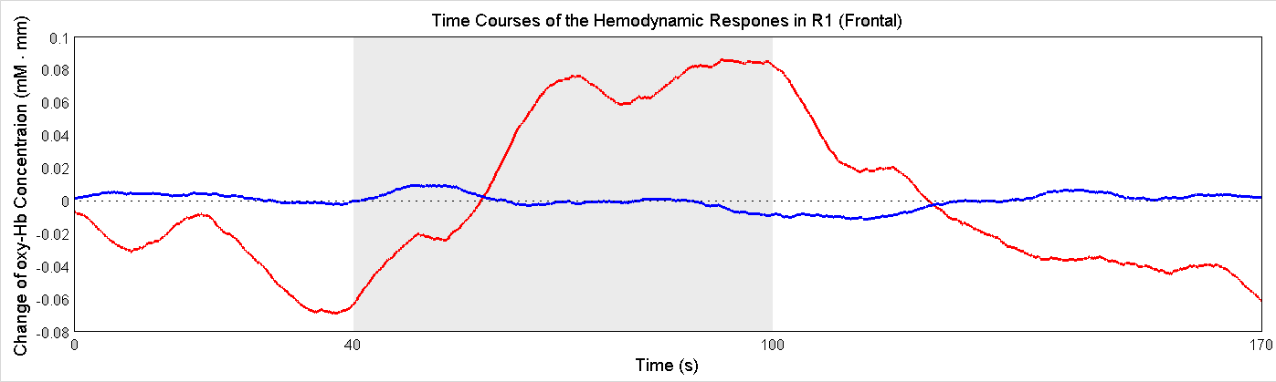
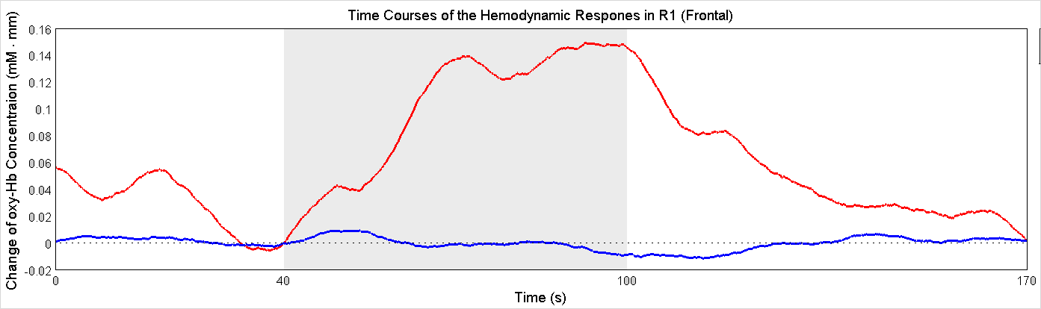
Processing (6)
Set zero level (after group averaging)
Set the signal value at task onset (t = 40 s) to zero by subtracting the signal value at that time point (t = 40 s) from the entire signal.
To create fairer comparisons between regions and groups.
Before
After

Slide 8
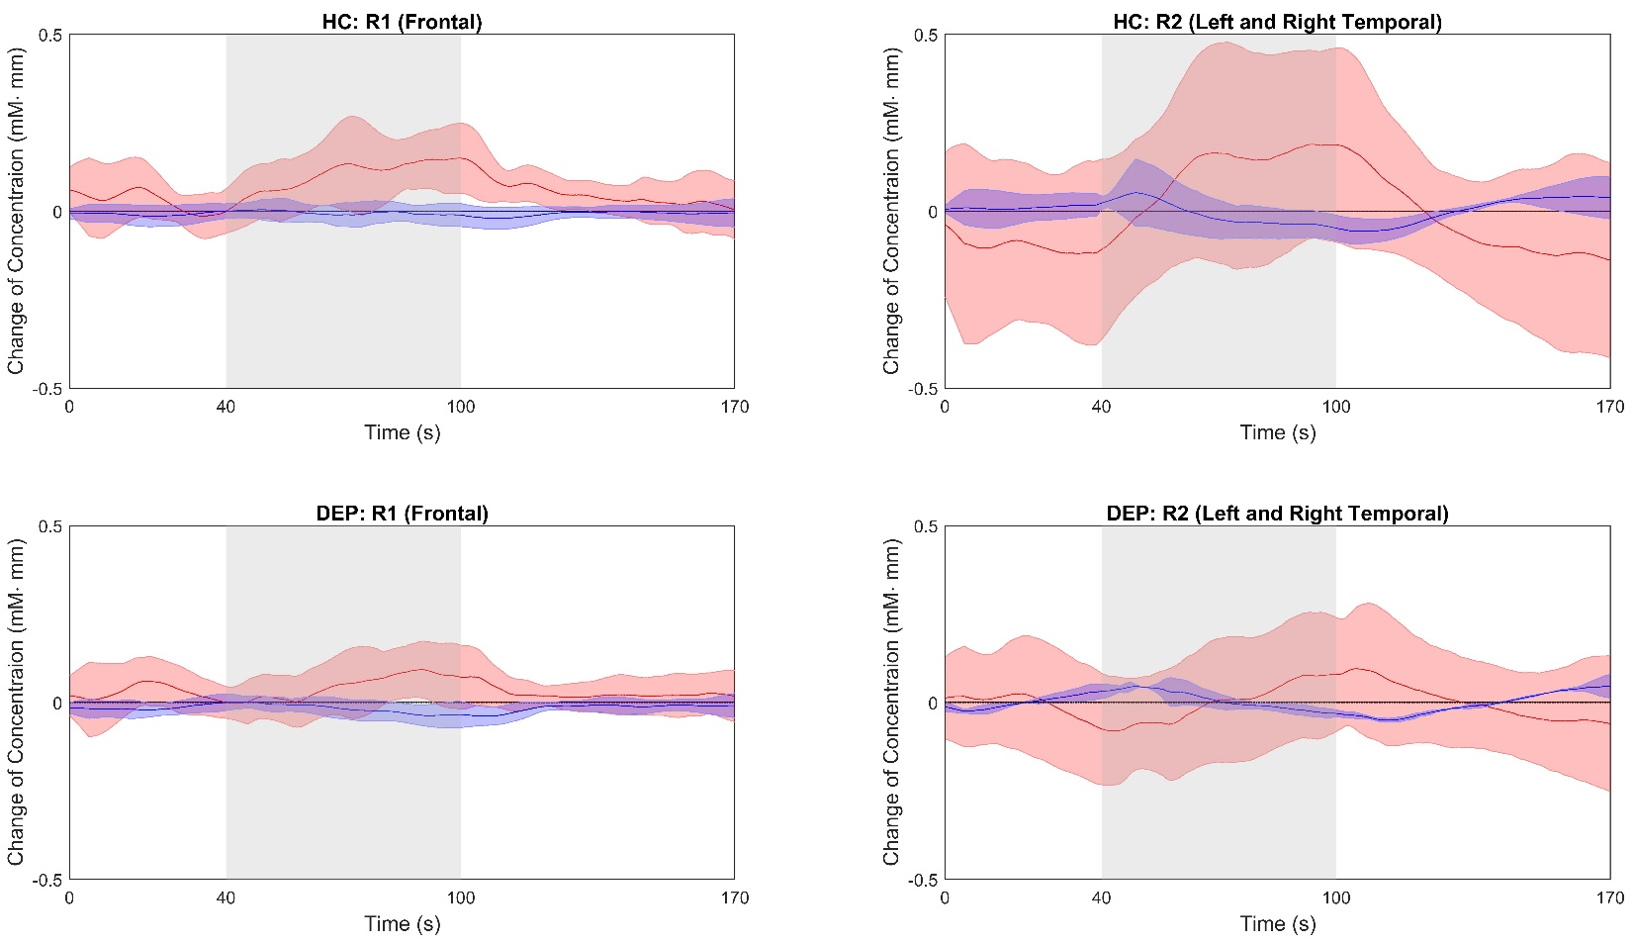
Results
Red = oxy-Hb; Blue = deoxy-Hb.
Some participants’ data are quite noisy.
Therefore, the standard deviation is quite large (refer to shaded regions).

Slide 9
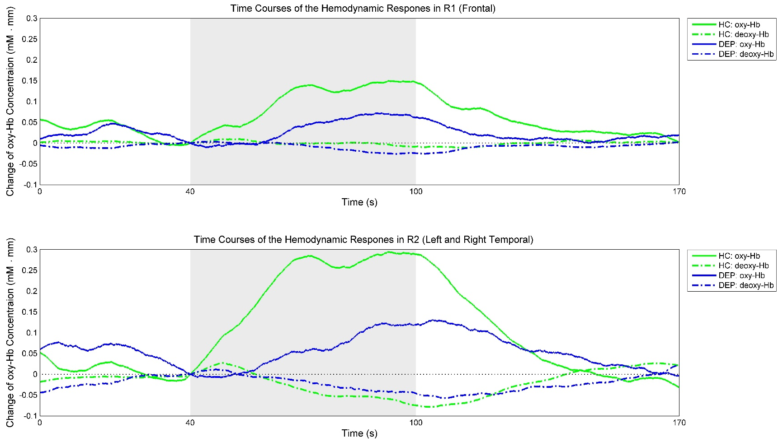
Region-Based Inter-Group Comparison
(Takizawa et al., 2014)
R1: HC > DEP; R2: HC > DEP; In both groups, R2 > R1.
Patterns of activation are similar to a previous research findings. (Takizawa et al., 2014)

Slide 10
References
Takizawa, R., Fukuda, M., Kawasaki, S., Kasai, K., Mimura, M., Pu, S., . . . Group, J. P. f. P. A. o. N.-I. S. (2014). Neuroimaging-aided differential diagnosis of the depressive state. Neuroimage, 85, 498-507.

