Slide 1

Automated Feedback for Unachievable High-Level Robot Behaviors
Vasu Raman
Hadas Kress-Gazit
Cornell University

Slide 2
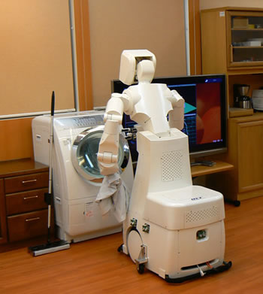
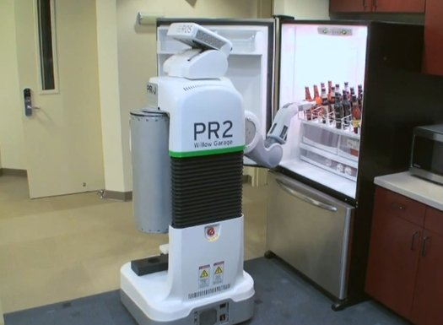
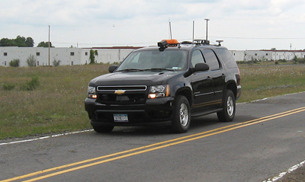
High-Level Tasks
Images: http://www.popsci.com/files/imagecache/article_image_large/articles/beerbot.jpg
http://www.news.cornell.edu/stories/Nov07/DarpaCar.jpg
http://www.technovelgy.com/graphics/content08/toyota-robot-maid-laundry.jpg

Slide 3
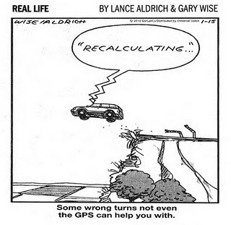
Automated High-Level Robot Control
Usual Approach
Hard-code high-level aspects
Path-planning during execution
Is the intended behavior even achievable?
Do there exist robot controllers that guarantee it?

Slide 4
Formal Methods for Robot Control
  Fainekos, Kress-Gazit and Pappas, ICRA 2005
  Kress-Gazit, Fainekos and Pappas, ICRA 2007
  Kloetzer and Belta, TAC 2008
  Bhatia, Kavraki and Vardi, ICRA 2010
  Wongpiromsarn, Topcu and Murray, HSCC 2010
Notes:
This motivates the verifiable integration of high-level planning with continuous control.
There has been a good amount of recent work applying formal methods to the construction of robot controllers. Approaches based on model checking extract a plan from a counterexample to the negated specification on a model of the robotic system. On the other hand, approaches based on synthesis generate a robot controller directly from the specification. Most approaches use some form of temporal logic, like CTL or LTL. The approach I am going to describe today is the one proposed by Hadas in 2009, and implemented in the LTLMoP toolkit.

Slide 5
Formal Methods for Robot Control
  Fainekos, Kress-Gazit and Pappas, ICRA 2005
  Kress-Gazit, Fainekos and Pappas, ICRA 2007
  Kloetzer and Belta, TAC 2008
  Bhatia, Kavraki and Vardi, ICRA 2010
  Wongpiromsarn, Topcu and Murray, HSCC 2010
Based on LTL Synthesis
yield correct-by-construction controllers IF THEY EXIST
Notes:
This motivates the verifiable integration of high-level planning with continuous control.
There has been a good amount of recent work applying formal methods to the construction of robot controllers. Approaches based on model checking extract a plan from a counterexample to the negated specification on a model of the robotic system. On the other hand, approaches based on synthesis generate a robot controller directly from the specification. Most approaches use some form of temporal logic, like CTL or LTL. The approach I am going to describe today is the one proposed by Hadas in 2009, and implemented in the LTLMoP toolkit.

Slide 6
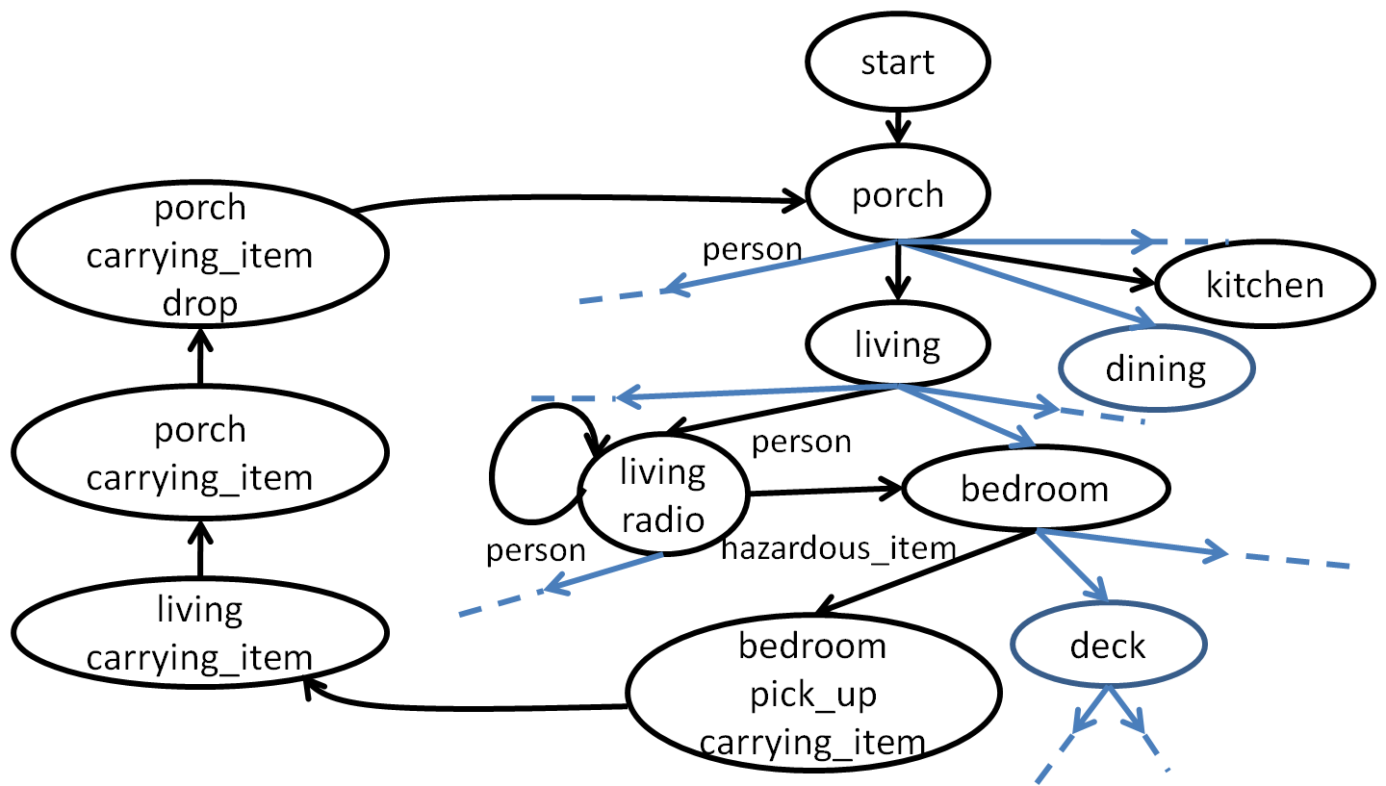
Unsynthesizable specifications
Unsynthesizable specifications
Specification
(FSA)
Synthesizable
Synthesis
Unsynthesizable
?
Hybrid Controller
Notes:
Traditional planning methods cannot provide the desired guarantees.
This motivates verifiable integration of high-level planning with continuous control. LTLMoP is a tooklit for motion planning that implements one such approach, via LTL synthesis. A discrete abstraction of the problem is used to specify the desired behaviour and environment assumptions, and LTL-synthesis is used to construct the corresponding controllers.

Slide 7
Unsynthesizable specifications
Unsynthesizable specifications
Specification
(FSA)
Synthesizable
Synthesis
Unsynthesizable
Specification Analysis
Feedback to the user
Hybrid Controller

Slide 8
Unsynthesizable specifications
Unsynthesizable specifications
Specification
(FSA)
Synthesizable
Synthesis
Unsynthesizable
Specification Analysis
Feedback to the user
Change the specification
Hybrid Controller

Slide 9
Unsynthesizable specifications
Unsynthesizable specifications
Specification
(FSA)
Synthesizable
Synthesis
Unsynthesizable
Specification Analysis
This work
Feedback to the user
Change the specification
Hybrid Controller

Slide 10
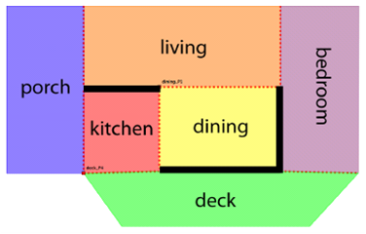
Unsynthesizable Specifications*
Unsatisfiable System:
System requirements cannot be fulfilled in any environment
Start in the deck, go to the porch.
Avoid the kitchen and the living room
Notes:
When the specification is feasible, a controller is generated; however, when there exist admissible environments in which the robot fails to achieve the desired behavior, controller synthesis fails – we call such a specification unsynthesizable.
An unsynthesizable specification is either unsatisfiable, in which case the robot cannot achieve the desired behavior no matter what happens in the environment, or unrealizable, in which case there exists at least one admissible environment that can thwart the robot.
When the specification is unsynthesizable, synthesis-based approaches fail to produce the desired behavior, but do not provide the user with the exact source of failure. This can make troubleshooting a specification an ad hoc and unstructured process.

Slide 11
Unsynthesizable Specifications*
Unsatisfiable System:
System requirements cannot be fulfilled in any environment
Unrealizable System:
System requirements cannot be fulfilled in some admissible environment
Start in the deck, go to the porch.
Avoid the kitchen and the living room
Start in the deck, go to the porch.
If you see fire, avoid the kitchen.
If you see a person, avoid the living room
Notes:
When the specification is feasible, a controller is generated; however, when there exist admissible environments in which the robot fails to achieve the desired behavior, controller synthesis fails – we call such a specification unsynthesizable.
An unsynthesizable specification is either unsatisfiable, in which case the robot cannot achieve the desired behavior no matter what happens in the environment, or unrealizable, in which case there exists at least one admissible environment that can thwart the robot.
When the specification is unsynthesizable, synthesis-based approaches fail to produce the desired behavior, but do not provide the user with the exact source of failure. This can make troubleshooting a specification an ad hoc and unstructured process.

Slide 12
Unsynthesizable Specifications*
Unsatisfiable System:
System requirements cannot be fulfilled in any environment
Unrealizable System:
System requirements cannot be fulfilled in some admissible environment
Start in the deck, go to the porch.
Avoid the kitchen and the living room
Start in the deck, go to the porch.
If you see fire, avoid the kitchen.
If you see a person, avoid the living room
Trivial System:
System requirements are vacuously fulfilled
If false, go to the porch.
Notes:
When the specification is feasible, a controller is generated; however, when there exist admissible environments in which the robot fails to achieve the desired behavior, controller synthesis fails – we call such a specification unsynthesizable.
An unsynthesizable specification is either unsatisfiable, in which case the robot cannot achieve the desired behavior no matter what happens in the environment, or unrealizable, in which case there exists at least one admissible environment that can thwart the robot.
When the specification is unsynthesizable, synthesis-based approaches fail to produce the desired behavior, but do not provide the user with the exact source of failure. This can make troubleshooting a specification an ad hoc and unstructured process.

Slide 13
Unsynthesizable Specifications*
Unsatisfiable System:
System requirements cannot be fulfilled in any environment
Unrealizable System:
System requirements cannot be fulfilled in some admissible environment
Environment
A person is always seen
A person is never seen
Environment assumptions are impossible
Environment
System can prevent the environment from satisfying the assumptions
A person is always seen in the porch
A person is never seen in the porch
Notes:
When the specification is feasible, a controller is generated; however, when there exist admissible environments in which the robot fails to achieve the desired behavior, controller synthesis fails – we call such a specification unsynthesizable.
An unsynthesizable specification is either unsatisfiable, in which case the robot cannot achieve the desired behavior no matter what happens in the environment, or unrealizable, in which case there exists at least one admissible environment that can thwart the robot.
When the specification is unsynthesizable, synthesis-based approaches fail to produce the desired behavior, but do not provide the user with the exact source of failure. This can make troubleshooting a specification an ad hoc and unstructured process.

Slide 14
Cases of (Un)synthesizability
 |  | S Y S
 |  | Unsatisfiable | Unrealizable | Synthesizable
ENV | Unsatisfiable | No automaton | Trivial automaton/ Unexpected behaviour | Trivial automaton/ Unexpected behaviour
 | Unrealizable | No automaton | Unexpected behaviour | Unexpected behaviour
 | Synthesizable | No automaton | No automaton | ‘’Good’’ automaton
Notes:
At a course level of granularity, let us consider what happens with different parts of the specification are faulty.

Slide 15
Cases of (Un)synthesizability
 |  | S Y S
 |  | Unsatisfiable | Unrealizable | Synthesizable
ENV | Unsatisfiable | No automaton | Trivial automaton/ Unexpected behaviour | Trivial automaton/ Unexpected behaviour
 | Unrealizable | No automaton | Unexpected behaviour | Unexpected behaviour
 | Synthesizable | No automaton | No automaton | ‘’Good’’ automaton

Slide 16
Cases of (Un)synthesizability
 |  | S Y S
 |  | Unsatisfiable | Unrealizable | Synthesizable
ENV | Unsatisfiable | No automaton | Trivial automaton/ Unexpected behaviour | Trivial automaton/ Unexpected behaviour
 | Unrealizable | No automaton | Unexpected behaviour | Unexpected behaviour
 | Synthesizable | No automaton | No automaton | ‘’Good’’ automaton

Slide 17
Cases of (Un)synthesizability
 |  | S Y S
 |  | Unsatisfiable | Unrealizable | Synthesizable
ENV | Unsatisfiable | No automaton | Trivial automaton/ Unexpected behaviour | Trivial automaton/ Unexpected behaviour
 | Unrealizable | No automaton | Unexpected behaviour | Unexpected behaviour
 | Synthesizable | No automaton | No automaton | ‘’Good’’ automaton

Slide 18
Cases of (Un)synthesizability
 |  | S Y S
 |  | Unsatisfiable | Unrealizable | Synthesizable
ENV | Unsatisfiable | No automaton | Trivial automaton/ Unexpected behaviour | Trivial automaton/ Unexpected behaviour
 | Unrealizable | No automaton | Unexpected behaviour | Unexpected behaviour
 | Synthesizable | No automaton | No automaton | ‘’Good’’ automaton

Slide 19
Example: Fire-fighting Scenario

Slide 20
Fire-fighting Scenario
Regions:
porch, deck, etc.
Robot-controlled actions:
pick_up, drop, radio, carrying_item
Environment-controlled sensors:
hazardous_item, person

Slide 21
Fire-fighting Scenario
Regions:
porch, deck, etc.
Robot-controlled actions:
pick_up, drop, radio, carrying_item
Environment-controlled sensors:
hazardous_item, person
Robot starts in the porch
Initial Conditions
A hazardous_item will never be seen in the porch
Environment Safety
If you sense a hazardous_item, pick_up unless you are already carrying_item
Avoid the porch if you are not carrying_item
Turn on the radio if and only if you are sensing a person
Stay in place while radioing
System Safety
System Liveness
Patrol all rooms when not carrying_item or radioing

Slide 22
Fire-fighting Scenario
Regions:
porch, deck, etc.
Robot-controlled actions:
pick_up, drop, radio, carrying_item
Environment-controlled sensors:
hazardous_item, person
Robot starts in the porch
Initial Conditions
A hazardous_item will never be seen in the porch
Environment Safety
If you sense a hazardous_item, pick_up unless you are already carrying_item
Avoid the porch if you are not carrying_item
Turn on the radio if and only if you are sensing a person
Stay in place while radioing
System Safety
Patrol all rooms when not carrying_item or radioing
System Liveness

Slide 23
Boolean Satisfiability
deadlock (a state with no next move)
livelock (state changes without satisfying goals)
If you see a person, radio
If you see a hazardous item, do not radio
If you see a person, radio
Turn off the radio infinitely often
Environment Counterstrategy
  First proposed for debugging hardware designs
                [Konighofer, Hofferek and Bloem, 2009]
  Specifies inputs to thwart the system at every time step

Slide 24
Unsynthesizable specifications
Specification
(FSA)
Synthesizable
Synthesis
Unsynthesizable
Boolean Satisfiability
Counterstrategy
Identify deadlock/livelock
Specification Analysis
Feedback to the user
Change the specification
Hybrid Controller

Slide 25
Linear Temporal Logic MissiOn Planning Toolkit
(LTLMoP)

Slide 26
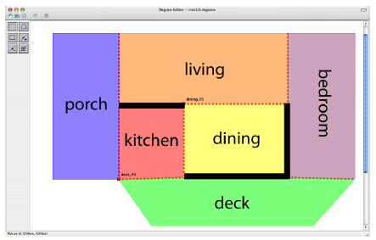
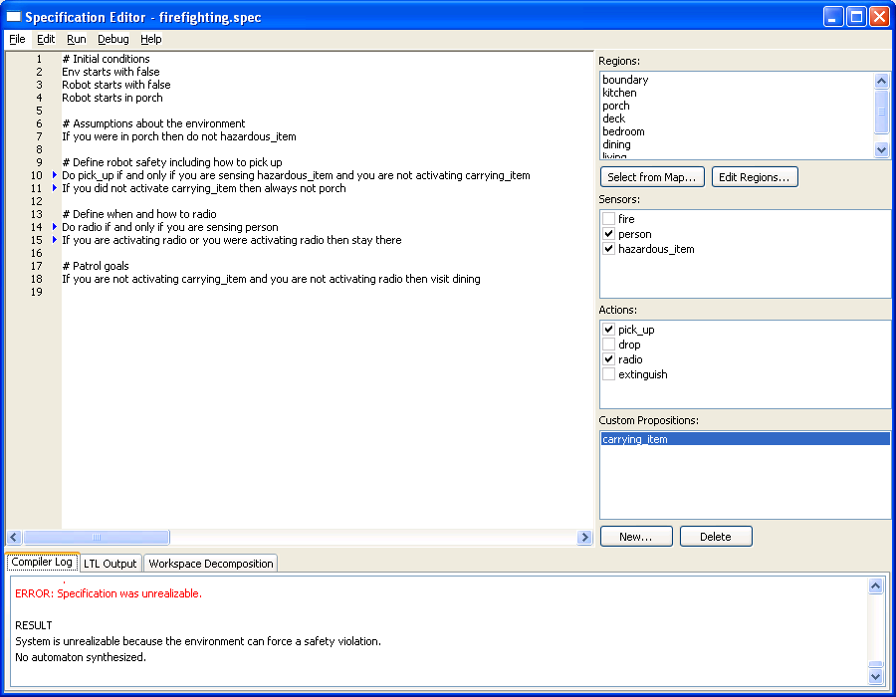
Linear Temporal Logic MissiOn Planning Toolkit
(LTLMoP)
Robot Capability Definitions (Sensors/Actions)
(Specification Editor)
(Region Editor)

Slide 27
Linear Temporal Logic MissiOn Planning Toolkit
(LTLMoP)
Robot Capability Definitions (Sensors/Actions)
(Specification Editor)
(Region Editor)
Structured English-to-LTL Parser

Slide 28
Linear Temporal Logic MissiOn Planning Toolkit
(LTLMoP)
Robot Capability Definitions (Sensors/Actions)
(Specification Editor)
(Region Editor)
Structured English-to-LTL Parser
Synthesis

Slide 29
Linear Temporal Logic MissiOn Planning Toolkit
(LTLMoP)
Robot Capability Definitions (Sensors/Actions)
(Specification Editor)
(Region Editor)
Structured English-to-LTL Parser
(FSA)
Synthesis

Slide 30
Linear Temporal Logic MissiOn Planning Toolkit
(LTLMoP)
Robot Capability Definitions (Sensors/Actions)
(Specification Editor)
(Region Editor)
Structured English-to-LTL Parser
(FSA)
Synthesis
Hybrid Controller

Slide 31
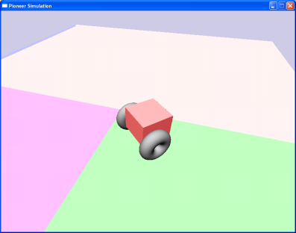
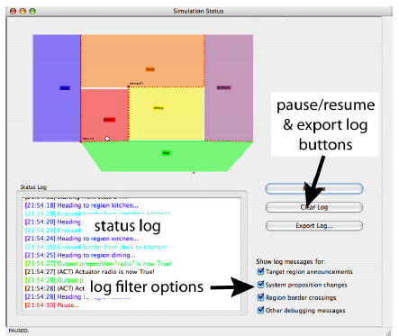
Linear Temporal Logic MissiOn Planning Toolkit
(LTLMoP)
Robot Capability Definitions (Sensors/Actions)
(Specification Editor)
(Region Editor)
Structured English-to-LTL Parser
(FSA)
Synthesis
Hybrid Controller
(Simulation)

Slide 32
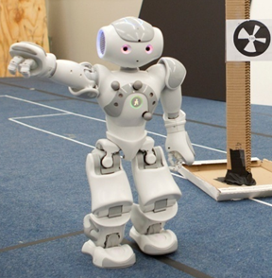
Linear Temporal Logic MissiOn Planning Toolkit
(LTLMoP)
Robot Capability Definitions (Sensors/Actions)
(Specification Editor)
(Region Editor)
Structured English-to-LTL Parser
(FSA)
Synthesis
Hybrid Controller
(Simulation)
(Physical Robot)

Slide 33
Linear Temporal Logic MissiOn Planning Toolkit
(LTLMoP)
Robot Capability Definitions (Sensors/Actions)
(Specification Editor)
(Region Editor)
Structured English-to-LTL Parser
(FSA)
Synthesis
Automated Analysis of Specifications
Hybrid Controller
(Simulation)
(Physical Robot)

Slide 35
#Define robot safety including how to pick_up
Do pick_up if and only if you are sensing hazardous_item and you are not activating carrying_item
If you did not activate carrying_item then always not porch
#Define when and how to radio
Do radio if and only if you are sensing person
If you are activating radio or you were activating radio then stay there
System is unrealizable because the environment can force a safety violation

Slide 36
Interactive Game for System Unrealizability
Allows the user to explore the cause of unrealizability
User (robot) vs. tool (environment)
Example
Start in the deck, go to the porch.
If you see fire, avoid the kitchen.
If you see a person, avoid the living room
fire and person cannot be seen together

Slide 37
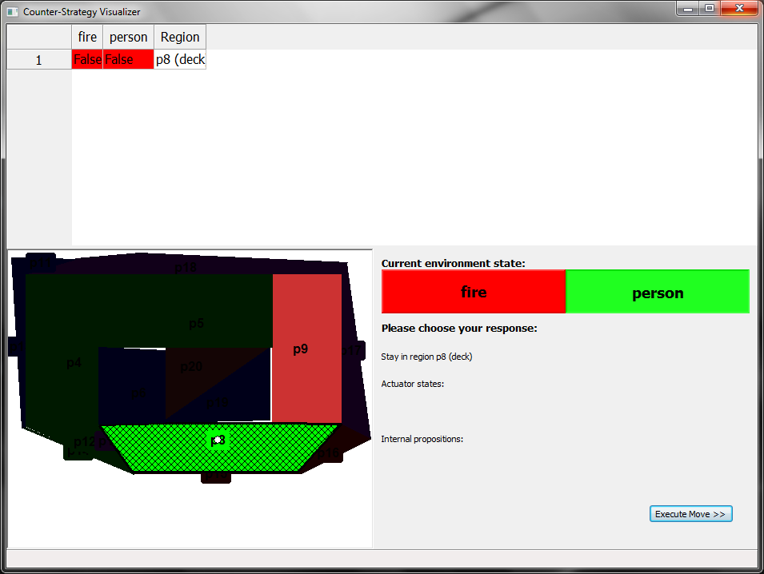
Interactive Game for System Unrealizability
regions impossible in next step
sensor values
living
porch
bedroom
kitchen
dining
deck
robot

Slide 38
Interactive Game for System Unrealizability

Slide 39
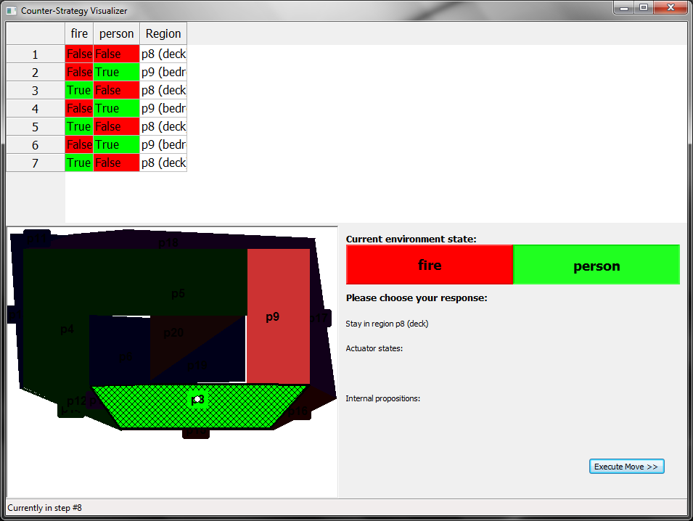
Interactive Game for System Unrealizability
history of moves

Slide 40
Unsynthesizable specifications
Specification
(FSA)
Synthesizable
Synthesis
Unsynthesizable
Boolean Satisfiability
Counterstrategy
Identify deadlock/livelock
Specification Analysis
Highlight spec. sentences
Interactive game
Feedback to the user
Change the specification
Hybrid Controller

Slide 41
Current and Future Work
Identifying domain-specific special cases of unsatisfiability
  e.g. disconnected topology
Further narrowing down the cause of unsynthesizability
  Unsatisfiable/unrealizable cores

Slide 42
Current and Future Work
Specification
Identifying domain-specific special cases of unsatisfiability
  e.g. disconnected topology
Further narrowing down the cause of unsynthesizability
  Unsatisfiable/unrealizable cores
Suggesting changes to the specification
    Add environment assumptions
(FSA)
Synthesizable
Synthesis
Unsynthesizable
Boolean Satisfiability
Counterstrategy
Identify deadlock/livelock
Specification Analysis
Highlight spec. sentences
Interactive game
Feedback to the user
Change the specification
Hybrid Controller

Slide 43

Automated Feedback For Unachievable High-Level Robot Behaviors
Vasu Raman (vraman@cs.cornell.edu)
Hadas Kress-Gazit (hadaskg@cornell.edu)
Cornell University
LTLMoP: http://ltlmop.github.com/ (GPL)

Slide 44


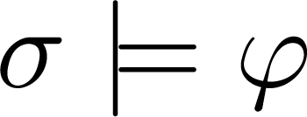







Linear Temporal Logic
Syntax
Let be a set of atomic propositions.
LTL formulae are recursively constructed from :
Semantics
The statement denotes that the infinite sequence of truth assignments satisfies the formula
Time
Realizability of LTL Formulas
is realizable if for every sequence of truth assignments to , there is a sequence of truth assignments to that satisfies .
inputs
outputs

Slide 45

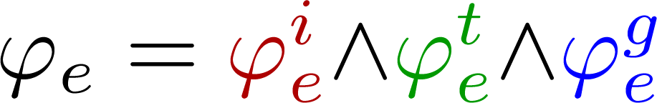
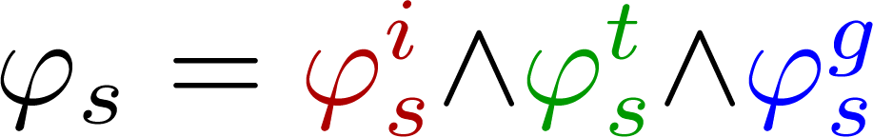
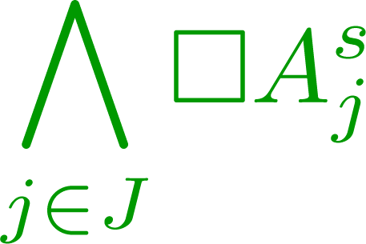


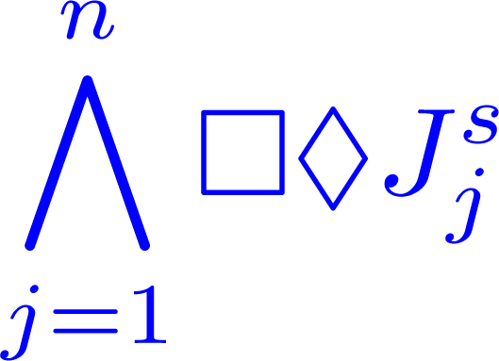
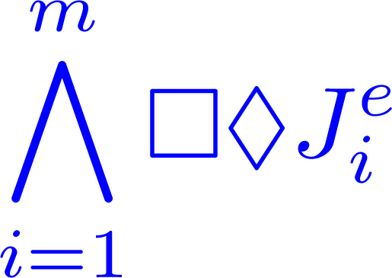

Task Specification in LTL:
where
Boolean combinations of
Boolean combinations of

Slide 46
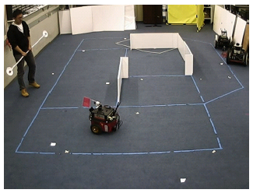
Linear Temporal Logic MissiOn Planning Toolkit
(LTLMoP)
Robot Capability Definitions (Sensors/Actions)
(Specification Editor)
(Region Editor)
Structured English-to-LTL Parser
(FSA)
Synthesis
Hybrid Controller
(Simulation)
(Physical Robot)

Slide 47
Formal Guarantees:
  Verifiable integration of high-level planning with
  continuous control.
Formal Methods: several recent approaches:
  Fainekos, Kress-Gazit and Pappas, ICRA 2005
  Kloetzer and Belta, TAC 2008
  Bhatia, Kavraki and Vardi, ICRA 2010
  Wongpiromsarn, Topcu and Murray, HSCC 2010
  Kress-Gazit, Fainekos and Pappas, ICRA 2007
Synthesis-based:
Discrete abstraction
Logic specifications
  environment assumptions
  desired system behaviour
correct-by-construction controllers IF THEY EXIST
Notes:
This motivates the verifiable integration of high-level planning with continuous control.
There has been a good amount of recent work applying formal methods to the construction of robot controllers. Approaches based on model checking extract a plan from a counterexample to the negated specification on a model of the robotic system. On the other hand, approaches based on synthesis generate a robot controller directly from the specification. Most approaches use some form of temporal logic, like CTL or LTL. The approach I am going to describe today is the one proposed by Hadas in 2009, and implemented in the LTLMoP toolkit.

Slide 48


Cases of (Un)synthesizability
 |  | S Y S
 |  | Unsatisfiable | Unrealizable | Realizable
ENV | Unsatisfiable | No automaton | Trivial automaton/ Unexpected behaviour | Trivial automaton/ Unexpected behaviour
 | Unrealizable | No automaton | Unexpected behaviour | Unexpected behaviour
 | Realizable | No automaton | No automaton | ‘’Good’’ automaton
False => False
False =>
False =>
=> False
=> False
Notes:
At a course level of granularity, let us consider what happens with different parts of the specification are faulty.

