Slide 1
Sensitive Data Exposure
Presented to: Dr Hicham Hage
By: Jad Jawlakh
& Veronica Rammouz

Slide 2
Introduction: The Database
Most important resource for an organization
Critical to businesses and their clients
Hence the importance to protect it

Slide 3
What Is Sensitive Data?
Anything the client might deem sensitive
Data protected under legislative regulations (EU GDPR, PA, etc…)
Health records, personal information, login credentials, etc…

Slide 4
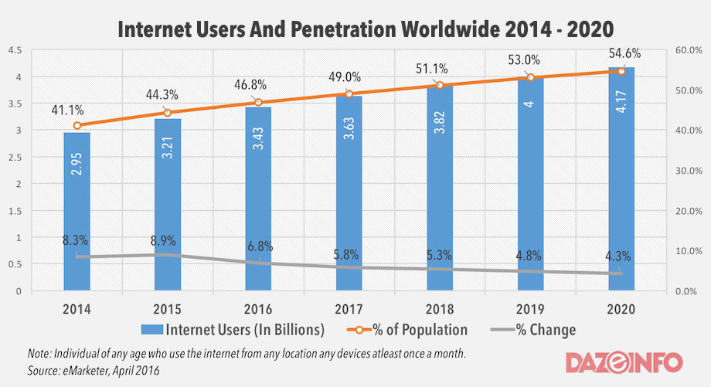
Who’s at Risk and Why?

Slide 5
Vulnerabilities
Definition: flaw(s) in a system
What are the vulnerabilities?
  Is the data being transferred/at rest encrypted?
  Are we using the latest technology for cryptographic algorithms?
  What’s the state of our cryptographic keys?

Slide 6
Possible Attacks
Interception via theft of cookies
Theft of keys through direct attacks
Theft of clear-text data during transit
Brute-force attacks via GPU technology to retrieve passwords
SQL injection
Heartbleed

Slide 7
Implications of Threats
Political controversy
Financial loss
Identity theft/hijacking
Decreased brand trust

Slide 8
Data Security Basic Flow
Prevention
Detection
Response
Recovery

Slide 9
Prevention
Encrypt data during transport and at rest
Minimize data surface area
Apply controls on forms (disable autocomplete, hide passwords, …)
Ensure up-to-date algorithms and proper key management
Disable cookies

Slide 10
Detection
Acknowledge the contemporary attacks
Ensure confidence in security experts
Make sure security tools are in check

Slide 11
Response
Detection of the attack at the right time
Have the reliable and up-to-date tools to respond efficiently and effectively
Ensure security expert’s alertness and productivity

Slide 12
Recovery
Self-defense patch for victimized servers
Deleting and reinstalling affected files and programs
Establish protective policies
Discard unnecessary data storage
Physical protection
Minimize insider threat

Slide 13
Thank You,
Any Questions?

