Slide 1
Demystifying Glove
-a brief walkthrough on word embedding Glove

Slide 2
NLP
Natural language processing deals with computer program that can understand hum language and process it to derive some useful insights from it
Computer program understands only numbers.
Text need to be converted to numerical representation

Slide 3
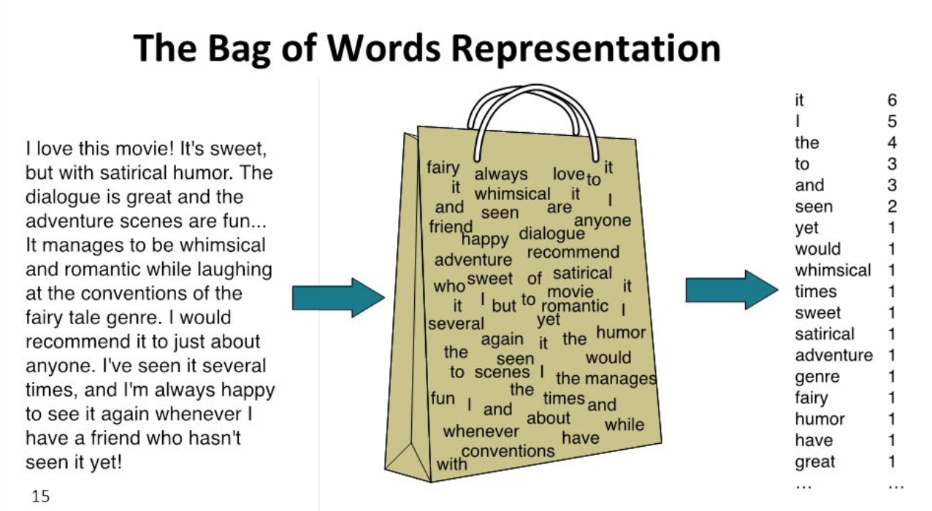
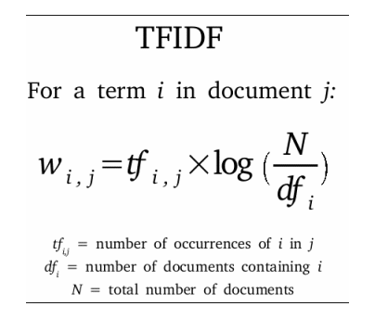
Prior Numerical Representation Of Text
Text -> numerical conversion using bag of words, TF/IDF
Emphasis on numerical conversation
Context of word was missing

Slide 4
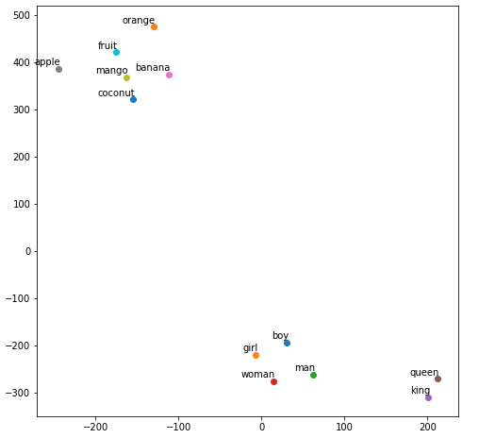
Why we needed word embedding???
Put words to a nice vector space, where similar words cluster together and different words repel.
Each word is mapped to one vector and the vector values are learned in a way that resembles a neural network.

Slide 5
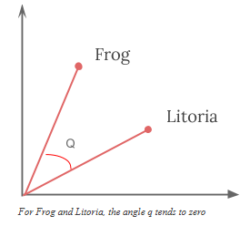
Word embedding : Word2Vec
Developed by Tomas Mikolov in 2013 at Google.
Predictive Model
Uses small neural networks to calculate word embeddings based on words’ context
Cosine similarity

Slide 6
Word2vec is not a single algorithm but a combination of two techniques –
CBOW(Continuous bag of words) : In this approach, the network tries to predict which word is most likely given its context. Words that are equally likely to appear can be interpreted as having a shared dimension.
Skip-gram model : In this approach, it uses the target word to predict its context.
Eg : I love NLP

Slide 7
For Word2Vec, a frequent co-occurrence of words creates more training examples, but it carries no additional information.
For example, take the sentence,
The cat sat on the mat
If you use Word2vec, it wouldn’t capture information like,
is “the” a special context of the words “cat” and “mat” ?
or
is “the” just a stopword?
This can be suboptimal, especially in the eye of theoreticians.

Slide 8
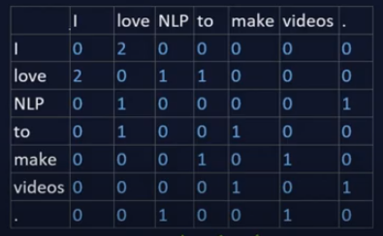
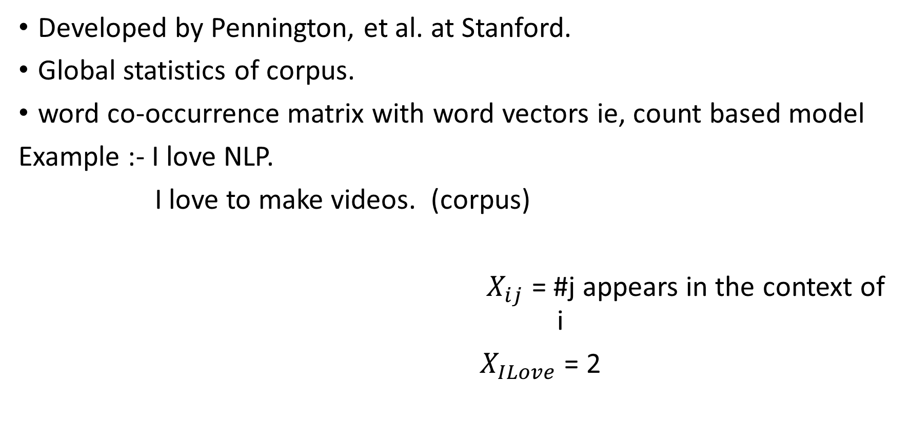
Word Embedding : Glove
Developed by Pennington, et al. at Stanford.
Global statistics of corpus.
word co-occurrence matrix with word vectors ie, count based model
Example :- I love NLP.
I love to make videos. (corpus)
$X_{ij}$ = #j appears in the context of i
$X_{ILove}$ = 2

Slide 9
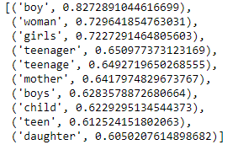


Slide 10
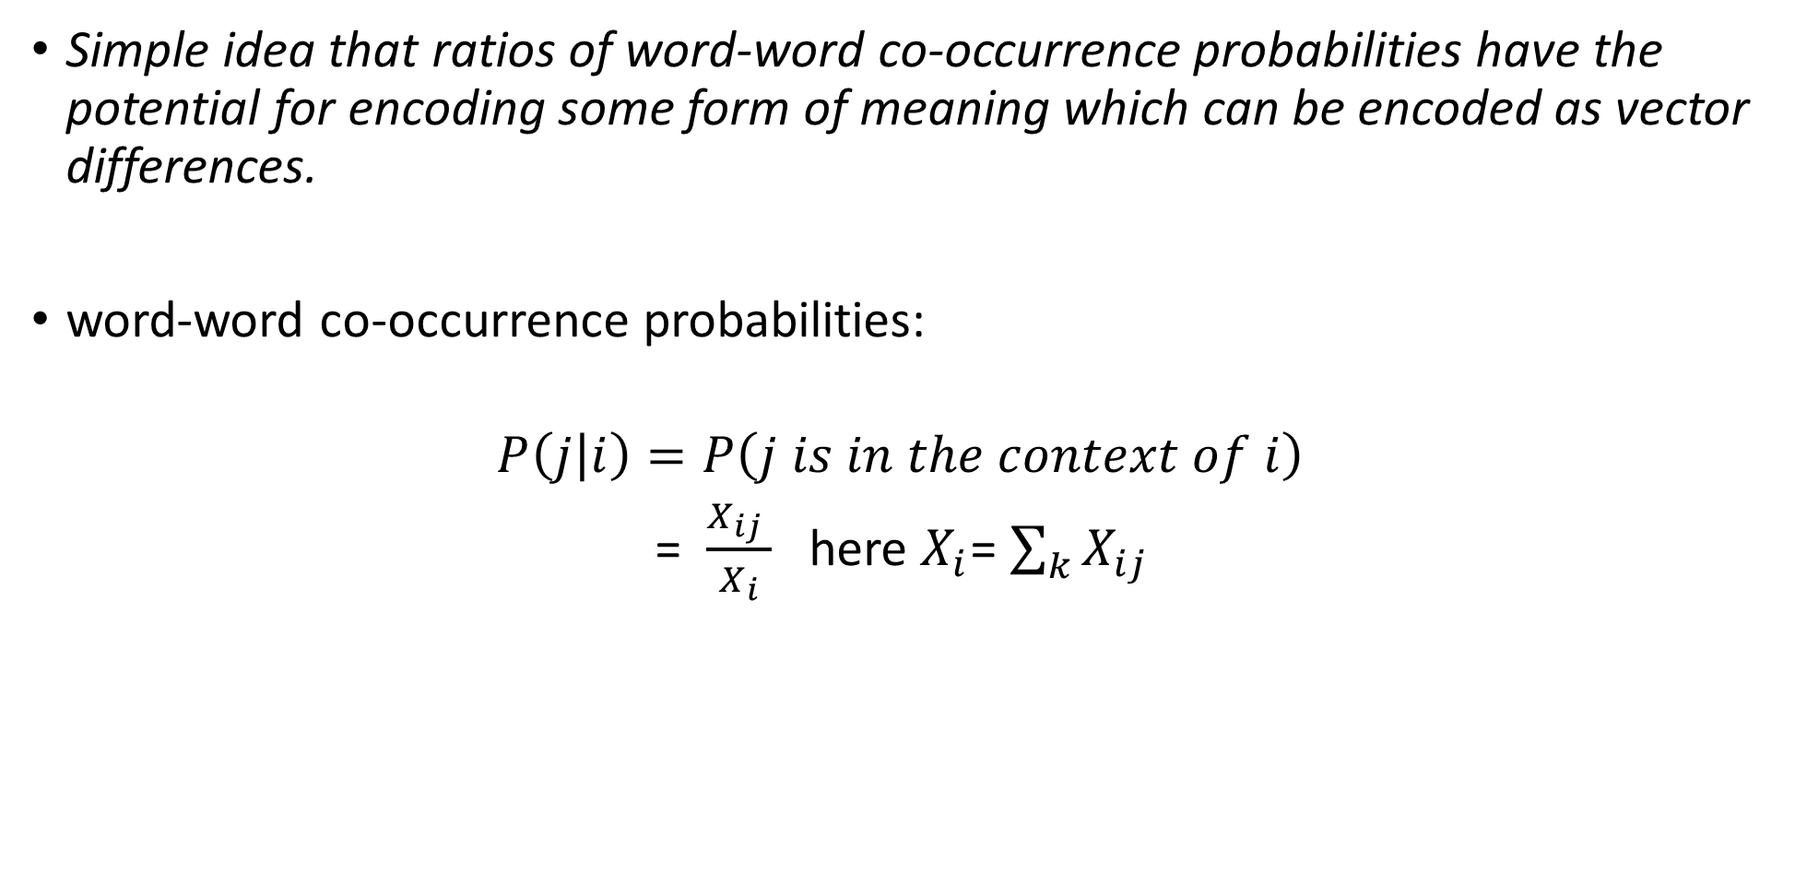
Logic of Glove
Simple idea that ratios of word-word co-occurrence probabilities have the potential for encoding some form of meaning which can be encoded as vector differences.
word-word co-occurrence probabilities:
$$P\left(j | i\right)=P\left(j is in the context of i\right)$$
= $\frac{X_{ij} }{X_{\begin{aligned}i \\ \end{aligned}}}$ here $X_{i}$= $\sum_{k}{X_{ij} }$

Slide 11
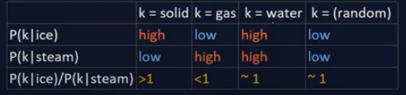
Ratios of word-word co-occurrence probabilities:
P(solid | ice) / P(solid | steam) = large.
P(gas | ice) / P(gas | steam) = small.
For a word related to both ice and steam, such as water we expect the ratio to be close to one.

Slide 12
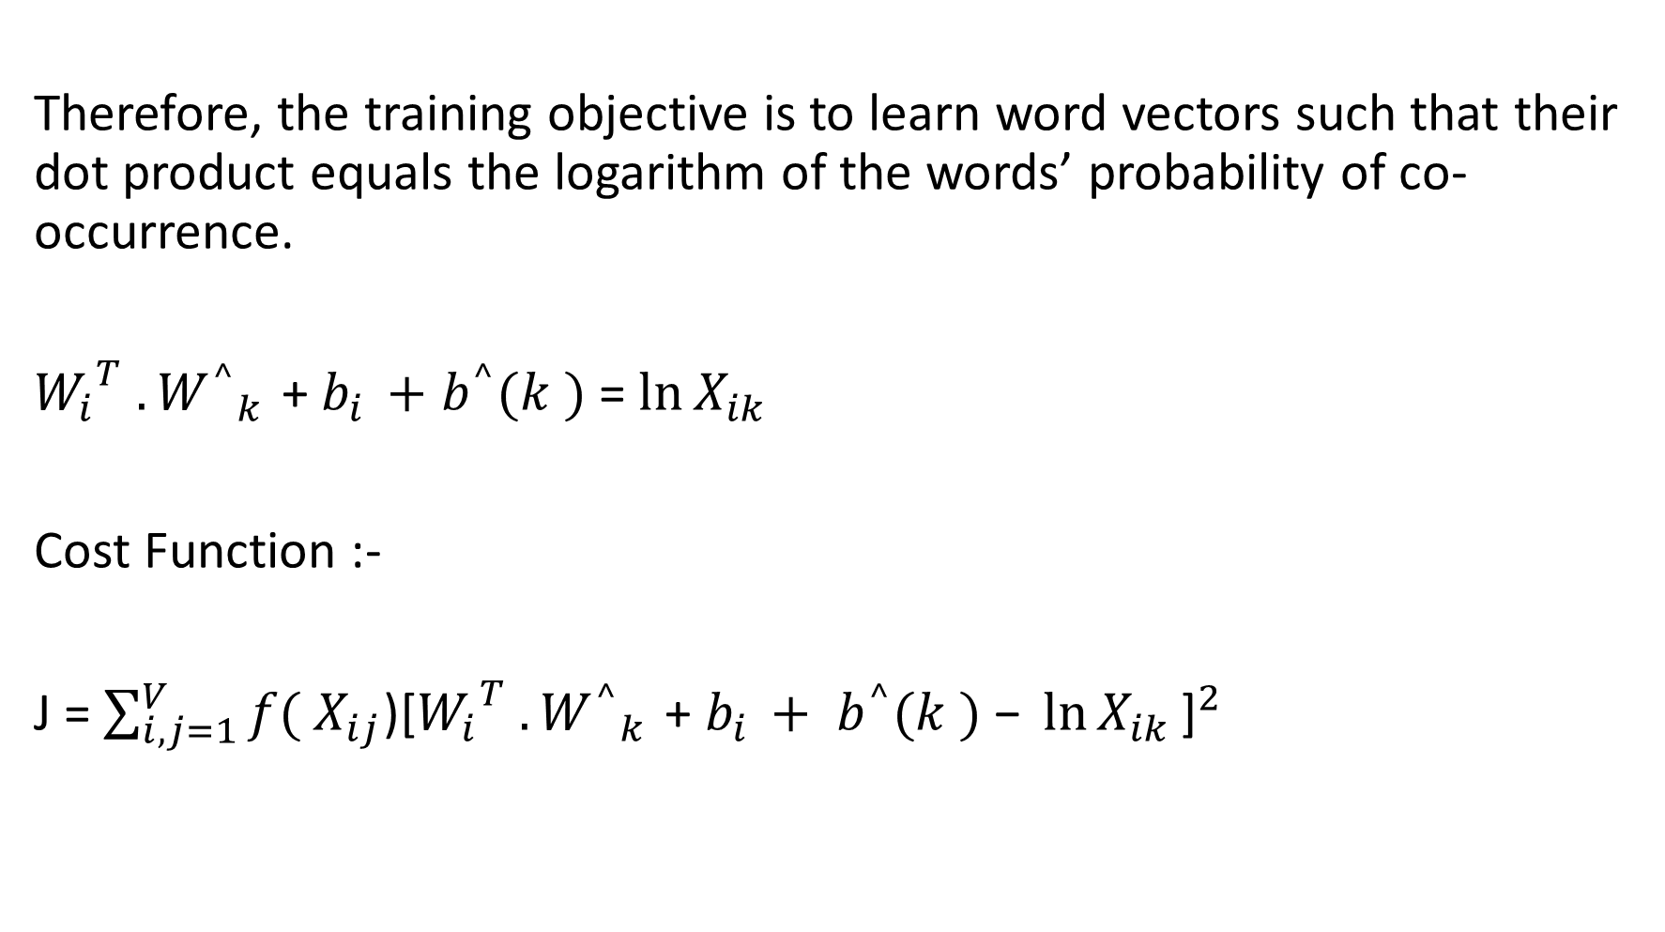
Therefore, the training objective is to learn word vectors such that their dot product equals the logarithm of the words’ probability of co-occurrence.
${W_{i}}^{T} .{W^{^}}_{k }$+ $b_{i }+$ $b^{^}(k )$ = $\ln{X_{ik}}$
Cost Function :-
J = $\sum_{i,j=1}^{V}{f(}$ $X_{ij}$)${\text{[}{W_{i}}^{T} .{W^{^}}_{k }\text{+ }b_{i }+ b^{^}(k )\text{ − }\ln{X_{ik}}\text{]}}^{2}$

Slide 13
Main Take-Aways
The two models differ in the way they are trained, and hence lead to word vectors with subtly different properties.
Glove model is based on leveraging global word to word co-occurance counts leveraging the entire corpus.
Word2vec on the other hand leverages co-occurance within local context (neighbouring words).

Slide 14
Code Walkthrough
Let us explore

Slide 15
References
https://machinelearningmastery.com/what-are-word-embeddings/
https://www.kaggle.com/jeffd23/visualizing-word-vectors-with-t-sne
https://www.kdnuggets.com/2018/08/word-vectors-nlp-glove.html
https://nlp.stanford.edu/pubs/glove.pdf
https://github.com/Suji04/NormalizedNerd/tree/master/Introduction%20to%20NLP
https://www.mygreatlearning.com/blog/word-embedding/

