Slide 1
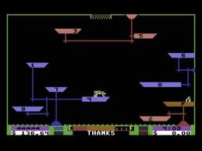
Drone Taxi
AR.Drone game inspired by an old Commodore 64 game Space Taxi

Slide 2
Drone Taxi
Fly as many passengers to their destinations as possible in given time
Other game modes available (Drone racing and free flight)
2D barcode tags to see which pad the drone is hovering on

Slide 3
Drone Taxi
Written using Qt
Runs (at least) on
  Desktop Linux
  Maemo 5
  Meego (ported here at Meegathon)

Slide 4
Drone Taxi
Flight control and video decoding based on Kate Alhola's MArdrone
Other libraries used
  ARDrone SDK libs
  ARToolKitPlus for tag detection
  Espeak for speech synthesis
  SDL for joystick input (Can be played with PS3 gamepad)

