Slide 1
Officer Candidate Training Management System
SYSTEM OVERVIEW · OCTOBER 2026
Academic monitoring, examinations and candidate performance — on the institution's own network.
Notes:
Introduce the system: one place for candidate records, grades, tablet examinations and qualification, running on the internal network.

Slide 2



One trusted record of every candidate
PURPOSE
One source of truth
Problems seen early
Examinations on tablets
Candidates, classes, subjects, grades and examinations kept together instead of in separate files.
Each candidate's standing is calculated as scores arrive, so those at risk are flagged before the period ends.
Quizzes and examinations taken on issued tablets, saved as candidates answer and scored by the server.
Notes:
The system replaces scattered records with one authoritative source, calculates standing as soon as scores are recorded, and moves quizzes and examinations onto tablets.

Slide 3




Four roles, each with only what it needs
WHO USES IT
Admin
Academic Administrator
Accounts, roles, periods, classes, subjects, grading rules and expenses.
Academic records, monitoring, qualification and reports.
Instructor
Candidate
Grades, question bank, examinations and records for the classes they teach.
Takes examinations on a tablet and sees only their own results.
Notes:
Access is permission-based and checked on the server. Instructors see only their assigned classes; candidates see only their own records and never a class rank.

Slide 4
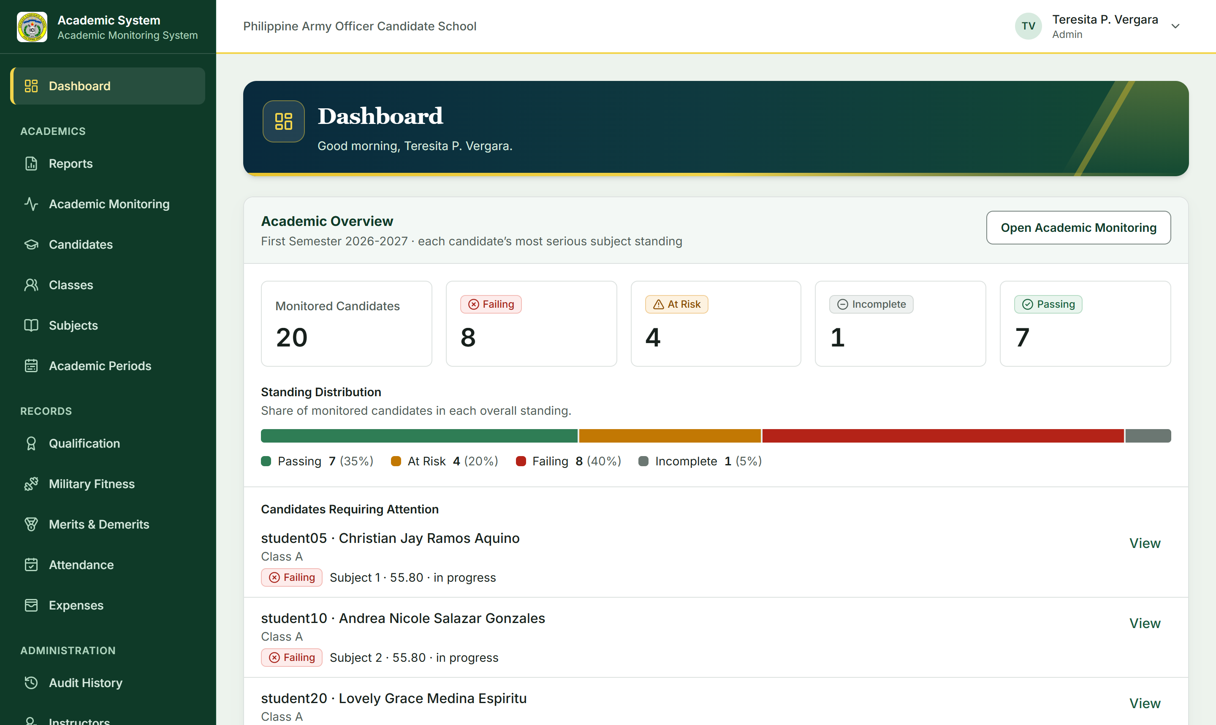
The whole class at a glance
ADMINISTRATORS
Standing of every candidate: Passing, At Risk, Failing or Incomplete.
Candidates requiring attention listed first.
Every figure comes from recorded data — no placeholder statistics.
Notes:
The administrator dashboard: counts by standing, the distribution bar, and the candidates who need attention first.

Slide 5
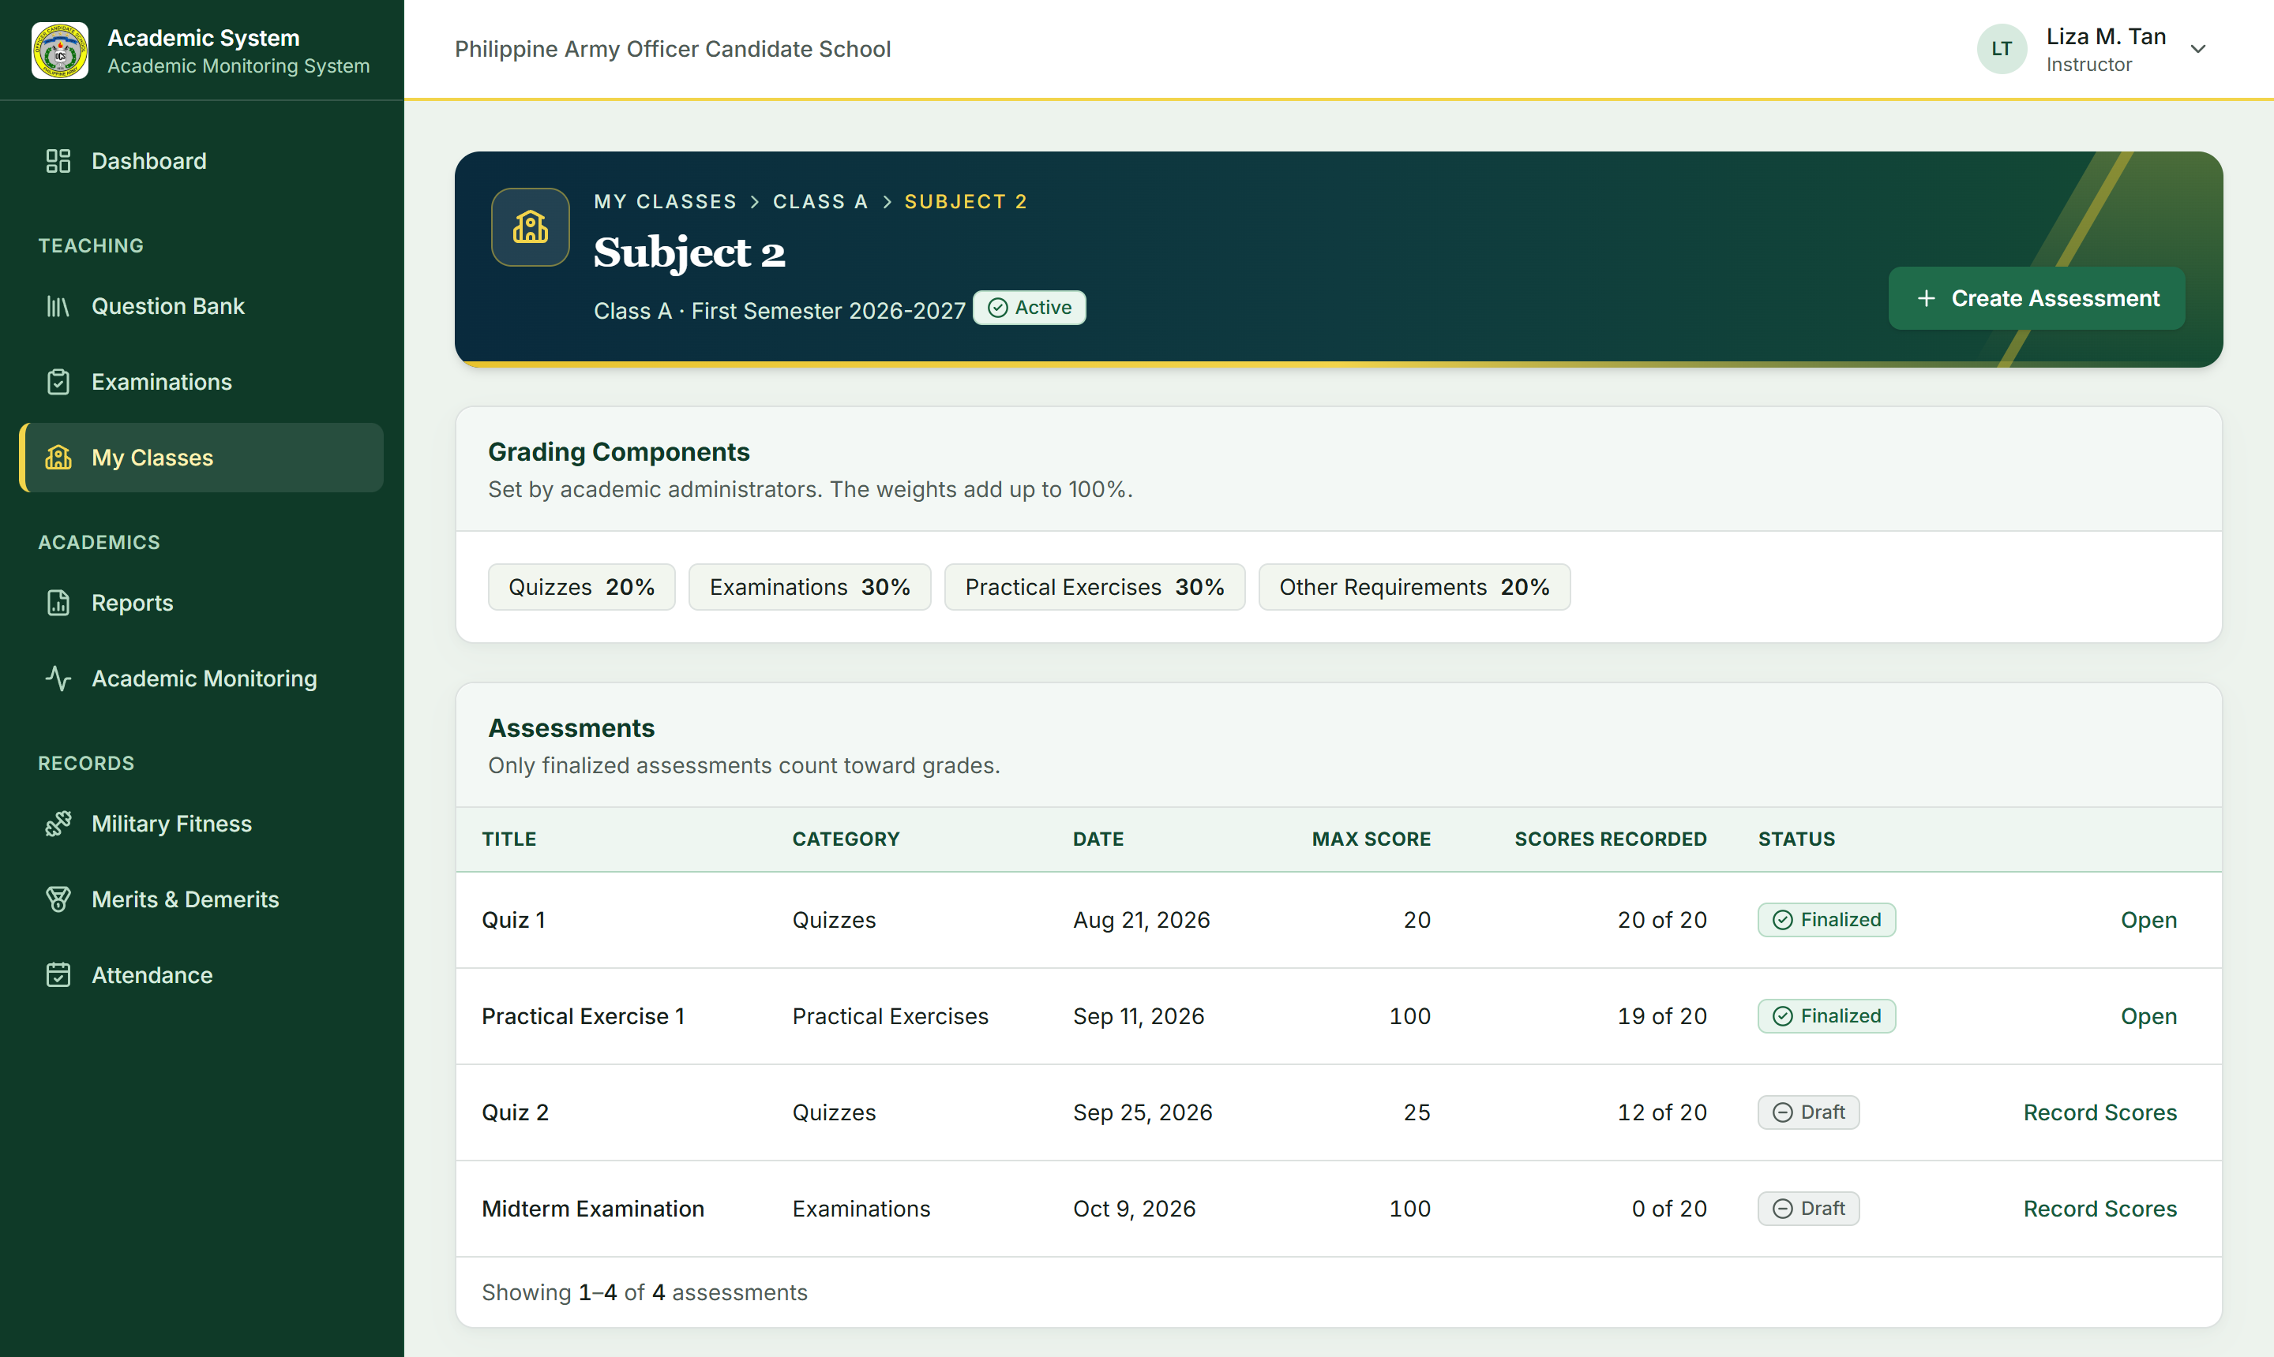
Grades calculated by one engine
INSTRUCTORS
Weights and thresholds are set by the institution, not hard-coded.
PASSING
AT RISK
FAILING
INCOMPLETE
Changed grades keep their history: who, when, the old and new value, and why.
Notes:
Instructors record scores directly. A single grade-calculation service applies the weights and thresholds; standing is always shown in words as well as colour.

Slide 6





From question bank to gradebook
EXAMINATIONS
01
02
03
04
05
Question bank
Build
Publish
Monitor
Score & post
Reusable multiple-choice, true/false and essay items, with images or media.
Choose the class, questions, time limit, attempts and rules.
Only to classes the instructor is assigned to.
Live status: active, submitted, not started, left the screen.
Objective items scored by the server; essays graded; results posted to the gradebook.
Timers, attempt limits and submission rules are enforced by the server, never by the tablet alone.
Notes:
Walk the examination lifecycle. Emphasise that the server is authoritative for time limits and scoring, and that answers are never broadcast during monitoring.

Slide 7
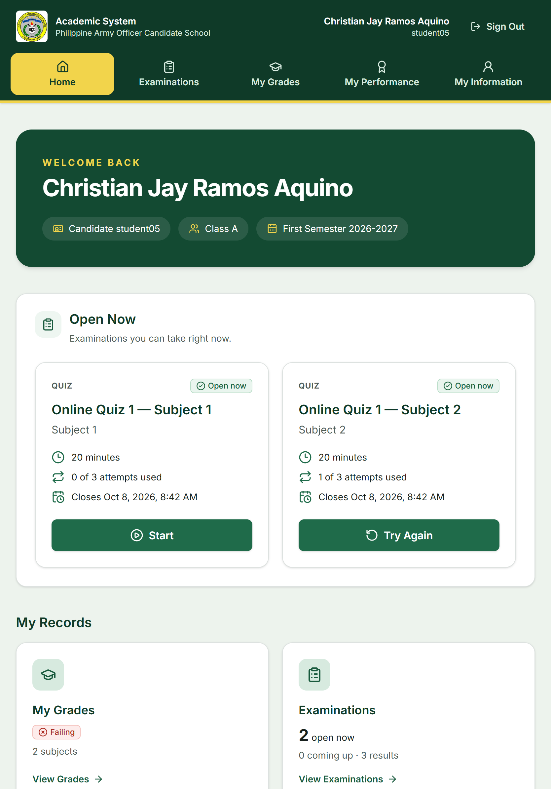
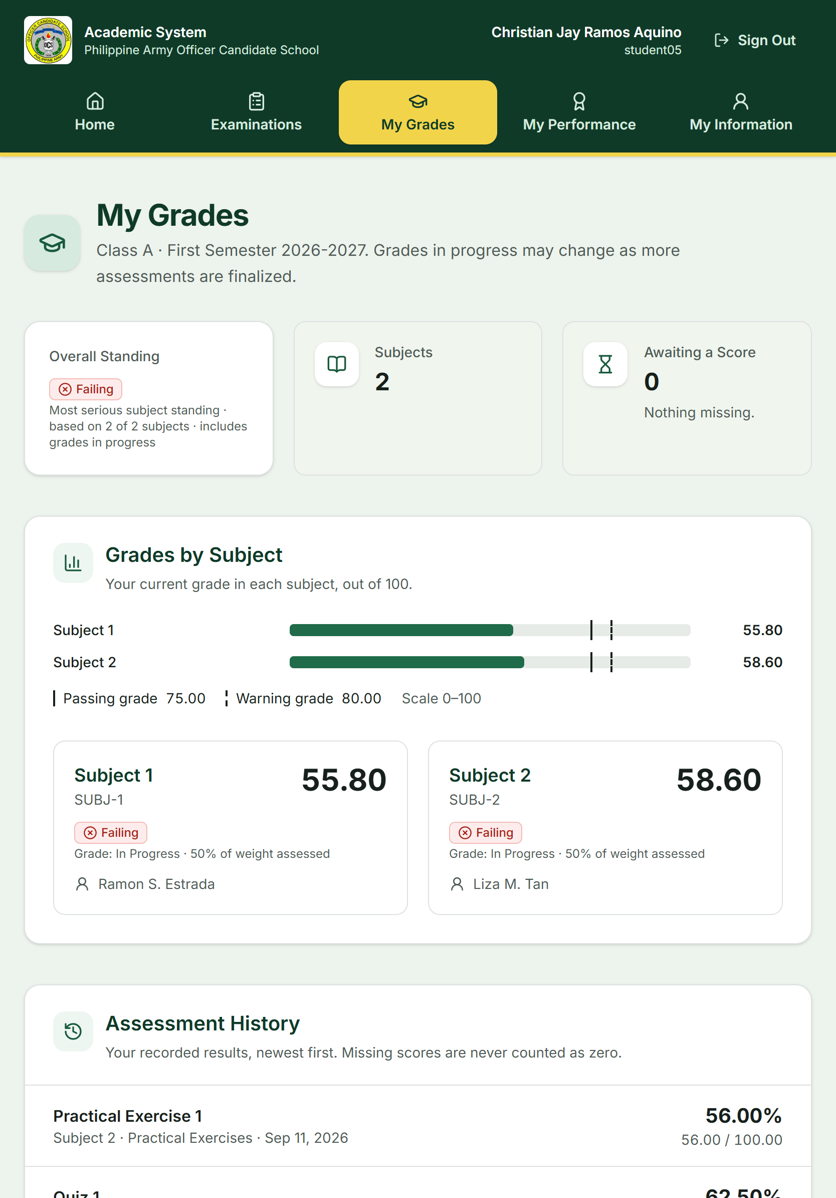




Made for the tablet
CANDIDATES
Answers saved as they are chosen
Short Wi-Fi drops kept on the device and synced
Visible timer; large, clear choices
Only the candidate's own records
Notes:
The candidate portal is an installable web app. Answers autosave; if the connection drops they are kept on the device and clearly marked as not yet saved to the server.

Slide 8
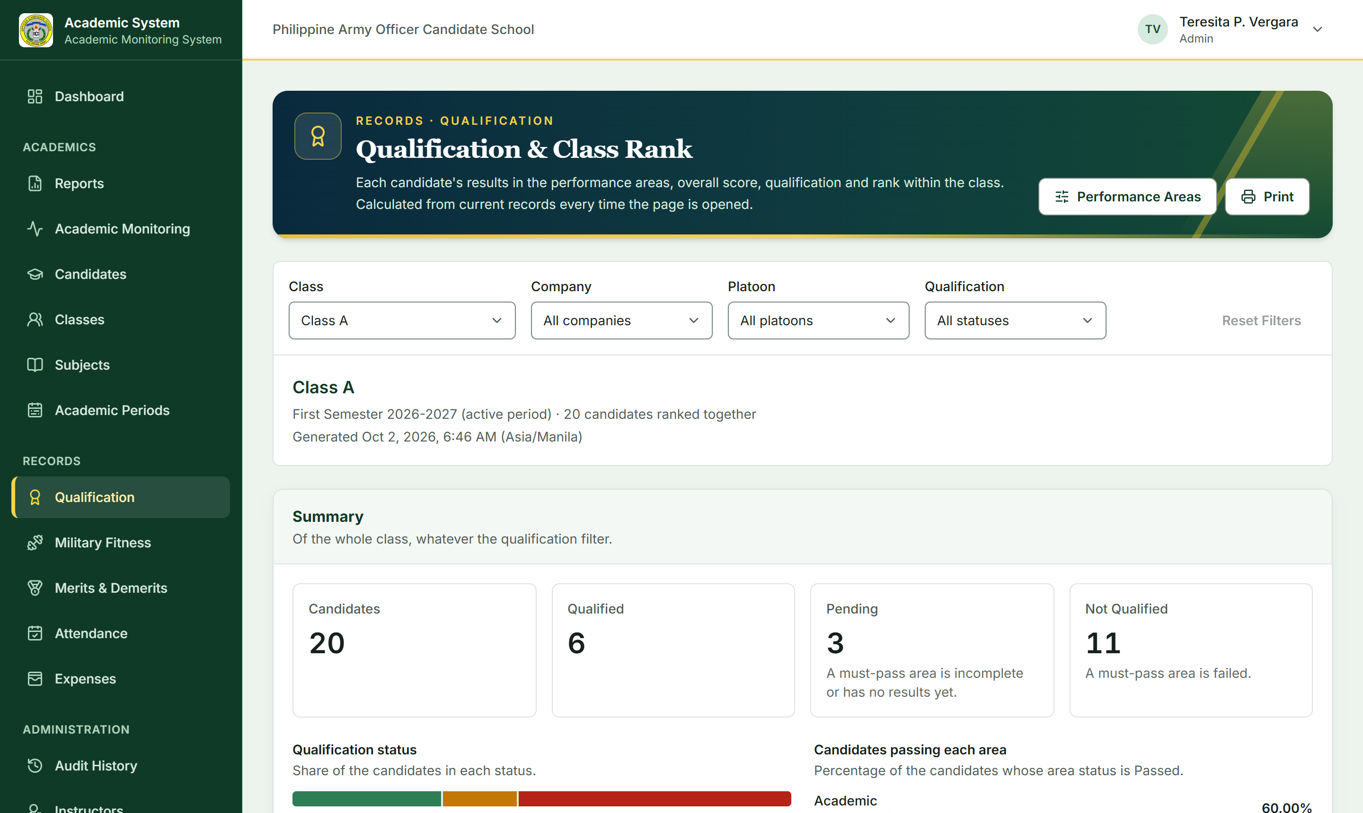





Qualification across every area
BEYOND GRADES
Academic
Military skills
Physical fitness
Conduct
Attendance
Areas, weights, passing grades and must-pass rules are configurable. Class rank is for staff only.
Notes:
The qualification engine combines subject grades, the latest fitness test, merits and demerits, and attendance into Qualified, Not Qualified or Pending, with the reasons shown. The five areas in the demo are placeholders until the official grading SOP is confirmed.

Slide 9
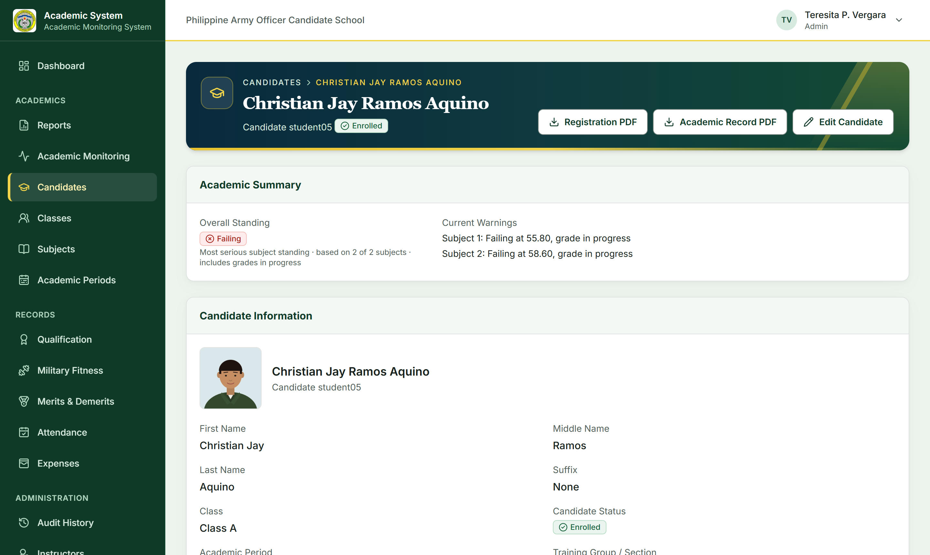
Every candidate on one page
CANDIDATE PROFILE
Personal and class details, with photo
Subject grades and standing
Examination results
Fitness, merits and demerits, attendance
Registration and academic record PDFs
Notes:
The candidate profile brings the academic and performance record together. Instructors see it only for candidates in the classes they teach.

Slide 10





Secure, traceable, and on your own network
BUILT FOR THE INSTITUTION
Internal network
Permission checks
Audit trail
Runs on the LAN and private Wi-Fi; no public internet or cloud services needed.
Every request is authorised on the server, not by hidden buttons.
Sign-ins, grade changes, publications and role changes are recorded.
Backups
Simple to host
Tested
Database and uploaded files backed up, with tested restores.
One Laravel application and one MySQL/MariaDB database.
Automated tests cover grading, examinations and access rules.
Notes:
Security and operations: internal deployment, server-side authorisation, an audit trail, backups, and a deliberately simple hosting footprint.

Slide 11
Ready for review and tablet trials
WHERE WE ARE
20
1,400+
4
development milestones completed
automated tests passing
roles with their own views
Next steps
1
Confirm the official grading SOP, area weights and fitness points tables
2
Trial on the institution's tablets and Wi-Fi
3
Deploy on the institution's server with HTTPS, scheduler and backups
Notes:
All planned milestones are done and the automated suite passes. Remaining work depends on the institution: the official grading rules, physical tablet trials, and the production server.

Slide 12
Thank you
OFFICER CANDIDATE TRAINING MANAGEMENT SYSTEM
Questions and live demonstration
Notes:
Open the floor for questions, then switch to the live demonstration following docs/demo-script.md.

