Slide 1

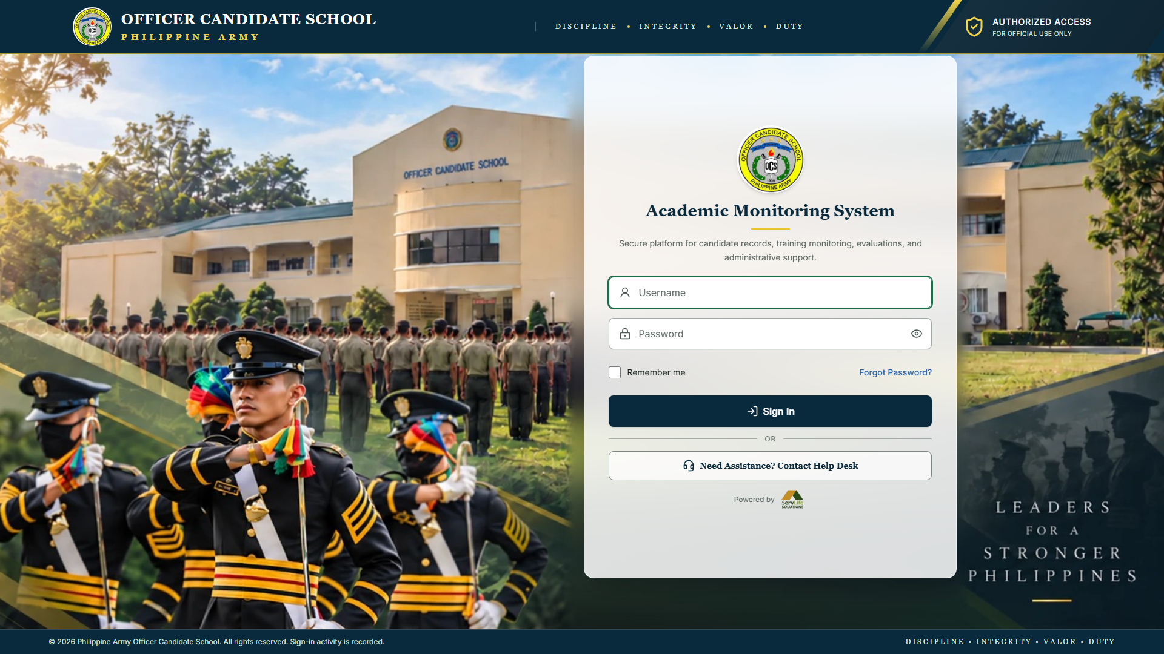
Philippine Army Officer Candidate School
ACADEMIC SYSTEM
SYSTEM PROPOSAL
Academic Monitoring System
One secure platform for candidate records, grades, digital examinations and academic monitoring — on the school’s own network.
The system’s sign-in page
PREPARED BY
ServLife Solutions
DATE
October 2026
Notes:
Introduce the Academic Monitoring System: one secure platform for the school, running on its own network. The screenshot is the real sign-in page.

Slide 2






WHY CHANGE
The Challenge
Paper quizzes and examinations
Manual grade computation
Problems noticed too late
Printing, collecting and checking papers by hand takes hours, and papers can be misplaced.
Weighted grades worked out by hand or in separate files are slow, and mistakes are hard to find.
A candidate falling behind may only be noticed when final grades are prepared.
Scattered records
Slow reporting
Limited traceability
Grades, results, fitness records and expenses sit in different files and offices.
Class and subject summaries must be compiled by hand for every request.
When a grade changes, it is hard to know who changed it, when and why.
Academic Monitoring System · System Proposal
2
Notes:
Common challenges when training records are kept on paper and in separate spreadsheets. Each grows with the number of candidates, subjects and examinations.

Slide 3










THE PROPOSED SYSTEM
One System, Twelve Connected Modules
Candidate Records
Academic Structure
Grades and Standing
Academic Monitoring
Profiles, photos and official PDFs
Periods, classes, subjects, instructors
Weights and automatic grades
Dashboards and early warning
Question Bank
Quizzes and Exams
Tablet Examinations
Live Monitoring
Reusable questions with media
Builder, settings, publishing
Timer, autosave and recovery
Active, finished or away
Reports
Military Fitness
Expenses
Audit History
Eight reports with charts
Events, standards, scoring
Charged to classes or candidates
Who changed what, when, why
Academic Monitoring System · System Proposal
3
Notes:
The system is organised into modules that share the same records. A score entered once updates grades, standing, dashboards and reports.

Slide 4




SETUP
How It Runs at the School
Candidate Tablets
Staff Computers
School Network
School Server
Quizzes and examinations; installable as an app
Administrators and instructors
Internal Wi-Fi or local area network
The system and its database, kept on site
No public internet required
The system does not rely on outside services or cloud storage, and the school’s records never leave the school’s network.
Academic Monitoring System · System Proposal
4
Notes:
Installed on a server at the school. Computers and tablets connect through the school’s own Wi-Fi or local network. No public internet is needed.

Slide 5



USERS
Who Uses the System
Super Administrator
Academic Administrator
Overall system management
Academic office
Manages accounts, roles and permissions
Access to every module and record
Reviews the full audit history
Charges candidates for expenses
Manages candidates, classes, subjects, periods
Assigns instructors
Sets grading rules and thresholds
Views monitoring, reports and fitness
Instructor
Candidate
Assigned classes and subjects only
On a school tablet
Records and finalizes grades
Builds questions, quizzes and exams
Monitors exams live, grades essays
Sees alerts for own candidates
Takes quizzes and examinations
Sees own grades and standing
Sees own released results
Downloads own registration and record
Academic Monitoring System · System Proposal
5
Notes:
Four roles. Access depends on the role and, for instructors, on the classes and subjects assigned to them.

Slide 6
GRADES
Accurate Grades, Computed Automatically
Instructors record scores once. The system applies the school’s own grading weights and works out every grade and academic standing — no hand computation, no separate spreadsheets.
Grading categories and weights for each subject
Passing and warning grades for each academic period
Missing scores stay missing — never counted as zero
Corrections need a reason and are kept in history
ACADEMIC STANDING
Passing
At Risk
Failing
Incomplete
Example only — weights are set by the academic office.
Academic Monitoring System · System Proposal
6
Notes:
Each subject has its own categories and weights set by the academic office. Instructors record scores; the system computes every grade and standing. The weights shown are only an example.

Slide 7
EARLY WARNING
See Who Needs Help — Early
400
342
38
14
6
Candidates
Passing
At Risk
Failing
Incomplete
Illustrative figures, showing how the administrator dashboard summarizes standing.
Administrator dashboard: standing, subject performance and grade distribution charts
Instructor dashboard: assigned subjects, upcoming assessments and alerts
At-risk and failing lists with filters
Candidate profile: grades by subject and overall standing
Academic Monitoring System · System Proposal
7
Notes:
Dashboards show the academic status at a glance and point to the candidates who need attention. The figures here are illustrative, not real school data.

Slide 8
EXAMINATIONS
Question Bank and Exam Builder
Question Bank
Quiz and Exam Builder
Multiple Choice
True or False
Essay
1
Settings
2
Questions
3
Review & Publish
Topics, points and explanations
Images, audio and video in questions
Images inside answer choices
Import many questions from a CSV file
Duplicate to make variations quickly
Deactivate instead of delete, keeping history
Opening and closing time, time limit, attempts
Passing score and optional access code
Shuffle questions and answer choices
A random set of questions per candidate
One question at a time; allow or block going back
Automatic submission when time runs out
Academic Monitoring System · System Proposal
8
Notes:
Instructors build reusable questions per subject and topic, then create quizzes and examinations in three guided steps. They can only publish to their own classes.

Slide 9





CANDIDATES
The Tablet Examination Experience
Open the portal
Sign in
Start the exam
Answer — saved automatically
Submit and get a receipt
Clear and calm
Brief Wi-Fi drops are handled
Fair and secure
Large answer buttons, visible progress and timer, and a question list showing answered, unanswered and flagged items.
Answers are kept on the tablet and sent when the connection returns. The screen always shows whether answers are saved.
Time and attempt limits are enforced by the server. A second submission is not possible. Results appear only when released.
Academic Monitoring System · System Proposal
9
Notes:
Candidates use a simple, touch-friendly screen on school tablets. Answers are saved automatically and survive brief Wi-Fi interruptions.

Slide 10




DURING AND AFTER
Live Monitoring, Scoring and Results
LIVE MONITORING
SCORING AND RESULTS
Instant scoring
Active
Submitted
Multiple choice and true/false scored on submission
answering now
finished
Essay grading queue
Points and feedback, with a change history
Not started
Inactive
yet to begin
no recent contact
Result release
Candidates see results only when released
Post to gradebook
Leaving the exam screen is recorded. Instructors see how often and for how long. An indicator only: no camera, microphone or automatic penalty.
Exam scores into subject grades in one step
Item analysis
Spot questions that were too hard or unclear
Academic Monitoring System · System Proposal
10
Notes:
During an examination the instructor’s screen refreshes on its own. Answers are never shown there. Leaving the exam screen is recorded as an indicator only — no camera or microphone.

Slide 11

REPORTS AND RECORDS
Reports, Fitness, Expenses and History
Military Fitness
Eight Ready-Made Reports
School-defined events and standards; results scored automatically and kept separate from academic grades.
Filtered, charted, printed or saved as PDF
Expenses
Candidate standing
Class performance
The administrator charges an expense to a whole class or chosen candidates — never twice; mistakes voided with a reason.
Subject performance
At-risk candidates
Audit History
Sign-ins, record and grade changes, exam publishing and result release — searchable by person, action and date.
Failing candidates
Examination results
Quiz results
Grade distribution
Candidate Portal
Each candidate sees only their own exams, grades, standing and records.
Academic Monitoring System · System Proposal
11
Notes:
Reports come straight from the records, so they are always current. The other records — fitness, expenses and the audit history — live in the same system.

Slide 12
BENEFITS
How Everyday Work Improves
Area | Typical manual process | With the system
Examinations | Printed papers, checked by hand | Taken on tablets; objective items scored instantly
Grade computation | By hand or in spreadsheets | Computed from the school’s own weights
Struggling candidates | Noticed when final grades are prepared | Flagged as soon as scores are recorded
Records | Spread across files and offices | One linked record for each candidate
Reports | Compiled by hand for each request | Eight reports, filtered and printed in minutes
Grade changes | Hard to trace | Person, time and reason always recorded
Exam integrity | Same paper for everyone | Shuffled questions, random sets, live monitoring
Academic Monitoring System · System Proposal
12
Notes:
A side-by-side view of common manual practices and the same work in the system.

Slide 13

TRUST
Security, Privacy and What the School Needs
Controlled access
Protected exams
What the school needs
A school server
Personal accounts; access by role and assignment. New staff passwords must be changed at first sign-in.
Answer keys never reach tablets. Limits enforced by the server. Results hidden until released.
Hosts the system and its database
The school network
Wi-Fi or LAN to classrooms
Safeguards
Traceable changes
Devices
Repeated failed sign-ins and code guesses are slowed. Candidates never see others’ records.
Corrections keep the old value, new value, person and reason.
Computers and tablets with a browser
Academic Monitoring System · System Proposal
13
Notes:
Security was built in from the start. To run it, the school needs a server, its network, and devices with a modern browser.

Slide 14
Thank You
One secure, reliable place for candidate records, grades, examinations, fitness results and expenses — on the school’s own network.
Notes:
Close and invite questions. Offer a live demonstration with sample (fictional) data.

