Slide 1
Enhancing Supermarket Operations with Text Analytics
Team 414
Meng Huang
Varshni Ravishankar
Shantanu Ravindra Kale
Sai Manikanta Bandi

Slide 2
OBJECTIVE
Our objective of the project is to enhance supermarket operations through text analytics.
customer behaviors
preferences
temporal visitation patterns
To optimize operations and improve overall efficiency in supermarkets.

Slide 3
PROJECT DATASET
Business
Review
Checkin
The dataset provides a detailed overview for analysis of business characteristics and services. It include ID, name, address, location, star rating, review count, open/closed status, attributes like takeout and parking, categories, and operating hours for each day.
Contains full review text data including the user_id and the business_id.
The dataset contains check-in information for businesses, which provides insights into the frequency and timing of customer visits to the respective businesses. It include the business ID and a comma-separated list of timestamps indicating the dates and times of each check-in.

Slide 4
APPROACH
Text Processing Techniques
Sentiment Analysis
Topic Modeling with BERT

Slide 5
APPROACH
A natural language processing technique used to determine the sentiment expressed in text, categorizing it as positive, negative, or neutral. It helps extract opinions, attitudes, or emotions about a topic, product, or service, enabling insights into customer feedback, brand reputation, and market trends.
Text processing techniques
Topic Modeling with BERT
1. Lowercasing
2. Removing non-ASCII characters
3. Removing punctuation and numbers
4. Tokenization
5. Removing stopwords
6. Lemmatization
7. Joining tokens
Utilizes the BERT language model to extract topics from text data. By leveraging BERT's contextual understanding of language, it captures nuanced relationships between words and documents. This approach offers improved semantic representation but may require substantial computational resources for training and fine-tuning.
Sentiment Analysis

Slide 6
Location
We have highlighted the supermarkets located in Arizona.

Slide 7
COMPETITORS
Walmart Supercenter
Trader Joe’s
Whole Foods Market
AJ's Fine Foods
Safeway
Fry's
Costco
Fry's Food & Drug Stores
Target

Slide 8
GOAL:
"Our goal is to determine which supermarket receives the highest consumer star rating and which receives the lowest, based on an analysis of customer reviews and ratings."

Slide 9
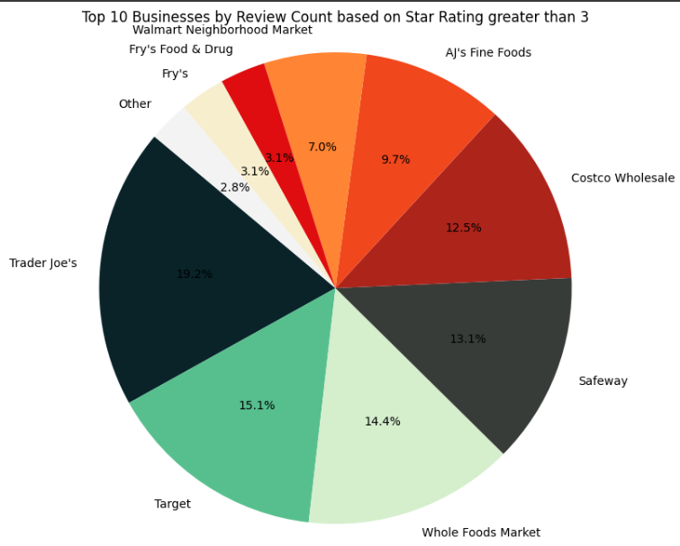
COMPARISON BASED ON STAR RATING AND SENTIMENT

Slide 10
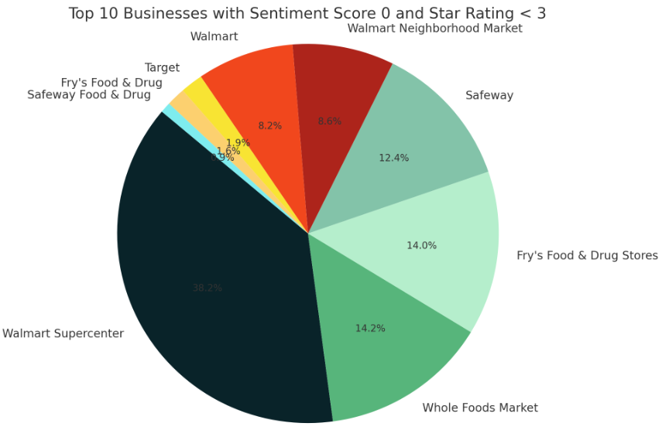
COMPARISON BASED ON STAR RATING AND SENTIMENT

Slide 11
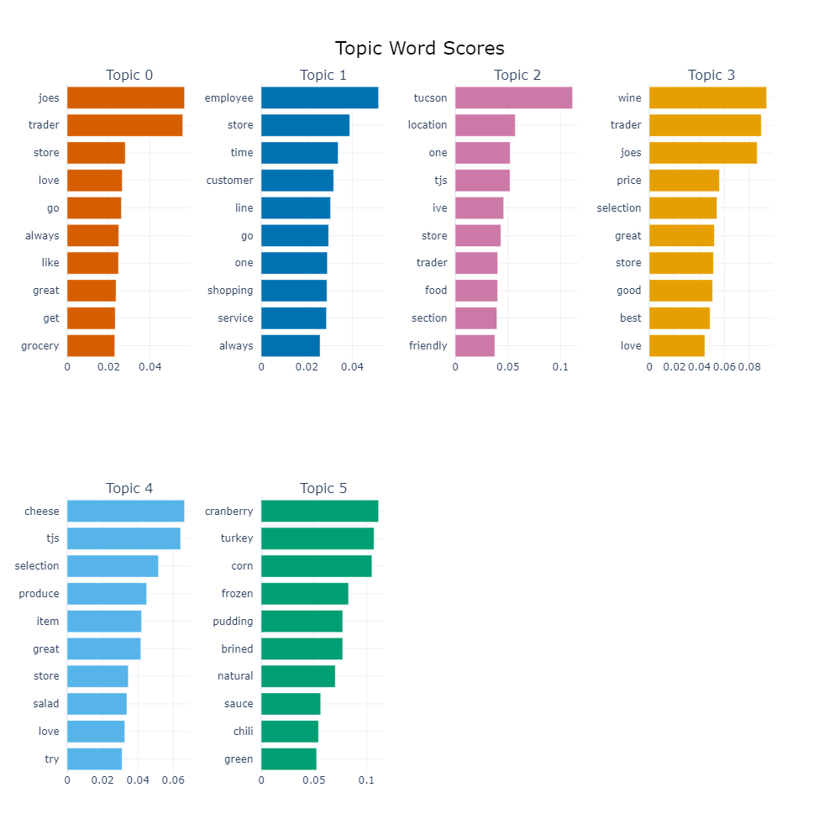
TOPIC MODELING ANALYSIS
Topic 0 : Positive sentiment regarding Trader Joe's shopping experience.
Topic 1 : Focus on customer service efficiency and interactions.
Topic 2 : Highlighting a specific Trader Joe's location, possibly in Tucson, praised for its friendliness.
Topic 3 : Favorable opinions on the quality and pricing of wine.
Topic 4 : Emphasis on cheese and food selection quality.
Topic 5 : Discussion around Thanksgiving or festive meal items.
Conclusion: customers express positive views on various aspects, including service, locations, product quality, and selection at Trader Joe's.

Slide 12
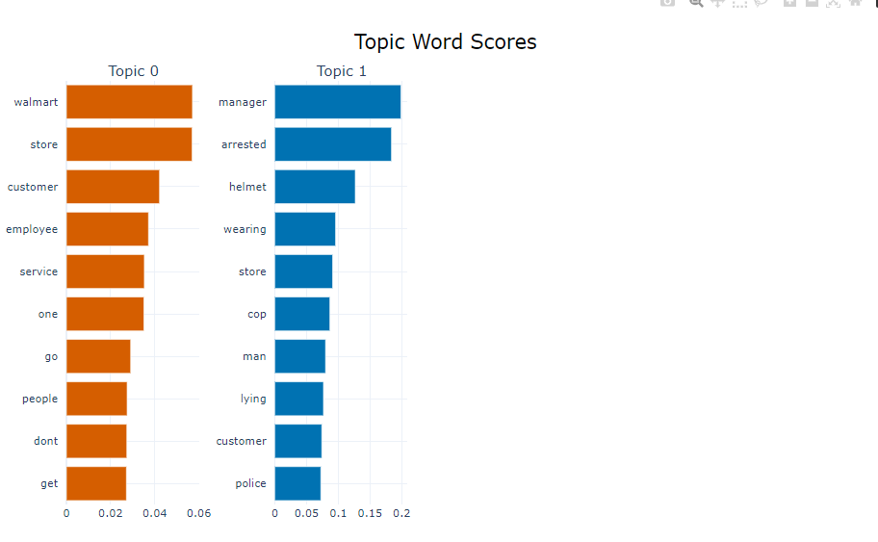
TOPIC MODELING ANALYSIS
Topic 0:
- Walmart, store, customer, employee, and service are central keywords, implying discussions regarding the overall atmosphere, service quality, and interactions with staff.
Topic 1:
- The presence of words like manager, arrested, helmet, cop, and police indicates a more specific and potentially negative aspect of the customer experience.
- This topic suggests a need for Walmart to address security concerns, management practices, or incidents involving law enforcement to improve the overall customer experience and safety perception.

Slide 13
WHY IT IS BETTER?
Trader Joe's success stems from its ability to consistently deliver a positive shopping experience and efficient customer service. Customers appreciate the inviting atmosphere and easy navigation within the stores, enhancing their overall satisfaction. The emphasis on friendly and helpful staff ensures that patrons feel valued and attended to during their visit. Furthermore, specific locations, like the one possibly in Tucson, stand out for their exceptional friendliness, fostering a sense of community and further enhancing the shopping experience. This personalized touch contributes to positive word-of-mouth and customer retention, driving the store's success.
Moreover, Trader Joe's is renowned for its quality products and competitive pricing, particularly in its extensive wine selection and diverse food offerings. The favorable opinions on wine quality and pricing highlight a key aspect of the store's appeal, attracting wine enthusiasts and casual shoppers alike. Additionally, the emphasis on high-quality cheeses and unique food items satisfies customers seeking distinctive options. Trader Joe's adeptness at catering to seasonal demands, evident in its specialty offerings for holidays like Thanksgiving, further solidifies its position as a customer-centric and adaptable retailer, ultimately contributing to its continued success in the market.

Slide 14
STEPS WHICH CAN BE IMPROVED FOR WALMART?
Walmart can enhance its customer experience by prioritizing employee training and engagement to ensure consistent and positive interactions with customers. Implementing initiatives that actively seek and address customer feedback can help identify and resolve issues promptly, while also incentivizing exemplary customer service. Additionally, strengthening security measures and management practices is crucial to address concerns regarding safety and incidents involving law enforcement or disputes with management. Collaborating with local law enforcement agencies and community organizations can further foster a culture of safety and accountability, ensuring a positive shopping environment for customers. Leveraging technology for customer support and data analytics can also provide valuable insights for personalized service offerings, ultimately contributing to an improved overall experience at Walmart.

Slide 15
GOAL
“To check the business check ins patterns based on consumer reviews.”

Slide 16
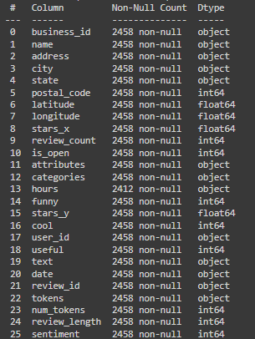
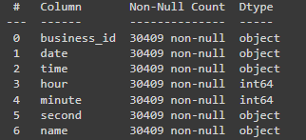
DATASET
Check-in data and customer sentiment, gleaned from reviews, have been collected for analysis.
Check in Data:

Slide 17
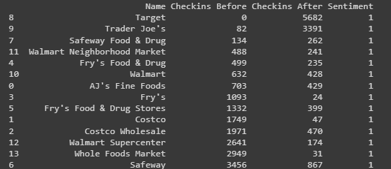
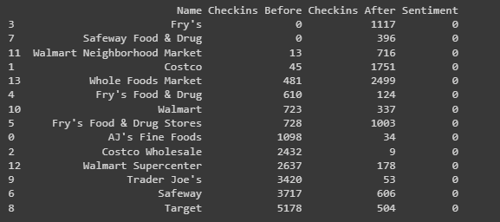
CHECK IN COUNTS

Slide 18
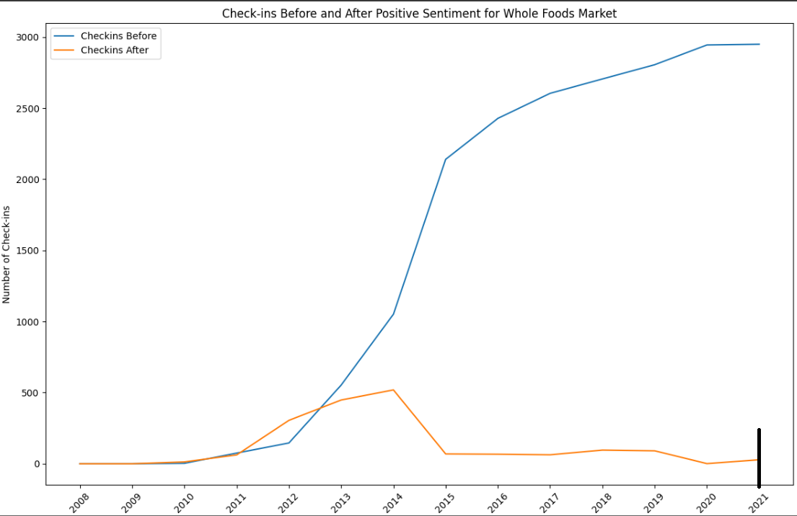
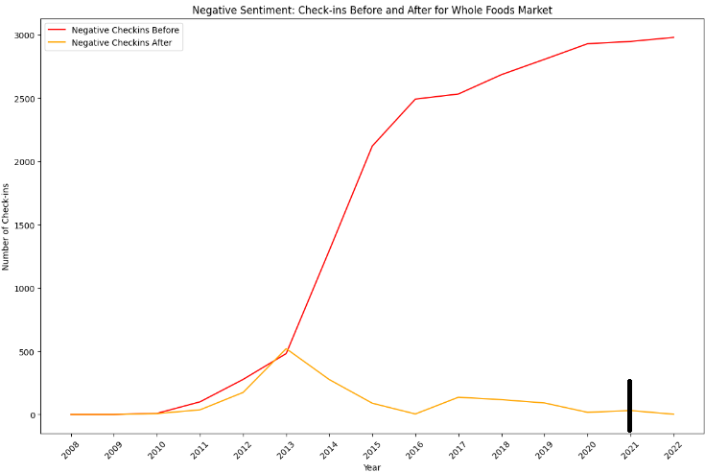
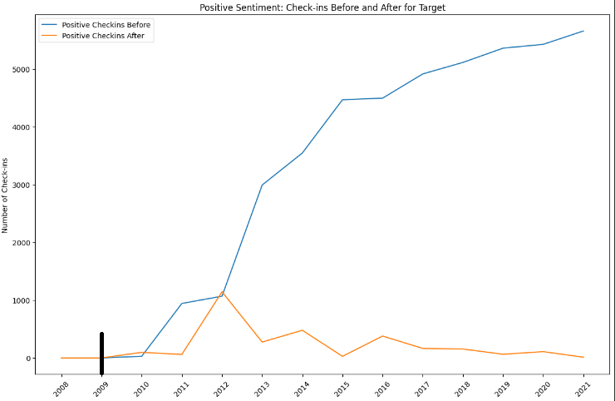
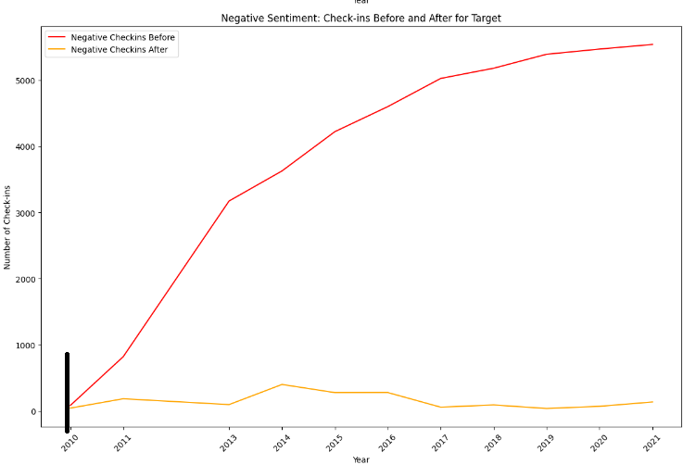
Whole Foods Market
Target

Slide 19
FINDINGS
TARGET
WHOLE FOODS MARKET
1. The data highlights a notable surge in positive sentiment check-ins towards the target starting from 2009, indicating a substantial improvement in public perception.
2.Before 2009, the target experienced a prolonged period of consistently high negative sentiment, as evidenced by the steadily increasing number of negative check-ins leading up to that year.
3. Following 2009, there was a remarkable decline in negative sentiment check-ins, suggesting a successful mitigation of factors leading to unfavorable public opinion.
4.The year 2009 emerges as a pivotal juncture where sentiment towards the target shifted significantly, indicating the potential influence of critical events or strategic changes.
5.Understanding the specific catalysts behind the sentiment shift post-2009 could provide valuable insights for replicating success in other contexts and optimizing strategies for managing public perception.
1. Positive sentiment for Whole Foods Market steadily increased until 2021, indicating growing popularity.
2. Negative sentiment initially peaked around 2016 but saw a sharp rise post-2021, suggesting a significant shift.
3. Pre-2021, both positive and negative sentiment trends were similar, but post-2021, they diverged notably.
4. 2021 serves as a pivotal year, with sustained positive sentiment but a notable increase in negative sentiment.
5. Whole Foods Market faces a challenge post-2021 to address the rise in negative sentiment while maintaining brand loyalty.

Slide 20
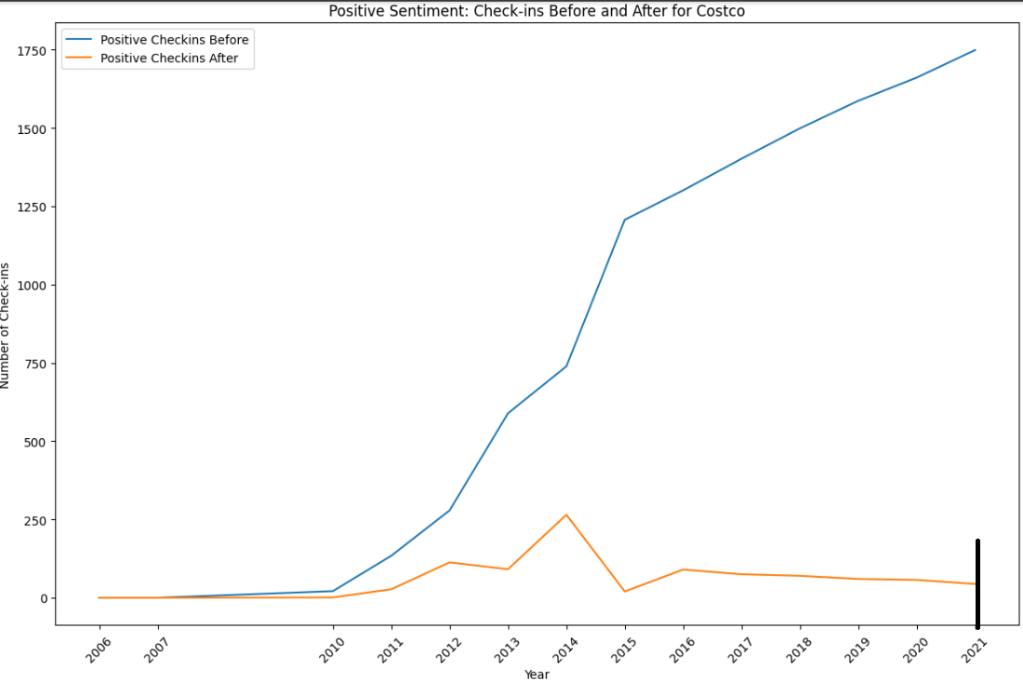
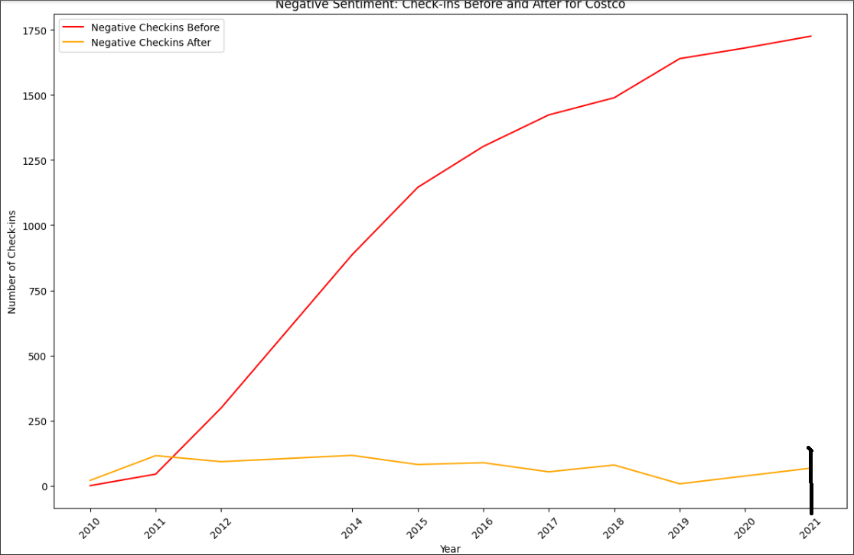
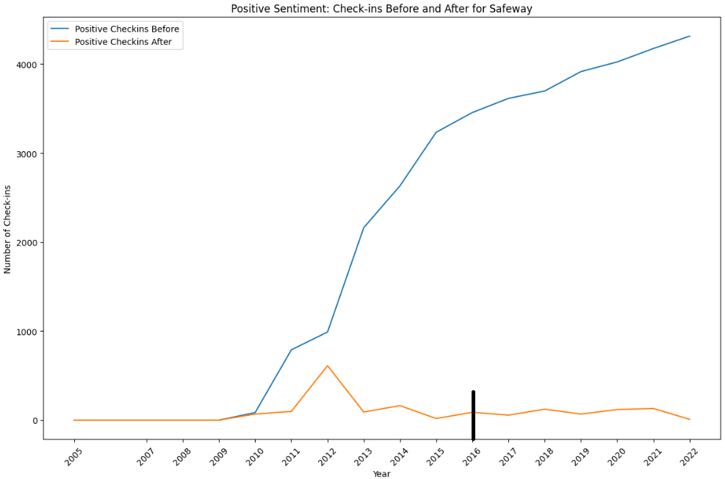
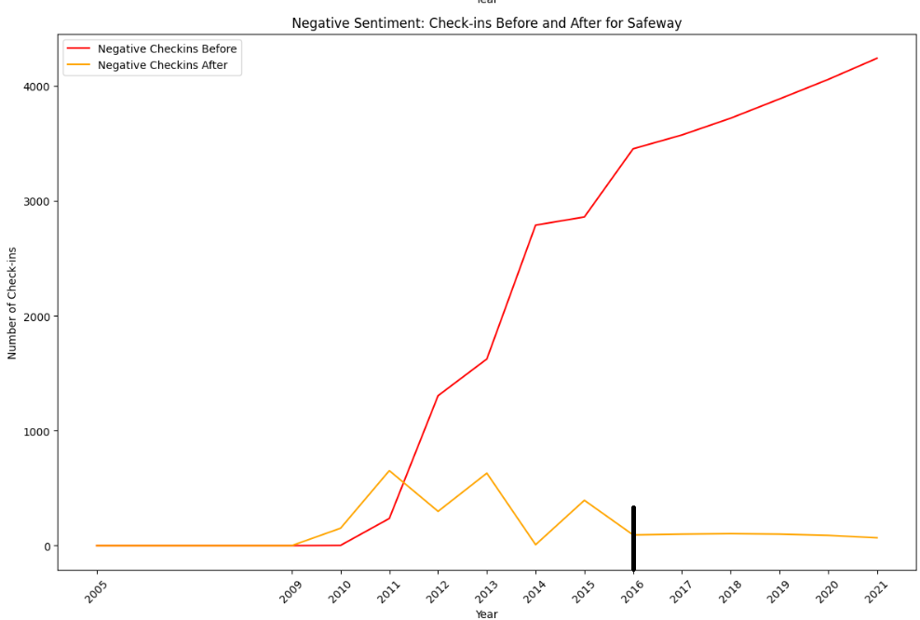
Costco
Safeway

Slide 21
FINDINGS
COSTCO
SAFEWAY
After a decline in 2020, there was a sharp recovery in positive sentiment check-ins in 2021 that surpassed previous years' levels.
The recovery suggests either a strong positive response to the events of 2021 or potential issues with data collection as mentioned before.
Negative sentiment check-ins did not show a decline in 2020 and continued to increase in 2021, indicating a possible accumulation of negative sentiment or a change in reporting/measuring practices.
Setting the threshold at 2021 highlights the year as a significant turning point for both positive and negative check-ins, but particularly underscores a remarkable recovery in positive sentiments and a concerning rise in negative sentiments that year.
Positive sentiment steadily rises from 2006 to 2016, continuing post-2016, albeit at a slower pace.
Negative sentiment fluctuates before 2016, peaking around 2015, then sharply decreases and levels off post-2016.
2016 serves as a pivotal year for Safeway, coinciding with positive sentiment growth and negative sentiment decline.
This suggests successful strategic initiatives implemented around 2016.
Implications include the need to analyze Safeway's strategies, marketing, and customer service policies pre- and post-2016, considering external factors like the economy and competition.

Slide 22
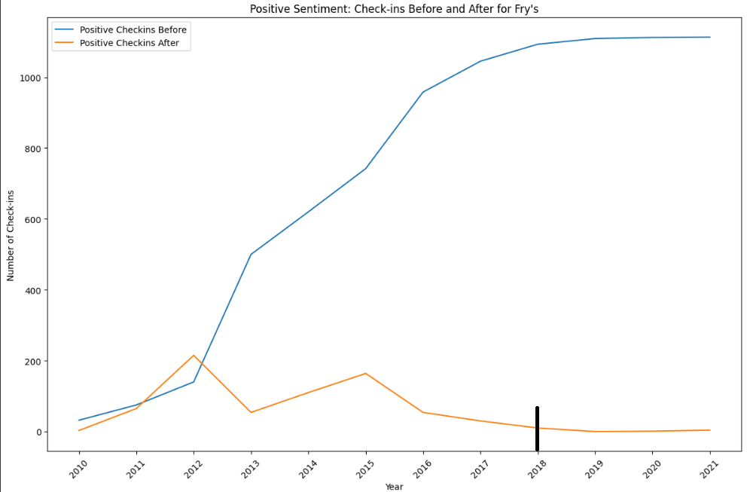
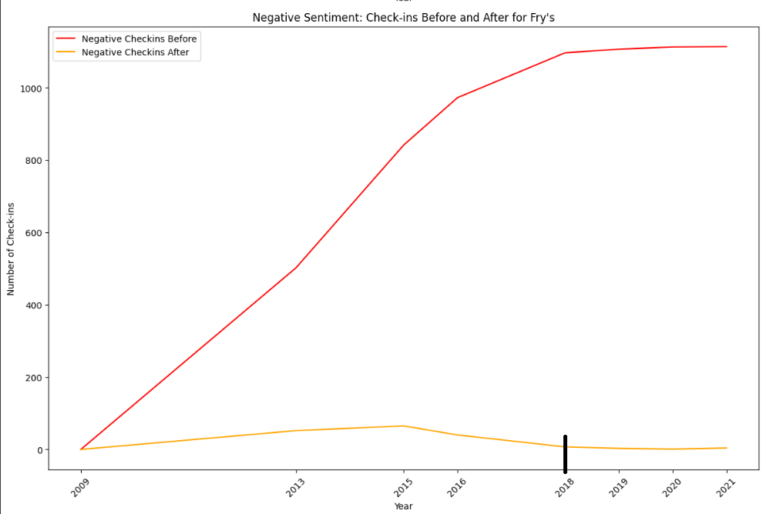
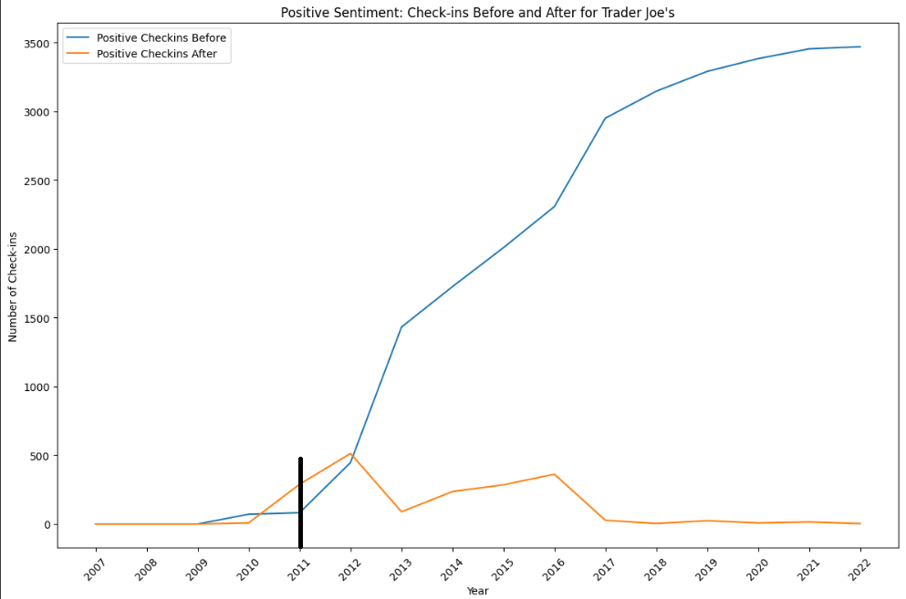
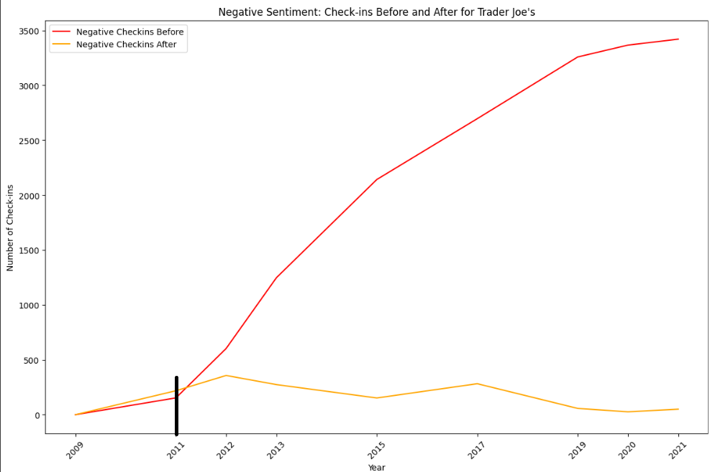
Fry’s
Trader Joe’s

Slide 23
FINDINGS
FRY’S
TRADER JOE’S
Positive check-ins exhibit a notable decline post-2018, indicating a shift in customer sentiment.
Preceding 2018, there was a consistent upward trend in positive check-ins, peaking circa 2017.
The onset of decline aligns precisely with the year 2018, suggesting a pivotal event or change influencing customer perceptions.
Negative check-ins, conversely, display a sharp increase post-2018, contrasting with the relatively low and stable levels observed before that year.
While the exact cause remains ambiguous from the data alone, potential factors such as management alterations, customer service issues, or product quality changes could have contributed to the sentiment shifts.
Positive sentiment check-ins showed modest growth before 2011, gradually increasing from 2007 onwards.
After 2011, there was a significant surge in positive sentiment check-ins, stabilizing at a high level from around 2015 onwards.
Before 2011, negative sentiment check-ins remained relatively low and stable.
Post-2011, there was a sharp rise in negative sentiment check-ins, steadily increasing without plateauing until around 2021.
Overall, the data indicates a notable increase in both positive and negative sentiment check-ins after 2011, potentially reflecting increased popularity or busyness of the Trader Joe's location.
Factors like changes in population, management, or broader economic trends should be considered.

Slide 24
CONCLUSIONS
Topic modeling on customer reviews has identified core themes such as overall satisfaction and quality of products.
01
Sentiment analysis suggests that events and seasonal offerings (e.g., Christmas) have a significant impact on customer sentiment.
02
Temporal analysis indicates potential seasonal and yearly trends in customer check-ins, which correlate with fluctuations in review sentiments.
03

Slide 25
THANKS!!

