Slide 1
What aggregate data can and cannot tell us: synthetic evenings for testing Lyft-transfer rules on Blue Jay Night Ride
Team FourSight · EN.553.602 Research and Design in Mathematics: Data Mining · Midterm, October 2026 · DRAFT
Presenters: P1 (slides 1–4) · P2 (5–8) · P3 (9–12), roles to be confirmed
Notes:
Title. P1 opens. One sentence: we set out to optimize the Night Ride shuttle; what we learned first is what the data can and cannot tell us, and how to build experiments that stay honest about that. Timing assumed 18.5 min + ~10 min questions, awaiting confirmation.

Slide 2
Blue Jay Night Ride, and what we proposed in September
The service
What we proposed
1 Request
a rider books a trip in the app (6 pm–2 am, Homewood area)
Replay real service nights from trip-level records
Compare dispatch methods: simple greedy rules vs an optimization model (a mixed-integer linear program, MILP) re-solved as requests arrive
Treat Lyft as paid overflow chosen inside the optimizer
Use the published service targets as hard constraints
2 Shared van
a dispatcher assigns a van; other riders may share it
3 Curb to curb
picked up at the curb, dropped at the destination
Proposal numbers we later corrected
"5,100 rides per hour at 6 pm" was a 30-day total: about 170 completed rides in one evening's 6 pm hour
"28 vans" counted all services, not only Homewood
"1 in 4 overflow to Lyft": a share of riders (people), not of requests or trips
or Lyft
Hopkins can send a Lyft instead; about 1 in 4 April riders (24.5%) rode Lyft
Source: Proposal deck (Sep 2026); April 2026 JHU/TransLoc dashboard: 44,374 riders, van + Lyft, 24.5% by Lyft (transloc_operations.md).
1
Notes:
P1, 1 min. Introduce the service exactly as in the proposal: request in the app, shared van, curb to curb, about 6 pm to 2 am. Lyft: in April about one rider in four (24.5% of 44,374 riders, van and Lyft together) rode Lyft. That is a share of riders, not of trips or requests. The proposal promised to replay real nights and compare a greedy method, a rolling-horizon MILP and a hybrid, with Lyft as paid overflow inside the MILP and the targets as hard limits. Say plainly: most of that changed, and the change is part of the result. Sources: proposal deck slides 5–15; transloc_operations.md (April data row).

Slide 3
How the research question changed
 | September proposal | Now
Data | Trip-level records were expected | Only aggregate dashboards: totals, shares, percentiles
Question | Which dispatch algorithm is best? | Which Lyft-transfer rule, with the van dispatcher held fixed?
Lyft | Paid overflow inside the optimizer | A separate, explicit transfer rule; no money modelled (cost unknown)
Targets | Hard constraints | Wait targets are reported, not imposed; plans may not create a ride longer than max(25 min, 2 × the direct drive + 5 min)
Claims | About real nights | About synthetic evenings consistent with April's totals
Research question
With the van dispatcher held fixed, which rule for transferring waiting riders to Lyft gives the best rider service for the Lyft use it requires, and why?
The six transfer rules we compare
R0 | never transfer
R1(10) | after 10 min of waiting
R1(15) | after 15 min of waiting
R1u(10) | after 10 min with no van assigned
R2(15) | if the predicted total wait > 15 min
R3(2) | if the van is predicted later than a Lyft (+2 min)
Why switch: on synthetic nights, a ranking of dispatch algorithms would mostly reflect our guesses about demand detail. Replaying the same night with one lever changed (the transfer rule, the decision Hopkins' dispatchers actually make) isolates that lever's effect under stated assumptions.
Source: Proposal deck; decision log D-23–D-27, D-45, D-49; research_review.md.
2
Notes:
P1, 1.5 min. Walk the table row by row. Data: trip records never arrived, so everything rests on monthly aggregates. Question: comparing dispatch algorithms needs real nights to be meaningful; with synthetic nights the defensible question is a policy question: hold one reasonable dispatcher fixed and vary the Lyft rule. Lyft: we separated it into its own rule (the JHU page says a dispatcher sends the Lyft) and we do not model money, because Hopkins' cost per Lyft trip is unknown (a rider's app showing no charge does not reveal it). Targets: we report against them; the hard limit is a ride guardrail. Corrections: the proposal's 5,100 rides at 6 pm is the 30-day total for that clock hour; 28 vans counted all services. Sources: decision log D-23 (Homewood scope), D-25 (dispatcher direction), D-45 (no money), D-49 (targets dated); proposal slides 6–7.

Slide 4
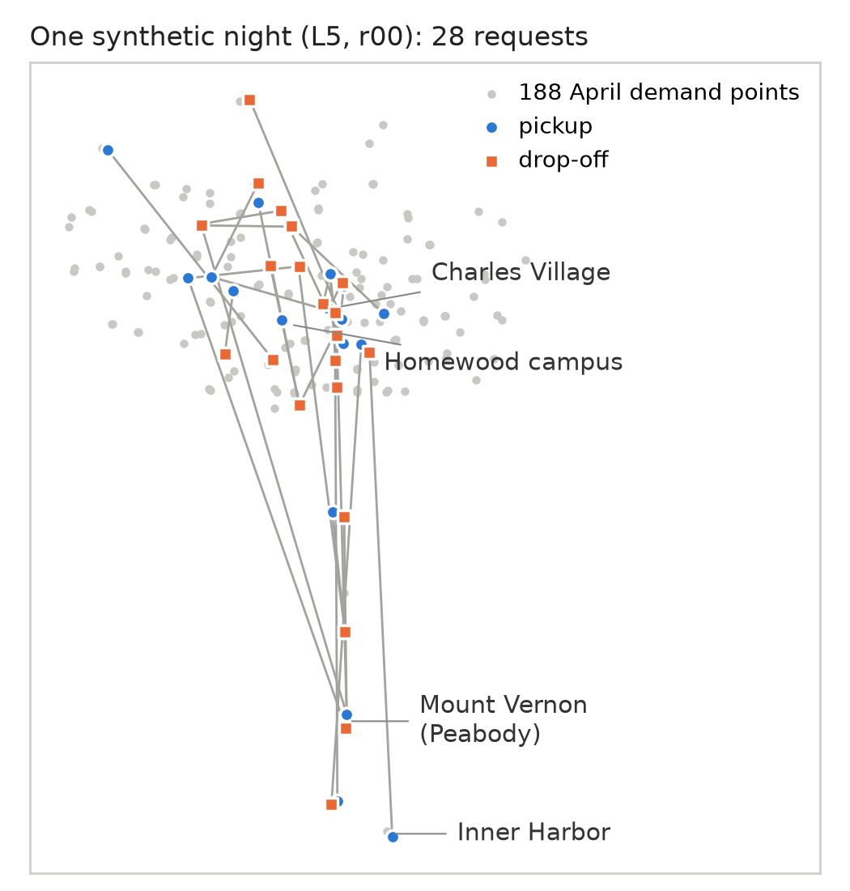
Building an evening from aggregate data
OBSERVED
DERIVED
UNKNOWN
CHOSEN
How many requests
About 5,100 completed rides in the 6 pm hour over 30 days (tooltip: 5,098); 27.6 vehicles on duty (all services)
÷30 → 170 per evening; ×2.087 requests per completion → 355; ÷27.6 → 12.85 requests per vehicle-hour
Homewood's share of the vehicles; rebookings
Load per van: 5 vans × 12.85 → 64 requests at 6 pm (64 / 50 / 54 over 3 h)
Where trips go
Pickup and drop-off totals per place, separately
A trip table matching both totals
Who travels where
Gravity prior (longer drives less likely, 0.1 per minute) + iterative fitting to both totals
Uncertain: the count is an illustrative range, ~150–260, not a confidence interval; a spread-out geography variant is built but not yet used in experiments
Lines pair each pickup with its drop-off, not road routes. Synthetic requests from the April-calibrated demand model.
Source: April dashboard aggregates via decision log D-35/D-36, D-18, D-49; methodology §4; figure: frozen L5 night r00.
3
Notes:
P1, 2.5 min. This is the heart of the story: what we observed, what we derived, what stayed unknown, what we chose. Volume worked example: the dashboard gives about 5,100 completed rides in the 6 pm clock hour summed over 30 days (its tooltip reads 5,098; our digitized value is 5,089), so about 170 per evening. Each completed ride corresponds to 2.087 recorded requests on average (50,297 requests / 24,095 completed), so about 355 requests in an evening's 6 pm hour, shared by 27.6 vehicles on duty: 12.85 requests per vehicle-hour. For five vans that is 64 requests at 6 pm, 50 at 7 pm and 54 at 8 pm (168 in three hours, rounded hour by hour). Unknown: what fraction of the 27.6 vehicles served Homewood, and how many requests were rebookings; so 168 is a derived workload with an illustrative range of about 150–260, not an estimate of April demand. Geography: the maps give how many pickups and how many drop-offs each place had, but never which pickup went with which drop-off. We start from a gravity prior, an assumption that nearby trips are more common (weight falls by e^-0.1 per minute of drive), and then rescale so both sets of totals are matched exactly (iterative proportional fitting). The data cannot tell us the decay rate: any rate reproduces the totals. The map shows one synthetic night. Sources: decision log D-18, D-35, D-36, D-49; methodology §4 and Appendix B.

Slide 5
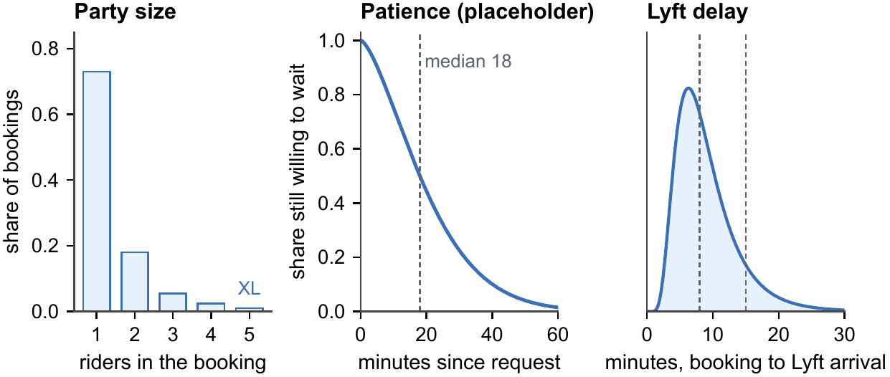
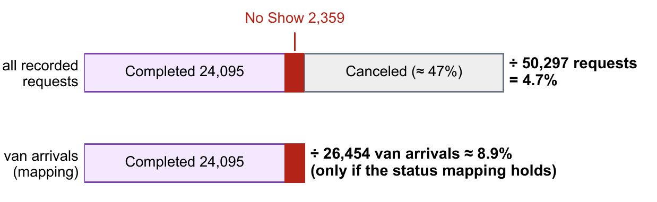
Assumptions that complete the evening
DERIVED
Group size: 1.386 van passengers per completed van booking. That fixes a mean, not the distribution; ours is assumed (mean 1.405). A party of 5 needs a larger Lyft (XL).
ASSUMED
"Canceled" (≈47% of requests) mixes riders who gave up with requests handed to Lyft. Riders give up at a hidden personal deadline (placeholder: median 18 min); their share of "Canceled" is a provisional 50–75% sensitivity range.
DERIVED
No-shows: 4.7% of all requests, or about 8.9% of van arrivals only if the status labels mean what we assume. We use 8.9% per arrival, provisionally.
ASSUMED
Lyft: booked 2 min after the decision; arrives after a random delay (median 8, 90th percentile 15 min).
Source: Decision log D-38, D-39, D-40, D-43, D-48; trail §6–§9; methodology §4 and Appendix C.
4
Notes:
P1, 1.5 min. These are the inputs April cannot pin down. Group size: the dashboard gives van passengers and completed van bookings; their ratio, 1.386, is a mean over completed van trips only. Many distributions share that mean; ours is an assumption with mean 1.405. In it, 1% of bookings are parties of five; a team correction established that a transferred party of five rides together in a larger Lyft (XL). Canceled: almost half of April requests ended 'Canceled', but that label includes requests the dispatcher moved to Lyft, so it is not a measure of rider impatience. We model a hidden personal deadline per rider and keep the abandonment share as a 50–75% range. No-shows: 4.7% of all requests; but many requests never had a van arrive, so per van arrival it is about 8.9%, and only if 'No Show' is recorded after a real arrival and 'Completed' excludes Lyft. That conditional is important. Lyft: a 2-minute dispatcher lag and a random arrival delay. Every orange badge is an assumption that later results depend on. Sources: decision log D-38–D-43, D-48; trail sections 6–9.

Slide 6
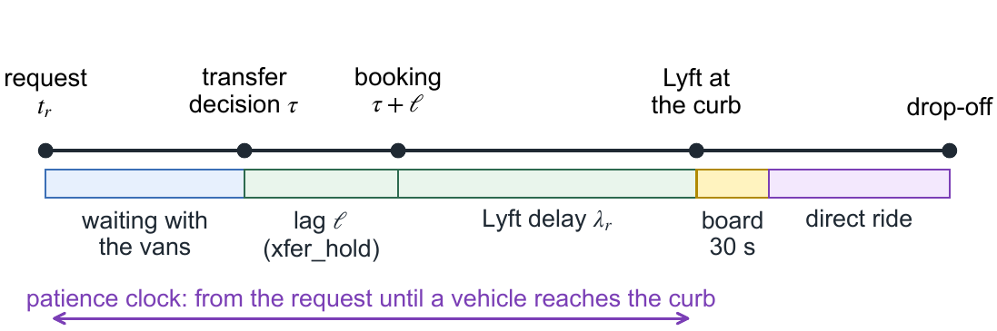
How our algorithm operates, every time something happens
1 Reveal new requests; update vans and riders
The dispatcher sees
Hidden until it happens
requests that have arrived
where each van is, who is aboard
travel times
each rider's patience deadline
whether the rider will be at the curb
each Lyft's actual delay
2 Generate feasible candidate routes per van
3 MILP selects one route per van
4 Lyft rule reads the predicted pickups
One actual transfer on a small designed evening (rule R2(15): transfer if predicted total wait > 15 min)
5 Apply accepted transfers
6 Re-plan once if anyone was transferred
7 Execute: vans drive to their next stop
repeat at every request, cancellation, no-show and every 2 minutes
Rider R011: asked 18:16:30 · at 18:20 a van was predicted at 18:35:20 (total wait 18 min 50 s > 15) → transferred · booked 18:22 · Lyft at the curb 18:30 (wait 13 min 30 s) · dropped 18:33:25
Source: scenario_spec.md v0.8 §17; decision log D-46, D-55; outputs/sim/m2_L4_report.md.
5
Notes:
P2, 2 min. The loop runs at every event and every two minutes of simulated time. Steps 1–3 are the van dispatcher: list feasible routes for each van, then a MILP picks one route per van so that every waiting request is either in a route or left waiting. Steps 4–6 are the separate Lyft rule: it reads the dispatcher's predicted pickup times, transfers riders that meet its condition, and the dispatcher re-plans once. Important distinction: the predicted pickups are the dispatcher's estimates; the simulator's actual events (arrivals, boardings, cancellations) come from travel times and the hidden rider traits on the right, which the dispatcher never sees. Worked timeline: on the designed L4 evening under the predicted-wait rule, R011 asked at 18:16:30; at 18:20 the plan predicted a van at 18:35:20, a total wait of 18 min 50 s, above 15, so it was transferred; booked at 18:22, Lyft at the curb 18:30, dropped at 18:33:25. Its wait is counted from the original request: 13.5 min. Sources: spec §17.3–17.5, D-55, m2_L4_report.

Slide 7
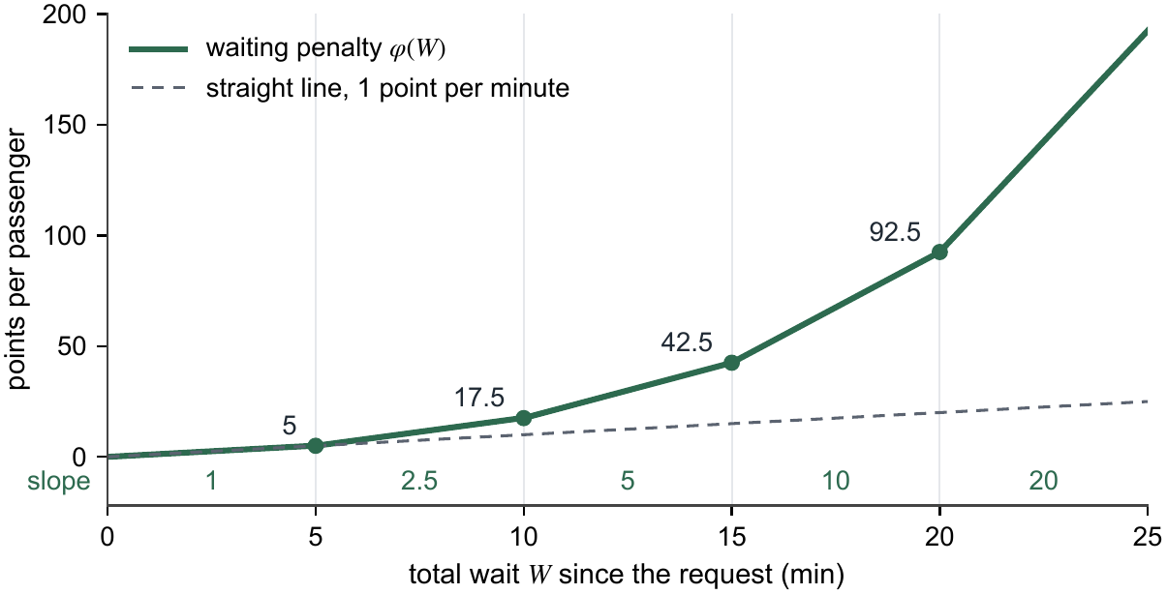
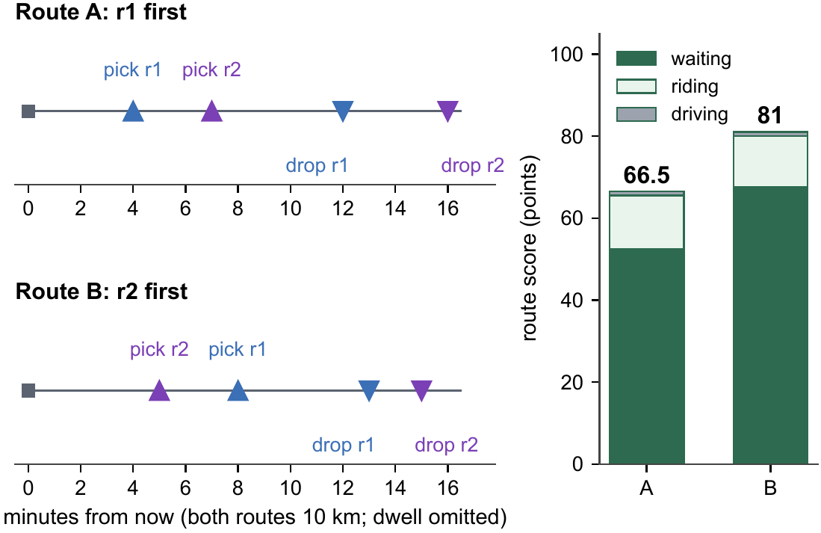
How the mathematics chooses a plan
Each candidate route gets penalty points (not money); the MILP picks the cheapest compatible set
route points = Σ party × φ(wait) + 0.5 × Σ party × ride minutes + 0.1 × km
A request in no chosen route is left waiting at a price (slide 7); a large constant makes the model first serve as many requests as it can.
One van; r1 (1 rider, waited 8 min) and r2 (2 riders, waited 1 min)
Route A (long waiter first): 66.5 points
Route B: 81.0 points → A is chosen
φ: each extra minute of waiting costs more the longer the rider has already waited (1, 2.5, 5, 10, 20 points per minute after 0, 5, 10, 15, 20 minutes)
"Optimal" means optimal over the candidate routes generated at that moment (up to 3 new pickups per van), proven by the solver. Not optimal over all possible routes, and not over the whole evening.
Source: model_design.md v0.5 §3–§4; methodology §6 (worked example); decision log D-29, D-52.
6
Notes:
P2, 1.5 min. The objective in words: waiting points, riding points, driving points. Waiting uses a convex penalty phi: the fifth minute of waiting costs 1 point, the sixteenth costs 10, the twenty-first costs 20. This is how the model protects riders who have already waited long. Riding costs half a point per passenger-minute; driving 0.1 point per km as a tie-breaker. A ride-time guardrail forbids plans that create a ride longer than max(25 min, 2 × direct + 5). Worked example (two requests, one van): serving the 8-minute waiter first costs 66.5 points, serving the party of two first costs 81.0, because the first rider's wait would cross 15 minutes where each minute costs 10 points. Points are priorities, not dollars. Qualify 'optimal': the solver proves optimality over the routes we generated at that epoch, with at most three new pickups per van; it is not a whole-evening optimum. Backup B1 has the full MILP and the bound that makes it serve as many requests as possible first. Sources: model_design §3.5, §4; D-29, D-52.

Slide 8
A weakness we found, tested and addressed
Problem: the price for leaving a request waiting (the "pending price") assumed a van could reach it at the next 2-minute re-plan, sooner than any van physically could. So the cheapest requests to postpone were often those that had waited longest.
Same small designed evening (16 requests), whole evening | Original price | A: earliest physical pickup | B: after a chosen route
Wait median / 90th pct / max (min) | 17.1 / 31.0 / 44.4 | 18.6 / 31.2 / 35.6 | 21.1 / 34.3 / 38.6
Mean wait (min) | 18.8 | 18.8 | 21.8
Total wait of the party of five that had already waited 15 min by 18:15 | 22 min 18 s | 19 min 28 s | 20 min 39 s
Extra MILP variables / total solve time | 0 / 0.1 s total | 0 / 0.1 s total | up to 9,828 / 4.8 s total
Decision: A (approved, provisional)
a direct physical pickup estimate
no new variables
keeps "serve as many as possible first"
Reason: clear meaning at no added cost, not that one rider was served sooner.
Still an approximation: A ignores work the nearest van is already doing, so postponing can still look too cheap. The experiment checked behaviour over a whole evening: A cut the longest waits but redistributed waiting (the median rose and the most recent request waited longer); it did not improve every outcome.
Source: Decision log D-53 (update 2, approval); outputs/sim/d53_experiment/d53_comparison.md; review note d53_pending_price_review.
7
Notes:
P2, 1.5 min. When a request cannot be served this epoch it gets a 'pending price'. The original price assumed pickup at the next 2-minute tick, which is physically impossible when vans are far away, so postponing looked cheap, and most of all for riders who would be picked up late, often the longest waiters. At 18:15 on the designed evening a party of five that had waited 15 minutes was left waiting. We ran a controlled experiment: three formulations, each run through the whole evening on identical inputs. A prices waiting at the earliest physical pickup by any van; B prices it after a chosen van's route. A added nothing to the model; B added up to about 9,800 variables here and about 135,000 in a synthetic five-van epoch, and its estimate can be wrong in both directions. We approved A provisionally for its meaning and cost, not because R002 was served sooner. A is still optimistic, and the change shifted waiting toward younger riders. Sources: D-53 update 2 and approval; d53_comparison.md.

Slide 9
How we know the code does what we specify
to the second
22 + 4
hand-computed answer keys reproduced on three designed evenings (L1–L3)
Lyft transfers and declined offers (there, riders accept with probability 0.9) matched on a fourth designed evening, summed over the five rules that transfer
292,181
253
plan combinations enumerated by an independent brute-force program (the designed evening under the original and the approved pending price); the MILP's choice matched at every epoch
automated tests (207 on the simulator); 168 written by independent reviewers who did not reuse the simulator's logic
Plus on every run: one outcome per request, counts reconcile, seats and pickup-before-drop-off hold, inputs unchanged, sampled reruns identical. This checks the code against our rules, not our rules against the real service.
Source: Phase 4 log; decision log D-52, D-55, D-57; tests/ (test_sim_*, test_m2_independent, test_pending_price_independent).
8
Notes:
P2, 1 min. Before trusting any result we checked the machinery. Three small designed evenings have answer keys computed by hand; the simulator reproduces every pickup, drop-off, no-show and cancellation time to the second. On the fourth designed evening, the Lyft bookkeeping before the vans come on duty matched: 22 transfers and 4 declined offers, summed over five separate rule runs (not one night). For the MILP, an independent brute-force program enumerated every compatible combination of candidate routes (151,710 under the original pending price and 140,471 under the approved one, on the designed evening) and agreed with the solver every time. 253 automated tests, two thirds of them written by independent reviewers. A simulation that is only plausible is not enough; these checks let us say the numbers on the next slides are what the model does. Sources: Phase 4 log; tests directory.

Slide 10
Thirty synthetic nights: what the rules actually did
Pilot: 30 synthetic one-hour nights, each replayed under all six rules (same riders, same hidden traits). Two vans for 28 requests: a heavy load by design (14 per van-hour, a 10-minute burst). Provisional settings; the five-van evening is not yet run.
A transfer is not a rescue
Patience keeps running: 95 of 196 requests transferred under R1(10) cancelled before their Lyft arrived (77 after booking); about a third under R2(15) and R3(2).
Assigned is not picked up
"Transfer after 10 min with no van assigned" (R1u(10)) fired only when a request stayed unassigned that long: 8 transfers on 6 of 30 nights, all for requests made during the burst.
Rides over the limit
Plans never exceed the ride limit, but rides did 36 times across the 180 runs (16 distinct requests on 10 nights); each coincided with a no-show wait on that van while the rider was aboard: consistent with, not proof of, that cause.
Mind the denominator
Wait percentiles cover only riders picked up (16 of 28 under never-transfer); "reached within 15 min" counts every request.
Source: outputs/sim/batch_L5_v1 (summary.md, per-run outcomes); decision log D-56, D-57. Counts are totals over 30 nights.
9
Notes:
P3, 2 min. Define L5 carefully: 30 synthetic nights, not real nights and not 180 independent nights; each night is replayed under all six rules with the same riders and the same hidden traits, so differences come from the rule. Two vans, 28 requests in an hour with a burst; this is a two-van pilot, not the proposed five-van evening. Settings are provisional: placeholder patience, 8.9% presence. Mechanism 1: a transfer does not stop the patience clock; with a 2-minute lag and an 8-minute typical Lyft delay, many late transfers end in cancellation after the booking was placed. Under 'transfer after 10 minutes waited', 95 of 196 transferred requests (almost half) cancelled before the Lyft arrived, 77 of them after the booking was placed. Mechanism 2: the unassigned-time rule measures assignment, not waiting; on the designed L4 evening it never fired after vans came on duty, while in L5 it fired 8 times on 6 nights, all for requests made during the burst, when two vans could not absorb the queue. Mechanism 3: the 36 guardrail excesses (16 distinct requests on 10 nights, repeated across rules that made the same decisions) each coincide with a no-show wait on the same van; this is an attribution consistent with timing, not a proof of cause. Mechanism 4: wait percentiles only describe riders who were picked up, so a rule that loses riders to cancellation can look better than it is. Sources: batch summary.md; D-56, D-57.

Slide 11
Service versus Lyft use: a trade-off among tested rules
Service = share of all requests a vehicle reached at the curb within 15 min. Rule P dominates Q if P has at least Q's service with no more Lyft bookings, and is strictly better in one.
Nondominated among the six tested
On the 30-night means: R0 (never transfer), R1(10) (after 10 min waited), R1(15) (after 15 min waited), R2(15) (predicted wait > 15 min), R3(2) (van later than Lyft + 2 min) are nondominated. R1u(10) (after 10 min unassigned) is technically dominated by R0, but the service gap (0.476 vs 0.477) is far inside the night-to-night spread (SD about 0.09): in practice indistinguishable from never transferring. Visible pattern: the two rules that read predicted pickups reach about 0.74 of requests, against 0.48–0.51 for the others, using about 9–10 Lyft bookings a night.
Not a frontier of all possible policies
Not a recommendation: picking a point needs a value judgement
Weights inside the routing objective are a different trade-off
Decision criteria (margins, intervals) are not yet agreed
Source: outputs/sim/batch_L5_v1/tradeoff.md (src/sim/tradeoff.py; descriptive, saved outputs only).
10
Notes:
P3, 1.5 min. Two objectives stated explicitly: service, the share of all requests a vehicle reaches within 15 minutes (curb arrival, larger is better), and Lyft use, bookings per night (smaller is better). Introduce dominance with the sentence on the slide. Each point is a rule's average over the 30 paired nights. Never-transfer uses no Lyft and reaches about 48%; the elapsed-time rules buy little extra reach per booking; the two rules that read predicted pickups reach about three quarters of requests with about 9–10 bookings. The unassigned-time rule is dominated on these means, very narrowly. Per night the picture varies: see backup B6. Four cautions on the slide: only six policies were tested; nondominated is not 'best'; this trade-off between transfer rules is different from the fixed exchange rate inside the routing objective; and the statistical decision criteria (margins, intervals) are a proposal not yet approved. Sources: tradeoff.md, computed from the saved batch with src/sim/tradeoff.py.

Slide 12
A leader–follower reading: possible, but not what we solved
Leader: policy designer
Formal version (an extension):
chooses the transfer rule and its threshold θ
choose θ to minimise E[ service loss(θ, y) + λ × Lyft bookings(θ) ]
subject to y ∈ argmin over feasible routes of routing cost(y; riders not transferred under θ)
What we implemented
Missing for a solved bilevel model
Follower: routing optimizer
a sequential policy simulation: plan → rule reads plan → transfers → re-plan once
six fixed rules compared by replaying nights
an upper-level optimisation over θ
the follower's response stated as constraints over the whole evening (ours is per epoch, restricted)
a treatment of the expectation over nights
re-plans the vans around the riders left after transfers
Riders follow assumed patience rules and Lyft is a delay distribution: they are not modelled as optimizing players.
Source: Bilevel and leader–follower terminology: Colson, Marcotte & Savard (2007); Dempe (2002); von Stackelberg (1934). Implementation: spec §17.4, D-55.
11
Notes:
P3, 1 min. Leader–follower (Stackelberg) models have a leader who decides first anticipating how a follower will respond optimally. A natural reading of our problem: the leader is a policy designer choosing the transfer rule and its threshold; the follower is the routing optimizer that re-plans the vans for the riders who remain. Written formally, that is a bilevel program: the upper level chooses theta to minimise expected service loss plus lambda times Lyft use, subject to the routes being optimal for the lower-level routing problem. We have not solved that. What we run is a sequential policy simulation: the dispatcher plans, the rule reads the plan, accepted transfers leave, the dispatcher re-plans once; and we compare six fixed rules by replaying nights. Missing: an optimisation over theta, the follower's optimality imposed as constraints over the evening (our dispatcher optimizes one epoch at a time over a restricted candidate set), and the expectation over nights. Any reduction of such a model to a single level would need specific assumptions and justification; we make no such claim. This is a possible extension, not something impossible and not something done. References: Colson, Marcotte & Savard (2007), Annals of Operations Research 153; Dempe (2002), Foundations of Bilevel Programming; von Stackelberg (1934).

Slide 13
Limitations, next experiments and what we contribute
Limitations
Next
Intended contribution
Aggregate data only; no comparison with real nights yet
Patience is a placeholder; no-show probability provisional
Results so far: two-van pilot; five-van evening not yet run
Up to 3 new pickups planned per van; some runs take minutes
One night pattern; designed evenings are small
Agree the decision criteria, then compute paired intervals on the saved 30 nights (to size the main experiment, not to conclude)
Sweep rule thresholds to trace trade-off curves
Build the five-van evening and check the MILP is fast enough there
Test sensitivity to patience and Lyft delay
A transparent, code-verified way to turn aggregate dashboards into paired synthetic experiments that say clearly what is observed, what is assumed and what the simulation produced. Not yet validated against real service nights.
Source: Phase 4 plan and log; decision log D-50, D-56, D-57; methodology §7–§9.
12
Notes:
P3, 1.5 min. Be direct about limits: aggregate data only; patience is a placeholder and the 8.9% no-show probability depends on how statuses were recorded; all results so far are from the two-van pilot; the five-van evening is designed but not run. Next steps in order: agree the decision criteria and compute paired intervals on the saved 30 nights; sweep thresholds to turn six points into curves; build and benchmark the five-van evening; test sensitivity. Contribution: not a claim that one rule wins, but a method that keeps observed, assumed and simulated facts separate and is verified to the second. Invite questions.

Slide 14
Backup slides
B1 MILP and bound · B2 event order and lifecycle · B3 code key · B4 parameter provenance · B5 all-rule batch table · B6 per-night trade-off · B7 pending-price formulas · B8 numerical diagnostics

Slide 15
B1 The route-selection MILP at one epoch
min Σ_v Σ_k c_vk y_vk + Σ_r π_r u_r
s.t. Σ_k y_vk = 1 for every van v (one route per van)
Σ_{v,k: r ∈ S_k} y_vk + u_r = 1 for every open request r (served once, or pending)
y, u ∈ {0, 1}
c_vk: route points (waiting φ, riding 0.5/passenger-min, 0.1/km; Ψ only for unavoidable guardrail excesses); exact integers
Candidates: every subset of ≤ 3 open requests per van, best order of all its stops (exact search); the van's committed-work route is always a candidate
π_r = b_r + M with b_r from pending price A; M = 1 + Σ_v (max_k c_vk − min_k c_vk) + Σ_r b_r guarantees that every proven-optimal solution leaves the fewest requests pending (per request, not per passenger)
HiGHS: relative gap 0, absolute gap 0.5 units, node limit 100,000; ties broken canonically; a failed solve is logged, never replaced by a heuristic
Source: model_design.md v0.5 §3; decision log D-47, D-52 (amendments), D-53 approval.
B1
Notes:
Backup for questions on the formulation, the M bound and solver handling.

Slide 16
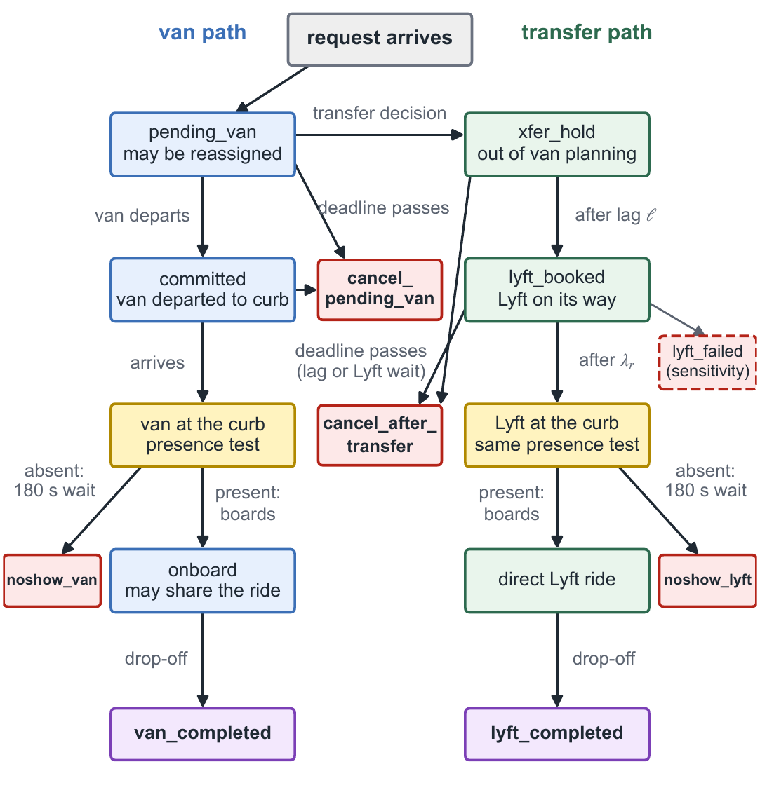
B2 Event order and a request's life
Same-second order: drop-offs → curb arrivals (stop the patience clock) → service ends → vans on/off duty → new requests → patience checks → Lyft bookings → planning epoch → departures
A van commits to a stop when it departs toward it
During an absent rider's 3-min curb wait, planning assumes possible boarding at expiry; the simulator never boards an absent rider (D-54)
Planning takes zero simulated time; wall-clock time is logged only
Source: scenario_spec.md v0.8 §17; decision log D-46, D-54.
B2
Notes:
Backup: event order and lifecycle.

Slide 17
B3 Code key
Code | Plain meaning
R0 | Never transfer to Lyft (reference)
R1(10), R1(15) | Transfer after 10 or 15 minutes of waiting
R1u(10) | Transfer after 10 minutes with no van assigned in the plan
R2(15) | Transfer if the predicted total wait exceeds 15 minutes
R3(2) | Transfer if the van is predicted later than a Lyft could arrive, plus 2 minutes
L1–L4 | Small designed evenings with hand-computed answer keys (L4: Lyft bookkeeping, vans from 18:15)
L5 | Pilot: 30 synthetic one-hour nights, 2 vans, 28 requests each
C | Our van dispatcher: a restricted route-selection MILP solved with HiGHS
A | Pending price: a waiting request is charged its earliest physically possible pickup
D-xx | Numbered entry in the decision log
MILP | Mixed-integer linear program
XL | Larger Lyft vehicle, used for a party of 5
Source: lyft.py; scenario_spec.md §6, §8; decision log.
B3
Notes:
Backup: code key.

Slide 18
B4 Where each input comes from
Input | Status | Value | Basis
Requests per hour | DERIVED | 64 / 50 / 54 for five vans (pilot: 28 in one hour, two vans) | D-35, D-36; L5 design
Trip pairing | ASSUMED + fitted | Gravity prior, decay 0.1/min, fitted to both April margins | D-18
Group size | ASSUMED (mean derived) | P(1..5) = .73/.18/.055/.025/.01; April 1.386 van passengers per completed van booking | D-38
Patience | ASSUMED placeholder | Weibull, shape 1.5, median 18 min | D-39
No-show | DERIVED, conditional | 8.9% per arrival if status mapping holds (4.7% of all requests) | D-48
Lyft | ASSUMED | Lag 2 min; delay lognormal, median 8, 90th pct 15 min | D-43
Travel times | OBSERVED (routing) | Local OSRM road network; van × 1.2 in the pilot | D-31, D-47
Source: decision log D-18–D-48; methodology §4.
B4
Notes:
Backup: parameter provenance.

Slide 19
B5 All six rules over 30 synthetic nights
Per night | R0 never transfer | R1(10) after 10 min waited | R1(15) after 15 min waited | R1u(10) after 10 min unassigned | R2(15) predicted wait > 15 min | R3(2) van later than Lyft + 2 min
Reached within 15 min (share of 28) | 0.48 (0.09) | 0.51 (0.08) | 0.50 (0.09) | 0.48 (0.10) | 0.73 (0.07) | 0.75 (0.08)
Requests picked up (of 28) | 16.1 (2.4) | 17.2 (2.6) | 16.5 (2.6) | 16.2 (2.5) | 20.2 (2.0) | 20.4 (2.3)
Wait median, min (picked up) | 8.6 (1.8) | 8.3 (1.6) | 8.4 (1.5) | 8.9 (2.1) | 7.5 (1.0) | 7.3 (1.0)
Wait 90th pct, min (picked up) | 20.2 (5.3) | 18.1 (2.4) | 19.6 (4.0) | 20.2 (4.6) | 13.3 (1.5) | 12.2 (1.7)
Wait 90th pct, min (passengers) | 20.1 (5.8) | 17.4 (2.7) | 19.2 (4.8) | 19.6 (4.7) | 13.2 (2.3) | 12.7 (2.7)
Van completed | 16.1 (2.4) | 14.1 (2.3) | 14.6 (2.4) | 16.1 (2.5) | 14.0 (2.7) | 13.3 (2.6)
Lyft completed | 0.0 (0.0) | 3.1 (1.4) | 1.8 (1.2) | 0.1 (0.3) | 6.2 (1.9) | 7.0 (1.6)
Cancelled waiting for van | 10.8 (2.3) | 6.5 (2.3) | 8.9 (2.5) | 10.5 (2.4) | 3.3 (1.7) | 2.6 (1.5)
Cancelled after transfer | 0.0 (0.0) | 3.2 (1.8) | 1.5 (1.0) | 0.1 (0.4) | 3.1 (1.5) | 3.5 (1.5)
Lyft bookings | 0.0 (0.0) | 5.9 (1.6) | 3.1 (1.4) | 0.2 (0.5) | 9.3 (2.5) | 10.5 (1.9)
Van-km | 51.2 (4.4) | 47.6 (5.5) | 48.6 (5.0) | 51.9 (4.8) | 45.7 (5.7) | 43.0 (4.0)
Run time, s | 43 (46) | 40 (44) | 49 (57) | 50 (56) | 5 (7) | 4 (5)
Cells: mean of nightly values (standard deviation across nights). Waits cover only requests picked up.
Source: outputs/sim/batch_L5_v1/summary.md.
B5
Notes:
Backup: the full batch table.

Slide 20
B6 Trade-off night by night
Rule | Reach (mean) | Lyft bookings (mean) | Nights nondominated | Nights = R0 | Reach above / below R0
R0 never transfer | 0.477 | 0.00 | 30 of 30 | 30 | 0 / 0
R1(10) after 10 min waited | 0.514 | 5.93 | 11 of 30 | 0 | 19 / 6
R1(15) after 15 min waited | 0.495 | 3.10 | 14 of 30 | 1 | 15 / 5
R1u(10) after 10 min unassigned | 0.476 | 0.23 | 26 of 30 | 24 | 2 / 2
R2(15) predicted wait > 15 min | 0.735 | 9.33 | 24 of 30 | 0 | 30 / 0
R3(2) van later than Lyft + 2 min | 0.750 | 10.47 | 12 of 30 | 0 | 30 / 0
A rule that makes no transfer on a night replays never-transfer exactly and ties it. Nights with reach above / below never-transfer are paired comparisons of the same synthetic night.
Source: outputs/sim/batch_L5_v1/tradeoff.md.
B6
Notes:
Backup: per-night nondominance and paired comparisons with never-transfer.

Slide 21
B7 The three pending prices
Original: b_r = q_r · φ(next tick − t_r)
A (approved, provisional): b_r = q_r · φ(max(next tick, L_r) − t_r), L_r = earliest any on-duty van can reach the pickup
B (experimental): price after a chosen van's route, linearised with continuous variables z_rj ≤ y_j, Σ_j z_rj = u_r
A is a lower bound on any future service (up to a 13-s matrix exception, vans not yet on duty, the next-tick floor); B can err in both directions and adds |requests| × |routes| variables
Neither is a guaranteed feasible joint schedule for all waiting riders
Source: model_design.md v0.5 §3.5; decision log D-53; research_notes/d53_pending_price_review_2026-10-22.md.
B7
Notes:
Backup: pending-price formulas.

Slide 22
B8 Numerical diagnostics (L5 pilot)
180 runs = 30 synthetic nights × 6 rules; every run passed every check; one code version for all runs
13,663 planning epochs; main solve proven optimal in all (none unproven, none failed)
41 epochs had an incomplete tie search (a solver error while looking for equally good plans); in all 41 a full enumeration shows a unique optimum, which is the plan chosen
36 ride-guardrail excesses across the 180 runs (16 distinct requests on 10 nights, repeated across rules), each coinciding with a no-show wait on that van while the rider was aboard (attribution check, not proof); 0 unexplained
Run time per run: mean 32 s, longest 253 s (Python, one core per run)
Reproducibility: 6 of 6 sampled reruns identical byte for byte; the 2 night-r00 batch runs identical to the earlier pilot outputs
Source: outputs/sim/batch_L5_v1 (summary.md, tie_incomplete_check.csv, reproducibility.json); decision log D-52 am. 5, D-57.
B8
Notes:
Backup: solver statuses, tie searches, runtime, guardrail attribution, reproducibility.

