Slide 1



Slide 2

Anthony J. Kearsley
En.553.602 Research & Design In Mathematics: Data Mining
S
Miles Zhou
Undergraduate Student
Applied Mathematics and Statistics
I
Irfan Setiadi
Graduate Student
Data Science, Applied Mathematics and Statistics
G
Vignesh Rajesh Babu
Graduate Student
Data Science, Applied Mathematics and Statistics
H
Youzhi Zhang
Graduate Student
Data Science, Applied Mathematics and Statistics

Slide 3

OPTIMIZING
The Blue Jay Night Ride Shuttle
Dispatch & routing models for JHU's on-demand shared shuttle
reducing rider wait times and Lyft overflow on Blue Jay Night Ride.

Slide 4





When should Night Ride move a waiting request to Lyft?
What April's aggregate data helped us build—and what our first simulations revealed.
Shared van
Lyft

Slide 5

The service and one request
Homewood-area Night Ride pools requests in shared vans. A dispatcher can move waiting riders to Lyft. We are studying when that transfer should happen.
Area: Homewood Night Ride, including the Peabody area; East Baltimore excluded.
transfer → a separate Lyft order; the rider can still cancel or be absent
Request
Wait
Vehicle reaches curb
Boarding
Drop-off
Vehicle reaches curb
Cancellation: rider gives up
No-show: absent after a 3-min curb wait
Booking
one Night Ride request, possibly with several passengers
Lyft order
a separate order placed after a transfer decision
Curb arrival
the vehicle reaches the pickup location
Pickup
the rider boards
Waiting time runs from the request to curb arrival. Each Lyft order is an extra trip Hopkins pays for (its cost is unknown to us), so moving riders to Lyft has a price.
Source: docs/technical/decision_log.md D-23, D-27; scenario_spec.md v0.8 §5–§6; JHU Night Ride page (3-min curb wait).
2
Notes:
Script: speaking_script.md#s02. Handbook: slide_explanations.md#s02. Scope: Homewood Night Ride including the Peabody area (D-23, D-27).

Slide 6
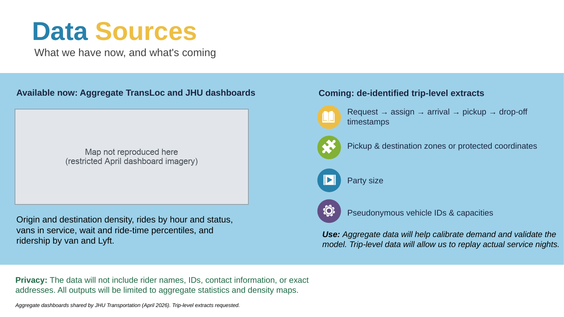
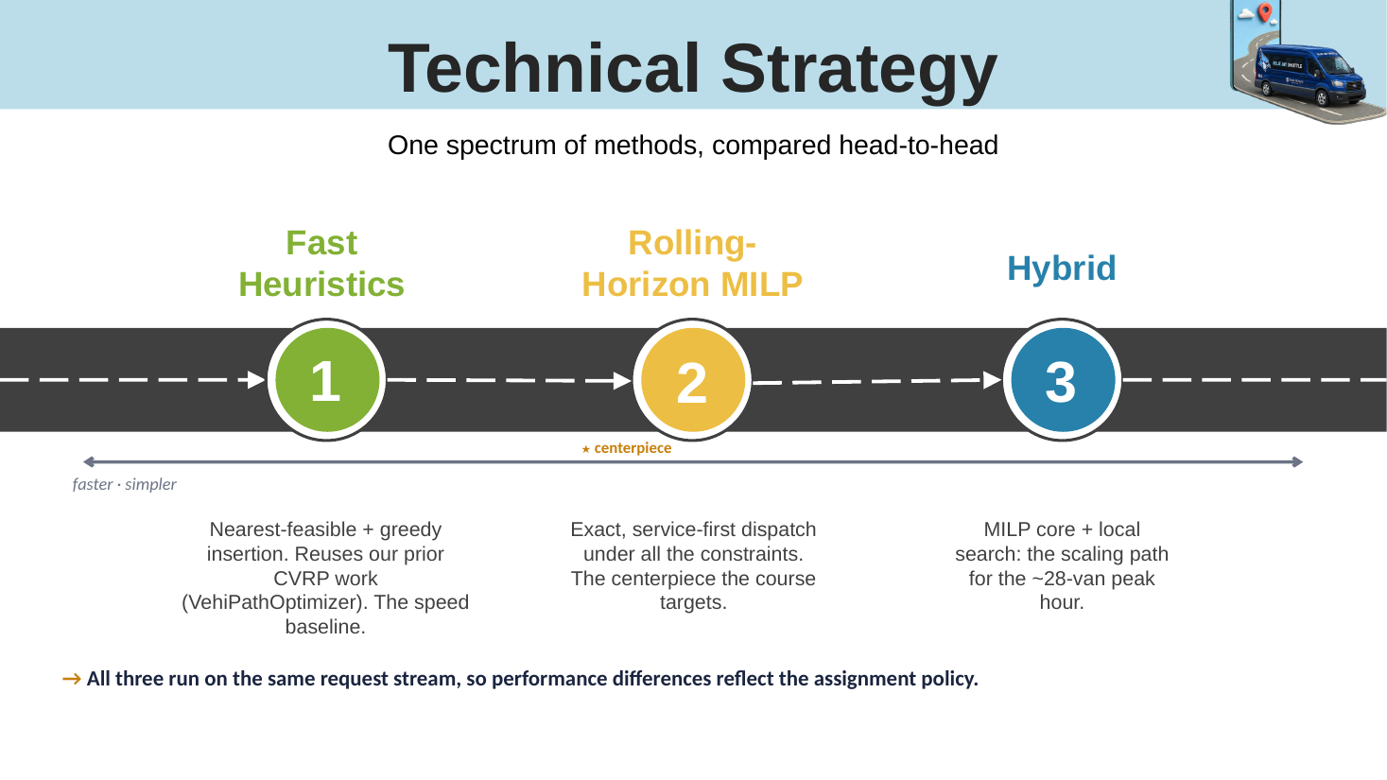
Where we started
ORIGINAL PROPOSAL
ORIGINAL PROPOSAL
Original proposal, slide 10: trip-level extracts were expected, to replay actual service nights
Original proposal, slide 11: compare heuristics, a rolling-horizon MILP and a hybrid on the same request stream
What changed: the trip-level extracts never arrived, so real nights could not be replayed. The data we have are April's aggregate dashboards. We also narrowed the question (next slides).
Source: BlueJayNightRide_Proposal.pptx (September, committed version), slides 10–11.
All proposal corrections: B9 →
3
Notes:
Script: speaking_script.md#s03. Handbook: slide_explanations.md#s03. Original slides 10 and 11 of the September proposal deck (committed version), reproduced as images; the dashboard map is masked.

Slide 7
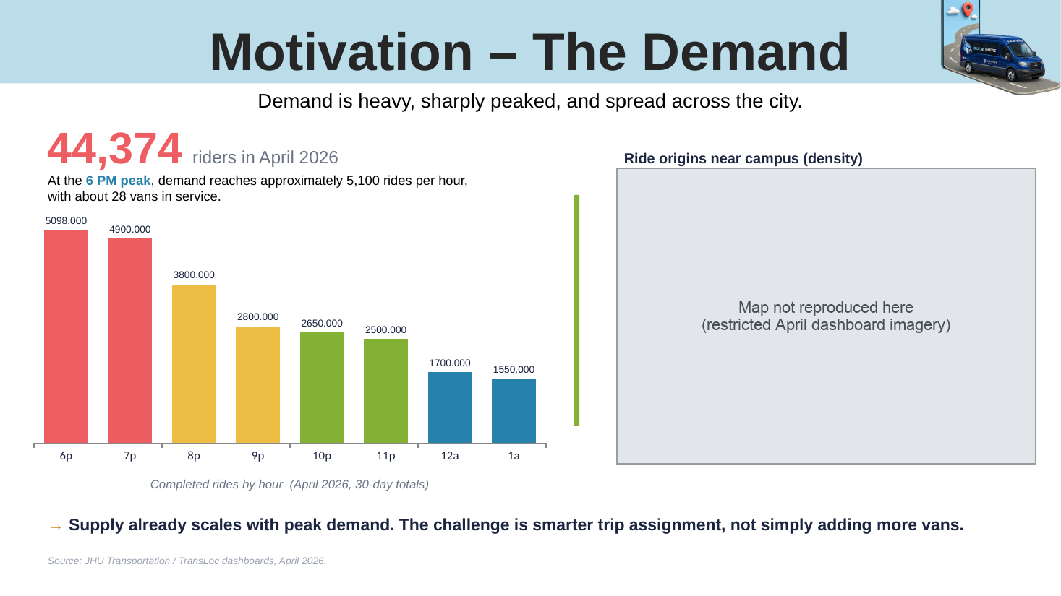
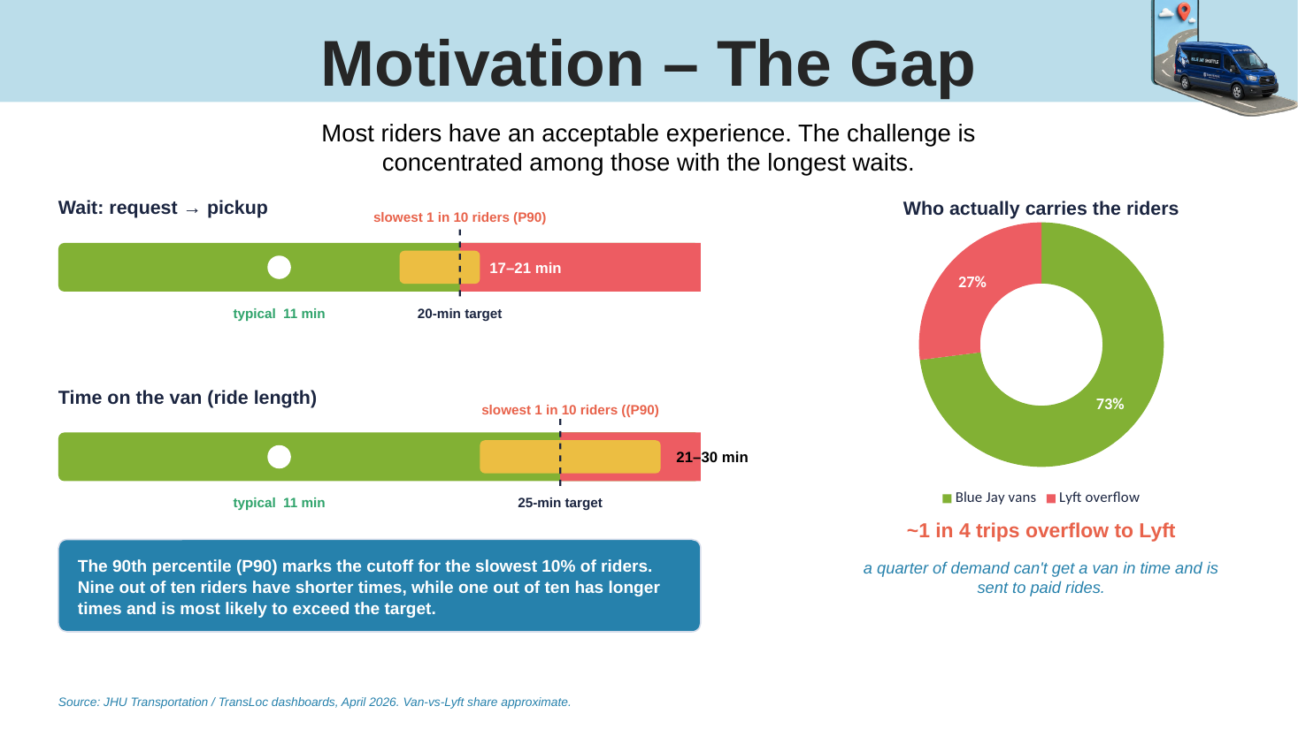
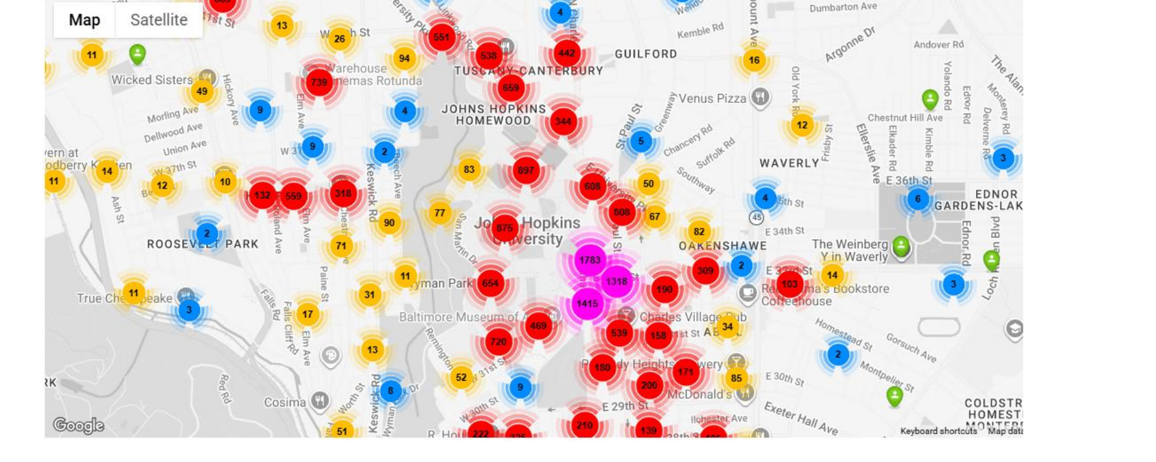
Where we started: numbers we later corrected
ORIGINAL PROPOSAL
ORIGINAL PROPOSAL
1
2
3
4
“about 5,100 rides per hour” at 6 pm → a 30-day total: about 170 completed rides in one evening's 6 pm hour
“about 28 vans in service” → the “All services” average (27.6 at 6 pm), not a Homewood-only count
1
2
7 pm bar “4,900” → our digitized value is 3,957 (also a 30-day total)
“~1 in 4 trips overflow to Lyft” → 24.5% of riders rode Lyft: a share of riders, not of trips or requests
3
4
Source: Proposal slides 7–8; April dashboards (digitized aggregates); methodology v1.5 §1a. Details: B9.
Details: B9 →
4
Notes:
Script: speaking_script.md#s04. Handbook: slide_explanations.md#s04. Original slides 7 and 8, with correction markers. The map is masked (restricted dashboard imagery).

Slide 8
We narrowed the question to one controllable decision
We now hold one specified van dispatcher fixed and change only the Lyft transfer rule.
Original
Evidence
Current Controlled
AMBITION
AVAILABLE
EXPERIMENT
Replay real service nights
Compare dispatch methods head to head
Lyft use decided inside the optimizer itself
Aggregate April dashboards only
No individual journeys
Hopkins' current dispatcher internals not verified
One specified van dispatcher, held fixed
Change only the Lyft transfer rule
Same constructed nights for every rule
This lets us study how the timing and information used by that rule change service and Lyft use.
Why: it is the question we chose, the real dispatcher's internals are not known to us, and a controlled comparison needs everything else held fixed. Our van dispatcher re-plans every 2 minutes and at each new request, cancellation or no-show while waiting, or van coming on duty: modelled on TransLoc's (the vendor's dispatch software) published 2016 design, not verified current Hopkins practice.
Source: docs/technical/scenario_methodology.md v1.5 §1a; decision_log.md D-25, D-51; transloc_operations.md.
5
Notes:
Script: speaking_script.md#s05. Handbook: slide_explanations.md#s05. Scope choice, not a claim that synthetic algorithm comparisons are invalid. Dispatcher modelled on TransLoc's published 2016 design (transloc_operations.md); current Hopkins practice not verified.

Slide 9
April describes totals—not individual journeys
We know how many requests ended in each status, where pickups and drop-offs accumulated, and how activity varied by hour. We cannot reconstruct each rider's journey.
Requests by final status: 50,297 in the month
Completed rides by hour (30-day totals)
Vehicles on duty by hour (27.6 at 6 pm, all services)
Pickup and drop-off counts at 188 map places
Wait-time percentiles
Riders by van and by Lyft (44,374; 24.5% by Lyft)
Missing: any single journey
When each request was made
Which pickup went with which drop-off
How long that rider waited
Whether they boarded, gave up or were moved to Lyft
Observed: totals and shares
OBSERVED
read from April's dashboards
DERIVED
computed from observed numbers
ASSUMED
our modelling choice, to be tested
DESIGNED
an experiment setting we chose
We therefore built plausible evenings from the evidence, while keeping the missing pieces visible.
Source: April 2026 operations dashboards (restricted; digitized aggregates in data/processed); docs/technical/scenario_methodology.md §3.
6
Notes:
Script: speaking_script.md#s06. Handbook: slide_explanations.md#s06. Restricted source: digitized aggregates only, no screenshots.

Slide 10
How busy should a constructed evening be?
We estimated a workload from April's completed rides, request-to-completion ratio and reported vehicle availability.
ASSUMED
This assumes the monthly request-to-completion ratio applies within the hour, and uses vehicle availability reported across services. It is an estimated workload, not observed arrivals.
Per vehicle on duty
355 ÷ 27.6 vehicles
Requests in that hour
≈ 12.85 requests / vehicle-hour
Requests per completed ride
170 rides × 2.09
DERIVED + ASSUMED
50,297 requests ÷ 24,095 completed
≈ 355 requests / hour
Completed rides, 6 pm hour
≈ 2.09 requests / ride
DERIVED + ASSUMED
≈ 5,100 rides ÷ 30 days
≈ 170 rides / evening
DERIVED
DERIVED
Five vans × hourly load → 64 / 50 / 54 requests in three hours = 168
PLANNED — NOT YET RUN
Five vans is our planned evening (a team design choice). Each hour uses its own rides and vehicles on duty. Illustrative range about 150–260 (unknown Homewood share of vehicles, repeat requests).
The five-van, 168-request evening is designed but has not been run.
Source: April dashboards (rides by hour, status totals, vehicles on duty); docs/technical/decision_log.md D-35, D-36, D-49.
Notes:
Script: speaking_script.md#s07. Handbook: slide_explanations.md#s07. D-35, D-36, D-49.

Slide 11
We started with a smaller, deliberately demanding hour
The current results come from two vans and 28 requests in one hour, repeated across 30 constructed nights.
burst: 11 of 28 placed here
2 vans
14 seats each
28 requests
in one hour
17 spread over the hour
18:00
18:10
18:20
18:30
18:40
18:50
19:00
30 nights
distinct constructed nights
× 6 rules
transfer rules, defined on slide 17
Arrivals 18:00–19:00. Background requests can also fall in the burst window, so 11–17 requests (mean 13.7) arrive in 18:20–18:30 on a night; 34–51 passengers per night.
TESTED IN SIMULATION
This is a controlled pilot, not a reconstruction of a typical April night.
Its load is 14 requests per van-hour, close to the 12.85 estimated for 6 pm (per vehicle reported across all services), but the burst deliberately concentrates demand, and two vans are a small fleet. It is designed to stress the transfer decision.
“Tested in simulation” means run in our model, not validated against Hopkins operations.
Source: data/scenarios/v2/L5 (frozen inputs); docs/technical/scenario_spec.md §8; decision_log.md D-56, D-57.
8
Notes:
Script: speaking_script.md#s08. Handbook: slide_explanations.md#s08. L5 pilot: D-56 settings, D-57 batch.

Slide 12
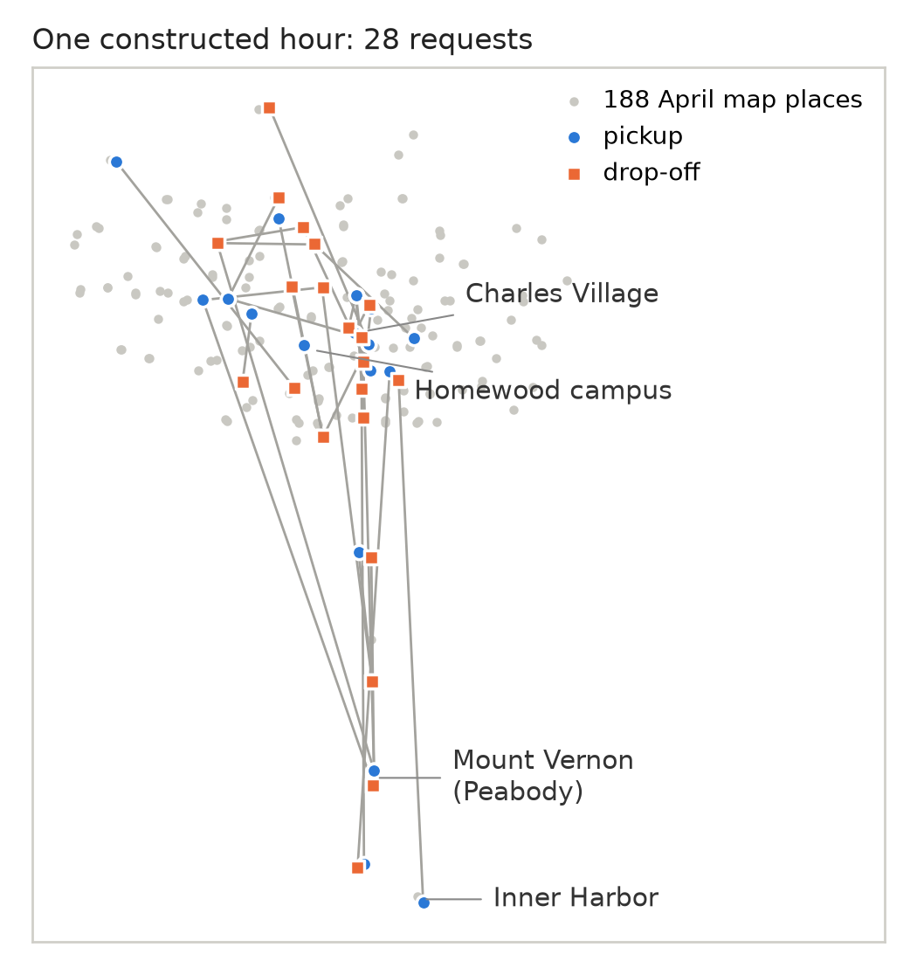
Knowing the endpoints does not identify the journeys
Two different sets of trips can produce exactly the same pickup and drop-off totals.
Trips, version 1
Trips, version 2
 | to X | to Y | total
from A | 2 | 0 | 2
from B | 0 | 2 | 2
total | 2 | 2 | 4
 | to X | to Y | total
from A | 1 | 1 | 2
from B | 1 | 1 | 2
total | 2 | 2 | 4
Green cells are all the maps show. Both versions match them exactly.
ASSUMED
We assumed nearby journeys were more likely, then balanced the synthetic trips to preserve the observed location totals.
Distance preference: each extra minute of driving multiplies a pair's weight by about 0.9 (assumed rate 0.1 per minute)
Balancing: rows and columns rescaled in turn until both April location totals match
Source: April pickup and drop-off maps (place totals); docs/technical/decision_log.md D-18; map: the first constructed pilot night.
9
Notes:
Script: speaking_script.md#s09. Handbook: slide_explanations.md#s09. Gravity prior + iterative proportional fitting, D-18.

Slide 13
One average can hide very different groups
April helps identify an average group size. It does not tell us the full distribution of groups.
DERIVED
1.386
van passengers per completed van request (ratio of two observed totals)
Requests with 3 or more passengers: Example A 8%, Example B 12.3%, ours 9%. Examples A and B are illustrations, not data.
ASSUMED
Our chosen group-size mix is an assumption informed by the average—not a distribution recovered from April. It covers all requests, so its mean (1.405) need not equal 1.386
Groups matter: seats per van, and waiting counted per passenger (slide 16)
A party of five transferred to Lyft rides together in one XL (team decision)
Source: April dashboards (passengers, completed van requests); docs/technical/decision_log.md D-38, D-33. Bar labels rounded.
10
Notes:
Script: speaking_script.md#s10. Handbook: slide_explanations.md#s10. D-38 (shares), D-33 (XL for a party of five).

Slide 14
One status label hides different events
‘Cancelled’ does not tell us whether a rider gave up or a dispatcher moved the request to Lyft.
O
H
Assumed
We assume Lyft transfers also show as “Canceled”; the share that is riders giving up is tested as a 50–75% range.
Observation
Hidden Rider Patience
A
Assumed
Observed
23,843 of 50,297 requests (47%) ended “Canceled”. The label alone does not
say why.
Each simulated rider gets a private deadline the dispatcher cannot see. Placeholder: median 18 minutes, waiting-dependent (Weibull).
Assumed Status Mapping
The patience distribution is provisional. It lets the simulator represent abandonment; it is not a behavioural distribution measured from April. Many different patience distributions could produce the same cancellation share, so a chosen share does not pin one down.
Source: April dashboard status totals (digitized sums also show 99 “Denied”); docs/technical/decision_log.md D-39, D-49; methodology Appendix C.
11
Notes:
Script: speaking_script.md#s11. Handbook: slide_explanations.md#s11. Patience: Weibull shape 1.5, median 18 min, placeholder (D-39); share of 'Cancelled' that is abandonment, 50-75% range (D-49).

Slide 15
The simulator needs a probability at vehicle arrival
The share of all requests marked ‘No Show’ is different from the chance of a no-show when a vehicle actually arrives.
Divide by all requests
Divide by van arrivals (completed + no-show)
2,359
= 4.7%
2,359
50,297
26,454
8.9
includes requests no vehicle ever reached
a no-show can only happen when a vehicle arrives
ARRIVALS
DERIVED + ASSUMED
DERIVED
REQUESTS
X
4.7
SIM
NO SHOW
8.9% holds only if:
“No Show” was recorded after a real van arrival; “Completed” counts van trips; and Lyft hand-offs sit in “Canceled”.
Our arrival-based probability is provisional because it depends on how the dashboard statuses were recorded.
The simulator gives each rider one presence
draw, used whichever vehicle arrives
(van or Lyft).
VAN / LYFT
L
Source: April dashboard status totals; docs/technical/decision_log.md D-40, D-48; scenario_methodology.md Appendix C.
12
Notes:
Script: speaking_script.md#s12. Handbook: slide_explanations.md#s12. D-40, D-48; methodology Appendix C.

Slide 16

The evidence becomes a scenario blueprint
Resources
Experiment Settings
A scenario combines evidence-based inputs, explicit assumptions and hidden rider behaviour.
Vans and duty times
Van dispatcher (fixed)
DESIGNED
DESIGNED
Capacity (14 seats)
Transfer rule (varied)
Source: docs/technical/scenario_spec.md v0.8 §3–§5; decision_log.md D-18–D-56.
DESIGNED
DESIGNED
Travel times × 1.2
Ordering lag 2 min
DERIVED + ASSUMED
ASSUMED
Demand
Behavior
Arrival times
Patience
DERIVED + ASSUMED
ASSUMED
Inputs are fixed before the run; outcomes are not. Cancellations, no-shows and transfers happen during the run, from the hidden draws meeting the rule and the vans. They are results, not counts imposed in advance.
Locations
DERIVED + ASSUMED
Presence at the curb
Trip pairing
DERIVED + ASSUMED
ASSUMED
Party sizes
Lyft delay
Where each input comes from: B4 →
13
DERIVED + ASSUMED
ASSUMED
Notes:
Script: speaking_script.md#s13. Handbook: slide_explanations.md#s13. Every input is frozen and hash-checked before any run.

Slide 17
Three components have different jobs
The simulator advances time and reveals events.
The van optimizer chooses among feasible candidate plans.
The transfer rule decides whether an eligible request moves to Lyft.
Scenario generator
built once, offline
Simulator
clock · van positions · riders aboard · request states
Reveals a request only when it arrives; applies a hidden draw only when its event happens
Decision step: van dispatcher + transfer rule (sees only what has happened)
Hidden from the dispatcher
future requests; each rider's patience and presence; the real Lyft delay
observable state
Route generation
candidate routes per van
Scenario inputs
requests, places, parties, vans, travel times
Van optimizer
mixed-integer linear program (MILP): one route per van
Hidden draws
patience, presence, Lyft delay
Transfer rule
reads plan predictions; may move requests to Lyft
plan and transfers
Recorded outcomes
event log, waits, Lyft orders
Execution
vans drive and commit to their next stop
Source: src/sim/engine.py, dispatch.py, lyft.py; docs/technical/scenario_spec.md v0.8 §17.
Event order: B3 →
14
Notes:
Script: speaking_script.md#s14. Handbook: slide_explanations.md#s14. Simulator = engine.py; van optimizer = dispatch.py (restricted route-selection MILP, HiGHS); transfer rule = lyft.py.

Slide 18
The same decision cycle repeats as the evening unfolds
The dispatcher sees requests that have arrived. It does not see future requests.
1 Reveal and update
new events applied; state observed
2 Generate routes
feasible candidates per van
3 Select routes
MILP: one route per van
4 Evaluate rule
each request still waiting for a van
8 Repeat
at the next trigger
7 Execute
vans depart; a van commits to its next stop
6 Re-plan once
only if a transfer happened
5 Apply transfers
accepted requests leave van planning; Lyft ordered after 2 min
When it runs: every 2 minutes, and at a new request, a cancellation or no-show while waiting for a van, or a van coming on duty
Transfers: a transfer offer is accepted with a set probability (1.0 in the pilot); a declined request is not offered again
No cascades: the rule runs once per decision moment; after transfers the optimizer re-plans once, and the rule is not re-run in that second
Commitments: a stop a van is already driving to is fixed; requests committed to a van are not eligible for transfer
Source: src/sim/engine.py (epoch and triggers); docs/technical/scenario_spec.md v0.8 §17; decision_log.md D-46, D-52, D-55.
15
Notes:
Script: speaking_script.md#s15. Handbook: slide_explanations.md#s15. engine.py:305-351. One rule pass per decision moment; at most one re-plan; at most one decision moment per second.

Slide 19
The optimizer compares the consequences of candidate plans
Waiting, riding, driving and unresolved requests enter the model in different ways.
Waiting
Riding
Driving
Unresolved
+
+
+
postponement price + large constant
party size × φ(wait)
0.5 × party size × ride minutes
0.1 × van kilometres
φ is convex: 1 point per minute for the first 5 min, then 2.5, 5, 10, 20 after 5, 10, 15, 20 min
a riding minute always counts less than a waiting minute
a tie-breaker
the plan first serves as many requests as its candidates allow
Hard constraints: seats; pickup before drop-off; one route per van; each request served once or postponed. Ride-time guardrail max(25 min, 2 × direct + 5): no plan may create or worsen an excess (an unexpected no-show wait can still push a ride over).
ILLUSTRATIVE
One van; rider 1 has waited 8 min; a party of two has waited 1 min
‘Optimal’ means best among the candidate plans generated at that decision moment—not the best possible whole evening.
Candidates: each van takes at most 3 new pickups, each set in its best stop order. Points are priorities, not money.
Candidate | Waiting | Riding | Driving | Points
Route A: rider 1 first | 52.5 | 13.0 | 1.0 | 66.5 ✓ chosen
Route B: party of two first | 67.5 | 12.5 | 1.0 | 81.0
In Route B rider 1 would wait 16 min; past 15 min each minute costs 10 points per passenger.
Formulation: B2 →
Source: docs/technical/model_design.md v0.5 §3–§4; scenario_methodology.md §6 (worked example; boarding time omitted).
16
Notes:
Script: speaking_script.md#s16. Handbook: slide_explanations.md#s16. Full formulation and M bound: B2. Weights D-29; guardrail D-47; postponement price D-53.

Slide 20
We changed the transfer decision, not the van dispatcher
Rule
What it reads
Moves the request to Lyft
Predicted total wait
Vans only | — | never
Wait ten minutes | time already waited | now − request time ≥ 10 min
Wait fifteen minutes | time already waited | now − request time ≥ 15 min
Unassigned for ten minutes | time continuously outside every van plan | ≥ 10 min (timer resets when the request enters a plan)
Predicted total wait exceeds fifteen minutes | predicted pickup clock time − request clock time | > 15 min
Lyft arrives sooner | predicted van pickup vs expected Lyft pickup | van predicted later than now + 2 lag + 8 typical + 2 margin
= predicted pickup clock time − request clock time
Predicted pickup: the van plan's time, or a tentative estimate if the request is postponed; no feasible van counts as an infinitely late pickup, so the rule fires.
Eligible requests
still waiting for a van, not committed to one, and never having declined a Lyft offer. Evaluated once per decision moment.
grey: waiting-time rules · green: continuously unassigned time · blue: the predictive rules (they read the van plan's prediction)
The six thresholds were specified before any run (spec §6) and not changed after seeing results.
Code key: B1 →
Source: src/sim/lyft.py; engine.py:305-330; docs/technical/scenario_spec.md v0.8 §6–§7; preregistration_v2.md (draft).
17
Notes:
Script: speaking_script.md#s17. Handbook: slide_explanations.md#s17. Codes: R0, R1(10), R1(15), R1u(10), R2(15), R3(2) — key in B1. lyft.py:13-30.

Slide 21
What does ‘Lyft arrives sooner’ actually compare?
The rule compares predicted van pickup with expected Lyft pickup, including the ordering delay.
DESIGNED
A small hand-built evening, separate from the randomized pilot. Here the Lyft delay is fixed, so expected and realized Lyft times coincide by design.
expected Lyft 18:27:00 is 3 min 8 s sooner > 2 min → transfer
Request
18:16:30
Predicted van pickup
18:30:08 (a prediction only)
Lyft ordered
18:19:00
18:15
18:20
18:25
18:30
Decision: compare
18:17:00
Lyft at the curb (realized)
18:27:00
Wait from request to curb: 10 min 30 s
Dropped off by the Lyft
18:30:25
Expected Lyft pickup = 18:17:00 + 2-min ordering lag + 8-min typical delay = 18:27:00. The van pickup time is a prediction. We do not observe what that van would have done after choosing a different action.
Source: outputs/sim/L4_R3-2 (epochs.jsonl, outcomes.csv: request R011); docs/technical/scenario_spec.md §6.
18
Notes:
Script: speaking_script.md#s18. Handbook: slide_explanations.md#s18. Designed evening L4 under R3(2), request R011, decision epoch at 1,020 s; Lyft delay fixed at 8 min by design; acceptance 0.9.

Slide 22
A cheap postponement price could keep a rider waiting
The first formulation could price postponement more cheaply than a physically possible pickup.
1 The flaw: at 18:15 on the designed evening, a party of five had waited 15 min
2 Controlled comparison: the whole designed evening, vans only, three formulations (all three in B5)
First Version
Adopted
Worst wait | 44.4 min | 35.6 min
Mean wait | 18.8 min | 18.8 min
Median wait | 17.1 min | 18.6 min
The adopted approximation reduced the worst wait in this designed case. It did not reduce average waiting.
Postponing looked cheaper than any service a van could really give, so a long-waiting party could be left waiting.
3 Adopted (provisionally): price postponement at the earliest time any on-duty van could physically reach the request. It changes cost coefficients only, adding no variables.
4 Still optimistic: it ignores the work the nearest van is already doing. One designed evening does not show a general improvement.
Three formulations: B5 →
Source: outputs/sim/d53_experiment; docs/technical/decision_log.md D-53; model_design.md v0.5 §3.5. Provisional choice.
19
Notes:
Script: speaking_script.md#s19. Handbook: slide_explanations.md#s19. Original pending price vs A (adopted, provisional) vs route-based B; D-53. Example from the math review of 21 Oct, §7.

Slide 23
Replay the same night; change one rule
Each rule faces the same requests and hidden rider inputs, so differences reflect the rule within this specified model.
One constructed night
same requests, places and parties
same hidden patience and presence
same Lyft delay per rider
same vans
Vans only
Thirty nights replayed six ways are thirty paired scenarios—not 180 independent nights.
Pairing removes night-to-night differences from each comparison. It does not make the nights representative of April.
Wait ten minutes
Wait fifteen minutes
Unassigned for ten minutes
Predicted total wait exceeds fifteen minutes
Lyft arrives sooner
TESTED IN SIMULATION
Provisional settings: 2-min ordering lag; every Lyft offer accepted; 8.9% no-show per arrival; placeholder patience; van travel × 1.2.
Source: docs/technical/decision_log.md D-56, D-57; outputs/sim/batch_L5_v1/summary.md.
20
Notes:
Script: speaking_script.md#s20. Handbook: slide_explanations.md#s20. Paired design: D-57 batch_L5_v1.

Slide 24
We checked implementation before interpreting outcomes
Verification asks whether the code implements the specified model. Validation asks whether the model represents the real service.
Verification evidence
Not validation
to the second
3 small designed evenings reproduce hand-computed event times
Do riders behave like our hidden draws?
Do our evenings resemble real Homewood nights?
Would the rules behave the same in real operations?
292,181
plan combinations on a designed evening, enumerated by a separate brute-force program over the same candidates; always the same choice
AI wrote the simulator code and the checks, under our direction. Separate implementations are useful checks, but they share our assumptions and do not replace our own understanding of the model.
253 tests
pass; 168 written by separate AI review agents that did not reuse the simulator's code
6 of 6
Diagnostics: B8 →
sampled reruns byte-identical
Source: Phase 4 log; tests/;
outputs/sim/batch_L5_v1/reproducibility.json; docs/ai_use_log.md.
21
Notes:
Script: speaking_script.md#s21. Handbook: slide_explanations.md#s21. Diagnostics in B8. AI use logged in docs/ai_use_log.md.

Slide 25
The predictive rules reached more requests promptly—and used more Lyft
30 constructed burst-demand nights; provisional rider behaviour.
In this two-van pilot, the predictive rules reached about three quarters of requests within fifteen minutes, compared with about half under vans only. They also used roughly nine to ten and a half Lyft orders per night.
Metric: a vehicle reaching the curb—not boarding or a completed trip. A rider moved after 10–15 min of waiting almost never reaches the curb within 15 min, so this measure favours early transfer.
This comparison does not isolate the benefit of prediction at an equal Lyft budget.
TESTED IN SIMULATION
blue: predictive rules · grey: the others
All metrics: B6 →
Source: outputs/sim/batch_L5_v1 (tradeoff.md, summary.md). Descriptive means; between-night SD 0.07–0.10.
22
Notes:
Script: speaking_script.md#s22. Handbook: slide_explanations.md#s22. Full table B6. Reached = vehicle curb arrival within 15 min of the request, over all 28 requests.

Slide 26
Moving a request to Lyft does not end its wait
The rider still waits through ordering and Lyft arrival. Their original patience clock continues running.
Waiting for a van
Ordering lag 2 min
Lyft travelling
curb
95 of 196
transferred under “Wait ten minutes” cancelled before the Lyft arrived; about a third under the prediction rules
transfer
the rider's hidden patience clock, running from the original request
Riders moved by the prediction rules had usually waited less when transferred. Under our placeholder patience, that is consistent with their lower share lost after transfer: a possible contributing mechanism, not an isolated cause.
ASSUMED
Whether the gap between policies survives other patience shapes is untested.
Source: outputs/sim/batch_L5_v1 per-run outcomes; transfers = Lyft orders + cancellations during the ordering lag.
23
Notes:
Script: speaking_script.md#s23. Handbook: slide_explanations.md#s23. Fates are totals over 30 nights. Elapsed wait at transfer: median 629 s / 932 s (waiting-time rules) vs 0 s (prediction rules); technical review A.

Slide 27
Better service and lower Lyft use can point to different choices
A tested rule is dominated if another tested rule is at least as good on both selected objectives and strictly better on one.
Dominance, in one picture
Reached within 15 min (higher is better)
Nondominated does not mean recommended.
Vans only stays nondominated through zero Lyft use.
“Unassigned for ten minutes” is dominated on the means: service within about one request in 840 of vans only, slightly more Lyft (0.23 vs 0 a night). No noise margin applied.
This is the nondominated set among six tested rules under these two objectives—not the complete frontier of possible policies.
Adding objectives or decision criteria can change the assessment.
service ↑
80%
Lyft arrives sooner
C
Predicted total wait exceeds fifteen minutes
A
B
60%
Wait fifteen minutes
Wait ten minutes
Lyft use →
Vans only; Unassigned for ten minutes (overlap)
A dominates B. A and C: neither dominates the other.
40%
0
4
8
12
Lyft orders per night (lower is better)
filled = not dominated among the six (means of 30 nights)
Night by night: B7 →
Source: src/sim/tradeoff.py; outputs/sim/batch_L5_v1/tradeoff.md. Descriptive, not a ranking; decision criteria (D-50) not agreed.
24
Notes:
Script: speaking_script.md#s24. Handbook: slide_explanations.md#s24. Nondominance computed in src/sim/tradeoff.py; per-night counts in B7.

Slide 28
Could we choose the transfer policy systematically?
One possible extension is to optimize transfer policy while anticipating how the routing dispatcher responds.
PROPOSED — NOT IMPLEMENTED
Today: six fixed rules compared on the same nights. A finite search finds the best option in a finite set for the average over our sampled nights—not the true expectation, not continuous thresholds, not all policies.
Policy designer
chooses the rule and its threshold
Dispatcher responds
re-plans the vans for the requests left after transfers
Service and resource outcomes
share reached, Lyft orders, van-km
outcomes inform the policy choice
To state this precisely as a leader–follower (bilevel) model, we would still need to define:
1. the leader's choices (rule family, threshold range)
2. the follower: one decision moment at a time, or the whole evening
3. how ties in the follower's best response are treated
4. the expectation over constructed nights
5. the loss and the weight on Lyft use
6. any budget or service-floor constraints
Source: docs/technical/scenario_methodology.md §7b; Colson, Marcotte & Savard (2007), Ann. Oper. Res. 153:235–256; Dempe (2002).
25
Notes:
Script: speaking_script.md#s25. Handbook: slide_explanations.md#s25. Bilevel terminology: Colson, Marcotte & Savard (2007); Dempe (2002). Technical review C.

Slide 29
Which assumptions could change the answer?
The findings are conditional on the evenings and behaviours we constructed.
Assumption
Status
How it could change the interpretation
Rider patience | ASSUMED placeholder | The assumption we most expect to matter (untested): it sets how many riders give up and the losses after transfer
Lyft delay | ASSUMED | A slower or more variable Lyft could weaken transfers; under our placeholder patience, late transfers most
Workload and burst | DERIVED + ASSUMED | The pilot is deliberately heavy; at lighter load the rules may barely differ
Geography and pairing | ASSUMED | Longer or more scattered trips change van reach and predicted pickups
Candidate restriction | DESIGNED | At most 3 new pickups per van per decision; a richer search could change van performance and the rules' predictions
Also open: the 15-minute measure favours early transfer; 8.9% no-show depends on the status mapping; two vans, not five; verification, not validation.
Source: docs/technical/scenario_methodology.md §7–§9; decision_log.md D-39, D-43, D-49, D-52.
26
Notes:
Script: speaking_script.md#s26. Handbook: slide_explanations.md#s26. 36 ride-time excess events (16 distinct requests, 10 nights) are in B8 and the handbook.

Slide 30
Test robustness before fine-tuning a winner
Next, we should test whether the findings survive different rider-patience and Lyft-delay assumptions, while checking feasibility at the larger fleet size.
1 Behavioral
Rerun the saved nights under other patience shapes and Lyft delays
Planned – Not Yet Run
Sensitivity
2 Five-van
Run the 168-request evening; check solve times and candidate limits
Planned – Not Yet Run
Feasibility
3 Agreed
Decide how much extra Lyft use one more rider reached is worth, then compute confidence intervals across the paired nights
Evaluation Criteria
Planned – Not Yet Run
4 Threshold
Only then sweep thresholds, or pursue the leader–follower extension
Planned – Not Yet Run
Policy Search
Order matters: a threshold tuned to placeholder behaviour could be tuned to our assumptions rather than to the service.
Source: docs/technical/scenario_methodology.md §8–§9; decision_log.md D-50, D-51.
27
Notes:
Script: speaking_script.md#s27. Handbook: slide_explanations.md#s27. Proposed next steps only; not run in this package.

Slide 31
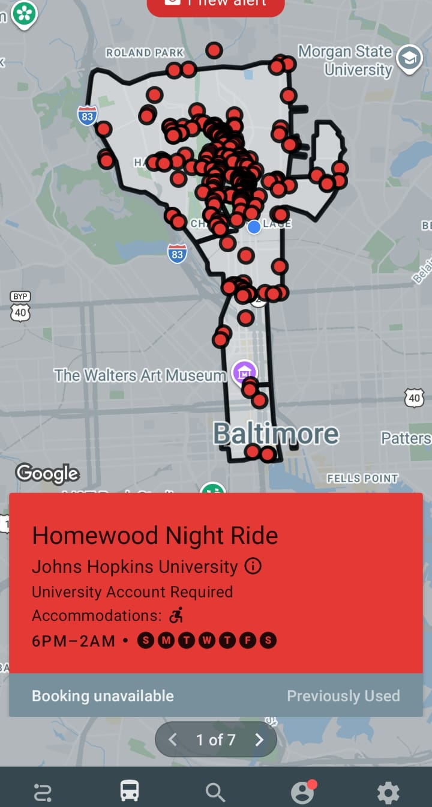
What we can defend today
Constraints Building
Aggregate did not give us individual journeys. It gave us constraints for building plausible evenings.
Acceptable Trade-off
Within our specified pilot, predictive transfer rules improved timely curb arrival while using more Lyft. Choosing a policy requires testing the assumptions and deciding what trade-off is acceptable.
TESTED IN SIMULATION
in simulation, on 30 constructed two-van nights · not a policy recommendation
Source: this deck, slides 6–27.
Backups →
28
Notes:
Script: speaking_script.md#s28. Handbook: slide_explanations.md#s28. Closing slide; questions follow.

Slide 32


Slide 33

Backup slides
B1 Code key
B2 Route-selection MILP
B3 Event order
B4 Where inputs come from
B5 Three postponement prices
B6 All metrics by rule
B7 Night by night
B8 Numerical diagnostics
B9 Corrected proposal claims
Notes:
Backup divider. Each backup links back to the main slide that uses it. Type a slide number and Enter to jump.

Slide 34
B1 Code key (files and questions only)
Said in the talk | Code in files and logs
Vans only | R0
Wait ten minutes | R1(10)
Wait fifteen minutes | R1(15)
Unassigned for ten minutes | R1u(10)
Predicted total wait exceeds fifteen minutes | R2(15)
Lyft arrives sooner | R3(2)
Small designed evenings with hand-computed answers | L1–L4 (L4: vans from 18:15, ordering lag 2 min, Lyft delay fixed 8 min, acceptance 0.9)
The two-van pilot | L5: 30 constructed one-hour nights, 2 vans, 28 requests
The van optimizer | Dispatcher C: restricted route-selection MILP (HiGHS)
The adopted postponement price | Pending price A (earliest physical pickup)
Lyft order; ordering lag | “booking” and “booking lag” in files (D-43)
Numbered decisions | D-xx entries in docs/technical/decision_log.md
Source: src/sim/lyft.py; scenario_spec.md §6, §8; decision log.
← back to slide 17
30
Notes:
Script: speaking_script.md#s30. Handbook: slide_explanations.md#s30. Backup B1.

Slide 35
B2 The route-selection MILP at one decision moment
min Σ_v Σ_k c_vk y_vk + Σ_r π_r u_r
s.t. Σ_k y_vk = 1 for every van v (one route per van)
Σ_{v,k: r ∈ S_vk} y_vk + u_r = 1 for every waiting request r (served once, or postponed)
y, u ∈ {0, 1}; S_vk = requests picked up by candidate route k of van v
c_vk: route points (waiting φ with slopes 1/2.5/5/10/20 per passenger-minute after 0/5/10/15/20 min; riding 0.5 per passenger-minute; 0.1 per km; Ψ only for unavoidable existing guardrail excess); exact integers
Candidates: every subset of at most 3 waiting requests per van, each in its best stop order (exact search); the van's committed work is always a candidate
π_r = b_r + M; b_r from the adopted postponement price; M = 1 + Σ_v (max_k c_vk − min_k c_vk) + Σ_r b_r: every proven-optimal solution postpones the fewest requests the candidates allow
Ride-time guardrail max(25, 2 × direct + 5) min: no candidate may create or worsen an excess
HiGHS: relative gap 0, absolute gap 0.5 units; ties broken by a fixed canonical order; a failed solve is logged, never replaced by a heuristic
Source: model_design.md v0.5 §3; decision log D-47, D-52 (amendments), D-53.
← back to slide 16
31
Notes:
Script: speaking_script.md#s31. Handbook: slide_explanations.md#s31. Backup B2.

Slide 36
B3 Event order and a request's life
Same-second order: drop-offs → curb arrivals (stop the patience clock) → service ends → vans on/off duty → new requests → patience checks → Lyft orders → decision moment → departures
Decision-moment triggers in the code: new request; cancellation or no-show while waiting for a van; van coming on duty; the 2-minute tick (van going off duty does not trigger one; Lyft events never do)
A van commits to a stop when it departs toward it; a committed request is not eligible for transfer
After a transfer: a 2-min ordering lag, then the rider's hidden Lyft delay; the rider may cancel at any point before the Lyft reaches the curb
During an absent rider's 3-min curb wait, planning assumes possible boarding at expiry; the simulator never boards an absent rider
Presence is one draw per rider, used whichever vehicle arrives; planning takes zero simulated time
Source: src/sim/engine.py; scenario_spec.md v0.8 §17; decision log D-46, D-48, D-54.
← back to slide 14
32
Notes:
Script: speaking_script.md#s32. Handbook: slide_explanations.md#s32. Backup B3.

Slide 37
B4 Where each input comes from
Input | Status | Value | Basis
Requests per hour | DERIVED + ASSUMED | 64 / 50 / 54 for five vans (planned); pilot: 28 in one hour, two vans | D-35, D-36, D-56
Trip pairing | ASSUMED + fitted | Distance prior, rate 0.1 per min, balanced to both map totals | D-18
Party size | ASSUMED (mean derived) | Shares 1–5: .73/.18/.055/.025/.01; April 1.386 van passengers per completed van request | D-38
Patience | ASSUMED placeholder | Weibull, shape 1.5, median 18 min (scale ≈ 23.0 min) | D-39
No-show | DERIVED, conditional | 8.9% per vehicle arrival if the status mapping holds (4.7% of all requests) | D-40, D-48
Lyft | ASSUMED | Ordering lag 2 min; delay lognormal, median 8 min, 90th percentile 15 min | D-43
Travel times | DERIVED; × 1.2 ASSUMED | Local OSRM routing on OpenStreetMap; van times × 1.2 in the pilot (placeholder) | D-31, D-47
Source: decision log D-18–D-56; methodology v1.5 §4.
← back to slide 13
33
Notes:
Script: speaking_script.md#s33. Handbook: slide_explanations.md#s33. Backup B4.

Slide 38
B5 Three postponement prices compared
 | First version | Adopted (earliest physical pickup) | Route-based
Price of postponing a request | as if served at the next 2-min re-plan | as if served at the earliest time any on-duty van can reach it | as if served after a chosen van's route
Wait median / 90th pct / worst (min) | 17.1 / 31.0 / 44.4 | 18.6 / 31.2 / 35.6 | 21.1 / 34.3 / 38.6
Mean wait (min) | 18.8 | 18.8 | 21.8
Party of five from slide 19: wait | 22 min 18 s | 19 min 28 s | 20 min 39 s
Extra variables | 0 | 0 | up to 9,828
Total MILP solve time on this evening (s) | 0.1 | 0.1 | 4.8
Direction of error | optimistic | optimistic (ignores the van's other work) | either direction
Designed evening, vans only, one run per formulation. Adopted for its meaning and no added variables, provisionally; computing the earliest pickups is extra work per decision, not separately timed. None guarantees a feasible schedule for all waiting riders.
Source: outputs/sim/d53_experiment; decision log D-53; review d53_pending_price_review (22 Oct).
← back to slide 19
34
Notes:
Script: speaking_script.md#s34. Handbook: slide_explanations.md#s34. Backup B5.

Slide 39
B6 All six rules over 30 constructed nights
Per night | Vans only | Wait ten minutes | Wait fifteen minutes | Unassigned for ten minutes | Predicted total wait exceeds fifteen minutes | Lyft arrives sooner
Reached within 15 min (share of 28) | 0.48 (0.09) | 0.51 (0.08) | 0.50 (0.09) | 0.48 (0.10) | 0.73 (0.07) | 0.75 (0.08)
Requests picked up (of 28) | 16.1 (2.4) | 17.2 (2.6) | 16.5 (2.6) | 16.2 (2.5) | 20.2 (2.0) | 20.4 (2.3)
Wait median, min (per request picked up) | 8.6 (1.8) | 8.3 (1.6) | 8.4 (1.5) | 8.9 (2.1) | 7.5 (1.0) | 7.3 (1.0)
Wait 90th pct, min (per request picked up) | 20.2 (5.3) | 18.1 (2.4) | 19.6 (4.0) | 20.2 (4.6) | 13.3 (1.5) | 12.2 (1.7)
Wait 90th pct, min (per passenger picked up) | 20.1 (5.8) | 17.4 (2.7) | 19.2 (4.8) | 19.6 (4.7) | 13.2 (2.3) | 12.7 (2.7)
Van completed | 16.1 (2.4) | 14.1 (2.3) | 14.6 (2.4) | 16.1 (2.5) | 14.0 (2.7) | 13.3 (2.6)
Lyft completed | 0.0 (0.0) | 3.1 (1.4) | 1.8 (1.2) | 0.1 (0.3) | 6.2 (1.9) | 7.0 (1.6)
Cancelled waiting for van | 10.8 (2.3) | 6.5 (2.3) | 8.9 (2.5) | 10.5 (2.4) | 3.3 (1.7) | 2.6 (1.5)
Cancelled after transfer | 0.0 (0.0) | 3.2 (1.8) | 1.5 (1.0) | 0.1 (0.4) | 3.1 (1.5) | 3.5 (1.5)
Lyft orders | 0.0 (0.0) | 5.9 (1.6) | 3.1 (1.4) | 0.2 (0.5) | 9.3 (2.5) | 10.5 (1.9)
Van-km | 51.2 (4.4) | 47.6 (5.5) | 48.6 (5.0) | 51.9 (4.8) | 45.7 (5.7) | 43.0 (4.0)
Run time, s | 43 (46) | 40 (44) | 49 (57) | 50 (56) | 5 (7) | 4 (5)
Cells: mean of nightly values (standard deviation across nights). Waits cover only requests picked up. 30 nights replayed six ways, not 180 independent nights.
Source: outputs/sim/batch_L5_v1 (per_night_metrics.csv), via make_numbers.py.
← back to slide 22
35
Notes:
Script: speaking_script.md#s35. Handbook: slide_explanations.md#s35. Backup B6.

Slide 40
B7 Trade-off night by night
Rule | Reached (mean) | Lyft orders (mean) | Nights not dominated | Nights identical to vans only | Nights reach above / below vans only
Vans only | 0.477 | 0.00 | 30 of 30 | 30 | 0 / 0
Wait ten minutes | 0.514 | 5.93 | 11 of 30 | 0 | 19 / 6
Wait fifteen minutes | 0.495 | 3.10 | 14 of 30 | 1 | 15 / 5
Unassigned for ten minutes | 0.476 | 0.23 | 26 of 30 | 24 | 2 / 2
Predicted total wait exceeds fifteen minutes | 0.735 | 9.33 | 24 of 30 | 0 | 30 / 0
Lyft arrives sooner | 0.750 | 10.47 | 12 of 30 | 0 | 30 / 0
Ties: a rule that makes no transfer on a night replays vans only exactly; identical results do not dominate each other, so both count as not dominated. Above / below counts are paired comparisons on the same constructed night, with no intervals yet.
Source: outputs/sim/batch_L5_v1/tradeoff.md.
← back to slide 24
36
Notes:
Script: speaking_script.md#s36. Handbook: slide_explanations.md#s36. Backup B7.

Slide 41
B8 Numerical diagnostics (two-van pilot)
180 runs = 30 constructed nights × 6 rules; every run passed every per-run check; one code version for all runs
13,663 decision moments (epochs); the main solve was proven optimal over its candidates in all of them
41 decision moments had an incomplete search for equally good plans (a solver error); in all 41, full enumeration shows a unique optimum, which is the plan chosen
36 ride-time excess events across the 180 runs (16 distinct requests on 10 nights, repeated across rules); each coincided with a no-show wait on that van while the rider was aboard (attribution check, not proof); 0 unexplained
Run time per run: mean 32 s, longest 253 s (Python, one core per run)
Reproducibility: 6 of 6 sampled reruns byte-identical; the 2 first-night batch runs identical to the earlier pilot outputs
Source: outputs/sim/batch_L5_v1 (summary.md, tie_incomplete_check.csv, reproducibility.json); decision log D-52 am. 5, D-57.
← back to slide 21
37
Notes:
Script: speaking_script.md#s37. Handbook: slide_explanations.md#s37. Backup B8.

Slide 42
B9 Corrected proposal claims
Proposal said | Corrected | Why
About 5,100 rides per hour at 6 pm | ≈ 170 completed rides in one evening's 6 pm hour | The bar is a 30-day total (tooltip 5,098; digitized 5,089)
About 28 vans in service | 27.6 vehicles on duty at 6 pm, “All services” average | Not a Homewood-only count
7 pm bar: 4,900 | 3,957 (digitized 30-day total) | Proposal chart value differs from our digitized reading
~1 in 4 trips overflow to Lyft | 24.5% of 44,374 riders rode Lyft | A share of riders, not of trips or requests
Trip-level extracts coming | Constructed evenings from aggregate dashboards | The extracts did not arrive
Compare dispatch methods | Hold one specified dispatcher fixed; vary the transfer rule | Scope choice: isolate one controllable decision
Lyft as paid overflow inside the optimizer | A separate, explicit transfer rule; no money modelled | A dispatcher sends the Lyft; cost per Lyft trip unknown (D-45)
Targets as hard constraints (20/25 min) | Reporting thresholds plus a ride-time guardrail | Target wording changed over time (15/20/20 around April; 20/25/25 on the 21 Oct page) (D-49)
The September proposal deck is unchanged; these corrections are recorded in methodology v1.5 §1a.
Source: methodology v1.5 §1a; decision log D-25, D-35, D-36, D-45, D-47, D-49, D-51.
← back to slide 4
38
Notes:
Script: speaking_script.md#s38. Handbook: slide_explanations.md#s38. Backup B9.

