Slide 1



Slide 2

Anthony J. Kearsley
En.553.602 Research & Design In Mathematics: Data Mining
S
Miles Zhou
Undergraduate Student
Applied Mathematics and Statistics
I
Irfan Setiadi
Graduate Student
Data Science, Applied Mathematics and Statistics
G
Vignesh Rajesh Babu
Graduate Student
Data Science, Applied Mathematics and Statistics
H
Youzhi Zhang
Graduate Student
Data Science, Applied Mathematics and Statistics

Slide 3
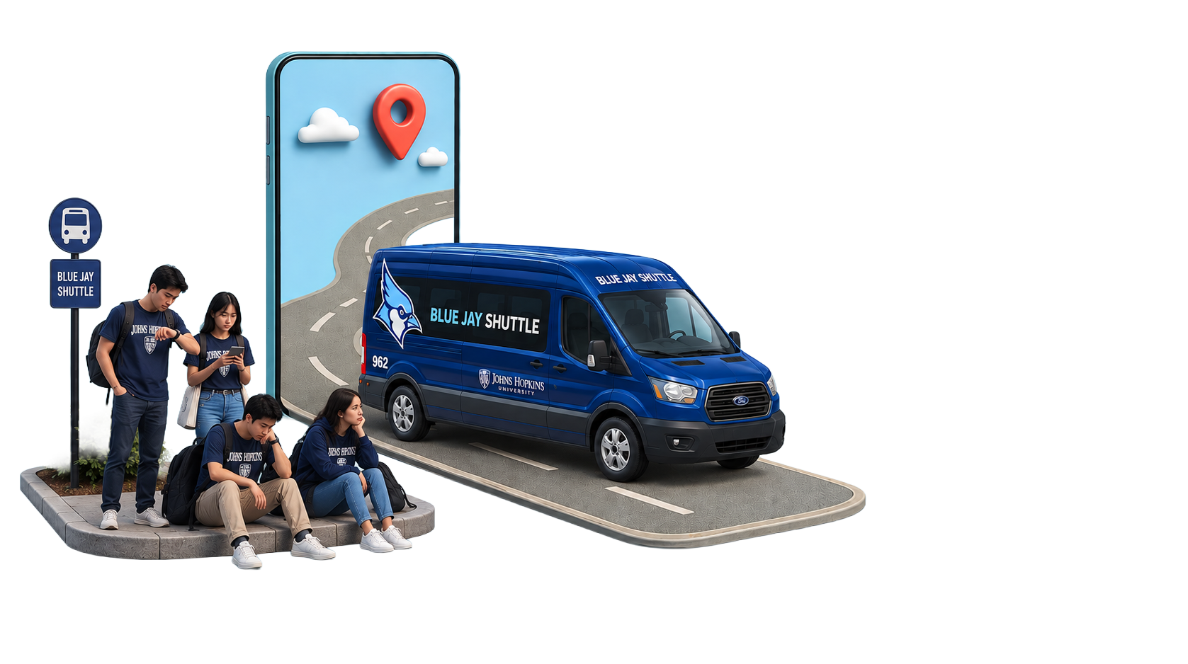

Slide 4
OPTIMIZING
The Blue Jay Night Ride Shuttle
Dispatch & routing models for JHU's on-demand shared shuttle
reducing rider wait times and Lyft overflow on Blue Jay Night Ride.

Slide 5

How Shuttle Works
01
Request
Rider books a trip in the TransLoc app.
02
Pool
A shared van is assigned; it may pick up others first
03
Curb to Curb
Dropped at the destination, ~6PM to 2AM, Homewood area

Slide 6
Model’s Constraints
Published service promises become constraints for our model
20 Minutes
20 Minutes
Pickup target (25 when busy)
25 Minutes
25 Minutes
Max ride length
3 Minutes
5 Max
5 Max Group
Max group size
3 Minutes
Van waits at pickup
→ A safety-first service with firm limits on wait time, ride time, and capacity. Distance alone does not determine the solution.
If no van can meet these promises, dispatch assigns the trip to Lyft as paid overflow.

Slide 7
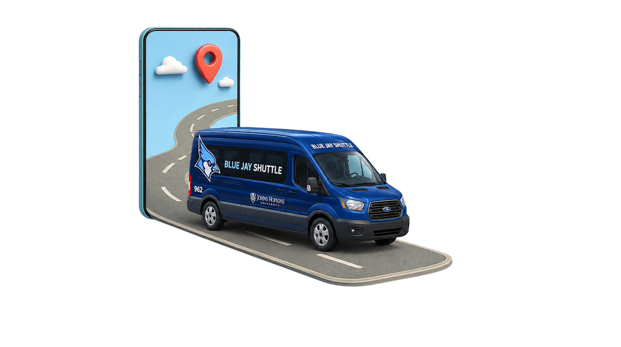
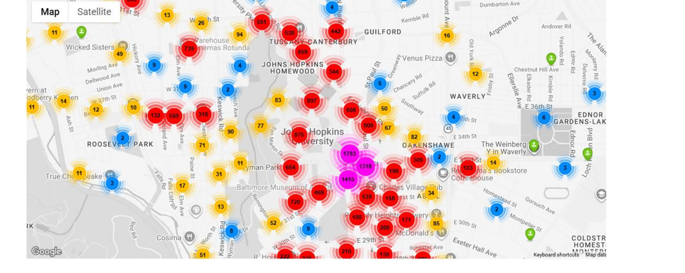
Motivation – The Demand
Demand is heavy, sharply peaked, and spread across the city.
44,374 riders in April 2026
Ride origins near campus (density)
At the 6 PM peak, demand reaches approximately 5,100 rides per hour, with about 28 vans in service.
Completed rides by hour (April 2026, 30-day totals)
→ Supply already scales with peak demand. The challenge is smarter trip assignment, not simply adding more vans.
Source: JHU Transportation / TransLoc dashboards, April 2026.

Slide 8
Motivation – The Gap
Most riders have an acceptable experience. The challenge is concentrated among those with the longest waits.
Wait: request → pickup
slowest 1 in 10 riders (P90)
Who actually carries the riders
17–21 min
typical 11 min
20-min target
Time on the van (ride length)
slowest 1 in 10 riders ((P90)
21–30 min
typical 11 min
25-min target
~1 in 4 trips overflow to Lyft
The 90th percentile (P90) marks the cutoff for the slowest 10% of riders. Nine out of ten riders have shorter times, while one out of ten has longer times and is most likely to exceed the target.
a quarter of demand can't get a van in time and is sent to paid rides.
Source: JHU Transportation / TransLoc dashboards, April 2026. Van-vs-Lyft share approximate.
Notes:
The median experience is good (~11 min wait, ~11 min ride). The pain is the tail: the slowest 1 in 10 wait 17–21 min and ride 21–30 min — brushing or breaking the 20- and 25-minute targets. And ~1 in 4 trips overflow to paid Lyft. That tail + overflow is exactly what a smarter assignment policy can target. Define P90 out loud using the explainer box so nobody has to ask.

Slide 9
The Problem Class
This is a Dial-a-Ride problem, not ordinary routing
P1
D1
Pickup must precede drop-off
Paired pickup → drop-off, same van
P2
D2
P = pickup D = drop-off
Paired pickup → drop-off, same van, riders pooled, requests arrive live.
Ordinary routing (CVRP)
Our problem: Dial-a-Ride
1
Van load changes en route (capacity)
Requests arrive online; some moves are committed
2
D
3
Visit fixed stops from a depot, minimize distance.

Slide 10
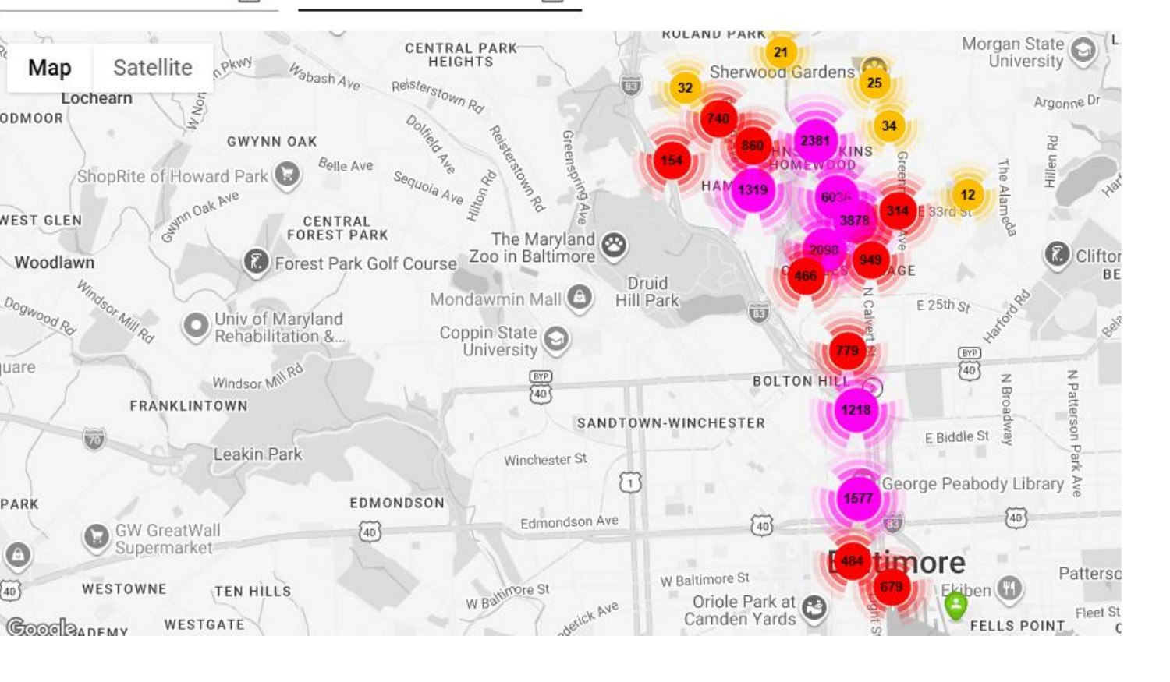
Data Sources
What we have now, and what's coming
Available now: Aggregate TransLoc and JHU dashboards
Coming: de-identified trip-level extracts
Request → assign → arrival → pickup → drop-off timestamps
Pickup & destination zones or protected coordinates
Party size
Pseudonymous vehicle IDs & capacities
Origin and destination density, rides by hour and status, vans in service, wait and ride-time percentiles, and ridership by van and Lyft.
Use: Aggregate data will help calibrate demand and validate the model. Trip-level data will allow us to replay actual service nights.
Privacy: The data will not include rider names, IDs, contact information, or exact addresses. All outputs will be limited to aggregate statistics and density maps.
Aggregate dashboards shared by JHU Transportation (April 2026). Trip-level extracts requested.

Slide 11
Technical Strategy
One spectrum of methods, compared head-to-head
Fast
Heuristics
Rolling-Horizon MILP
Hybrid
1
2
3
★ centerpiece
faster · simpler
Nearest-feasible + greedy insertion. Reuses our prior CVRP work (VehiPathOptimizer). The speed baseline.
Exact, service-first dispatch under all the constraints. The centerpiece the course targets.
MILP core + local search: the scaling path for the ~28-van peak hour.
→ All three run on the same request stream, so performance differences reflect the assignment policy.

Slide 12
The Model
The Optimization at The Core
Decide the route and who rides together
↑ minimize in priority order
service before shaving miles
P2
P1
D2
1. Overflow to Lyft
van
2. Rider wait time
D1
3. Excess ride time
Binary choices: which van, which arc, or overflow to Lyft.
Continuous: arrival times, load, wait, excess ride time.
4. Van travel
Objective: service first
Constraints
same van picks up & drops off
pickup before drop-off
vehicle capacity
service time windows
max ride time
committed actions

Slide 13
Making it Dynamic
From a Snapshot to a Live Dispatcher
1
3
Freeze
Commit
Lock in actions already underway
Execute the next move, then reoptimize when a new request arrives.
Observe
2
Resolve
4
current van positions, onboard riders, committed stops, pending requests
optimize the rest under a short time limit, warm-started
repeat as each new request arrives
→ The MILP optimizes a single moment. The loop turns it into a real-time dispatcher while preserving pickups already in progress.
Notes:
The MILP solves a snapshot. Real dispatch is a moving target, so we wrap it in a rolling-horizon loop: re-solve as requests arrive, but never rip out a pickup a van has already started. Two knobs we'll tune: re-optimization trigger (per request vs. fixed interval) and solver time limit.

Slide 14
Proof of Concept
Simulating Dispatch on Real Map Geometry
Tighter pooling · shorter waits · no overflow
● pickup ● drop-off
Optimized Dispatch
Longer detours · one request overflows to Lyft
Greedy Dispatch
Prototype in progress: Synthetic requests calibrated to April demand, routed on real streets using OSRM, and visualized in Folium. This is illustrative and does not represent final results.
Notes:
To make it concrete and prove we can build the pipeline: a small simulation on real map geometry. Left is greedy assignment — longer detours, a request overflows. Right is optimized — tighter pooling, shorter waits, no overflow, on the same requests. Be explicit it's synthetic demand calibrated to April's patterns, not a results claim; the real evaluation comes with trip-level data.

Slide 15
How we will Judge it
A fair comparison on identical inputs
Same input for every
Comparison of
Meaningful
POLICY
METHODS
METRICS
Request Stream
Fleet Availability
Travel Time
Starting State
Reconstructed Historical
Nearest-feasible
Greedy Insertion
Rolling-horizon MILP
Hybrid
Wait: median & slowest 10% (P90)
% pickups within the 20-min target
Ride time & % within 25 min
% overflow to Lyft
Total & empty miles · van utilization
Solver time & optimality gap
Honest by design: If a simple rule performs as well as the MILP, that is a valid and reportable finding. If trip-level data is delayed, we will evaluate performance using synthetic request streams calibrated to aggregate data, with multiple random seeds and sensitivity analyses.
Reconstructed-historical baseline becomes primary once trip-level data arrives.
Notes:
Every method sees identical inputs, so differences are the policy, not luck. Emphasize the tail and overflow metrics — they match the problem we opened with. Own the negative-result possibility: if a simple rule ties the MILP, that's a real result; the validated model and replay environment still stand. Synthetic-calibration fallback if data is late.

Slide 16
Plan & Scope
A de-risked path this semester
Data Audit
Simulator
MILP
Experiments
1
2
3
4
5
6
7
8
Travel Matrix
Baselines
Rolling Horizon
Report
Risk & Fallbacks
Scope
1. If trip-level data is delayed: calibrate synthetic request streams using aggregate data.
2. If the MILP is too slow: use pruning, warm starts, or a hybrid approach.
3. If historical trips cannot be reconstructed: compare transparent heuristic baselines.
A retrospective decision-support study for JHU Transportation that examines the causes of long waits and Lyft overflow, and whether optimization can reduce them. The study will not affect live vans or TransLoc operations.

Slide 17


