Slide 1
Medication Safety Signal Monitor
A morning safety screen for a hospital pharmacy safety officer, built in Palantir Foundry from public FDA and NLM data. Every flag traces to its source.
1
Which drugs have side effects reported that the label does not mention?
2
Which drugs have an active recall?
3
What has changed since my last review?
Pilot: 13 drugs (8 opioids + 5 GLP-1 drugs) · FAERS 2026Q1-2026Q2 · numbers captured from Foundry 2026-11-05
Soragence technical build brief · hand-in demo, 20 minutes: slides, then the live app, then under the hood
Notes:
Script: speaking_script.md#s01. Handbook: slide_explanations.md#s01. Time 0:00–0:20.

Slide 2
Her three morning questions, and one trust rule
Communication
0:20–1:30 · slides
Today she hears about drug safety problems late and from scattered places. We built one screen to answer her three questions: machine load 11.5 s; a human walk-through will be timed in rehearsal.
1 · Not in the label
Which drugs have side effects being reported that their label does not mention?
Trust rule
Every flag traces to its source: the label versions searched (DailyMed) and the FDA recall record open in one click; the FAERS case reports are reachable by query, not yet from her screen.
App page 1
2 · Active recalls
Which of my drugs are under an active FDA recall?
App page 2
Scope we chose (narrow, working)
13 drugs (8 opioids + 5 GLP-1 drugs) (D014, D018). Opioids: oxycodone, hydrocodone, morphine, fentanyl, hydromorphone, methadone, buprenorphine, tramadol. GLP-1s: semaglutide, liraglutide, dulaglutide, tirzepatide, exenatide.
DESIGNED
3 · What changed
What changed since my last review: new label versions, recalls, signals?
App page 3
Public data only
No patient-level or proprietary data.
The four public sources
FAERS
FDA Adverse Event Reporting System: voluntary reports of side effects, released as quarterly files
DailyMed (SPL)
NLM site with the official drug labels, as Structured Product Labeling XML, every version
openFDA
FDA's public API; we use its recall (enforcement), Drugs@FDA and NDC endpoints
RxNorm (RxCUI)
NLM's standard drug names; one RxCUI id per ingredient joins all sources
Source: docs/00-brief/brief-summary.md; DECISIONS D014 (8 opioids + 5 GLP-1), D018 (formulary = 13 RxCUIs); numbers.json scope.
2
Notes:
Script: speaking_script.md#s02. Handbook: slide_explanations.md#s02.

Slide 3
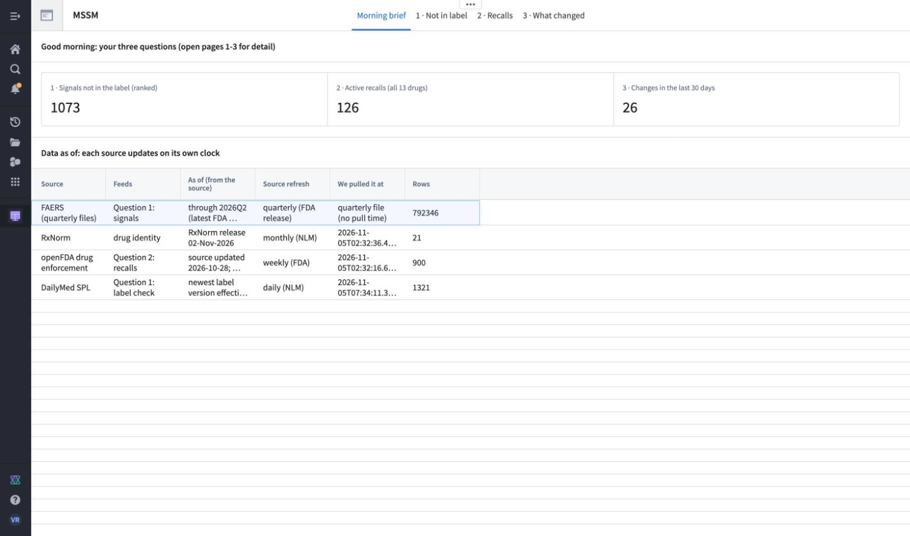
Morning brief: three numbers, and how fresh each source is
The application
1:30–3:00 · app page 0
One look answers all three questions. The table shows how old each source is: they update on different clocks.
LIVE IN THE APP ▶ Workshop module MSSM Safety Officer · tab “Morning brief” (page 0). Screenshot = fallback if the app is slow.
1,073
OBSERVED
signals not in the label, ranked: a review queue, not findings
126
OBSERVED
active recalls (status Ongoing) of 900 recalls for our 13 drugs
26
OBSERVED
change events in the last 30 days (not “since yesterday”; page 3 narrows to “since my last review”)
Data as of
FAERS through 2026Q2 (freshness check: 130 days old); openFDA 8 days old at capture. Our pipeline refreshes when a build runs: no schedule yet.
OBSERVED
Timed on v0.9.0 (browser script, View mode): brief on screen in 11.5 s; page switches 0.8–2.4 s. A human two-minute walk-through has not been run.
Source: numbers.json (signals, recalls, changes, monitoring, app.timing_s; timed on v0.9.0, app now v0.10.0), 2026-11-05; screens/app-0-morning-brief.jpg; D045. The 30-day count is live.
3
Notes:
Script: speaking_script.md#s03. Handbook: slide_explanations.md#s03.

Slide 4
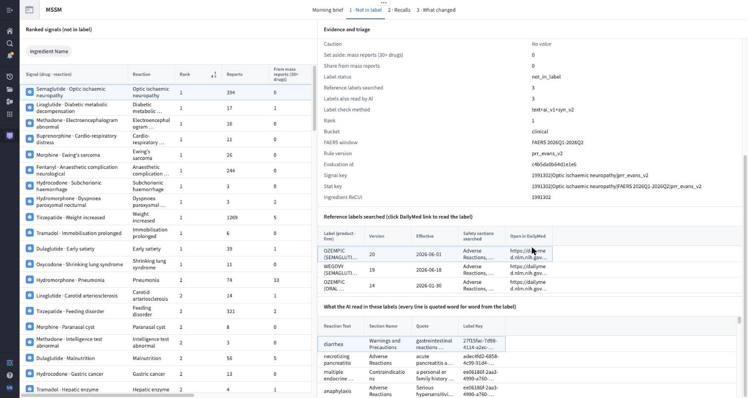
Not in label: from one flag to its evidence to a saved decision
Application · AI reliability
3:00–6:00 · app page 1
NAION is semaglutide's top-ranked signal. Every number in its record traces to FAERS rows and the labels searched.
LIVE IN THE APP ▶ Page 1 → name the noise → semaglutide → NAION → Ozempic v20 on DailyMed, find “optic” → AI quotes → Triage.
1
Flag Filter to semaglutide; rank is within each drug. NAION (FAERS term “Optic ischaemic neuropathy”), rank 1: sudden vision loss from poor blood flow to the optic nerve.
2
Evidence 394 of 20,892 semaglutide reports name NAION. PRR 112.5 (95% CI 92.19–137.24).
3
Trace 3 labels searched (Ozempic v20, Wegovy v19, oral v14): no text or synonym match. Open Ozempic v20 on DailyMed, find “optic”. The AI read all 3: retinopathy yes, optic nerve no.
4
Decide “Triage this signal”: decision saved with reviewer and time, never overwritten. Only the project owner can submit today.
Known positive, not a discovery
EMA's PRAC called NAION a very rare side effect of semaglutide (6 Jun 2025); WHO alert (27 Jun 2025). Our 3 US labels do not mention it. Finding it from FAERS alone checks that the monitor works.
OBSERVED
PRR (proportional reporting ratio): how many times more common this reaction is among the drug's reports than among other drugs' reports — a reporting pattern, not risk. Evans rule: at least 3 reports, PRR ≥ 2, χ² ≥ 4.
Not proof of harm; the 394 reports do not open from her screen yet.
Rehearsal check: “optic” must not land on the retinopathy warning; else search “ischemic optic”.
Source: numbers.json signals.naion, app; screens/app-1e-ai-quotes-panel-naion.jpg (Workshop v0.10.0); A019; known positive: EMA/PRAC 6 Jun 2025; WHO 27 Jun 2025 (DECISIONS learning 2026-11-05).
4
Notes:
Script: speaking_script.md#s04. Handbook: slide_explanations.md#s04. NAION a=394, PRR 112.5 (95% CI 92.19–137.24), chi2 10653.8.

Slide 5
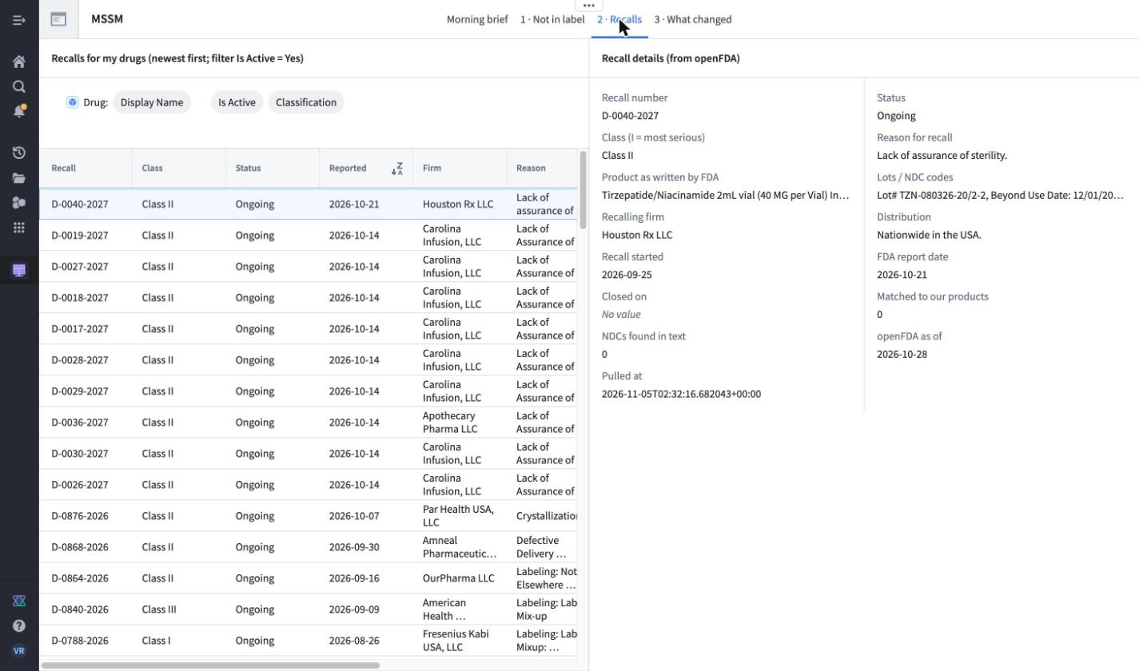
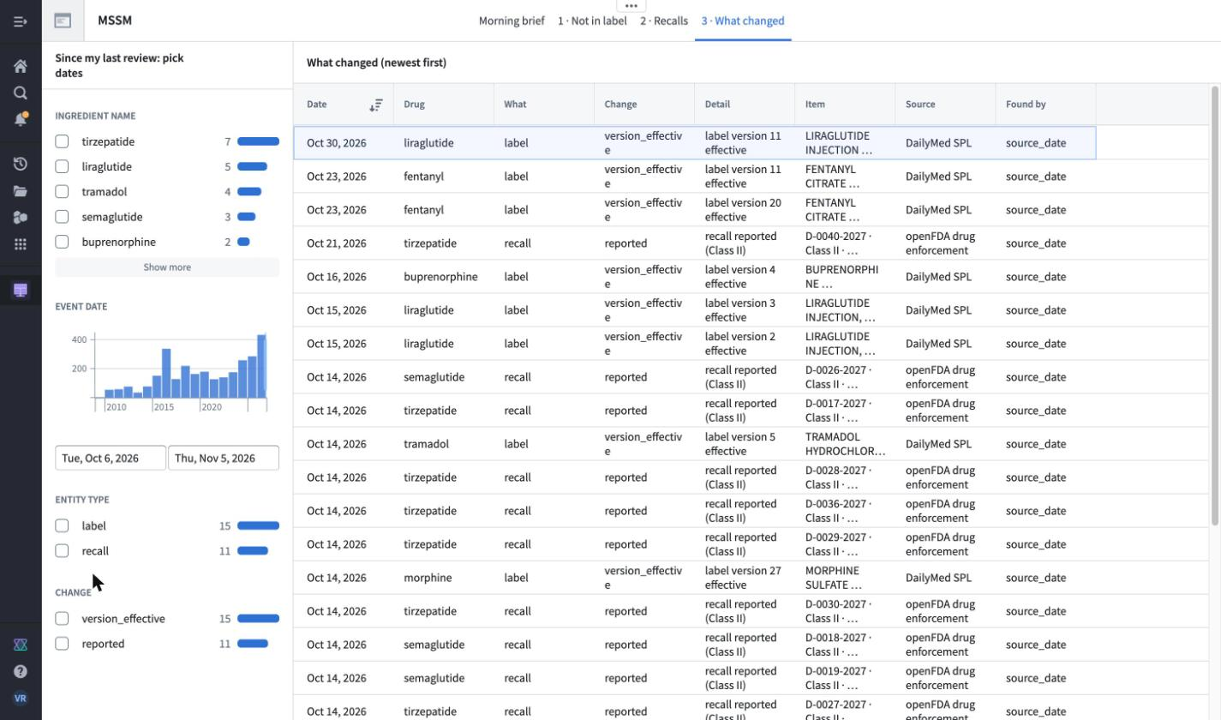
Recalls, and what changed since my last review
The application
6:00–7:30 · app pages 2–3
A recall says when it matches none of the FDA-listed products we track. “What changed” starts from the date of my last review.
LIVE IN THE APP ▶ Page 2 → newest row → openFDA record tab → Classification (Class I first). Page 3 → Start date = my last review.
Question 2 · 126 active (Ongoing) of 900 recalls
Newest: D-0040-2027 (2026-10-21), a compounded tirzepatide vial. It matches none of the 658 FDA-listed products we track for our 13 drugs (we have no purchasing or inventory data). The FDA's own record opens in a second tab. Class I first: click Classification (count = rehearsal check, not measured).
Question 3 · 2,898 dated change events
900 recalls reported, 767 terminated, 1,231 label versions effective (the 1,231 of 1,321 label versions that carry an effective date), dated by the source; “past month” = the brief's 26. A label row says a new version took effect, not what changed in it. Signals change only with each FAERS quarter (~130 days behind).
OBSERVED
OBSERVED
Source: numbers.json recalls, changes, monitoring; 658 products: foundry/ontology/README.md (MSSM Product); screens/app-2-recalls.jpg, app-3b-…jpg; D045.
5
Notes:
Script: speaking_script.md#s05. Handbook: slide_explanations.md#s05.

Slide 6
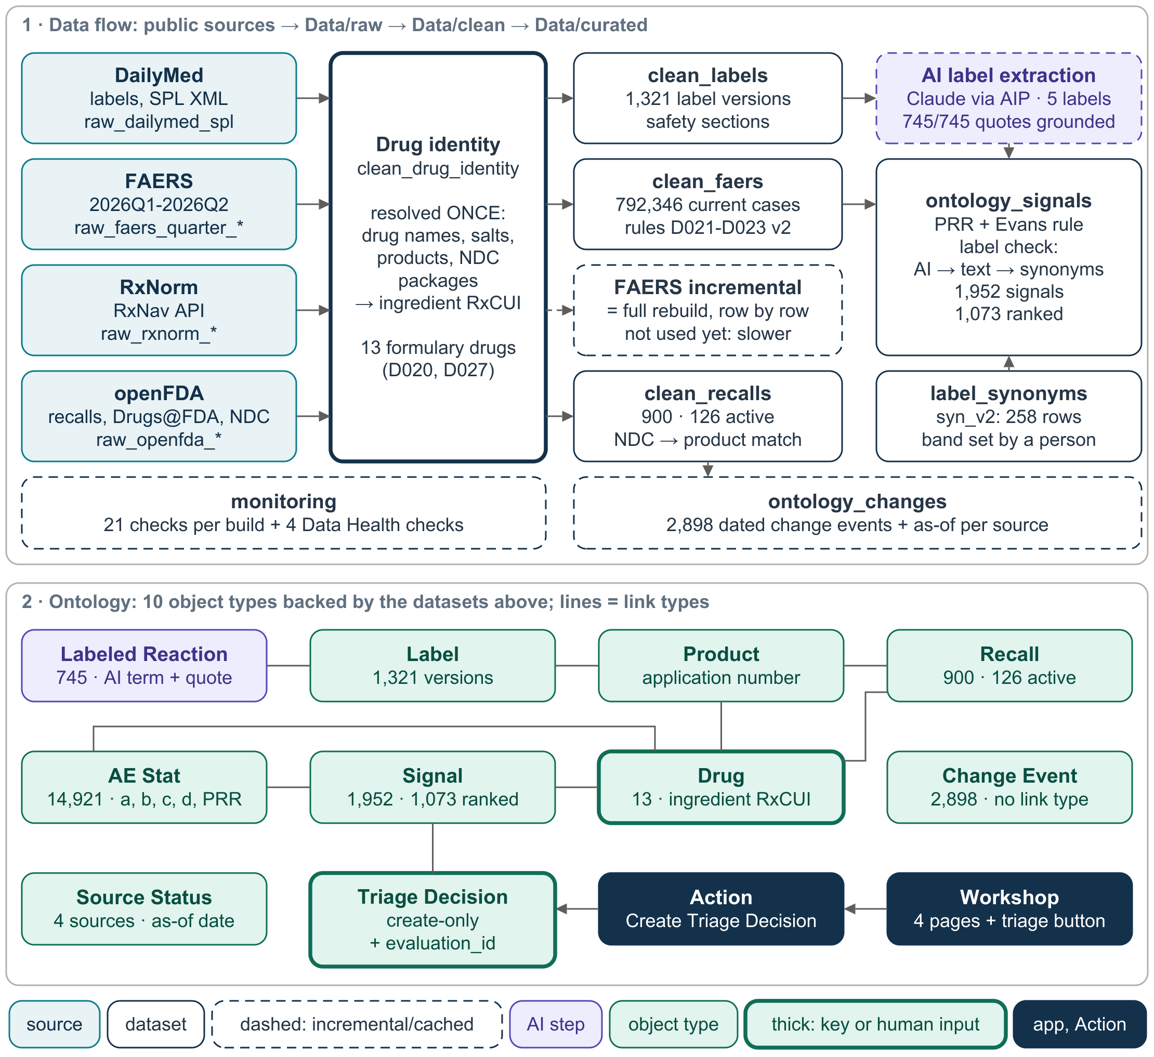
Architecture: drug identity resolved once, reused everywhere
Architecture
7:30–9:30 · diagram 38 + Lineage
Four public sources → raw → clean (identity resolved once) → curated → Ontology → Workshop app, with write-back.
Raw
Source replies kept as received: FAERS quarter files, openFDA JSON, DailyMed XML, RxNorm.
Clean
clean_drug_identity maps every FAERS drug name to an RxNorm ingredient (RxCUI), then product (application number) and package (NDC). Done once; everyone joins on it (D020, D027).
Curated
Statistics, signals, change events, monitoring: the tables the app needs.
Ontology
Business objects on top of curated tables: Drug, Label, Recall, Signal …
Workshop
The app; its button writes a decision back through an Action.
Foundry terms: a dataset is a versioned table; a transform is the Python code that builds one, kept in a Code Repository; Data Lineage draws which dataset feeds which. Dashed boxes = incremental or cached.
BUILT · TESTED IN FOUNDRY
▶ SWITCH Data Lineage: raw → clean → curated graph
Fallback screenshot: B12 →
Source: diagrams/png/38-handin-architecture-onepage-v2.png (from the one-page architecture note); detailed flow: diagram 30 v3; foundry/README.md; DECISIONS D020, D027, D036.
6
Notes:
Script: speaking_script.md#s06. Handbook: slide_explanations.md#s06.

Slide 7
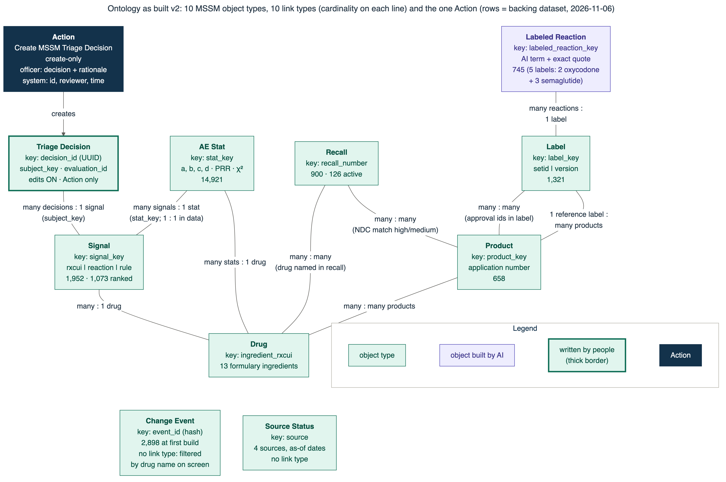
Ontology: objects, links, and one create-only Action
Architecture
9:30–11:30 · diagram 31 + OE
The app reads objects, not tables. Links let the officer walk from a signal to its counts, its drug, its products and its labels.
Object type: a business thing backed by one curated dataset (e.g. MSSM Signal).
Link type: a typed relation with cardinality, e.g. many signals : 1 drug.
Action: the only way to write. Create MSSM Triage Decision is create-only: past decisions are never edited.
Survives rebuilds: decisions live in their own object, so rebuilding signals does not erase them (2 saved so far).
10 link types
History: a duplicate Signal → Drug link added in step 11 was deleted on 6 Nov after checking nothing used it.
BUILT · TESTED IN FOUNDRY
▶ SWITCH Ontology Manager → MSSM Signal; Object Explorer → NAION → Links
Source: diagrams/png/31-handin-ontology-v2.png; foundry/ontology/README.md; DECISIONS D040, D042; numbers.json app.triage_decisions, ontology.
7
Notes:
Script: speaking_script.md#s07. Handbook: slide_explanations.md#s07.

Slide 8
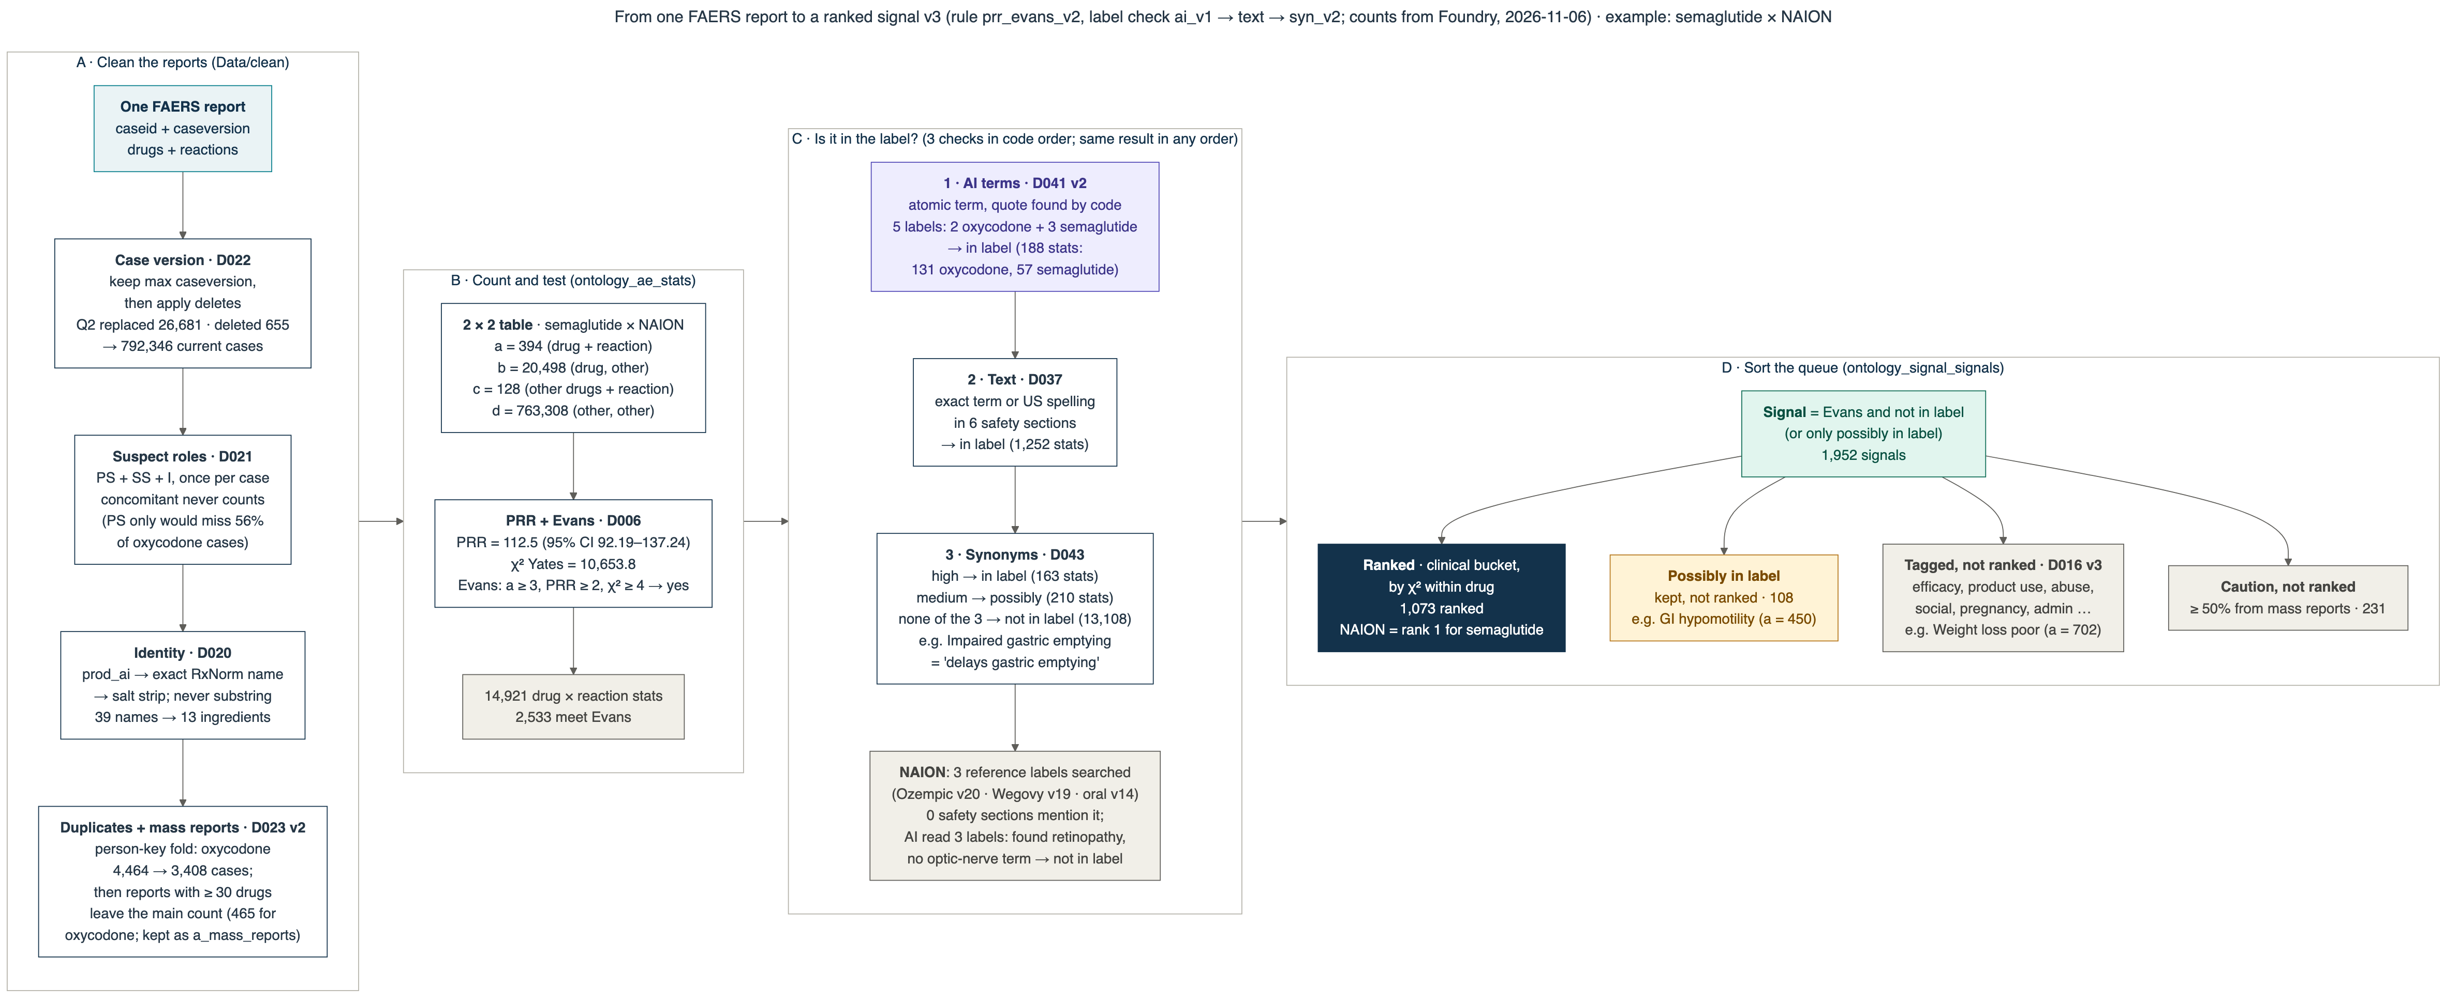
From one FAERS report to a ranked signal
Data judgment · AI reliability
11:30–12:50 · diagram 32
Clean the reports (A), count and test (B), check the label three ways (C), then sort the queue (D).
A: D022 latest case version + deletes · D021 suspect roles · D020 exact ingredient · D023 v2 duplicates and mass reports. B: 2×2 table → PRR + Evans (D006). C: AI term with a quote (D041 v2, 188 stats) → exact text (D037, 1,252) → reviewed synonym (D043, 163 high, 210 medium); same outcome in any order. D: buckets (D016 v3) decide ranked / possibly in label / tagged / caution.
Source: diagrams/png/32-handin-signal-pipeline-v3.png (NAION counts from the local run, equal to Foundry, A014; label-check counts from Foundry after D041 v2, numbers.json signals.label_check_stats); foundry/pipelines/*/README.md.
8
Notes:
Script: speaking_script.md#s08. Handbook: slide_explanations.md#s08.

Slide 9
1,073 ranked signals is a review queue, not 1,073 findings
Data judgment
12:50–13:30 · slide
Label checks and buckets shrank the queue by 21% without hiding anything: removed items stay visible with a reason.
From statistics to the ranked queue
Ranked queue after each label-check or bucket change
OBSERVED
DERIVED
counts from Foundry; the % is computed from them
Every signal keeps a label status
1,844 not in label · 108 possibly in label (kept, never ranked). 12 of 13 drugs have signals (exenatide has no reference label).
Synonym table syn_v2: 258 rows
69 high (same idea → in label) · 72 medium (→ possibly) · 117 rejected, kept for audit. Drafted by Claude; a pharmacist has not reviewed it yet.
Why not MedDRA groupings?
MedDRA's term hierarchy needs a licence we do not have, so a hand-reviewed synonym table and keyword buckets stand in (D043, D016 v3).
Source: numbers.json signals (ae_stats, total, ranked, ranked_history, not_in_label, possibly_in_label), synonyms; 21% = (1355 − 1073) / 1355.
9
Notes:
Script: speaking_script.md#s09. Handbook: slide_explanations.md#s09.

Slide 10
AI extraction: quotes are real; accuracy on a small key
AI reliability
13:30–14:45 · eval + AI dataset
Claude Sonnet 5.5 (via AIP) read 21 label sections (5 labels: 2 oxycodone + 3 semaglutide), listing each side effect with an exact quote.
745 / 745
35 / 35
F1 0.97
0 calls
OBSERVED
OBSERVED
DERIVED
OBSERVED
quotes found word-for-word, all 21 sections (no invented quotes)
answer-key items found (first prompt: 11 of 35)
only on 35 items (2 oxycodone labels, short sections, Claude-written key); target 0.85 (D015)
on forced rebuild: 21 / 21 from cache (adding semaglutide: 12 calls once)
How we know
What this does not show
Where the AI meets the screen
Grounding: code checks each quote is in that section's text. Catches invented text.
Answer key: frozen before the model ran. Catches wrong or missing items.
Cache key: label, version, section, text hash, prompt and model. Unchanged text never calls the model.
A small key (35 reactions, short sections only), written by Claude; no pharmacist has checked it.
The long sections and the semaglutide labels are not scored.
A real quote can still be the wrong item. Grounding is not correctness.
D041 v2: it read the 3 semaglutide labels. NAION: retinopathy terms, 0 optic-nerve terms.
Page 1 shows its quotes word for word (“What the AI read in these labels”).
It does not change the signal list: text matching already finds its terms.
BUILT · TESTED IN FOUNDRY
PLANNED — NOT BUILT
planned = pharmacist-labelled key incl. long sections
▶ SWITCH Optional: ai_label_section_extractions in SQL (from_cache = true)
Details: B5 →
Source: numbers.json ai (incl. ai.d041_v2); eval/ai-eval-v1.md; A019; DECISIONS D015 (target), D041 v2; F1 computed from recall and precision.
10
Notes:
Script: speaking_script.md#s10. Handbook: slide_explanations.md#s10.

Slide 11
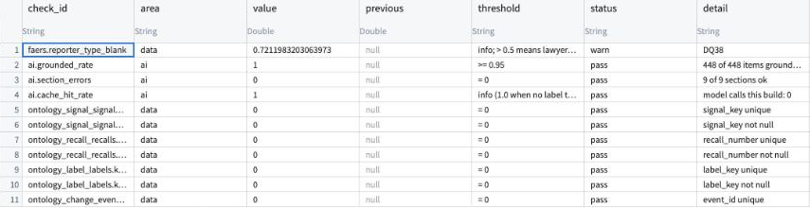
Monitoring: 21 checks per build caught two real shifts
AI reliability · monitoring
14:45–15:30 · monitoring data
Each build appends one row per check: keys, row counts, freshness, AI grounding, cache hits, field fill rates. History is kept.
Warning 1 · reporter type blank 34% → 72%
Share of FAERS reports with no reporter type, 2026Q1 → Q2 (DQ38; likely FDA's switch to a new intake system). Lawyer / consumer tagging would break silently, so we show “unknown”.
OBSERVED
monitoring_checks, latest run (Code Repository SQL panel): the warn row first, then AI checks, then key checks.
Warning 2 · recalls ×3.3
10 recalls reported for our drugs in the last 4 weeks vs 3 in the 4 before (D009 window).
21
4
3
computed checks appended per build
Foundry Data Health checks (alert the owner)
monitoring runs so far
Honest limit
Drift is a historical replay from source dates, not weeks of live builds. No schedules or health page yet.
BUILT · TESTED IN FOUNDRY
▶ SWITCH monitoring_checks; signals → Health tab
Diagram: B9 →
Source: numbers.json monitoring; screens/hood-monitoring-checks-sql.jpg (cropped, 5 Nov); DECISIONS D046, D009, D025; DQ38. ×3.3 = 10 / 3.
11
Notes:
Script: speaking_script.md#s11. Handbook: slide_explanations.md#s11.

Slide 12
Optimization log: four measured tries, two helped, two did not
Optimization
15:30–16:45 · optimization log
Rule: measured, not asserted. Every entry has a before and an after number, and failed tries stay in the log.
# | Pipeline · change | Before | After | Helped?
O1 | AI extraction · cache by content hash | 9 model calls, 70,776 tokens | 0 calls, 0 tokens | Yes
O2 | FAERS clean · incremental by quarter | full rebuild 32 s | 88 s (×2.75 slower) | No
O3 | DailyMed pull · reuse unchanged XML | 3 m 23 s, 1,321 XML downloads | 1 m 23 s, 2 XML downloads (−59% time; index still pulled) | Yes
O3a | FAERS clean · parse fewer columns | 12.3-13.0 s (local) | 12.2 s (local) | No
Build time, seconds (Foundry)
OBSERVED
DERIVED
×, % computed from the two numbers
Where it paid
Skipping unchanged input: the AI cache (O1; O1b: 0 calls for 21 sections) and DailyMed XML reuse (O3, D047; fewer HTTP 429 risks).
Where it did not
O2: at 2 quarters the kept state costs more than it saves. O3a: parsing is not the bottleneck; reverted.
Partitioning: not done, on purpose
Largest table 2,554,017 rows; clean builds ≤ 32 s. Revisit at 8+ quarters or a 5-minute build (D048).
Caveats
Each timing is one run. O3's baseline is an earlier build. O3a timed locally only.
Source: numbers.json optimization, ai; docs/08-optimization-log/optimization-log.md (O1, O1b, O2, O3, O3a); DECISIONS D044, D047, D048 (accepted).
12
Notes:
Script: speaking_script.md#s12. Handbook: slide_explanations.md#s12.

Slide 13
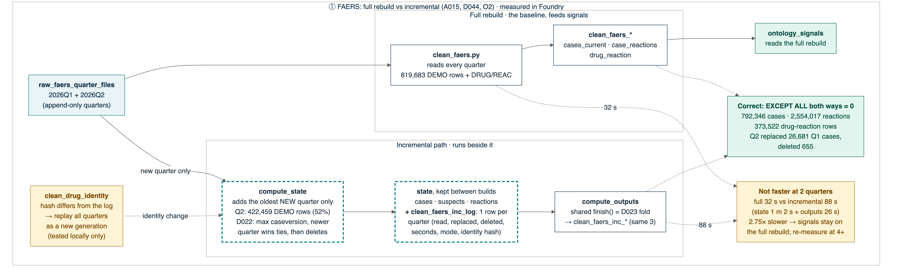
Incremental FAERS: proven correct, but slower at two quarters
Optimization
16:45–17:30 · diagram 33
It runs beside the full rebuild. Signals keep reading the full rebuild (D044, accepted) until it is faster.
Correct
Same output as the full rebuild, row for row (EXCEPT ALL both ways = 0): 792,346 cases, 2,554,017 reactions, 373,522 drug-reaction rows.
Slower
Adding Q2: state (three state datasets + one quarter log) 62 s + outputs 26 s = 88 s, vs 32 s full (×2.75).
Next
Re-measure at 4+ quarters, when re-reading history costs more. Try one build for state + outputs.
Source: diagrams/png/33-handin-incremental-faers-v2.png (FAERS panel, cropped; unchanged in v3); A015; numbers.json faers, optimization.O2. Full diagram (v3): B2.
13
Notes:
Script: speaking_script.md#s13. Handbook: slide_explanations.md#s13.

Slide 14
Data judgment: what we found, and what we chose not to do
Data judgment
17:30–19:00 · slide (+ monitoring)
The brief warned the data is messier than documented. Four messes we fixed or flagged, and noise we left, said plainly.
What we found | Evidence | What we did | Ref
FAERS sends new versions of old cases and deletes old cases in later quarters. Appending quarters creates phantom rows. | Q2 replaced 26,681 Q1 cases and deleted 655 | Keep the latest version per case; apply deletes to the full history | DQ36 · D022
One patient filed by many companies; reports listing dozens of drugs inflate odd signals. | Fold rule removes them from the main count (diagram 32) | Person-key fold; reports with 30+ drugs leave the main count but stay as evidence; caution flag | DQ37 · D023 v2
Reporter type went blank for most reports. | 34% → 72% blank, Q1 → Q2 | Show “unknown”, do not guess; checked on every build | DQ38 · D046
DailyMed answered HTTP 200 with the text “None” instead of a label. | 2 of 1,321 labels | Keep the reply as received; mark has_xml = false; retry next build | DQ42 · D047
Noise we left: indication terms count as reactions; reports spike after news or lawsuits. | Liraglutide's rank 1 is “Diabetic metabolic decompensation” (page 1) | Not handled; the pharmacist's triage decides. NAION's reporter split not measured | DQ06 · DQ04
What we chose not to do
No MedDRA licence: no term hierarchy; a reviewed synonym table and keyword buckets instead.
No patient data: public sources only.
Cut for depth: ClinicalTrials.gov, OnSIDES, daily FAERS, label-change backtest (D031).
OBSERVED
Evidence column = measured in Foundry. Full register: DQ01–DQ42.
▶ SWITCH Optional: reporter-type check row
Identity and FAERS rules: B3 →
Source: data-issues-register.md (DQ04, DQ06, DQ36–38, DQ42); screens/app-1-not-in-label-naion.jpg; numbers.json; D022, D023 v2, D031, D043, D046, D047.
14
Notes:
Script: speaking_script.md#s14. Handbook: slide_explanations.md#s14.

Slide 15
With another month: a pharmacist review loop first
Communication
19:00–19:40 · slide
Only Claude has checked the synonym bands, answer key and ranked signals. A named pharmacist is the gap.
Claude prepares
an evidence packet: label quote, FAERS counts, PubMed, ClinicalTrials.gov, FDA safety notices, OnSIDES. Every claim linked.
Pharmacist decides
confirm, re-band or reject, with a one-line reason and at least one evidence link.
Action records it
create-only Review Decision: who, when, which evidence. Claude cannot submit.
Pipelines rebuild
synonyms v3, answer key v3, triage labels; then report agreement and pharmacist-scored F1.
Then
Schedules: builds run on a timer
Live drift over 3–4 weeks (D009), not only replay
Workshop health page
Score the long label sections with the pharmacist
Widen AI extraction to the other drugs (today 5 labels)
To review: 258 synonym rows, AI items from the long label sections, the top ranked signals per drug.
Rules
No patient data in the loop (connectors are not covered by Anthropic's BAA, the HIPAA contract). Hide Claude's draft on a random sample to measure automation bias.
PLANNED — NOT BUILT
ASSUMED
Effort is an estimate (≈ 7–8 build days + 3–4 pharmacist days)
Sources and risks: B10 →
Source: docs/09-roadmap/another-month-sources-and-pharmacist-review.md (§3 loop, §3.3 estimate, §4 risks); numbers.json synonyms.
15
Notes:
Script: speaking_script.md#s15. Handbook: slide_explanations.md#s15.

Slide 16
What to take away
Communication
19:40–20:00 · then Q&A
Answers her questions
Three questions on one screen; every flag traces to its source: labels searched and the FDA recall record in one click; FAERS case reports by query, not yet from her screen.
Built to be extended
Identity resolved once. Incremental where it paid (AI cache, XML reuse); full rebuild where it did not, by measurement.
Honest about limits
A review queue, not findings. A small, Claude-written answer key. Drift as a replay. A pharmacist is the next step.
New here? Start with R00 “Start here” (docs/11-handin/reports/pdf/R00-start-here.pdf): which report to read for which question.
What did not work, or is not finished
Questions: jump to a backup (type the slide number + Enter in slide show)
Incremental FAERS is slower at 2 quarters (88 s vs 32 s).
Parsing fewer columns (O3a) did not help; reverted.
The AI does not change the signal list yet.
Answer key written by Claude; pharmacist review pending.
The semaglutide label sections are not scored (no answer key).
Machine timings are from v0.9.0; no human walk-through yet.
B1 (18) · Architecture · how to extend
B2 (19) · Optimization · full diagram
B3 (20) · Data judgment · identity rules
B4 (21) · Application · trace + write-back
B5 (22) · AI reliability · eval details
B6 (23) · Communication · decisions
B7 (24) · Ripple map
B8 (25) · Change feed
B9 (26) · Monitoring
B10 (27) · Another month · sources
B11 (28) · Demo map
B12 (29) · Under-the-hood screenshots
Source: numbers.json optimization.O2, app.timing_s; eval/ai-eval-v1.md (D041 v2 update); A019.
16
Notes:
Script: speaking_script.md#s16. Handbook: slide_explanations.md#s16.

Slide 17
Backup slides for questions
One per rubric row, then the ripple map, change feed, monitoring, another month, the demo map and screenshots. New to the project? Start with R00 “Start here” (docs/11-handin/reports/pdf/R00-start-here.pdf).
B1 · slide 18 · Architecture · how to extend
B2 · slide 19 · Optimization · full diagram
B3 · slide 20 · Data judgment · identity rules
B4 · slide 21 · Application · trace + write-back
B5 · slide 22 · AI reliability · eval details
B6 · slide 23 · Communication · decisions
B7 · slide 24 · Ripple map
B8 · slide 25 · Change feed
B9 · slide 26 · Monitoring
B10 · slide 27 · Another month · sources
B11 · slide 28 · Demo map
B12 · slide 29 · Under-the-hood screenshots
17
Notes:
Backup divider. Handbook: slide_explanations.md#backups.

Slide 18
B1 · How another engineer would extend it
Architecture
Q&A backup
Each kind of change has one place to make it. The rest follows by rebuild (see the ripple map, B7).
I want to … | Change this | Where | Decision
add a drug to the formulary | the RxCUI list in clean_drug_identity, and its copies in the 4 raw pull files (raw pulls take no dataset inputs) | clean_drug_identity.py + raw_*.py | D018, D020, D027, D038
add a public source | a raw pull that stores the reply as received, then a clean transform | pipelines_raw_ingest → pipelines_clean | D038, D039 (contracts)
say a FAERS term is in the label | a synonym row with a band (high / medium / rejected) | label_synonyms.py | D043
stop ranking a kind of reaction | a bucket keyword (tag, don't remove) | ontology_signals.py | D016 v3
change the statistical rule | rule version in the signal key and evaluation id | ontology_signals.py | D006, D042
add a check | one row per check per build | monitoring.py | D046
show a new object in the app | curated dataset → object type → Workshop widget | Ontology Manager, Workshop | D040
Layers: Data/raw → Data/clean → Data/curated → Ontology → Workshop. Names, grains and keys follow the conventions in A007 / D036.
Source: foundry/README.md; foundry/pipelines/*/README.md; foundry/ontology/README.md; docs/04-architecture/foundry-conventions; DECISIONS.
18
Notes:
Script: speaking_script.md#s18. Handbook: slide_explanations.md#s18.

Slide 19
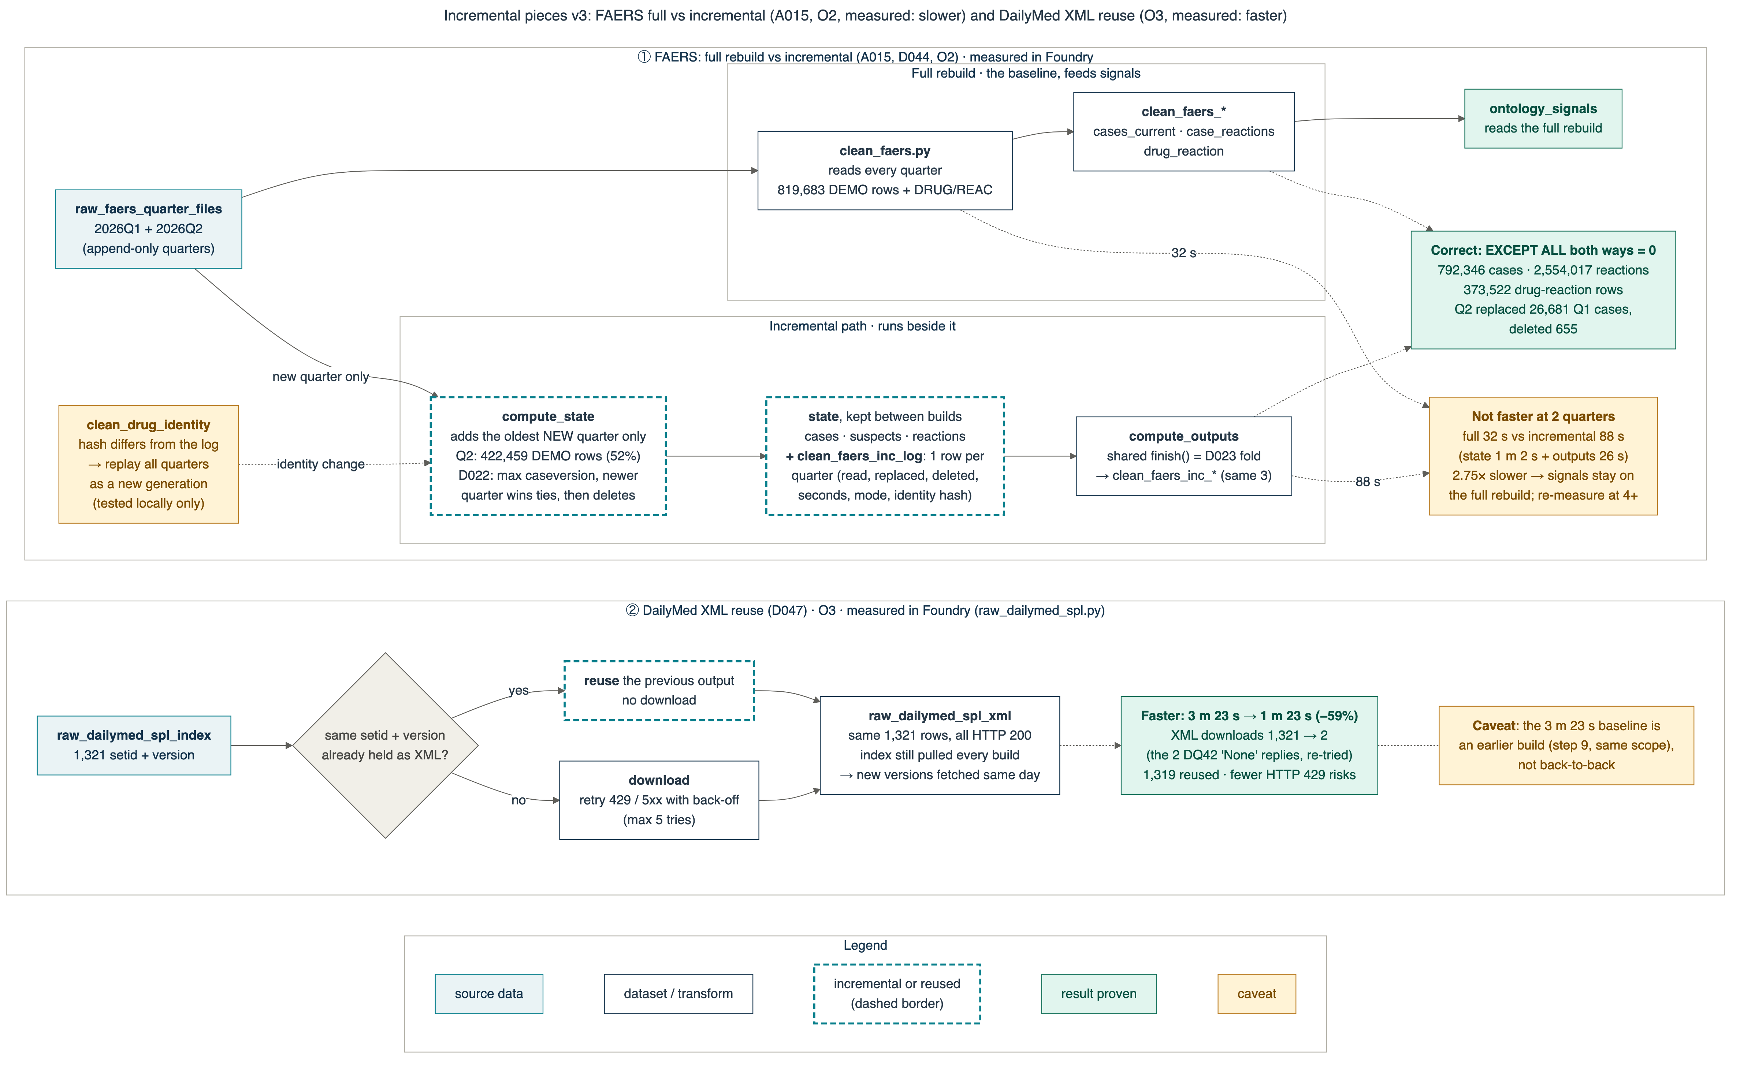
B2 · Incremental pieces in full (diagram 33 v3)
Optimization
Q&A backup
Both incremental pieces, both measured in Foundry: FAERS (O2, correct but slower) and DailyMed XML reuse (O3, faster).
O3 in numbers
XML downloads 1,321 → 2 (1,319 reused); 3 m 23 s → 1 m 23 s. D047 accepted.
O1 in tokens
First run (9 sections): 41,704 + 29,072 tokens. Rebuild with unchanged text: 0. O1b: same at 21 sections.
Freshness unchanged
The DailyMed index is still pulled every build, so a new label version is fetched the same day.
Source: diagrams/png/33-handin-incremental-faers-v3.png; optimization-log.md O1, O1b, O3; numbers.json ai, optimization.
19
Notes:
Script: speaking_script.md#s19. Handbook: slide_explanations.md#s19.

Slide 20
B3 · Drug identity and FAERS counting rules
Data judgment
Q&A backup
These rules run before any counting. Each fixes a problem we measured on the real quarterly files.
Rule | Problem it fixes | What we do | Status
D020 identity | Substring matching pulls in other drugs (“morphine” matches apomorphine) (DQ34) | Split the product ingredient field, strip salts, exact RxNorm ingredient; never substring | Accepted (G6)
D021 suspect roles | The secondary-suspect role often repeats the primary drug; primary-only drops real reports (DQ35) | Suspect = primary + secondary + interacting; count each ingredient once per report | Accepted (G6)
D022 versions + deletes | New case versions and deletes arrive in later quarters (DQ36) | Keep the latest version; apply deletes to full history (Q2: 26,681 replaced, 655 deleted) | Accepted (G6)
D023 v2 duplicates | Same patient filed by many companies; mass polypharmacy re-filings (DQ37) | Person-key fold; reports with 30+ drugs out of the main count, kept as evidence with a caution | Accepted
D037 + D043 label check | “Is it in the label?” is a string question; synonyms differ | AI term with a code-found quote, exact term or US spelling in 6 safety sections, reviewed synonym (code order) | Accepted (D037 on 6 Nov)
Source: DECISIONS D020–D023 (accepted for the pilot via D039 G6), D023 v2, D037, D043; data-issues-register DQ34–DQ37; numbers.json faers.
20
Notes:
Script: speaking_script.md#s20. Handbook: slide_explanations.md#s20.

Slide 21
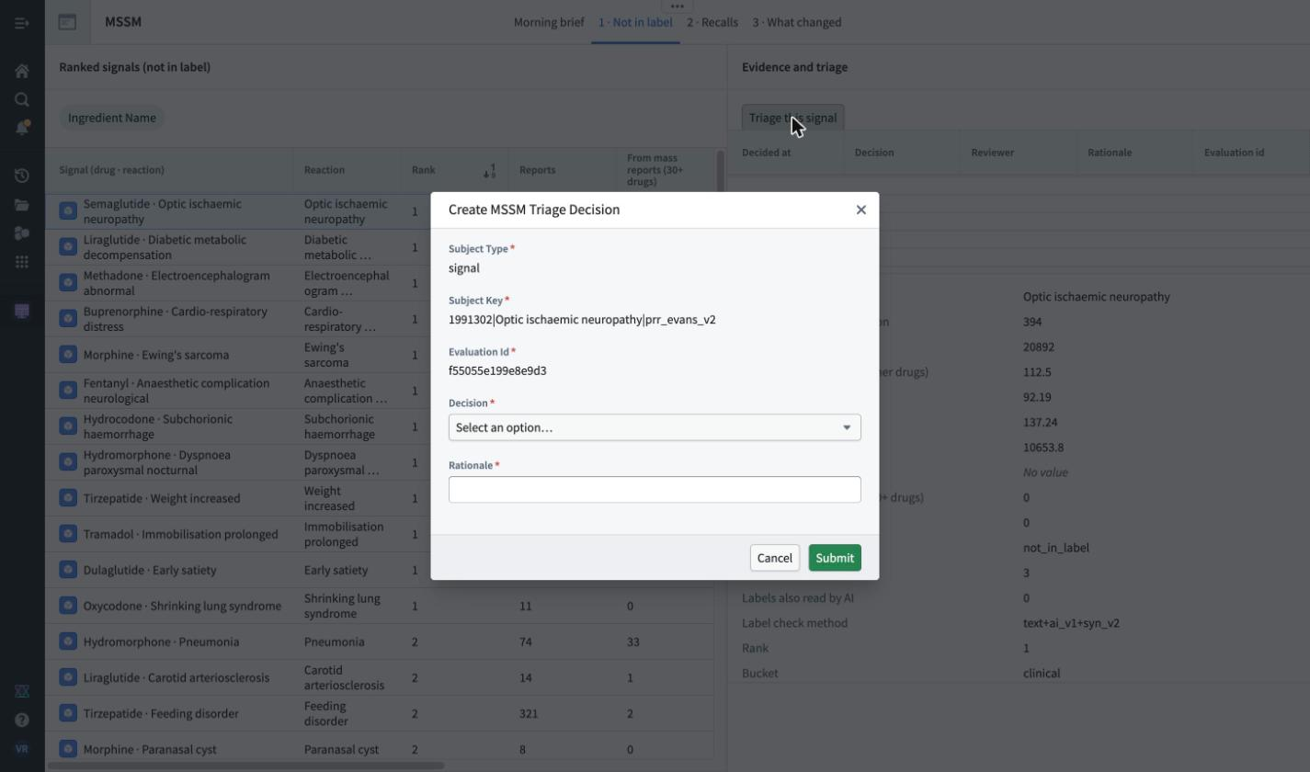
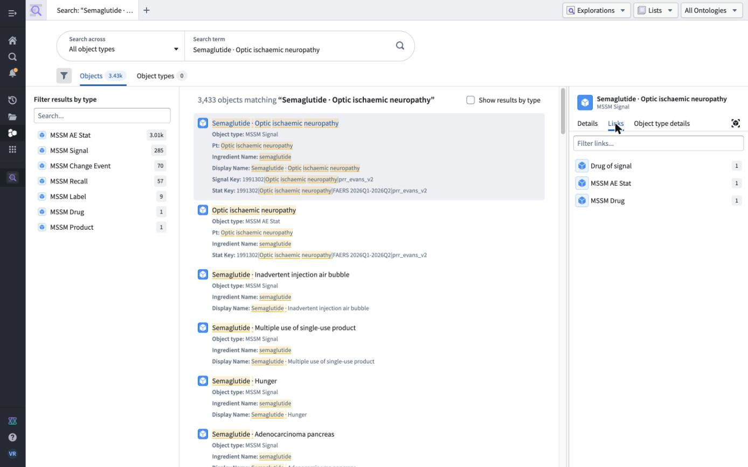
B4 · Trace and write-back: the trust rule in practice
The application
Q&A backup
The triage form fills the signal and its evaluation id for her; she only chooses a decision and writes why.
Write-back
Create-only Action → MSSM Triage Decision. Reviewer and time come from the system. 2 decisions saved; both survived a full rebuild at the baseline gate. App: 4 pages, Workshop v0.10.0.
Trace by hand
At the baseline gate, 5 random ranked signals were re-counted from FAERS rows and their reference labels re-searched: all matched (baseline-gate.md). Object Explorer: Signal → AE Stat → Drug. (Screens from 5 Nov: the form shows NAION's old evaluation id, and 'Drug of signal' is the duplicate link deleted on 6 Nov.)
Source: screens/app-1b-triage-action-form.jpg, hood-object-explorer-naion-links.jpg; docs/11-handin/baseline-gate.md; numbers.json app.
21
Notes:
Script: speaking_script.md#s21. Handbook: slide_explanations.md#s21.

Slide 22
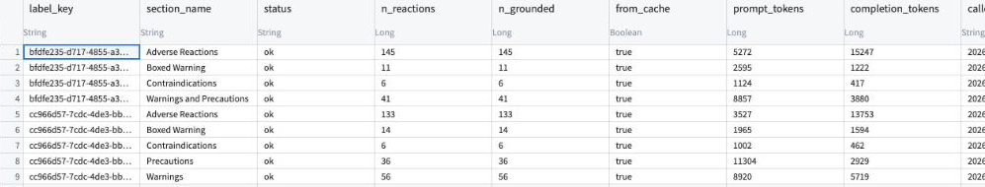
B5 · AI evaluation details
AI reliability
Q&A backup
The first prompt returned long phrases; prompt p2 asks for single terms. Answer-key items found: 11 of 35 → 35 of 35.
Numbers
Grounded 745/745 (all 21 sections, 5 labels). On the 35-item key (2 oxycodone labels, short sections, Claude-written): found 35 of 35; precision ≥ 35/37; F1 0.97 vs target 0.85.
ai_label_section_extractions on 5 Nov (v1 pilot, 9 sections): status ok, every reaction grounded, from_cache = true on rebuild. Now 21 rows.
If it got worse, how we would notice
Every build: grounded rate (fail below 0.95), section errors, cache hit rate in monitoring_checks.
A new model, prompt or parser changes the cache key, so every section is re-extracted and re-scored against the key before it is accepted.
With another month: a pharmacist-labelled sample of long sections, scored each release; drift = F1 drop > 0.05.
Limits, said plainly
Small key, short oxycodone sections only, written by Claude and frozen before the run, not yet checked by a pharmacist. The semaglutide sections are not scored. The model: Claude Sonnet 5.5 via AIP. The AI does not change the signal list today.
Source: eval/ai-eval-v1.md; numbers.json ai; screens/hood-ai-extractions-cache-sql.jpg (cropped, 5 Nov); DECISIONS D041 v2, D015.
22
Notes:
Script: speaking_script.md#s22. Handbook: slide_explanations.md#s22.

Slide 23
B6 · Where the reasoning lives, and what was accepted
Communication
Q&A backup
Every choice where the brief was silent is written down. Changed decisions get a new version; nothing is edited in place.
Decision | What | Status
D014 · D018 | Formulary: 13 drugs (8 opioids + 5 GLP-1 drugs), as an explicit RxCUI list | Accepted
D020–D024 | Identity, suspect roles, versions + deletes, duplicates, FAERS → label join | Accepted (G6)
D016 v3 · D043 | Buckets (MedDRA stand-in); label ↔ FAERS synonym table | Accepted
D005 · D041 v2 · D044 | AI only on new label versions, cached; exact quotes; 5 labels incl. semaglutide; incremental FAERS beside the full rebuild | Accepted (v2 on 6 Nov)
D006 · D015 · D025–D029 · D037 | Evans rule; AI target F1 ≥ 0.85 (target only; benchmark stays cut, D031); field fill-rate monitoring, bridge sources, two-level identity, since-last-review, FAERS quarterly; label-mention rule | Accepted 6 Nov (batch)
D045 – D048 | Change feed; monitoring; DailyMed XML reuse; no partitioning | Accepted 6 Nov (batch)
Read in this order
R00 Start here → architecture note (one page) → COMPASS.md → DECISIONS.md (D001–D048, changes, learnings) → approaches A000–A019 (kept and dropped) → data issues DQ01–DQ43 → optimization log → eval/ai-eval-v1.md → roadmap.
DECISIONS ACCEPTED · 6 NOV 2026
Source: docs/11-handin/architecture-note/; docs/06-decisions/DECISIONS.md; docs/05-approaches/INDEX.md; COMPASS.md.
23
Notes:
Script: speaking_script.md#s23. Handbook: slide_explanations.md#s23.

Slide 24
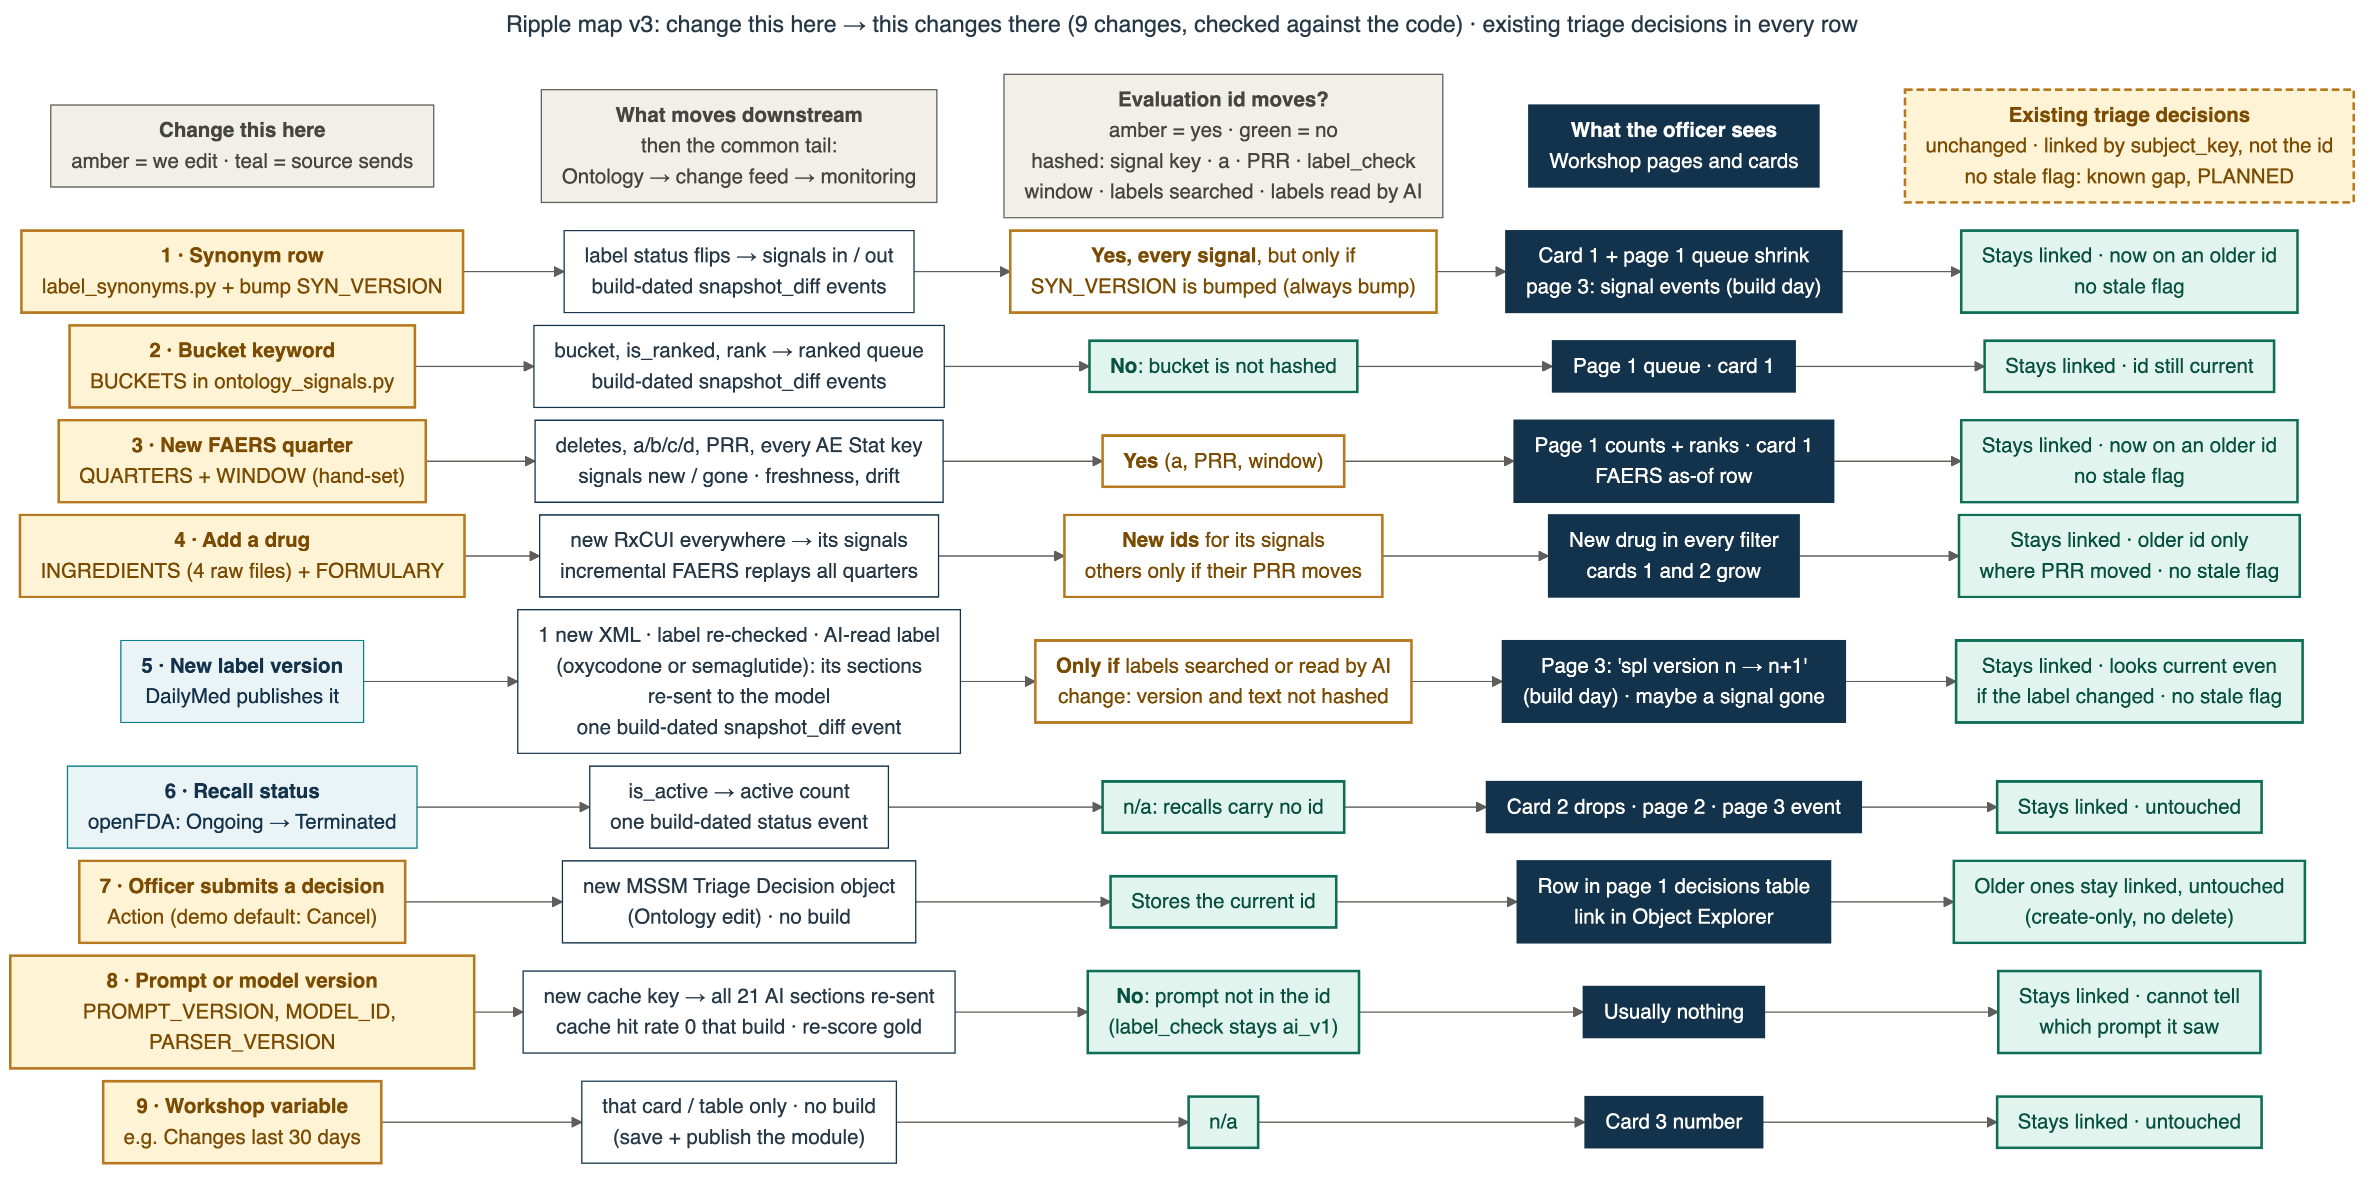
B7 · Ripple map: change this here, this changes there
Architecture
Q&A backup
How to read it
Nine changes, checked against the code. Existing triage decisions stay linked in every row (by signal key); some end up on an older evaluation id.
Known gap
No stale flag: the screen does not say when a decision's evidence has moved.
PLANNED — NOT BUILT
Source: diagrams/png/37-handin-ripple-v3.png (checked against the code); numbers in the diagram from the build history (A014, D016 v3, A019).
24
Notes:
Script: speaking_script.md#s24. Handbook: slide_explanations.md#s24.

Slide 25
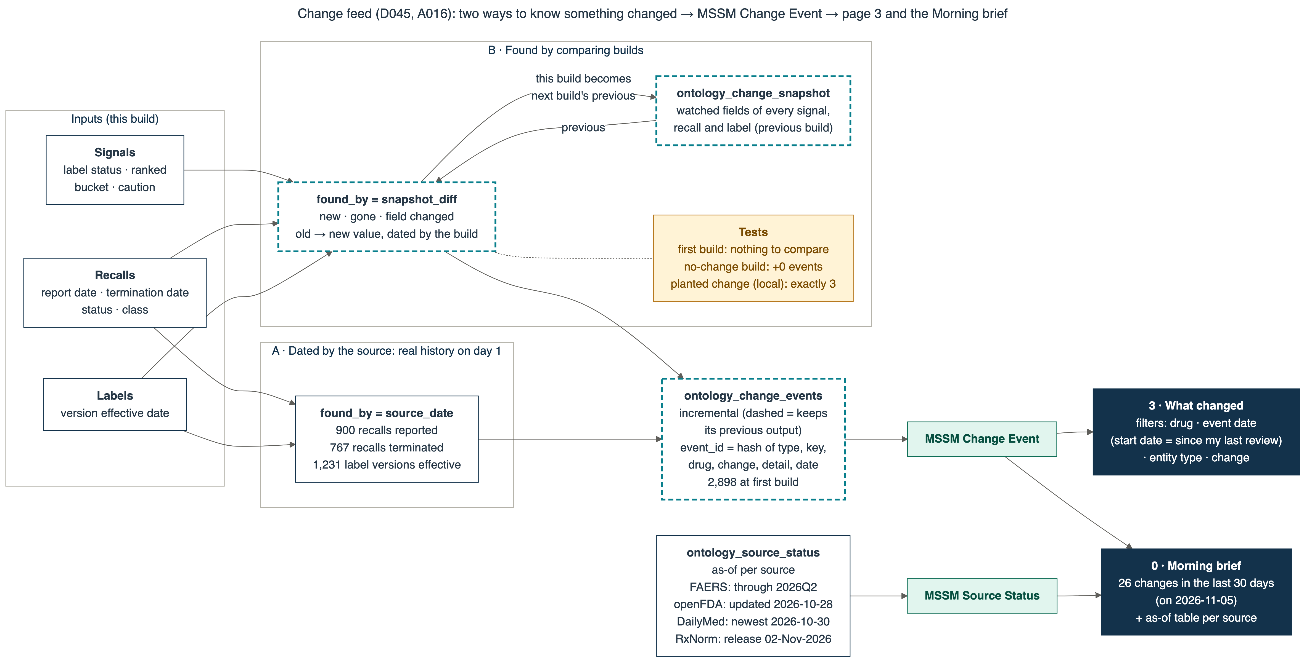
B8 · Change feed: two ways to know something changed
The application
Q&A backup
Dated by the source
900 recalls reported, 767 terminated, 1,231 label versions: real history on day one.
Found by comparing builds
Signals new / gone / changed. A no-change rebuild added 0.
BUILT · TESTED IN FOUNDRY
D045, change feed
Source: diagrams/png/34-handin-change-feed-v1.png; numbers.json changes; A016.
25
Notes:
Script: speaking_script.md#s25. Handbook: slide_explanations.md#s25.

Slide 26
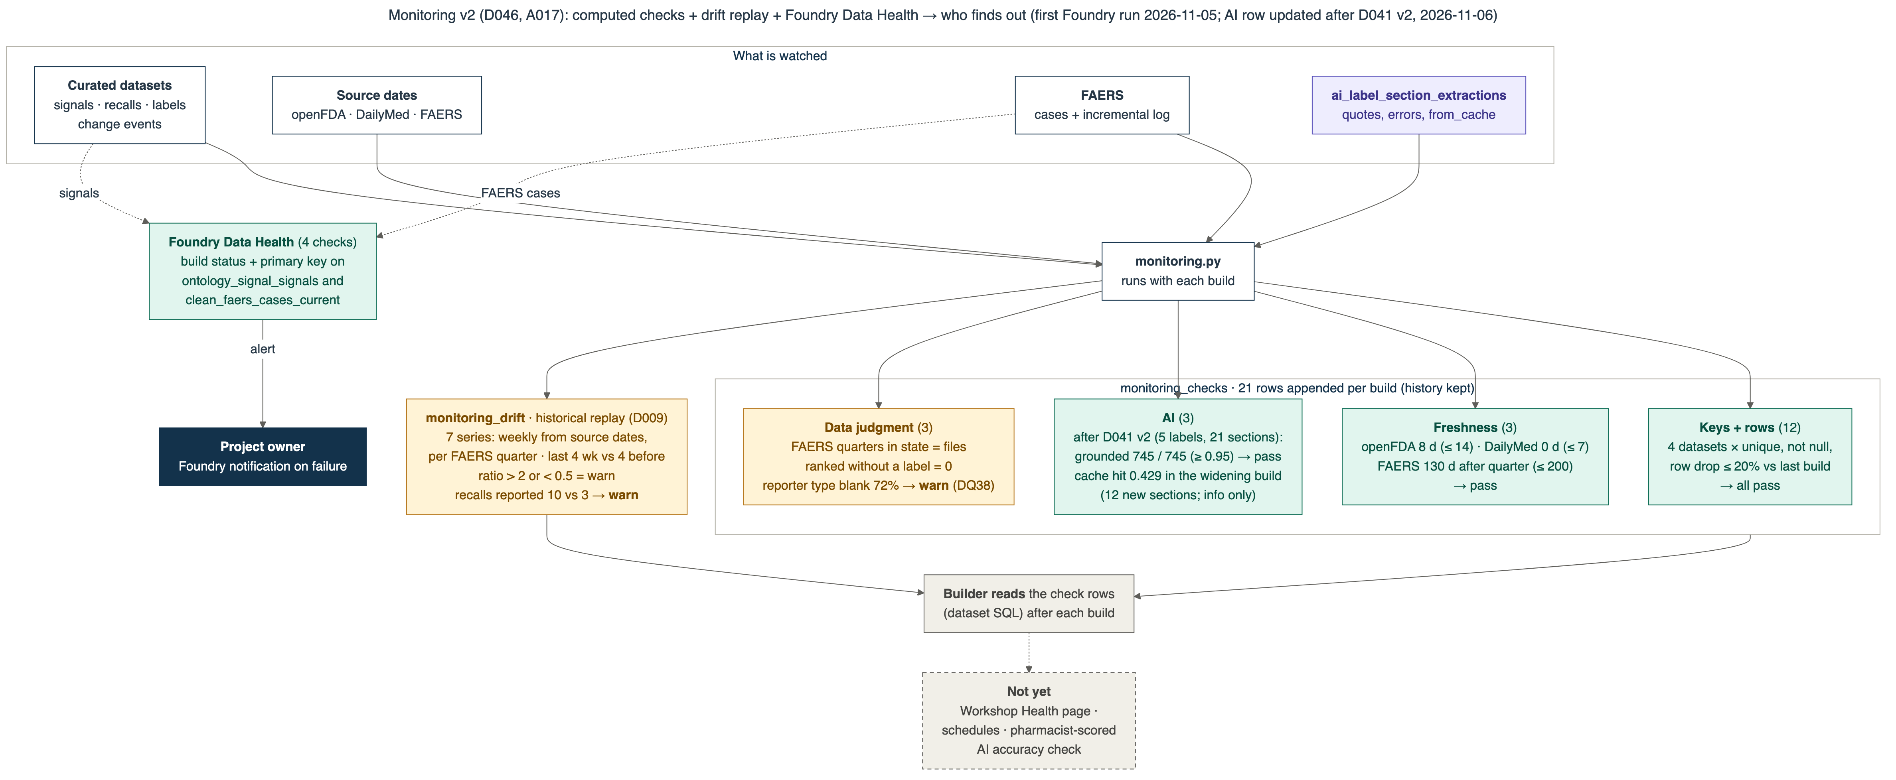
B9 · Monitoring: what is watched, and who finds out
AI reliability · monitoring
Q&A backup
21 computed checks per build + drift replay + 4 Foundry Data Health checks. Only Data Health alerts the owner today; the builder reads the check rows. Not built: health page, schedules, pharmacist-scored AI check.
Source: diagrams/png/35-handin-monitoring-v2.png; numbers.json monitoring, ai; A017; D046.
26
Notes:
Script: speaking_script.md#s26. Handbook: slide_explanations.md#s26.

Slide 27
B10 · Another month: sources researched for the review loop
Communication
Q&A backup
Read-only web scan, 2026-11-05. Fit = how much it helps a pharmacist decide. Nothing here is in pilot scope.
Source | Gives us | Licence / cost | Fit
OnSIDES | Label side effects, 4 regions, quarterly | CC BY 4.0 | High
FDA Drug Safety Communications + SrLC | Has FDA warned? When did the label change? | Free | High
Claude connectors (PubMed, ClinicalTrials.gov) | Cited lookups for the evidence packet | Free connectors; not under BAA | High
Palantir Ontology MCP | Claude reads our signals (read-only tools) | Part of Foundry | Medium-high
ClinicalTrials.gov | Trial side effects vs placebo | Free | Medium
FDA Orange Book | Reference listed drug, interchangeable generics | Free | Medium
MedDRA | Term hierarchy and standard groupings | Licence; $0 non-profit | High (production)
DrugBank · NIDA · “ClinHub” | Commercial API · population misuse · sponsor trial hub | Paid / restricted | Low
Risks we would manage
Patient data creeping in: written rule, no case narratives in packets.
Automation bias: hide Claude's draft on a blind sample.
Hallucinated evidence: link required and opened; quotes checked by code.
Licences: MedDRA, DrugBank and SIDER limits.
Audit: create-only Action, system-set reviewer and time.
ASSUMED
fit ratings are our judgment
Source: docs/09-roadmap/another-month-sources-and-pharmacist-review.md §2 (comparison), §4 (risks); licence facts as found on the linked pages.
27
Notes:
Script: speaking_script.md#s27. Handbook: slide_explanations.md#s27.

Slide 28
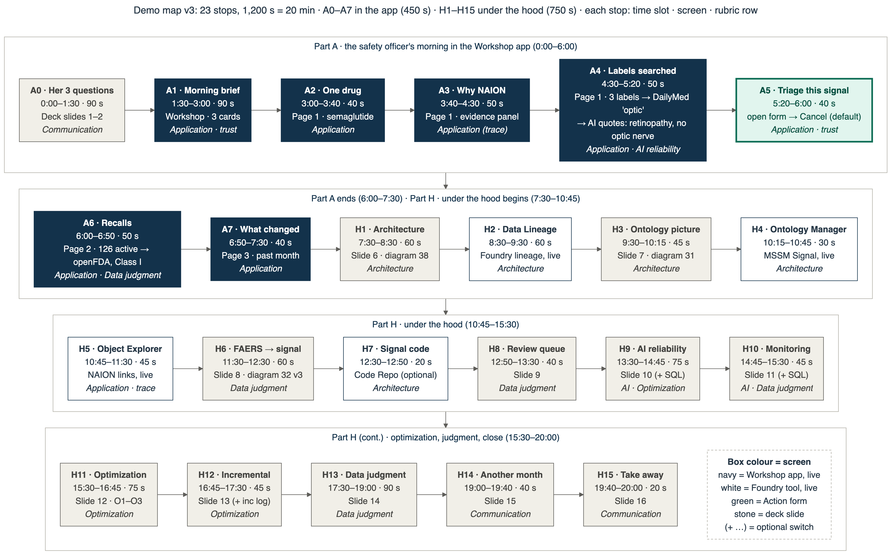
B11 · Demo map: the 23 stops
Communication
Q&A backup
How the talk uses it
A0–A7: the officer's morning (slides 1–5, mostly live in the app). H1–H15: under the hood (slides 6–16, with live Foundry switches).
Source: diagrams/png/36-handin-demo-map-v3.png; docs/11-handin/AGENT-BRIEF.md agenda; demo navigation guide.
28
Notes:
Script: speaking_script.md#s28. Handbook: slide_explanations.md#s28.

Slide 29
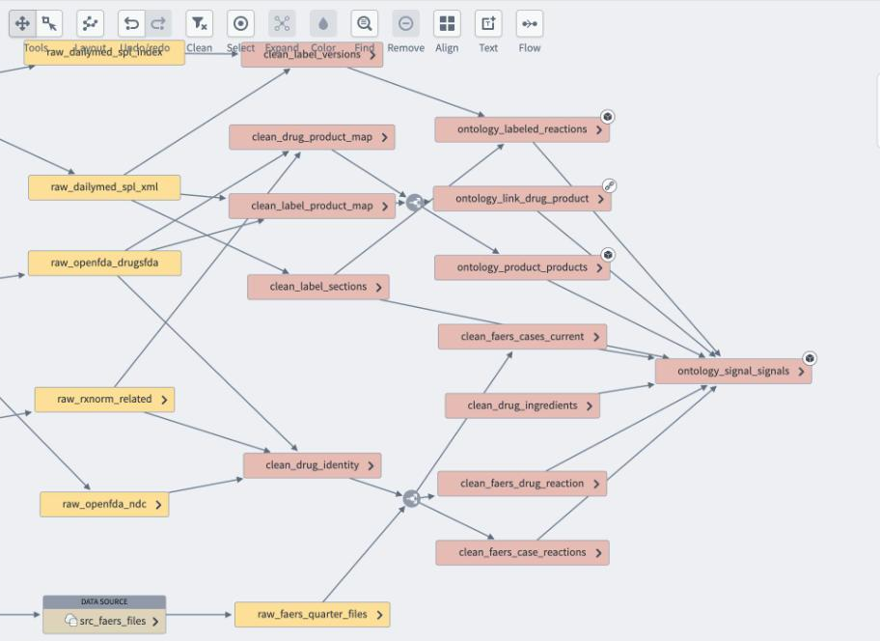
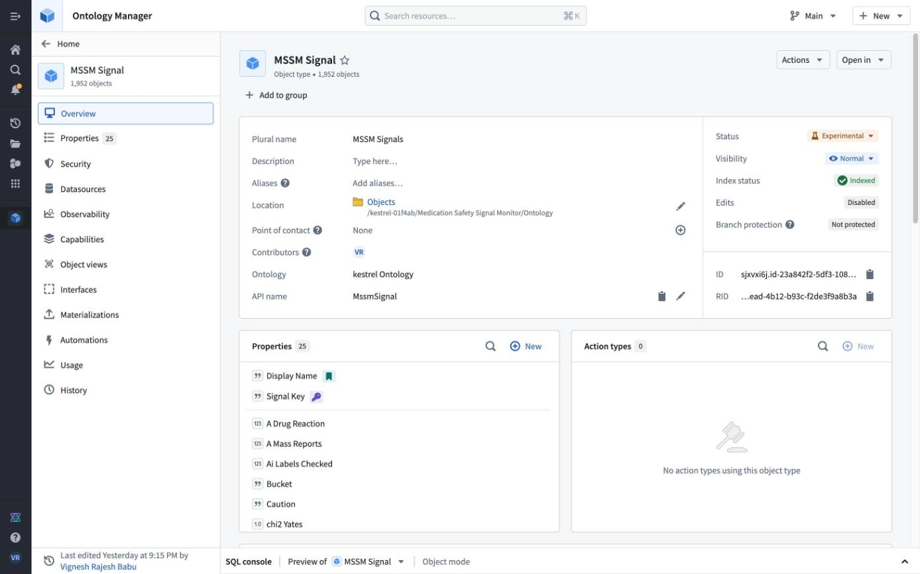
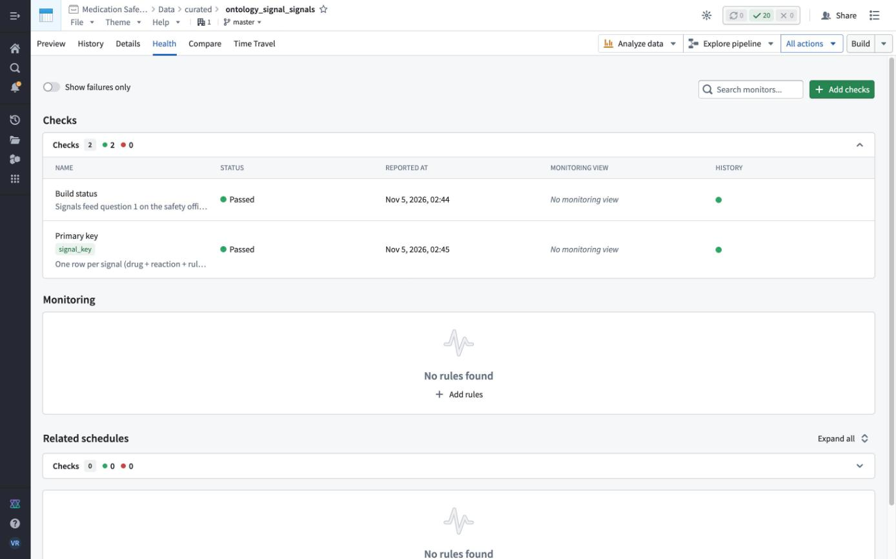
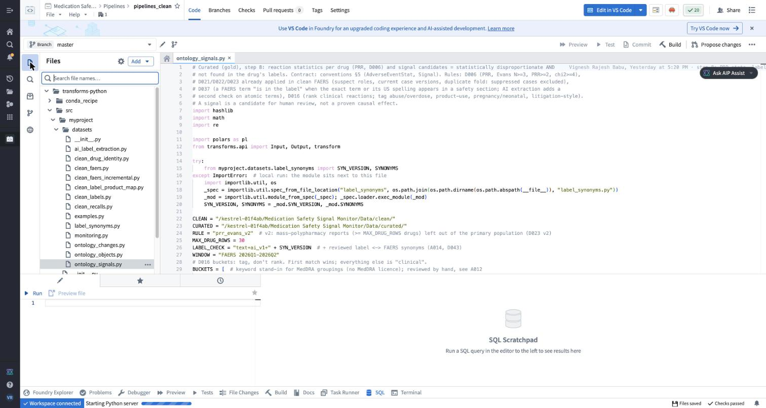
B12 · Under the hood: fallback screenshots
Architecture
Q&A backup
Data Lineage (cropped): raw → clean → curated → ontology_signal_signals
Ontology Manager: MSSM Signal object type
Data Health: build status + primary key checks, both passed
Code Repository pipelines_clean: ontology_signals.py
Source: docs/11-handin/screens/hood-*.jpg (captured 2026-11-05); lineage cropped to the graph (deck/assets).
29
Notes:
Script: speaking_script.md#s29. Handbook: slide_explanations.md#s29.

