Slide 1

CSCI 2270-305 Recitation 01/16: Introduction to C++
Varad Deshmukh

Slide 2
Introductions and Logistics
Recitation: Thursdays, 330-415 pm
TA: Varad Deshmukh (varad.deshmukh@colorado.edu)
Co-TA: Elizabeth Spaulding
CA: Aazer Rae
Office hours: ECAE 190
- Thursdays 10:45-11:45 AM, 2-3 PM;
- Fridays 9-11 AM

Slide 3
Resources
Moodle:
‘CSCI 2270 - Zagrodzki, Ashraf, Trivedi - CS2: Data Structure’
Enrollment key: DataStructs
Course and recitation material, grades, assignment submissions
Login with the identikey
Piazza:
CSCI 2270 Computer Science 2 Data Structures
Course announcements, discussion forum
Login with the Colorado.edu account

Slide 4
Setup
Setup VSCode
For Windows 10 Users:
Install the Windows Subsystem for Linux
Install Ubuntu from Microsoft Store
Install g++
For MAC/Linux Users:
Install g++
If you don’t have the setup ready today: https://coding.csel.io/
Jupyter notebook interface
Lot of logins may cause excessive website load

Slide 5
Syllabus: Rough Outline
Introduction to C++
Arrays and Structs (Contiguous linear allocation)
Pointers and Dynamic Memory Allocation
Linked Lists
Stack and Queues
Trees (Binary Trees, BSTs, Traversal, Balancing)
Graphs (Graph Search, Traversal and Shortest Paths)
Hash Tables
Heaps (Flexibility and Speed)

Slide 6
Course Structure and Grading
Weekly coding assignments (40%)
Assigned Saturday and due on Sunday the following week
Weekly quizzes (10%)
Assigned at the end of the week
Weekly recitations (15%)
Please don’t forget to sign into the attendance sheet!
Recitations graded based on your attendance
Can miss one during the semester without losing points
A maximum of three midterm examinations (20%):
Third examination optional to replace the lowest of the first two.
Final Project (15%)

Slide 7
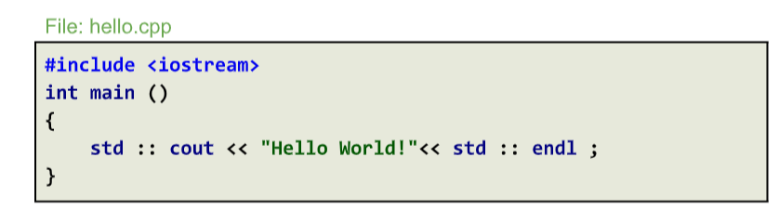
C++: Hello World!
Header with declarations for cout, endl, etc.
std :: cout prints to standard output (screen). This is an output stream object.
Newline character with flush
Stream insertion operator (used for output)

Slide 8
Compiling and Running “Hello World”
g++ -std=c++11 hello.cpp –o hello
Compiler
Version
File to be compiled
Name of output binary
./hello

Slide 9
Some Simple Bash Commands
ls : List all the files in the current directory
cd <dir>: Navigate to directory
mkdir <dir>: Create a new directory
cat <file1> <file2>: Display concatenated contents of file1 and file2.
cp <path1> <path2>: Copy contents of path1 to path2
mv <path1> <path2>: Move contents of path1 to path2
rm <path>: Delete file at path.

Slide 10
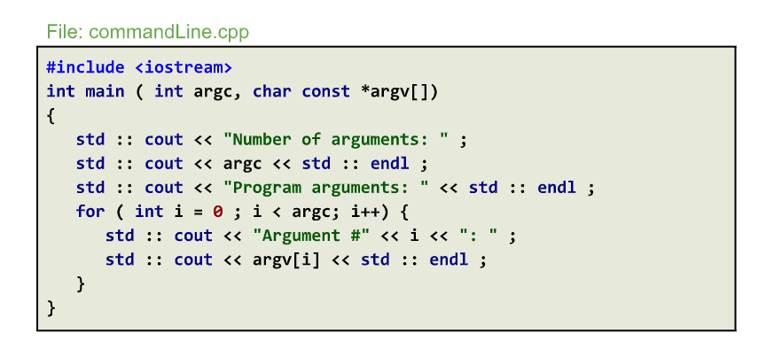
Command Line Arguments
# of arguments
Array of strings storing the cmdline args
g++ -std=c++11 commandLine.cpp –o commandLine

Slide 11
Command line arguments
./cmdline arg1 arg2 arg3
argc
argv (pointer array of length 4)
4
“./commandline”
“arg1”
“arg2”
“arg3”

Slide 12
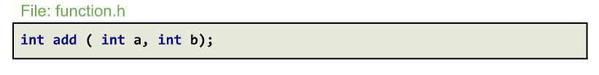
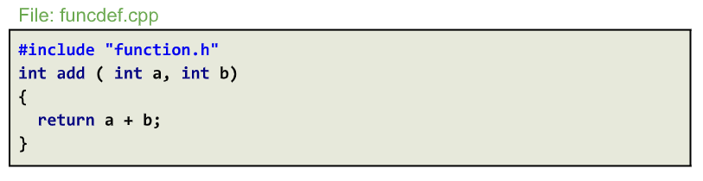
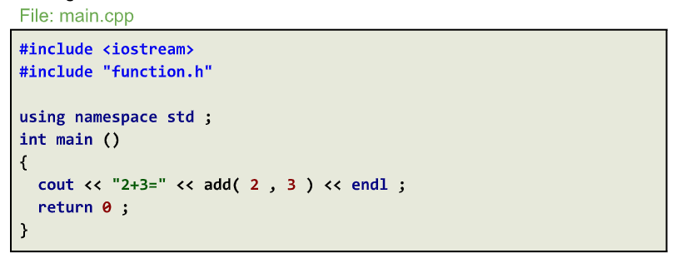

Functions And Multiple Files
Header file: Function prototype and variable declarations
Function definition
Function call

Slide 13
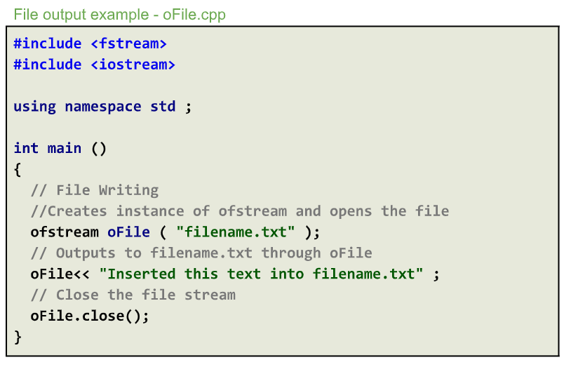
File I/O: Output
Declarations for file streaming objects.
Use namespace to avoid writing std:: everytime.
Output file stream object.
Insertion operator used for file streams.

Slide 14
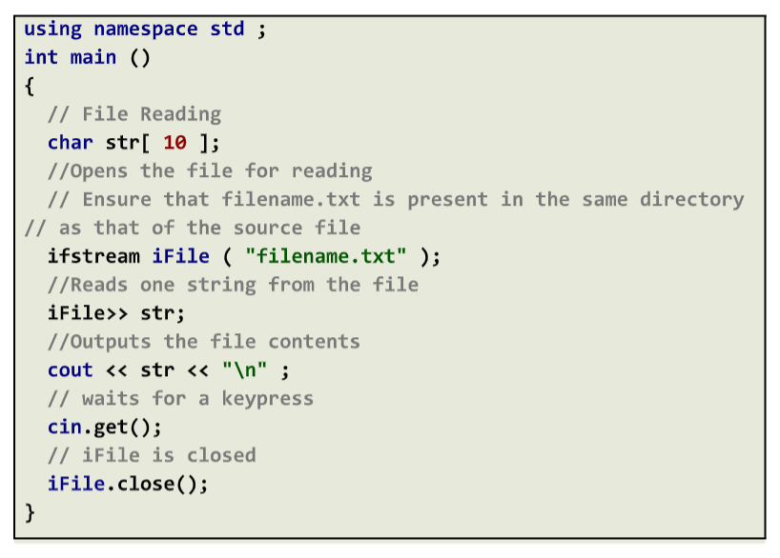
File I/O: Input
Input file stream object.
Extraction operator (used for reading I/O)

Slide 15
Recitation Exercise and Questions
Implement the “Hello World”, “Command Line Argument” and “Function” exercises in your setup.

