Slide 1

CSCI 2270-305 Recitation 01/23: Pointers
Varad Deshmukh

Slide 2
Logistics
VS Code Setup (hopefully done.)
Homework 1: Start early! Saturday night debugging isn’t fun.
No hardcoding please.
Recitation assignments: Show your work to me, Elizabeth or Aazer before you leave.
Lots of questions in the recitation encouraged!
Pointers are tricky, and need some getting used to
Segmentation faults, address v/s values, associativity and precedence, etc.

Slide 3
What is a Pointer?
In C/C++, a pointer is a variable which contains the address of other variables.
Memory Layout
Regular variables
Address | Value
101 | 4
102 | 3
103 | 101
104 | 103
Pointer type
int a = 4;
float b = 3;
int *p = &a;
int **q = &p;
Pointer variables
Example: pointer_address.cpp

Slide 4
Syntax: Examples
* and &
Example | Meaning
float * p; | p is a pointer to a float
float ** q; | q is a pointer to a pointer to a float
float a; a = *p; | The value stored at the address contained in p is stored in a
q = &a; | The address of the variable a is now stored in q

Slide 5
Arrays and Pointers
float a[] = {1.0, 1.618, 3.14, 2.718}
Pointer operations | Value
a
a[1]
*(a+1)
a+1
&a[2]
Memory Layout
Address | Value
100 | 1.0
104 | 1.618
108 | 3.14
112 | 2.718

Slide 6
Arrays and Pointers
float a[] = {1.0, 1.618, 3.14, 2.718}
Pointer operations | Value
a | 100
a[1] | 1.618
*(a+1) | 1.618
a+1 | 104
&a[2] | 108
Memory Layout
Address | Value
100 | 1.0
104 | 1.618
108 | 3.14
112 | 2.718

Slide 7
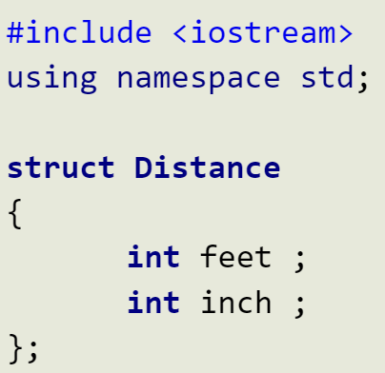
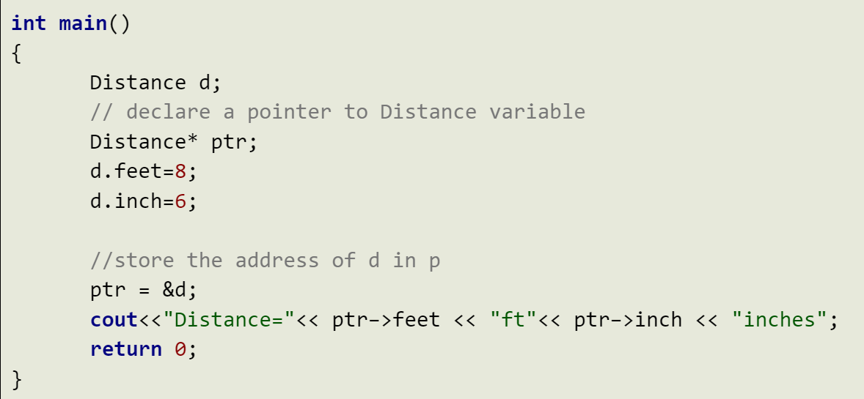
Structures and Pointers
Struct variable: Access members using the ”.” operator.
Pointer to struct variable: Access members using the ”->” operator.
Example: pointer_to_struct.cpp

Slide 8
Pass by value v/s Pass by reference
Caller function needs to pass information about a variable.
int var;
add(var);
Called function creates a copy to access the variable.
void add(int var)
{ int x = var; }
Value
Called function copies over the address, but the address points to the same variable.
void add(int * addr)
{ int x = *addr; }
Caller function needs to pass information about a variable.
int var;
add(&var);
Reference
Example: pass_by.cpp

Slide 9
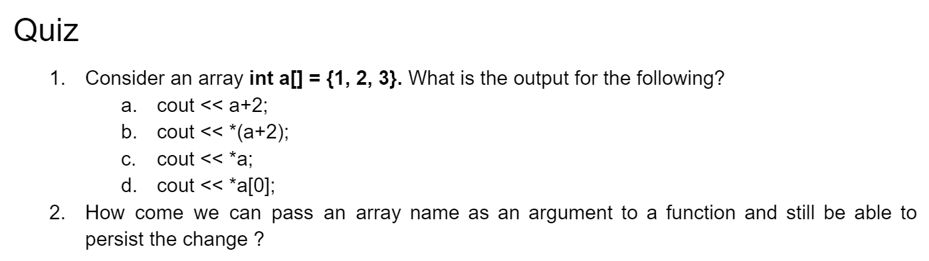
Quiz Exercise

Slide 10
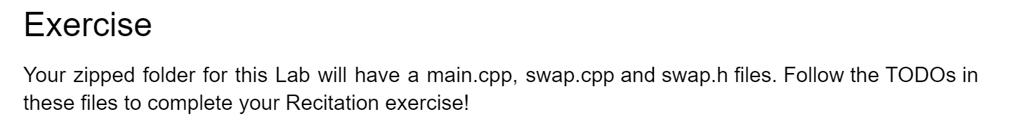
Programming Exercise
Show your effort to either of the TAs/CAs before you leave the recitation.

