Slide 1

CSCI 2270-305 Recitation 01/30: Dynamic Memory
Varad Deshmukh

Slide 2
Logistics
Homeworks: No hard-coding – we will be checking your code.
Click Finish Attempt and Submit all and Finish
Recitation Exercise: Sign your attendance only after showing your work to me or Elizabeth.

Slide 3
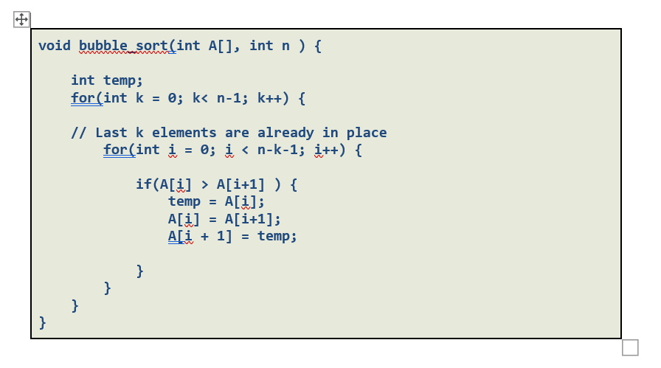
Useful Material for Sorting
Example: Bubble Sort
Sorting visualization: https://visualgo.net/bn/sorting
Inner loop moves the n^{th} largest element to the n^{th} place from the end.

Slide 4
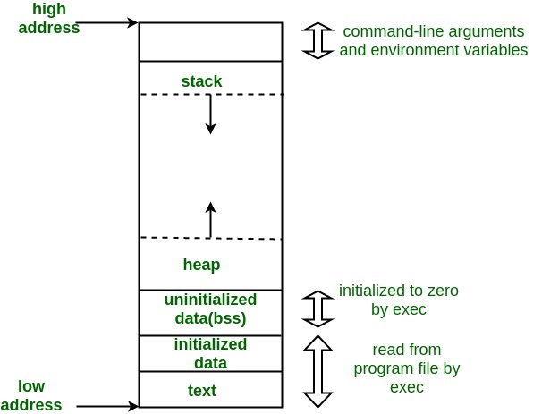
Program Memory Layout
Source: geeksforgeeks

Slide 5
Static Memory Variables
Used for allocating data (variables) known at compile time.
Variables are stored on stack.
Not useful when the memory required depends on user input.
Can lead to space wastage.
Can lead to insufficient memory.
Examples: int a; float b[100];
Recall Homework 1: Creating a sorted array of 100 integers. What if the input file contained 50 or 150 integers?

Slide 6
Dynamic Memory Variables
Used for allocating data (variables) not known at compile time.
Variables are stored on heap.
Not useful when the memory required depends on user input.
Prevents space wastage.
Allocate as much memory as dictated by user input.
Examples: int *a = new int; float b[] = new float[10];
Recall Homework 1: Creating a sorted array of 100 integers. What if the input file contained 50 or 150 integers?
Dynamically update the array as you read more integers.

Slide 7
Allocation/Deallocation of Dynamic Memory
Allocation
int * a = new int;
float *b = new float[20]
De-allocation
delete a;
delete [] b;

Slide 8
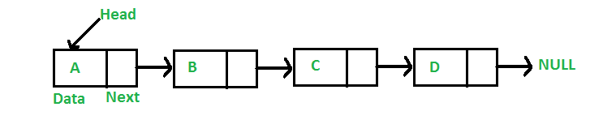
Example: Linked List
Linked List is a dynamically allocated data structure arranged sequentially as nodes.
Each node contains:
Data (This can be any data type: int, float, struct, etc.)
Link to the next node. (This is a pointer)

Slide 9
Exercise: Array Doubling
Problem: Read a file of numbers, and start storing them into an array.
Start with dynamically allocating an array of size 10.
Start populating the array with numbers as you read them.
When the total numbers read exceeds the size of the array,
Create a new array of double the original size.
Copy the contents from the original array to the new array.
Delete the memory allocated to the original array.
Insert the next element in the next index and continue.

Slide 10
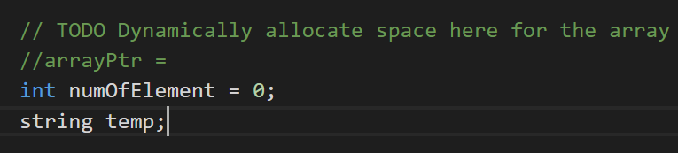
Step 1: Dynamically allocate a new array
Function main()

Slide 11
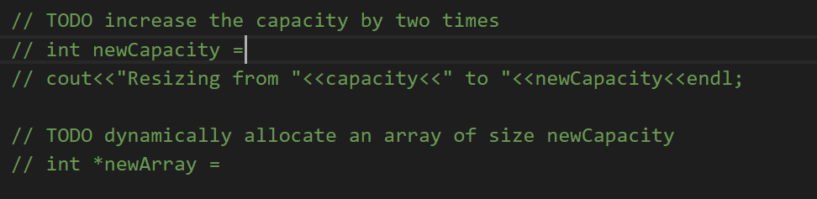
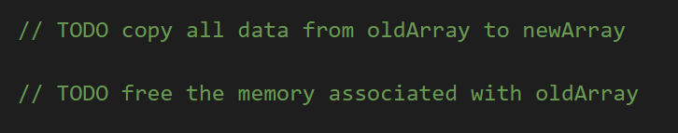
Step 2: On capacity exceeded,
Dynamically allocate a new array of twice the size.
Copy the contents of the old array into the new one.
Delete the memory of the old array.

Slide 12
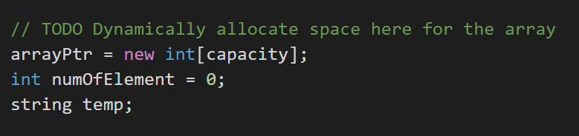
Solution: main()

Slide 13
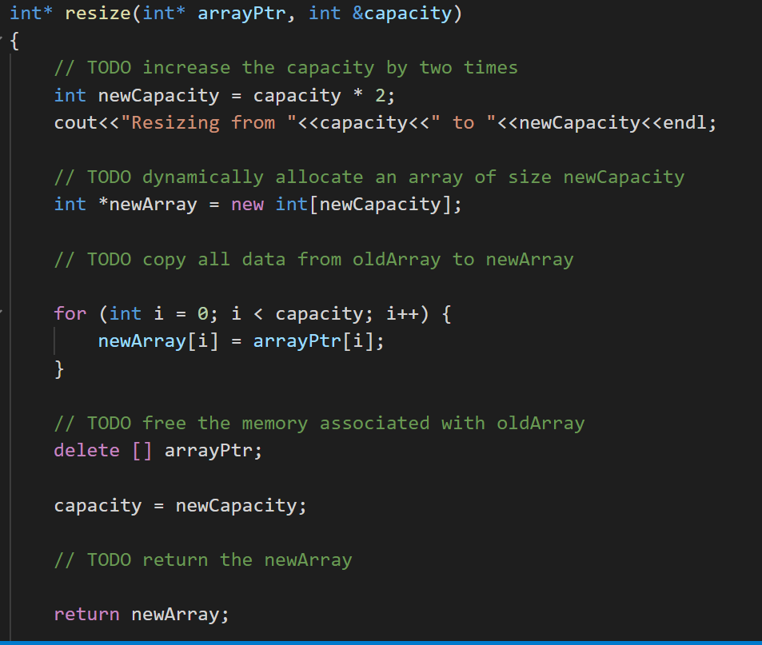
Solution: resize()

