Slide 1

CSCI 2270-305 Recitation 02/13: Stacks and Queues
Varad Deshmukh

Slide 2
Logistics
Assignment 4 due on Sunday
Click Finish Attempt and Submit all and Finish (Still seeing a lot without these ☹)
FCQ’s available: Search for an email from Rajshree Shreshtha.
TA Name: Varad Deshmukh
Mid-term coming up!
If you need special accommodation, please let us know by Friday 02/14.
Practice midterm available on Moodle

Slide 3
Today’s Recitation
Stacks and Queues
Silver Problem (Mandatory): Implement a Queue with a Linked List.
Gold Problem (Optional): Use a stack to perform parenthesis matching.
Recitation Exercise: Sign your attendance only after showing your work to me or Elizabeth.
Data Structures Visualization: https://visualgo.net/

Slide 4

Stacks

Slide 5
Stacks
Abstract Data Structure
Last In First Out (LIFO)
Operations:
Push an element onto the stack
Pop the topmost element from the stack
Corner cases:
Stack is empty when trying to pop.
Stack is full when trying to push.
Stack applications:
Recall the stack frame when the function calling?

Slide 6
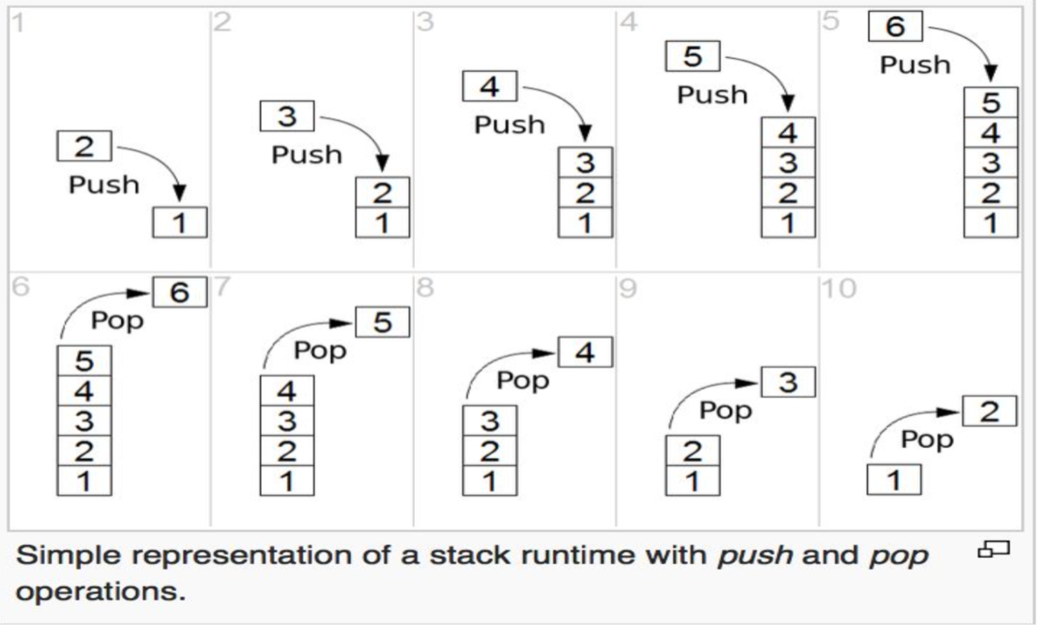
Stacks Visualization

Slide 7
Implementing Stacks: Array
Allocate an empty array of sufficiently large size:
Use an integer to keep track of the total elements in the stack (let’s call it top)
To push:
To pop:
top
9
12
4

Slide 8
Implementing Stacks: Array
Allocate an empty array of sufficiently large size:
int stack[100]; (How about making it dynamic?)
Use an integer to keep track of the total elements in the stack (let’s call it top)
int top = -1;
To push:
Increment the top variable: top = top + 1
Insert the element: stack[top] = 10;
To pop:
Decrement top: top = top – 1;
top
9
12
4

Slide 9
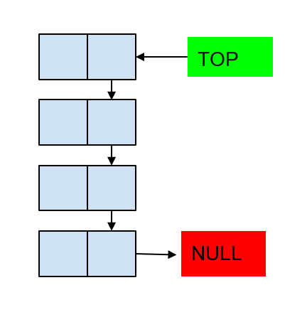
Implementing Stacks: Linked List
Don’t allocate any predetermined memory
Create a pointer to point to the head of the list:
Node * top = nullptr; (Empty stack)
To push:
Create a new linked list node.
Make it the new top (head) of the linked list.
To pop:
Make the next node as the top (head).
Delete the old head.
Visualization: https://visualgo.net/en/list (Hit the stacks button)

Slide 10
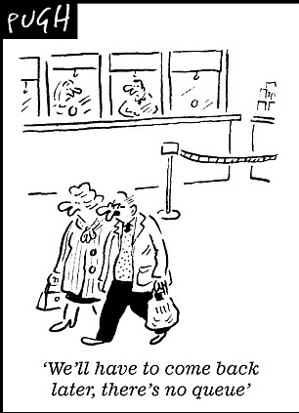

Queues

Slide 11
Queues
Abstract Data Structure
First In First Out (FIFO)
Operations:
Queue an element to the end
Dequeue an element from the front
Peek at the front element of the queue
Corner cases:
Queue is empty when trying to dequeue.
Queue is full when trying to enqueue.
Real world application?

Slide 12
Implementing Queues: Array
Allocate an empty array of sufficiently large size:
int queue[100]; (How about making it dynamic?)
Use two integers to keep track of the span of the queue.
int front = -1; int tail = -1; (Empty queue)
Additionally, maintain a variable queueSize = 0
To enqueue:
Increment the tail variable: tail = (tail + 1) % queueSize;
Insert the element: queue[tail] = 10;
To dequeue:
Increment tail: front = (front + 1) % queueSize;
front
end
12
4
9
13
17

Slide 13
Exercise (Silver Problem)
Implement the enqueue() and dequeue() functions in the file QueueLL.cpp.
Compile using the following command: g++ QueueLL.cpp DriverQueue.cpp
Handle the corner case:
Enqueueing to an empty queue
Dequeueing the last node from the queue
Dequeueing from an empty queue

Slide 14
Implementing Queues: Linked List
Don’t allocate any predetermined memory
Use two pointers to keep track of the first and last element in the queue
Node * front = nullptr; Node * end = nullptr; (Empty queue)
To enqueue (Exercise -- Also handle corner cases):
Allocate a new node, pointed to by Node * temp;
Make temp the new end.
To dequeue (Exercise -- Also handle corner cases):
Make a new pointer Node *temp = front;
Make front point to the next node in the queue;
Delete temp

