Slide 1

CSCI 2270-305 Recitation 02/20: Midterm Review
Varad Deshmukh

Slide 2
Logistics
Assignment 5 due next Sunday
Good job on hitting “Submit All and Finish” for Assignment 4. ☺
Practice midterm solutions available on Moodle
No Recitation Assignment today!
Interview grading (Feb 28th) – Waiting on booking the room.

Slide 3
Useful tips for the Exam
Remember the name of your section and the name of your TA!
Write legibly on the exam paper.
Use comments to describe your code –
It will help us know your thought process, and
Help you get partial credit even if the code has a bug.
Remember to cover as many corner cases as possible.
Try to avoid memory leaks!
Node * temp = new Node;
temp = head;

Slide 4
Midterm Examination Format
3 Coding Questions
First question is mandatory
Choose one of questions 2 and 3 (Don’t attempt to solve both – no extra points).
If you solve both 2 and 3, the question with the higher grade will be considered.
MCQ Questions

Slide 5
Command line arguments
./cmdline alpha beta gamma
argc
argv (pointer array of length 4)
4
“./commandline”
“alpha”
“beta”
“gamma”

Slide 6
Command line arguments
./cmdline alpha beta gamma
argc
argv (pointer array of length 4)
What is argv[2]?
4
“./commandline”
“alpha”
“beta”
“gamma”

Slide 7
Command line arguments
./cmdline alpha beta gamma
argc
argv (pointer array of length 4)
What is argv[2]?
4
0
1
2
3
“./commandline”
“alpha”
“beta”
“gamma”

Slide 8
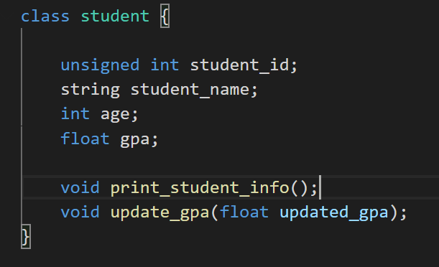
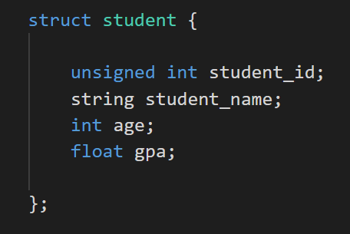
Structures and Classes

Slide 9
Pointers
In C/C++, a pointer is a variable which contains the address of other variables.
Memory Layout
Regular variables
Address | Value
101 | 4
102 | 3
103 | 101
104 | 103
Pointer type
int a = 4;
float b = 3;
int *p = &a;
int **q = &p;
Pointer variables
Example: pointer_address.cpp

Slide 10
Pointers and Dynamic Memory
Allocation
De-allocation

Slide 11
Pointers and Dynamic Memory
Allocation
int * a = new int;
float *b = new float[20]
De-allocation
delete a;
delete [] b;

Slide 12
Pointers and Dynamic Memory
Allocation
int * a = new int;
float *b = new float[20]
De-allocation
delete a;
delete [] b;
Don’t delete pointers to static variables!

Slide 13
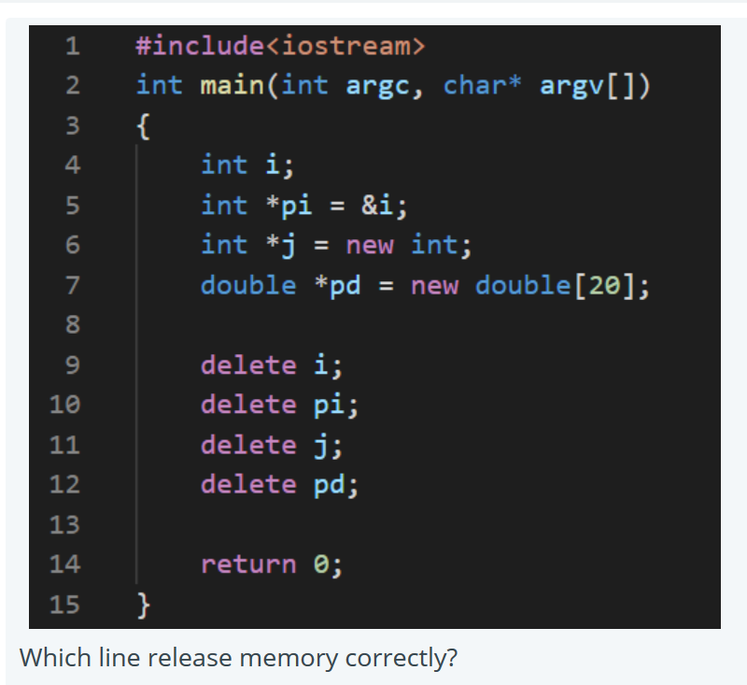
Pointers and dynamic memory

Slide 14
Function arguments: Pass by value
void reset_value(int c, int d) { c = 7; d = 8; }
void reset_pointers(int * c, int * d) { *c = 9; *d = 10; }
void reset_reference(int & c, int & d) { c = 11; d = 12; }
int main() {
int a = 3; int b = 4;
reset_value(a, b);
cout << a << b << endl;
reset_pointer(&a, &b);
cout << a << b << endl;
reset_reference(a, b);
cout << a << b << endl;
}
Values of a and b are copied into c and d.
c
d
a
b

Slide 15
Function arguments: Pass by value
void reset_value(int c, int d) { c = 7; d = 8; }
void reset_pointers(int * c, int * d) { *c = 9; *d = 10; }
void reset_reference(int & c, int & d) { c = 11; d = 12; }
int main() {
int a = 3; int b = 4;
reset_value(a, b);
cout << a << b << endl;
reset_pointer(&a, &b);
cout << a << b << endl;
reset_reference(a, b);
cout << a << b << endl;
}
Values of a and b are copied into c and d.
c
d
a
b
Updating c and d doesn’t update parameters a and b

Slide 16
Function arguments: Pass by pointers
void reset_value(int c, int d) { c = 7; d = 8; }
void reset_pointers(int * c, int * d) { *c = 9; *d = 10; }
void reset_reference(int & c, int & d) { c = 11; d = 12; }
int main() {
int a = 3; int b = 4;
reset_value(a, b);
cout << a << b << endl;
reset_pointer(&a, &b);
cout << a << b << endl;
reset_reference(a, b);
cout << a << b << endl;
}
Addresses of a and b are copied into c and d.
c
d
&a
&b

Slide 17
Function arguments: Pass by pointers
void reset_value(int c, int d) { c = 7; d = 8; }
void reset_pointers(int * c, int * d) { *c = 9; *d = 10; }
void reset_reference(int & c, int & d) { c = 11; d = 12; }
int main() {
int a = 3; int b = 4;
reset_value(a, b);
cout << a << b << endl;
reset_pointer(&a, &b);
cout << a << b << endl;
reset_reference(a, b);
cout << a << b << endl;
}
Addresses of a and b are copied into c and d.
c
d
&a
&b
Updating *c and *d updates the parameters a and b

Slide 18
Function arguments: Pass by reference
void reset_value(int c, int d) { c = 7; d = 8; }
void reset_pointers(int * c, int * d) { *c = 9; *d = 10; }
void reset_reference(int & c, int & d) { c = 11; d = 12; }
int main() {
int a = 3; int b = 4;
reset_value(a, b);
cout << a << b << endl;
reset_pointer(&a, &b);
cout << a << b << endl;
reset_reference(a, b);
cout << a << b << endl;
}
c and d act as place holders for a and b
&c
&d
&a
&b

Slide 19
Function arguments: Pass by reference
void reset_value(int c, int d) { c = 7; d = 8; }
void reset_pointers(int * c, int * d) { *c = 9; *d = 10; }
void reset_reference(int & c, int & d) { c = 11; d = 12; }
int main() {
int a = 3; int b = 4;
reset_value(a, b);
cout << a << b << endl;
reset_pointer(&a, &b);
cout << a << b << endl;
reset_reference(a, b);
cout << a << b << endl;
}
c and d act as place holders for a and b
&c
&d
&a
&b
Updating c and d updates the parameters a and b

Slide 20
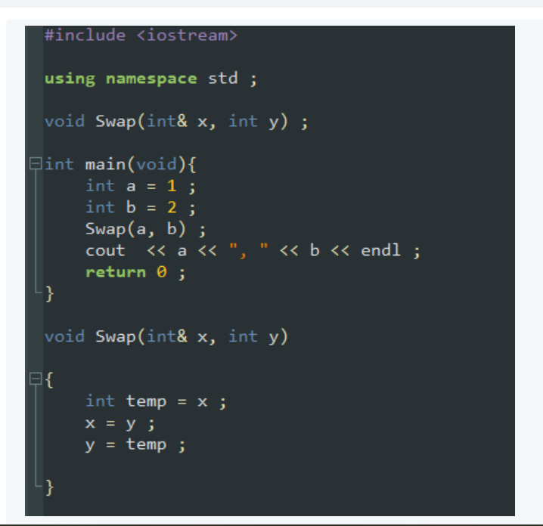
Quiz Question

Slide 21
Linked Lists
data
next
struct Node;
2
4
6
8
10
12
NULL
head

Slide 22
Traversing a Linked List
temp
2
4
6
8
10
12
NULL
head
while (temp != NULL) {
temp = temp->next;
}

Slide 23
Traversing a Linked List
temp
2
4
6
8
10
12
NULL
head
while (temp != NULL) {
temp = temp->next;
}

Slide 24
Traversing a Linked List
temp
2
4
6
8
10
12
NULL
head
while (temp != NULL) {
temp = temp->next;
}

Slide 25
Traversing a Linked List
temp
2
4
6
8
10
12
NULL
head
while (temp != NULL) {
temp = temp->next;
}

Slide 26
Traversing a Linked List
temp
2
4
6
8
10
12
NULL
head
while (temp != NULL) {
temp = temp->next;
}

Slide 27
Traversing a Linked List
temp
2
4
6
8
10
12
NULL
head
while (temp != NULL) {
temp = temp->next;
}

Slide 28
Traversing a Linked List
2
4
6
8
10
12
NULL
head
temp = NULL
while (temp != NULL) {
temp = temp->next;
}

Slide 29
Modify traversal to do a search?
temp
2
4
6
8
10
12
NULL
head
while (temp != NULL) {
if ( … ) { … }
temp = temp->next;
}

Slide 30
Modify traversal to do a search?
temp
2
4
6
8
10
12
NULL
head
while (temp != NULL) {
if (temp->data == 8) { break;}
temp = temp->next;
}

Slide 31
Traversing and Searching
temp
2
4
6
8
10
12
NULL
head
while (temp != NULL) {
if (temp->data == 8) { break;}
temp = temp->next;
}

Slide 32
Traversing and Searching
temp
2
4
6
8
10
12
NULL
head
while (temp != NULL) {
if (temp->data == 8) { break;}
temp = temp->next;
}

Slide 33
Traversing and Searching
temp
2
4
6
8
10
12
NULL
head
while (temp != NULL) {
if (temp->data == 8) { break;}
temp = temp->next;
}

Slide 34
Deleting the node 8
2
4
6
8
10
12
NULL
head

Slide 35
Deletion Step-1: Searching the node
prev = null
pres = head
2
4
6
8
10
12
NULL
head
while (pres != NULL) {
if (pres->data == val) { break; }
prev = pres;
pres = pres->next;
}

Slide 36
Deletion Step-1: Searching the node
prev
pres
2
4
6
8
10
12
NULL
head
while (pres != NULL) {
if (pres->data == val) { break; }
prev = pres;
pres = pres->next;
}

Slide 37
Deletion Step-1: Searching the node
prev
pres
2
4
6
8
10
12
NULL
head
while (pres != NULL) {
if (pres->data == val) { break; }
prev = pres;
pres = pres->next;
}

Slide 38
Deletion Step-1: Searching the node
prev
pres
2
4
6
8
10
12
NULL
head
while (pres != NULL) {
if (pres->data == val) { break; }
prev = pres;
pres = pres->next;
}

Slide 39
Deletion Step-2: Deleting the node
prev
pres
2
4
6
8
10
12
NULL
head
prev->next = pres->next;
delete pres;

Slide 40
Deletion Step-2: Deleting the node
prev
pres
2
4
6
8
10
12
NULL
head
prev->next = pres->next;
delete pres;

Slide 41
Deletion Step-2: Deleting the node
prev
pres
2
4
6
10
12
NULL
head
prev->next = pres->next;
delete pres;

Slide 42
Deletion Step-2: Deleting the node
prev
2
4
6
10
12
NULL
head

Slide 43
Inserting node 13 after node 10 (pointed to by prev)
prev
2
4
6
10
12
NULL
head

Slide 44
Inserting
prev
2
4
6
10
12
NULL
head
Node * temp = new Node;
temp->next = prev->next;
prev->next = temp;

Slide 45
Inserting
temp
13
2
4
6
10
12
NULL
head
prev
Node * temp = new Node;
temp->next = prev->next;
prev->next = temp;

Slide 46
Inserting
temp
13
2
4
6
10
12
NULL
head
prev
Node * temp = new Node;
temp->next = prev->next;
prev->next = temp;

Slide 47
Inserting
temp
13
2
4
6
10
12
NULL
head
prev
Node * temp = new Node;
temp->next = prev->next;
prev->next = temp;

Slide 48
Inserting
2
4
6
10
13
12
NULL
head

Slide 49
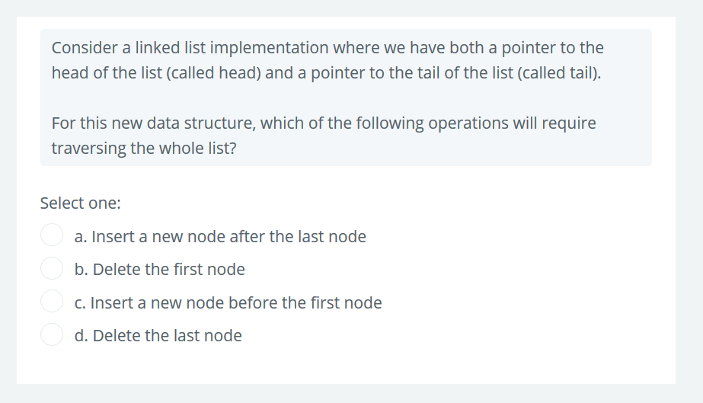
Linked List: Quiz

Slide 50
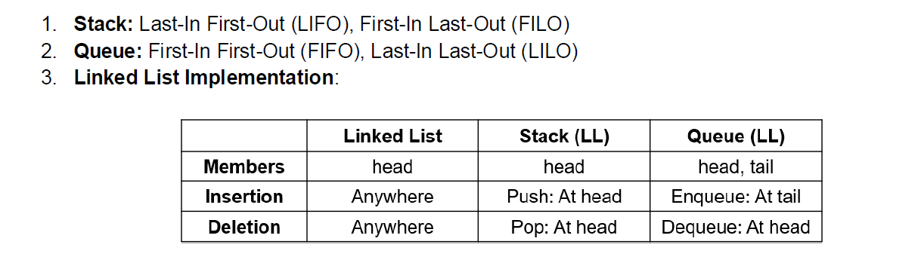
Stacks and Queues

Slide 51
Stack (ADT)
stack.push(1);
stack.push(2);
stack.push(3);
stack.push(4);
stack.push(5);
stack.pop();
stack.pop();
stack.pop();
stack.push(6);
stack.push(7);

Slide 52
Stack (ADT)
stack.push(1);
stack.push(2);
stack.push(3);
stack.push(4);
stack.push(5);
stack.pop();
stack.pop();
stack.pop();
stack.push(6);
stack.push(7);
1
top

Slide 53
Stack (ADT)
stack.push(1);
stack.push(2);
stack.push(3);
stack.push(4);
stack.push(5);
stack.pop();
stack.pop();
stack.pop();
stack.push(6);
stack.push(7);
2
top
1

Slide 54
Stack (ADT)
stack.push(1);
stack.push(2);
stack.push(3);
stack.push(4);
stack.push(5);
stack.pop();
stack.pop();
stack.pop();
stack.push(6);
stack.push(7);
3
top
2
1

Slide 55
Stack (ADT)
stack.push(1);
stack.push(2);
stack.push(3);
stack.push(4);
stack.push(5);
stack.pop();
stack.pop();
stack.pop();
stack.push(6);
stack.push(7);
4
top
3
2
1

Slide 56
Stack (ADT)
stack.push(1);
stack.push(2);
stack.push(3);
stack.push(4);
stack.push(5);
stack.pop();
stack.pop();
stack.pop();
stack.push(6);
stack.push(7);
5
top
4
3
2
1

Slide 57
Stack (ADT)
stack.push(1);
stack.push(2);
stack.push(3);
stack.push(4);
stack.push(5);
stack.pop();
stack.pop();
stack.pop();
stack.push(6);
stack.push(7);
4
top
3
2
1

Slide 58
Stack (ADT)
stack.push(1);
stack.push(2);
stack.push(3);
stack.push(4);
stack.push(5);
stack.pop();
stack.pop();
stack.pop();
stack.push(6);
stack.push(7);
3
top
2
1

Slide 59
Stack (ADT)
stack.push(1);
stack.push(2);
stack.push(3);
stack.push(4);
stack.push(5);
stack.pop();
stack.pop();
stack.pop();
stack.push(6);
stack.push(7);
2
top
1

Slide 60
Stack (ADT)
stack.push(1);
stack.push(2);
stack.push(3);
stack.push(4);
stack.push(5);
stack.pop();
stack.pop();
stack.pop();
stack.push(6);
stack.push(7);
6
top
2
1

Slide 61
Stack (ADT)
stack.push(1);
stack.push(2);
stack.push(3);
stack.push(4);
stack.push(5);
stack.pop();
stack.pop();
stack.pop();
stack.push(6);
stack.push(7);
7
top
6
2
1

Slide 62
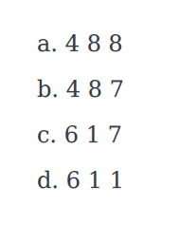
Queue (ADT): Quiz
queue.enqueue(1);
queue.enqueue(6);
queue.enqueue(4);
queue.enqueue(8);
queue.dequeue(); queue.dequeue();
queue.peek_front();
queue.dequeue();
queue.peek_front();
queue.enqueue(7);
queue.peek_front();
Options:

Slide 63
Queue (ADT)
queue.enqueue(1);
queue.enqueue(6);
queue.enqueue(4);
queue.enqueue(8);
queue.dequeue(); queue.dequeue();
queue.peek_front();
queue.dequeue();
queue.peek_front();
queue.enqueue(7);
queue.peek_front();
end
1
front

Slide 64
Queue (ADT)
queue.enqueue(1);
queue.enqueue(6);
queue.enqueue(4);
queue.enqueue(8);
queue.dequeue(); queue.dequeue();
queue.peek_front();
queue.dequeue();
queue.peek_front();
queue.enqueue(7);
queue.peek_front();
end
6
1
front

Slide 65
Queue (ADT)
queue.enqueue(1);
queue.enqueue(6);
queue.enqueue(4);
queue.enqueue(8);
queue.dequeue(); queue.dequeue();
queue.peek_front();
queue.dequeue();
queue.peek_front();
queue.enqueue(7);
queue.peek_front();
end
4
6
1
front

Slide 66
Queue (ADT)
queue.enqueue(1);
queue.enqueue(6);
queue.enqueue(4);
queue.enqueue(8);
queue.dequeue(); queue.dequeue();
queue.peek_front();
queue.dequeue();
queue.peek_front();
queue.enqueue(7);
queue.peek_front();
end
8
4
6
1
front

Slide 67
Queue (ADT)
queue.enqueue(1);
queue.enqueue(6);
queue.enqueue(4);
queue.enqueue(8);
queue.dequeue(); queue.dequeue();
queue.peek_front();
queue.dequeue();
queue.peek_front();
queue.enqueue(7);
queue.peek_front();
end
8
4
6
front

Slide 68
Queue (ADT)
queue.enqueue(1);
queue.enqueue(6);
queue.enqueue(4);
queue.enqueue(8);
queue.dequeue(); queue.dequeue();
queue.peek_front();
queue.dequeue();
queue.peek_front();
queue.enqueue(7);
queue.peek_front();
end
8
4
front

Slide 69
Queue (ADT)
queue.enqueue(1);
queue.enqueue(6);
queue.enqueue(4);
queue.enqueue(8);
queue.dequeue(); queue.dequeue();
queue.peek_front();
queue.dequeue();
queue.peek_front();
queue.enqueue(7);
queue.peek_front();
end
8
4
front

Slide 70
Queue (ADT)
queue.enqueue(1);
queue.enqueue(6);
queue.enqueue(4);
queue.enqueue(8);
queue.dequeue(); queue.dequeue();
queue.peek_front();
queue.dequeue();
queue.peek_front();
queue.enqueue(7);
queue.peek_front();
end
8
front

Slide 71
Queue (ADT)
queue.enqueue(1);
queue.enqueue(6);
queue.enqueue(4);
queue.enqueue(8);
queue.dequeue(); queue.dequeue();
queue.peek_front();
queue.dequeue();
queue.peek_front();
queue.enqueue(7);
queue.peek_front();
end
8
front

Slide 72
Queue (ADT)
queue.enqueue(1);
queue.enqueue(6);
queue.enqueue(4);
queue.enqueue(8);
queue.dequeue(); queue.dequeue();
queue.peek_front();
queue.dequeue();
queue.peek_front();
queue.enqueue(7);
queue.peek_front();
end
7
8
front

Slide 73
Queue (ADT)
queue.enqueue(1);
queue.enqueue(6);
queue.enqueue(4);
queue.enqueue(8);
queue.dequeue(); queue.dequeue();
queue.peek_front();
queue.dequeue();
queue.peek_front();
queue.enqueue(7);
queue.peek_front();
end
7
8
front

Slide 74
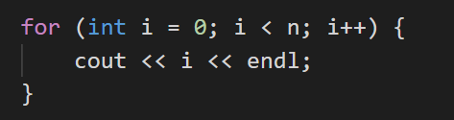
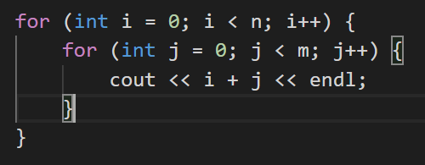
Complexity
Complexity is a best-case/worst-case estimate of the running time of a program.
O(n) reflects the worst case complexity.
How many times does this line execute?
How many times does this line execute?

Slide 75
Complexity
Complexity is a best-case/worst-case estimate of the running time of a program.
O(n) reflects the worst case complexity.
How many times does this line execute?
O(n) complexity
How many times does this line execute?
O(mn) complexity

Slide 76
Good luck with the Mid-terms!

