Slide 1

CSCI 2270-305 Recitation 03/19: Graphs
Varad Deshmukh

Slide 2
Logistics
Assignment 7 is due this Sunday.
Click on Attempt and Submit All and Finish when you are done!
Assignment 7 Helper Notes emailed to you.
Office Hours Zoom link: https://cuboulder.zoom.us/j/975589526
Thursday: 10:45 to 11:45 am, 2-3 pm
Friday: 9-11 am

Slide 3
Recitation Format
Participation: If you have questions, please raise your hand (zoom feature), or PM Elizabeth/Aazer and they will prompt me.
If there is no response, just unmute yourself and speak up!
Recitation attendance is not compulsory.
Submit your recitation exercise on Moodle by Sunday (Recitations 9 and 10).
We will hang around to help you with the exercise (breakout rooms).
Recommended that you keep your video on, since we are already socially distanced.

Slide 4
What is a Graph
Graph is a collection of a vertices (nodes) connected to each other via edges.
5
6
1
3
2
4
This graph has 6 nodes and 7 edges.

Slide 5
Graphs can have directed edges …
5
6
1
3
2
4

Slide 6
… or bi-directional/undirected edges.
5
6
1
3
2
4

Slide 7
Bi-directional and Undirected are the same
5
5
-1
-1
7
4
7
4
2
2
3
3

Slide 8
Graph: A More Formal Definition
A graph G is an ordered pair (V,E) such that:
V is a set of elements called nodes or vertices.
E is a set of ordered pairs (u,v) for some u,v 𝜖 V

Slide 9
Directed Graph
5
6
1
3
2
4
V = {1, 2, 3, 4, 5, 6}
E = {(1,5), (2,4), (2,6), (3,1), (3,5), (4,1), (6,5)}

Slide 10
Undirected Graph
5
6
1
3
2
4
V = {1, 2, 3, 4, 5, 6}
E = {(1,5), (2,4), (2,6), (3,1), (3,5), (4,1), (6,5), (5,1), (4,2), (6,2), (1,3), (5,3), (1,4), (5,6)}

Slide 11
Graphs seen earlier in this course

Slide 12
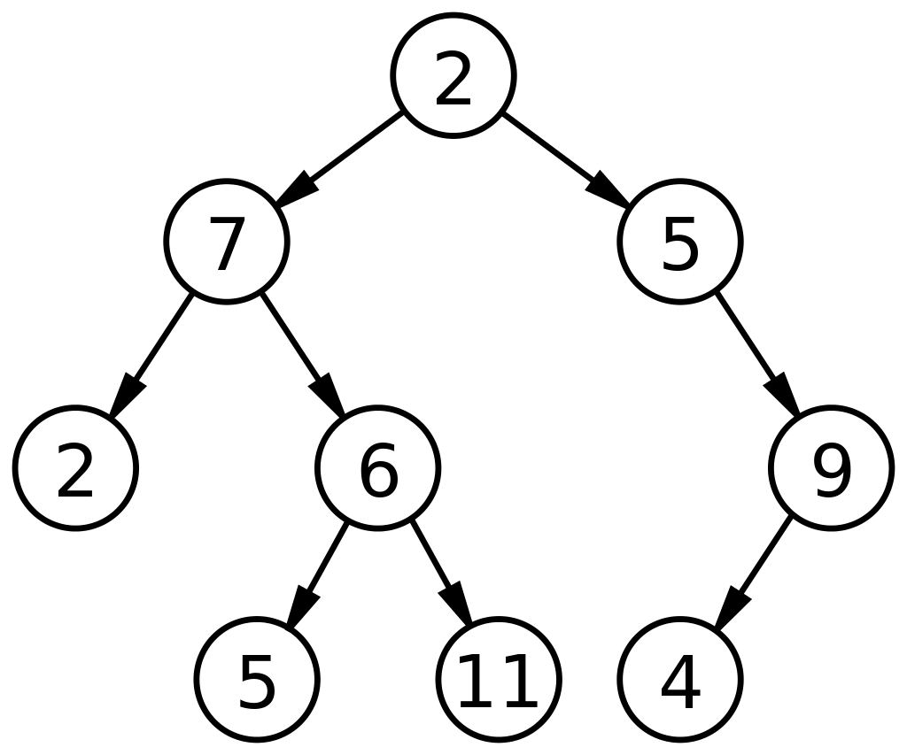
Graphs seen earlier in this course
2
4
6
8
4
3
N
head
Linked List
Tree

Slide 13
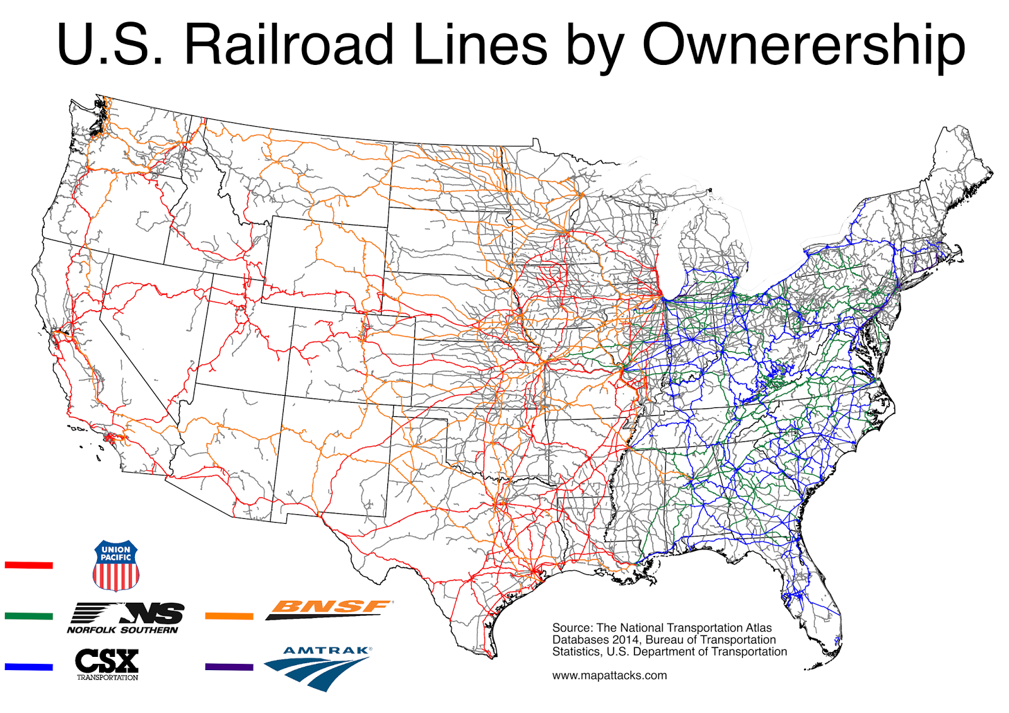

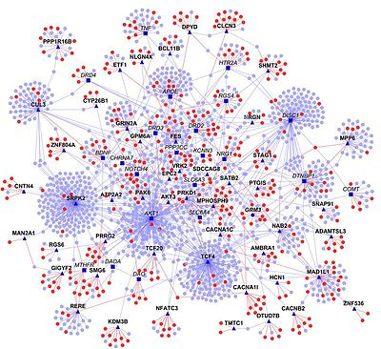
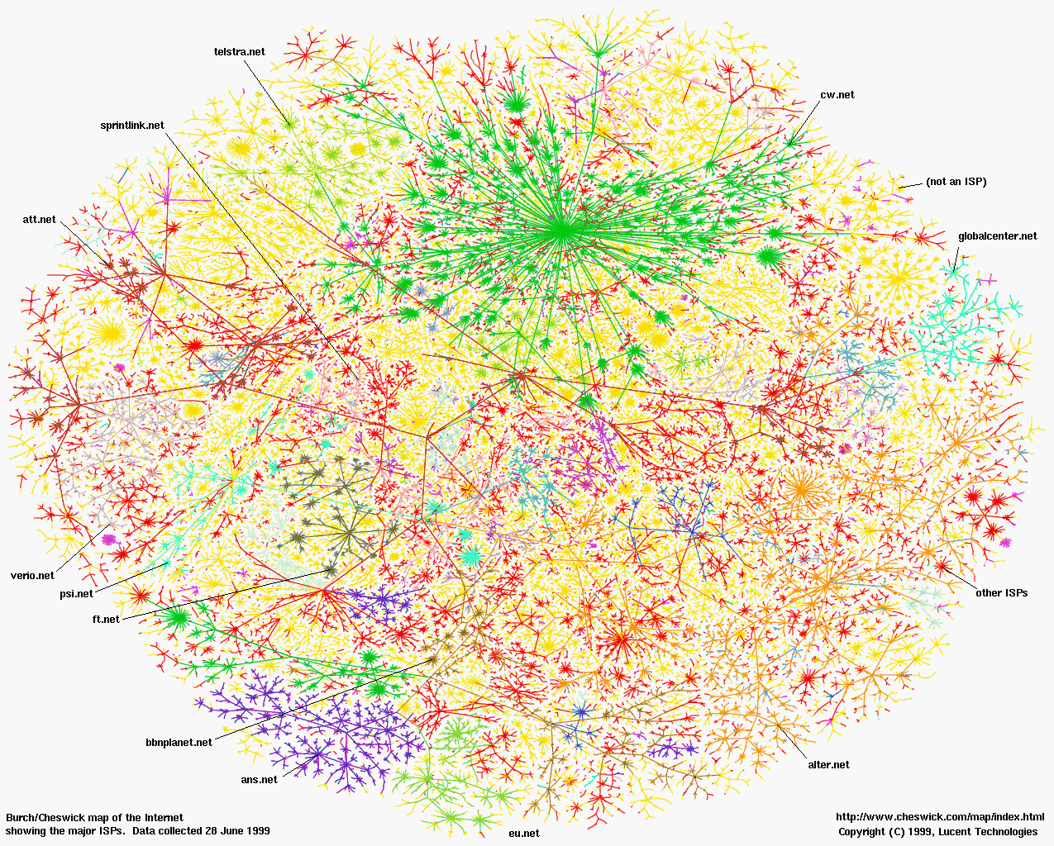

Some Graphs seen in real life
Social Network
Railroad Network
The Internet
Neural Network
Biological Networks

Slide 14
Designing the Graph Data Structure
Need a data structure that incorporates both the nodes and the edges.
Two known methods:
Adjacency Matrix
Adjacency List

Slide 15
Adjacency Matrix
For a graph with n vertices and e edges,
construct an matrix A with dimensions [n x n].
Set the matrix A_{ij} = 0, Ɐ i,j 𝜖 [0,n-1]
Order/label the set of vertices: 0 to n-1.
For each edge e = (i,j) in the set of edges, set the A_{ij} = 1

Slide 16
Adjacency Matrix: Directed Example
v₅
v₆
v₁
v₃
v₂
v₄

Slide 17

Adjacency Matrix: Directed Example
4
5
v₅
v₆
$$A_{6,6}=\left[\begin{matrix} & & & & & \\ & & & & & \\ & & & & & \\ & & & & & \\ & & & & & \\ & & & & & \end{matrix}\right]$$
0
2
v₁
v₃
v₂
v₄
1
3

Slide 18
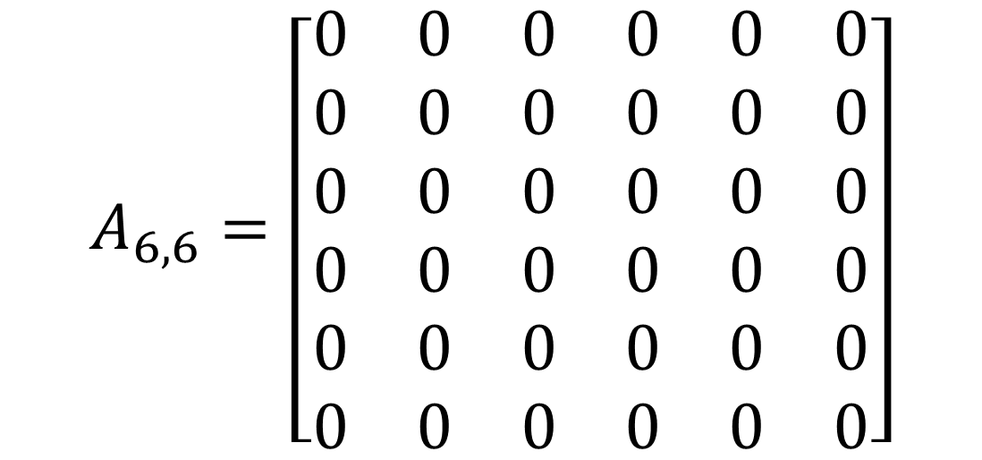
Adjacency Matrix: Directed Example
4
5
v₅
v₆
$$A_{6,6}=\left[\begin{matrix}0 & 0 & 0 & 0 & 0 & 0 \\ 0 & 0 & 0 & 0 & 0 & 0 \\ 0 & 0 & 0 & 0 & 0 & 0 \\ 0 & 0 & 0 & 0 & 0 & 0 \\ 0 & 0 & 0 & 0 & 0 & 0 \\ 0 & 0 & 0 & 0 & 0 & 0\end{matrix}\right]$$
0
2
v₁
v₃
v₂
v₄
1
3

Slide 19
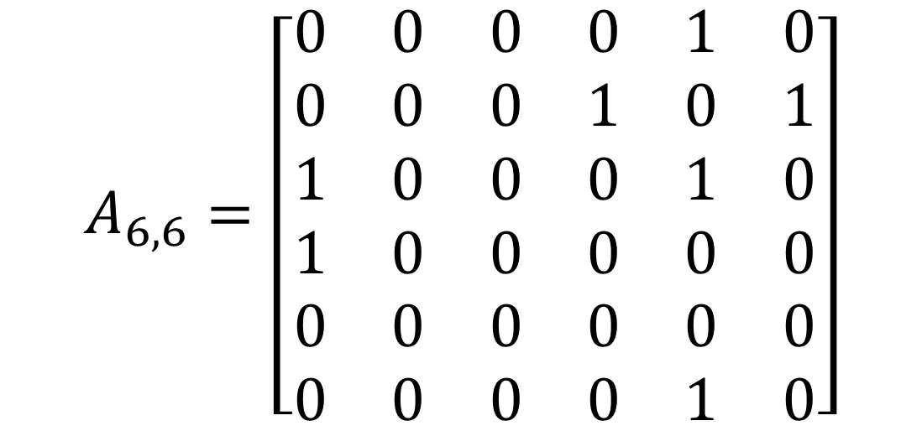
Adjacency Matrix: Directed Example
4
5
v₅
v₆
$$A_{6,6}=\left[\begin{matrix}0 & 0 & 0 & 0 & 1 & 0 \\ 0 & 0 & 0 & 1 & 0 & 1 \\ 1 & 0 & 0 & 0 & 1 & 0 \\ 1 & 0 & 0 & 0 & 0 & 0 \\ 0 & 0 & 0 & 0 & 0 & 0 \\ 0 & 0 & 0 & 0 & 1 & 0\end{matrix}\right]$$
0
2
v₁
v₃
v₂
v₄
1
3

Slide 20
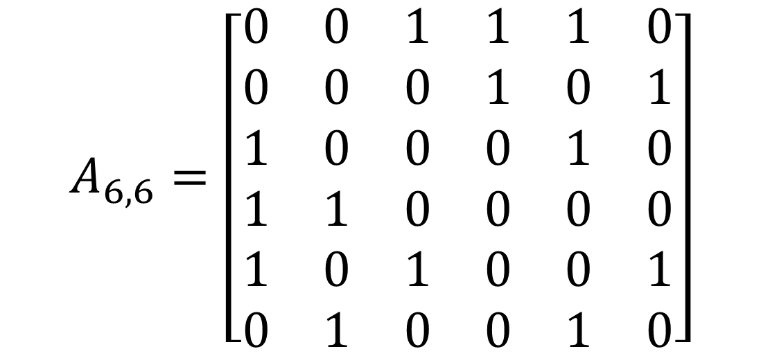
Adjacency Matrix: Undirected Example
4
5
v₅
v₆
$$A_{6,6}=\left[\begin{matrix}0 & 0 & 1 & 1 & 1 & 0 \\ 0 & 0 & 0 & 1 & 0 & 1 \\ 1 & 0 & 0 & 0 & 1 & 0 \\ 1 & 1 & 0 & 0 & 0 & 0 \\ 1 & 0 & 1 & 0 & 0 & 1 \\ 0 & 1 & 0 & 0 & 1 & 0\end{matrix}\right]$$
0
v₁
2
v₃
v₂
v₄
1
3

Slide 21
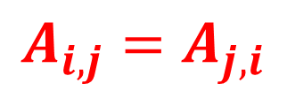
Adjacency Matrix: Undirected Example
v₅
v₆
$$A_{6,6}=\left[\begin{matrix}0 & 0 & 1 & 1 & 1 & 0 \\ 0 & 0 & 0 & 1 & 0 & 1 \\ 1 & 0 & 0 & 0 & 1 & 0 \\ 1 & 1 & 0 & 0 & 0 & 0 \\ 1 & 0 & 1 & 0 & 0 & 1 \\ 0 & 1 & 0 & 0 & 1 & 0\end{matrix}\right]$$
v₁
v₃
v₂
v₄
$$A_{i,j}=A_{j,i}$$

Slide 22
Adjacency List
For a graph with n vertices and e edges,
Create a list L of n entries corresponding to n vertices.
For the vertex u,
The entry L_{u} is the list of all vertices sharing an edge with u
L_{u} = {v | Ɐ (u,v) 𝜖 E }
In this class, these lists will be implemented using the C++ vector class

Slide 23
Adjacency List: Directed Example
v₅
v₆
v₁
v₃
v₂
v₄

Slide 24

Adjacency List: Directed Example
v₅
v₁
v₆
v₂
v₁
v₃
v₃
v₄
v₂
v₄
v₅
v₅
$$List L with entries= \# of vertices$$

Slide 25
Adjacency List: Directed Example
v₅
v₁
v₅
v₆
v₂
v₄
v₆
v₁
v₃
v₃
v₁
v₅
v₄
v₁
v₂
v₄
v₅
v₅
v₆

Slide 26
Adjacency List: Directed Example
v₅
v₁
v₅
v₆
v₂
v₄
v₆
v₁
v₃
v₃
v₁
v₅
v₄
v₁
v₂
v₄
v₅
v₅
v₆
Each entry in L is a list of vertices

Slide 27
Adjacency Matrices or Adjacency Lists?

Slide 28
Adjacency Matrices or Adjacency Lists?
Space Complexity for a graph with m edges and n vertices:
Adjacency Matrix: O(n²)
Adjacency List: O(m + n)
Adjacency List is better for a sparse graph (m << n)
Adjacency Matrix is better for a dense graph (m = n(n-1) / 2)
Adjacency List is also more flexible for adding or deleting a vertex.
Other fancier graph implementations: CSR, CSC, etc.

Slide 29
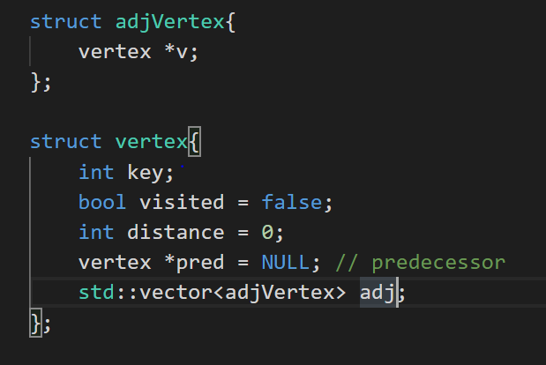
Implementing a Graph
How do you store list of vertices?
std::vector<vertex*> vertices;
How do you access the key of the second vertex?
How do you access the visited flag of the third vertex?

Slide 30
Implementing a Graph
How do you store list of vertices?
std::vector<vertex*> vertices;
How do you access the key of the second vertex?
vertices[2]->key
How do you access the visited flag of the third vertex?
vertices[3]->visited

Slide 31
Implementing a Graph
How do you access the adjacency list of a vertex 3?

Slide 32
Implementing a Graph
How do you access the adjacency list of a vertex 3?
vertices[3]->adj

Slide 33
Implementing a Graph
How do you access the adjacency list of a vertex 3?
vertices[3]->adj
adj its itself a list.
How do you access the second vertex in the adj list of vertex 3?

Slide 34
Implementing a Graph
How do you access the adjacency list of a vertex 3?
vertices[3]->adj
adj its itself a list.
How do you access the second vertex in the adj list of vertex 3?
vertices[3]->adj[2].v

Slide 35
Implementing a Graph
How do you access the adjacency list of a vertex 3?
vertices[3]->adj
adj its itself a list.
How do you access the second vertex in the adj list of vertex 3?
vertices[3]->adj[2].v
How do you check if that vertex was visited?

Slide 36
Implementing a Graph
How do you access the adjacency list of a vertex 3?
vertices[3]->adj
adj its itself a list.
How do you access the second vertex in the adj list of vertex 3?
vertices[3]->adj[2].v
How do you check if that vertex was visited?
vertices[3]->adj[2].v->visited

Slide 37
Graph Traversal
Depth First Search (DFS)
Breadth First Search (BFS)

Slide 38
Depth First Search Pseudo-code
For the vertex u,
Recursively visit each of it’s neighbor if it hasn’t been visited before.
DFS(G, u) u.visited = true for each v ∈ G.Adj[u] if v.visited == false DFS(G,v) init() { for each u ∈ G u.visited = false for each u ∈ G If u.visited==false DFS(G, u) }

Slide 39
DFS Traversal Simulation Using a Stack
Stack
DFS(G, u) u.visited = true for each v ∈ G.Adj[u] if v.visited == false DFS(G,v) init() { for each u ∈ G u.visited = false for each u ∈ G If u.visited==false DFS(G, u) }
v₃
v₆
v₁
v₄
v₅
v₂
Visit Order:

Slide 40
DFS Traversal Simulation Using a Stack
Stack
DFS(G, u) u.visited = true for each v ∈ G.Adj[u] if v.visited == false DFS(G,v) init() { for each u ∈ G u.visited = false for each u ∈ G If u.visited==false DFS(G, u) }
v₃
v₆
v₁
v₄
v₅
v₂
Visit Order:

Slide 41
DFS Traversal Simulation Using a Stack
Stack
DFS(G, u) u.visited = true for each v ∈ G.Adj[u] if v.visited == false DFS(G,v) init() { for each u ∈ G u.visited = false for each u ∈ G If u.visited==false DFS(G, u) }
v₃
v₆
v₁
v₄
v₅
v₂
Visit Order:
Called on vertex v₁

Slide 42
DFS Traversal Simulation Using a Stack
Stack
DFS(G, u) u.visited = true for each v ∈ G.Adj[u] if v.visited == false DFS(G,v) init() { for each u ∈ G u.visited = false for each u ∈ G If u.visited==false DFS(G, u) }
v₃
v₆
v₁
v₄
v₅
v₂
Visit Order:
Called on vertex v₁

Slide 43
DFS Traversal Simulation Using a Stack
Stack
DFS(G, u) u.visited = true for each v ∈ G.Adj[u] if v.visited == false DFS(G,v) init() { for each u ∈ G u.visited = false for each u ∈ G If u.visited==false DFS(G, u) }
v₃
v₆
v₁
v₄
v₅
v₂
v2, v3, v4
v₁
Visit Order: v₁
Potential neighbors to visit

Slide 44
DFS Traversal Simulation Using a Stack
Called on vertex v₂
Stack
DFS(G, u) u.visited = true for each v ∈ G.Adj[u] if v.visited == false DFS(G,v) init() { for each u ∈ G u.visited = false for each u ∈ G If u.visited==false DFS(G, u) }
v₃
v₆
v₁
v₄
v₅
v₂
v2, v3, v4
v₁
Visit Order: v₁

Slide 45
DFS Traversal Simulation Using a Stack
Stack
DFS(G, u) u.visited = true for each v ∈ G.Adj[u] if v.visited == false DFS(G,v) init() { for each u ∈ G u.visited = false for each u ∈ G If u.visited==false DFS(G, u) }
v₃
v₆
v₁
v₄
v₂
v₅
v₂
v3, v4
v₁
Visit Order: v₁

Slide 46
DFS Traversal Simulation Using a Stack
Stack
DFS(G, u) u.visited = true for each v ∈ G.Adj[u] if v.visited == false DFS(G,v) init() { for each u ∈ G u.visited = false for each u ∈ G If u.visited==false DFS(G, u) }
v₃
v₆
v₁
v₄
v5
v₂
v₅
v₂
v3, v4
v₁
Visit Order: v₁ v₂

Slide 47
DFS Traversal Simulation Using a Stack
Stack
DFS(G, u) u.visited = true for each v ∈ G.Adj[u] if v.visited == false DFS(G,v) init() { for each u ∈ G u.visited = false for each u ∈ G If u.visited==false DFS(G, u) }
v₃
v₆
v₁
v₄
v₅
v₂
v₅
v₂
v3, v4
v₁
Visit Order: v₁ v₂

Slide 48
DFS Traversal Simulation Using a Stack
Stack
DFS(G, u) u.visited = true for each v ∈ G.Adj[u] if v.visited == false DFS(G,v) init() { for each u ∈ G u.visited = false for each u ∈ G If u.visited==false DFS(G, u) }
v₃
v₆
v₁
v₄
v₅
v6
v₂
v₅
v₂
v3, v4
v₁
Visit Order: v₁ v₂ v₅

Slide 49
DFS Traversal Simulation Using a Stack
Stack
DFS(G, u) u.visited = true for each v ∈ G.Adj[u] if v.visited == false DFS(G,v) init() { for each u ∈ G u.visited = false for each u ∈ G If u.visited==false DFS(G, u) }
v₃
v₆
v₆
v₁
v₄
v₅
v₂
v₅
v₂
v3, v4
v₁
Visit Order: v₁ v₂ v₅

Slide 50
DFS Traversal Simulation Using a Stack
Stack
DFS(G, u) u.visited = true for each v ∈ G.Adj[u] if v.visited == false DFS(G,v) init() { for each u ∈ G u.visited = false for each u ∈ G If u.visited==false DFS(G, u) }
v₃
v₆
v3
v₆
v₁
v₄
v₅
v₂
v₅
v₂
v3, v4
v₁
Visit Order: v₁ v₂ v₅ v₆

Slide 51
DFS Traversal Simulation Using a Stack
Stack
DFS(G, u) u.visited = true for each v ∈ G.Adj[u] if v.visited == false DFS(G,v) init() { for each u ∈ G u.visited = false for each u ∈ G If u.visited==false DFS(G, u) }
v₃
v₆
v₃
v₆
v₁
v₄
v₅
v₂
v₅
v₂
v3, v4
v₁
Visit Order: v₁ v₂ v₅ v₆

Slide 52
DFS Traversal Simulation Using a Stack
Stack
DFS(G, u) u.visited = true for each v ∈ G.Adj[u] if v.visited == false DFS(G,v) init() { for each u ∈ G u.visited = false for each u ∈ G If u.visited==false DFS(G, u) }
v₃
v₆
v₃
v4
v₆
v₁
v₄
v₅
v₂
v₅
v₂
v3, v4
v₁
Visit Order: v₁ v₂ v₅ v₆ v₃

Slide 53
DFS Traversal Simulation Using a Stack
Stack
DFS(G, u) u.visited = true for each v ∈ G.Adj[u] if v.visited == false DFS(G,v) init() { for each u ∈ G u.visited = false for each u ∈ G If u.visited==false DFS(G, u) }
v₃
v₄
v₆
v₃
v₆
v₁
v₄
v₅
v₂
v₅
v₂
v3, v4
v₁
Visit Order: v₁ v₂ v₅ v₆ v₃

Slide 54
DFS Traversal Simulation Using a Stack
Stack
DFS(G, u) u.visited = true for each v ∈ G.Adj[u] if v.visited == false DFS(G,v) init() { for each u ∈ G u.visited = false for each u ∈ G If u.visited==false DFS(G, u) }
v₃
v₄
v₆
v₃
v₆
v₁
v₄
v₅
v₂
v₅
v₂
v3, v4
v₁
Visit Order: v₁ v₂ v₅ v₆ v₃ v₄

Slide 55
DFS Traversal Simulation Using a Stack
Done processing. Pop!
Stack
DFS(G, u) u.visited = true for each v ∈ G.Adj[u] if v.visited == false DFS(G,v) init() { for each u ∈ G u.visited = false for each u ∈ G If u.visited==false DFS(G, u) }
v₃
v₄
v₆
v₃
v₆
v₁
v₄
v₅
v₂
v₅
v₂
v3, v4
v₁
Visit Order: v₁ v₂ v₅ v₆ v₃ v₄

Slide 56
DFS Traversal Simulation Using a Stack
Stack
DFS(G, u) u.visited = true for each v ∈ G.Adj[u] if v.visited == false DFS(G,v) init() { for each u ∈ G u.visited = false for each u ∈ G If u.visited==false DFS(G, u) }
v₃
v₆
v₃
v₆
v₁
v₄
v₅
v₂
v₅
v₂
v3, v4
v₁
Visit Order: v₁ v₂ v₅ v₆ v₃ v₄

Slide 57
DFS Traversal Simulation Using a Stack
Stack
DFS(G, u) u.visited = true for each v ∈ G.Adj[u] if v.visited == false DFS(G,v) init() { for each u ∈ G u.visited = false for each u ∈ G If u.visited==false DFS(G, u) }
v₃
v₆
v₆
v₁
v₄
v₅
v₂
v₅
v₂
v3, v4
v₁
Visit Order: v₁ v₂ v₅ v₆ v₃ v₄

Slide 58
DFS Traversal Simulation Using a Stack
Stack
DFS(G, u) u.visited = true for each v ∈ G.Adj[u] if v.visited == false DFS(G,v) init() { for each u ∈ G u.visited = false for each u ∈ G If u.visited==false DFS(G, u) }
v₃
v₆
v₁
v₄
v₅
v₂
v₅
v₂
v3, v4
v₁
Visit Order: v₁ v₂ v₅ v₆ v₃ v₄

Slide 59
DFS Traversal Simulation Using a Stack
Stack
DFS(G, u) u.visited = true for each v ∈ G.Adj[u] if v.visited == false DFS(G,v) init() { for each u ∈ G u.visited = false for each u ∈ G If u.visited==false DFS(G, u) }
v₃
v₆
v₁
v₄
v₂
v₅
v₂
v3, v4
v₁
Visit Order: v₁ v₂ v₅ v₆ v₃ v₄

Slide 60
DFS Traversal Simulation Using a Stack
Stack
DFS(G, u) u.visited = true for each v ∈ G.Adj[u] if v.visited == false DFS(G,v) init() { for each u ∈ G u.visited = false for each u ∈ G If u.visited==false DFS(G, u) }
v₃
v₆
v₁
v₄
v₅
v₂
v3, v4
v₁
Visit Order: v₁ v₂ v₅ v₆ v₃ v₄

Slide 61
DFS Traversal Simulation Using a Stack
Stack
DFS(G, u) u.visited = true for each v ∈ G.Adj[u] if v.visited == false DFS(G,v) init() { for each u ∈ G u.visited = false for each u ∈ G If u.visited==false DFS(G, u) }
v₃
v₆
v₁
v₄
v₅
v₂
v4
v₁
Visit Order: v₁ v₂ v₅ v₆ v₃ v₄

Slide 62
DFS Traversal Simulation Using a Stack
Stack
DFS(G, u) u.visited = true for each v ∈ G.Adj[u] if v.visited == false DFS(G,v) init() { for each u ∈ G u.visited = false for each u ∈ G If u.visited==false DFS(G, u) }
v₃
v₆
v₁
v₄
v₅
v₂
v₁
Visit Order: v₁ v₂ v₅ v₆ v₃ v₄

Slide 63
DFS Traversal Simulation Using a Stack
Stack
DFS(G, u) u.visited = true for each v ∈ G.Adj[u] if v.visited == false DFS(G,v) init() { for each u ∈ G u.visited = false for each u ∈ G If u.visited==false DFS(G, u) }
v₃
v₆
v₁
v₄
v₅
v₂
Visit Order: v₁ v₂ v₅ v₆ v₃ v₄

Slide 64
Breadth First Search (BFS)
Create an empty queue.
Add a source vertex to the queue and mark as visited.
While queue is not empty,
Pop the front vertex from the queue.
Add all the neighbors of the popped vertex to the tail of the queue, if they are unvisited,
and mark them as visited.

Slide 65
Breadth First Search
BFS(v₁)
v₃
v₆
v₁
Queue
v₄
v₅
v₂
Visit Order:

Slide 66
Breadth First Search
BFS(v₁)
v₃
v₆
Front
v₁
Queue
v₁
v₄
End
v₅
v₂
Visit Order: v₁
Enqueue v₁ and mark

Slide 67
Breadth First Search
BFS(v₁)
v₃
v₆
v₁
Queue
v₄
v₅
v₂
Visit Order: v₁
Dequeue v₁

Slide 68
Breadth First Search
BFS(v₁)
v₃
v₆
Front
Queue
v₄
v₃
v₂
v₁
v₄
End
v₅
v₂
Visit Order: v₁ v₂ v₃ v₄
Enqueue neighbors of v₁ and mark them

Slide 69
Breadth First Search
BFS(v₁)
v₃
v₆
Front
v₁
Queue
v₄
v₃
v₄
End
v₅
v₂
Visit Order: v₁ v₂ v₃ v₄
Dequeue v₂

Slide 70
Breadth First Search
BFS(v₁)
v₃
v₆
Front
Queue
v₅
v₄
v₃
v₁
v₄
End
v₅
v₂
Visit Order: v₁ v₂ v₃ v₄ v₅
Enqueue neighbors of v₂ and mark them

Slide 71
Breadth First Search
BFS(v₁)
v₃
v₆
Front
Queue
v₅
v₄
v₁
v₄
End
v₅
v₂
Visit Order: v₁ v₂ v₃ v₄ v₅
Dequeue v₃

Slide 72
Breadth First Search
BFS(v₁)
v₃
v₆
Front
Queue
v₆
v₅
v₄
v₁
v₄
End
v₅
v₂
Visit Order: v₁ v₂ v₃ v₄ v₅ v₆
Enqueue neighbors of v₃ and mark them

Slide 73
Breadth First Search
BFS(v₁)
v₃
v₆
Front
Queue
v₆
v₅
v₁
v₄
End
v₅
v₂
Visit Order: v₁ v₂ v₃ v₄ v₅ v₆
Dequeue v₄, but it has no unvisited neighbors.

Slide 74
Breadth First Search
BFS(v₁)
v₃
v₆
Front
Queue
v₆
v₁
v₄
End
v₅
v₂
Visit Order: v₁ v₂ v₃ v₄ v₅ v₆
Dequeue v₅, but it has no unvisited neighbors.

Slide 75
Breadth First Search
BFS(v₁)
v₃
v₆
v₁
Queue
v₄
v₅
v₂
Visit Order: v₁ v₂ v₃ v₄ v₅ v₆
Dequeue v₆, but it has no unvisited neighbors.

Slide 76
Silver Problem: findShortestPath
Find the shortest distance between two vertices source s and destination d.
We will use BFS, by starting from the source vertex s.
Each vertex maintains a member called as distance.
For the start vertex, distance = ____?
When you dequeue a node, obtain the distance.
When you enqueue a node’s neighbors, set their distance to ________?
Once you reach the destination vertex d, print its distance.

Slide 77
findShortestPath (v₁, v₆)
BFS(v₁)
v₃
v₆
v₁
Queue
v₄
v₅
v₂
Visit Order:

Slide 78
findShortestPath (v₁, v₆)
BFS(v₁)
v₃
v₆
distance = 0
Front
v₁
Queue
v₁
v₄
End
v₅
v₂
Visit Order: v₁
Enqueue v₁ and mark

Slide 79
findShortestPath (v₁, v₆)
BFS(v₁)
v₃
v₆
distance = 0
v₁
Queue
v₄
v₅
v₂
Visit Order: v₁
Dequeue v₁

Slide 80
findShortestPath (v₁, v₆)
BFS(v₁)
distance = 1
v₃
v₆
distance = 0
Front
distance = 1
Queue
v₄
v₃
v₂
v₁
v₄
End
v₅
v₂
Visit Order: v₁ v₂ v₃ v₄
distance = 1
Enqueue neighbors of v₁ and mark them

Slide 81
findShortestPath (v₁, v₆)
BFS(v₁)
distance = 1
v₃
v₆
distance = 0
Front
distance = 1
Queue
v₄
v₃
v₁
v₄
End
v₅
v₂
Visit Order: v₁ v₂ v₃ v₄
distance = 1
Dequeue v₂

Slide 82
findShortestPath (v₁, v₆)
BFS(v₁)
distance = 1
v₃
v₆
distance = 0
Front
distance = 1
Queue
v₅
v₄
v₃
v₁
v₄
End
v₅
v₂
distance = 2
Visit Order: v₁ v₂ v₃ v₄ v₅
distance = 1
Enqueue neighbors of v₂ and mark them

Slide 83
findShortestPath (v₁, v₆)
BFS(v₁)
distance = 1
v₃
v₆
distance = 0
Front
distance = 1
Queue
v₅
v₄
v₁
v₄
End
v₅
v₂
distance = 2
Visit Order: v₁ v₂ v₃ v₄ v₅
distance = 1
Dequeue v₃

Slide 84
findShortestPath (v₁, v₆)
BFS(v₁)
distance = 1
v₃
distance = 2
v₆
distance = 0
Front
distance = 1
Queue
v₆
v₅
v₄
v₁
v₄
End
v₅
v₂
distance = 2
Visit Order: v₁ v₂ v₃ v₄ v₅ v₆
distance = 1
Enqueue neighbors of v₃ and mark them

Slide 85
findShortestPath (v₁, v₆)
BFS(v₁)
distance = 1
v₃
distance = 2
v₆
distance = 0
Front
distance = 1
Queue
v₆
v₅
v₁
v₄
End
v₅
v₂
distance = 2
Visit Order: v₁ v₂ v₃ v₄ v₅ v₆
distance = 1
Dequeue v₄, but it has no unvisited neighbors.

Slide 86
findShortestPath (v₁, v₆)
BFS(v₁)
distance = 1
v₃
distance = 2
v₆
distance = 0
Front
distance = 1
Queue
v₆
v₁
v₄
End
v₅
v₂
distance = 2
Visit Order: v₁ v₂ v₃ v₄ v₅ v₆
distance = 1
Dequeue v₅, but it has no unvisited neighbors.

Slide 87
findShortestPath (v₁, v₆)
BFS(v₁)
distance = 1
v₃
distance = 2
v₆
distance = 0
distance = 1
Queue
v₁
v₄
v₅
v₂
distance = 2
Visit Order: v₁ v₂ v₃ v₄ v₅ v₆
distance = 1
Dequeue v₆, but it has no unvisited neighbors.

Slide 88
Gold Problem: printPath
Print the shortest path between two vertices source s and destination d.
We will use BFS, by starting from the source vertex s.
Each vertex maintains a member called as predecessor.
This is the pointer to the predecessor vertex.
For the start vertex, predecessor = ____
When you enqueue a node’s neighbors, set their predecessor?
Once you reach the destination vertex d:
Use a while loop to trace back the path via the predecessor and store the path in an array.
End the while loop when you reach _____?
Print the array (what order?)

