Slide 1
Lab ML for Data Science: Part 1
Getting Insight into Unsupervised Dataset

Slide 2
Outline
The project Objective
Method and Algorithm
Experimental Result
Discussion and Insight

Slide 3
The Project Objective

Slide 4
The Project Objective
Dataset description: the annual spending of wholesale customers for six different product categories (Fresh, Milk, Grocery, Frozen, Detergents_Paper, and Delicassen) at wholesale stores in Portugal. The data contains information about channel (1-Horeca and 2-Retail) and region (1-Lisbon, 2-Oporto, and 3-other) where the purchase happened.
Anomaly Detection: detecting anomalous spending behaviour using unsupervised Machine Learning technique
Additional Explanation: exploring the reason of the anomaly (e.g. why specific instance is predicted to be anomalous)
Reproducibility: introducing a mechanism that favour robust resampling

Slide 5
Method and Algorithm

Slide 6
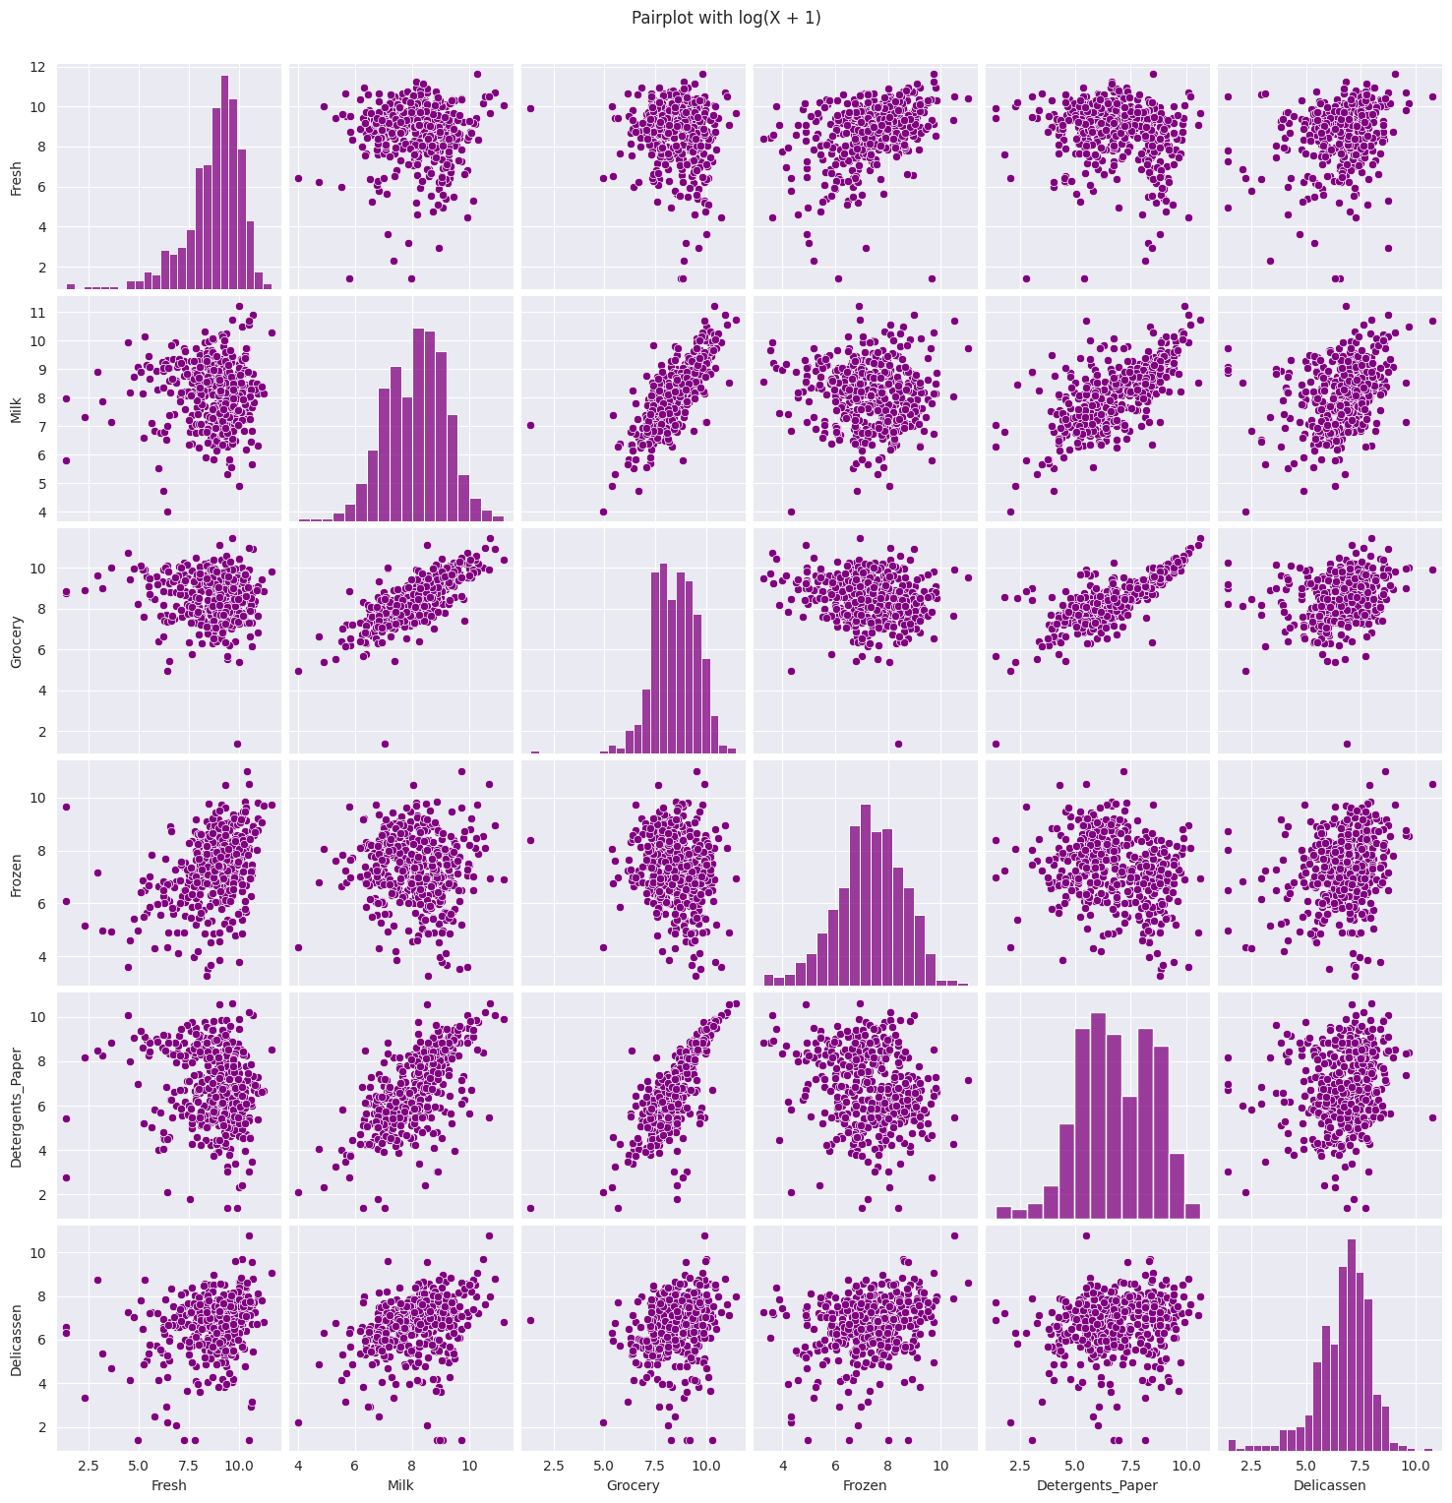
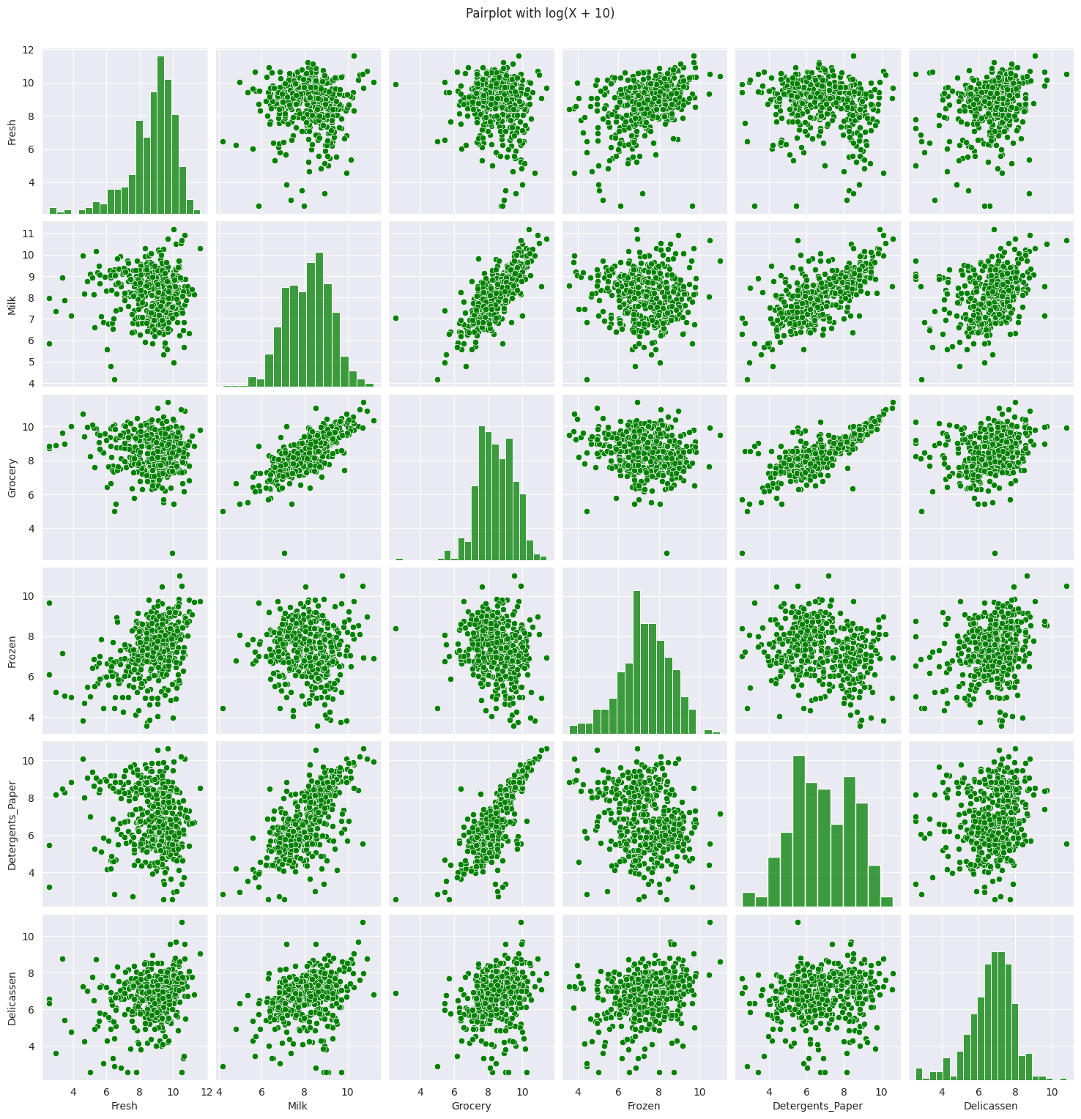
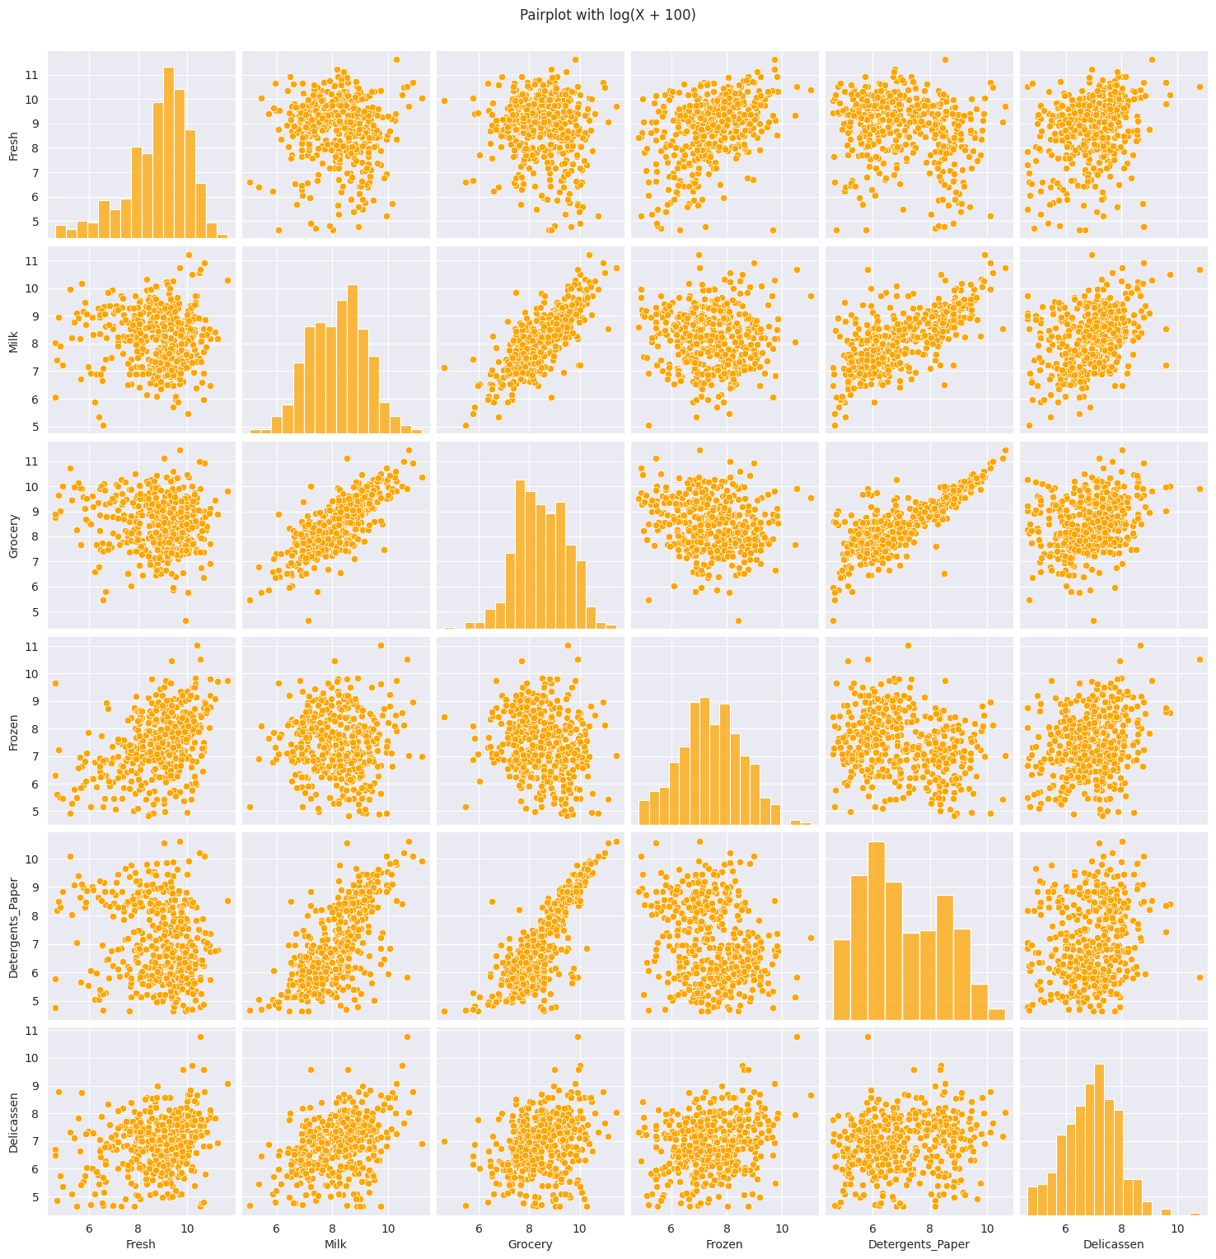


Initial Data Analysis
Non-linear transformation:
Create a scatter plot each for $θ$ = 1, $θ$ = 10, $θ$ = 100
Choose $θ$ that shows a result that is more normally distributed
$$x→\log\left(x+θ\right)$$

Slide 7
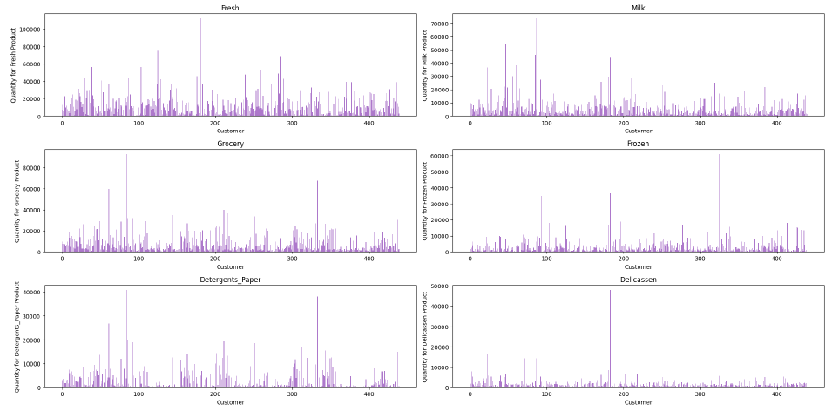
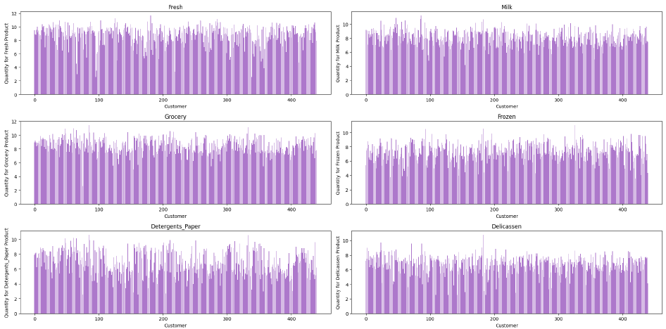
Initial Data Analysis
Non-linear transformation
Before transformation
After transformation

Slide 8
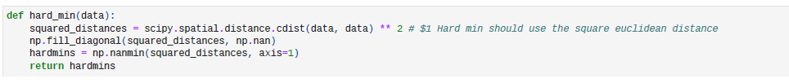


Detecting Anomalies
Calculating hard minimum (squared distance):
Implementation:
$$z_{jk}={\left\|x_{j}−x_{k}\right\|}^{2}$$
$$y_{j}=\min_{k≠j}{ z}_{jk}$$

Slide 9
Detecting Anomalies
Calculating hard minimum (squared distance):

Slide 10
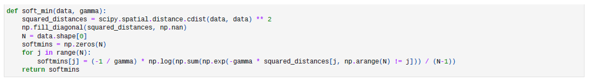

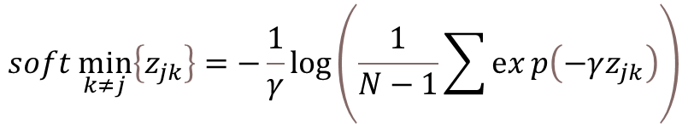
Detecting Anomalies
Calculating soft minimum (considering multiple neighbour):
Implementation:
$$y_{j}=soft \min_{k≠j}\left\{\vec{z_{jk}}\right\}$$
$$soft \min_{k≠j}\left\{z_{jk}\right\}=−\frac{1}{γ}\log\left(\frac{1}{N−1}\sum{ⅇx}p\left(−γz_{jk}\right)\right)$$

Slide 11

Detecting Anomalies
Selecting suitable parameter $γ$ using bootstrap with sample size = 440 and the number of sampling = 1000
Notes:
Bootstrap: a larger sampling leads to more accurate estimates of the sampling distribution. The sampling that we choose is sampling with replacement. We test the gamma parameter with value 0.001, 0.01, 0.1, 1, 5, 10, and visualize the result on this graph. We decide gamma 0.1 is the best, because we can see clearly the separability, while still having a decent spread.

Slide 12
Getting Insights into Anomalies
Anomaly Score Based on Channel
Anomaly Score Based on Region
Notes:
This histogram is created by using the soft-minimum anomaly score.

Slide 13
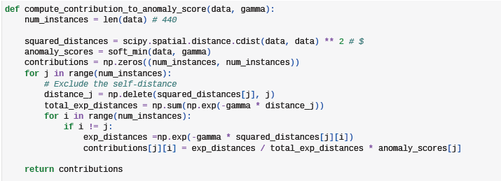
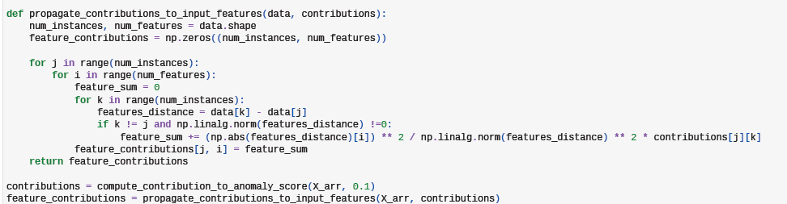
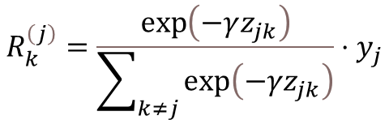
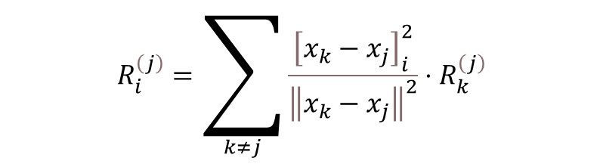
Getting Insights into Anomalies
Identifying input features that drive anomaly
Contribution of data point k to the anomaly score of instance j
Implementation:
Contribution of input feature i to the anomaly score of instance j.
Implementation:
$$R_{i}^{\left(j\right)}=\sum_{k≠j}{\frac{{\left[x_{k}−x_{j}\right]}_{i}^{2}}{{\left\|x_{k}−x_{j}\right\|}^{2}}}⋅R_{k}^{\left(j\right)}$$
$$R_{k}^{\left(j\right)}=\frac{\exp\left(−γz_{jk}\right)}{\sum_{k≠j}{\exp\left(−γz_{jk}\right)}}⋅y_{j}$$

Slide 14
Experimental Result

Slide 15
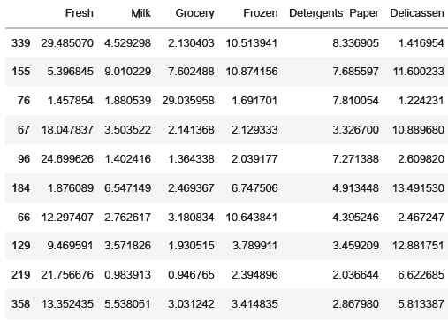
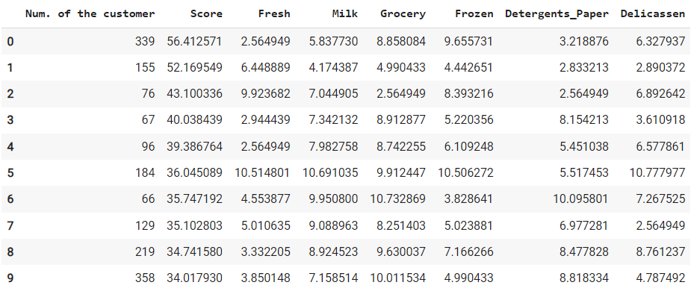
What makes the top 10 anomalies?
Feature contributions of the top 10 anomalous instance
The soft-minimum score of the top 10 anomalous instance
Notes:
Table on the left: Feature contributions
Table on the right: Score – soft minimum score, Column Products – number after log transformation
We are trying to look on which feature that contributes the most for these points identified as the anomaly. We are also trying to see from the data after log transformation, and it is pretty evident that majority it has shown as the lower number of purchase of those products.

Slide 16
Top 10 Anomalies Purchase
Soft minimum score visualization for the top 10 anomaly purchase:
Notes:
Here is the soft-minimum score of the top 10 anomaly purchase in comparison with other data.

Slide 17
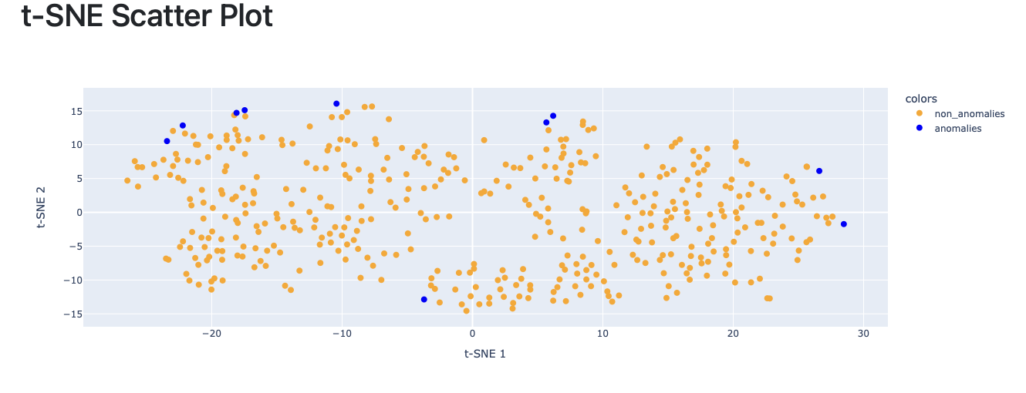
Top 10 Anomalies Purchase

Slide 18
Discussion and Insight

Slide 19
Insight for The Top 10 Anomalies
The most contributing features for the top-10 anomalies are generally Fresh and Delicatessen product.
In the Fresh product category, most anomalies are associated with low purchase volumes, while anomalies in the Delicatessen and Frozen product categories tend to occur with middle to low purchase volumes. Conversely, the anomalies in the Grocery product category are primarily due to high purchase volumes.
Notes:
Table of Feature Contributions.

Slide 20
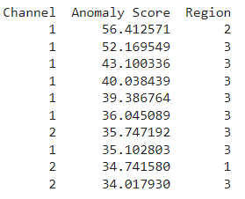
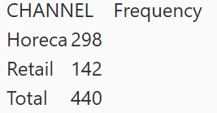
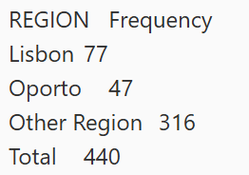
Insight for The Top 10 Anomalies
The top 10 anomalies are dominated from Channel 1 (Horeca) and Region 3 (Other). This could be because data imbalance since the data are coming from this particular channel and region has significantly higher than the others. So, the possibility of anomaly is also higher.
Despite Channel 2 (Retail) exhibiting fewer anomalies compared to Channel 1 (Horeca), analysis of the top 10 data points consistently indicates that Fresh products are the primary contributors to these anomalies. These anomalies are primarily due to low purchase quantities. It is plausible that customers visiting retail stores tend to purchase a wider variety of goods, given the broader range of products.
Although only one data point from the Oporto region appears in the top 10 anomaly list, this region exhibits the highest anomaly score compared to all other regions.
Notes:
Table at the left: Feature Contributions
Here, we would like to see the top 10 anomalies and its relation with the Channel and Region where the transaction happened.
The top 10 anomalies are dominated with Channel 1- Hotel restaurant and café and Region 3 – Other. (Because data imbalance)
For channel 2, all the anomaly are consistently showing that Fresh products are the most contributed factors. (possible because retailer stores has broader range of products)
Region 2 (Oporto) is only 1 data that is inside the top 10 list, but it has the highest anomaly score.

Slide 21
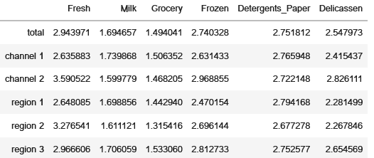
Insight for Overall Purchase Data
The most contributing features for overall purchase are Fresh product, followed by Detergents and Frozen product.
Fresh products are challenging to handle and must be consumed and sold quickly leading to a clear distinction between Fresh products and the others.
Retail shops have demonstrated a significant influence in selling Fresh products, despite the lower frequency of purchases compared to Horeca.
The Oporto region appears to be a promising location with high potential for purchasing Fresh products.
Notes:
To remember:
Overall purchase feature contribution: Fresh, followed by Detergents. The reason might be: Fresh products need to be consumed quickly
Retail shops has much more contribution than Horeca channel, even though the frequency of purchase less than Horeca
The feature contribution for Oporto is higher compared to other region for Fresh product, even though the frequency is also less than other region

Slide 22
Discussion
These findings can inform the distribution and marketing strategies for the products.
The most effective channel and location for selling Fresh product is through retail shop in Oporto.
For detergents, the optimal channel and location is through hotels, restaurants, and cafés in Lisbon.
Additionally, Fresh products have demonstrated strong purchase potential across all other regions in Portugal.
Notes:
Comparing the top-10 list feature contribution and the overall feature contribution:
The top 10 list contribution doesn’t really align with the overall feature contribution. In the top 10 list, the feature that contributes the most are Fresh products and followed by Delicatssen. While in the overall feature contribution, it is Fresh products and followed by Detergents.
The channel and region for top 10 list are mainly channel 1 and region 3. While in overall, it is channel 2 and region 2.
Fresh is better in retail in Oporto
Detergents in horeca and Lisbon

