Slide 1

Telegram API, bots and mini-apps
Tim Vrečič

Slide 2
API
Webhooks
Payments
Mini-apps
Games
Groups

Slide 3
Bot
Postgresql database
Commands and message handling
Polling
Hosted on Railway
Bot link

Slide 4
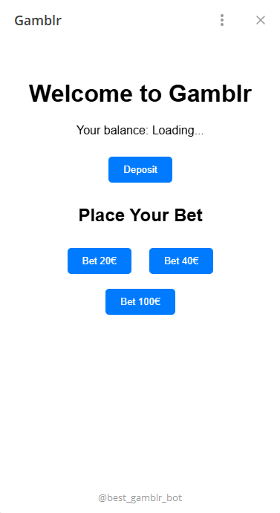
Mini-app
Simple Flask server
Simple UI

Slide 5
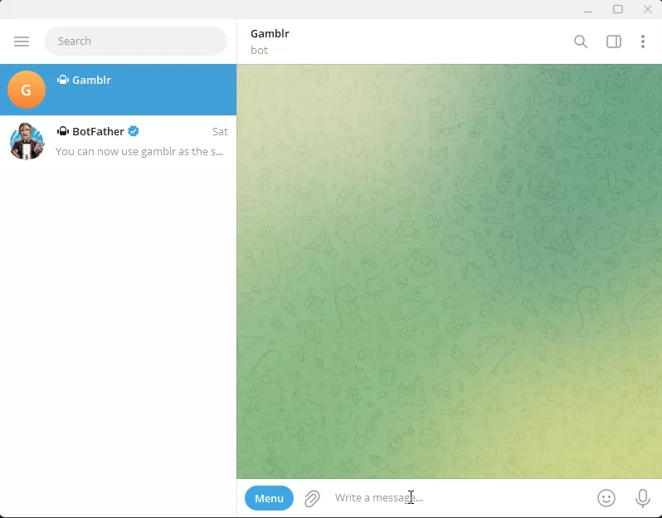
Video

