Slide 1

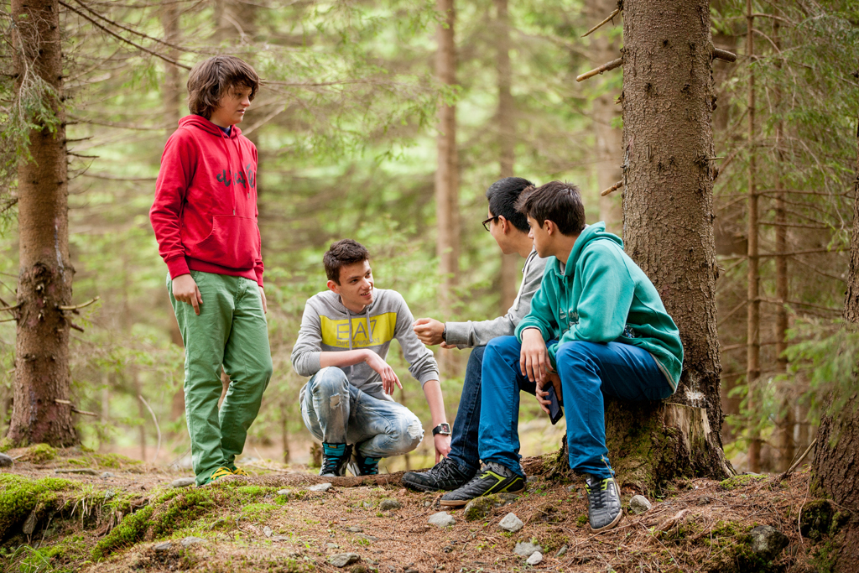
WWF’s work
EnviroMap
for WWF
Hack4Good Kiev, 2nd place
9 February, 2014
Alex Kovbasko
artimia@gmail.com
Alex Kovbasko
© Dan Dinu

Slide 2

WWF IN SHORT
+100
+5000
WWF is in over
100 countries, on
5 continents
WWF has over
5,000 staff worldwide
1961
+5M
WWF was founded
In 1961
WWF has over
5 million supporters

Slide 3
Challenge!
Prioritizing short-term profits at the expense of the environment has led to a bunch of environmental problems in Ukraine. Often it is happening illegally – clear-cuts in the forests, unauthorized waste disposal, land grabbing in the national parks. It’s time to start exercising our rights as citizens! This map will be a platform for citizens to flag out environmental problems they encounter, team up and solve them with the support of NGOs.
* We still haven’t come up with a catchy name, for now it’s EnviroMap

Slide 4
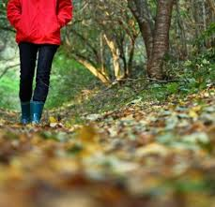
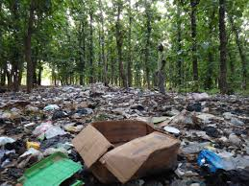
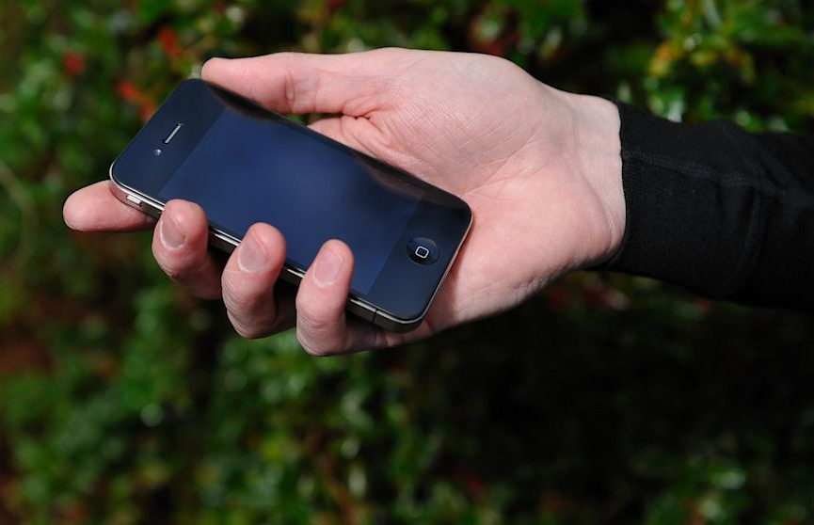
Imagine…
Notes:
You walk in the forest. Alone. Or with a girl.
Suddenly you see huge pile of trash in the valley.
What would you do?
Knowing about our tool you would take out your phone, take a photo and… [next slide]

Slide 5
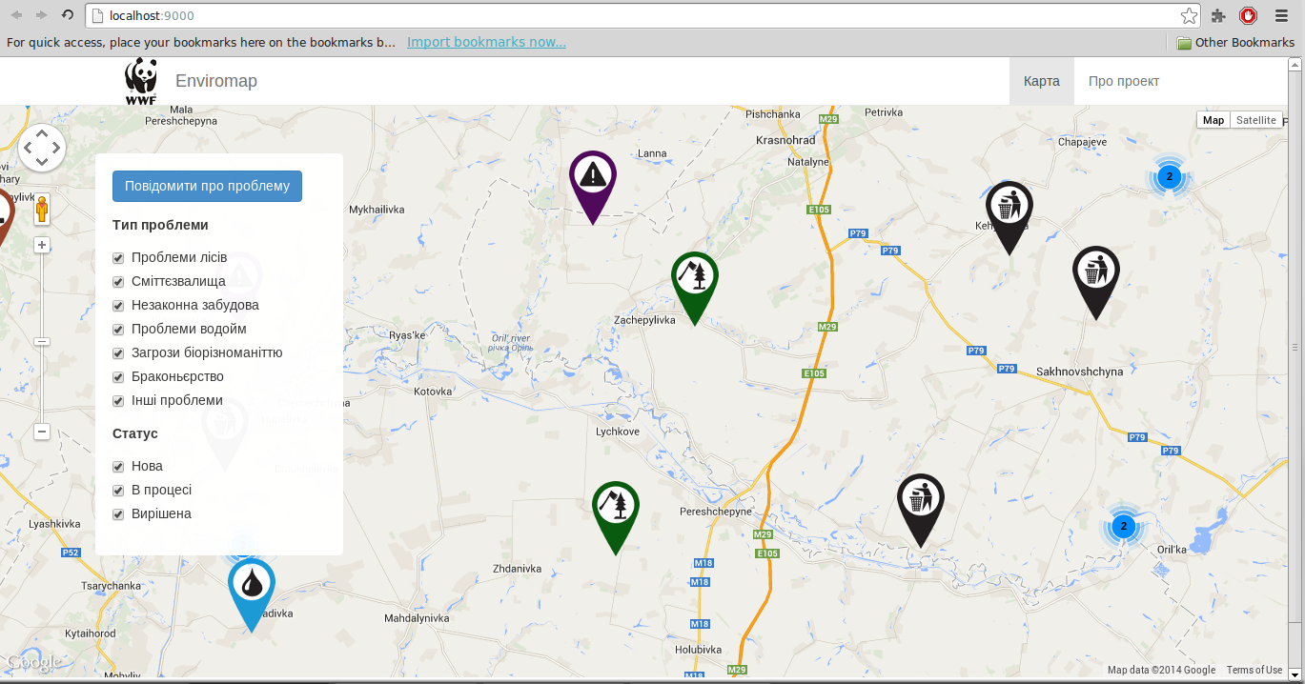
..tag in on the map
Notes:
Environmental problems can be filtered by categories (forest-, water-related problems, waste, threats to biodiversity, poaching and other) and status (new, in the process, solved). Pressing blue button on the left, one can report a problem.

Slide 6
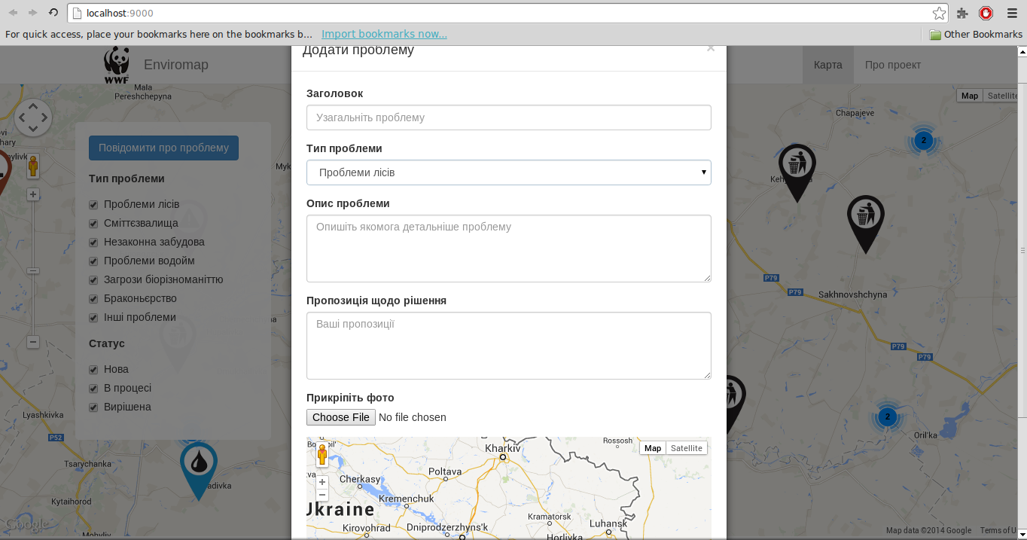
Reporting a problem
Notes:
When reporting a problem user is offered to add not only problem description, photo and a location but also to suggest his solution to this problem. This way we encourage citizens to make a step from just complaining to constructive dialog. Moderator receives notifications about new entries, reviews them and can contact users who reported similar problems nearby. Moderator will be able to support users with legal information on how to notify responsible authorities about the problem and which local NGO can help

Slide 7
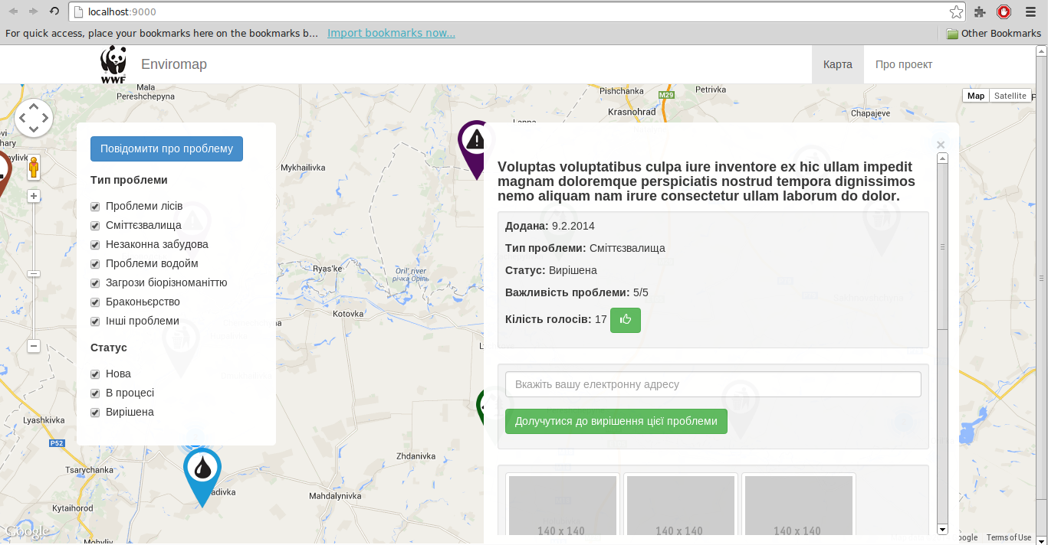
View existing problem
Notes:
Any visitor is able to vote for the importance of the problems on the map. Those problems that get most of the votes will have bigger bubbles and will be given more attention.

Slide 8
In the future..
Global roll-out
Integration on different platforms
Full problem solution cycle

Slide 9
Thank you
wwf.panda.org/ukraine

