Slide 1
Творимо майбутнє разом!
“Ніколи не сумнівайтеся, що невелика група відданих своїй справі людей може змінити світ. Насправді тільки таким групам і вдавалося щось змінити” Маргарет Мід, антрополог
Розкажи про проблему і разом ми вирішимо її.

Slide 2
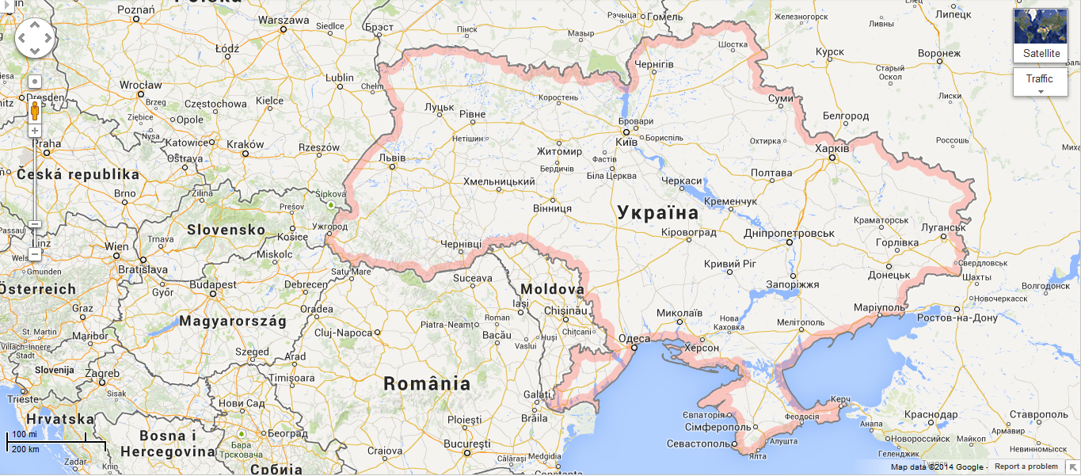
Front page. Екологічна карта України
Про проект Новини Ресурси Долучитися
LEGEND
Signs , not arrows – river, forest, energy, birds, waste dump, illegal construction, other problem
TAG CLOUD
Forests, waste, birds abused, pollution, flood, illegal construction
SHARE
Facebook, Twitter, Vk..
Пошук:
Notes:
Prioritizing short-term profits at the expense of the environment has led to a bunch of environmental problems in Ukraine. Often it is happening illegally – clear-cuts in the forests, unauthorized waste disposal, land grabbing in the national parks. It’s time to start exercising our rights as citizens! This map will be a platform for citizens to flag out environmental problems they encounter, team up and solve them with the support of NGOs.

Slide 3
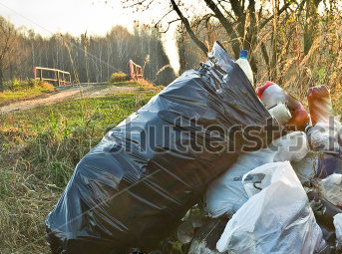
Front page
Про проект Новини Ресурси Долучитися
Problem: unauthorised waste dump near village X.
Who works to solve it: Sergiy K., email@gmail.com
Help solve it!
User clicks on the arrow to see the problem

Slide 4
Front page. Екологічна карта України
Про проект Новини Ресурси Долучитися
LEGEND
Signs – river, forest, energy, birds, waste dump, illegal construction, other problem
TAG CLOUD
Forests, waste, birds abused, pollution, flood, illegal construction
SHARE
Facebook, Twitter, Vk..
Неурядові організації в моєму місті
Інформаційний запит: що це та як його писати
Скаржимось ефективно
Волонтер\ приватна особа
НГО
Бізнес
Пошук:
Notes:
3 stages of the project:
-> fill the map with the problems
-> public votes on most important problems (bubbles on the map grow depending on the number of votes)
-> map protected areas in UA, at least the biggest – raise awareness about them + PAs may use this tool to ask volunteers for help

Slide 5
Adding new spot to the map
Left click on the map -> pop up ‘add to map’ -> pop up with fields: problem description (please be as specific as possible), is there someone working to solve it? attach a photo-> save ->
‘thank you for your submission! a) Would you like to help solve the problem? We’ll keep you informed about the next steps
b) Would you like to coordinate the process? We’ll provide you assistance on the way ’ -> yes -> enter email
-> no -> Please vote on which problem you consider most important. Thanks, till next time!

Slide 6
Открытый доступ - в конце дня модератор получает список новых точек
Берем бесплатную версию Google maps, если интерес привышает ее возможности – расширяемся

