Slide 1
Hackathon Customer Credit Transfer
Team Name: Ramki
Participants: Appu V
Paul Varghese
Renjith KR
Notes:
Cover slide option #3

Slide 2


high level architecture
Apache Kafka
Http/s
MX
Http/s
MT
Transaction Service
Schema Service
Account Service
Transaction Service
Postgres

Slide 3









Tech Stack

Slide 4
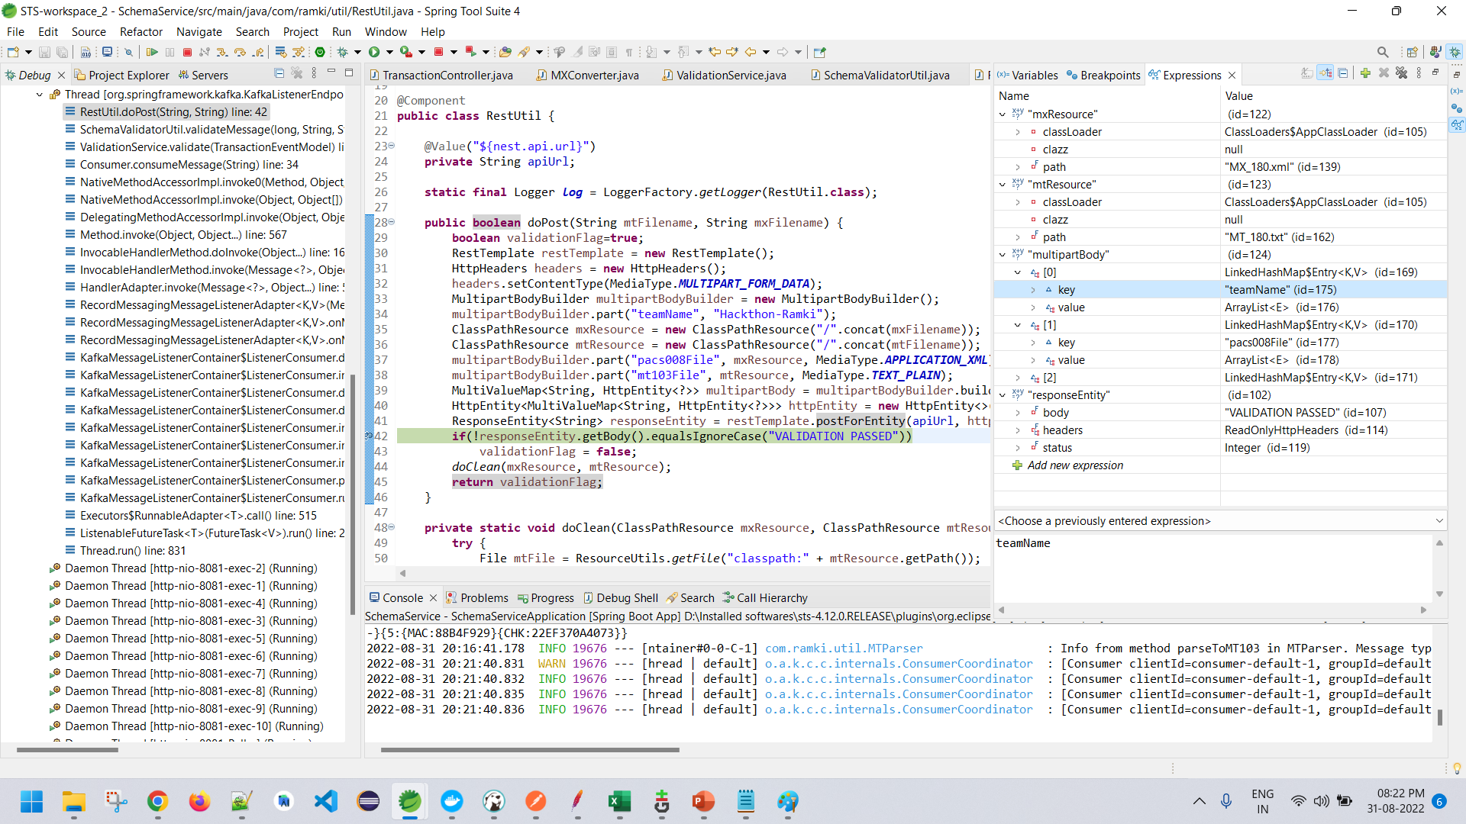
Validation Report

Slide 5
Thank you

