Slide 1

Network Debugging with Wireshark and TCPDump

Slide 2
Why?
See what’s “on the wire”
Inspect traffic at a packet and frame levels
Distinguish between network issues vs App Issues
Check for data leaks and other unwanted behavior
Why not?

Slide 3
TCPDump
Command line utility for capturing network traffic
Generally comes in *nix environments including Android
Limitations:
  If running on a device/emulator requires root privileges :(
Useful links:
  https://www.sans.org/security-resources/tcpip.pdf
  https://www.sans.org/security-resources/ipv6_tcpip_pocketguide.pdf

Slide 4
Yahoo Article
Check out this article
http://www.yahoo.com@3627729892

Slide 5
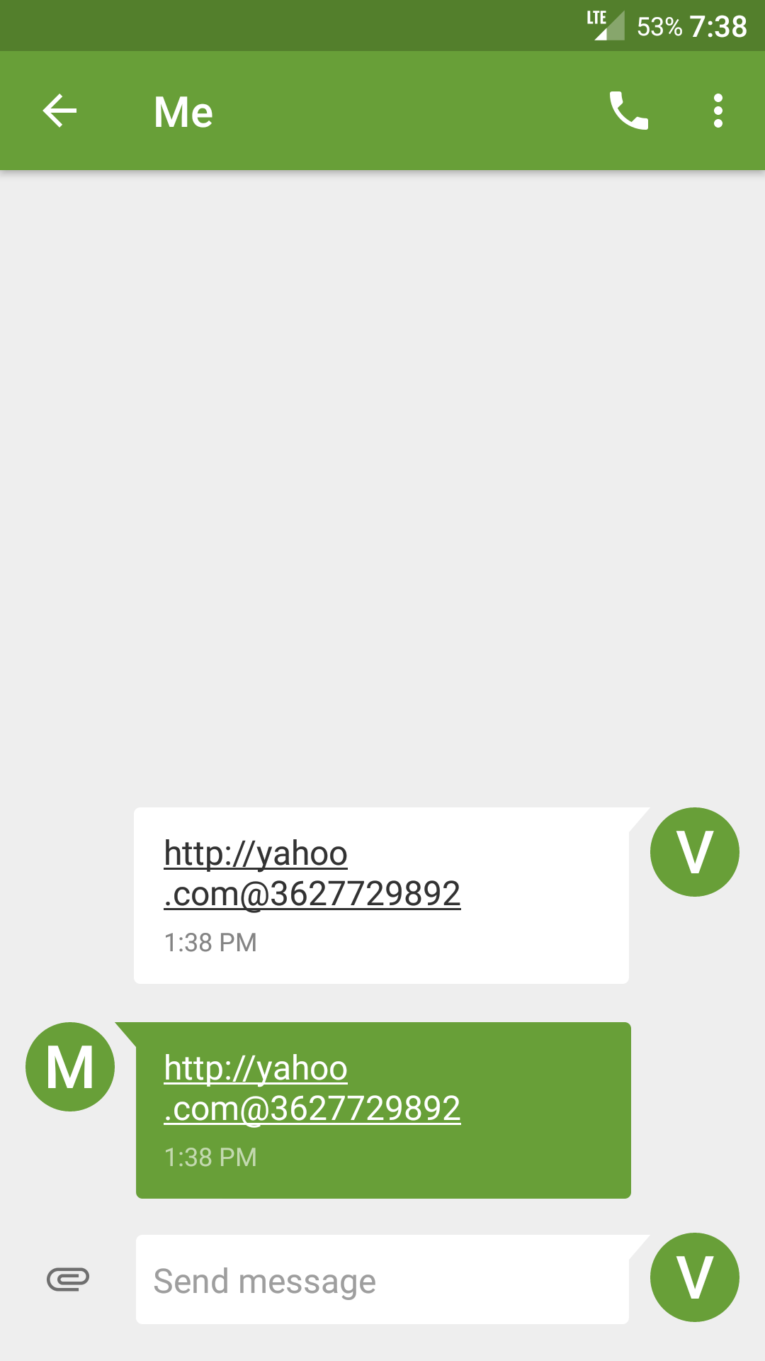

Results

Slide 6
What just happened?
7
URL format
  scheme:[//[user[:password]@]host[:port]][/path][?query][#fragment]
    1 “http:” - Scheme (What it is)
    2 “//” – Structured URL constant
    3 – user credenitals field
    4 “@” – user credentials delimiter
    5 - host specification (address and optional port)
    6 – Unix path to resource
    7 – query
    8 – fragment
What does IPV4 Address Look like?
  AAA.BBB.CCC.DDD – notation to make your life easier. Maybe???
  IP address is an integer stored in network byte order
  Who lives at 216.58.195.228?
  google.com
  What does 216.58.195.228 looks like in the integer form?
  3627729892
Lets look at the article URL again:
  http://www.yahoo.com@3627729892
2
3
4
5
6
8
1
1
2
3
4
5

Slide 7
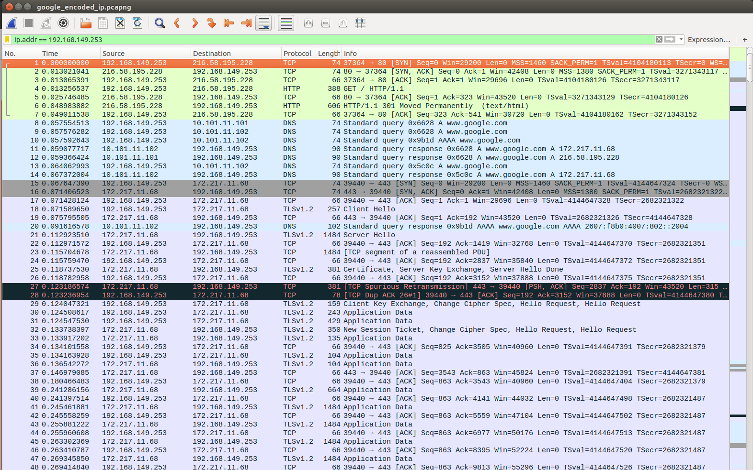
Notice Anything Strange?
No DNS Resolution for yahoo.com

Slide 8
General Android Workflow
ADB (if devices is rooted):
  Capture traffic with TCPDump and save it in an accessible location
  Transfer the capture file via ADB to the local computer
  Load capture file in Wireshark
WiFi AP (all other cases):
  Create a wireless access point and use it to capture traffic

Slide 9
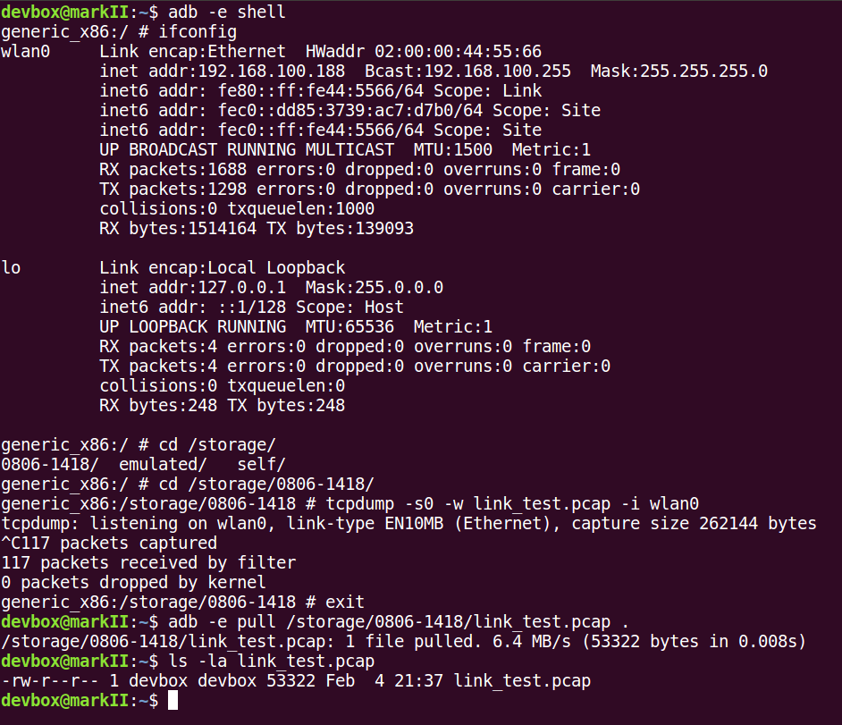
TCPDump Emulator Example
Start Adb Shell
Check for interfaces
Change directory to SDCard
Start TCPDump
    -s0 Don’t truncate packets
    -w save output to link_test.pcap
    -i capture on wlan0 interface
Stop capture with Ctl+C
Exit adb shell
Transfer the file

Slide 10
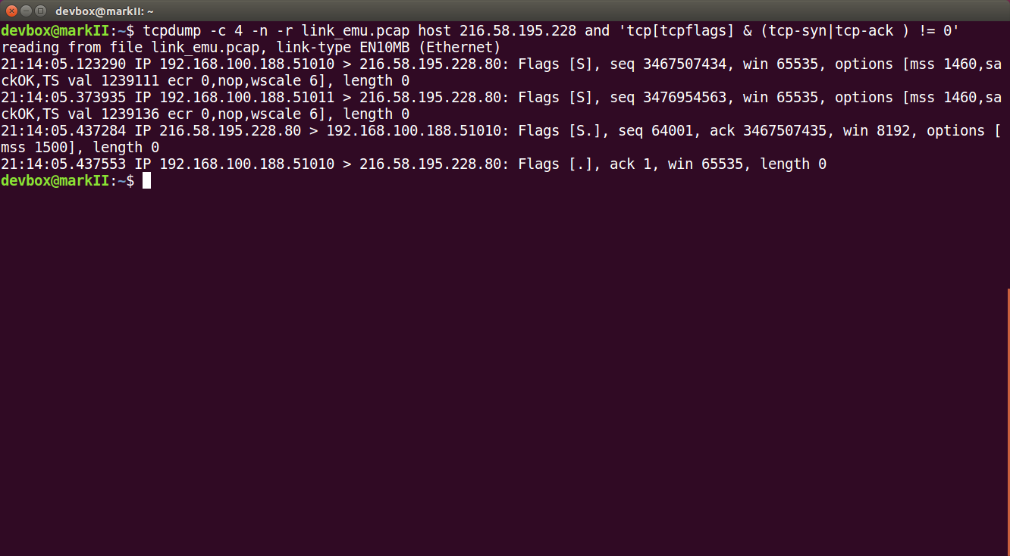
TCPDump TCP Handshake Examination
-c 4: get 4 packets
-n do not resolve names
-r read from file
Berkley packet filter expression
Super readable output
Right?
What would make it readable?
Wireshark

Slide 11
Device Capture Demo

Slide 12
Debugging Station Setup
Kali Linux VM
WiFi Card supporting AP(Master) mode
Hostapd – creates WiFi hot spot
Dnsmasq – DNS/DHCP server
iptabes – Linux firewall/packet filter

Slide 13
Setup considerations
Setup USB device filters in your VM
Disable Network-Manager
Disable wpa_supplicant.service
Setup port forwarding
Start hostapd
Start dnsmasq
Install Certificates generated earlier
Start apache2 server
Have fun

Slide 14
Live WiFi AP Demo

