Slide 1
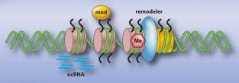
Computational Epigenetics: Processing, Applications, & Methods
Vince Reuter
14 March 2017

Slide 2
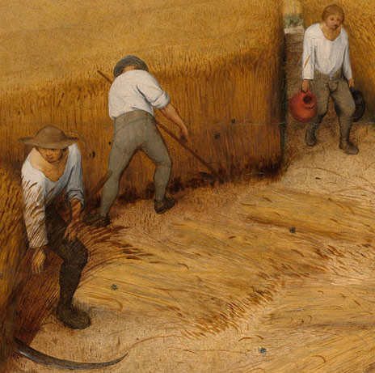


Typical Bioinformatics Processing
Starts small, manual
More tools, more chaos
Repetitive frustration

Slide 3



Solution: Looper
Portable
Environment variables
CeMM
UVA
Resource flexibility
Memory/cores/time
Supercomputer/cluster
Monitoring/logging
Automatically in output directories
Could put on web/email
Restartable
Lockfiles/flags
Don’t duplicate work

Slide 4
Configuration + sample sheet

Slide 5
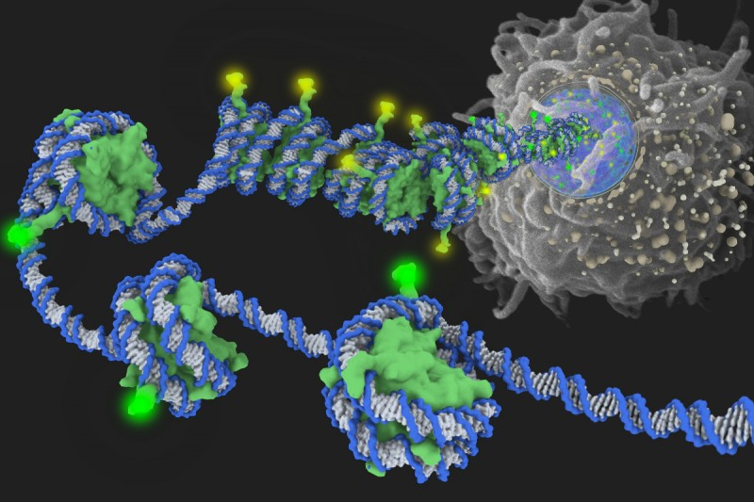
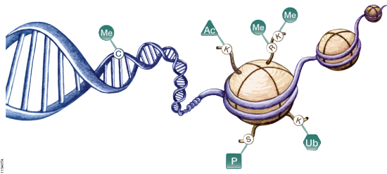
Epigenetics, broadly
Growing extent of understood influence
Development and
Disease
Development/differentiation
Several main forms
DNA methylation
Histone modifications
Methylation
Acetylation
Ubiquitination
Histone protein variants

Slide 6
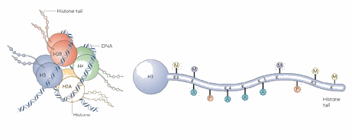
Histones, briefly
Location-dependent
H3K4me1 at enhancer
H3K4me3 at promoter
Different additives
me, ac, ub
Chromatin accessibility
Core protein variants

Slide 7
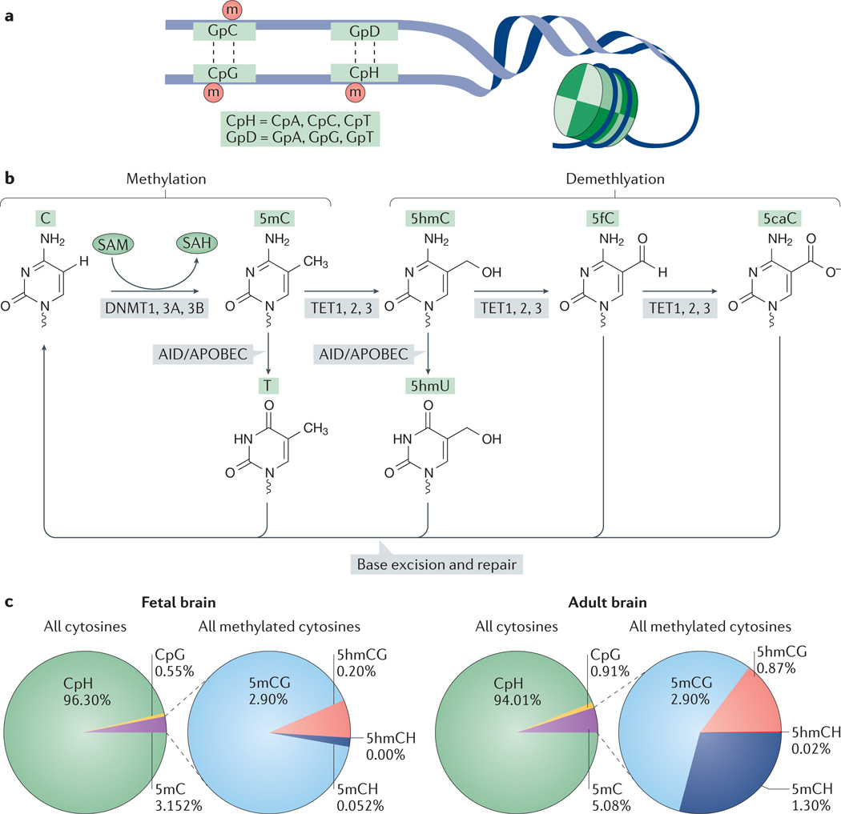
DNA Methylation, specifically
Much of mature genome is methylated
Interest in epigenetic landscape during development
Methylation changes are maintained/stable (DNMT)
De novo: DNMT3A/B
Maintenance: DNMT1
Heritable
Reversibility: TET family
Research to be done into 5mC derivatives

Slide 8
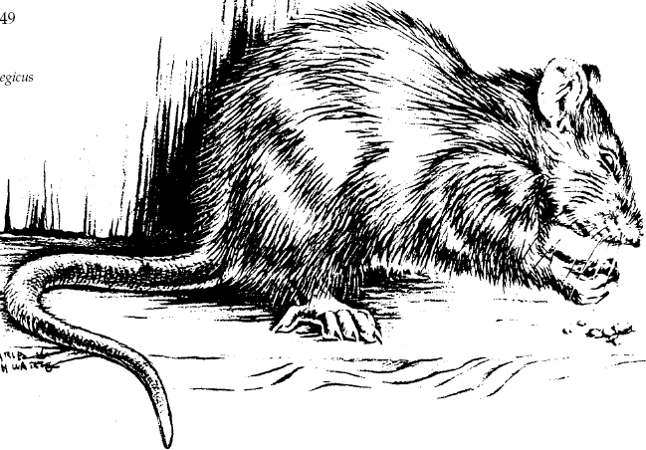
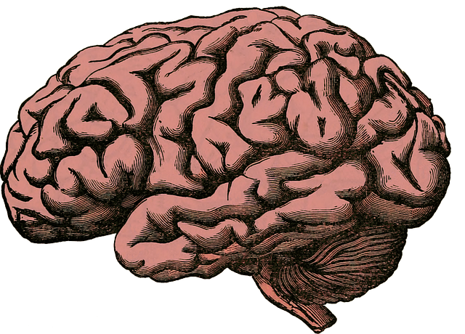

Methylation and rat brain gender
Neuronal methylome particularly dynamic
Methylation suppresses expression of maculinizing genes.
Ongoing methylation maintenance is required.

Slide 9
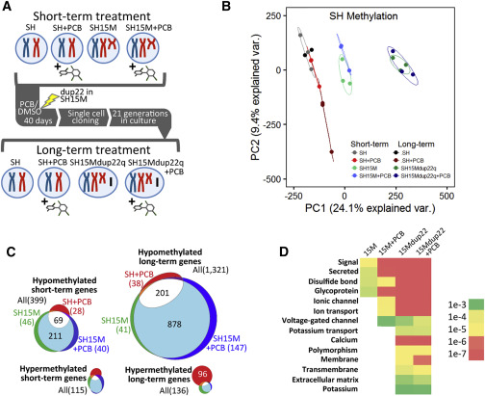
Effect of PCBs on autism candidate genes via epigenetic marks
Cell line to model neuronal function and differentiation (SH-SY5Y)
10 or 40 days
+/- Dup15q
+/- PCB
Methylation profile partitions with respect to structural chromosome aberration

Slide 10
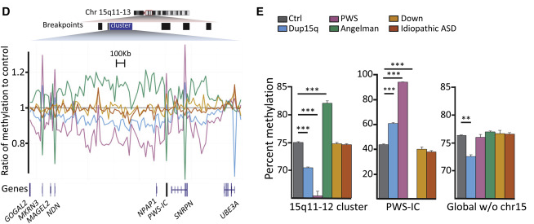
Non-uniform structural effect
Inclusion of brain tissue from Down Syndrome
Global and local differences
Imprinting

Slide 11
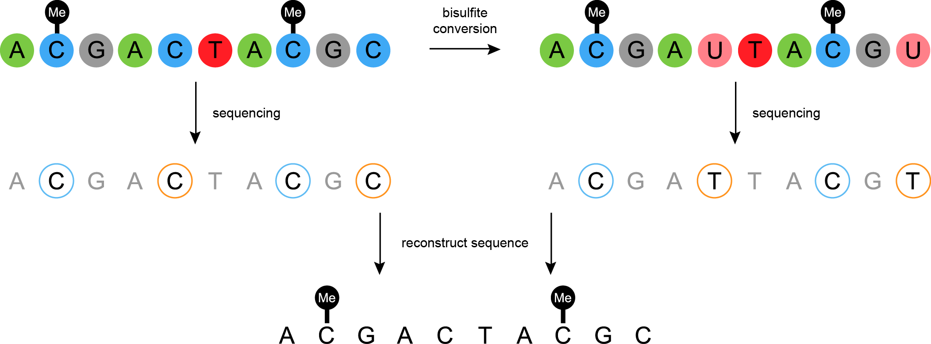
Bisulfite Sequencing
Conversion efficiency
Spike-in control
Typically > 99%
Derivatives
5hmC
5fC, 5caC
Oxidative bisulfite sequencing (ox-BS)

Slide 12




WGBS & RRBS
CpG occurs much less often than expected by chance (< 1% vs. ~4.5%)
Hypothesis: 5mC → T
Information/cost trade-off
Some novelty sacrifice
RRBS much cheaper
$: Mspl recognizes CpG
t: fewer data observations

Slide 13
Processing methylation
Axes for inquiry
Age
Cell type
Tissue region
Over time
Condition/phenotype
Steps
Filter/trim
Align
Call methylation
Further analysis

Slide 14
Epilog
Current capabilities
Ideas for development
Methclone-like, but more flexible
Epipolymorphism
Combinatorial entropy
Deterministic vs. stochastic evolution of methylation accumulation susceptibility is associated with CTCF occupancy and histone modification (connect to brief overview of histone modification.) (“Epigenetic polymporphism and stochastic formation….”)
ESCs and germline cells able to establish stable methylation program rather than random changes seen in somatic cells (“Epigenetic polymporphism…”)
Applications
Epiallelic composition across time scales in brain regions/cell types/times/conditions

Slide 15
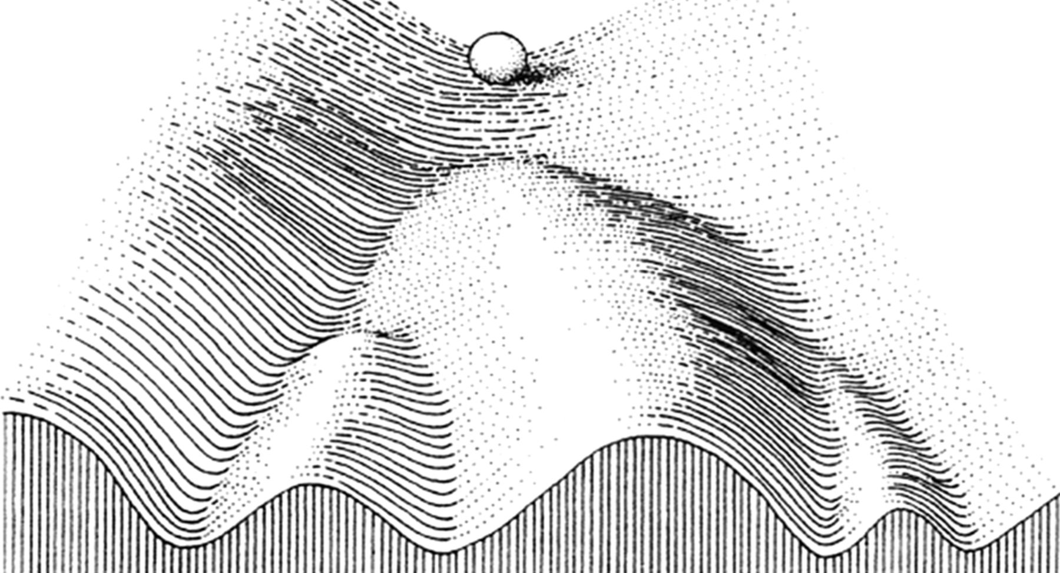
Thank you for listening

