Slide 1
Computational Epigenetics: Processing, Applications, & Methods
Vince Reuter
13 March 2017

Slide 2
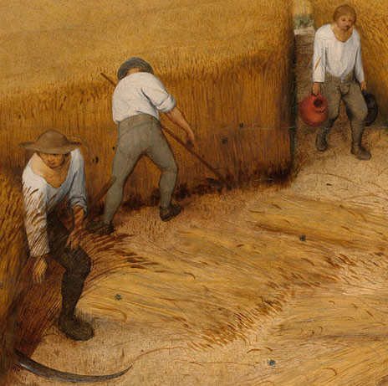
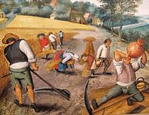
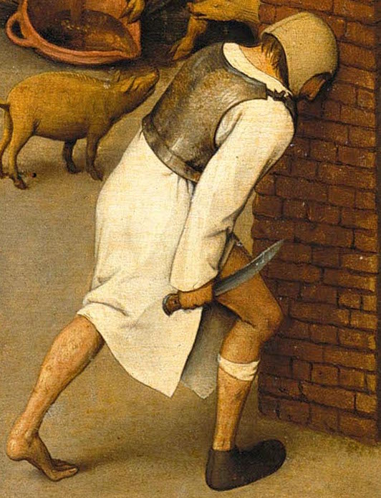
Typical Bioinformatics Processing
Starts small, manual
More tools, more chaos
Repetitive frustration

Slide 3



Solution: Looper
Portable
Environment variables
CeMM
UVA
Resource flexibility
Memory/cores/time
Supercomputer/cluster
Monitoring/logging
Automatically in output directories
Could put on web/email
Restartable
Lockfiles/flags
Don’t duplicate work

Slide 4
Configuration + sample sheet

Slide 5
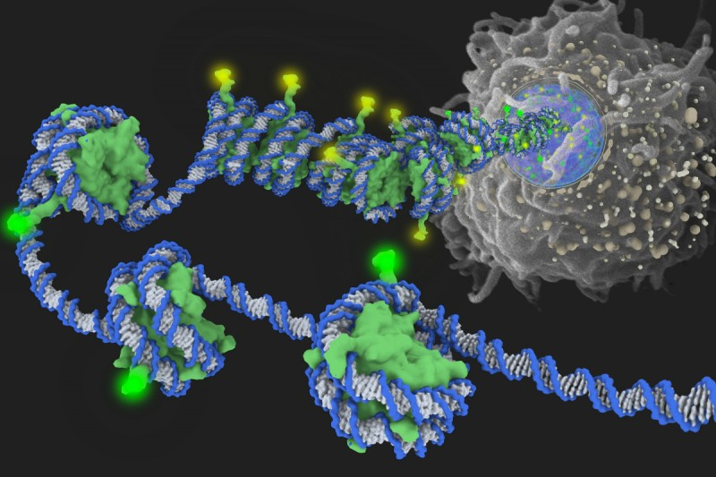
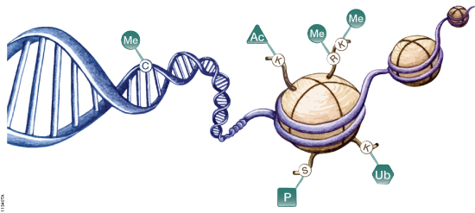
Epigenetics, broadly
Growing extent of understood influence
Development and
Disease
Development/differentiation
Several main forms
DNA methylation
Histone modifications
Methylation
Acetylation
Ubiquitination
Histone protein variants

Slide 6
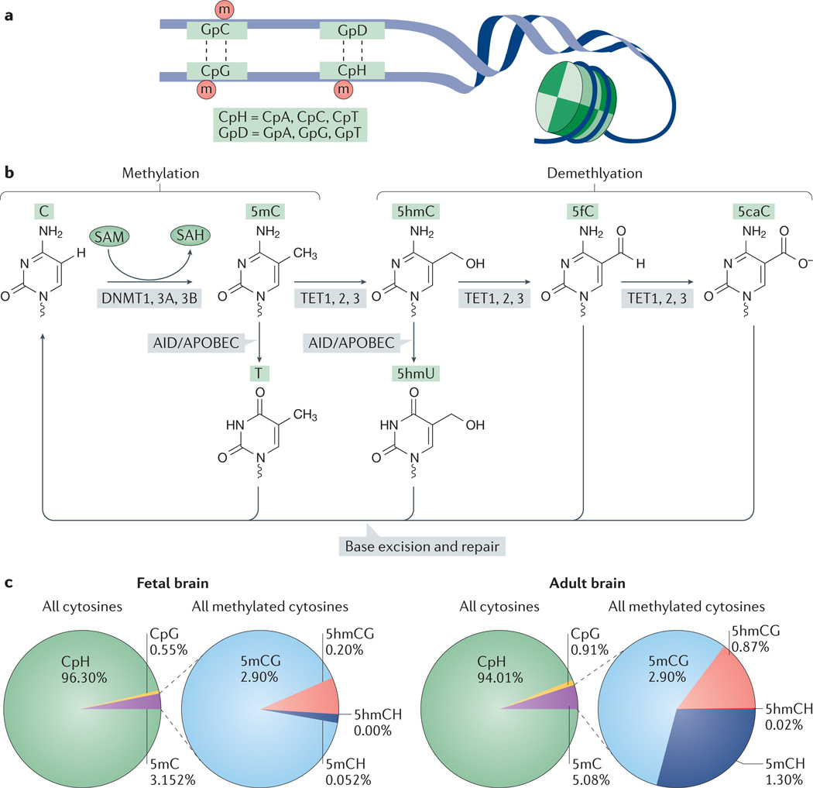
DNA Methylation, specifically
Much of mature genome is methylated
Interest in epigenetic landscape during development
Methylation changes are maintained/stable (DNMT)
De novo: DNMT3A/B
Maintenance: DNMT1
Heritable
Reversibility: TET family
Research to be done into 5mC derivatives

Slide 7
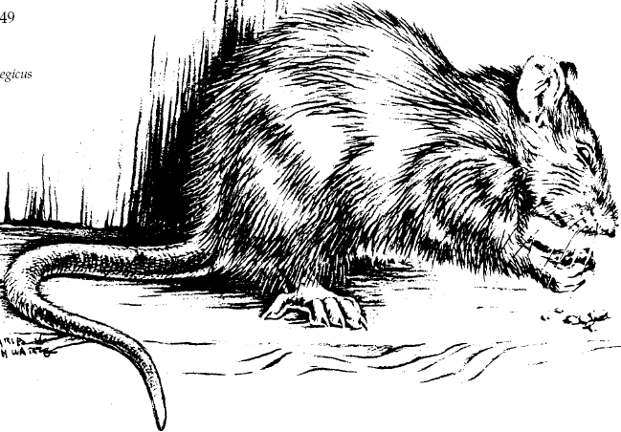
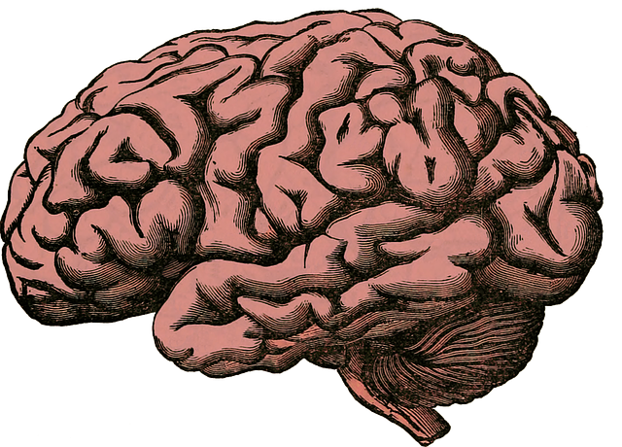

Methylation and rat brain gender
Jks vd

Slide 8
Effect of PCBs on autism candidate genes via epigenetic marks

Slide 9
Bisulfite Sequencing
Conversion efficiency

Slide 10
Histone modifications
Location-dependent
H3K4me1 at enhancer
H3K4me3 at promoter
Acetylation on tails general an activation mark

Slide 11
Whole-genome vs. Reduced-representation
WGBS
RRBS

Slide 12
Aging

Slide 13
Methclone

Slide 14
Epilog
Current capabilities
Ideas for development
Methclone-like, but more flexible
Epipolymorphism
Combinatorial entropy
Deterministic vs. stochastic evolution of methylation accumulation susceptibility is associated with CTCF occupancy and histone modification (connect to brief overview of histone modification.) (“Epigenetic polymporphism and stochastic formation….”)
ESCs and germline cells able to establish stable methylation program rather than random changes seen in somatic cells (“Epigenetic polymporphism…”)
Applications
Epiallelic composition across time scales in brain regions/cell types/times/conditions

