Slide 1
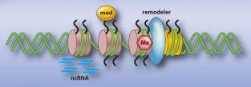
Epigenetics Processing, Applications, & Methods
Vince Reuter
14 March 2017

Slide 2
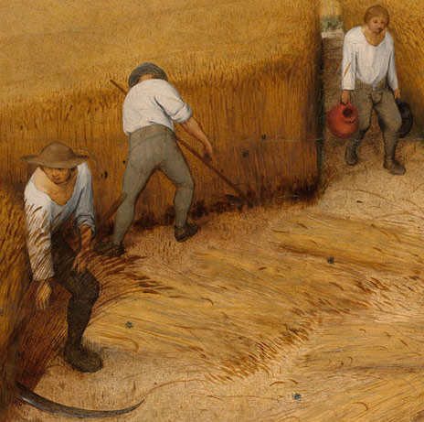


Typical Bioinformatics Processing
Starts small &manual
Add tools, add chaos
Repetitive frustration

Slide 3



Solution: Looper
Portable
Environment variables
CeMM
UVA
Resource flexibility
Memory/cores/time
Supercomputer/cluster
Monitoring/logging
Automatically in output directories
Could put on web/email
Restartable
Lockfiles/flags
Don’t duplicate work

Slide 4
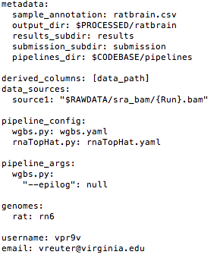
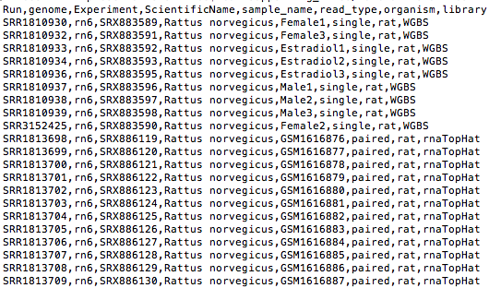
Configuration + sample sheet
Project configuration
Sample annotations

Slide 5
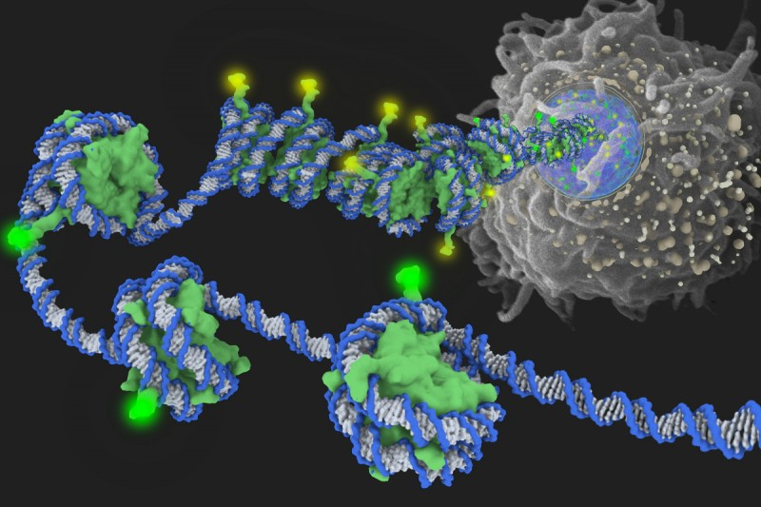
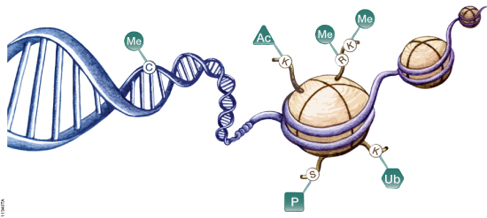
Epigenetics, broadly
Growing extent of understood influence
Development/differentiation
Disease
Environmental response
Several main forms
DNA methylation
Histone modifications
Histone protein variants

Slide 6
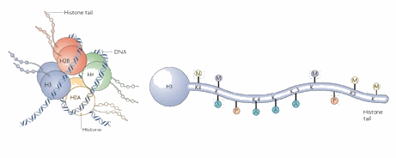
Histones, briefly
Location-dependent
H3K4me1 at enhancer
H3K4me3 at promoter
Different additives
me, ac, ub
Chromatin accessibility
Core protein variants

Slide 7
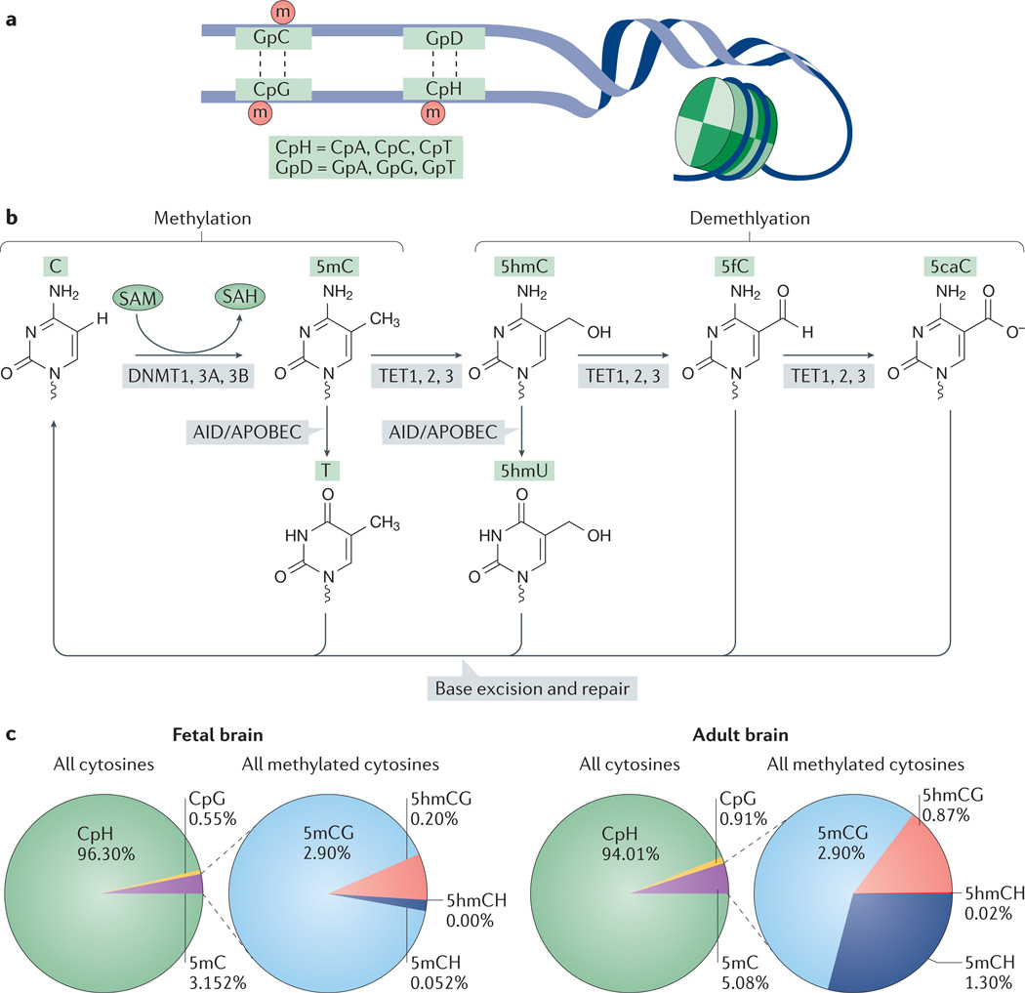
DNA Methylation, specifically
Much of mature genome is methylated
Interest in epigenetic landscape during development
Methylation changes are maintained/stable (DNMT)
De novo: DNMT3A/B
Maintenance: DNMT1
Heritable
Reversibility: TET family
Research to be done into 5mC derivatives

Slide 8
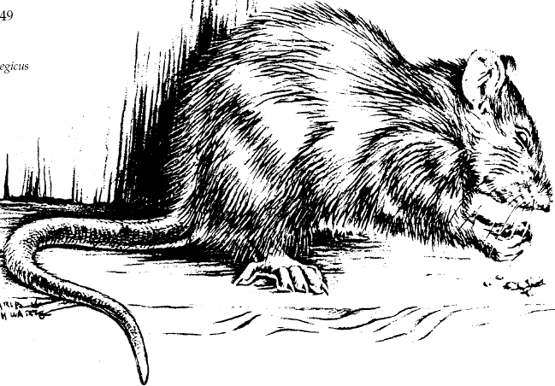


Methylation and rat brain gender
Neuronal methylome particularly dynamic.
Methylation suppresses expression of maculinizing genes.
Ongoing methylation maintenance is required (DNMT1).
Estradiol treatment sharply cuts proportion of fully-methylated CpG sites.
Timing is important
Knockout of DNMT3a is slow, little effect
Hormonal treatment differential
DNMT inhibition with Zeb still elevates masculine protein proxy (spinophilin Neurabin II)

Slide 9
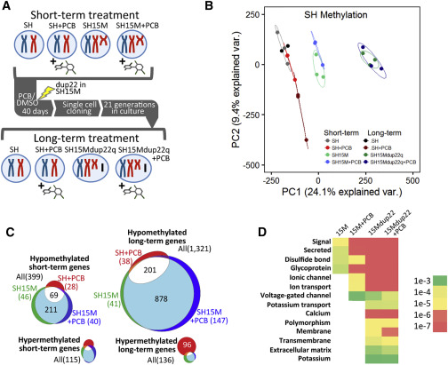
Effect of PCBs on autism candidate genes via epigenetic marks
Cell line to model neuronal function and differentiation (SH-SY5Y)
10 or 40 days
+/- Dup15q
+/- PCB
Methylation profile partitions with respect to structural chromosome aberration

Slide 10
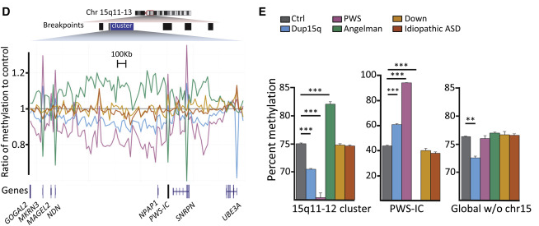
Non-uniform structural effect
Imprinting
Global and local differences
Inclusion of brain tissue from Down Syndrome

Slide 11
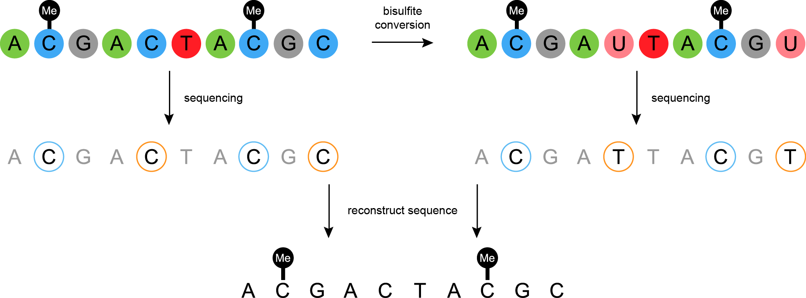
Bisulfite Sequencing
Conversion efficiency
Spike-in control
Typically > 99%
Derivatives
5hmC
5fC, 5caC
Oxidative bisulfite sequencing (ox-BS)

Slide 12




WGBS & RRBS
CpG occurs much less often than expected by chance (< 1% vs. ~4.5%)
Hypothesis: 5mC → T
Information/cost trade-off
Some novelty sacrifice
RRBS much cheaper
$: Mspl recognizes CpG
t: fewer data observations

Slide 13
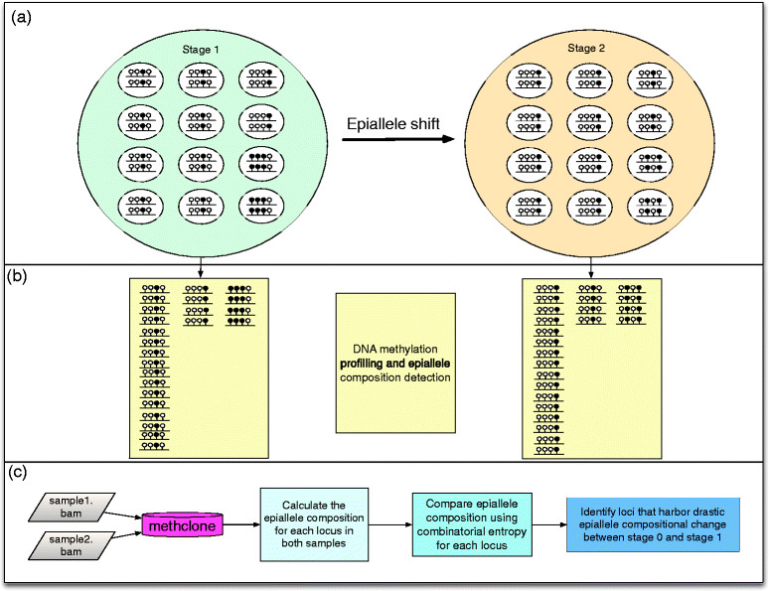
Processing methylation
Axes for inquiry
Age
Cell type
Tissue region
Over time
Condition or phenotype
Steps
Filter/trim
Align
Call
Analyze

Slide 14
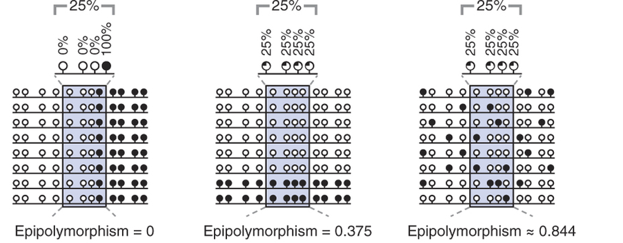
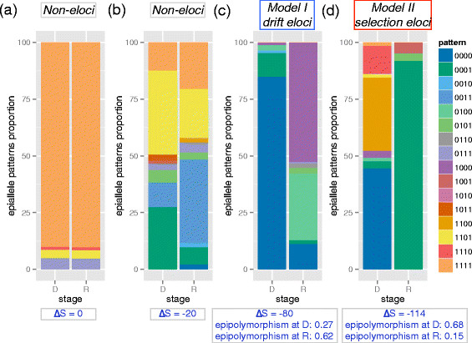

Slide 15
Improvements: Epilog
Current tools
Often consider CpG in groups of 4
Groups/sites analyzed independently
Instead
Allow flexibility in terms of base count
Investigate specific epiallele patterns
Spatial autocorrelation
Pairings
ATAC-Seq
Hyperactive transposase
Assesses DNA not nucleosome-bound, free of binding proteins
ChIP-Seq
Histone modifications
Epigenetic regulatory interactions

Slide 16
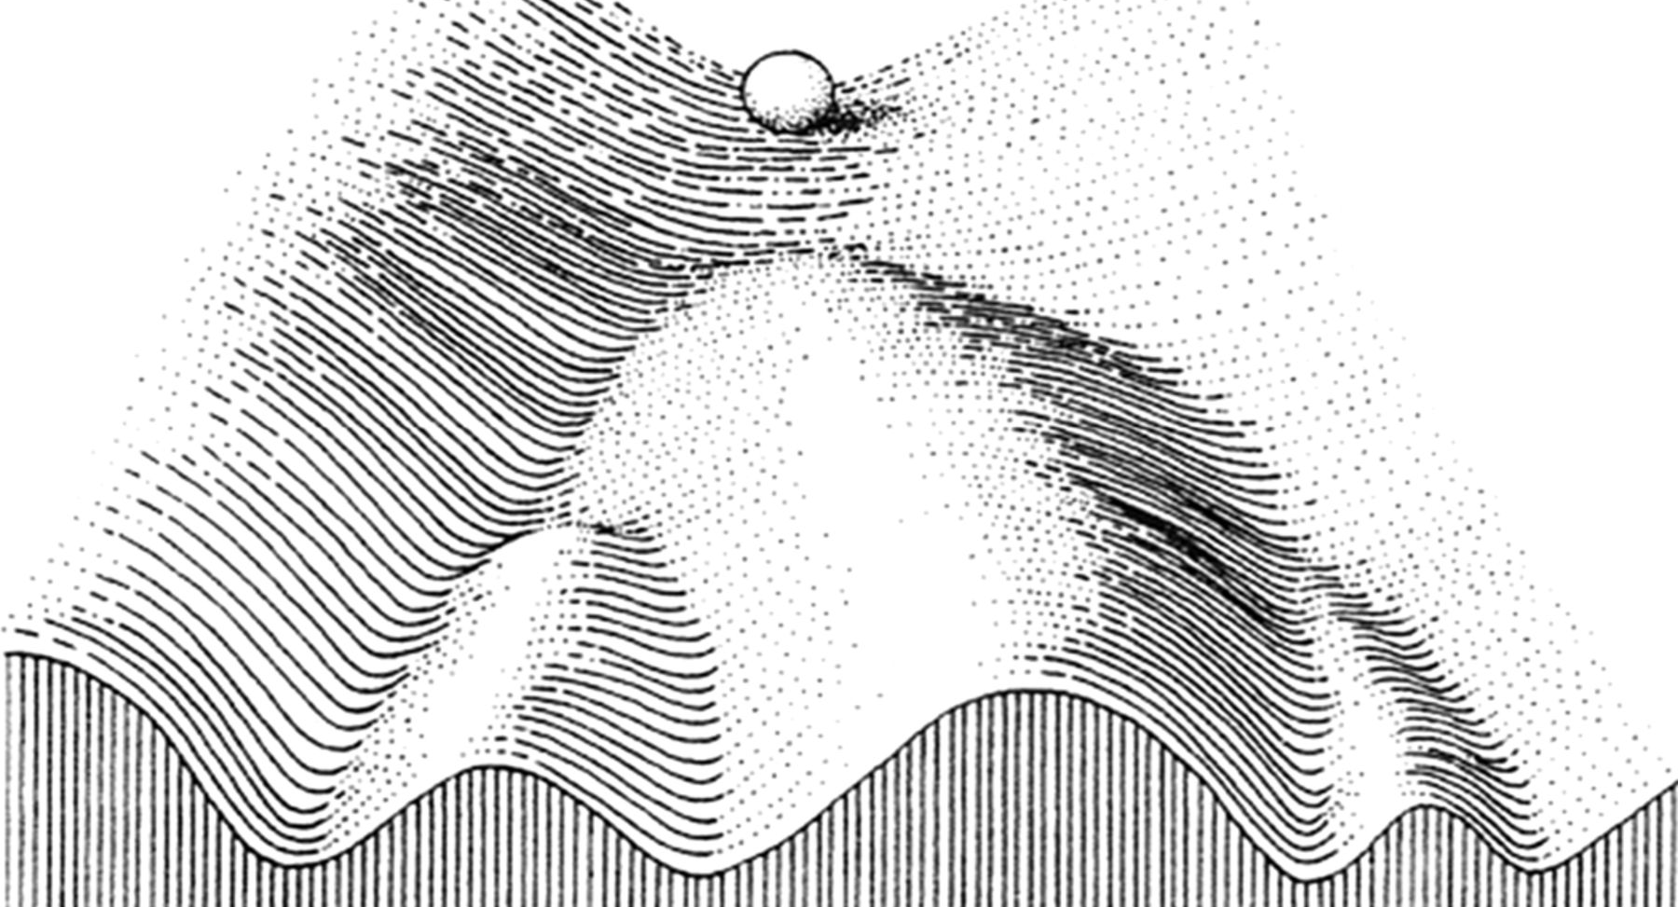
Thank you for listening

