Slide 1
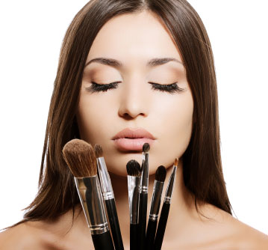
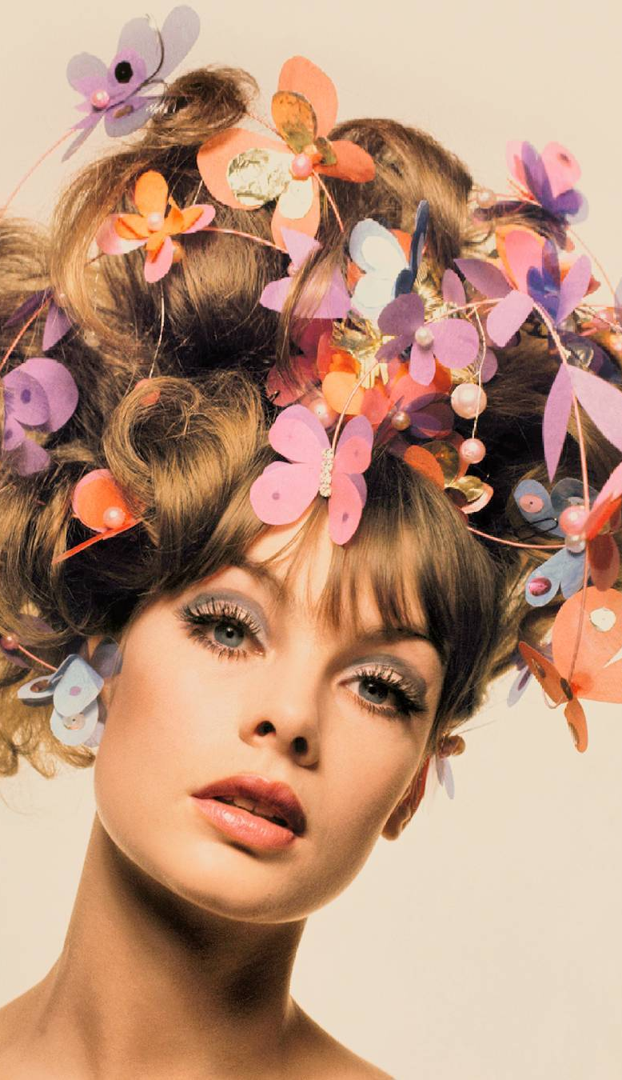
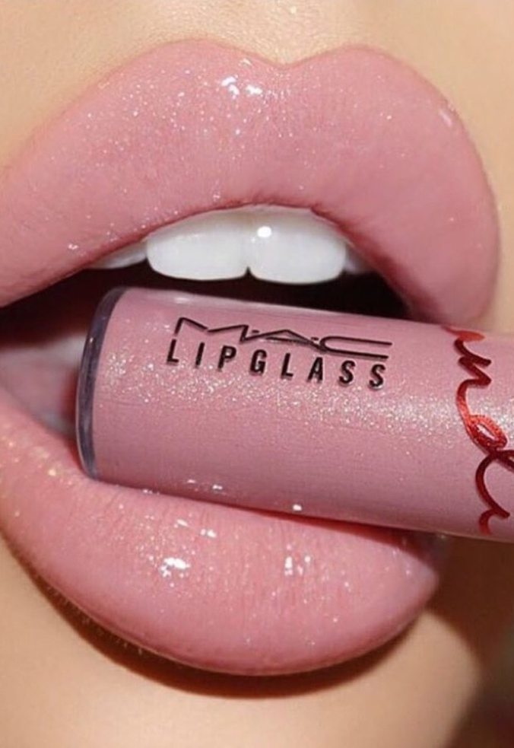

Live the life of LUXXury and
Visit us today!
Are you ready to upgrade your look? Take your lashes to dramatic lengths and get pampered at Luxx Beauty Bar. Located at the end of Hall of Fame Avenue, Luxx Beauty Bar is Stillwater’s first and only lash extension studio that offers makeup artists and lash specialists guaranteed to make you look and feel fierce!
1440 E. Hall of Fame Ave.
Stillwater, Ok 74045
Luxxbeauty.com
Get Fierce. Be Fierce.

Slide 2
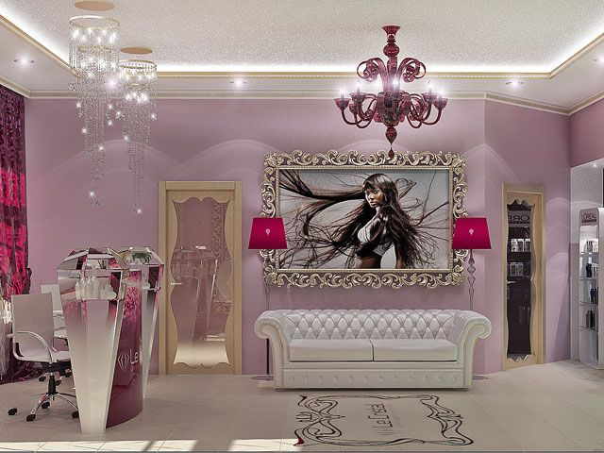
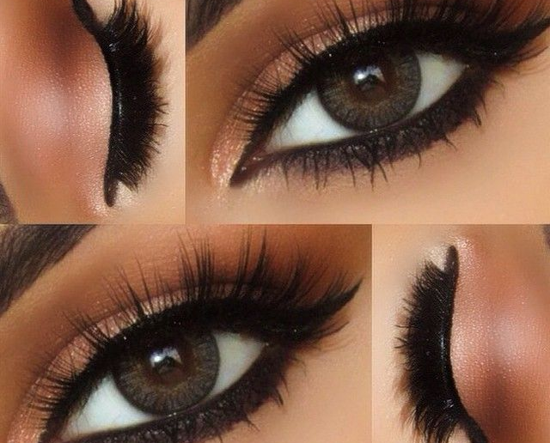
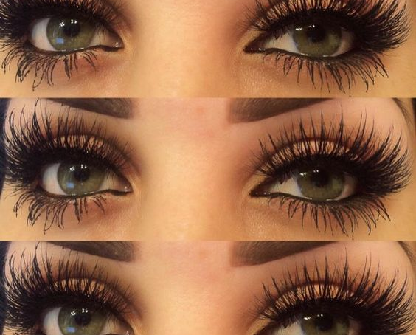
Services
Get fierce. Be fierce.
New to lash extensions?
No problem. Our beauty advisors will assist you with selecting the best lashes tailored for your eye shape and look you want to achieve.
The Cowgirl $150
The cowgirl is a natural lash look that accentuates the natural shape of your eyes. This style is perfect for the every-day girl who wants LUXXury lashes but not as dramatic.
Lash extensions tips
Your lashes will stay full for 2-3 weeks. When you start to see gaps, come back in and we’ll fill them!
You CAN get them wet but please refrain from water activities until 24 hours after application.
Stay away from mascara as it may damage the extensions.
Ultimate Luxx Girl $210
The Luxx Girl is a LUXXury lash look that calls for your inner diva. This dramatic lash style is thicker than the Cowgirl, placing multiple lash extensions on each individual lash.
Luxx beauty Lash Bar is open Tuesday-Saturday 10 a.m. to 4 p.m. and on Sunday from 9 a.m. to 3 p.m.
Whether you visit us for senior pictures, a special occasion or you just want to upgrade your look, we got you covered! It is our specialty to create custom looks to fit your theme or personal style.
Makeup Services $100-300
Makeup styles vary from each artist. All beauty specialists are able to customize looks and will have you walking out looking fierce!
*The duration of lash services is 1-2 hours depending on natural lash thickness and fullness of extensions.
3

