Slide 1

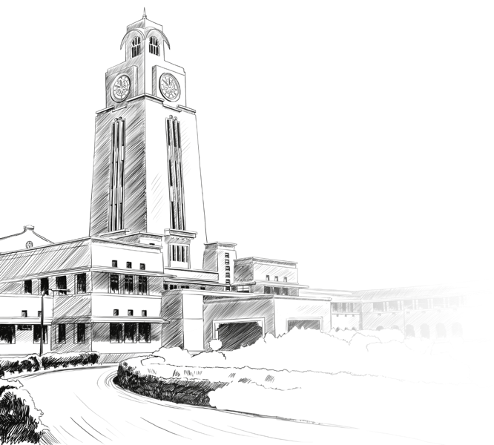
FIN F315 Financial Management
Assignment On Cost Of Capital
Group 20

Slide 2
Group Members
YASHVI AGRAWAL–2021A4PS3218H
VRIHEN ARORA–2021A7PS3206H
RITISH SACHDEVA–2020B3A71862H
ADITYA UPADHYAY–2021A4PS2397H
SAYAN ROY—2021A4PS3104H

Slide 3
OBJECTIVE OF THE ASSIGNMENT
For the primary company : Adani Enterprises Ltd.(ADANIENT.NS)
Calculation of Cost of equity Capital
A) Using Top Down Approach
B) Using Bottom Up Approach
Calculation of Cost of Debt
Calculation of Cost of Capital
Python Code Link :
https://colab.research.google.com/drive/1XYUr3EN2Hdf5ZRSrfagxP8IEOLLShqDr#scrollTo=coUzJZ6bIINn

Slide 4






Comparing Firms

Slide 5
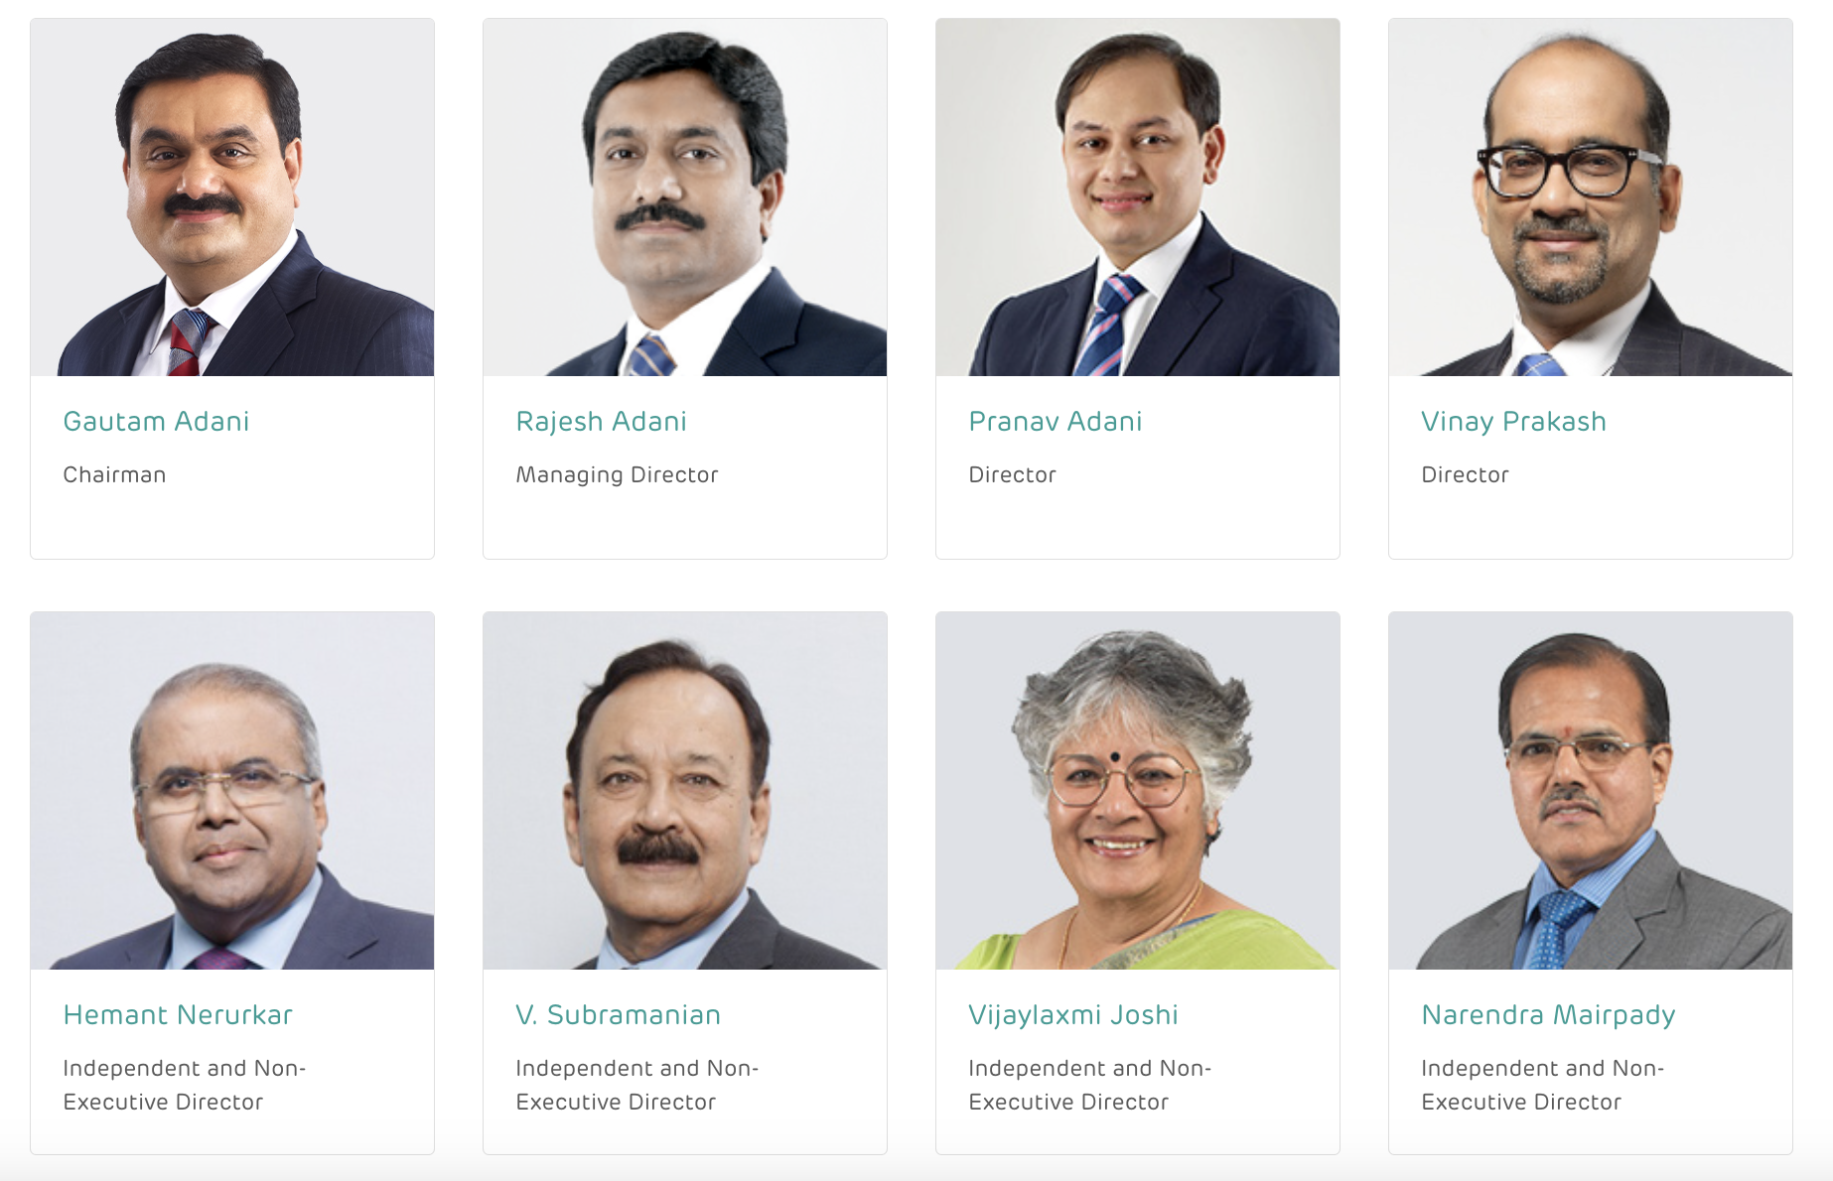
Board Of Directors

Slide 6
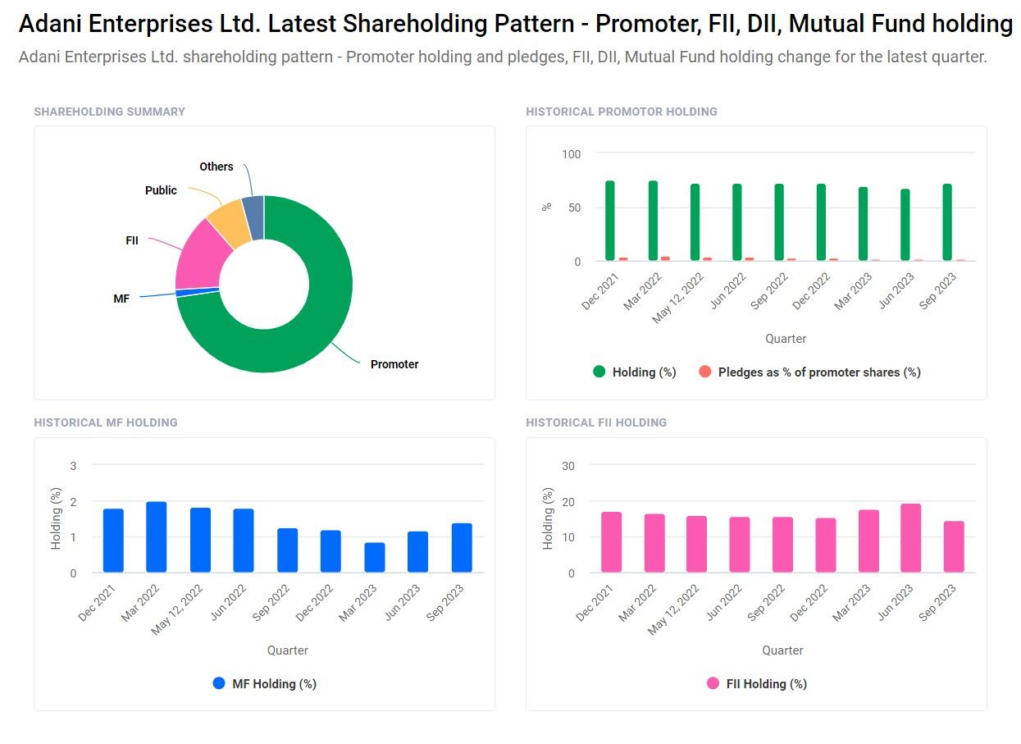
Company Fundamentals :
Adani Enterprises LTD. (ADANIENT.NS) ; Market Cap : 2,57,418 Cr. ; Metal & Mining Industry

Slide 7

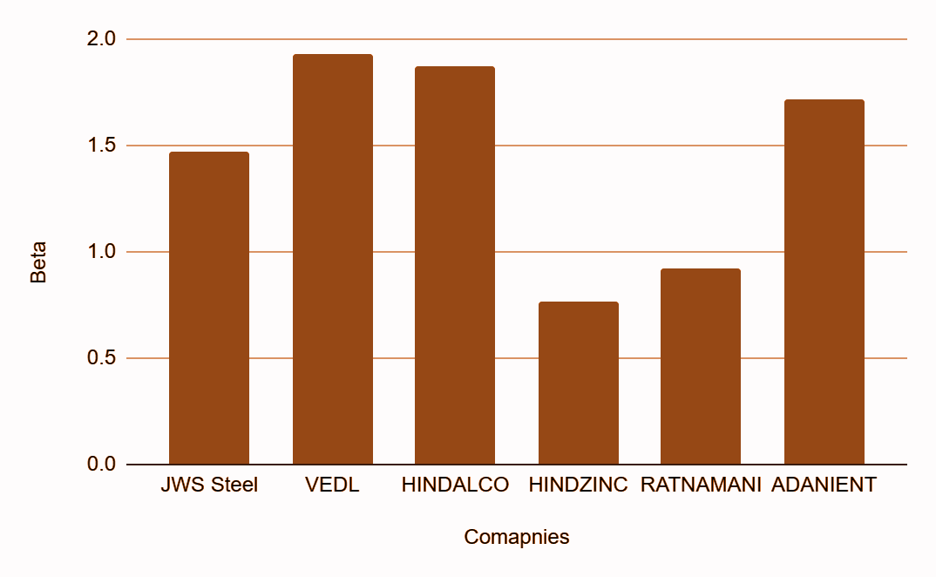
Regression ( )
Regression seeks to discover the degree of the relationship (Beta) between dependent variable (company’s returns) and independent variables (market returns).

Slide 8
TOP DOWN APPROACH
Calculation of beta through regression
Calculation of cost of equity using CAPM

Slide 9
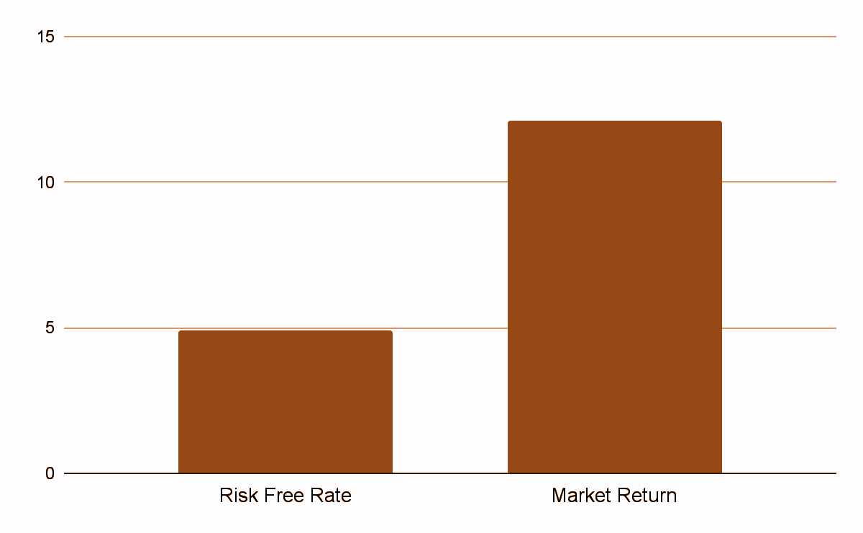
TOP DOWN APPROACH
By regressing returns of ADANIENT with respect to Market Returns
We found the value of β = 1.6412
By using the CAPM Model :
Cost of Equity = 17.249%

Slide 10
BOTTOM UP APPROACH
Relever the beta using the capital structure of target company
Calculation of average of unlevered beta of comparable firms
Calculation of cost of equity

Slide 11
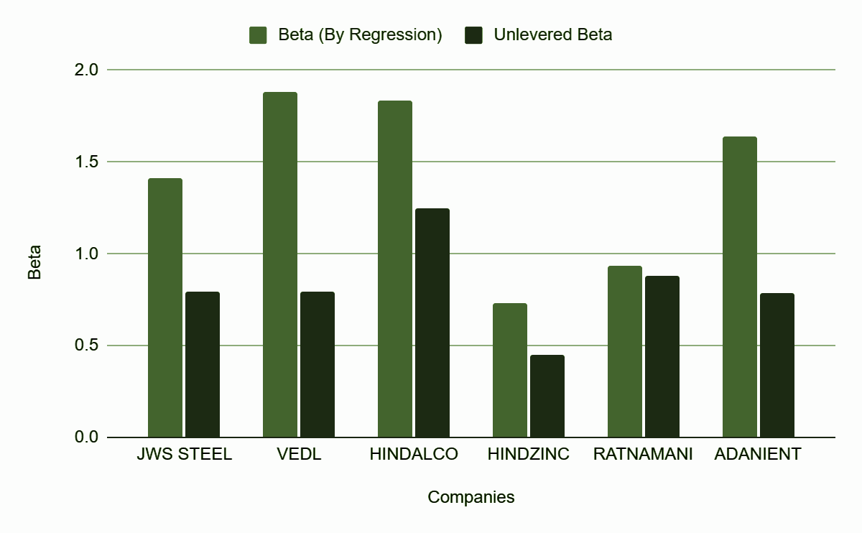
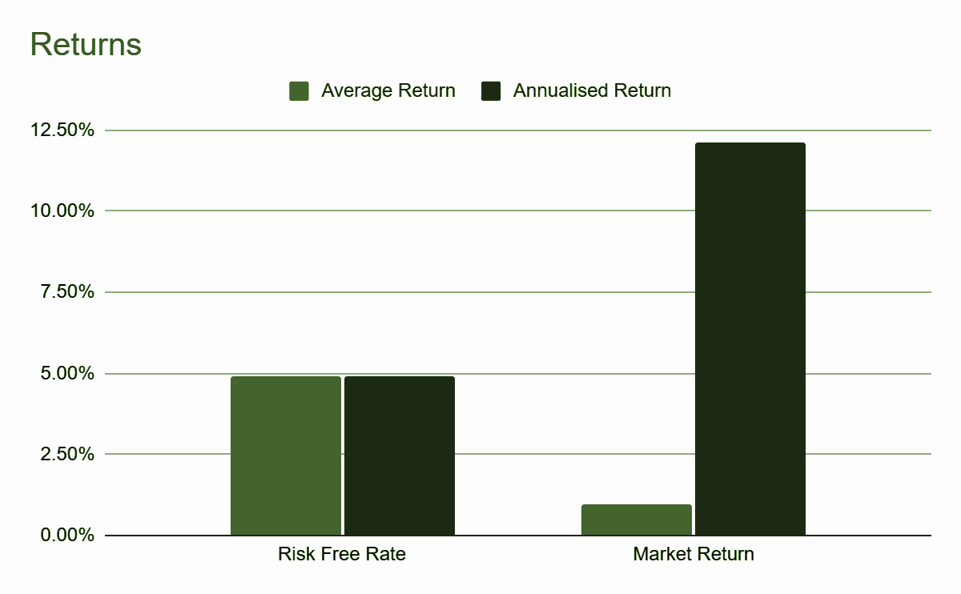
BOTTOM UP APPROACH
Avg Unlevered β of comparable firms = 0.839
β (Relevered) for ADANIENT= 1.6412
Cost of Equity Capital (Rs) = 17.249%

Slide 12
COST OF DEBT
Risk Free Rate
Spread Value
Cost of Debt
The primary company (ADANIENT) falls under the Category of High Market Cap & based on its Interest Coverage Ratio its Credit Rating is B- which corresponds to a Spread Value of 8.00%

Slide 13
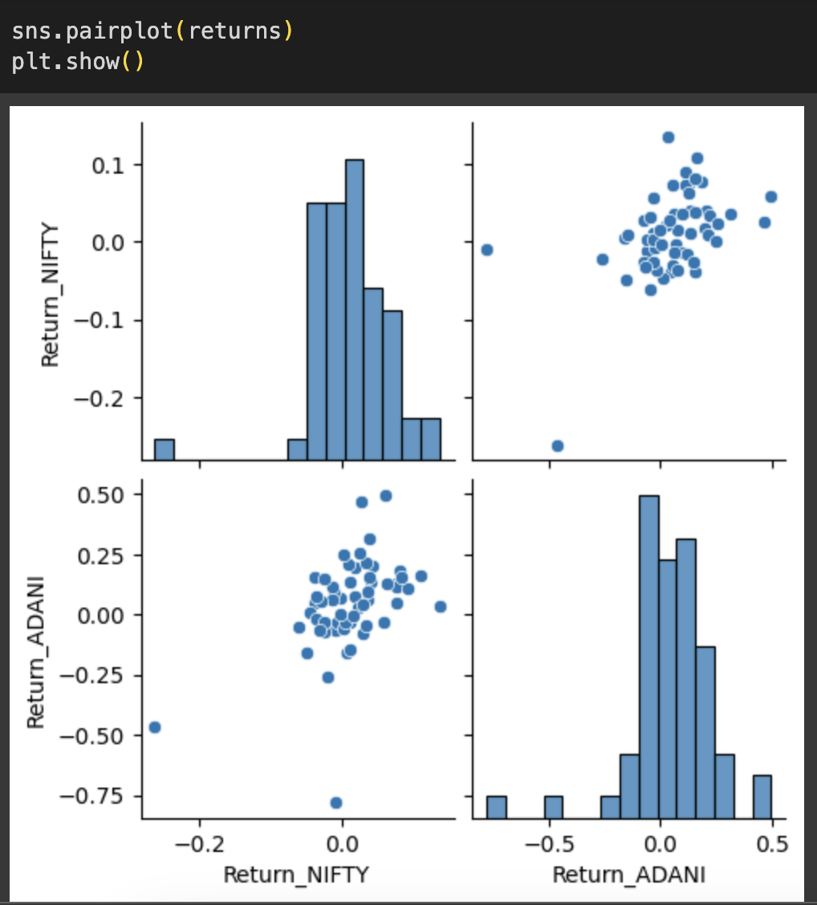
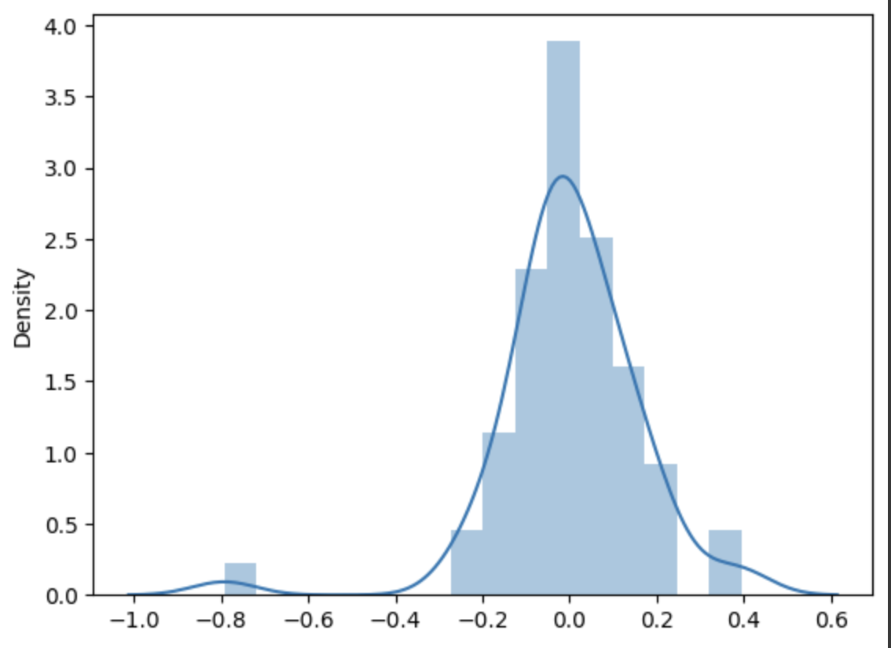
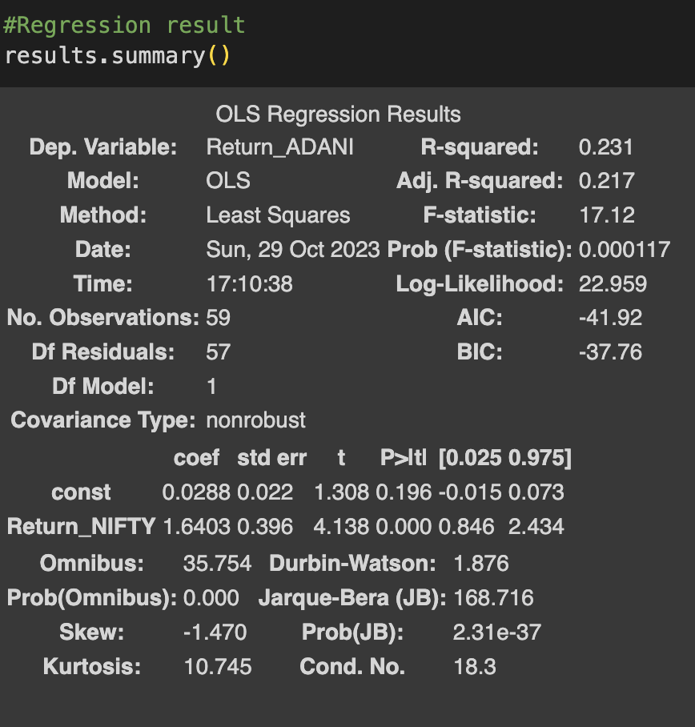
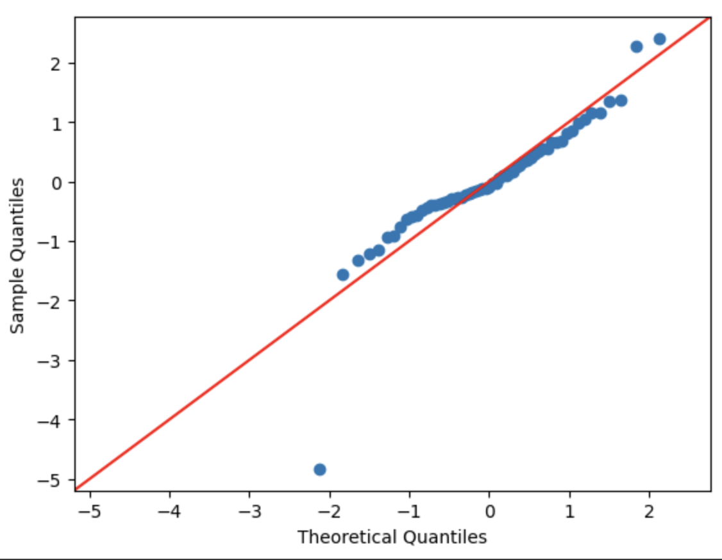
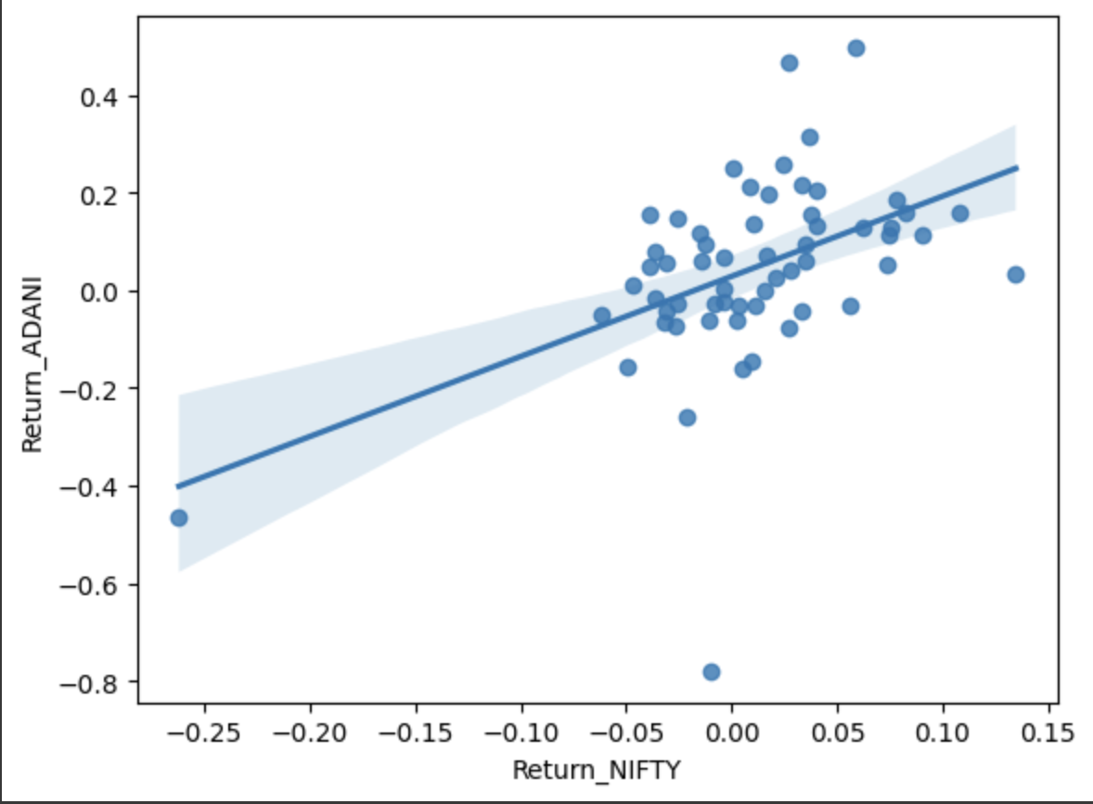
Various Observations From the Code :

Slide 14
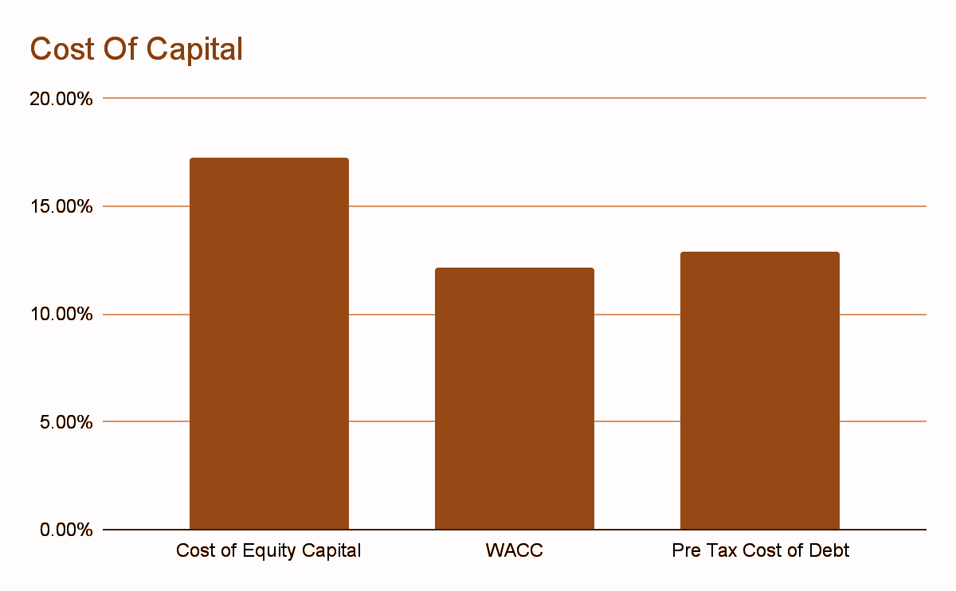
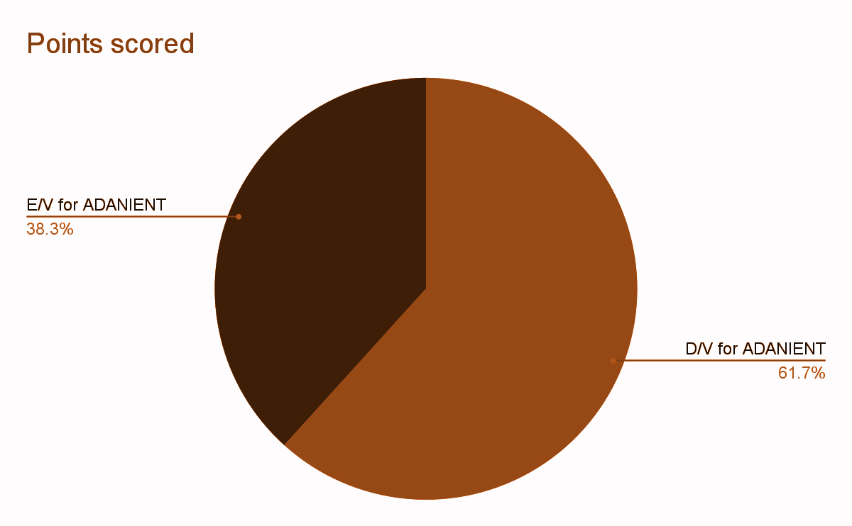
WACC from TOP DOWN
Tax Rate = 30%
WACC = E/V*Rs + D/V*(1-Tax Rate)*Rb

Slide 15
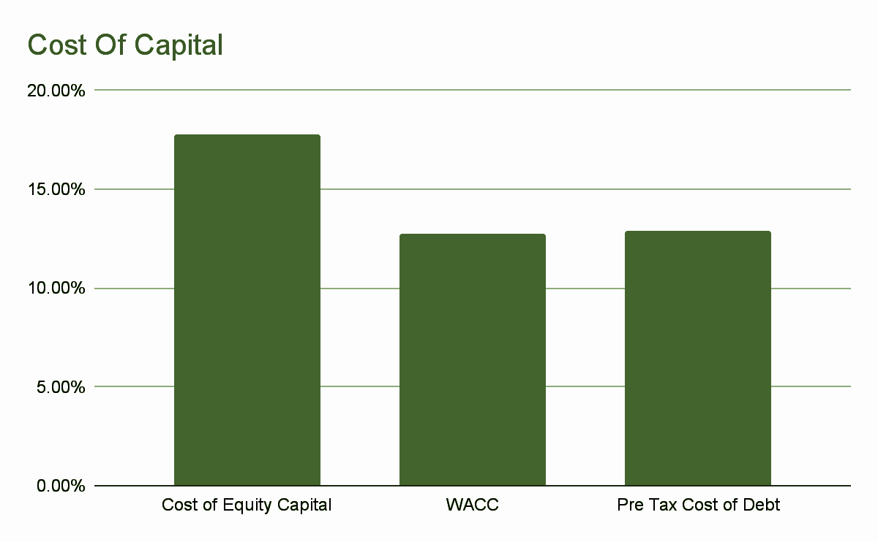
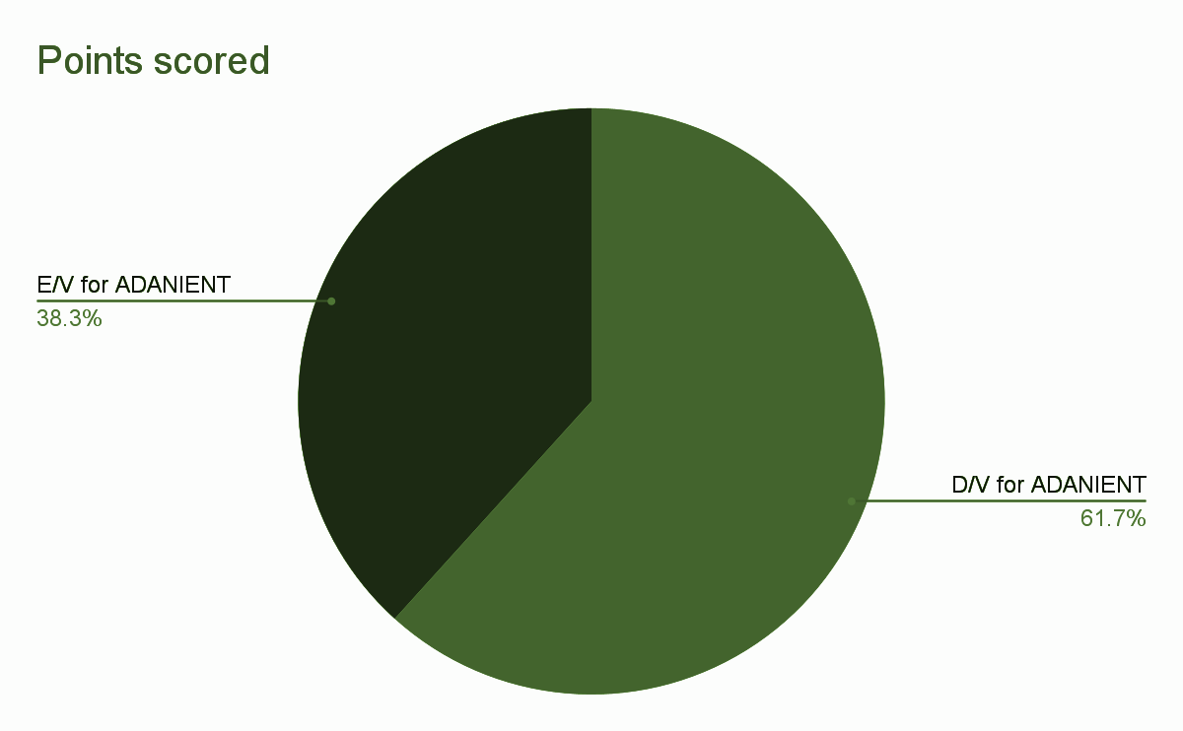
WACC from BOTTOM UP
Tax Rate = 30%
WACC = E/V*Rs + D/V*(1-Tax Rate)*Rb

Slide 16
Thank You

