Slide 1
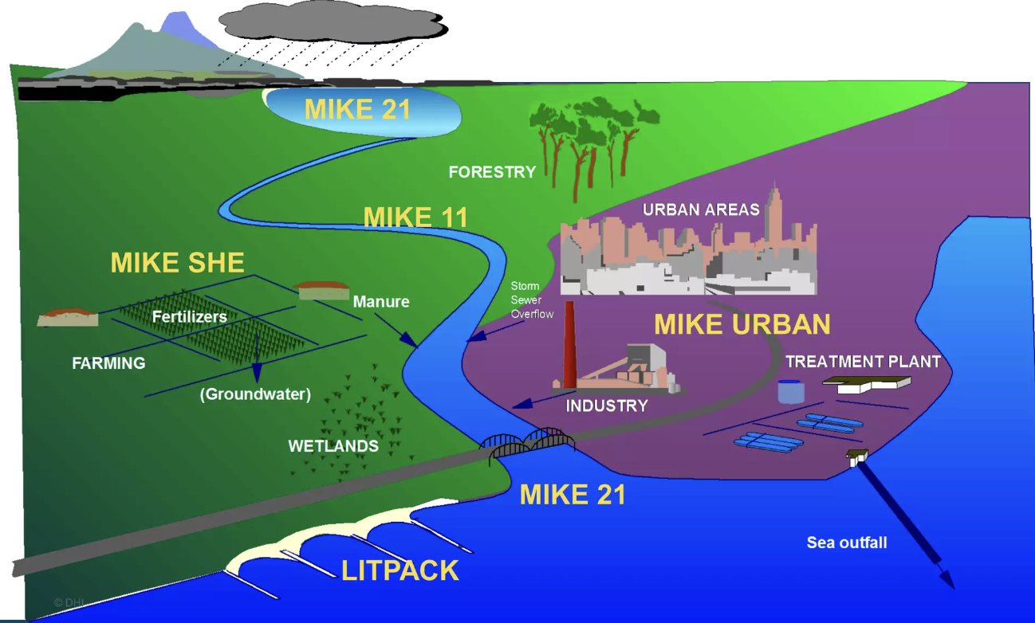

Slide 2
INTRODUCTION
02
What is MIKE SHE?
MIKE SHE is a fully integrated hydrological simulation software system designed to model the complete land-based water cycle with exceptional scientific rigour. It combine surface water, unsaturated zone, groundwater, evapotranspiration and river interactions within a single, physically-based framework, enabling reliable catchment-scale analysis.
Physically-based
Fully distributed
Modular & flexible
Solves governing equations (Richards, Darcy, Saint-Venant) rather than relying solely on empirical relationships.
Represents spatial variability across a grid; every cell can have unique soil, land-use and climate properties.
Users choose process complexity (simple water-balance to full 3-D) according to data availability and study goals.
2 / 9

Slide 3
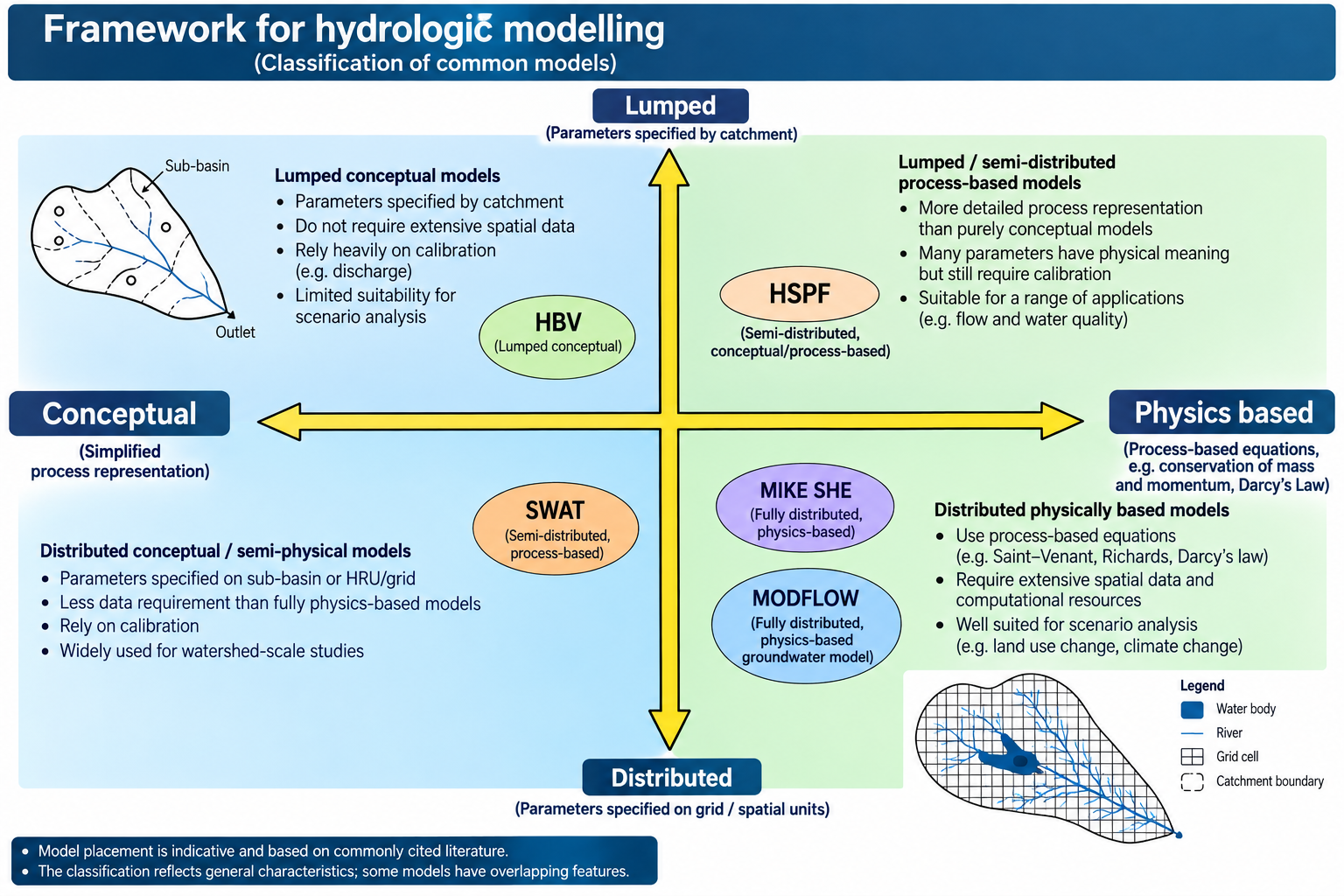

Slide 4
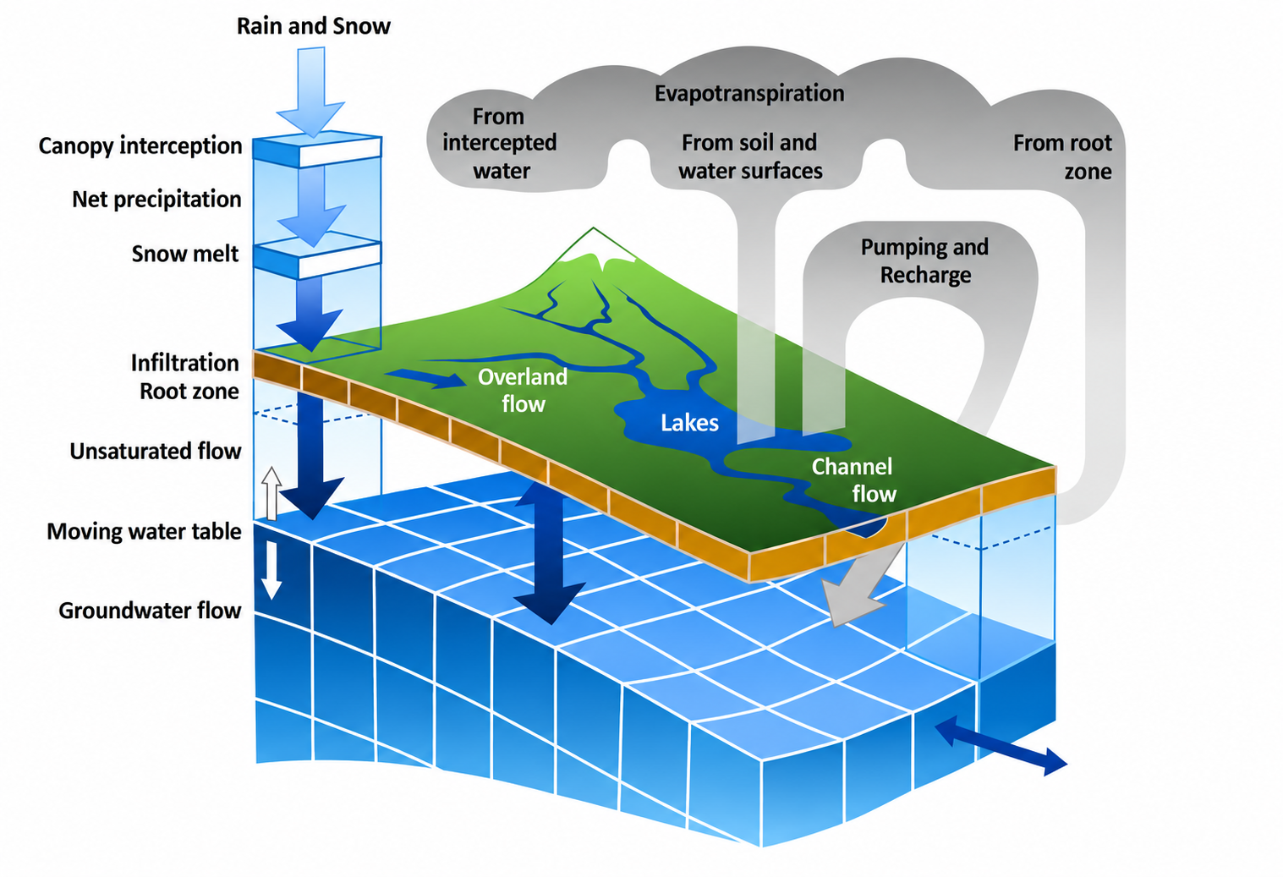

Slide 5
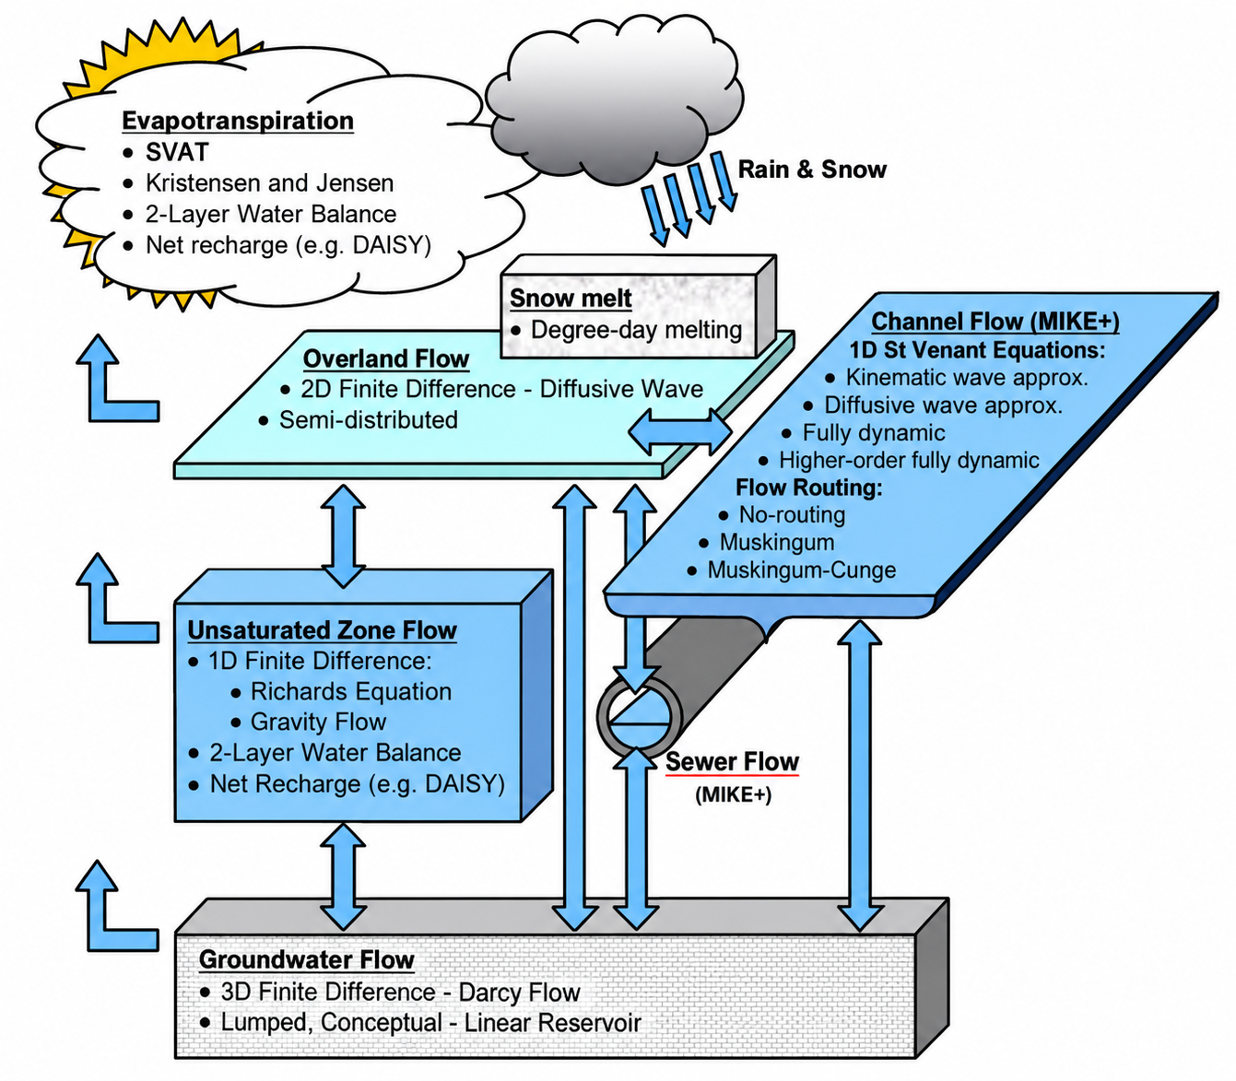

Slide 6
MODEL STRUCTURE
03
Core Process Components
Six process-oriented modules coordinated by a central FRAME component that manages time-stepping and data exchange.
ET
Evapotranspiration
OC
Overland & Channel
UZ
Unsaturated Zone
Interception, canopy & soil evaporation, plant transpiration (Kristensen–Jensen or simplified two-layer).
2-D overland flow (diffusive wave) + 1-D channel / river network (MIKE 1D).
Vertical infiltration & soil moisture (Richards equation, gravity flow or two-layer water balance).
SZ
Saturated Zone
SM
Snow Melt
EX
Exchange
3-D or 2-D groundwater flow using Darcy’s law; multi-layer aquifers.
Degree-day or energy-balance snow accumulation and melt processes.
Dynamic exchange between aquifers and river systems (baseflow, bank storage).
3 / 9

Slide 7
Selected literature references for application areas of MIKE SHE
Application areas | References
General MIKE SHE References (Distributed hydrologic modeling and applications) | Abbott & Refsgaard (1996), Abbott et al. (1986 a & b), Havnø et al. (1995), Refsgaard et al. (1998), Refsgaard & Storm (1995), Storm & Refsgaard (1996)
River Basin Management and Modeling | Andersen et al. (2001), Christensen (2004), Henriksen et al. (2003), Jain et al. (1992), Jensen et al. (2002), Refsgaard & Sørensen (1994), Refsgaard et al. (2003, 1998, 1992), Sandholt et al. (1999), Vazquez (2003)
Integrated Surface Water and Groundwater | Graham & Refsgaard (2001), Kaiser-Hill (2001), Olesen et al. (2000), Refsgaard et al. (1998), Sørensen et al. (1996)
Groundwater Modeling | Christiansen and Feyen (2001, 2002), Madsen & Kristensen (2002), Sonnenborg et al. (2003), Refsgaard et al. (1998)
Groundwater Pollution, Remediation and Water Quality Modeling | Brun and Engesgaard (2002), Brun et al. (2002), Christiansen et al. (2004), Hansen et al. (2001), Refsgaard et al. (1999, 1998), Sørensen and Refsgaard (2001), Thorsen et al. (1998)
Wetlands | Copp et al. (2004), Jacobsen et al. (1999), Lasarte et al. (2002), Refsgaard et al. (1998, 1994), Refsgaard & Sørensen (1994), Thompson et al. (2004), Yan et al. (1999)
Soil Erosion Modeling | Lørup & Styzcen (1996), Morgan et al. (1999, 1998), Nielsen et al. (1996), Storm et al. (1987)
Agricultural Management | Boegh et al. (2004), Hansen et al. (2001), Refsgaard et al. (1999), Styzcen & Storm (1993a,b,c), Thorsen et al. (2001, 1998)
Irrigation | Carr et al. (1993), Jayatilaka et al. (1998), Lohani et al. (1993), Singh et al. (1999a & b, 1997)
Remote Sensing – Weather Radar and Satellite | Andersen et al. (2002a & b), Boegh et al. (2004), Butts et al. (2004a & b), Sandholt et al. (2003, 1999)
Land use change and anthropogenic effects | Lørup et al. (1998), Refsgaard & Knudsen (1996), Refsgaard & Sørensen (1997, 1994)
Model Parameter Estimation, Calibration and Validation | Butts et al. (2004), Christiansen & Feyen (2002a & b, 2001), Madsen (2003), Madsen & Kristensen (2002), Mertens et al. (2004), Sonnenborg et al. (2003), Refsgaard (2001a & b, 1997a & b), Refsgaard et al. (1998), Refsgaard & Butts (1999), Refsgaard & Knudsen (1996), Vazquez (2003), Vazquez et al. (2002)

Slide 8
Application area | References | References shown | Corpus papers in this area
General MIKE SHE references (model description, distributed modelling, reviews) | Abbott et al. (1986a), Abbott et al. (1986b), Bathurst (1986a), Bathurst (1986b), Bathurst & O’Connell (1992), Borah & Bera (2003), Borah & Bera (2004), Butts & Graham (2005), Devia et al. (2015), Keller et al. (2022), Ma et al. (2016), Refsgaard & Knudsen (1996) | 12 | 34
River basin management, water allocation and IWRM | Al‐Khudhairy et al. (1999), Farjad et al. (2017b), Fennell et al. (2022), Hansen et al. (2009), Hoang et al. (2012), Lee et al. (2007), Mishra et al. (2005), Oogathoo (2006), Prucha et al. (2016), Qin et al. (2013), Singh et al. (2010), Zheng et al. (2020) | 12 | 108
Integrated surface water – groundwater modelling | Abdulkareem et al. (2018), Borah & Bera (2003), Borah & Bera (2004), Devia et al. (2015), El‐Nasr et al. (2005), Golmohammadi et al. (2014), Jaber & Shukla (2012), Keller et al. (2022), Ridler et al. (2014), Stisen et al. (2011), Thompson et al. (2004), Vansteenkiste et al. (2012) | 12 | 313
Groundwater modelling, recharge and water-table dynamics | Clilverd et al. (2016), Dai et al. (2010), Fennell et al. (2022), Fennell et al. (2023), Fu et al. (2011), House et al. (2016), Keilholz et al. (2015), Stisen et al. (2011), Stoll et al. (2011), Sultana & Coulibaly (2010), Thorndahl et al. (2016), Waseem et al. (2020) | 12 | 201
Groundwater pollution, solute transport and remediation | Azinheira et al. (2014), Borah & Bera (2004), Follin et al. (2008), Hansen et al. (2009), Manna et al. (2019), Neumann et al. (2021), Olesen et al. (2019), Reszler & Fank (2016), Seidenfaden et al. (2022), Sun et al. (2013), Thorsen et al. (1998), Windolf et al. (2011) | 12 | 39
Nutrient transport and catchment water quality | Borah & Bera (2004), Clilverd et al. (2016), Hansen et al. (2009), Hoang et al. (2012), Neumann et al. (2021), Olesen et al. (2019), Refsgaard & Hansen (2010), Sun et al. (2013), Waseem et al. (2018), Waseem et al. (2020), Windolf et al. (2011), Zhao (2012) | 12 | 49
Wetlands and peatlands | Al‐Khudhairy et al. (1999), Clilverd et al. (2016), Cui et al. (2005), Dai et al. (2010), Dai et al. (2011), Hansen et al. (2009), House et al. (2015), House et al. (2016), Kumar et al. (2021), Singh et al. (2010), Sterte et al. (2021a), Windolf et al. (2011) | 12 | 90
Ecohydrology, riparian zones, habitat and environmental flows | Amatya et al. (2016), Clilverd et al. (2016), Doummar et al. (2012), Fabris et al. (2018), House et al. (2015), House et al. (2016), Keilholz et al. (2015), Ma et al. (2016), Papadimos et al. (2022), Sterte et al. (2022), Thompson et al. (2013b), Zheng et al. (2020) | 12 | 54
Soil erosion and sediment transport modelling | Borah et al. (2022), Dimitriou et al. (2018), Kameyama (2013), Ke et al. (2024), Kumar (2021), Kumar et al. (2021), Neumann et al. (2021), Olaleye et al. (2024), Refsgaard (1995), Ryan et al. (2015), Wang et al. (2010), Zhao et al. (2023) | 12 | 33
Agricultural management and field drainage | Broekhuizen et al. (2019), Broekhuizen et al. (2021), De Schepper et al. (2017), Hoang et al. (2012), Mahmood et al. (2023a), Mernild et al. (2007), Oogathoo (2006), Ramos & Besharat (2021), Sandu & Vîrsta (2015), Waseem et al. (2018), Waseem et al. (2020), Zhou et al. (2013) | 12 | 42
Irrigation and crop water management | Amatya et al. (2016), Borah & Bera (2003), Borah & Bera (2004), Jayatilaka et al. (1998), Keilholz et al. (2015), Mishra et al. (2005), Papadimos et al. (2022), Prucha et al. (2016), Qin et al. (2013), Rujner et al. (2018), Singh et al. (1999), Singh et al. (2010) | 12 | 80
Evapotranspiration, soil moisture and unsaturated-zone processes | Bitew & Gebremichael (2011), Bosson et al. (2012), House et al. (2016), Jaber & Shukla (2012), Qin et al. (2013), Ridler et al. (2014), Rujner et al. (2018), Stisen et al. (2011), Stoll et al. (2011), Thompson et al. (2013a), Vázquez (2002), Zheng et al. (2020) | 12 | 225
Remote sensing, weather radar and data assimilation | Amatya et al. (2016), Andersson & Nilsson (1998), Bitew & Gebremichael (2011), Guzinski et al. (2015), He et al. (2019), Khattab et al. (2025), Luo et al. (2017), Mendiguren et al. (2017), Qin et al. (2013), Ridler et al. (2014), Shu et al. (2018), Zhang et al. (2016) | 12 | 92
Land-use / land-cover change and anthropogenic effects | Amatya et al. (2016), Aredo et al. (2021), Dai et al. (2010), Dai et al. (2011), Farjad et al. (2017a), Im et al. (2008), Jaber & Shukla (2012), Keller et al. (2022), Sterte et al. (2021a), Trinh & Chui (2013), Zhang et al. (2008), Zheng et al. (2020) | 12 | 121
Climate change impact assessment | Devia et al. (2015), House et al. (2016), Jaber & Shukla (2012), Keilholz et al. (2015), Keller et al. (2022), Ridler et al. (2014), Stoll et al. (2011), Thompson (2012), Thompson et al. (2013a), Thompson et al. (2013b), Vansteenkiste et al. (2012), Zhang et al. (2021) | 12 | 185
Flood modelling, inundation mapping and flood forecasting | Azinheira et al. (2014), Clilverd et al. (2016), Farjad et al. (2017a), Guinot & Gourbesville (2003), House et al. (2015), Huţanu et al. (2020), Keilholz et al. (2015), Kumar et al. (2021), Lucatero et al. (2018), Marshall et al. (2025), Mernild et al. (2007), Thompson (2012) | 12 | 173
Drought, low flow and baseflow | Chan et al. (2020), Fennell et al. (2022), Fennell et al. (2023), Kumar et al. (2021), Liu et al. (2016), Sterte et al. (2022), Thompson et al. (2013a), Thompson et al. (2013b), Thompson et al. (2017), Vansteenkiste et al. (2012), Vu et al. (2017), Vázquez et al. (2007) | 12 | 69
Urban hydrology, stormwater and green infrastructure | Broekhuizen et al. (2019), Broekhuizen et al. (2021), Jaber & Shukla (2004), Kumar et al. (2021), LaBianca et al. (2023), Mauck (2017), Poozan et al. (2024), Ramos & Besharat (2021), Rujner et al. (2018), Thorndahl et al. (2016), Trinh & Chui (2013), Zhao (2012) | 12 | 44
Snow, glacier and permafrost hydrology | Bosson et al. (2012), Bøggild et al. (1999), Foster & Allen (2015), Hasan et al. (2025), Keilholz et al. (2015), Krajčí et al. (2016), Liu et al. (2016), Liu et al. (2017), Luo et al. (2017), Mernild et al. (2007), Oogathoo (2006), Sterte et al. (2021a) | 12 | 34
Reservoir, dam, canal and hydropower operation | Bizhanimanzar et al. (2020), Jaber & Shukla (2004), Jaber & Shukla (2012), Jeníček (2006), Khattab et al. (2025), Khwairakpam et al. (2018), Olaleye et al. (2024), Prucha et al. (2016), Singh et al. (2010), Thompson (2004), Thompson (2012), Zhang et al. (2021) | 12 | 54
Mining, quarry and construction dewatering | Abdulkareem et al. (2018), Chalkidis et al. (2016), Goodall et al. (2007), Johansson et al. (2005), Maest et al. (2020), Olaleye et al. (2024), Ping et al. (2017), Quang et al. (2022), Rubarenzya et al. (2006), Tolson & Shoemaker (2008), Turgeon et al. (2018), Zhou et al. (2025) | 12 | 21
Coastal groundwater, salinity and sea-level rise | Andreassen (2008), Cui et al. (2023), Daneshmand (2018), Flannery et al. (2010), Iravani & Thompson (2022), Keilholz et al. (2015), Mauck (2017), Ridler et al. (2014), Roshani et al. (2015), Ryan (2007), Thoe et al. (2010), Yamagata et al. (2012) | 12 | 17
Karst and fractured-rock hydrology | De-ba (2014), Doummar (2012a), Doummar (2012b), Doummar et al. (2011), Doummar et al. (2012), Vrsalović (2025) | 6 | 6
Isotope, tracer and travel-time studies | Andreassen (2008), Azinheira et al. (2014), Doummar (2012a), Johansson et al. (2005), LaBianca et al. (2022), LaBianca et al. (2023), Manna et al. (2019), Seddon (2019), Sharma et al. (2025), Sterte et al. (2021a), Sterte et al. (2021b), Sterte et al. (2022) | 12 | 30
Carbon, greenhouse gas and biogeochemical coupling | Andreassen (2008), Clilverd et al. (2016), Cui et al. (2005), Karlsson et al. (2014), Neumann et al. (2021), Ryan (2007), Sterte et al. (2021a), Sterte et al. (2021b), Sterte et al. (2022), Sun et al. (2013), Sun et al. (2020), Zheng et al. (2020) | 12 | 26
Nature-based solutions, restoration and managed aquifer recharge | Al‐Khudhairy et al. (1999), Azinheira et al. (2014), Clilverd et al. (2016), Dai et al. (2010), Fennell et al. (2022), Fennell et al. (2023), Kumar et al. (2021), Poozan et al. (2024), Singh (2010), Sun et al. (2013), Thompson (2004), Trinh & Chui (2013) | 12 | 60
Model parameter estimation, calibration and validation | Bitew & Gebremichael (2011), Borah & Bera (2004), Devia et al. (2015), El‐Nasr et al. (2005), Golmohammadi et al. (2014), Jaber & Shukla (2012), McMichael et al. (2005), Refsgaard & Knudsen (1996), Sahoo et al. (2006), Thompson et al. (2013a), Wang et al. (2012), Xevi et al. (1997) | 12 | 292
Uncertainty, sensitivity, scale and model-structure analysis | Borah & Bera (2003), Christiaens & Feyen (2001), Keller et al. (2022), McMichael et al. (2005), Ridler et al. (2014), Stisen et al. (2011), Stoll et al. (2011), Thompson et al. (2013a), Thompson et al. (2013b), Wang et al. (2012), Xevi et al. (1997), Yang et al. (2000) | 12 | 207
Model comparison, benchmarking and intercomparison | Bandini et al. (2017), Bizhanimanzar et al. (2020), Bøggild et al. (1999), Huţanu et al. (2020), Kumar et al. (2021), Olesen et al. (2019), Qin et al. (2013), Refsgaard & Knudsen (1996), Stisen et al. (2011), Stoll et al. (2011), Thorsen et al. (1998), Zhu et al. (2014) | 12 | 60
Machine learning, surrogate modelling and computational performance | Abdulkareem et al. (2018), Ali et al. (2025), Andreassen (2008), Bizhanimanzar et al. (2019), Bizhanimanzar et al. (2020), Chin & Lai (2025), Li et al. (2021), Mahmood et al. (2023b), Marshall et al. (2025), Olaleye et al. (2024), Papagera et al. (2014), Thoe et al. (2010) | 12 | 33
Water-related public health and palaeo-/archaeo-hydrology | Camkin & Neto (2024), Lim et al. (2026), Mishra et al. (2026), Nilges et al. (2025), Thoe et al. (2010), Thoe et al. (2022), William & Schmidt (2015) | 7 | 7

Slide 9
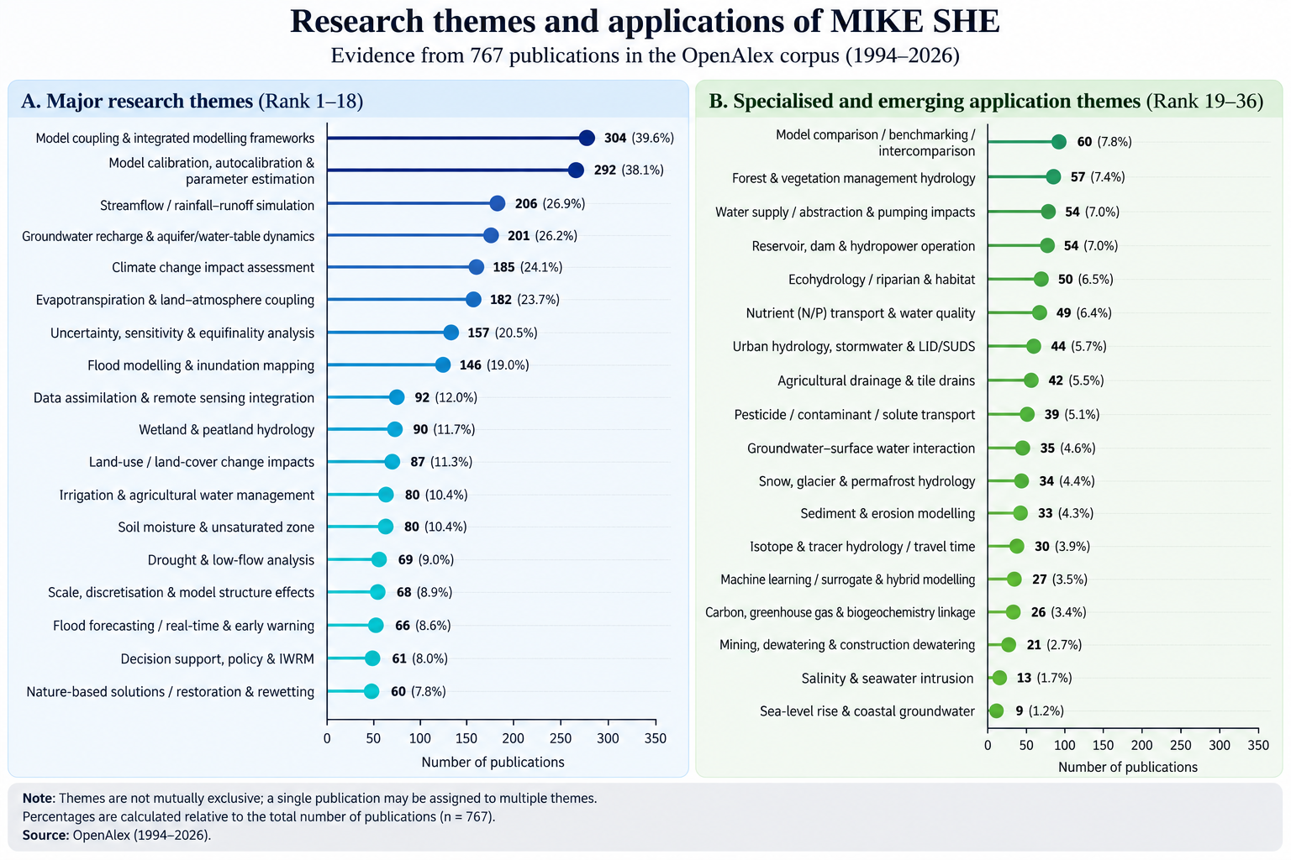

Slide 10
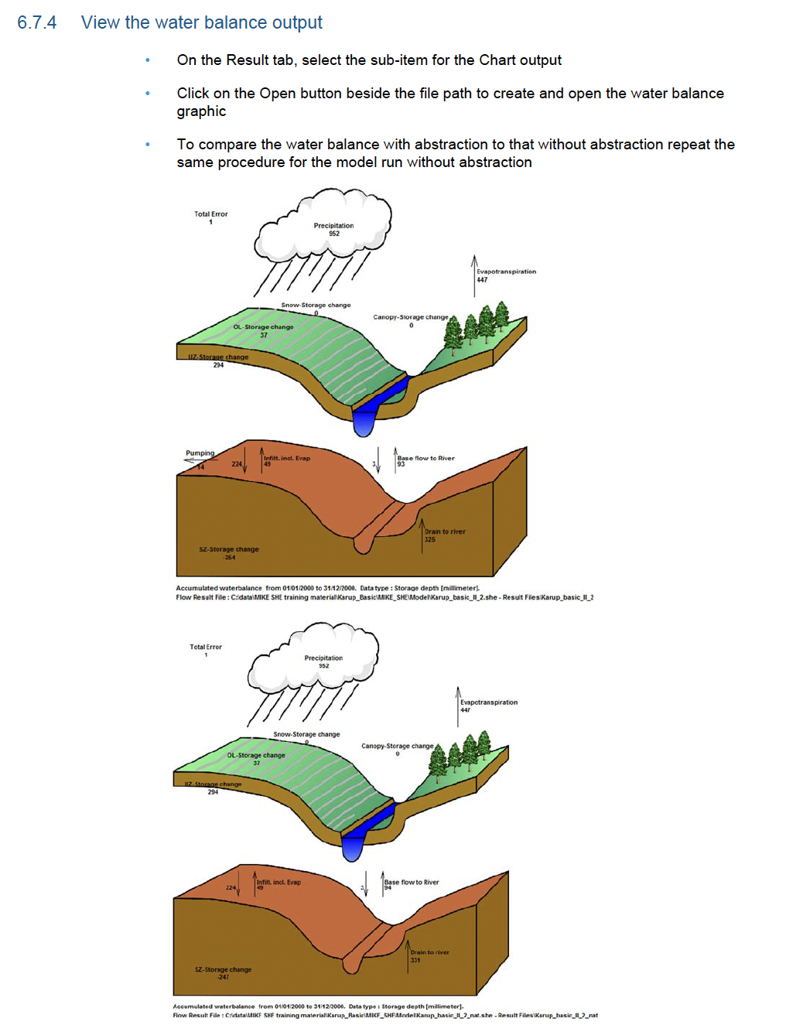

Slide 11
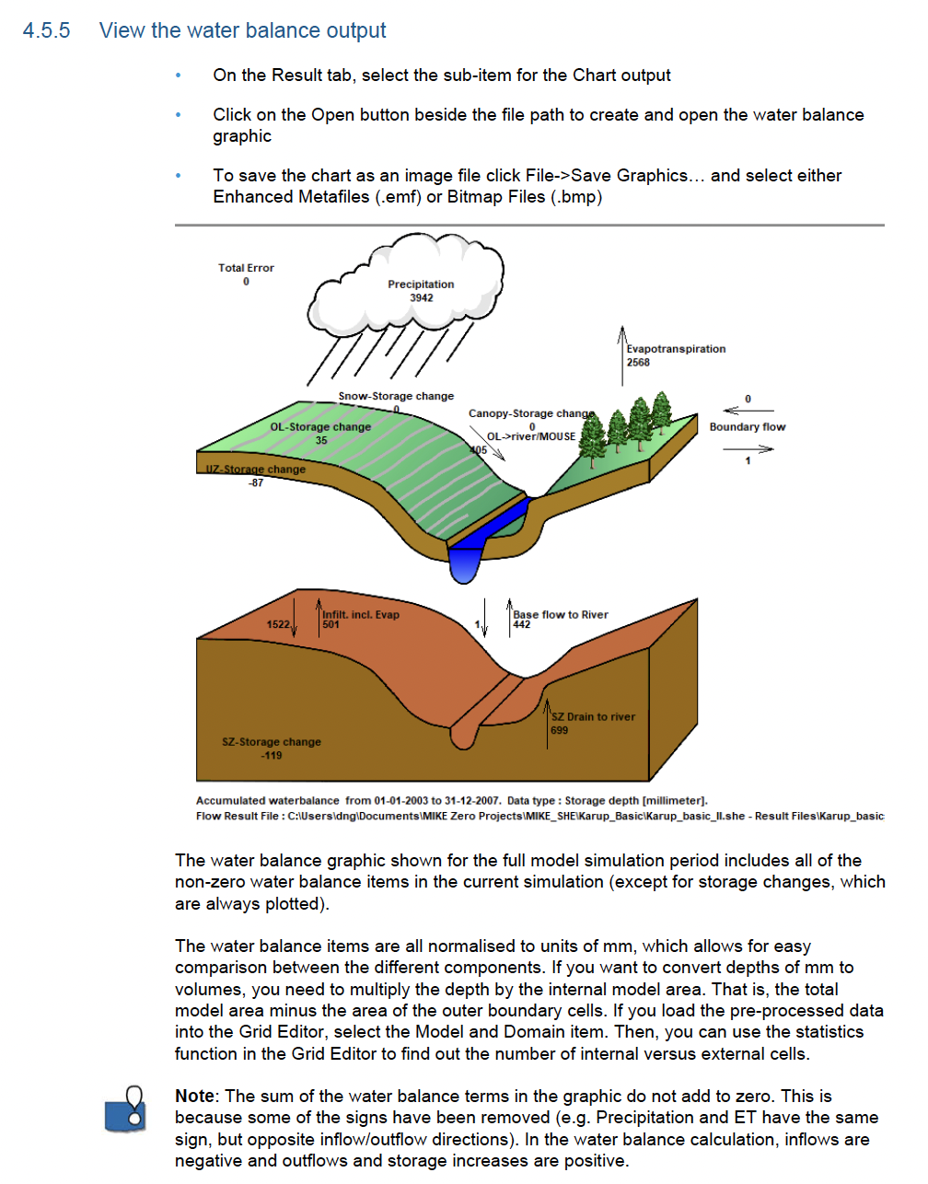

Slide 12
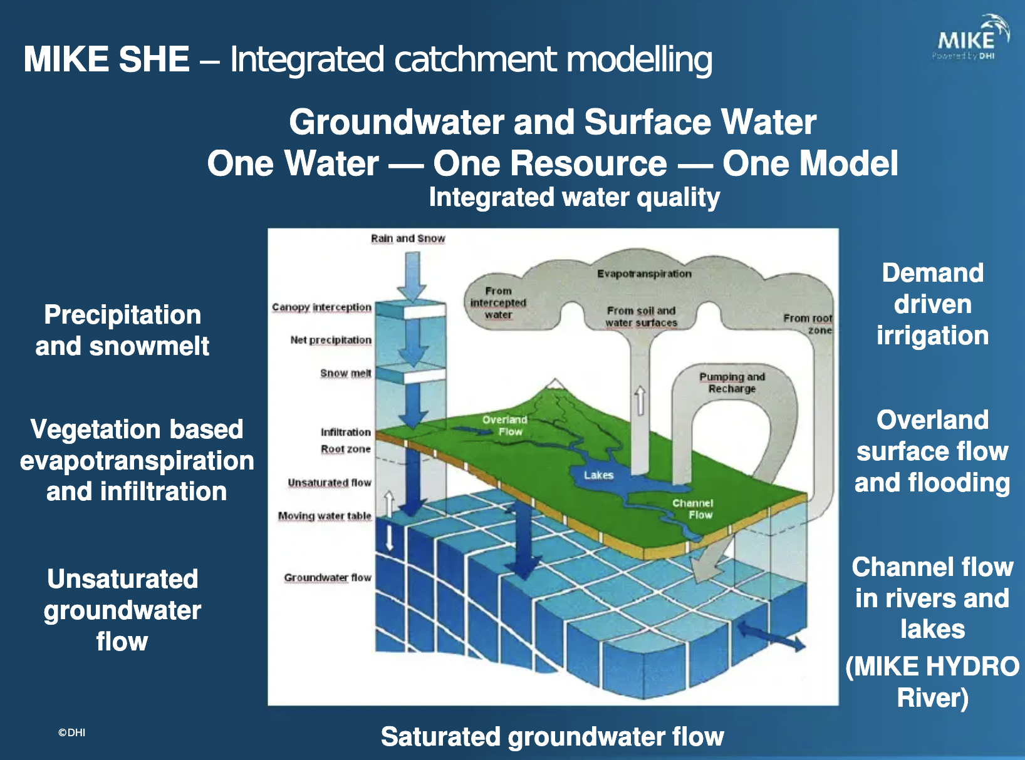

Slide 13
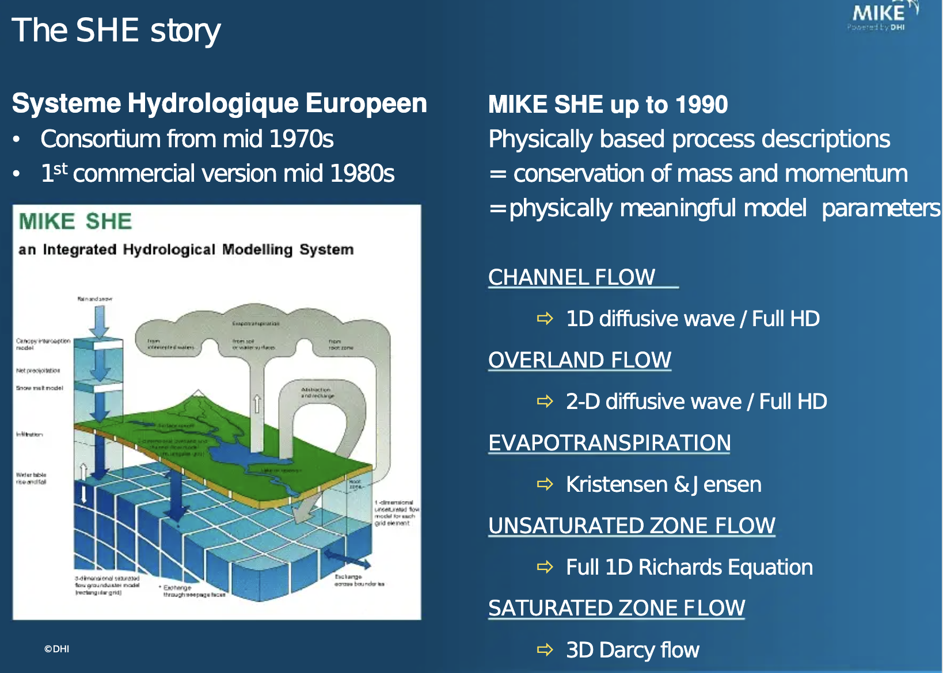

Slide 14
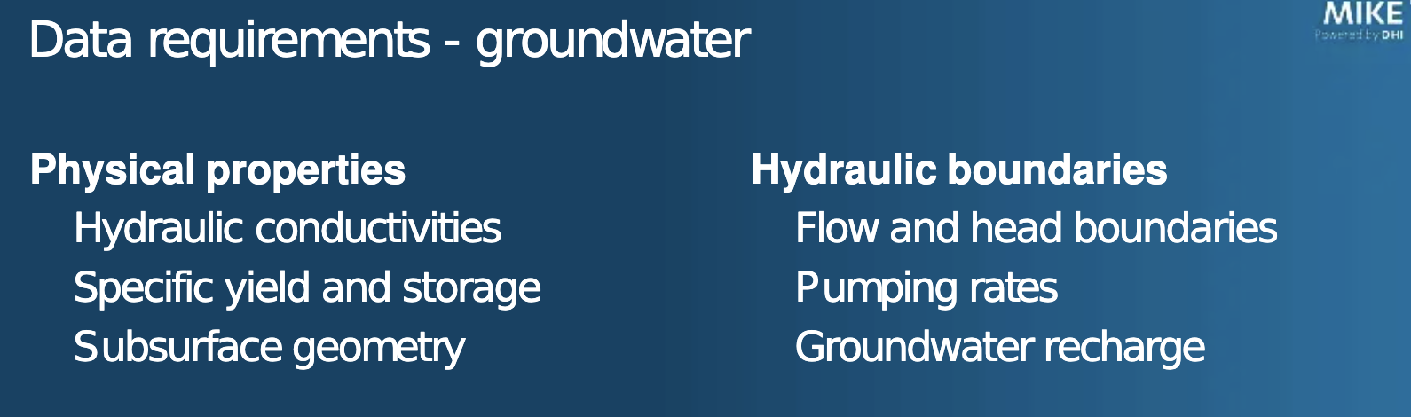

Slide 15
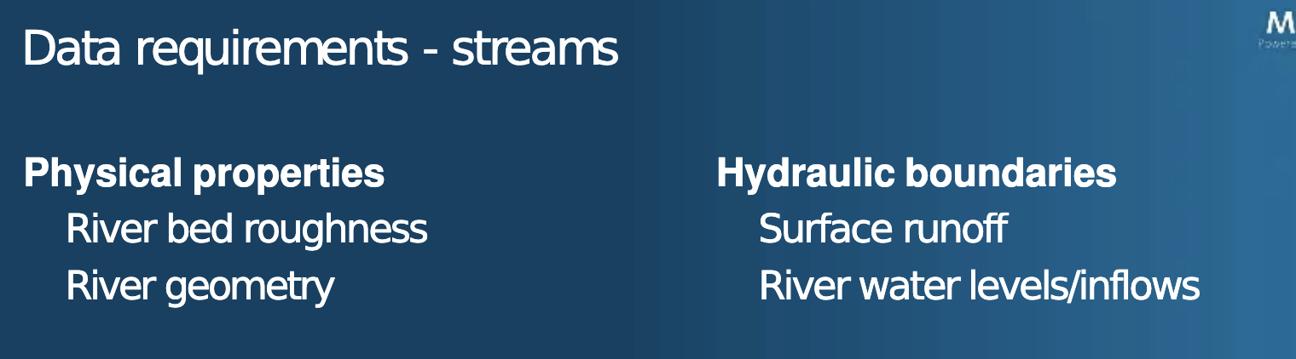

Slide 16
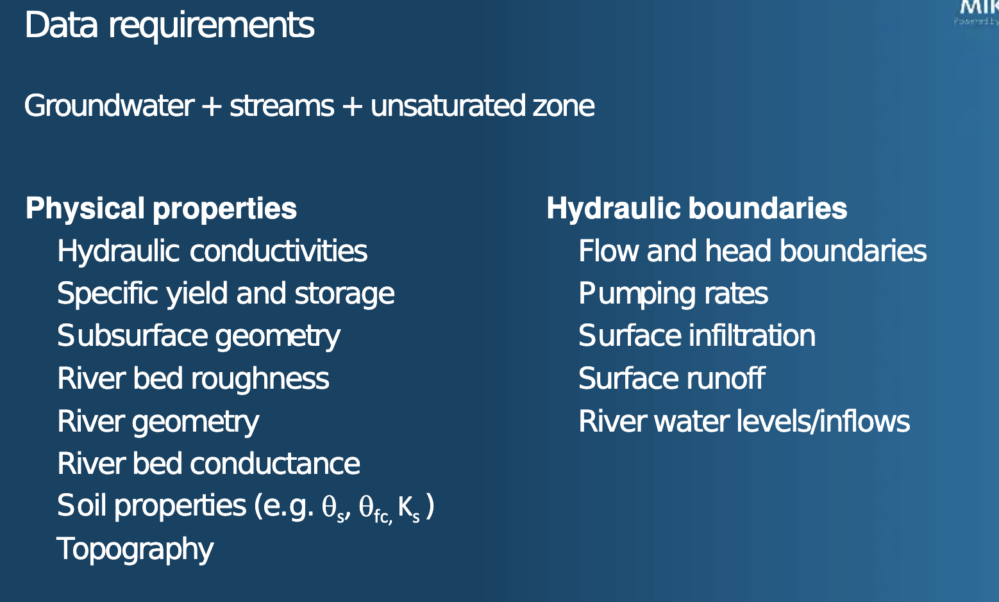

Slide 17
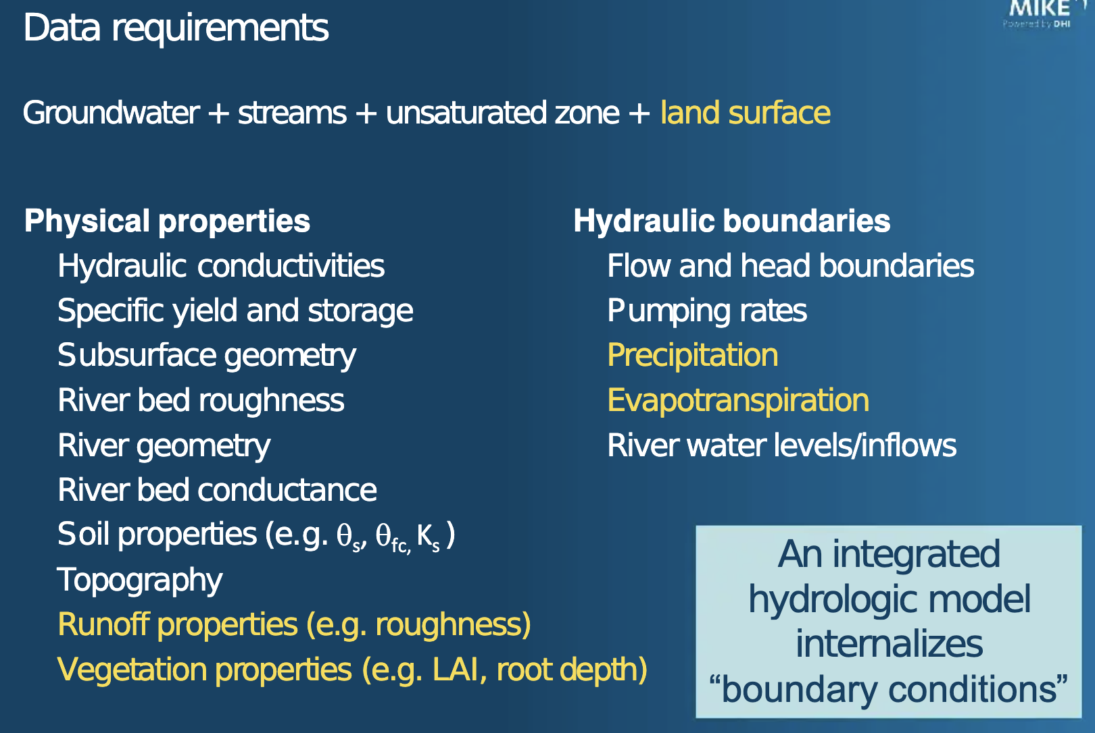

Slide 18
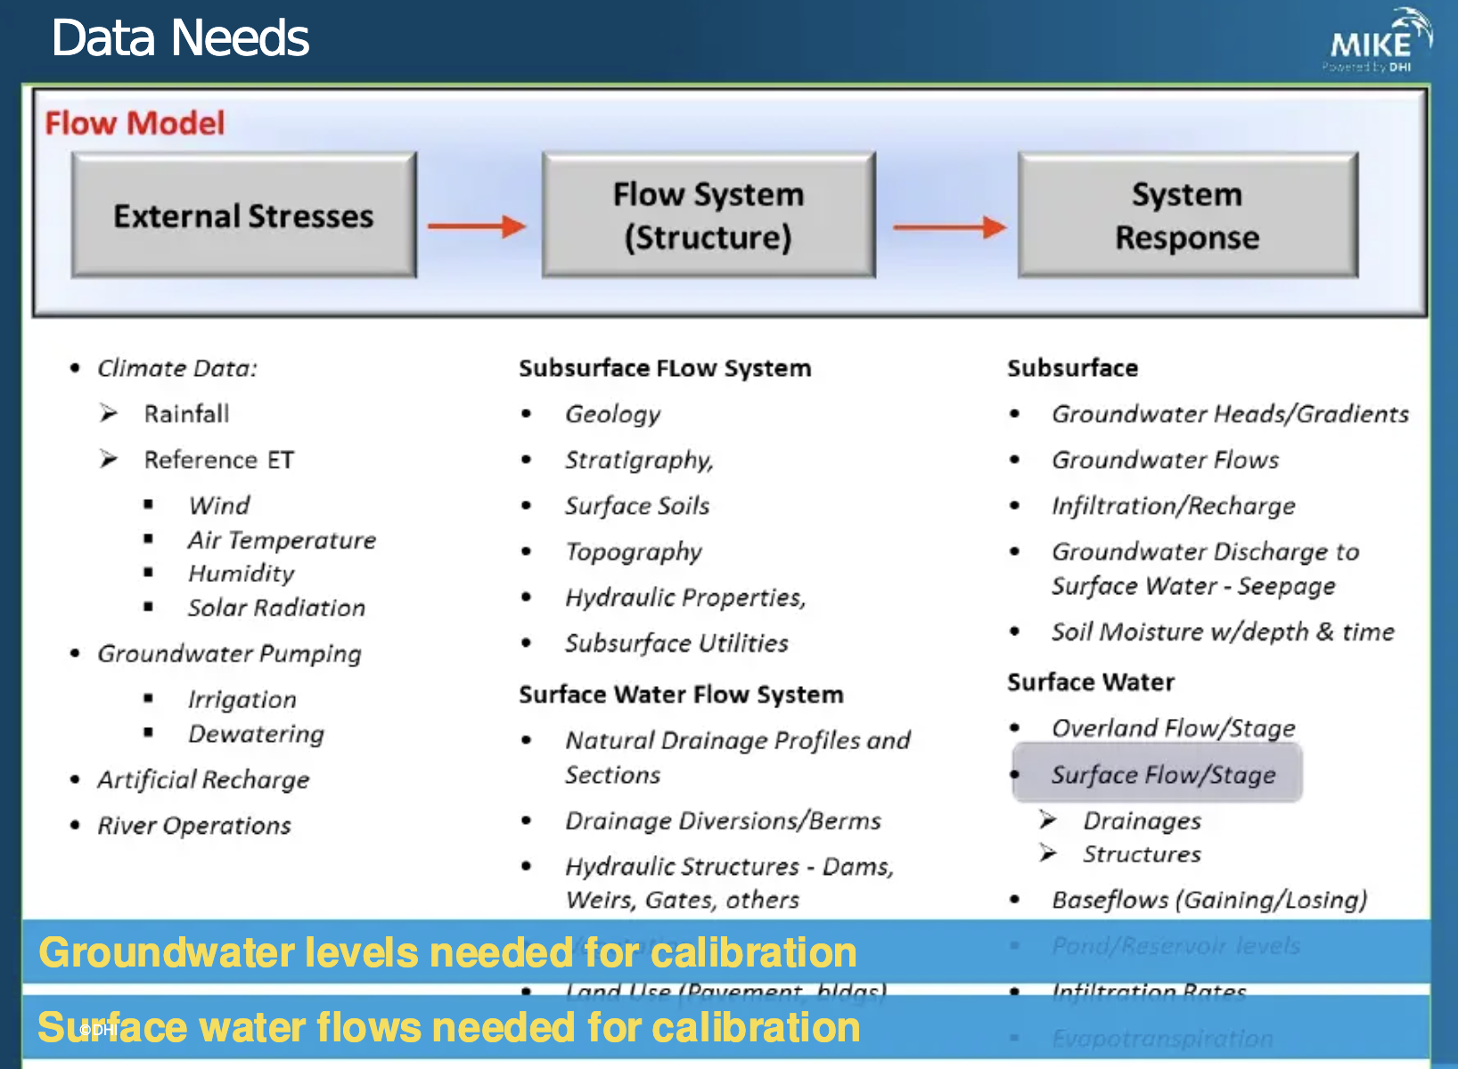

Slide 19
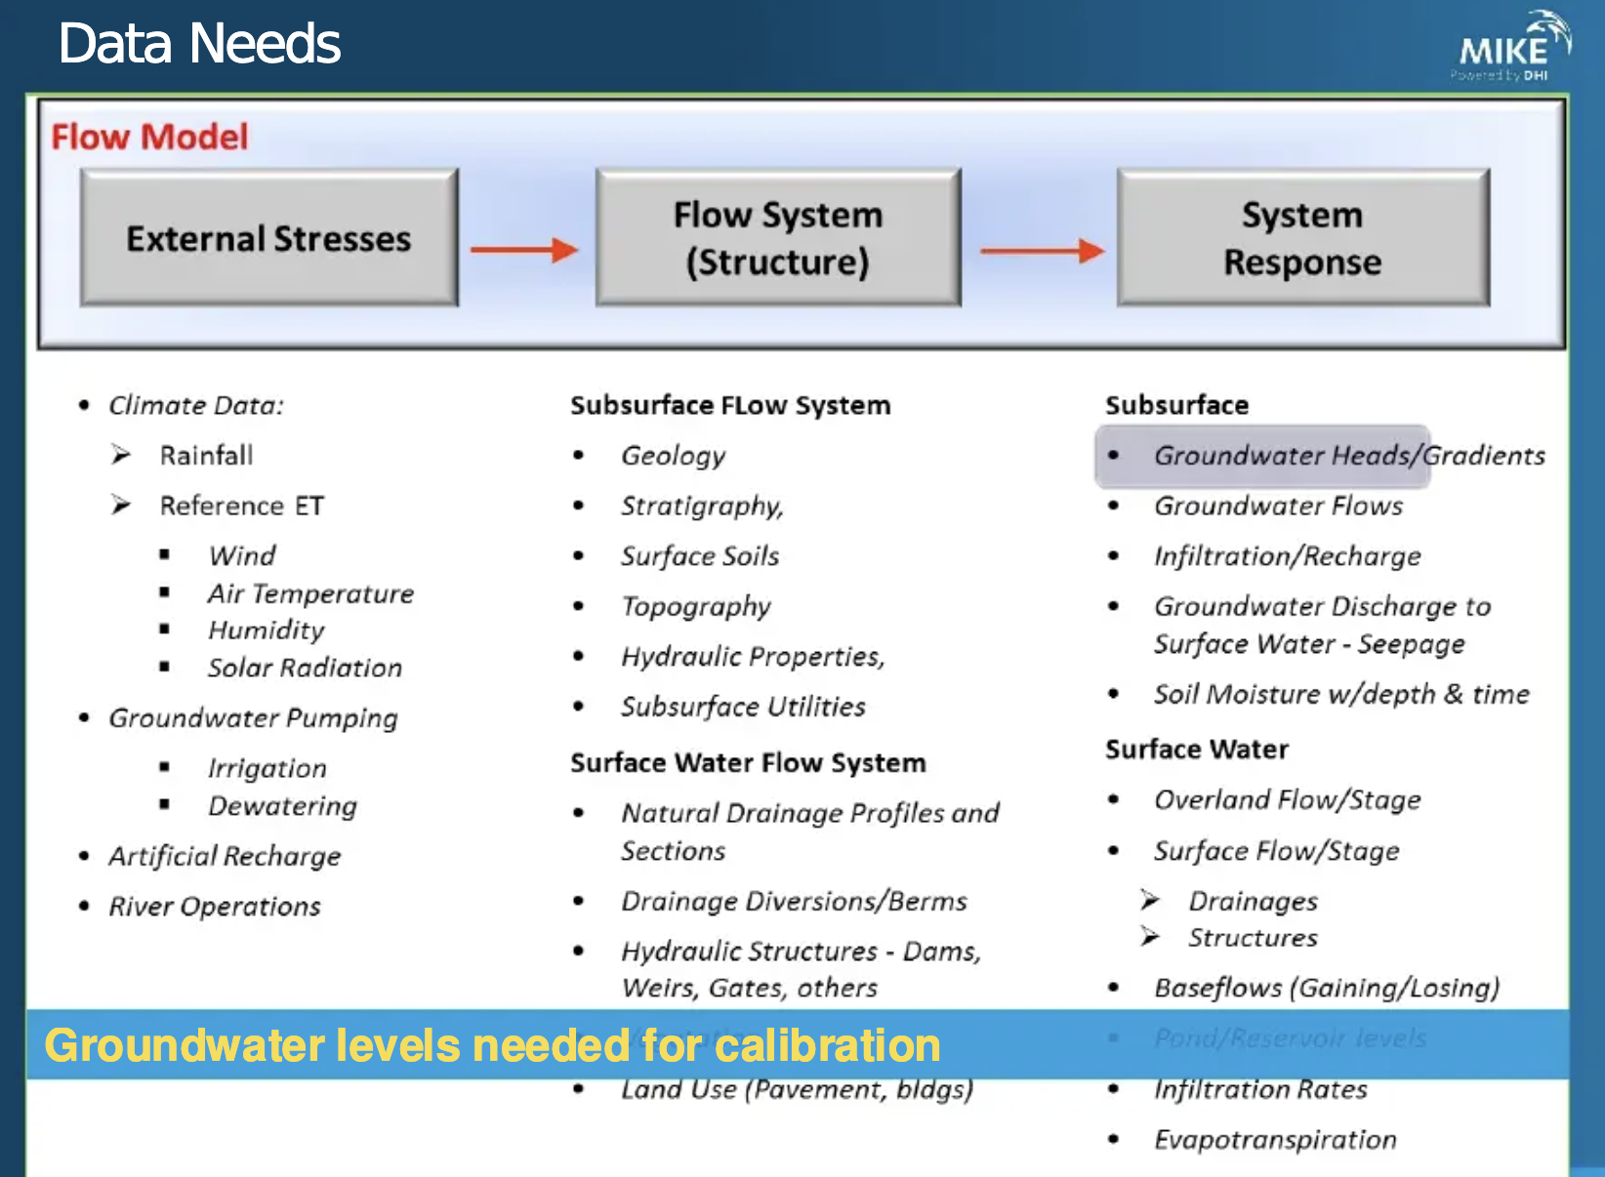

Slide 20
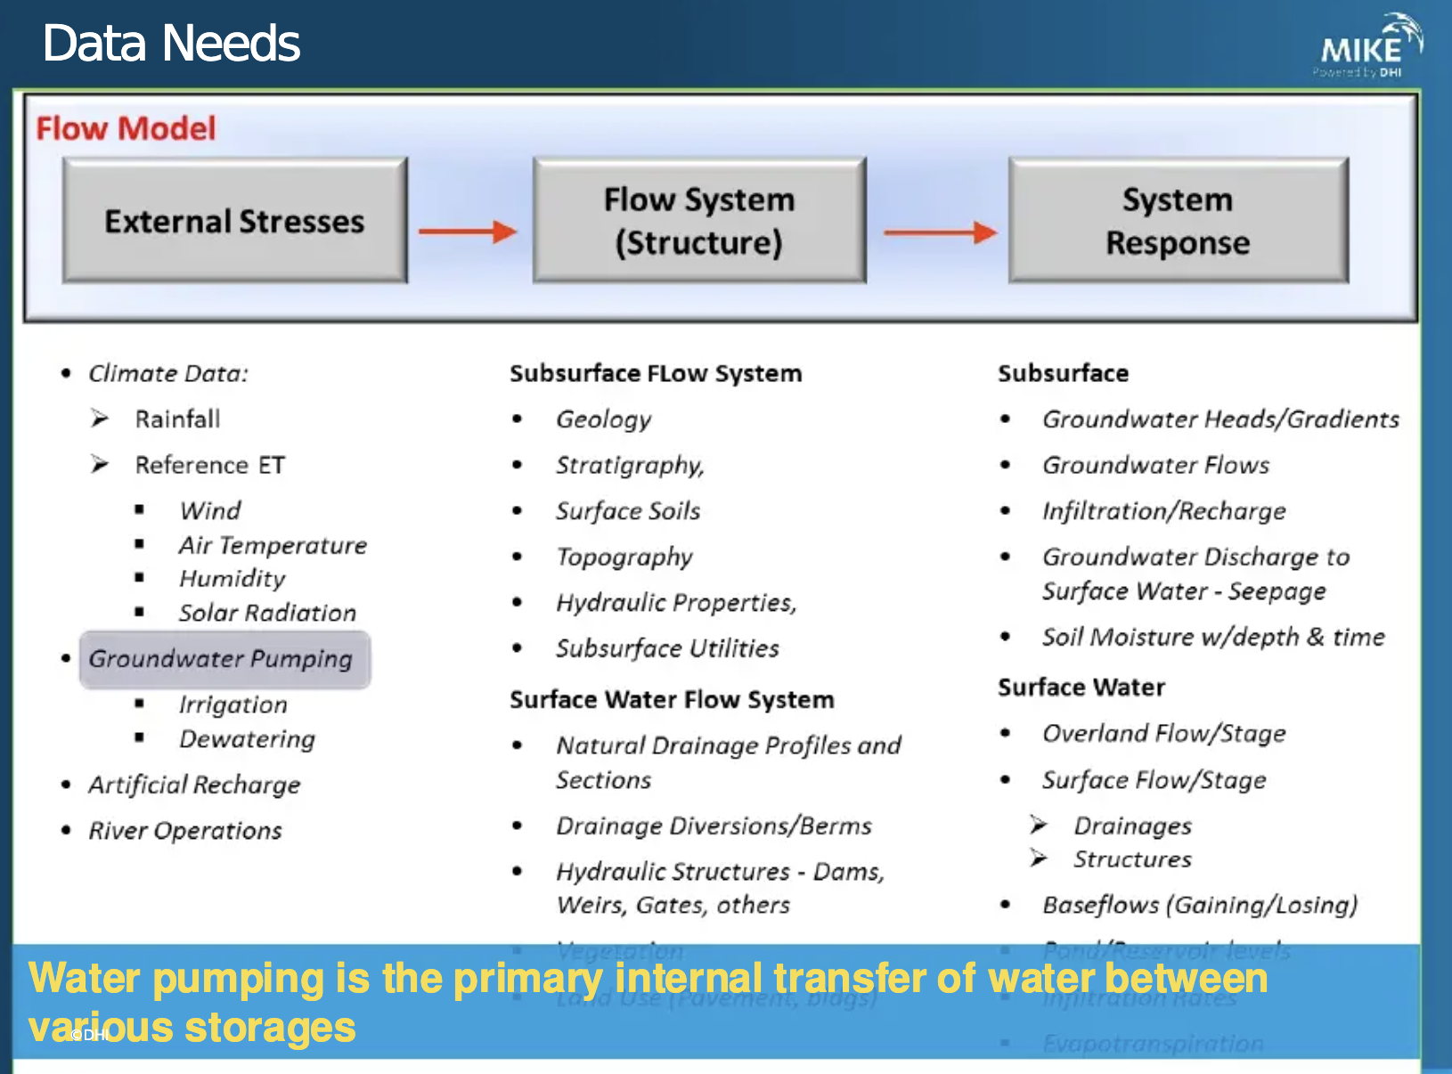

Slide 21
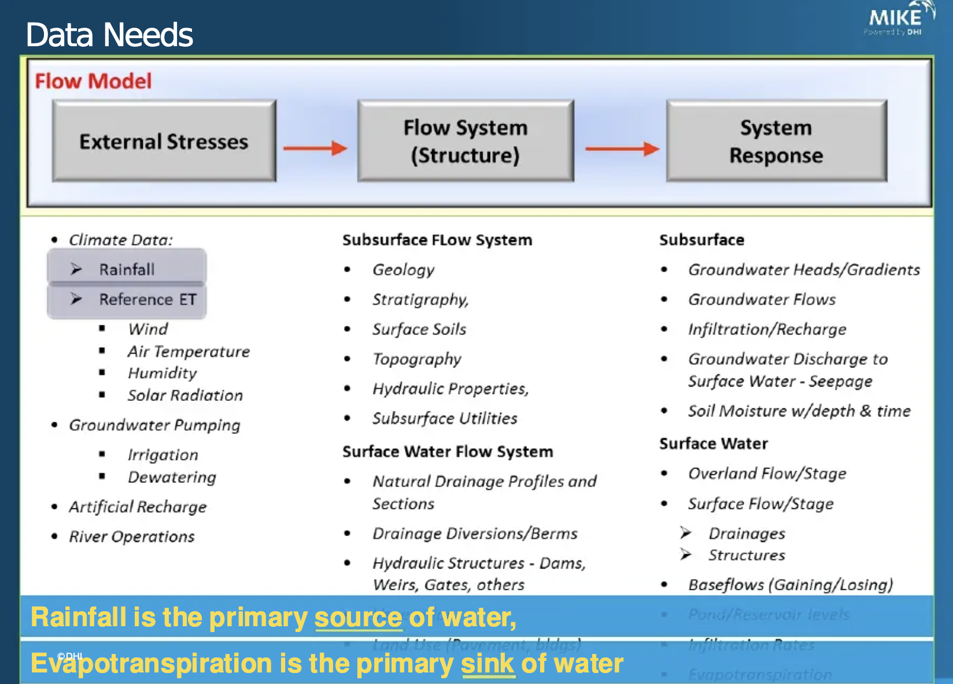

Slide 22
RESEARCH APPLICATIONS
08
Further Academic & Applied Domains
Irrigation scheme optimisation & crop-water modelling
Green infrastructure / nature-based solutions
Mine-water management and dewatering assessment
Land-use change impact studies
Environmental Impact Assessments (EIAs)
Water-protection-zone vulnerability mapping
Eutrophication mitigation & nutrient budgets
Integrated Water Resources Management (IWRM)
Why researchers choose MIKE SHE
Ability to represent complex surface–subsurface feedbacks at catchment scale • Flexible process complexity • Seamless coupling with MIKE 1D / MIKE+ • Rich spatial and temporal outputs • Strong water-balance diagnostics • Decades of peer-reviewed application worldwide
8 / 9

